Slide 1
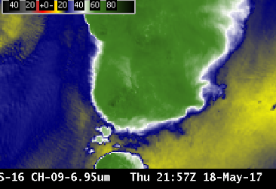
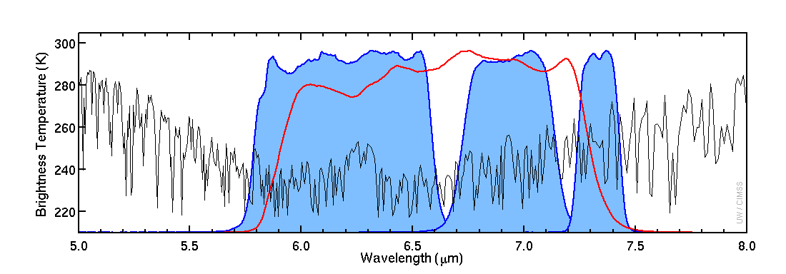
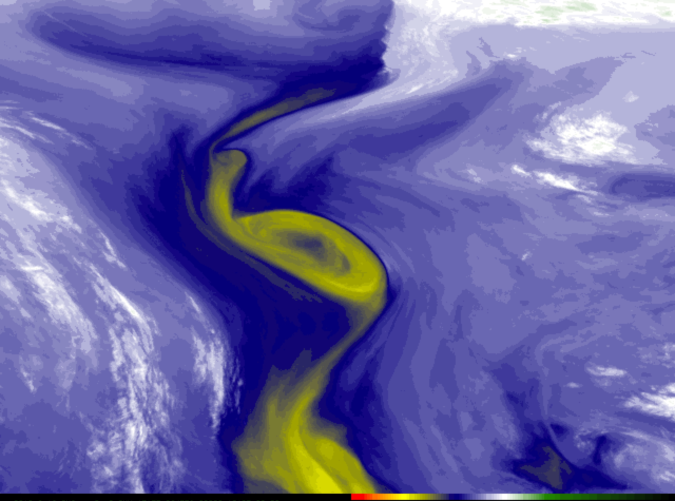
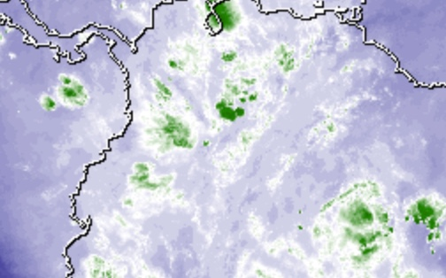
ABI Band 9 (6.9 μm)
Quick Guide
Why is “Mid-level water vapor” band imagery important?
The 6.9 µm “Mid-level water vapor” band is one of three water vapor bands on the ABI, and is used for tracking middle-tropospheric winds, identifying jet streams, forecasting hurricane track and mid-latitude storm motion, monitoring severe weather potential, estimating mid-level moisture (for legacy vertical moisture profiles) and identifying regions where turbulence might exist. Surface features are usually not apparent in this band. Brightness Temperatures show cooling because of absorption of energy at 6.9 µm by water vapor.
Comparison of ABI Water Vapor Bands
Left: U.S. Standard Atmosphere Earth-emitted temperatures and spectral responses for ABI and GOES-13 Water Vapor Channels. The Legacy channel (6.5 μm) covers much of the 6.2 μm and 6.9 μm and 7.3 μm bands on ABI (Figure: Mat Gunshor, CIMSS)
6.5 μm
6.2 μm
6.9 μm
7.3 μm
Impact on Operations
Limitations
Primary Application Atmospheric feature identification (jet streams, vorticity centers, signatures of potential turbulence, contrails).
Regions of dense cloudiness: The presence of optically-dense clouds obstructs the view of lower altitude moisture features.
Impact on operations: The lower noise and higher bit depth of ABI data, coupled with the improved spatial and temporal resolutions will allow for more small scale features to be resolved.
Interpretation of water vapor imagery: The “water vapor” bands are technically infrared bands that sense the mean temperature of a layer of moisture — a layer whose altitude and depth can vary, depending on both the temperature/moisture profile of the atmospheric column and the satellite viewing angle. Thus, examination of water vapor weighting function plots might be necessary to interpret correctly the three-dimensional aspects of patterns displayed on water vapor imagery.
Input into Baseline Products: 6.9 µm imagery is input for the creation of Derived Motion Winds, the Cloud Mask, Stability Indices and Total Precipitable Water products. In addition, radiances from this and other bands can be assimilated into numerical models.
Contributors: Scott Bachmeier, Tim Schmit, Jordan Gerth (UW-Madison CIMSS/NOAA) August 2017

Slide 2
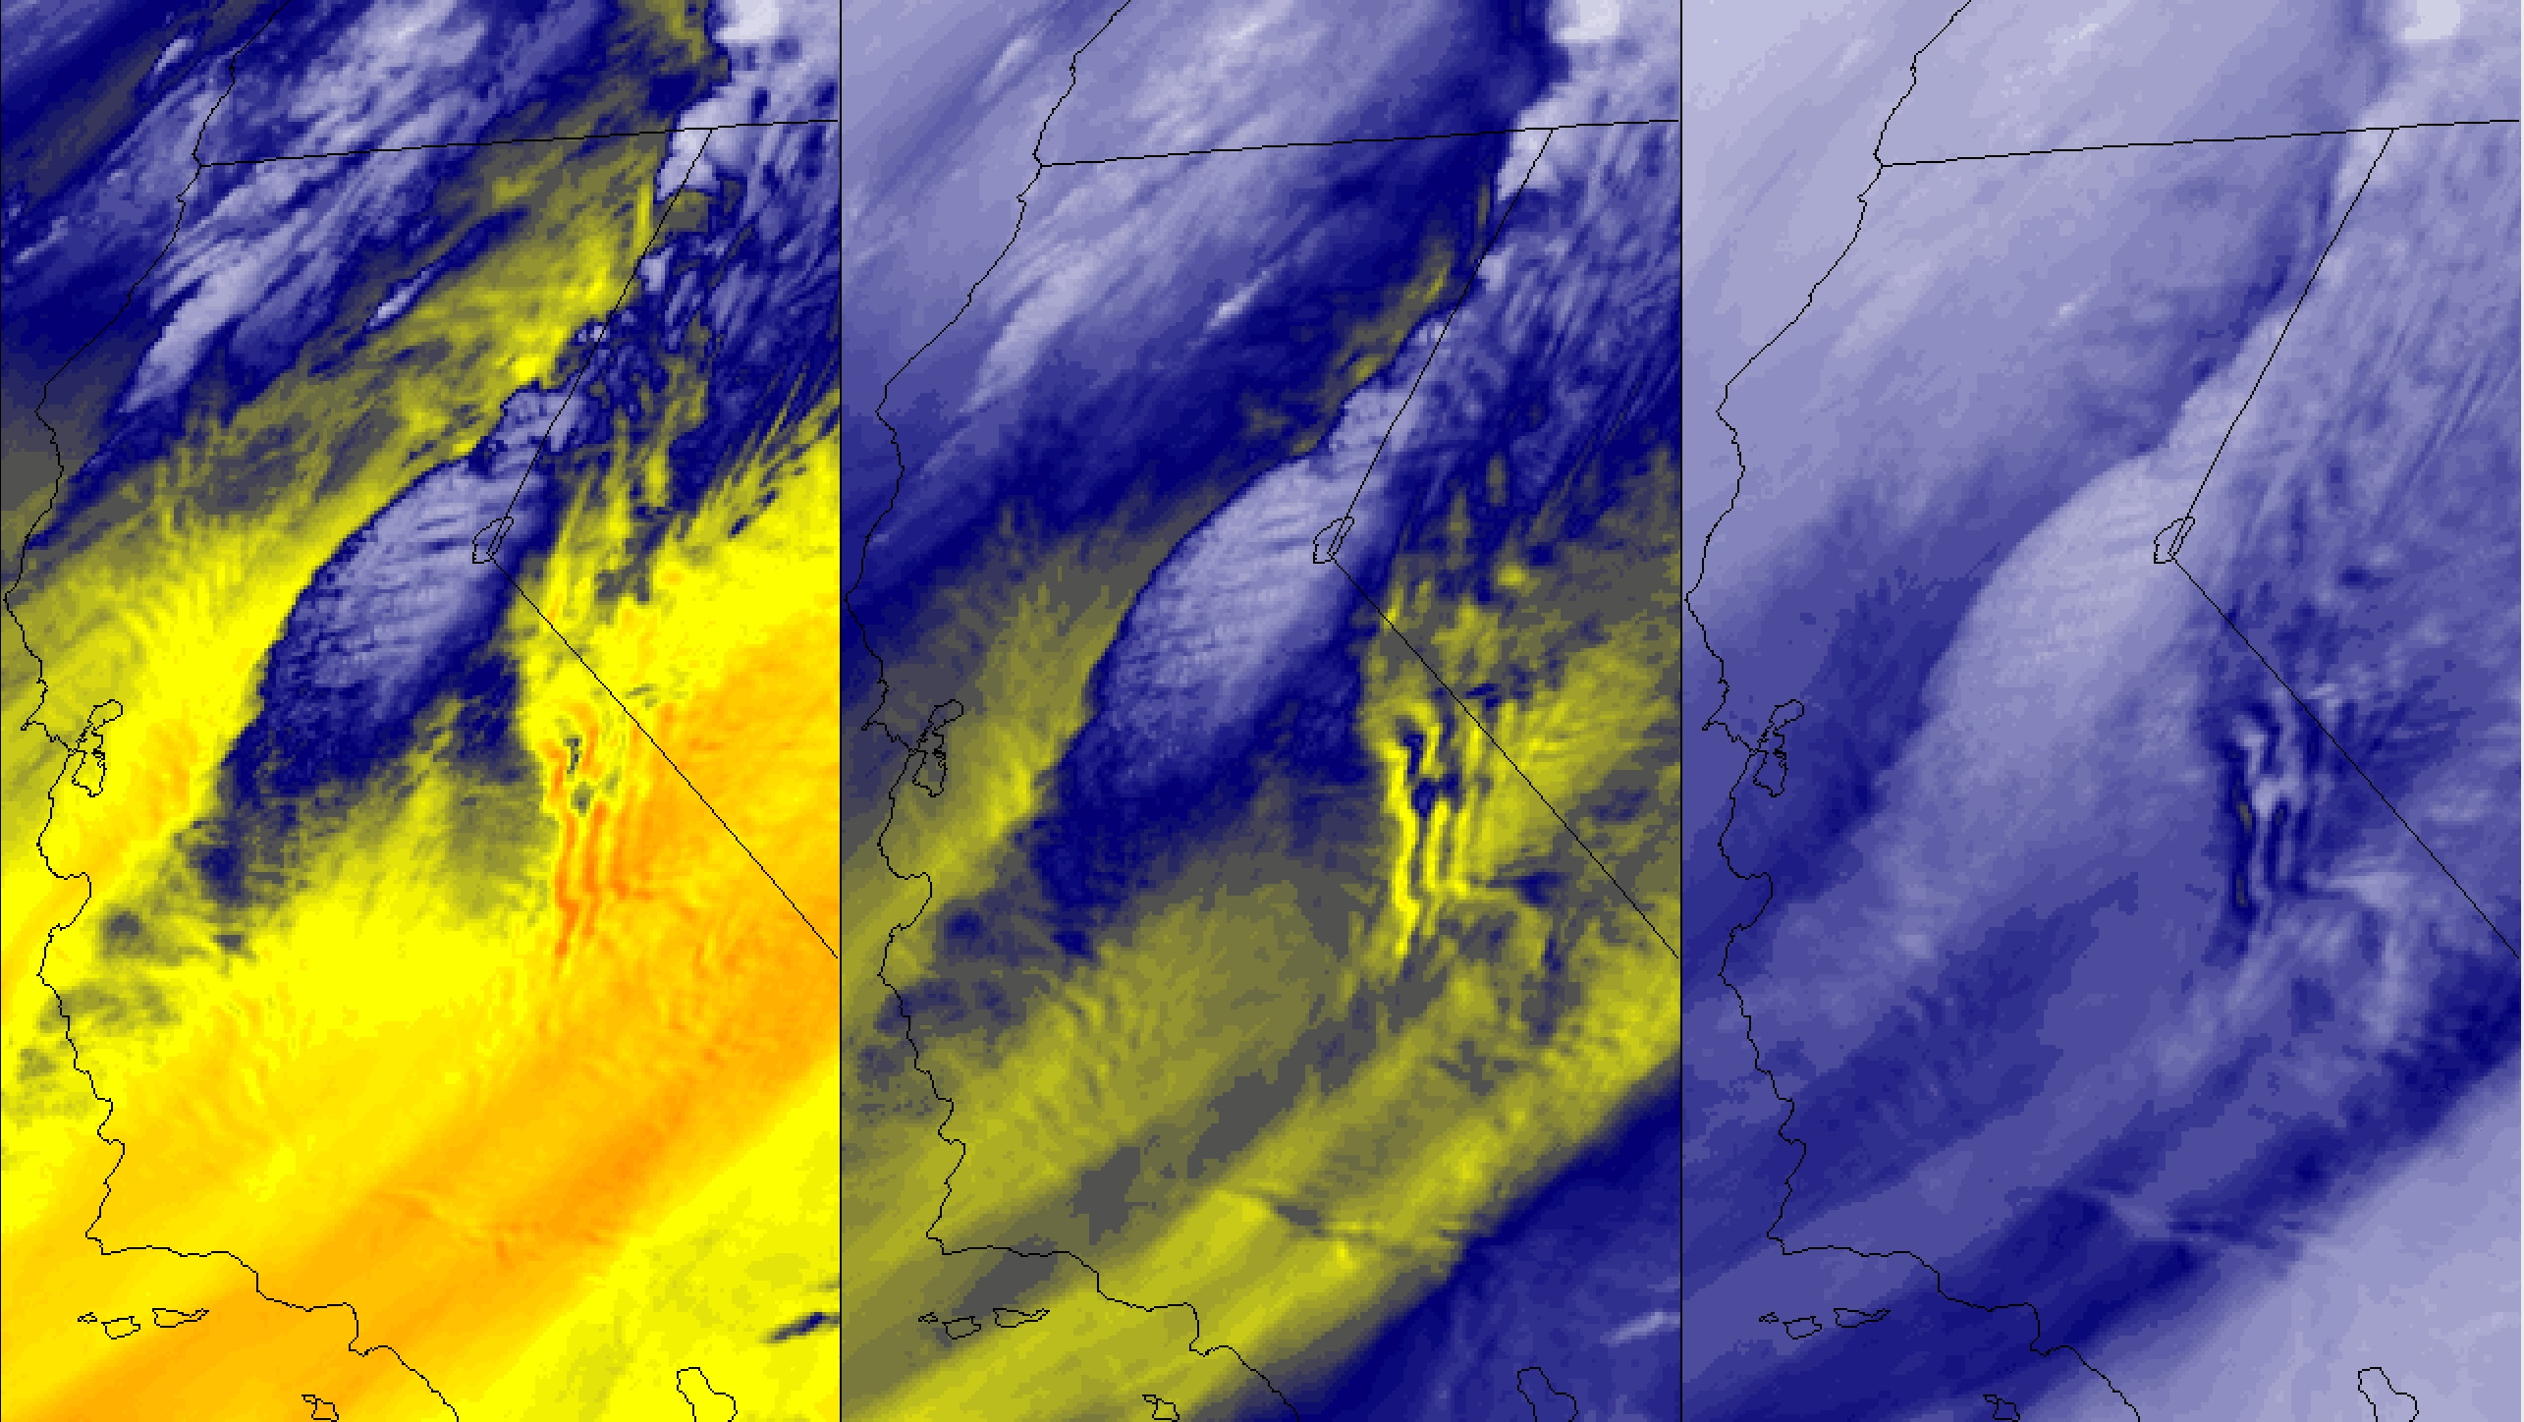
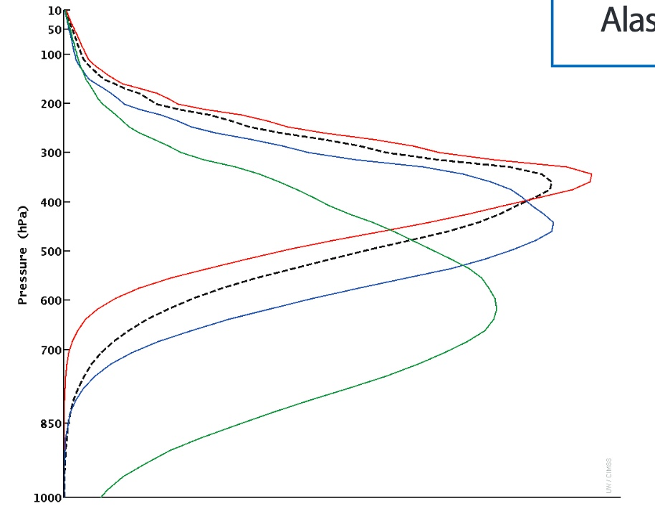
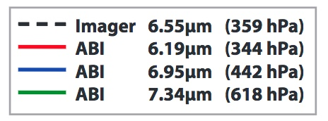
ABI Band 9 (6.9 μm)
Mid-Level Water Vapor
Image Interpretation
Axis of strong middle / upper tropospheric jet streak
Mountain waves downwind of the Coastal Ranges and the Sierra Nevada.
Depending on the topography as well as the atmospheric temperature and moisture profile, mountain waves might show up better on any of the water vapor bands. You may have to apply different enhancements as well.
Band 10 (7.3 µm)
Band 9 (6.9 µm)
Band 8 (6.2 µm)
1
1
2
2
2
2
3
1
1
1
2
4
2
2
2
GOES-16 water vapor Band 10, Band 9 and Band 8 images at 12:02 UTC on 13 April 2017
Weighting functions, plotted at right for legacy GOES and for ABI, depict the layer of the atmosphere from which radiation sensed by the satellite originated. These assume a clear sky and a US standard atmosphere. Weighting functions change as the vapor distribution changes, but in general the Mid Level Water Vapor band peaks in the middle of the three ABI bands. (Credit: CIMSS)
Infrared Water Vapor Channels are affected by cooling as the view angle increases. If the pixel location is farther from the sub-satellite point, the path the energy takes from Earth to satellite includes more of the colder upper atmosphere. For identical conditions, the brightness temperature might be 8 C cooler at the limb vs. at nadir.
Resources
BAMS Article Schmit et al., 2017
GOES-R.gov ABI Band 9 Fact Sheet
Real-Time Weighting Functions for Legacy GOES
ABI Weighting Functions for theoretical atmospheres
Hyperlinks do not work in AWIPS but they do in VLab
0.64 µm

