Slide 1
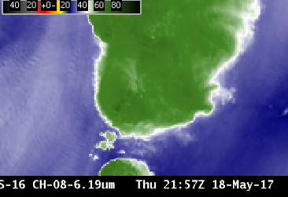
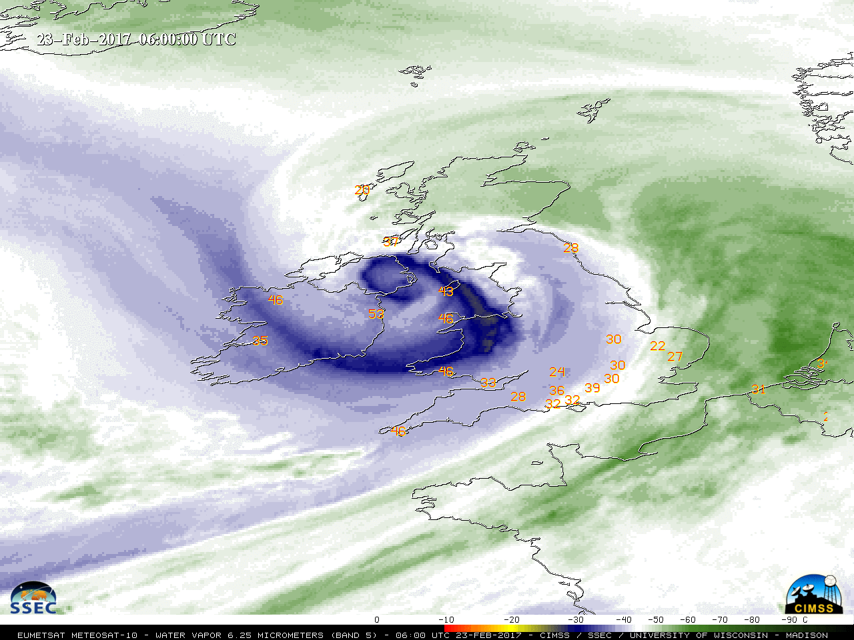
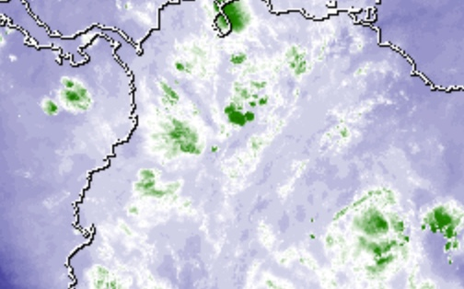
ABI Band 8 (6.2 μm)
Quick Guide
Why is “Upper-level water vapor” band imagery important?
The 6.2 µm “Upper-level water vapor” band is one of three water vapor bands on the ABI, and is used for tracking upper-tropospheric winds, identifying jet streams, forecasting hurricane track and mid-latitude storm motion, monitoring severe weather potential, estimating upper/ mid-level moisture (for legacy vertical moisture profiles) and identifying regions where the potential for turbulence exists. Further, it can be used to validate numerical model initialization and warming/cooling with time can reveal vertical motions at mid- and upper levels.
Comparison of ABI Water Vapor Bands
ABI Band | Approximate Central Wavelength (µm) | Band Nickname | Type | Nominal Pixel Resolution at sub-satellite point
8 | 6.2 | Upper-level tropospheric water vapor | Infrared | 2 km
9 | 6.9 | Mid-level tropospheric water vapor | Infrared | 2 km
10 | 7.3 | Lower-level tropospheric water vapor | Infrared | 2 km
Comparison of ABI Water Vapor Bands
Impact on Operations
Limitations
Primary Application Atmospheric feature identification (jet streams, troughs/ridges, signatures of potential turbulence).
Regions of dense cloudiness: Optically dense clouds obstruct the view of lower altitude moisture features.
Input into Baseline Products: 6.2 µm imagery is input for the creation of Derived Motion Winds and Total Precipitable Water products.
Input into RGB imagery: Upper-level water vapor imagery is a key component of the Airmass RGB product, helping to highlight jet stream axes as well as dry ozone-rich stratospheric air associated with potential vorticity anomalies and tropopause folds.
Feature Identification: Cloudless features that will soon produce clouds/precipitation can be identified in 6.2 μm imagery.
Interpretation of water vapor imagery: The “water vapor” bands are infrared bands that sense the mean temperature of a layer of moisture — a layer whose altitude and depth can vary, depending on both the temperature/moisture profile of the atmospheric column and the satellite viewing angle. Examination of water vapor weighting function plots can help in the correct interpretation of the three-dimensional aspects of patterns displayed on water vapor imagery.
Contributors: Scott Bachmeier, Tim Schmit, Jordan Gerth (UW-Madison CIMSS/NOAA) August 2017

Slide 2
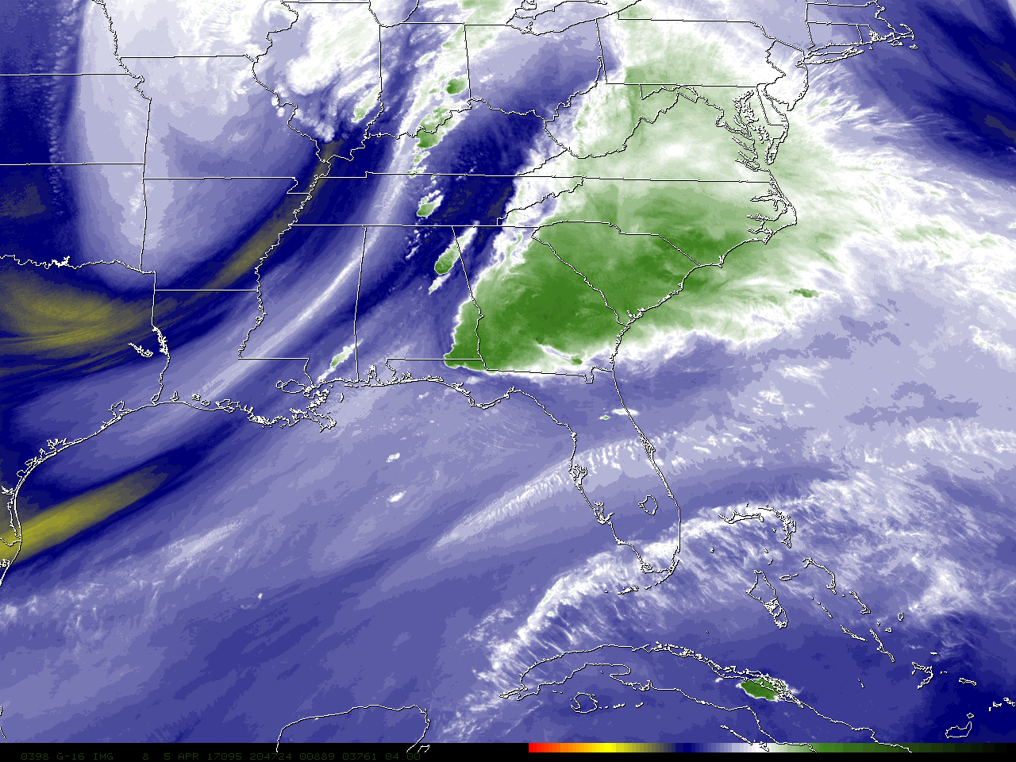
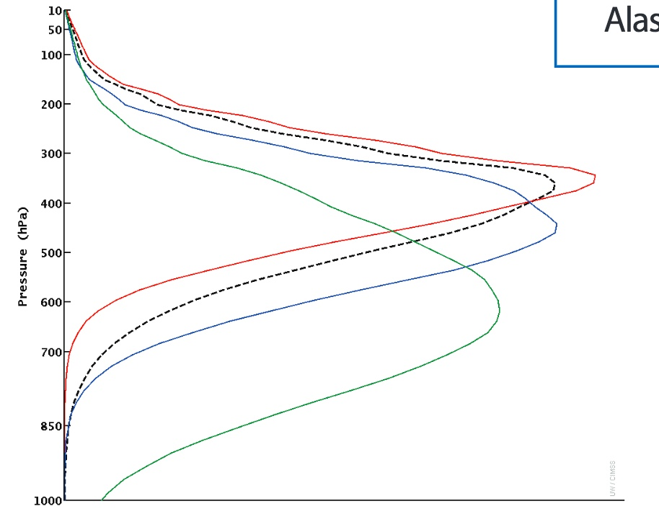
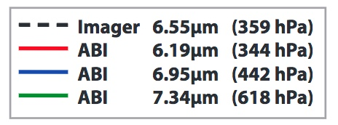
ABI Band 8 (6.2 μm)
Upper Level Water Vapor
Satellite Image Interpretation
Upper-level trough
Dry slot
Polar jet stream axis
Subtropical jet steam axis.
In this example, there is diffluent flow aloft (depicted by arrows) between the subtropical and polar jets. High-impact weather is possible where diffluence occurs:
Thunderstorms in this case.
1
1
2
3
2
Severe
Thunderstorms
3
4
4
1
Upper-Level Water Vapor Band (6.2 μm) image at 20:47 UTC on 05 April 2017
Weighting functions, plotted at right for legacy GOES and for ABI, depict the layer of the atmosphere from which radiation sensed by the satellite originated. These assume a clear sky and a US standard atmosphere. Weighting functions change as the vapor distribution changes, but in general the Upper Level Water Vapor band has the highest peak of the three ABI bands. (Credit: CIMSS)
Infrared Water Vapor Channels are affected by cooling as the view angle increases. If the pixel location is farther from the sub-satellite point, the path the energy takes from Earth to satellite includes more of the colder upper atmosphere. For identical conditions, the brightness temperature might be 8 C cooler at the limb vs. at nadir.
Resources
BAMS Article Schmit et al., 2017
GOES-R.gov ABI Band 8 Fact Sheet
Real-Time Weighting Function for Legacy GOES
ABI Weighting Functions for theoretical atmospheres
Hyperlinks do not work in AWIPS but they do in VLab

