Slide 1
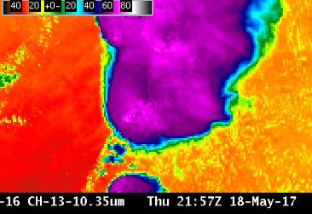
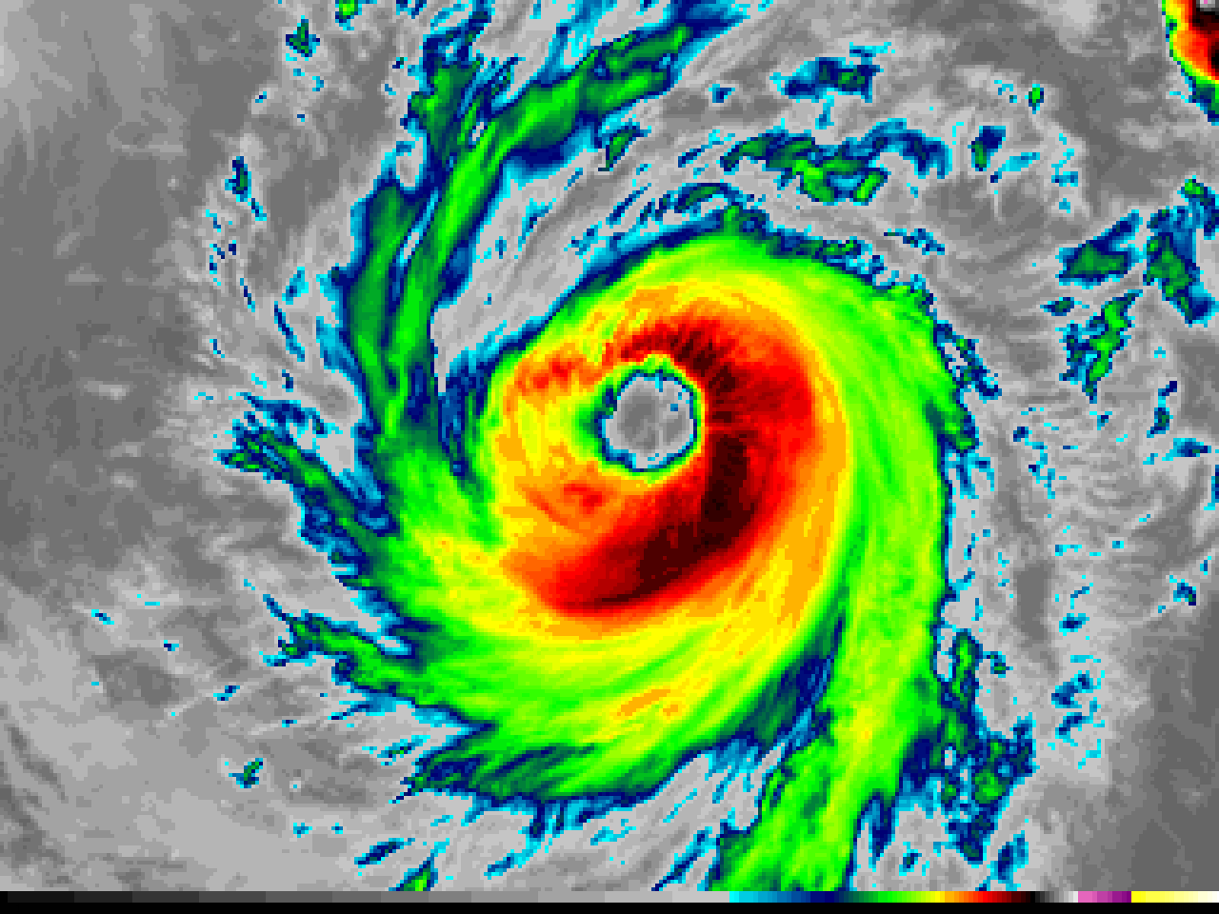
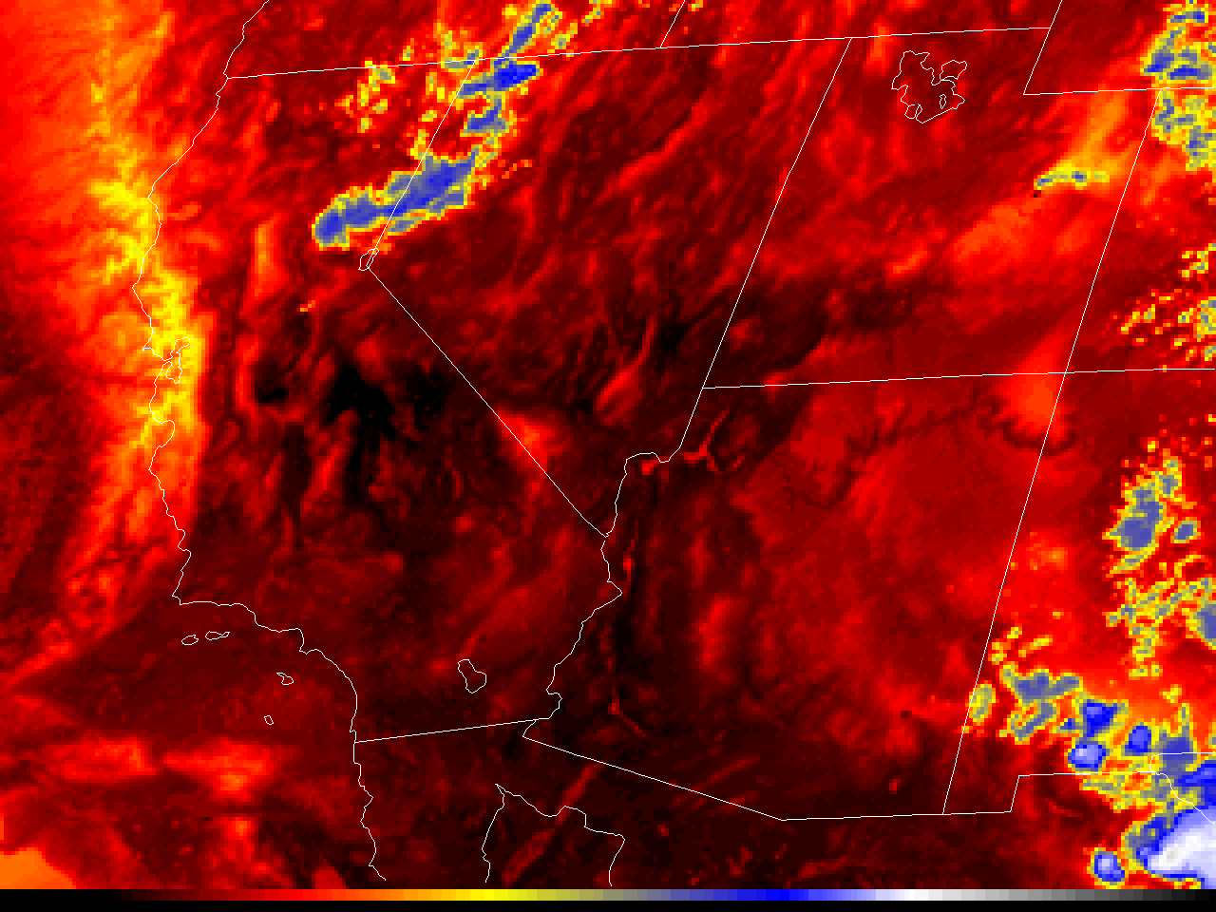
ABI Band 13 (10.3 μm)
Quick Guide
Why is “Clean longwave infrared window” band imagery important?
The 10.3 μm “clean” infrared window band is less sensitive than other infrared window bands to water vapor absorption, and therefore improves atmospheric moisture corrections, aids in cloud and other atmospheric feature identification/classification, estimation of cloud-top brightness temperature and cloud particle size, and surface property characterization in derived products.
Comparison of ABI Infrared Window Bands
Left: U.S. Standard Atmosphere Earth-emitted temperatures and spectral responses for ABI and GOES-13 Window Channels. The Legacy channel (10.7 μm) covers parts of the 10.3 μm and 11.2 μm bands on ABI (Figure: Mat Gunshor, CIMSS)
ABI Band | Approximate Central Wavelength (µm) | Band Nickname | Type | Nominal Pixel Resolution at sub-satellite point
13 | 10.3 | “Clean” Longwave Infrared Window | IR | 2 km
14 | 11.2 | Longwave Infrared Window | IR | 2 km
15 | 12.3 | “Dirty” Longwave Infrared Window | IR | 2 km
Comparison of ABI Water Vapor Bands
10.7 μm
10.3 μm
11.2 μm
12.3 μm
Impact on Operations
Limitations
Primary Application Continuous day/night cloud feature identification and classification, convective severe weather signatures, and hurricane intensity.
Infrared vs surface air temperature: 10.3 µm brightness temperatures are not necessarily representative of 2-m shelter air temperatures,
Input into Baseline Products: The 10.3 µm imagery is used in the creation of legacy vertical temperature/moisture profiles, stability indices, total precipitable water, sea surface temperature, Hurricane Intensity Estimate (HIE), and snow cover products. Input into RGBs: 10.3 μm imagery is used in many RGB composites and band differences.
especially during the day, when the land can warm substantially compared to the near-surface air. Because there is some absorption of upwelling energy by atmospheric water vapor, the satellite-measured infrared brightness temperatures do not provide a truly accurate “skin temperature.” A Baseline Product is available that provides the Land Surface Temperature.
Contributors: Scott Bachmeier, Tim Schmit, Jordan Gerth (UW-Madison CIMSS/NOAA) August 2017

Slide 2
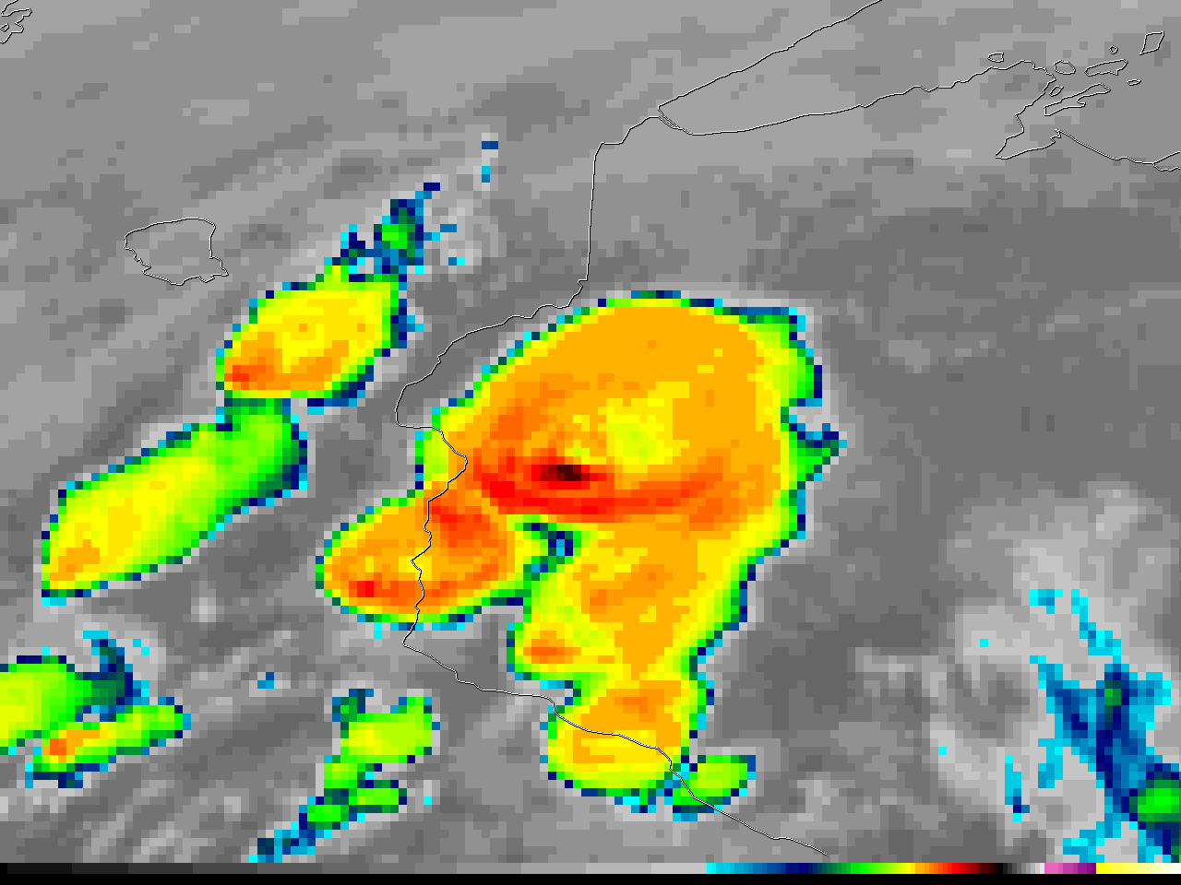
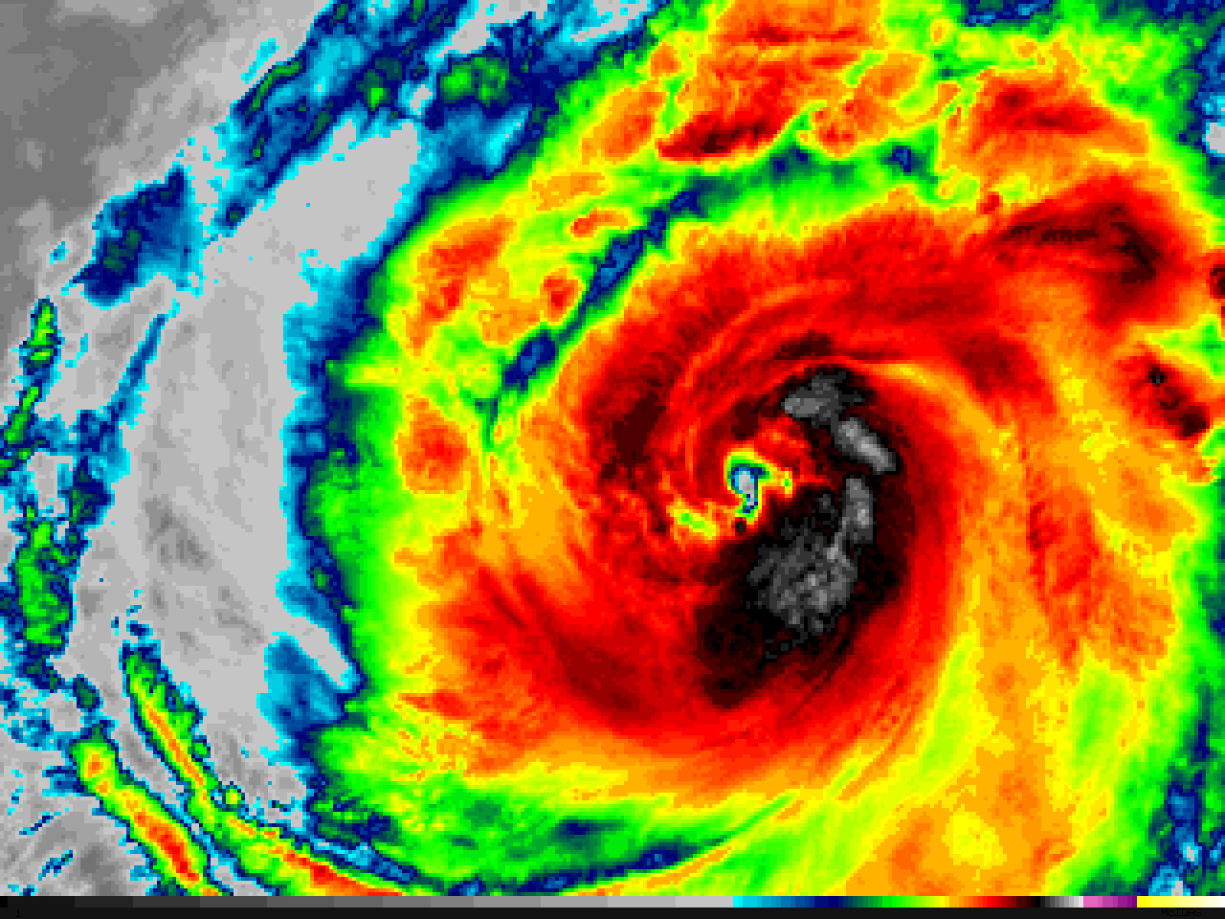
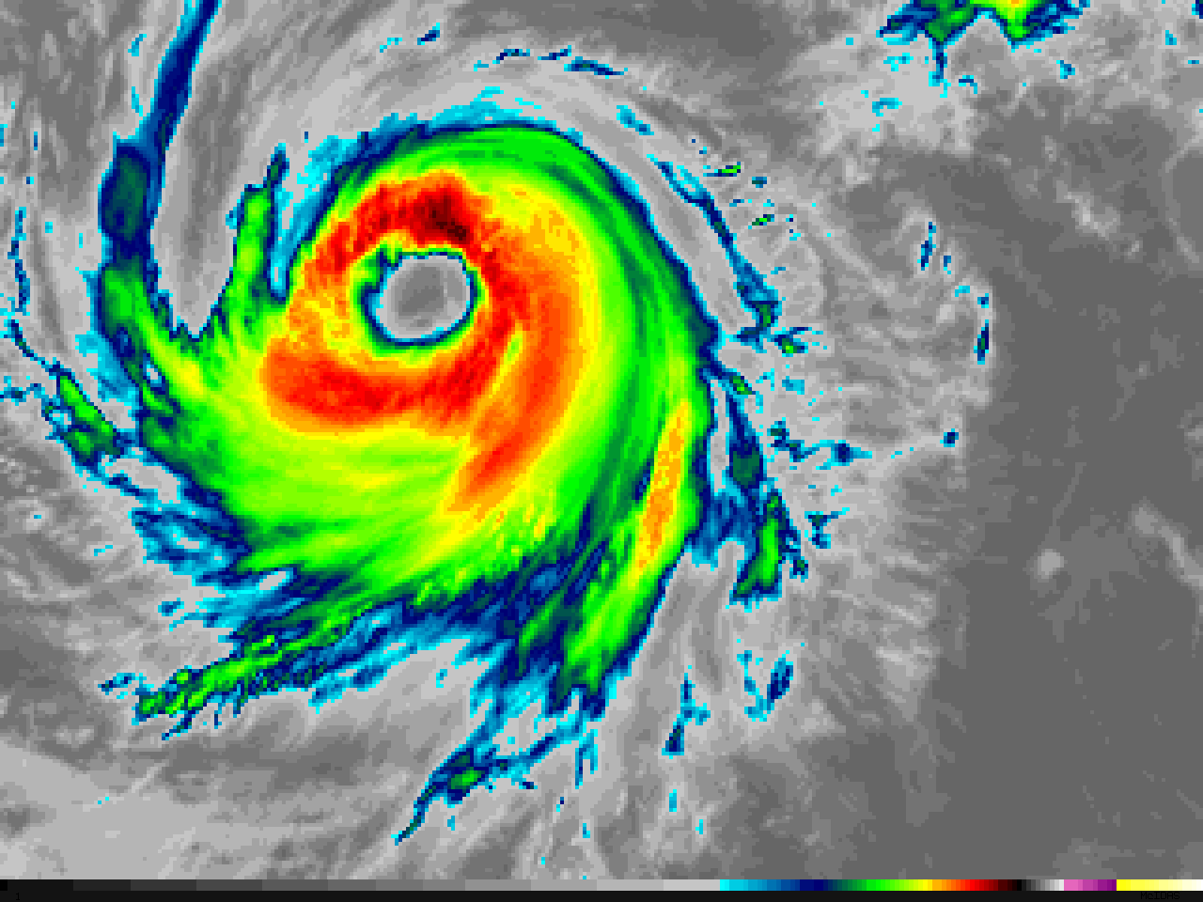
ABI Band 1 (0.47 μm)
ABI Band 13 (10.3 μm)
Quick Guide
“Clean” Infrared Window
Image Interpretation
Enhanced-V signature (Reds) with Overshoot in Black
Cold (Black) / Warm (Yellow to Green) Thermal Couplet
The “Enhanced-V” and/or “Thermal Couplet” infrared storm-top signatures are associated with thunderstorms that are or will presently (usually within 20-30 minutes) be producing either damaging winds, large hail, or tornadoes
1
2
2
Minnesota
Wisconsin
1
GOES-16 “Clean” Infrared Window (10.3 µm) image, 21:27 UTC on 16 May 2017
7.3 µm
6.9 µm
Resources
BAMS Article Schmit et al., 2017
GOES-R.gov ABI Band 13 Fact Sheet
Hyperlinks do not work in AWIPS but they do in VLab
0.64 µm
GOES-16 10.3 µm “Clean” Infrared Window images of Hurricane Dora in the East Pacific Ocean, showing the development of a well-defined eye during the 12-hour period between 14 UTC on 26 June (left) and 02 UTC on 27 June 2017 (right). Images are the same scale, showing storm contraction during intensification. (Credit: CIMSS)

