Slide 1
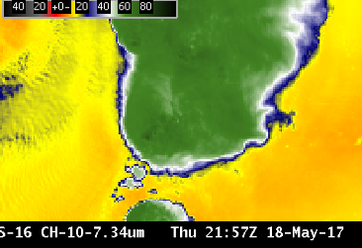
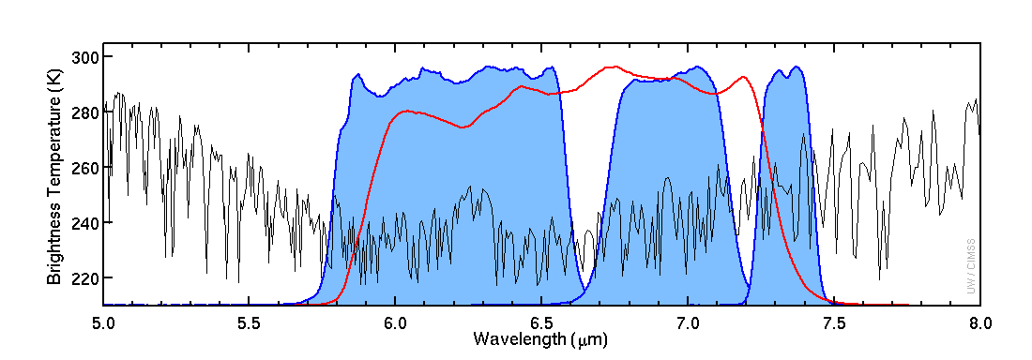
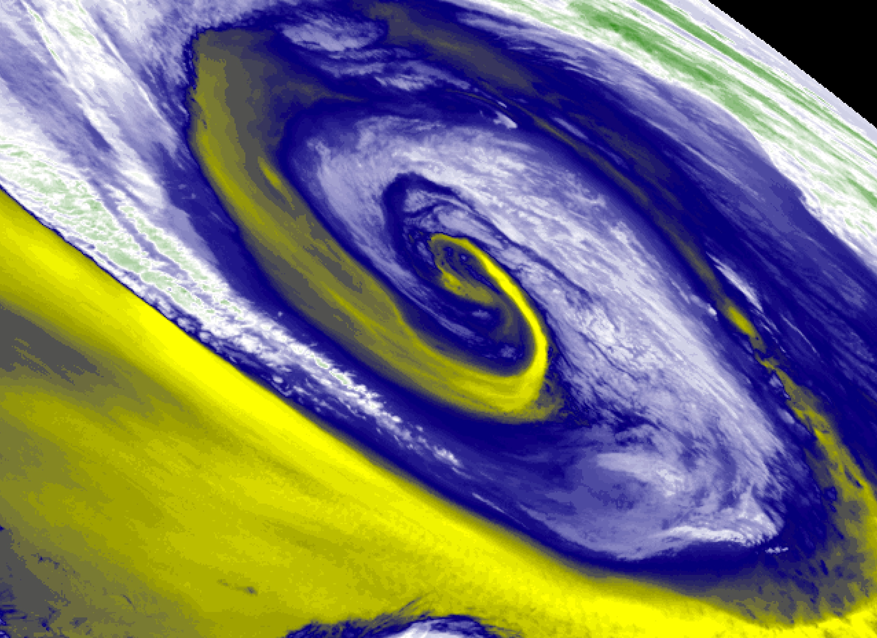
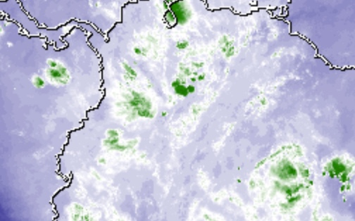
ABI Band 10 (7.3 μm)
Quick Guide
Why is “Lower-level water vapor” band imagery important?
The 7.3 µm “Lower-level water vapor” band is one of three water vapor bands on the ABI. It typically senses farthest down into the mid-troposphere in cloud-free regions, to around 500-750 hPa. It is used to track lower-tropospheric winds, identify jet streaks, monitor severe weather potential, estimate lower-level moisture (for legacy vertical moisture profiles), identify regions where the potential for turbulence exists, highlight volcanic plumes that are rich in sulphur dioxide (SO₂) and track Lake-Effect snow bands.
Comparison of ABI Water Vapor Bands
Left: U.S. Standard Atmosphere Earth-emitted temperatures and spectral responses for ABI and GOES-13 Water Vapor Channels. The Legacy channel (6.5 μm) covers much of the 6.2 μm and 6.9 μm and 7.3 μm bands on ABI (Figure: Mat Gunshor, CIMSS)
6.5 μm
6.2 μm
6.9 μm
7.3 μm
Impact on Operations
Limitations
Primary Application Atmospheric feature identification (jet streaks, dry slots, signatures of potential turbulence, contrails, downslope winds., Lake Effect)
Regions of dense cloudiness: The presence of optically-dense clouds obstructs the view of lower altitude moisture features.
Interpretation of water vapor imagery: The “water vapor” bands are technically infrared bands which sense the mean temperature of a layer of moisture — a layer whose altitude and depth can vary, depending on both the temperature/moisture profile of the atmospheric column and the satellite viewing angle. Water vapor weighting function plots may help you correctly interpret the three-dimensional aspects of patterns displayed on water vapor imagery. Band 8 and Band 9 Quick Guides contain simple plots.
Input into Baseline Products: The 7.3 µm imagery is used in the creation of Derived Motion Winds, the Cloud Mask, Stability Indices, Total Precipitable Water, Rain Rate, and Volcanic Ash products.
Application: Identification of volcanic plumes that have a high concentration of SO₂.
Contributors: Scott Bachmeier, Tim Schmit, Jordan Gerth (UW-Madison CIMSS/NOAA) September 2017

Slide 2
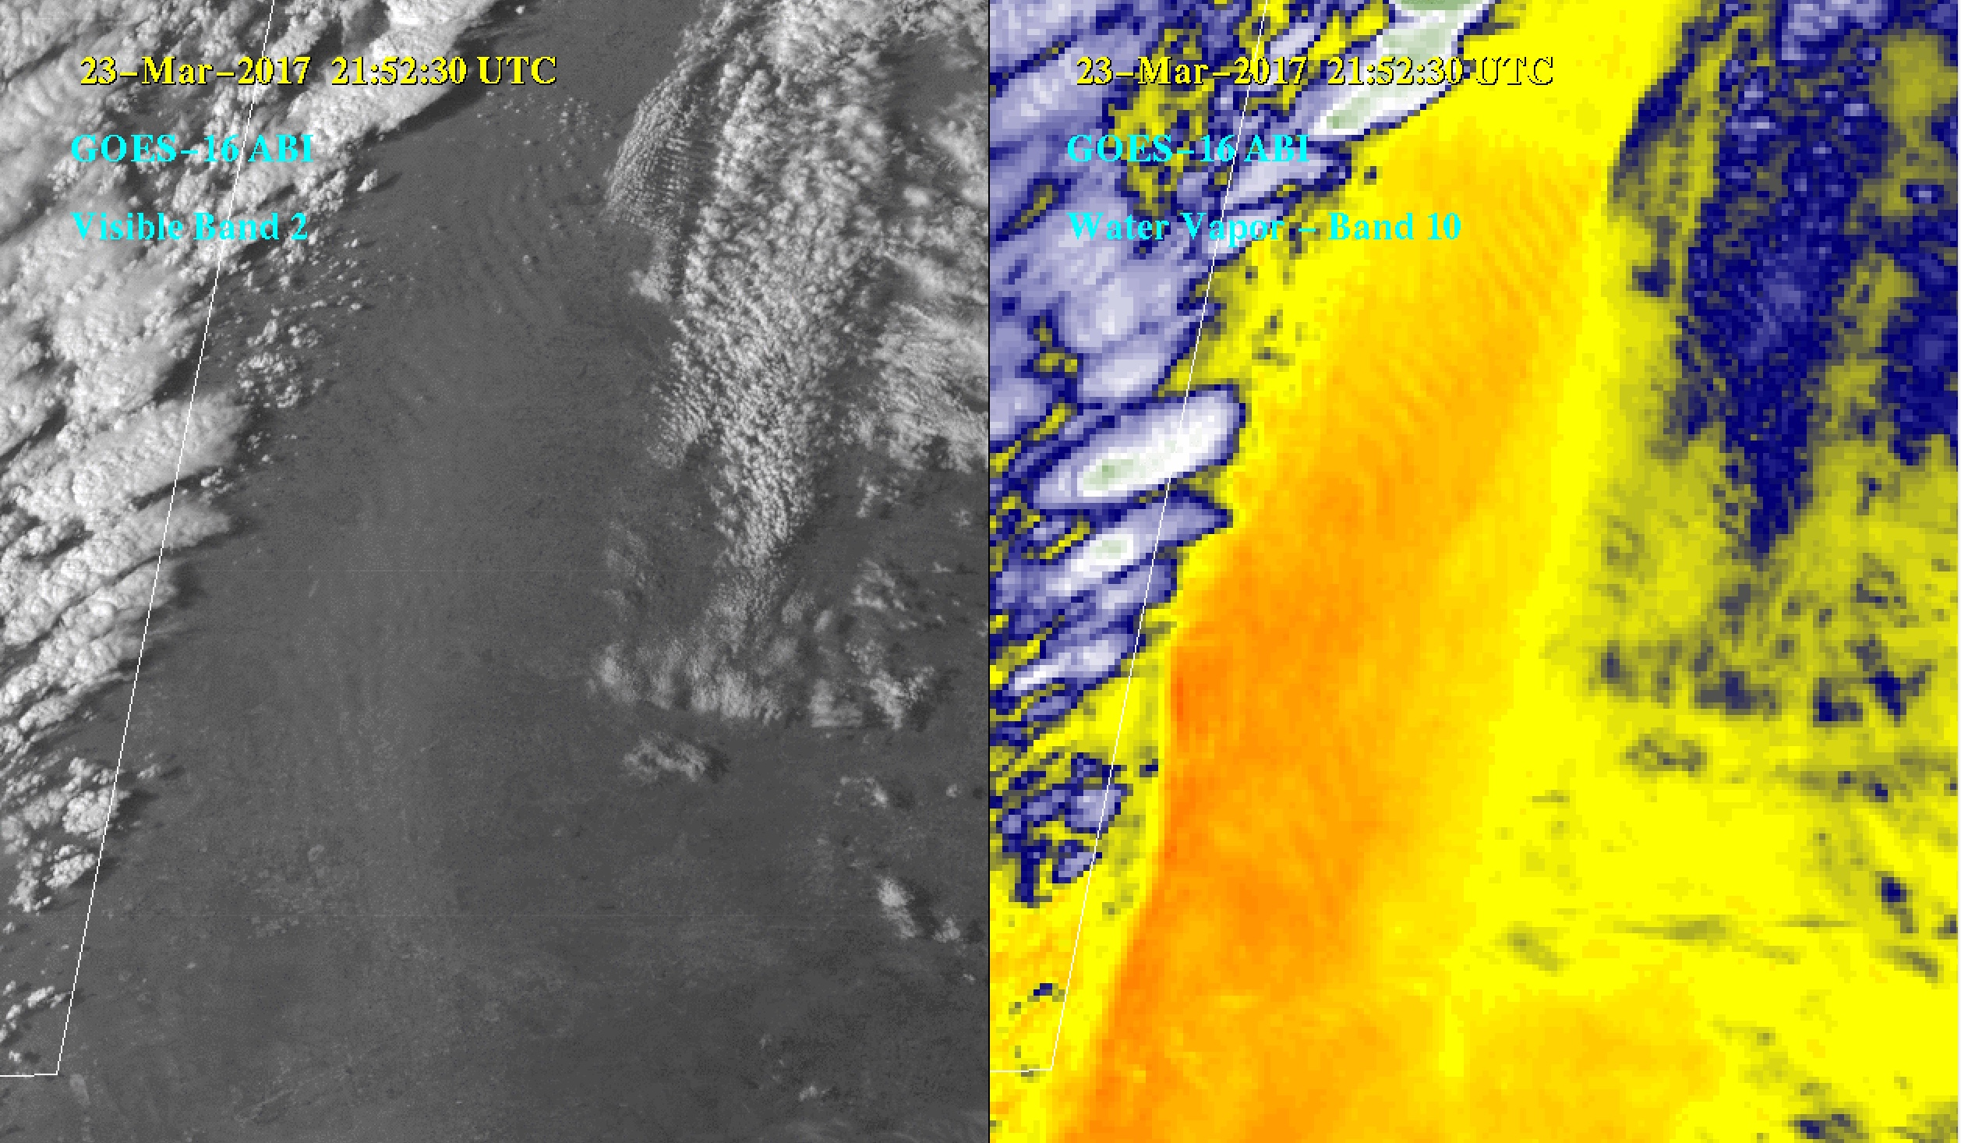
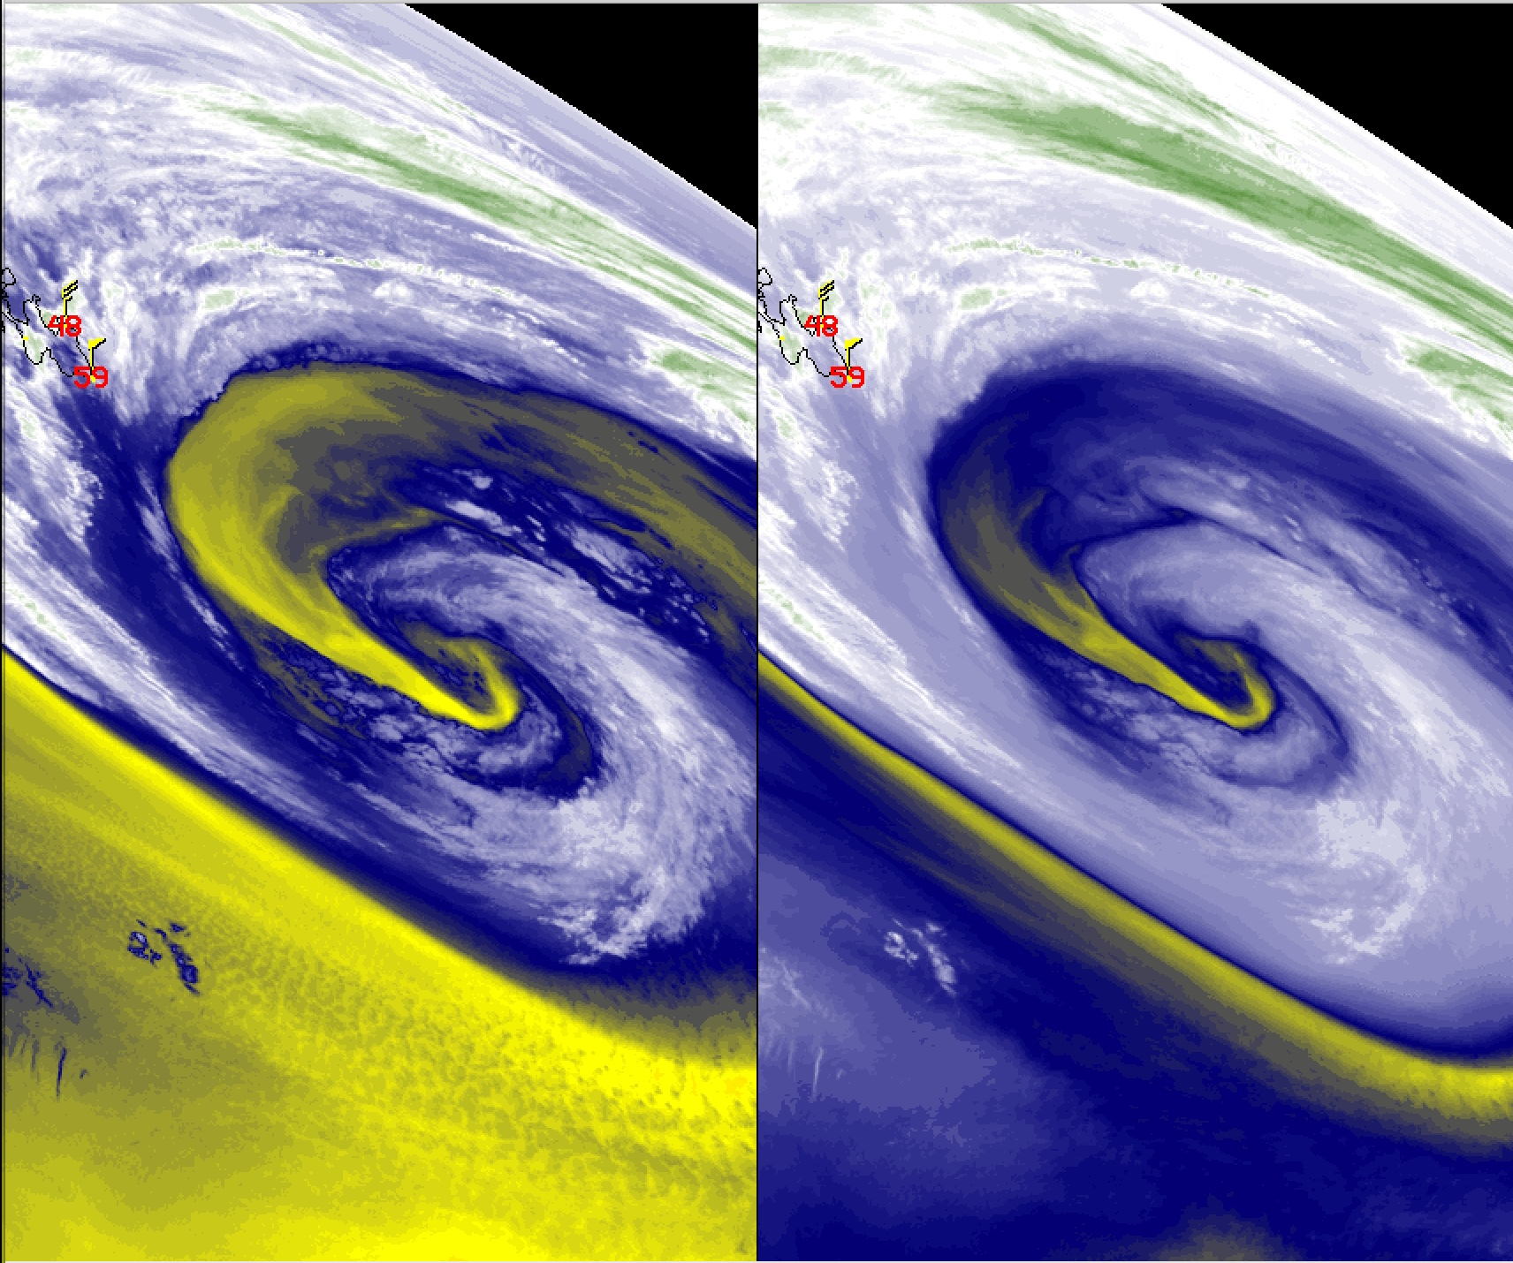
ABI Band 1 (0.47 μm)
ABI Band 10 (7.3 μm)
Quick Guide
Low-Level Water Vapor
Image Interpretation
Horizontal convective rolls
Dryline
To the east of the dryline oriented N-S along the Texas / New Mexico border, strong southerly winds caused blowing dust; plumes of lofted dust were organized into horizontal convective rolls aligned parallel to the wind flow
23 March 2017 2152 UTC
23 March 2017 2152 UTC
1
GOES-16 ABI
GOES-16 ABI
2
Visible Band 2
Water Vapor Band 10
1
1
2
1
1
2
Texas
Texas
Visible (0.64 µm) and Lower-Level Water Vapor (7.3 µm) images, 21:52 UTC on 23 March 2017
7.3 µm
6.9 µm
Resources
BAMS Article Schmit et al., 2017
GOES-R.gov ABI Band 10 Fact Sheet
VISIT Satellite Chat GOES-16 Water Vapor Band Ororgraphic Applications
Hyperlinks do not work in AWIPS but they do in VLab
0.64 µm
The 7.3 µm band can detect lower-level clouds when the middle/upper atmosphere is relatively dry— this example shows marine boundary layer stratocumulus over the Atlantic Ocean. (Credit: CIMSS)

