Slide 1
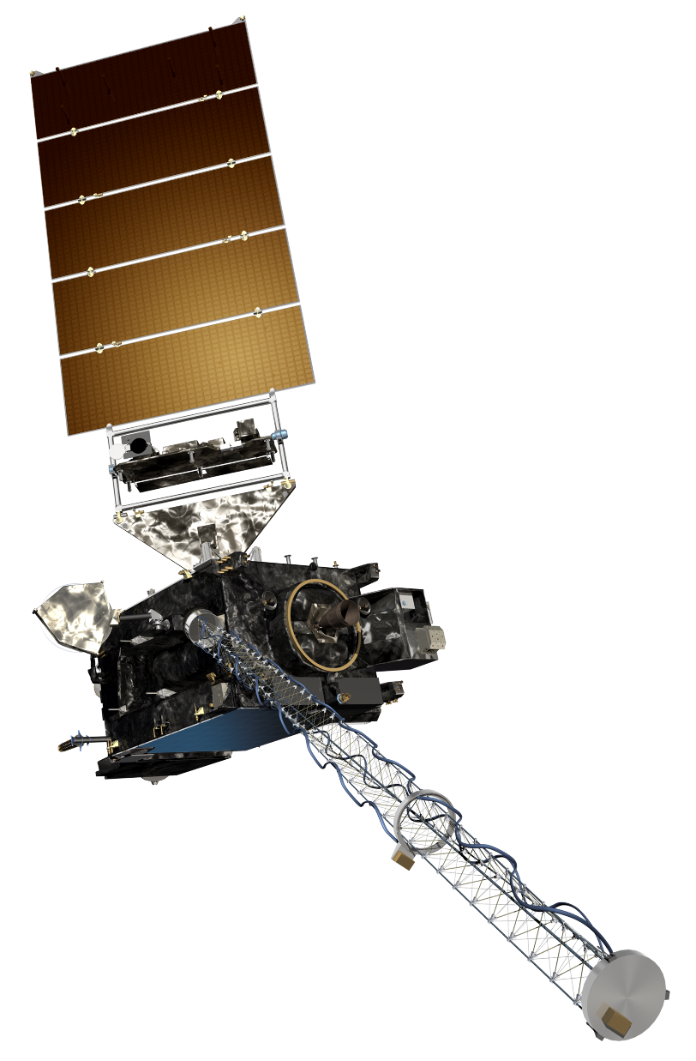
The GOES-R Series:
Welcome to GOES-R:
The 0.64 μm Red Band
Scott Lindstrom
UW Madison CIMSS
with Kaba Bah, Margaret Mooney, Kathy Strabala, Scott Bachmeier, and more!
SHyMet Introductory Course
Notes:
This is the SHyMet course on the Advanced Baseline Imager (the ABI), one of two sensors on GOES-R that measures the Earth's atmosphere (the Geostationary Lightning Mapper is the second). This course has been created with funding from the GOES-R Program and it should show you uses for the 16 channels on ABI. Contributors to this training are listed in this slide.

Slide 2
ABI: Bands 1-6 (Visible / NearIR)
ABI Band | Wavelength (µm) | Wavelength range (µm) | Sub-point pixel spacing (km) | Descriptive Name
1 | 0.47 | 0.45 - 0.49 | 1 | “Blue”
2 | 0.64 | 0.60 - 0.68 | 0.5 | “Red”
3 | 0.864 | 0.847 - 0.882 | 1 | “Veggie”
4 | 1.373 | 1.366 - 1.380 | 2 | “Cirrus”
5 | 1.61 | 1.59 - 1.63 | 1 | “Snow/Ice”
6 | 2.24 | 2.22 -2.27 | 2 | “Cloud Particle Size”
Six visible or near visible bands on ABI
(there was only one on heritage imager)
Notes:
This table is based on Schmit et al, 2017. (References are listed at the end of this training) Band numbers are shown (you can also call them channels), as well as the central wavelength, the wavelength range, the pixel resolution at the satellite sub-point (That is, nadir), and the nickname. The green circles are around bands5 1, 3 and 5, which bands have 1-km resolution at the sub-satellite point. The highest-resolution band, band 2, the 0.64 micrometer band (the so-called “Red Visible”) has half-kilometer resolution at the sub-satellite point. This is also the band that was on earlier GOES instruments.
You might be asking: WHY are these wavelengths chosen for band placement? Are they random? No! As you'll see next, there's a reason.

Slide 3
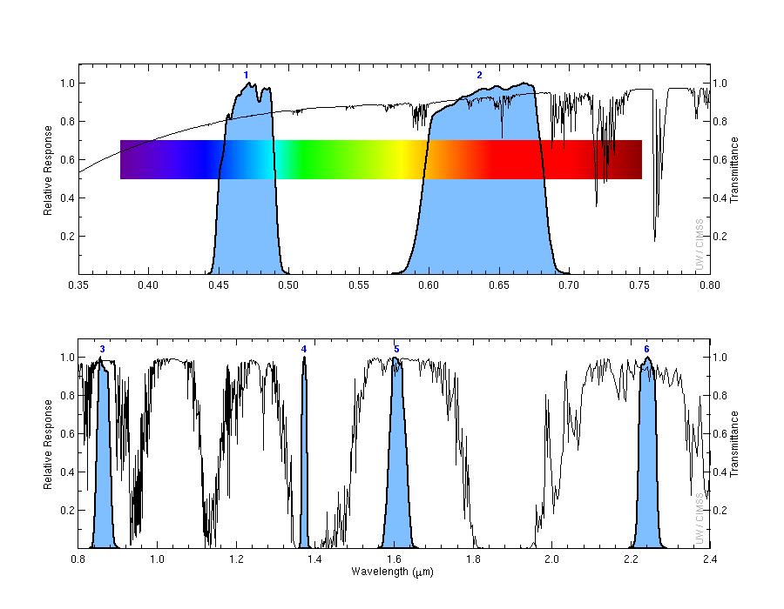
Transmittance is fairly very strong in the Red Band as compared to the blue Band
1
2
Transmittance
0.47 μm
0.64 μm
3
4
5
6
Transmittance
0.86 μm
1.38 μm
1.61 μm
2.2 μm
Notes:
Visible and near-infrared imagery relies on reflected solar radiation to create a signal. This chart shows similar information to the previous slide. Band number is shown across the top. The Roy G Biv visible spectrum is shown too - do you see why they're nicknames the blue and red bands? The blue regions - the spectral response function - shows where information is detected for each channel. The black line is transmittance through the atmosphere - note how it decreases across the 'blue band', band 1, because atmospheric scattering increases. Band 4, at 1.38 micrometers, is special among these 6 bands because it occupies a region with strong absorption (by water vapor). As you'll see, that means it has a much different look than the other bands in the visible and near-infrared part of the spectrum.

Slide 4
Why use the Red Band
Legacy GOES visible channel.
0.5-km, spatial resolution.
Can be used for hurricane analysis, detection of fog, estimate solar insolation, day time snow and ice cover, volcanic ash, smoke, low level cloud drift winds.
Excellent for revealing features such as:
Above anvil plumes
Pulsating overshooting tops.
Low level derived motion winds
Information from 0.64 μm are needed for multiple Baseline Products
0.64 μm data are used in ‘True Color’ imagery.
Notes:
The 0.64 µm, or “Red” visible band, is the primary band used to identify features in the visible and a legacy channel that extends GOES observations at visible wavelengths . It has the finest spatial resolution of all the ABI bands at 0.5km and as a result, also consumes more data space than all the 10 infrared channels combined. Besides being used as a stand along band for major critical decision making such as during hurricanes and fog detections, it plays key roles in multiple GOES-R baseline products as well “True color” imagery.
Besides being the primary band for identifying features in the visible range, this channel is also very useful in mesoscale sectors for rapidly changing phenomena.
The “Red” band (0.64 µm) in combination with a “Green” band simulated from the “Vegetation” band (0.86 µm) and the “Blue” band (0.47 µm), provides approximate “natural true color” imagery of the Earth.

Slide 5
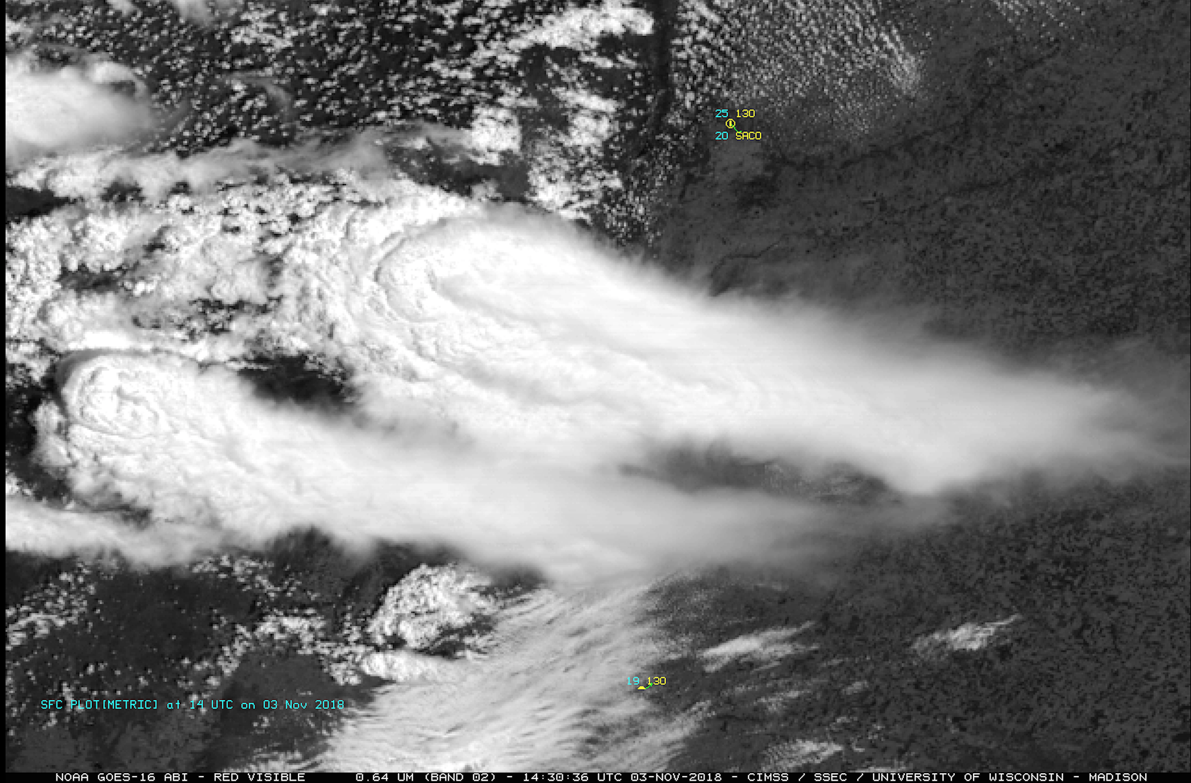
The 0.64 μm detects above anvil plumes.
Notes:
This example shows very distinct above-anvil plumes as observed by GOES-16 ABI 0.64 µm over northern Argentina on 03rd November 2018 at 14:30 UTC. This plume was found to be between 2-3km above the main thunderstorm anvil and resulted in producing major thunderstorms south of Cordoba, Argentina.

Slide 6
Pulsating overshooting top apparent at 0.64 μm
Notes:
This example shows the development of a thunderstorm, which produced an EF-4 tornado near Alonsa, Manitoba during the early evening hours on 03 August 2018.
The high spatial and temporal resolution of the 0.64 micrometer, made is very easy to visualize and analyze the series of pulsating overshooting tops as the thunderstorm matured.
This tornado resulted into at least one death in Manitoba and is among the strongest tornado confirmed in 2018 in all of North America. The haziness evident in the Visible imagery was
due to smoke from wildfires in the western US and Canada.

Slide 7
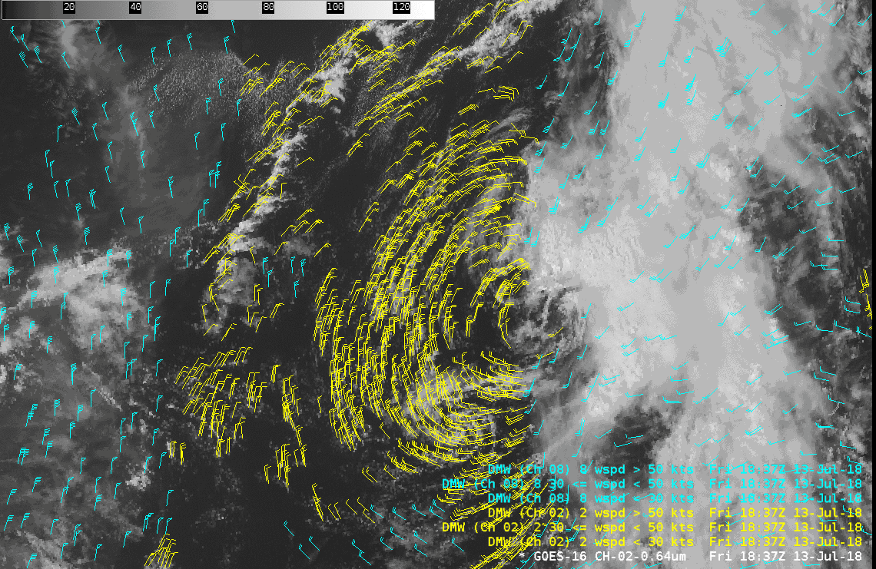
Low level derived motion winds.
Notes:
The ”Red” band -0.64 µm is the primary source of low-level (surface to 700 hPa) Derived Motion Winds during the daytime hours. Besides being helpful for identifying areas of wind shear and jet maxima's, they are also very critical for numerical model assimilation.

Slide 8
Red Band is necessary for True Color
Notes:
AWIPS includes simulated True Color imagery, and the ‘Red Band’ is a necessary component of that, along with the ‘blue Band’ – at 0.47 µm, and a simulated green band that considers output from the ‘Veggie Band’.

Slide 9
Why use the Red Band
0.5-km Resolution, finest ABI spatial resolution.
Ideal for identifying daytime small scale features
Can better reveal features such as”
River fogs
Cumulus clouds
Overshooting tops
Snow and ice cover
Hurricane analysis
Volcanic ash detection
Low level cloud-wind drift.
Information from 0.64 μm is critical for multiple Baseline Products
Land features stands out well because atmospheric scatting is not as large at 0.64um compared to other visible bands.
Notes:
A summary of what you’ve just learned.

Slide 10
Thank you
For more information visit www.goes-r.gov --
or find your favorite social media link below
www.facebook.com/GOESRsatellite
www.youtube.com/user/NOAASatellites
twitter.com/NOAASatellites
www.flickr.com/photos/noaasatellites
Notes:
There are places online that you can find. Here as some Social Media contacts as of 2018.

