Slide 1
REAL ESTATE 410
Fixed Rate Mortgages
Spring 2017

Slide 2
Topics
Constant payment mortgages
Financing cost and yield calculations
Effective borrowing cost
Reverse Mortgages
Other mortgage products

Slide 3
Fixed-Rate Mortgages
Technically, a fixed rate mortgage (FRM) is any mortgage with a fixed interest rate over the life of the loan.
FRM loan terms:
    Loan amount
      Limits for conforming conventional home mortgages
    Loan maturity date of 15 to 30 years
    Fixed interest rate
    Periodic payments
      The amount of payments will depend on payment terms, interest rate, and loan maturity date
      Payments can technically be fixed or variable

Slide 4
Constant Payment Mortgage
Constant payment mortgage (CPM) is commonly referred to as FRM
Most common form of financing for residential in the U.S.
CPM has the following three characteristics:
  Fixed interest rate
  Leveled payments
      Fixed periodic payments (usually in arrears, i.e., at period’s end)
      Payments are usually monthly for most home mortgages
  Fully amortizing
      Periodic payments consist of both interest and amortization of principal, which is fully repaid at the end of the term.
      Equity buildup over time (Is this a real benefit?)
Residential CPMs are usually for 15, 20, or 30 years.

Slide 5
CPM DS Calculation
Example 1
Consider a CPM loan of $500,000 at 12% for 25 years, compounded annually. What is the periodic DS in order to fully repay the loan after 25 payments?
At origination, the PV of payments equal to loan amount.
This is the special case of the more general formula seen earlier.
NB: The periodic discount rate is the annual interest rate divided by the number of payment during the year. Since payment are annual in this example, the discount rate is equal to the interest rate.

Slide 6
CPM DS Calculation
Therefore, we have:

Slide 7
CPM DS Calculation
Mortgage Constant
  PVAIF_{12%, 25} is the PV of an annuity factor at 12% for 25 years. It is the PV of a stream of $1 CFs.
  The inverse of PVAIF_{12%, 25} is referred to as the mortgage constant.

Slide 8
CPM DS Calculation
  If you want, you can first calculate the mortgage constant as presented here and then multiply with loan amount to get the periodic payment as done below.
  But it is much easier these days to a financial calculator or Excel:
    Calculator: PV=500,000; FV=0; I=12%; N=25; PMT=?
    Excel: PMT(rate (12%), nper (25), PV(500,000), FV(0))

Slide 9
Example 2
Calculating the Payment for a CPM
  $100,00 Mortgage
  7% Interest rate
  30 Years
  Monthly Payments
Solution:
  PV = $100,000
  n = 30 x 12 = 360
  FV = $0
  i = 7/12 = .5833 (or change P/Y to 12 and enter 7)
  PMT = $665.30

Slide 10
Example 2
Interest paid in the first month
  (.07/12) x $100,000 = $583.33
Principal paid in the first month
  $665.30 - $583.33 = $81.96
Every month, interest portion declines and the principal portion increases.
  Why?
  Because you are paying down the mortgage!

Slide 11
Amortization Schedule
Period | Loan Balance | Payment | Accrued Interest | Principal Repayment | Ending Balance
1 | $100,000.00 | $665.30 | $583.33 | $81.97 | $99,918.03
2 | $99,918.03 | $665.30 | $582.86 | $82.45 | $99,835.58
3 | $99,835.58 | $665.30 | $582.37 | $82.93 | $99,752.66
4 | $99,752.66 | $665.30 | $581.89 | $83.41 | $99,669.24
5 | $99,669.24 | $665.30 | $581.40 | $83.90 | $99,585.34
356 | $3,269.08 | $665.30 | $19.07 | $646.23 | $2,622.85
357 | $2,622.85 | $665.30 | $15.30 | $650.00 | $1,972.85
358 | $1,972.85 | $665.30 | $11.51 | $653.79 | $1,319.05
359 | $1,319.05 | $665.30 | $7.69 | $657.61 | $661.44
360 | $661.44 | $665.30 | $3.86 | $661.44 | $0.00

Slide 12
Amortization Schedule

Slide 13
Example 3
CPM with these characteristics
  $60,000 Mortgage
  12% Interest rate
  30 Years
  Monthly Payments?
Solution
  PV = $60,000
  n = 30 x 12 = 360
  FV = $0
  i = 12/12 = 1 (or change P/Y to 12 and enter 12)
  PMT = $617.17

Slide 14
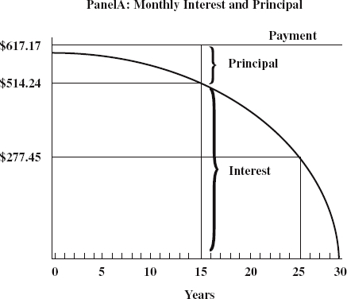
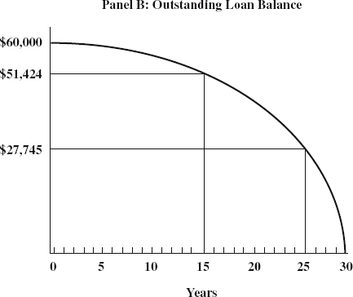
Example 3
Monthly Payment, Principal, Interest, and Loan Balances

Slide 15
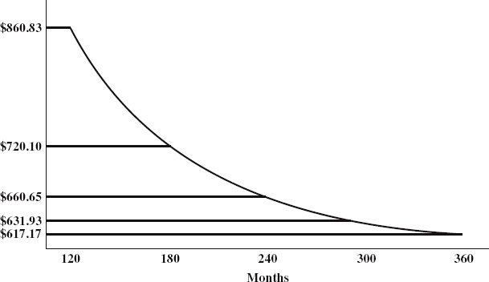
Example 3 - Extension
Relationship between Monthly Mortgage Payments and Maturity Periods

Slide 16
Computing Loan Balance
This is essentially about “removing” the interest that was built into the periodic payments due.
Methods:
  Amortization schedule
    Long and cumbersome
  Mathematical methods
    Compute the present value of the remaining payments using the fundamental equation (PV Method).
    Start from an earlier period balance and compute the future value of the previous CFs (FV Method)

Slide 17
PV Method
The outstanding loan balance (OLB) at time t is the PV at time t of remaining periodic payments discounted at the contracted interest rate.
For Example 2, what is the remaining balance at the end of year 8 (OLB₉₆)?
PMT = $665.30
n = 22 x 12 = 264
FV = $0
i = 7/12 = .58333
OLB₉₆ = PV = $89,491.65

Slide 18
FV Method
The outstanding loan balance (OLB) at time t is also the FV at time t of the initial loan amount (or any previous loan balance) and periodic payments in between compounded at the contracted interest rate. (NB: Watch out cash flow signs!)
Example 2 (again)
OLB₉₆ =?
PMT = $665.30
n = 8 x 12 = 96
PV = -$100,000
i = 7/12 = .58333
OLB₉₆ = FV = $89,491.65

Slide 19
Loan Costs
Additional finance charges levied by the lender that are part of the cost of borrowing:
  Origination Fees
    Cover origination expenses.
  Discount Fees (Points)
    Borrower trade-off: points vs. contract rate
    1 Point = 1% of the loan amount
    Used to raise the yield on the loan
  Prepayment Penalty
    Fees charged by the lender on the outstanding loan balance at the time of prepayment (not allowed for some residential mortgages)
By adjusting the fees that are charged, different effective returns or yields may be achieved by mortgage lenders.

Slide 20
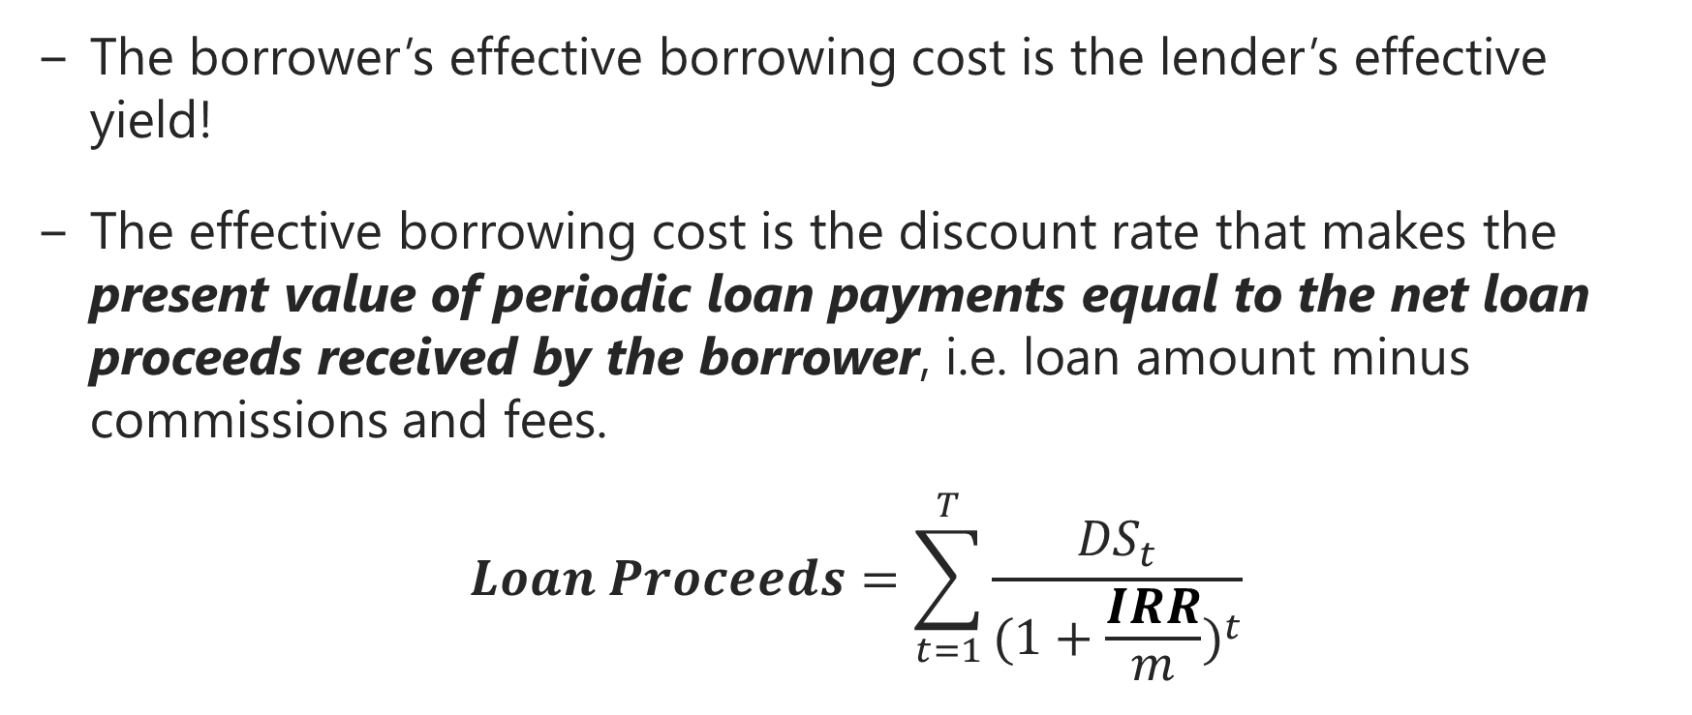
Effective Borrowing Cost (Yield)
The borrower’s effective borrowing cost is the lender’s effective yield!
The effective borrowing cost is the discount rate that makes the present value of periodic loan payments equal to the net loan proceeds received by the borrower, i.e. loan amount minus commissions and fees.
$$Loan Proceeds=\sum_{t=1}^{T}{\frac{{DS}_{t}}{{(1+\frac{IRR}{m})}^{t}}}$$

Slide 21
Origination Fees
Origination or financing fees are generally meant to compensate the lender for origination costs, which are normally different from true borrowing costs.
  Since origination costs are higher for commercial mortgages, origination fees are more common there.
  The possibility of prepayment make most lenders reluctant to include these costs in the interest rate charged on the loan. Why?
These fees result in:
  Effective yield being higher than the contract rate
  Effective yield decreases with time to prepayment

Slide 22
Origination Fees
Example 3 (again)
A $60,000 mortgage at 12% interest rate for 30 years with monthly payments of $617.17
Assume the lender charges a 3% origination fees. What is the effective yield if the mortgage is held to maturity?
Loan proceeds = 60,000*(1-.03) = $58,200
PV = $58,200
FV = $0
n = 360
PMT = - $617.17
i = 12.41%

Slide 23
Origination Fees
Same question, but the mortgage is now repaid at the end of year 5.
Outstanding Loan Balance at end of yr. 5?
PMT = $617.17
n = 25*12 = 300
i =12%
FV = $0
Effective Yield?
PV = $58,200
FV = ($58,597.93)
n = 60
PMT = ($617.17)
If the mortgage is repaid after 1 year, the effective yield would be 15.26% (do the math).
OLB₆₀ = $58,597.93
i = 12.82%

Slide 24
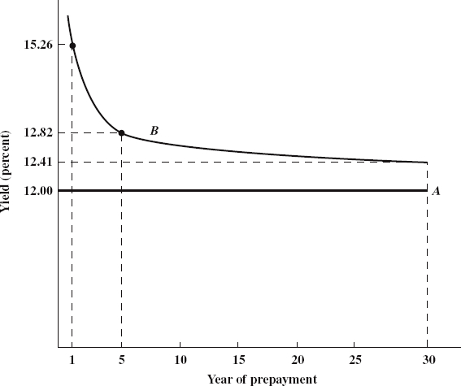
Origination Fees
Impact of origination fees on effective
yield at various repayment dates for Example 3.

Slide 25
Discount Points
Discount points (or points) are fees generally charged by lenders in lieu of higher interest rates.
  They are similar to, but somewhat different, from origination fees because a borrower may opt to pay points in order to bring down the interest rate?
Lenders may charge points for various reasons:
  Point are a way to price in the risk of a borrower. Point may also be used to mitigate prepayment risk.
  With mortgage rates being sticky, lenders may use points to increase returns.
  They could be used to cover origination and overhead costs, but origination fees would probably fit better.
  They could allow lenders to earn a profit on loans sold to investors at a yield equal to or lower than the loan interest rate.

Slide 26
Discount Points – Example 4
What is the effective borrowing cost for this loan?
  Home value: $250,000
  80% LTV Loan at 8% Interest with 4 points
  30 years with monthly payments
Solution:
Step 1: Compute periodic payment
PV = 250,000*.80 = $200,000
n = 360
i = 8%/12
PMT = $1,467.53
As with origination fees, the borrower actually receives less than the full loan amount.

Slide 27
Discount Points – Example 4
Step 2:
Loan Amount $200,000
− Points Paid =.04 x $200,000 $8,000
Amount Received $192,000
Compute the effective borrowing cost, using the amount received from Step 2 and the payment from Step 1.
PV = $192,000
n = 360
PMT = $1467.53
i = .70*12 = 8.44%
As expected, the effective borrowing is slightly higher!

Slide 28
Discount Points – Example 4
What is the effective cost if the loan might be repaid after 8 years?
  Step 1: Compute PMT = $1467.53
  Step 2: Compute the outstanding balance at end of year 8
FV = $0
n = 24*12 = 264
PMT = $1467.53
i = 8/12
  OLB₉₆ = PV = $182,035.40

Slide 29
Discount Points – Example 4
  Step 3: Compute effective interest cost.
  PV = $192,000
  FV = ($182,035.40)
  PMT = ($1467.53)
  n = 96
  i = 0.73*12 = 8.72%
  Therefore, points increase the effective cost of financing, particularly for borrowers who prepay.
  As result, points are a valuable tool for assessing prepayment risk since, unlike with origination fees, borrowers often can choose a higher rate instead!

Slide 30
Prepayment Penalties
Prepayment penalties are meant to discourage prepayments.
  They are generally 1-3% of the loan balance
  They are added to the final payment when computing yields
Prepayment risk is an important consideration to lenders because, on average, prepayments negatively affect yields.
Prepayment penalties allow lenders to optimally price prepayment risk rather than spread the costs to all.
Conforming conventional mortgages allow repayments without penalties.
  Prepayment penalties for common for non-conforming mortgages and commercial mortgages

Slide 31
Prepayment Penalties
Suppose now that the loan in Example 4 comes with a prepayment penalty of 2%. What is the effective yield if the loan prepays at the end of year 8?
Solution:
OLB₉₆ = $182,035.40
Net payment at the end year 5 = $182,035.40*1.02
Effective interest rate = ?
  PV = $192,000 ($200K minus 4% discount points)
  FV = ($185,676.11)
  PMT = ($1467.53)
  n = 96
  i = 0.74%*12 = 8.89%

Slide 32
Annual Percentage Rate
The Annual Percentage Rate (APR) is the discount rate which brings the future payment stream back to present value such that it exactly equals the net cash disbursed by the lender.
    To prevent residential mortgage lenders from advertising low rates and hiding fees, True in Lending Act requires that lenders disclose APR to borrowers .
    APR still confusing because it assumes that the loan is held to maturity and it does not include all fees (e.g., prepayment penalties).
    Calculation is similar to effective interest rate calculations.

Slide 33
Effective Borrowing Cost
Lenders offer borrowers a choice between different combinations of discount points and interest rates.
  E.g., high interest rate with a low to no discount points or low interest rate with high discount points.
The challenge for the borrower is choosing the mortgage contract that minimizes the real cost of borrowing.
Effective borrowing cost expresses interest rate and all fees on the mortgage loan as a single annualized rate.
  It is the IRR that equalizes the disbursed loan amount (loan less any fees or commissions) to the PV of all periodic payments.
It is similar to the effective yield on a loan computed by the lender.

Slide 34
Effective Borrowing Cost
Differences between Effective Borrowing Cost and APR
  APR assumes that loan is held to maturity, whereas effective borrowing cost uses expected investment holding period.
  APR and effective borrowing cost are the same if mortgage held to maturity and all costs are included in APR.
    Otherwise, effective borrowing cost is higher.
  For adjustable rate mortgages, APR calculations are based on initial interest rate, and may therefore be misleading.
Mortgages should be compared using effective borrowing cost rather than APR.

Slide 35
Effective Borrowing Cost
Example
A borrower has a choice between two $500,000, 30-year mortgages.
Mortgage 1:
A 10% contract rate (compounded monthly) plus a 4% origination fee.
Mortgage 2:
A contract rate of 11% (compounded monthly) with no origination fee.
Which one of these two mortgages is cheaper if the loan is held to maturity?

Slide 36
Effective Borrowing Cost
Solution:
We need to compute the effective borrowing cost for each mortgage and choose the one with the lowest IRR – in this case the effective borrowing cost is the APR.
Mortgage 1
  DS₁=?
  PV=$500K, FV=0, i=10%/12, N=360. Thus PMT₁=$4,387.86
  IRR₁=?
  Loan Proceeds = (1-0.04)*500,000=$480,000
  N=360; PMT=$4,387.86, FV=0, PV =$480,000
  Solving this gives: IRR₁=0.87433%*12=10.49%

Slide 37
Effective Borrowing Cost
Mortgage 2
  Since no point is charged for the this mortgage, the effective borrowing cost and contract rate are the same: IRR₂=11%
Therefore, Mortgage 1 is cheaper than Mortgage 2 because it has a lower effective borrowing cost.
But be careful! The above calculation spreads the origination fee for Mortgage 1 over the 30-year term – in fact the IRR is the APR here. IRR would be higher if borrower prepays as we saw earlier. Mortgage 2 might even be preferable.

Slide 38
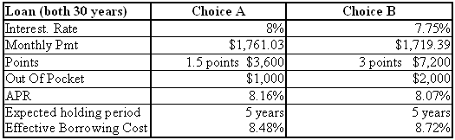
Effective Borrowing Cost
Example
The table below compares two loans of $240,000 where the APR is not the best indicator of the best consumer choice if the loan is to be held 5 years or less
The quicker the loan is to be repaid the better choice A becomes even though the initial contract rate is higher

Slide 39
Partially Amortizing FRM
Only a portion of the loan is amortized and repaid during the life of the loan.
  Periodic payments cover interest accrued and loan amortization, which is smaller compared to full amortization.
  Borrower builds up equity over time, but less than for fully amortizing CPMs.
At the maturity of the loan, the borrower needs to repay the unamortized portion of the loan (called the balloon payment – hence these loans are referred as balloon mortgages).

Slide 40
Partially Amortizing FRM
Smaller equity buildup than under fully amortizing CPM.
  Is it a problem for the borrower?
Riskier for the lender than a (fully amortizing) CPM. Why?
  Smaller amortizations, therefore higher LTV than CPM over time
  Balloon payment involves refinancing risk because loans are often refinanced at maturity.
Very common in commercial real estate finance.

Slide 41
Partially Amortizing FRM
Example 2 (again)
Assume $100,000 partially amortizing mortgage with a $30,000 balloon for 30 years at 7% with monthly payments.
Solution:
  PV = $100,000
  n = 30 x 12 = 360
  FV = - $30,000
  i = 7% per year
  PMT = - $640.71
  Except for the 1st payment, the interest piece will be higher than for fully amortizing CPM.

Slide 42
Interest-Only FRM
For interest-only (IO) mortgages, there is no amortization of the loan principal.
  Periodic payments cover only accrued interest for the respective period.
  At the maturity of the loan, the borrower needs to repay the loan principal all at once.
Riskier than amortizing mortgages for the lender.
  No equity buildup – Lender somewhat betting on the value of the real estate
  Substantial refinancing risk at maturity.
  What risk mitigants can lenders use?
IO loans more common in commercial real estate finance.

Slide 43
Interest-Only FRM
Example 2 (again)
Assume $100,000 interest only mortgage for 30 years at 7% with monthly payments.
Solution:
  PV = $100,000
  n = 30 x 12 = 360
  FV = - $100,000
  i = 7% per year
  PMT = -$583.33
  In fact, the calculation is much simpler, PMT is initial loan amount times periodic interest rate
  PMT = $100,000*0.07/12 = $583.33

Slide 44
Negative Amortization Mortgages
Periodic payments required during the life of the loan not sufficient to cover interest due.
  Pay rate smaller than accrual rate.
  Unpaid interest and is added to the principal each period.
  No equity buildup, rather equity erosion over time.
Traditionally, used in commercial mortgage lending.
  But became more popular in subprime financing during the recent housing boom – negative amortization only allowed for the 1st few years.
Negative amortization mortgages’ risk profile lies between IO and zero-coupon mortgages (discussed next).

Slide 45
Negative Amortization Mortgages
Example 2 (again)
Assume $100,000 mortgage for 30 years with monthly payments and an accrual annual interest rate of 7%, with a negative amortization during the 1st 3 years at 5%.
Solution:
  During the 1st 3 years, the borrower will only pay interest at 5%, the remaining accrued interest will then be added to the loan balance every month, resulting in the loan balance increasing during that period.
  At the end of the negative amortization period (year 3), the new loan balance will then be fully amortized over the remaining life of the loan (27 years in this case).
  You have to use Excel or do the calculations manually period by period during the negative amortization period.

Slide 46
Negative Amortization Mortgages
Solution: (cont.)
  The loan balance at the end of 3 years is $106,178.35 (refer to the Excel Spreadsheet)
  Now we need to amortize this amount over 27 years at 7%
  PV = $ 106,178.35
  n = 27 x 12 = 324
  FV = 0
  i = 7% per year
  PMT = -$730.31
  Because of the negative amortization, payments increase from $665.3 to $730.3. This is a 9.8% increase will be a huge payment shock for the borrower!

Slide 47
Zero-Coupon Mortgages
As zero-coupon bonds, no periodic payments required during the life of the loan – no interest, no principal amortization.
Extreme form of negative amortization
Interest accrues over the life of the loan and is added to the principal.
  The loan amount is therefore the PV of the final payment discounted at the accrual interest rate
No equity buildup of course, erosion of equity instead.
Riskiest of all.
Usually allowed for a short term with the balance amortized or refinanced using another loan.
More common in commercial real estate financing.

Slide 48
Zero-Coupon Mortgages
Example 2 (again)
Calculating loan balance at maturity if no interest payments or principal amortizations – same loan parameters as before.
Solution:
  PV = $100,000
  n = 360
  i = 7% per annum
  PMT = 0
  FV = - $811,649.75
    The amount owed increases exponentially over time. It is unsustainable for long periods, but useful sometimes

Slide 49
Loan Balance under Various Structures

Slide 50
Loan Balance under Various Structures

Slide 52
Constant Amortization Mortgage
The principal of constant Amortization Mortgage (CAM) loan is fully repaid over time at constant amortization speed.
  Periodic amortization is loan amount divided by number of payments.
At end of each period, the accrued interest during that period is added to the constant amortization amount to determine that period’s payment.
Since the principal owed decreases over time, CAMs tilts payment towards the earlier years. In fact, periodic payments decreases over time as the loan is repaid.
Have to do the computation manually or use Excel.

Slide 53
Constant Amortization Mortgage
Example 3 (again)
Suppose the $60,000 loan at 12% over 30 years with monthly payments is structured as a CAM. Draw the amortization schedule.
Periodic amortization = 60,000/360 = $166.67
Period | Begin. Balance | Interest | Amortization | Payment | Ending Balance
1 | $60,000.00 | $600.00 | $166.67 | $766.67 | $59,833.33
2 | $59,833.33 | $598.33 | $166.67 | $765.00 | $59,666.67
3 | $59,666.67 | $596.67 | $166.67 | $763.33 | $59,500.00
358 | $500.00 | $5.00 | $166.67 | $171.67 | $333.33
359 | $333.33 | $3.33 | $166.67 | $170.00 | $166.67
360 | $166.67 | $1.67 | $166.67 | $168.33 | $0.00

Slide 54
Constant Amortization Mortgage

Slide 55
CAM vs. CPM
Example 3 Loan Balances

Slide 56
CAM vs. CPM
Example 3 Interest Payments

Slide 57
CAM vs. CPM
Example 3 Principal Amortizations

Slide 58
CAM vs. CPM
Example 3 Payments

Slide 59
Callable Loans
A callable loan gives the lender the option to initiate full repayment of the loan, at a pre-determined time, e.g., at the end of 10 or 15 years.
This feature, which often takes the form of a clause included in the loan document, is more common in commercial mortgages.
Generally, a callable loan will bear a lower interest rate to compensate the borrower for the option written to the lender.
The pricing of callable is generally computed as if call will occur since the yield on the loan would likely be higher under that scenario.

Slide 60
Reverse Annuity Mortgages
Reverse Annuity Mortgages (RAM) are upside down mortgage whereby the borrower receives receive periodic payments from the lender until such payments plus accrued interest reach the agreed-upon loan amount.
RAMs are largely used by the elderly who want to stay in their home and supplement their (retirement) income by using the equity built in their home over time.
  This is way RAMs are also referred to as Home Equity Conversion Mortgages (HECMs)

Slide 61
RAM Requirements
Must at least 62 years of age.
  The older you are, the more lenient the qualifications become, as the mortality rate increases with age.
Must have title to the home and home must be the borrower’s primary residence.
  During the loan and the remainder of its life, you cannot be asked to leave the property, as you still are the owner and deed holder.
Loan does not have to be repaid unless the borrower leaves permanently the home.
  Interest rates may be fixed or floating. RAMs usually require high up-front costs.
Must continue to maintain residence and pay property taxes and hazard insurance

Slide 62
RAM
Example:
Your house is worth $1,000,000. You obtain a RAM in an amount not to exceed $500K for a period of 10 yrs at 10%. What is the maximum monthly “take-down” or “draw” you are allowed to make?
Solution:
FV = -$500K
i = 10%
n = 120
PV=0
PMT = $2,440.87

Slide 63
RAM
The borrower will owe $500K at the end of year 10. If the borrower makes no more draws, the loan balance will continue to grow.
The homeowner's obligation to repay the loan is deferred until the owner dies, the home is sold, or the owner leaves (e.g., into aged care).
If a property value goes up after a RAM is taken out, it is possible to acquire a 2nd (or 3rd) RAM over the increased home equity. But in the U.S., a reverse mortgage must be the only mortgage on the property.
Question: Loan balance at the end of yr. 4?
  i = 10%, n = 48, PV = 0, PMT = $2,440.87, FV = ?

Slide 64
The Tilt Effect
The impact of inflation expectation on mortgage affordability.
In periods where inflationary expectations are low and relatively stable, the CPM have proven to be an outstanding financial instrument.
However, when inflation is expected to increase in the future, the CPM requires inflation expectations to be built into the interest rate charged on the mortgage, resulting in higher payments.
The burden of making the mortgage payments shifts (tilts) against the borrower in the early years of the repayment schedule for CPMs because income lags inflation.
Also, the higher the expected inflation, the greater the burden of the tilt effect.

Slide 65
The Tilt Effect
This makes CPMs less affordable during periods of high expected inflation, like in the 1970s.
The tilt effect makes a CPM problematic if inflation is expected to go up since borrowers are forced to make larger periodic payments out of current income in anticipation of future income increases.
Floating and adjustable rate mortgages are more affordable because expected inflation is not built in.
  For those products, mortgage rates (payments) and income contemporaneously increase with inflation, leaving mortgage affordability unchanged.

Slide 66
Graduated Payment Mortgage
Graduated payment mortgages (GPMs) deal with the non-affordability of payments under CPMs by charging a fixed interest rate, but allowing payments to gradually increase over time.
  Lender and borrower must agree on rate of graduation and graduation period (Amortization more complicated)
GPMs thus offset the tilt effect, to some extent, by reducing the payment burden during the earlier years.
They are meant to provide a better match between the borrower's future income and payments.
Also, the smaller initial payments make it easier for the borrower to qualify for financing under GPMs than CPMs.

Slide 67
GPM
Example: Graduated Payment Mortgage (GPM) Payments & Interest Component: $1,000,000, 12%, 30-year, monthly payments; 4 Annual 7.5% steps.

Slide 68
GPM
GPM results in negative amortization during the early years if the rate of payment increase is lower than the accrual rate and higher payments later than under CPM.
Default risk GPM vs. CPMs?
  Probability of default?
  Expected loss in case of a default?

Slide 69
Growing Equity Mortgage
Variable payments tied to the borrower’s means.
Similar to GPM, but initial payments are not lowered. Payment increase periodically, usually as a % of change in disposable income.
Increases in payments above the original amount are used to repay principal, decreasing the life of the loan.
Less risk for the lender, compared to CPM or GPM, resulting in lower cost for the borrower.
Suitable for borrowers expecting significant income growth.
Caution is recommended; preferable to make additional payment under CPM if prepayment is allowed than use GPM, unless the rate saving is substantial.

Slide 70
Shared Appreciation Mortgages
In a shared appreciation mortgage (SAM), the appreciation in the property value is split proportionally between the borrower and the lender.
Because of the sharing of the upside potential, interest rates on SAMs should be lower than those on comparable CPMs, resulting in lower payments – the lender does not participate in the downside!
SAMs contain a tacit agreement by the lender to refinance the loan if the value of the property goes up.

Slide 71
Shared Appreciation Mortgages
Lender will only agree to a SAM if the expected yield of the SAM is greater than that of a comparable CPM.
Risk for both the lender and the borrower:
      Value of property may go down affecting the lender.
      Payments will be higher after refinancing if value goes up.
SAMs are not common in residential. Banks prefer not to have any equity interest on the property they finance. One reason is “moral hazard” problem.
For commercial properties, mezzanine debt providers may be more open to this kind of arrangements.

Slide 72
Shared Appreciation Mortgages
Example:
SAM for $100,000 at 10% interest rate for 30 years with monthly payments. Lender gets 50% of any appreciation (not depreciation) and appreciation payment is due at the end of 10 years when the property is sold. For simplicity, assume that the current market value is $120K and that it is expected to increase at the inflation rate of 4% annually. What is the effective yield?
Solution:
PMT = $878 (more exactly, $877.57)
Property value after 10 years = 120K (1.04)^10 = $177,630
lender gets (177,630 - 120,000)/2 = $28,815
PV = $100,000
PMT = $878 for 10 years
FV = loan balance + share appreciation = $90,938 + $28,815
Yield = 11.59%
How much would have been the yield if the value of the property did not appreciate?

Slide 73
Final Notes on FRM
Characteristics of CPM: fixed interest rate, leveled payments, and fully amortizing
  But payments are larger and likely less affordable due built in inflation expectations. The longer maturity the larger this effect.
  GPMs alleviate this problem, but may result in negative amortization.
The lender, rather than the borrower, bears the interest rate risk.
Possibility to refinance if interest rates fall and refinancing is allowed .
Any benefit to borrower is priced in the mortgage rate.

Slide 74
Future of Residential Finance
Efficiency and speed of processing loans (technology) will play a greater role in attracting business in a market that is already very thin on margins.
  Loan applications can actually be taken online using pre-formatted forms.
  Credit checks can be ordered on line, employment verified or financial reports accessed.
  An appraisal can be ordered on line and in some cases performed without the need for physical inspections using fully computerized data bases, GIS and property address electronic photo banks.
Given the uncertainty regarding the GSEs, the future of the secondary mortgage market is somewhat uncertain. But securitization will remain, at least for prime mortgages and commercial mortgages.
Lending guidelines will be stricter and 30-year mortgages may be difficult to get if government withdraws from housing financing.

Slide 75
Next:
Adjustable Rate Mortgages

