Slide 1
REAL ESTATE 410 Mortgages: Introduction
Spring 2017

Slide 2
Topics
Mortgage underwriting process
Mortgage default
Type of mortgages
Determinants of mortgage rates
Basic mortgage concepts

Slide 3
Mortgage Underwriting
Two main reasons why a borrower may default on a mortgage loan:
Borrower may lose the ability to make the required periodic loan payments (income/financial motive).
Borrower may be in a negative equity situation when the loan balance is larger than the value of the real estate (strategic default).
The mortgage originator must adhere to underwriting standards that seek to minimize the likelihood of default.
Mortgages must meet specific underwriting standards to qualify for purchase by Fannie Mae and Freddie Mac (former government -sponsored enterprises - GSEs).

Slide 4
Mortgage Underwriting
What is mortgage underwriting?
Process of evaluating the borrower and the property offered as security for the mortgage to determine the transaction’s level of default and foreclosure loss risk.
For commercial mortgages, the focus is generally on the property and the income-generating capacity of the property
Little attention is generally focused on the investor beyond normal due diligence

Slide 5
Assessing Probability of Default
For residential mortgages, five income tests are generally used to assess borrower risk:
Income
Sources of income that are considered include wages from full time employment, part time employment, net rental property income, alimony and child support, expected sales commissions, bonuses, dividends or interest, retirement annuities
Ability to Meet Mortgage Expenses
On a conventional mortgage, expenses considered in the underwriting criteria are the principal and interest payments, and additional payments for mortgage insurance, property taxes, property insurance, any association fees, expected utility payments and sometimes a maintenance expense

Slide 6
Assessing Probability of Default
Other Financial Obligations
Automobile loans, alimony requirements, payments on credit card accounts, etc.

Slide 7
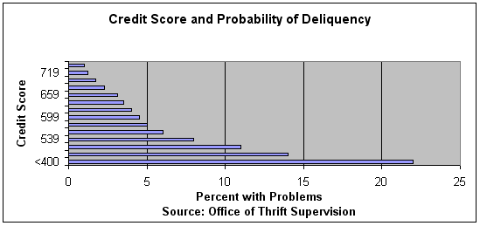
Assessing Probability of Default
Credit risk
Credit scoring (e.g., FICO scores) has been shown to be a highly significant indicator of mortgage default.
Net Worth
The borrower’s other assets may provide an alternative source of funds for making mortgage payments.

Slide 8
Assessing Probability of Default
In evaluating the property, the lender wants to determine that the property provides adequate security for the debt.
The value of property assessed by appraiser
Acceptable LTV for conventional loans are typically 80% for non-insured mortgages and up to 95% with private mortgage insurance (PMI).
LTV is the strongest predictor of probability of default
Different LTV thresholds for commercial loan
In the property evaluation process, the practice of redlining is prohibited
Lenders not permitted to designate some geographic areas as unacceptable loan risks for home mortgages.

Slide 9
LTV Calculation
$$LTV=\frac{Loan Amount}{Property Value}$$
Property is general taken as the smaller of purchase and appraised value
Example
If a lender is subject to a maximum LTV of 80 %, what is the maximum property value s/he will finance for a borrower with $10,000 equity?
Value = $10,000/(1-0.8)=$50,000

Slide 10
Conventional Home Mortgages
Conventional mortgages are residential mortgages that are not guaranteed or insured by the federal government.
Conforming mortgages are conventional mortgages meeting the underwriting standards for purchase by the Government-Sponsored Enterprises (GSEs).
They are predominantly 80% - 95% of the appraised value or selling price
Loans over 80% LTV require Private Mortgage Insurance (PMI) to reduce lender risk to 80% of home value (alternative, 2nd mortgage).
A 620 FICO was required (these days, not less than 700).
Borrower must meet income tests discussed earlier.
Max loan amount for conforming loans varies from county to county from $417,000 to $729,750

Slide 11
Conventional Home Mortgages
Non-conforming mortgages are conventional mortgages not meeting the underwriting standards for purchase by the GSEs.
Jumbo mortgages
Those granted to borrowers with good credit, but exceeding the GSE lending limits
Alt-A mortgages
Mortgages to borrowers with good credit ratings, but unsatisfactory income documentation
Subprime mortgages
Mortgages to borrowers with poor credit ratings and unsatisfactory to deficient income documentation
This is in contrast to prime mortgages, which are conforming mortgages: generally granted to borrowers with good credit and satisfactory income documentation

Slide 12
Non-Conventional Mortgages
FHA Loans
The Federal Housing Authority (FHA) provides government insurance to lenders on loans made to low-income home buyers.
The borrower pays FHA an insurance premium.
VA Loans
After World War II, Congress authorized the VA to guarantee a portion of loans made to veterans.
The VA can make direct loans if loans cannot be obtained from approved VA lenders.
These programs are handled by Government National Mortgage Association (GNMA or Ginnie Mae)

Slide 13
Determinants of Mortgage Rates
Mortgage rates driven by demand and supply of funds for mortgages in the capital market.
Factors affecting demand:
Real estate demand factors
Demand for mortgage financing is essentially derived demand
Factors affecting supply:
Capital market conditions, including level of interest rate
Expected return on alternative investments
Level of economic activity
Real estate market cycle

Slide 14
Components of Mortgage Rates
Where: r_{t} is the real interest rate
f_{t} is the expected inflation rate over the period of the loan
p_{t} is risk premium which depends on the risks associated with the mortgage loan

Slide 15
Components of Interest Rates
Real interest rate
Time preference for consumption
One would rather consume now than later; interest is compensation to delay consumption
Production opportunities in the economy
Competition for funds when there are other investment opportunities (opportunity costs)
Expected inflation
Consensus between lenders and borrowers about future inflation
Directly impacts nominal interest rates

Slide 16
Mortgage Loan Risks
Default risk
Likelihood of borrower to default on paying back the loan
Interest rate risk
Future changes in interest rates and unanticipated Inflation
Liquidity risk
Ease of selling the loan in the secondary market
Regulatory risk
Governments periodically change the “rules of the game. Lenders may be forced to modify agreed financing terms after the fact as we have seen during the recent crisis. (impact is relatively small in the U.S.)
Other risks, including prepayment risk

Slide 17
Default Risk
Always the possibility that a borrower will not be able to make payments and default on the loan.
Expected default risk is measured primarily through the household income net of required expenses, i.e., income available to service the mortgage.
But borrowers may also default when property value drops. Strategic default refers to default caused by loan balance exceeding the value of the property, rather than the borrower inability to pay.
LTV at origination is best indicator of possible loss.
Loss severity increases with LTV.

Slide 18
Interest Rate Risk
Whenever lenders commit to a mortgage loan that has a fixed interest rate over some time period, they must charge a premium for the possibility that interest rates may increase over term of the loan.
The longer the period the rate is fixed, the larger the interest rate risk premium.
Mortgage rates have to be competitive means that risk premiums have to be competitive
If interest rates increase during the term of the loan, chances are that the lending institutions’ cost of funds may increase and thus the spread or profit they are making on the loan will be reduced.
This is funding mismatch problem that doomed the Savings & Loans (S&Ls) in the 80s.

Slide 19
Liquidity Risk
Risk that an investment (e.g., a mortgage loan) has when it does not trade in a large organized market which allows the investor to easily convert the investment to cash.
There is a liquid secondary market for residential mortgages
Even after the devastating mortgage crisis we just witnessed, the prime mortgage market is very liquid
Secondary markets for commercial mortgages were slower to develop causing liquidity for such lenders. But there is now a vibrant market for securitized and whole loans now.

Slide 20
Other Risks
Other risks may exist for specific mortgage investments:
Prepayment risk
Environmental risk
Political risk
Risk unique to a particular borrower
Etc.
It is important to remember that all risks are generally fairly priced by mortgage lenders.

Slide 21
Mortgage and Treasury Rates

Slide 22
Mortgage Financing
Real estate investors can choose the financing that makes the most sense for their projects.
Financing options may vary depending on:
Type of property (housing vs. commercial)
Market conditions
Financing options have increased, partly due to financial engineering.
Two key considerations:
Interest rate structure (fixed vs. adjustable rates)
Payment structure (amortization speed)
Payments are made in arrears, i.e., at end of periods.

Slide 23
Payment Structure
Four types of payment terms are available to borrowers, provided risk is acceptable to lender.
Fully amortizing mortgage loan
Partially amortizing loan
Interest-only loan
Negative amortization (including zero-coupon mortgage loans)
Most of options may be available for commercial properties, but not for residential mortgages.

Slide 24
Loan Amortization Patterns
Amortization | Pay Rate | Loan Balance at Maturity
Fully Amortizing | > Interest piece | Fully repaid
Partially Amortizing | > Interest piece | Not fully repaid
Interest Only | = Interest piece | = Amount Borrowed
Negative Amortizing | < Interest piece | > Amount Borrowed

Slide 25
Amortizing Loans
Also referred to as partially or fully self-liquidating loans.
Gradual repayment of loan principal over time.
Loan fully repaid with the last payment for fully amortizing mortgages.
Periodic payments composed of both interest accrued over the period and repayment of a portion of principal.
Amortizing mortgages are considered as less risky for the lender.
Why?
Allows for equity buildup.
Not necessarily an advantage for the borrower!

Slide 26
Basic Mortgage Concepts
Loan principal
Amount borrowed at purchase or the remaining balance of the loan.
Initial Principal = LTV*(Market Value)
Loan duration (term or life)
Typically, 15, 20 to 30 years for residential mortgages, much shorter for commercial mortgages.
Loan amortization
Amortization refers to periodic repayment of the loan principal. Any remaining principal must be repaid at maturity.
Debt Service
Periodic mortgage payments or debt service (DS) composed of interest expense and principal amortization.

Slide 27
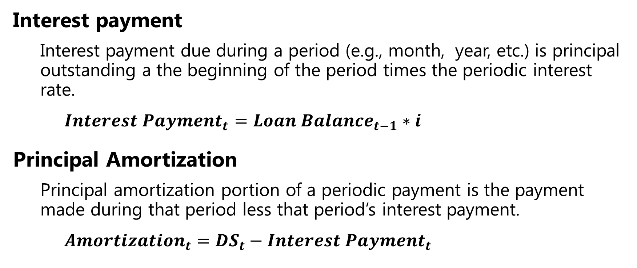
Breaking up Payment
Interest payment
Interest payment due during a period (e.g., month, year, etc.) is principal outstanding a the beginning of the period times the periodic interest rate.
$${Interest Payment}_{t}={Loan Balance}_{t−1}∗i$$
Principal Amortization
Principal amortization portion of a periodic payment is the payment made during that period less that period’s interest payment.
$${Amortization}_{t}={{DS}_{t}−Interest Payment}_{t}$$

Slide 28
Fundamental Equation
At origination (and at point in time) the present value (PV) of periodic debt payments discounted at the contracted interest rate(s) is equal to initial loan amount (fundamental equation)
$${Loan}_{0}=\frac{{DS}_{1}}{(1+\frac{i_{1}}{m})}+\frac{{DS}_{2}}{{(1+\frac{i_{2}}{m})}^{2}}+\frac{{DS}_{3}}{{(1+\frac{i_{3}}{m})}^{3}}+⋯+\frac{{DS}_{mn}}{{\left(1+\frac{i_{mn}}{m}\right)}^{mn}}$$
Loan₀ : initial loan amount
DS_{t} : payment due at the end of period t
m: number of payments per year
n: loan term in years
i_{t} : annual interest rate applicable at the end of period

Slide 29
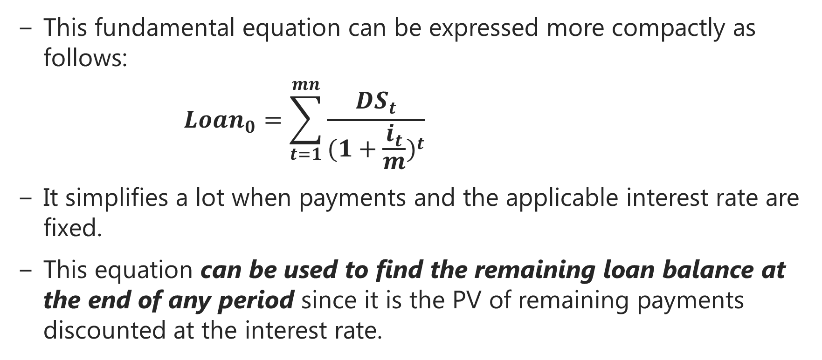
Fundamental Equation
This fundamental equation can be expressed more compactly as follows:
$${Loan}_{0}=\sum_{t=1}^{mn}{\frac{{DS}_{t}}{{(1+\frac{i_{t}}{m})}^{t}}}$$
It simplifies a lot when payments and the applicable interest rate are fixed.
This equation can be used to find the remaining loan balance at the end of any period since it is the PV of remaining payments discounted at the interest rate.

Slide 30
Next:
Fixed-Rate Mortgages

