Slide 1
REAL ESTATE 410
Valuation Income Properties
Spring 2017

Slide 2
Topics
Concept of value
Sales comparison approach
Cost approach
Income approach
Meaning of capitalization (cap) rate
Valuation case study

Slide 3
Introduction
Purpose of valuation?
  Estimate market value
Why valuation?
  Market value not directly observable for most real estate
Reasons for valuation?
  Financing, sale, refinancing, etc.
Who perform valuations?
  Appraisers

Slide 4
What is Market Value?
Generally, the market value of a property refers to an estimate of the property’s worth under normal or typical conditions.
Valuation is the primary consideration before any other questions can be raised.
Knowing what a real estate asset is worth is necessary before making any other decision related to the land and/or buildings.
  Investment decision
  Financing decision
  Operating decision
  Disposal
  Redevelopment

Slide 5
What is Market Value?
Do you know exactly how much your property is going to sell for?
  No, there is a probability distribution of possible prices.
In theory, the market value of a property depends then on the probability distribution of possible prices.
It is the expected value derived from the set of possible prices and their attached probability of occurrence.
There is some uncertainty attached to the valuation. The wider (tighter) the distribution of possible price, the less (more) reliable the value estimate.
The reliability of the estimate is measured by the variance of the distribution or standard deviation, which is the squared root of the variance.

Slide 6
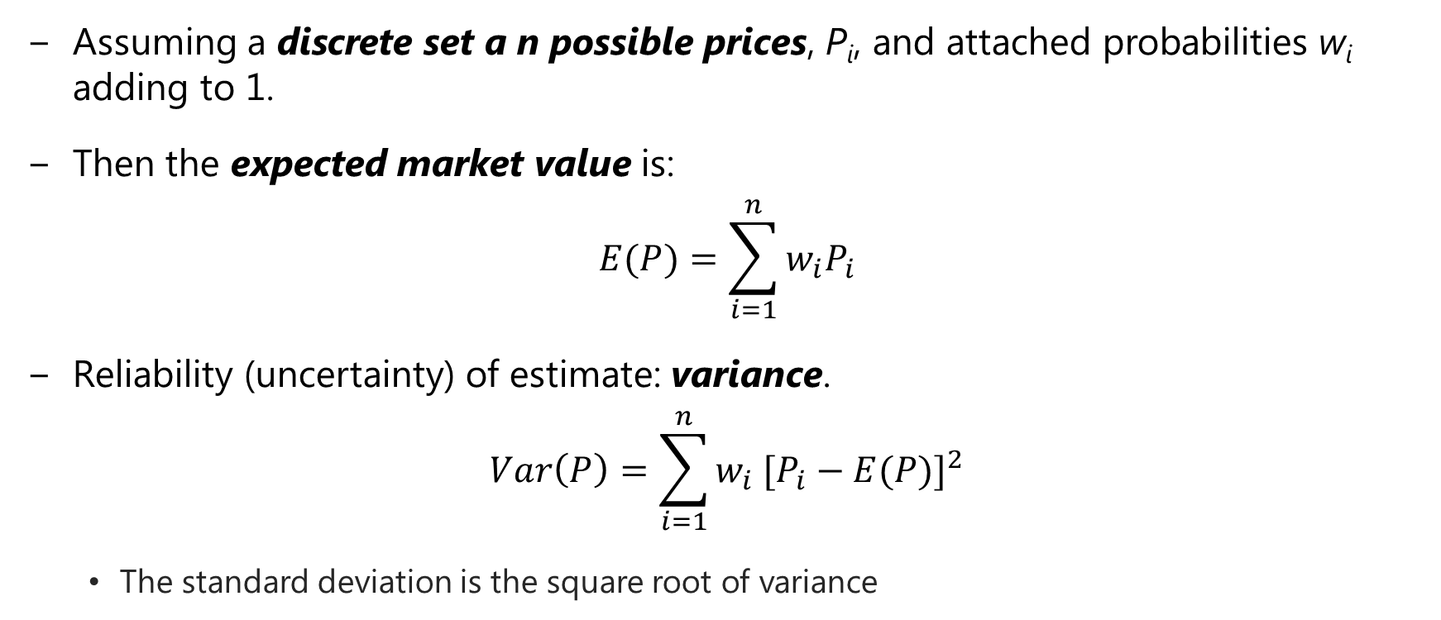
What is Market Value?
Assuming a discrete set a n possible prices, P_{i}, and attached probabilities w_{i} adding to 1.
Then the expected market value is:
$$E(P)=\sum_{i=1}^{n}{w_{i}P_{i}}$$
Reliability (uncertainty) of estimate: variance.
$$Var\left(P\right)={\sum_{i=1}^{n}{{w_{i} [P}_{i}}−E(P)]}^{2}$$
  The standard deviation is the square root of variance

Slide 7
Example

Slide 8
What is Market Value?
Market value refers to how much a property is worth to the marginal investor group.
Market value is not defined with respect to a specific buyer and therefore does not consider any potential buyer’s personal circumstances.
Market value is based on expected future before-tax cash flows (i.e., NOI).
  Remember, NOIs are property level cash flows, the earnings that will be split between the equity owner (i.e., the buyer of the property) and the providers of the remaining financing.
The (market) value of real estate is generally derived through appraisal.

Slide 9
What is Investment Value?
Investment value refers to how much a property is worth to someone as an investor – more to come later.
Investment value is defined with respect to a specific owner, given his specific characteristics.
Investment value is derived for a specific holding of the asset and integrates the investor’s competitive advantage in owning and operating the asset.
Unlike market value, investment value is based on expected future net after-tax cash flows from the asset to that particular investor.

Slide 10
Market vs. Investment Values
Market value
  How much the property is likely sell for today. The value it is likely to fetch if put in highest and best use.
  Market value is generally not investor specific.
Investment value
  What the property is worth to you as an investor, if you’re not going to sell it for a long time.
  Investment value is always investor specific.
The appraisal process is meant to estimate market value, not investment value.

Slide 11
Appraisal Process
The appraisal process is performed by appraisers and others seeking to estimate market value.
  Physical and legal identification
  Identify property rights to be valued
  Specify the purpose of the appraisal
  Specify effective date of value estimate
  Gather and analyze market data
  Apply techniques to estimate value

Slide 12
Appraisal Process
The three approaches:
  Cost Approach
  Sales Comparison Approach
  Income Approach
At least two of the three methods are used when valuing income properties.
We will focus on the income approach, but the other two have substantial validity also.

Slide 13
Cost Approach
The rationale is that informed buyers would not pay more for a property than the cost to build a new one.
  This assumes, of course, that they took the time to construct a new asset into account, and the relative risks of ground up development.
Valuation Process:
  Estimate the construction (reproduction) cost if new
  Account for physical deterioration, functional obsolescence, and/or external obsolescence
  Add land cost

Slide 14
Cost Approach
The cost method generally generates the highest value estimate relative to other valuation methods.
  Remember, new construction will only take place if current market rent is at or above replacement cost rent.
The cost approach is often used for real estate assets that do not have an efficient market for tenants to lease space.
  Examples: Heavy automobile manufacturing facilities, stadiums, churches,

Slide 15
Sales Comparison
The rationale for this method is that an investor will never pay more than investors recently paid for similar properties.
Valuation Process:
  Use data from recently sold “comparable” properties to derive subject property’s market value.
  Adjust comparable sales prices for feature, age, and size differences, etc.
  Adjust the value of each comparable.
  Derive a value for the subject property.

Slide 16
Sales Comparison
The sales comparison approach is a generally more subjective process compared to cost approach and income methods.
The accuracy depends on the availability of “true” comparables in terms of both property characteristics and timing of sale.
The objective should be to minimize adjustments.
  The more adjustments made the less accurate the value estimate!

Slide 17
Sales Comparison
Sales comparison method indirectly derives a property value by estimating the value of its various components.
This can be achieved more accurately by estimating a hedonic price model using regression analysis.
This method allows to extract the prices of the various property attributes (e.g., room, bathroom, garage) and then applying these prices to the quantities of the subject property to estimate its value.
This requires having a large sample of relevant properties transactions. The more attributes to estimate the large the sample required

Slide 18
Income Approach
The income approach estimates a property’s value by capitalizing (assigning a value today) future income stream from the property.
Rationale
  Valuing an income producing property is similar to valuing the income (cash flows) it is expected to generate throughout its economic life.
  Thus the value of a property is the value today (or the present value) of the future income stream using a discount rate that reflects the risk associated with the cash flow.

Slide 19
Income Approach
There are three methods for the income approach.
  Gross Income Multipliers (“GIM”)
  Direct Capitalization (Cap Rate) Method
  Discount Cash Flow (Present Value) Method

Slide 20
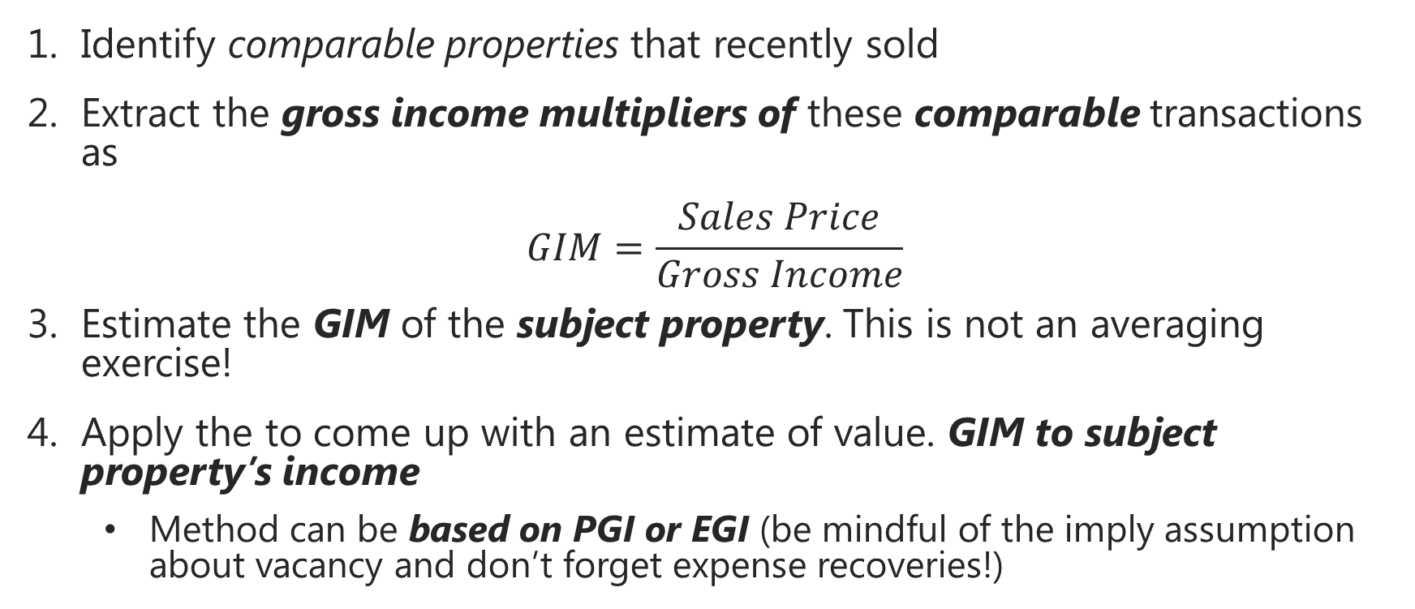
GIM Method
Identify comparable properties that recently sold
Extract the gross income multipliers of these comparable transactions as
$$GIM=\frac{Sales Price}{Gross Income}$$
Estimate the GIM of the subject property. This is not an averaging exercise!
Apply the to come up with an estimate of value. GIM to subject property’s income
  Method can be based on PGI or EGI (be mindful of the imply assumption about vacancy and don’t forget expense recoveries!)

Slide 21
GIM Method
 | Subject Property | Comp. 1 | Comp. 2 | Comp. 3
Sales Price | ? | $600,000 | $750,000 | $450,000
PGI | $120,000 | $100,000 | $128,000 | $74,000
GIM | ? | 6x | 5.86x | 6.08x
  Which one is most similar to the subject property and what weighting should we to come up with a GIM?
  Assuming 6x is determined to be the appropriate GIM
  Value Estimate = 6 x $120,000 = $720,000

Slide 22
GIM Method
The intuition behind this method is not very clear since it use revenue rather than cash flow generated by the subject property.
But it is easy to implement because no estimate of operating expenses is required.
May lead to inaccurate value estimates because:
  GIMs are not widely published
  There is no guarantee that comparables used to estimate the GIM have similar operating expenses
The direct capitalization and discounted cash flow methods produce more accurate estimates.

Slide 23
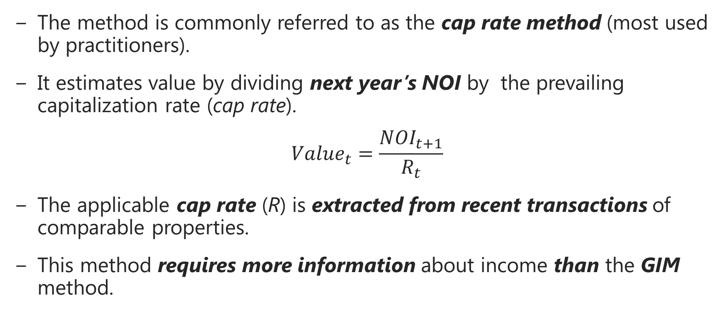
Direct Capitalization Method
The method is commonly referred to as the cap rate method (most used by practitioners).
It estimates value by dividing next year’s NOI by the prevailing capitalization rate (cap rate).
$${Value}_{t}=\frac{{NOI}_{t+1}}{R_{t}}$$
The applicable cap rate (R) is extracted from recent transactions of comparable properties.
This method requires more information about income than the GIM method.

Slide 24
Direct Capitalization Method
Example:
Want a value a property expected to generate NOI of $58,000 next year. Recent similar property sales:
 | Comp. 1 | Comp. 2 | Comp. 3 | Comp. 4
Sales Price | $368,500 | $425,000 | $310,000 | $500,000
NOI | $50,000 | $56,100 | $42,700 | $68,600
R | 13.57% | 13.20% | 13.77% | 13.72%
Cap rate range: 13.20% < R < 13.77%
The choice of which cap rate to use is an educated opinion of the appraiser.
  Which property is most similar to the subject?

Slide 25
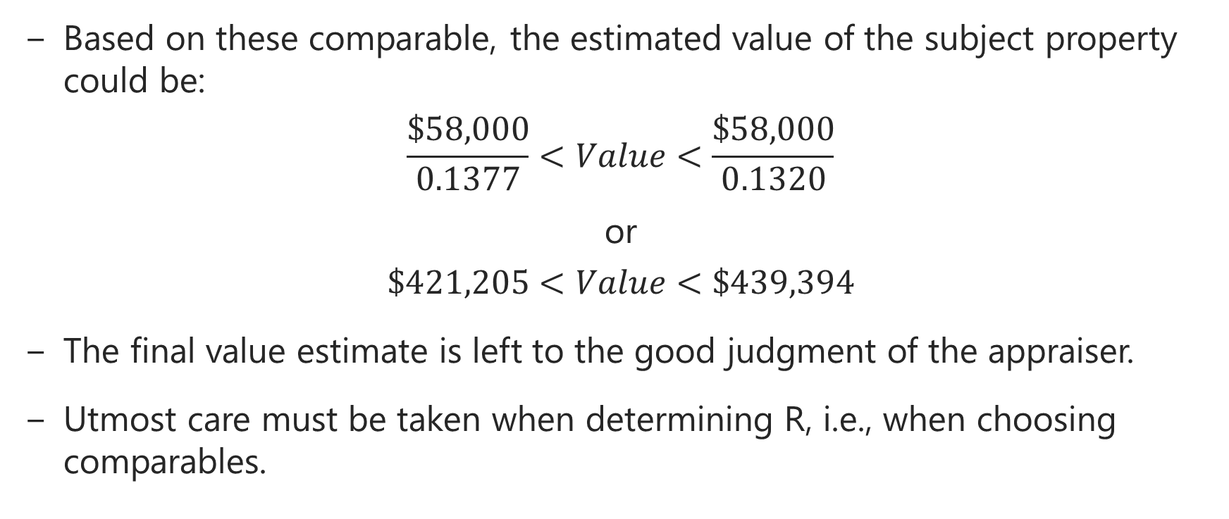
Direct Capitalization Method
Based on these comparable, the estimated value of the subject property could be:
$$\frac{\$58,000}{0.1377}<Value<\frac{\$58,000}{0.1320}$$
or
$$\$421,205<Value<\$439,394$$
The final value estimate is left to the good judgment of the appraiser.
Utmost care must be taken when determining R, i.e., when choosing comparables.

Slide 26
Dangers of Direct Capitalization
Direct capitalization methods can be misleading for market value if subject property does not have cash flow growth and risk patterns typical of comparable properties from which cap rate was obtained.
With GIM, it is even more dangerous because operating expenses must also be typical!
Cap rate is most appropriate for buildings with short-term leases in less cyclical markets, like apartments.
Market-based ratio valuation won’t protect you from “bubbles”!

Slide 27
Determining Cap Rates
Consider the comparables:
  Similarity to subject property
    Physical attributes, location, lease terms, operating efficiency
  How is NOI determined?
    Stabilized NOI
    Adjust for nonrecurring capital outlays
    Was NOI skewed by a one-time outlay?
  Depending on the analyst, leasing commissions, tenant improvements, and recurring capital outlays may or may not be included in the calculation of NOI, but appropriate cap rate must be used then.

Slide 28
Cap Rate and Cost of Capital
Also cap rate can be thought of as a return on and capital, all capital used to buy the property.
  Return on capital is the price for providing the capital (both equity and debt) to buy the property.
  The higher investors’ required returns, the higher cap rates and the lower property valuations.
  Also, the lower required rates of return on capital (e.g., long-term interest rates), the lower cap rates and the higher property values.

Slide 29
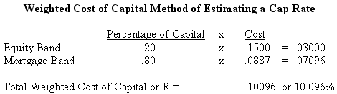
Cap Rate and Cost of Capital
NOI is the income share by providers of capital (equity owner and debtholders).
Therefore, cap rate can also be thought of as weighted average cost of capital (WACC). WACC weights costs of equity and debt as follows:
When recent comparable property sales are not available, then the WACC approach can be relied upon to estimate cap rates for valuation purposes.

Slide 30
Cap Rate and Cost of Capital
The cap rate calculation does not consider rental growth.
Remember, cap rate is next year’s NOI divided by property value, it does not directly factor in rental growth.
Intuitively, properties with higher rental growth rates (and faster price appreciation) should fetch lower cap rates (higher prices).
We will see later the relation between cap rate, required return, and rental income growth.

Slide 31
Market Conditions and Cap Rates
Market conditions affect both property values, appreciation rates, and income risk.
A market becoming over supplied (overbuilt) will increase the uncertainty of income which implies higher risk and also reduce rental growth rates, causing higher cap rates.
If the market demand is getting stronger with little possibility of new supply, we will see faster rental growth and lower cap rates.

Slide 32
Property Age and Cap Rates
Older properties tend to have more uncertain repairs and capital improvement expenditures, and tend to be located in lower appreciation areas.
Both these factors cause higher cap rates.
As a result, going-out cap rates (disposals) tend to be higher than going-in cap rates (acquisitions), everything else the same.
    More to come!

Slide 33
Summary of Influences on Cap Rates
Valuation Factor | Impact on Cap Rate
Growth in income | Faster growth means a low cap rate and higher value
Risk | Higher risk means a higher cap rate and lower value
Economic obsolescence | Shorter economic life means a higher cap rate and lower value
Interest rates or cost of capital | Higher interest rates imply higher cap rates and lower value
Market conditions | Stronger rental market imply lower cap rates and higher values
Property age | Older properties typically have more risk as a result of greater repair volatility. More risk means higher cap rates and lower values

Slide 34
Cap Rate Spreads
Normally, there are two cap rates:
  Going-in cap rates for property buyers.
  Going-out cap rates for property sellers.
  Going-in cap rates is normally lower than the going out cap rates.
    Why?
The difference between the going-out cap rate and the going-in cap rate is referred to as the cap rate spread. It is like the bid-ask spread for bonds.
  Cap rate spreads shrink during hot markets, with the opposite being true in cold markets.
  Cap rate spreads reflect market liquidity (i.e., ease to find a party to a transaction).

Slide 35
Discounted Cash Flow Method
The discounted cash flow (DCF) method estimates market value of an income-producing asset as the discounted value of expected cash flows.
Cash flows are projected for entire holding period (or life of the asset if the investor has no plan to sell the asset in the future).
The valuation is based on before-tax cash flows using projected net operating incomes (NOIs).
If the investor is planning to sell the asset at some point in the future, a resale value must be estimated.
The appropriate discount rate is the return required by investors for cash flow of similar risk.

Slide 36
DCF Method
What are the inputs required to compute the present value of a property’s cash flows?
  Choose the holding period
  Forecast NOIs throughout the holding period
  Determine the reversion value of property
  Select an appropriate discount rate (r) based on risk and return of comparable investments (i.e., market conditions)

Slide 37
DCF Method
The market value of the subject property today (MV₀) is therefore the sum of discounted future NOIs from the property and the net selling price (NSP) at the end of the investment horizon assumed to last T periods.
Again, the calculation should use an appropriate discount rate (r), also referred to as the required rate of return or yield.

Slide 38
DCF Method
If the investor is not planning to sell the property (infinite holding period), then we have an infinite series of NOIs and NSP is zero. The valuation formula then becomes:
If NOI is also assumed constant over time (no income growth), then the valuation formula collapses to:
This formula is similar to that of the cap rate method. The cap rate method is therefore intuitively sound as long as the underlying assumptions are correct.

Slide 39
DCF Method
Assuming the cash flows are perpetually growing at a constant rate of g per year and assuming a discount rate of r, with g < r, then the valuation formula is:
This formula gives a more general interpretation of property cap rates (R) as:
R = r - g
Cap rates are approximately equal to required rate of return less real income (rent) growth rate.

Slide 40
DCF – Reversion Cash Flow
But we still need to estimate the cash flow from the disposal of the property (i.e., NSP), unless we assume that the property will not be sold.
Remember,
The final year cash flow at the end of period T is composed of that year’s NOI and the net sale price.

Slide 41
DCF – Reversion Cash Flow
NSP is the expected sale price at the disposal of the property at the end of period T (SP) less any selling expenses (e.g., fees and commissions)
The easiest way to compute the expected sale price (SP_{T}) is to apply the cap rate method to NOI at the end of period T+1 as follows.
SP_{T} = NOI_{T+1} / R
But the relevant cap rate here is the expected going-out cap rate at the end of year T.
The challenge is to estimate going-out cap rate.

Slide 42
DCF Example 1
The subject property is an office building with a single lease. The asking price is $13,453,000. Suppose the present time is the end of the year 2002. The building has a 6-year "net lease" which provides the owner with $1,000,000 at the end of each year for the next three years (2003, 2004, 2005). After that, the rent "steps up” to $1,500,000 for the following three years (2006 through 2008), according to the lease. At the end of the sixth year (2008) the property can be expected to be sold for 10 times that year’s rent. Thus, the investment is expected to yield $1,000,000 in each of its first three years, $1,500,000 in each of the next two years, and finally $16,500,000 in the sixth year (consisting of the $1,500,000 rental payment plus the $15,000,000 "reversion" or sale proceeds).

Slide 43
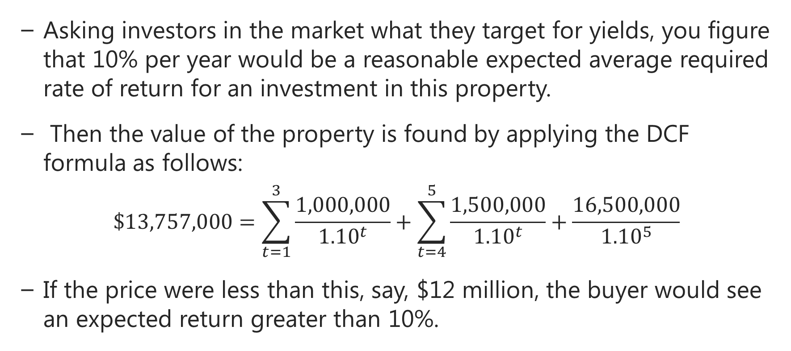
DCF Example 1
Asking investors in the market what they target for yields, you figure that 10% per year would be a reasonable expected average required rate of return for an investment in this property.
Then the value of the property is found by applying the DCF formula as follows:
$$\$13,757,000=\sum_{t=1}^{3}{\frac{1,000,000}{{1.10}^{t}}+\sum_{t=4}^{5}{\frac{1,500,000}{{1.10}^{t}}+\frac{16,500,000}{{1.10}^{5}}}}$$
If the price were less than this, say, $12 million, the buyer would see an expected return greater than 10%.

Slide 44
DCF Example 2
An investor is looking to purchase a property consisting of 8 apartments, renting currently for $2,000 per month each. Rent expected to grow at 2% for the foreseeable future.
Assume vacancy rate at 5%, operating expenses at 40% of EGI and capital expenditure allowance at 5% of EGI.
If the required rate of return is 8% and the current going-in cap rate is 7%, what is the value of this property using income capitalization rate and the discounted cash flow methods?
Assuming and investment horizon is 3 years and NSP of property is $1,700,000 at the end of the 3rd year, what is the expected going-out rate?

Slide 45
DCF Example 2
NOIs
 | Year 0 | Year 1 | Year 2 | Year 3
PGI | 192,000 | 195,840 | 199,757 | 203,752
VC |  | (9,792) | (9,988) | (10,188)
EGI |  | 186,048 | 189,769 | 193,564
OE |  | (74,419) | (75,908) | (77,426)
CAPEX |  | (9,302) | (9,488) | (9,678)
NOI |  | 102,327 | 104,373 | 106,460

Slide 46
DCF Example 2
Valuation using the DCM:
MV₀ = NOI₁/(Cap Rate) = 102,327/.07 = $1,461,814
Valuation using the DCF Method:
 | Year 0 | Year 1 | Year 2 | Year 3
NOI |  | 102,327 | 104,373 | 106,460
NSP |  |  |  | 1,700,000
Total CF |  | 102,327 | 104,373 | 1,806,460
PV of CF |  | 94,747 | 89,483 | 1,434,026
MV₀ = sum PVs = $1,618,256
What is the expected going-out cap rate at the end of year 3?

Slide 47
DCF Example 3
A property has a projected year 1 NOI of $200,000. NOI is projected to grow by 4% per year for the following 2 years, then by 2% per year for the subsequent 2 years at a 1% constant rate afterward. Given a constant required return of 13% for the foreseeable future (a gross approximation!), what is the value of the property?

Slide 48
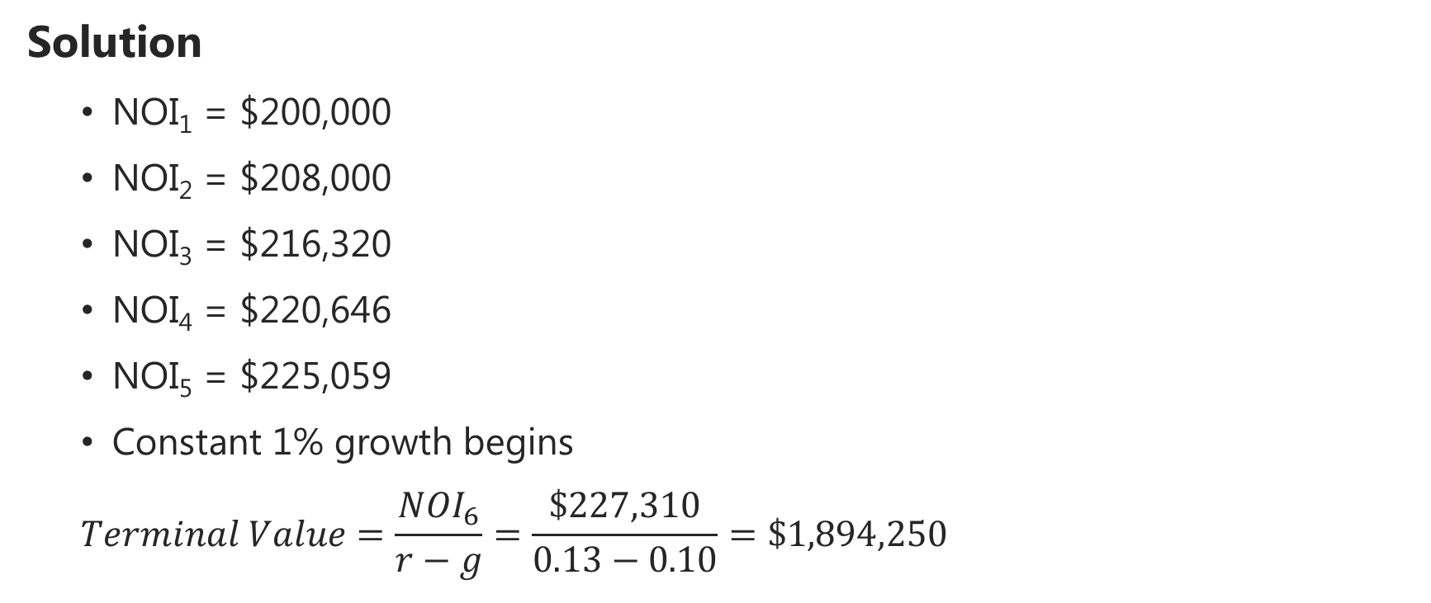
DCF Example 3
  Solution
  NOI₁ = $200,000
  NOI₂ = $208,000
  NOI₃ = $216,320
  NOI₄ = $220,646
  NOI₅ = $225,059
  Constant 1% growth begins
  $$Terminal Value=\frac{{NOI}_{6}}{r−g}=\frac{\$227,310}{0.13−0.10}=\$1,894,250$$

Slide 49
DCF Example 3
  Solution
  CF0 = 0
  CF1 = $200,000
  CF2 = $208,000
  CF3 = $216,320
  CF4 = $220,646
  CF5 = $225,059 + $1,894,250
  i = 13%
  PV = $1,775,409

Slide 50
DCF as Appraisal Method
DCF can easily reflect any unusual variations in the rental and expense flows of the subject property.
DCF procedure differs from simpler valuation approaches in that it technically makes explicit the long-term period by period return estimates.
Use of DCF does not preclude or supersede the application of insight and intuition.
The valuation estimate should make sense and it is important to check its sensitivity to various assumptions built in the model.

Slide 51
DCF as Appraisal Method
GIGO (garbage in, garbage out)
  A valuation result can be no better than the quality of the cash flow proforma and discount rate assumptions that go into the right-hand-side of the DCF valuation formula
Forecasted cash flows and the required return should be realistic expectations – neither "optimistic" nor "pessimistic", outlooks into the future.
The discount rate should generally be found by considering the likely total returns and risks offered by other types of investments.

Slide 52
Common Mistakes in DCF
Rent income growth assumption is too high – “We all know rents grow with inflation, don’t we!” But …
  Properties tend to depreciate over time in real terms (net of inflation).
  Usually, rents and income within a given building do not keep pace with inflation, in the long run.
Capital improvement expenditure projection, terminal cap rate projection, or both are too low.
  Capital improvement expenditures typically average at least 10%-20% of the NOI (1%-2% of the property value) over the long run.
  Going-out cap rate is typically at least as high as the going-in cap rate. Why? – Older properties are more risky and have less growth potential!

Slide 53
Common Mistakes in DCF
The discount rate (expected return) is too high.
  This third mistake may offset the first two, resulting in a realistic estimate of property current value, thereby hiding all three mistakes!
  However, an optimistic (too low) discount rate would amplify the effects of the other two, resulting in a high value estimate.

Slide 54
Mortgage – Equity Capitalization
Abstracting from taxes, NOI is split between the equity investor (owner) and the debt investor (mortgage lender).
Technically then, the value of the property (V) is equal to the value of mortgage debt (M) plus the value of equity (E).
  M is the present value of debt payments discounted at the effective interest rate.
  E is the present value of the residual NOI after debt payment discounted at a risk-adjusted discount rate k.
    The higher leverage, the higher the risk associated with residual cash flows to equity owners, hence the higher k.
    More to come on this …

Slide 55
Mortgage – Equity Capitalization
The value of the property almost remains constant no matter how the property is financed, but it is split differently between the mortgage holder and the equity investor depending on leverage.
Determining the right equity discount rate (k) is a challenge:
  It should be greater than the discount rate for the lender.
  It should normally be higher than the rate of return for the property.
  It should be competitive when compared to other investments.
So, we can technically use the cost of debt and the equity discount rate to compute the discount rate (WACC or weighted average cost of capital) to the property-level cash flows (NOI).

Slide 56
Determining Discount Rates
Broadly speaking, discount rates are determined in capital markets.
Usually a single ("blended") multi-year rate is appropriate for valuation and investment analysis ("going-in IRR").
One source of information is direct surveys of market participants.
Another source is historical evidence ...
So we can get an idea what the market's expected total return (discount rate) is for different types of properties by:
Observing the cap rates at which similar properties are sold.
Making reasonable assumptions about growth expectations (g) for the property sector.

Slide 57
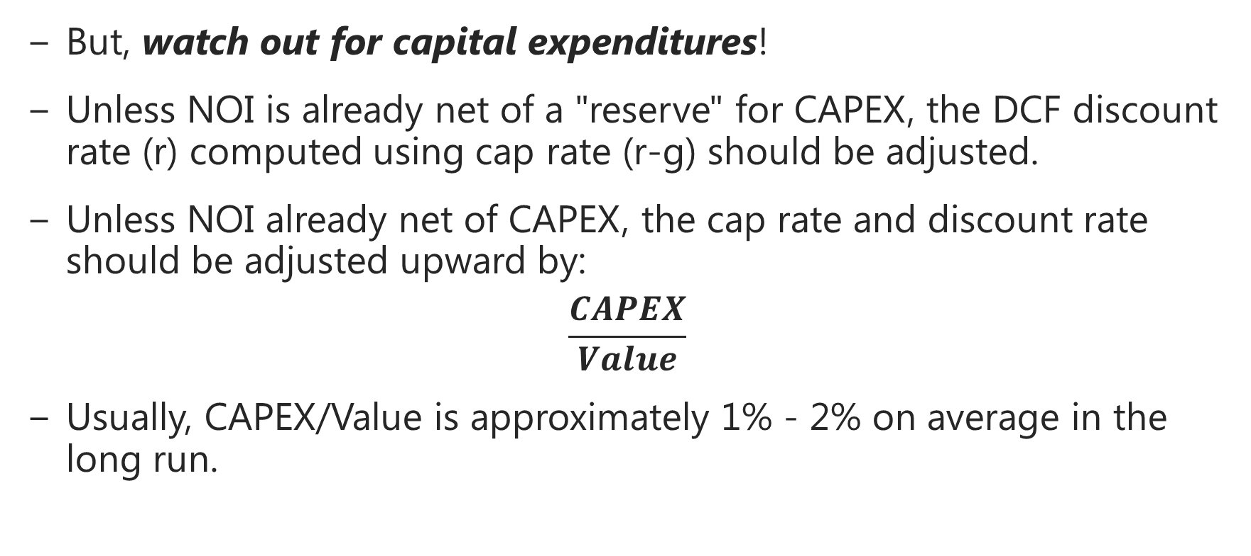
Determining Discount Rates
But, watch out for capital expenditures!
Unless NOI is already net of a "reserve" for CAPEX, the DCF discount rate (r) computed using cap rate (r-g) should be adjusted.
Unless NOI already net of CAPEX, the cap rate and discount rate should be adjusted upward by:
$$\frac{CAPEX}{Value}$$
Usually, CAPEX/Value is approximately 1% - 2% on average in the long run.

Slide 58
Case Study: Oakwood Apartments
Building Name | Oakwood
Address | 1234 Elm Street
Total Units (two bedrooms) | 95
Unit Size | 1,100
Building Size (SF) | 104,500
Analysis Begin Date | 1/1/2000
Holding Period | 5
Discount Rate | 11%
Terminal Rate | 9%
Selling Cost | 5%
Inputs | Apartment Unit
Units | 95
Monthly Rent | $1,200
Lease Term (Yrs) | 1
Market Monthly Rent | $1,250
Market Rent Increase | 3%
Laundry Income/unit/year | $120
Laundry Income increase | 3%
Market Vacancy Rate | 5%
Credit Loss Rate | 1%

Slide 59
Oakwood Apartments
Rental Income
Year | 1 | 2 | 3 | 4 | 5 | 6
Income:
Current Rent | $1,368,000 | $0 | $0 | $0 | $0 | $0
Market Rent from lease renewals | $0 | $1,467,750 | $1,511,783 | $1,557,136 | $1,603,850 | $1,651,966
Laundry Income | $11,400 | $11,742 | $12,094 | $12,457 | $12,831 | $13,216
Potential Gross Income (PGI) | $1,379,400 | $1,479,492 | $1,523,877 | $1,569,593 | $1,616,681 | $1,665,181
Less: Vacancy | $68,400 | $73,388 | $75,589 | $77,857 | $80,193 | $82,598
Less: Credit Loss | $13,794 | $14,795 | $15,239 | $15,696 | $16,167 | $16,652
Effective Gross Income (EGI) | $1,297,206 | $1,391,310 | $1,433,049 | $1,476,040 | $1,520,322 | $1,565,931

Slide 60
Oakwood Apartments
Operating Expenses
Year | 1 | 2 | 3 | 4 | 5 | 6
Real Estate Taxes | $87,000 | $89,175 | $91,404 | $93,689 | $96,032 | $98,433
Office Expenses | $20,000 | $20,600 | $21,218 | $21,855 | $22,510 | $23,185
Insurance | $14,250 | $14,678 | $15,118 | $15,571 | $16,039 | $16,520
Repairs & Maintenance | $52,250 | $53,818 | $55,432 | $57,095 | $58,808 | $60,572
Advertising | $8,000 | $8,240 | $8,487 | $8,742 | $9,004 | $9,274
Management | $155,665 | $166,957 | $171,966 | $177,125 | $182,439 | $187,912
Utilities | $45,000 | $46,350 | $47,741 | $49,173 | $50,648 | $52,167
Miscellaneous Expenses | $15,000 | $15,450 | $15,914 | $16,391 | $16,883 | $17,389
Total Expenses | $397,165 | $415,267 | $427,279 | $439,641 | $452,361 | $465,452

Slide 61
Oakwood Apartments
Year | 1 | 2 | 3 | 4 | 5 | 6
Effective Gross Income (EGI) | $1,297,206 | $1,391,310 | $1,433,049 | $1,476,040 | $1,520,322 | $1,565,931
Total Expenses | $397,165 | $415,267 | $427,279 | $439,641 | $452,361 | $465,452
Net Operating Income (NOI) | $900,041 | $976,042 | $1,005,770 | $1,036,400 | $1,067,960 | $1,100,479
Expenses % of EGI | 30.62% | 29.85% | 29.82% | 29.79% | 29.75% | 29.72%
Net Operating Income | $900,041 | $976,042 | $1,005,770 | $1,036,400 | $1,067,960 | $1,100,479
PV Factors | 0.90090 | 0.81162 | 0.73119 | 0.65873 | 0.59345
Present Value | $810,848 | $792,178 | $735,410 | $682,709 | $633,782
Resale | $12,227,545 |  |  | Sum PV NOI | $3,654,927
Selling Cost | $611,377 |  |  | PV Resale | $6,893,630
Net Resale | $11,616,168 |  | Estimated Property Value |  | $10,548,557
PV Factor | 0.59345
PV Resale | $6,893,630 |  | Implied Change in Value |  | 15.92%

Slide 62
Next:
Investment and Risk Analysis

