Slide 1
REAL ESTATE 410
Additional Mortgage Topics
Spring 2017

Slide 2
Topics
Incremental borrowing cost analysis
Mortgage refinancing analysis
Early loan repayment
Market value of a mortgage
Below market financing / cash equivalency
Wraparound and buydown loans
After-tax effective interest rate
Impact of debt
Mortgage options

Slide 3
Incremental Borrowing Cost
As you borrow more money, the interest rate on the loan is bound to increase.
  E.g., interest rate on a 90% LTV loan higher than that on a 80% LTV loan.
Basically, borrowing a little bit more increases the total borrowing cost.
  The question is then: “What is the real cost of borrowing more money at a higher interest rate?”
We need to find the marginal or incremental cost of the borrowing.

Slide 4
Incremental Borrowing Cost
Example 1
  Home value: $150,000
  Two financing alternatives:
    Option 1: 90% LTV ($135,000), 8.5% interest rate, 30 years
    Option 2: 80% LTV ($120,000), 8% interest rate, 30 years
  What option to choose, assuming that you can afford the additional $15,000 if required?

Slide 5
Incremental Borrowing Cost
Solution
  It appears there is only a 0.5% interest rate increase. BIG DEAL!
  But what is the real cost of the incremental borrowing of $15,000 if option 1 is selected?
  This cost should be compared to the opportunity cost of the additional $15,000 downpayment required if option 2 is selected.

Slide 6
Incremental Borrowing Cost
Solution (cont’d)
 | Option 1 | Option 2
LTV | 90% | 80%
Interest rate | 8.5% | 8%
Term | 30 years | 30 years
Down payment | $15,000 | $30,000
Loan | $135,000 | $120,000
Payment | $1,038.03 | $880.52

Slide 7
Incremental Borrowing Cost
Solution (Cont’d)
Cash flow differences:
  Borrow $15,000 more
  Pay $157.51 more per month for 30 years
  What is the effective interest rate on such loan?
    PV = $15,000; PMT = -$157.51; n = 360; FV = $0
    Then, i = 12.28%
  Thus the additional borrowing cost is much higher than 8.5%. You need to compare this to the opportunity cost of the additional downpayment or the cost of a 2nd mortgage.
  Whether you plan to prepay will also matter!

Slide 8
Incremental Borrowing Cost
Example 1 with Early Repayment
 | Option 1 | Option 2
LTV | 90% | 80%
Interest rate | 8.5% | 8%
Term | 30 years | 30 years
Prepayment | 10 years | 10 years
Down payment | $15,000 | $30,000
Loan | $135,000 | $120,000
Payment | $1,038.03 | $880.52
Balance end yr. 10 | $119,613.44 | $105,269.64

Slide 9
Incremental Borrowing Cost
Cash flow differences:
  Borrow $15,000 more
  Pay $157.51 more per month for 10 years and repay $14,343.80 at the end of year 10.
  What is the effective interest rate on the loan?
    PV = $15,000; PMT = $157.51; n = 120;
    FV = $14,343.80; Therefore, i = 12.38%
Early repayment only slightly increases the cost of additional borrowing in this case. Any prepayment fees would cause cost of borrowing to be even higher.

Slide 10
Incremental Borrowing Cost
With origination Fee:
 | Option 1 | Option 2
LTV | 90% | 80%
Interest rate | 8.5% | 8%
Term | 30 years | 30 years
Origination fee | 1.5% | 1%
Down payment | $15,000 | $30,000
Loan | $135,000 | $120,000
Loan proceeds | $132,975 | $118,800
Payment | $1,038.03 | $880.52

Slide 11
Incremental Borrowing Cost
Cash flow differences:
  Borrow $15,000 more, but effectively receive $14,175
  Pay $157.51 more per month for 30 years
  What is the effective interest rate on the loan?
    PV = $ 14,175; PMT = $157.51; n = 360; FV = $0
    Therefore, i = 13.06%
Higher origination fees would increase the cost of additional borrowing. The impact would even be higher if the loan is repaid before maturity

Slide 12
Incremental Borrowing Cost
Incremental borrowing rates must be competitive with interest rates charged on 2nd mortgages.
For the previous example the interest rate on 2nd 10% LTV loan above 80% LTV must be less or equal to 12.28% (without fees). Otherwise, the borrower would be better of taking a 90% LTV loan and paying 8.5% interest.
In the event the borrower can afford the additional downpayment, she must compare her opportunity cost to the incremental borrowing cost.

Slide 13
Marginal vs. Average Costs
The interest rate charged on a 90% LTV loan can be viewed as the weighted average of the rate on a 80% LTV loan and the incremental cost of a 10% LTV loan.
Since interest rates increase with LTV because of the higher risk of default, marginal interest rate must increase at an even higher rate. This is depicted in example presented next.
In general, for the average of a variable to increase, its marginal must lie above and be increasing at an even a higher rate.

Slide 14
Marginal vs. Average Costs
The interest rate charged on a 90% LTV loan can viewed as the weighted average of the rate on a 80% LTV loan and the incremental cost of a 10% LTV loan.
Since interest rates increase with LTV because of the higher risk of default, marginal interest rate must increase at an even higher rate. This is depicted in example presented next.
In general, for the average of a variable to increase, its marginal must lie above and be increasing at an even a higher rate.

Slide 15
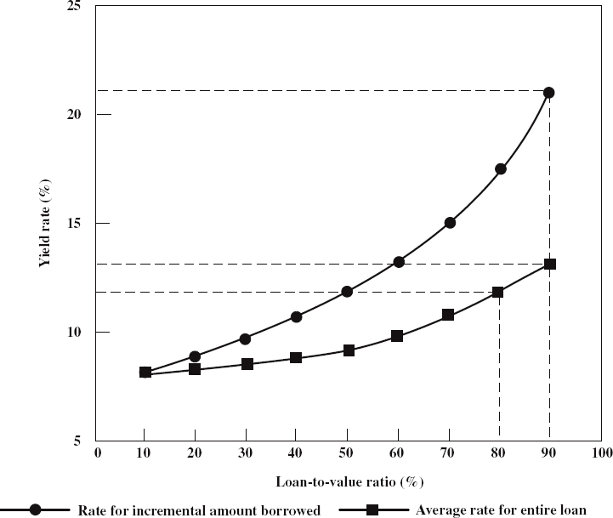
Marginal vs. Average Costs
Effect of LTV on Loan Cost:

Slide 16
Marginal vs. Average Costs
Takeaway:
The more you borrow, the higher the interest rate will be.
There is a point at which you should not borrow more money. The interest rate will be just too high.
It is not economically rational to borrow as much money as possible.

Slide 17
Marginal vs. Average Costs
Most FRMs mortgages allow borrowers to prepay, with or without penalty, by getting a new loan to pay the old one (this is the prepayment option).
But when does mortgage refinancing make sense?
Abstracting from equity extraction, exercising the prepayment option only makes sense if mortgage rates are lower and the resulting saving in payments is greater than refinancing costs (i.e., any penalties plus fees on the new loan).
The decision hinges on finding the return on the refinancing investment.

Slide 18
Refinancing Decision
Information required in any refinancing decision.
  Terms on the present outstanding loan
  Terms of the new loan being considered
  Any fees associated with paying off the old loan and obtaining the new loan
  Likelihood of prepayment
With this information in hand, the next step is to compute the return on the refinancing. Three methods:
  Internal Rate of Return (IRR)
  Market value of loan
  Effective cost of borrowing

Slide 19
Refinancing: IRR Method
The IRR method of analyzing a mortgage refinancing decision involves approaching the decision as an investment decision and computing its IRR.
The cost of the investment are all costs faced by the borrower at the time of refinancing – that is the cash flow at time 0.
This investment will lead to positive cash flows (and maybe negative ones) in the future representing futures payment savings resulting from the lower loan payments.
Next, compute the IRR of the stream of cash flows and compare it to your opportunity cost. If the IRR is higher, do the refinancing, otherwise, don’t.

Slide 20
Refinancing: IRR Method
  Example 1
  15 years ago, a borrower secured a 30-year, $120,000 loan at 7% with monthly payments. The borrower has now the opportunity to refinance the remaining balance on the loan with a 15-year mortgage at 6%. But the new loan requires the payment of up-front fees of $2,500.
  What is the return on investment if the borrower expects to remain in the home for the next 15 years? Should she refinance the loan?

Slide 21
Refinancing: IRR Method
Initial Loan:
  Loan amount: $120,000
  Term: 30 Years
  Interest rate: 7%
  Payment = $798.36
  Loan Balance at end year 15 = $88,822.64
New loan:
  Loan amount: $88,822.64
  Term: 15 years
  Interest rate: 6%
  Payment = $749.54

Slide 22
Refinancing: IRR Method
Refinancing cost = $2,500
  Payment savings = 798.36 - 749.54 = $48.82 per month for 15 years
  Refinancing return:
  PV = ($2500); FV = $0; PMT = $48.82; n = 180
  Then, IRR = 22.62%
  Technically, it makes sense to refinance whenever refinancing return is greater or equal current market rate. More accurately, the borrower should refinance if return greater or equal to opportunity cost, highest return from alternative investments of similar risk.

Slide 23
Refinancing: IRR Method
What is the return on investment if the borrower expects to sell the property and relocate after 7 years?
  Now the calculation is just slightly more complicated because we need to consider the expected future loan balances on the original loan and the refinancing loan 7 years from now, or at the end of year 22.

Slide 24
Refinancing: IRR Method
Balance on the original loan at the end of year 22 (7 years from now) would be $58,557.76
  i = 7%, n = 96, PMT = $798.36 and FV = $0
  PV = $58,557.76
Balance on the refinancing loan 7 years from now would be $57,036.41
  i = 6%, n = 96, PMT = $749.54 and FV = $0
  PV = $57,036.41
Therefore, you would owe $1,521.35 more under the existing loan in 7 years.

Slide 25
Refinancing: IRR Method
Next, compute the return on the refinancing investment:
PV= ($2500)
PMT saving = $48.82
FV (balance saving) = $1,521.35
n = 84
IRR = 20.93%
Refinancing appears to be a wealth enhancing, unless you have other investments of similar risk that can fetch more than 20.93%.

Slide 26
Refinancing: Loan Value Method
This alternative method of analysis refinancing decision applies the concept of the market value of a loan.
The question to answer is how much would an investor be willing to pay for the loan today given current market conditions?
  The investor would be buying the cash flow stream of the loan.
  The market value of the loan would be discounted value of the cash flows at the market rate of interest for investments of equivalent risk.

Slide 27
Refinancing: Loan Value Method
The next step involves comparing the market value of remaining payments to the loan balance.
One should then only refinance if the gain to refinancing is larger than the refinancing costs
Loan Value– Loan Balance > Refinancing costs
The difference between this method and the previous cost-benefit method is that this method assumes the current market rate as the borrower’s opportunity cost.

Slide 28
Refinancing: Loan Value Method
Example 2
Suppose you entered 5 years ago into a 30-year, $500,000 mortgage with monthly payments at an interest rate of 7%.
Suppose interest rate drops to 6.5% and you are not planning to sell the house.
Should you refinance if refinancing cost is $15,000?

Slide 29
Refinancing: Loan Value Method
Monthly PMT:
  PV = $500,000; FV = 0; N = 360; I = 7%; PMT=$3,326.51
Balance currently owed (i.e., end of year 5):
  PMT=$3,326.51; FV=0; N=300; i=7%; Balance=$470,657.95
Present value of remaining payments at current market rate:
  PMT=$3,326.51; FV=0; N=300; i=6.5%; Value=$492,665.46
Should you refinance then?
  Benefit = 492,665.46 - 470,657.95 = $22,007.51
  Since the benefit of refinancing is greater than refinancing cost of $15,000, then you should refinance.

Slide 30
Refinancing: Loan Value Method
Prepayment: Same setup as before, but now you plan to sell the house in 6 years from today. Should you refinance if refinancing cost is still $15,000?
Monthly PMT under existing loan: $3,326.51
Current loan balance existing loan: $470,657.95
Loan balance owed in 6 years (i.e., end of year 11):
  PMT=$3,326.51; FV=0; N=228; i=7%
  Balance=$418,854.75

Slide 31
Refinancing: Loan Value Method
The value of mortgage today is the value today (PV) of 72 payments of $3,326.51 to be made in the next 6 years and that of $418,854.75 to be repaid in 6 years.
  PMT=$3,326.51; N=72; i=6.5%; FV= $418,854.75
  Value mortgage = PV = 481,776.69
Benefit = 481,776.69 – 470,657.95 = $11,118.74
Benefit < Cost. Therefore, do not refinance, assuming that the borrower opportunity cost is the market rate. If lower use the IRR method.

Slide 32
Refinancing: Loan Value Method
With prepayment in 6 years, it turns out that the IRR of refinancing is negative (-1.71%, check it!), making the refinancing decision relatively easy.
When would the IRR be positive even though the PV of savings is less than the cost of refinancing? What to do in that instance?
  In this instance, IRR will be lower than the market rate used. Can proceed with the refinancing if opportunity cost is lower than IRR
Is it necessary that the refinancing loan and the existing loan mature at the same time?
  Not necessarily

Slide 33
Refinancing: Effective Cost Method
This method applies the effective borrowing cost concept seen previously to the refinancing problem by deducting refinancing costs from the amount to be refinanced and computing the effective borrowing cost under the new mortgage.
It consists of comparing this effective borrowing cost to existing mortgage interest rate.
If it is lower, the borrower should then proceed with the refinancing.
This method should lead to the same decision as the previous ones.

Slide 34
Refinancing: Effective Cost Method
Example 3
Back to our previous example: A 30-year, $500,000 CPM mortgage with monthly payments and annual interest rate of 7% signed 5 years ago. Use effective borrowing cost method to explore if borrower should refinance now at current interest rate of 6.5% if refinancing cost is $15,000.
Existing Loan:
PV = $500,000; FV = 0; N = 360; I = 7%; PMT=$3,326.51
Current Balance:
PMT=$3,326.51; FV=0; N=300; i=7%; Balance=$470,657.95

Slide 35
Refinancing: Effective Cost Method
New Loan:
PV = $470,657.95; FV = 0; N = 300; I = 6.5%
PMT=$3,177.92
Effective refinancing cost?
PV = 470,657-15,000=$455,657
PV= $455,657; PMT=($3,177.92); FV=0; N=300;
Then, i=6.85%
Since the effective refinancing cost is lower than the interest charged on the existing loan, the borrower should proceed with the refinancing.
Show using this method that refinancing would not optimal if the loan will be repaid in 6 yrs. (Answer: i=7.19%)

Slide 36
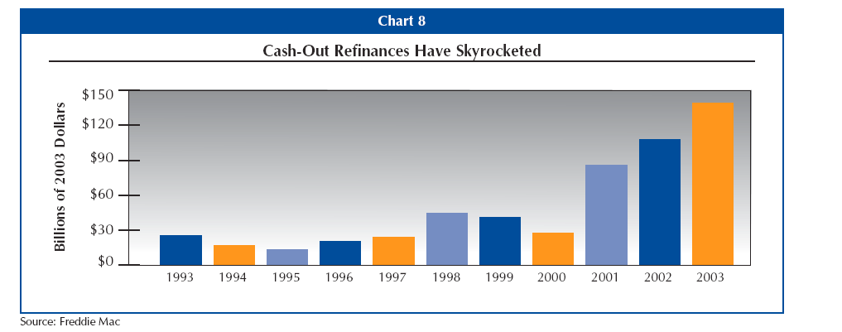
Cash-Out Refinancing

Slide 37
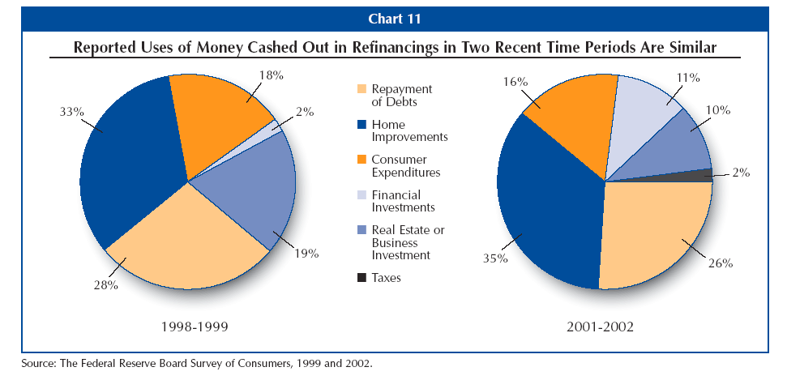
Uses of Cash

Slide 38
Early Repayment
During periods of rising interest rates, lender may try to induce early repayments by offering discounts on the remaining balance.
In this instance, the borrower should compare the discount rate equalizing the PV of remaining payments under the loan to the discount value of the loan balance to her opportunity cost.
If the borrower has money lying around, she should only repay if the discount rate is higher than the highest return (for comparable risk) she can earn outside.
If the alternative is to borrow to repay the loan, this would most likely not be a better option.

Slide 39
Cost of Several Loans
Sometimes a borrower may have to choose between getting one loan or two or more loans to finance the purchase of a property. How should that decision be approached?
Basic Technique:
  Compute the payments for the loans
  Combine payments into a cash flow stream
  Compute the effective cost of the amount borrowed, given the cash flow stream.
  Compare the cost to alternative financing options.

Slide 40
Cost of Several Loans
  Example 4
  You need a $500,000 financing package to purchase a property. You can get 3 loans with the following characteristics. What is the effective borrowing cost?
  Loan 1: $100,000 at 7%, 30 years; then payment = $665.30
  Loan 2: $200,000 at 7.5%, 20 years; then payment = $1,611.19
  Loan 3: $200,000 at 8% 10 years; then payment = $2,426.55

Slide 41
Cost of Several Loans
Using the cash flow register of your calculator to compute the discount rate
CF0 = ($500,000)
CF1 = 665.30+1,611.19+2,426.55 = $4,703.04
N1 = 120
CF2 = 665.30+1,611.19 = $2,276.49
N2 = 120
CF3 = $665.30
N3 = 120
Then compute IRR = .6239 x 12 = 7.49%

Slide 42
Below Market Financing
A seller with a below market rate assumable loan in place may be able to sell the property for more than the seller would otherwise be able to.
All else equal, a buyer is paying a higher purchase price now in exchange for lower debt payments over the life of the loan.
Similar to other problems, we compute IRR on the additional purchase price amount and compare it to other investments of equivalent risk.

Slide 43
Below Market Financing
Example 5
Identical Homes A & B
 | A | B
Price | $120,000 | $115,000
Loan Balance | $80,000 (assumable) | $80,000 (new loan)
Down payment | $40,000 | $35,000
Interest | 7% | 8%
Term | 20 Years | 20 Years
Payment | $620.24 | $669.15

Slide 44
Below Market Financing
The buyer can secure below market financing by paying $5,000 more for an identical home.
The below market financing results in a monthly payment of $48.91 less than if regular financing was used.
Return on the investment:
PV = $5000; FV = $0; PMT = $48.91; n = 240 , Thus, IRR = 10.20%
The buyer earns 10.20% on the $5,000 investment by reducing the monthly payment by $48.91.
Whether or not it is a good investment depends on your opportunity cost.

Slide 45
Cash Equivalency
This is another way to analyze below market financing.
Rather than computing the return on the additional purchase amount, you compute the market value of the payments under the assumable loan using the current market rate.
Compare that value to the remaining balance on the assumable loan.
If the difference is higher than the additional cost of the property, then it makes sense to pay the higher price and assume the loan.

Slide 46
Cash Equivalency
Example 5 (bis)
Identical Homes A & B
 | A | B
Price | $120,000 | $115,000
Loan Balance | $80,000 (assumable) | $80,000 (new loan)
Down payment | $40,000 | $35,000
Interest rate | 7% | 8%
Term | 20 Years | 20 Years
Payment | $620.24 | $669.15

Slide 47
Cash Equivalency
Market value of the remaining payments under the assumable loan:
PMT=$620.24;
n=240
i=8%
FV=0
Thus, PV=$74,152.25
Benefit of assuming loan
  80,000-74,152.25= $5,847.75
Since the benefit is greater than the additional cost of $5,000, you should take the assumable if you opportunity cost is the market rate.

Slide 48
Wraparound Mortgages
Wraparound loans are used to obtain additional financing on a property while keeping an existing loan (with a below market interest rate) in place.
The wraparound lender (a different lender) makes a loan for an amount equal to the existing loan balance plus the additional financing.
The borrower only makes payments on the wraparound loan, and the wraparound lender makes payments on the existing loan.
The wraparound lender does not substitute for the borrower in the first mortgage.

Slide 49
Wraparound Mortgages
The wraparound lender is in fact providing a 2nd mortgage at a rate that is lower than the rate the first lender would charge on a 2nd mortgage and the incremental cost of borrowing if the lender had provided a refinancing loan for a higher amount.
The wraparound lender is not obligated to make payments under the first loan if the borrower misses payments on the wraparound loan.
But as 2nd mortgage lender, the wraparound lender may make advances on the 1st lien and add then to the balance of the wraparound loan.

Slide 50
Buydown Loans
The seller/builder of a property pays an amount to the lender to buy down (lower) the interest rate on the buyer’s loan for a specific period of time.
This is used to attract buyers during periods of high interest rates. The lower initial rate may make it easier for the buyer to qualify for the loan as well.
Typically though, sellers will add the buydown amount to the price of the property. The buyer may be better off negotiating a lower price and paying market rate.
Buydown loans are often combined with GPM or ARMs.
Buydowns are similar to discount points in the sense that points are supposed to lower rates.

Slide 51
Buydown Loans
Example 6
Price: $80,000, LTV = 75%, i = 15%, 30-year loan
Loan needed: $60,000.
PMT =$758.67, but the borrower qualifies for payments of 663.72 (i.e., i=13%).
So, the builder wants to lower the interest rate to 13% for the first 3 years by paying down the loans payments during that period.
Buydown amount = PV of (758.67 - 663.72) / mo., 15%, 3 yrs.) = $2,739.
The builder will probably add the buydown amount to the price. But you can on your own pay $2,739 in “points” to lower i. Sometimes the buyer’s parents or relatives pay the buydown fee.

Slide 52
After-Tax Effective Borrowing Cost
One of the key advantages of home ownership in the U.S. is that interest on the mortgage loan is fully tax deductible – property taxes are also tax deductible.
    This is one of the remaining few tax shelters available to the consumers (interest on consumer loans not tax deductible).
In addition, any points paid in connection with the loan (for purchase loans only) is also be tax deductible in the year points are paid.
These tax deductions create a cash benefit to borrowers by making effective borrowing cost lower.
This tax benefit is directly proportional to the borrower’s tax rate, i.e., income.

Slide 53
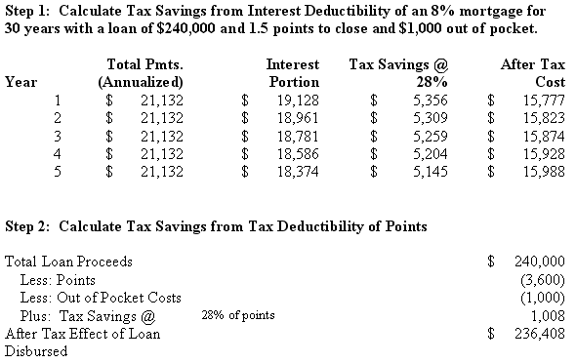
After-Tax Effective Borrowing Cost
Example 7

Slide 54
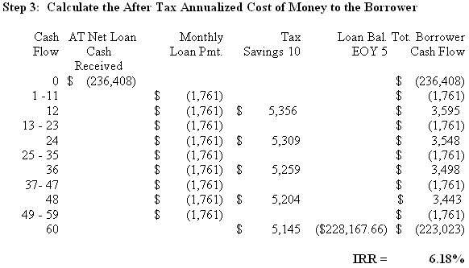
After-Tax Effective Borrowing Cost

Slide 55
Impact of Debt
Gain through value appreciation
    Assume that a borrower owns a $1,000,000 property with a $800,000 non-amortized mortgage loan against it. Next assume that the value of the property were to increase to $1,200,000. What is the equity rate of return?
    Because of leverage then, the owner-investor’s equity position doubles from $200,000 to $400,000, a 100% return on investment!
INTEREST IN | INITIAL EQUITY | POSITION AFTER INCREASE
PROPERTY | POSITION | IN PROPERTY VALUE
Market value | $ 1,000,000.00 | $ 1,200,000.00
Debt (fixed) | $ (800,000.00) | $ (800,000.00)
Owner's equity | $ 200,000.00 | $ 400,000.00

Slide 56
Impact of Debt
Gain through cash flow
  Assume that a commercial lot worth $1,000,000 is under a long-term net lease for $100,000 per year; that is the tenant pays all the operating costs.
    What is the rate of return if 100% equity finance?
    $100,000/ $1,000,000 =10%
    Assume buyer takes a loan of $900,000 @ 9% with no amortization. What is the rate of return?
Total annual net income | $ 100,000.00
Interest on debt | $ 81,000.00
Net CF to equity | $ 19,000.00
Equity position | $ 100,000.00
Rate of return | 19%

Slide 57
Impact of Debt
But this is just half of the story. Debt (i.e., financial leverage) increases returns during good times and decrease them during bad times.
Remember, investment returns are uncertain. The greater the amount of leverage, the greater the amount of risk.
Leverage allows the investor to increase the risk profile of an investment, which then increases expected return.
Debt financing increases the tradeoff between expected increase in return on equity and increased risk.
More to come!

Slide 58
Mortgage Options
A mortgage is a contract with several options. It is a straight debt contract with two options attached to it.
Default Option:
  Right of borrower to stop making payments in exchange for the property.
  Default = exercise of a put option
Prepayment Option:
  Right of borrower to prepay the mortgage at any time
  Prepayment = exercise of a CALL option

Slide 59
Default Option
The borrower’s option to default on the loan is considered to be a European put option (European vs. American options).
  Borrowers will only default when a payment is due.
  Thus, the mortgage can be thought of as a string of default options. Every time you make a payment, you are purchasing a put option giving you the right to sell the house to the lender for the mortgage balance next month.
Main driver of defaults:
  House price declines (strategic defaults)
  Income shocks and other trigger events (less likely)

Slide 60
Prepayment Option
The prepayment option is the right given to the borrower by the lender to pay off the mortgage at any time prior to maturity date.
  This prepayment option is considered to be an American call option because prepay is similar to calling back the mortgage on the property.
  Factors driving exercise of prepayment option:
  Financial factor: when interest rates fall below contract rate.
  Non-financial factors: borrower moves, divorce, etc.

Slide 61
Default and Prepayment
Default and prepayment options are mutually exclusive:
  If borrower prepays the mortgage, then he can’t default on the mortgage, but borrower most likely to exercise the most valuable option.
If borrower defaults on the mortgage, then she can’t prepay the mortgage.
Generally, when one option is “in the money”, then the other is “out of the money”. This has seriously implications on mortgage pricing.
When do these options become “out of money”?
  Are options worthless when they are out of money?

Slide 62
Next:
Commercial Mortgages

