Slide 1
REAL ESTATE 410 Adjustable Rate Mortgages
Spring 2017

Slide 2
Topics
Adjustable rate mortgages (ARMs)
ARMs vs. FRMs
Interest rate caps and floors
Payment caps
Interest rate risk and ARM popularity
Other adjustable rate mortgages

Slide 3
Review FRMs
Lender bears the interest rate risk and of course is compensated for taking that risk.
FRM products may then not be optimal for all borrowers
Expected inflation is built into the interest rate.
Product may not be suitable during periods of high expected inflation
Short-term payment affordability issues (tilt effect)
Prepayment risk is fully borne by the lender (or investor in MBS) and is of course priced into the mortgage.
Again optimality issues!

Slide 4
Adjustable Rate Mortgages
ARMs shift all or a portion of the interest rate risk back to the borrower by allowing for periodic interest rate adjustments (resets) as capital market conditions change.
Borrower is compensated for taking on that risk since ARM rates are lower than similar FRM rates at origination.
ARMs allow for interest rate risk sharing.
The frequency of interest rate resets varies but are generally standardized.

Slide 5
Interest Rate Structure
The contract interest on a adjustable mortgage loan rate is a composite interest rate equal to an index interest rate (i.e., the reference interest rate) plus a margin or spread.
Interest rate = index interest rate + margin
The index rate is generally an independent, market-determined base interest rate.
U.S. treasury rate
Average cost of funds index (COFI) of the 11th Federal Home Loan Bank (FHLB)
Libor (London interbank offered rate)
Home mortgage rate index

Slide 6
Federal Home Loan Bank System

Slide 7
Interest Rate Structure
ARM interest rates are therefore likely to change periodically as the index interest rate at resets to reflect current capital market conditions.
However, the interest rate margin remains fixed throughout the term of the loan
The shorter the time between periodic index interest rate resets, the more the interest rate risk borne by the borrower
Thus, ARMs do not generally totally eliminate interest rate risk for either party.

Slide 8
Interest Rate Structure
Interest margin
Lender’s compensation for the risk associated with the loan.
200-300 basis points (1 bp = 0.01%), but could be higher.
Depends on borrower credit, property type, and loan structure.
Extremely stable between lenders for most home mortgages and 1st-lien commercial mortgages.
Interest rate resets
Usually, 6 months to 1 year for home mortgages, but could vary from 1 month to up to 5 years. Initial interest rate generally fixed for 3, 5, 7, or 10 years (hybrids)
Applicable new index rate usually is the last published rate before the reset date (e.g., 45 days before reset date.)

Slide 9
Teaser Rates
Initial, temporarily reduced interest rates to make ARMs even more attractive for borrowers.
Initial rate below market rate, leading to lower initial payments.
Helps lower-income borrowers qualify for a mortgage.
Future payment shock when interest rate resets to its normal level.
Accrual rate or negative amortization?
High refinancing rate (teaser chasers)
It is not clear whether all residential borrowers comprehend or appropriately price the inherent risks in adjustable rate mortgages.

Slide 10
Repayment Terms
Like FRMs and other mortgages, payments are monthly in arrears (i.e., at the end of month).
ARMs are usually fully amortizing loans with fixed term. Commercial mortgages generally structured with balloons at the end.
At each interest reset, the new payment amount is computed by fully amortizing the loan balance for the remaining term using the new applicable rate.
Periodic payments fluctuate with interest rates.
Some ARM products are fully amortizing with leveled payments, but term cannot be fixed term then.

Slide 11
Interest Rate Caps
ARMs benefit borrowers during falling interest rates.
However, ARMs can inflict a lot of pain to borrowers during increasing interest rates.
Interest rate caps limit the interest rate risk faced by the borrower.
Interest rate caps fix the upper bounds for interest rate adjustments at interest rate resets or throughout the life of the loan.
Lenders will often include caps in mortgages! Why?

Slide 12
Interest Rate Caps
Types of interest rate caps:
Periodic interest rate cap
Lifetime interest rate cap
What is the applicable interest rate at reset if the loan comes with both a periodic cap and lifetime cap?
The minimum interest rate considering both periodic and life caps.
Interest rate caps do not apply to the initial rate or the teaser rate, if any.
Interest caps don’t come free; borrowers must pay.

Slide 13
Interest Rate Floors
Interest rate floors fix lower bounds for interest rate adjustments at resets or throughout the life of the loan, which benefits the lender.
Lenders have to compensate the borrower for this benefit.
Generally, interest rate floors are combined with caps to reduce the impact of caps on the interest rate.
Important to note that interest rate adjustments do not necessary benefit or hurt lenders if the funding of the loan is done right (may be difficult though).
Of course lenders will be hurt by lower interest rates if loans are funded with longer term money.

Slide 14
Payment Caps
Payment caps are meant to reduce payment shocks, rather than interest rate shocks.
Payment caps are limits on changes in periodic payments between interest rate resets, rather than interest rate changes.
Therefore, payment caps provide temporally relief to the borrower.
Careful, payment caps can result in negative amortization since unpaid interest added to the loan balance.
Payment caps may not work during prolonged rising interest rates.

Slide 15
Other Terms
Discount points
Similar uses as for FRMs.
Prepayment options:
Prepayment penalties generally not charged for most residential ARMs but charged for commercial mortgages. Why?
Lockout period:
Prohibition to prepay for some years.
But borrower may always negotiate with the lender.
Conversion option
Ability to switch to a FRM after a specific period of time.

Slide 16
Hybrid ARMs
Hybrid ARMs’ structures sit in between FRMs and traditional ARMs.
Widely used! Why?
Applicable initial interest rate is fixed for an extended period of time and then fluctuates with the market.
Initial reset period longer than for traditional ARMs (up to 10 years).
For 3/1, 5/1, 7/1, or 10/1 ARMs, initial interest rates are fixed for 3, 5, 7, or 10 years and then fluctuate annually thereafter.

Slide 17
Interest-Only ARMs
I.O. for initial period.
The payment of interest and amortization of principal after the initial period will depend on the type of real estate and negotiations between the borrower and the lender.
Fully amortizing payments required after initial period
Pay interest and some principal
Pay interest only
Sometimes negative amortization
Used more in commercial lending.

Slide 18
Pricing Considerations
The expected yield (cost) of ARMs generally is a function of these factors:
Initial interest rate
Index and margin
Any points charged
Frequency of payment resets
Inclusion of caps or floors on the interest rate, payments, or loan balances (more rare)
It is important to understand how each of these factors affects default risk alone and in combination with other factors. Analysis is more difficult with ARMs!
APR has no real meaning for ARMs!

Slide 19
Pricing Considerations
Default risk
Can borrower afford higher payments?
Check income tests using upper limit rates.
Impact of payment shocks and possible negative amortization?
Likelihood of default risk of specific borrowers
Income risk (volatility)
Interest Rate
Allocation of interest rate risk between the borrower and the lender.
The party more able to bear the risk should bear it!

Slide 20
Interest Rate Risk, Default Risk, and Risk Premiums: ARMs vs. FRMs

Slide 21
Interest Rate Risk, Default Risk, and Risk Premiums: ARMs vs. FRMs

Slide 22
FRMs v. ARMs
At origination, expected yields on ARM loans should be lower than on FRMs.
Provided that the increase in default for an ARM is lower than the reduction in interest rate risk.
ARMs tied to short-term indices are generally riskier for borrowers than ARMs tied to long-term indices.
This is about interest rate volatility, not the reset period!
Also, more frequent interest rate resets make ARMs riskier for the borrower. At the extreme, borrowers should prefer non-adjusting mortgages.

Slide 23
FRMs v. ARMs
Interest rate caps reduce interest rate risk for borrowers, which results in higher required yield by lenders. On the other hand, interest rate floors reduces exposure to interest rate risk for lenders, thus lowering required yield.
Caps can reduce default risk by limiting payment shocks.
Floors can be used by borrowers to balance out the cost associated with interest rate caps.
Payment caps do not necessarily reduce interest rate risk for borrowers because any reduction in payment will add to the loan principal (negative amortization), but reduce default risk.

Slide 24
Example 1
An unrestricted, fully amortizing ARM (with no caps or floors) of $100,000 for 30 years with 1-year interest rate resets and monthly payments. The starting interest rate (index/reference rate + margin and any teaser discount) is 5%.
What is the initial payment?
To compute the initial (or any payment for that matter), assume that the beginning of period rate applies to the remaining loan tenor.
PV = $100,000; n = 360; FV = $0; i = 5/12
Then, PMT = $536.82

Slide 25
Example 1
If the composite rate increase to 7% at the end of year 1, what is the new payment amount?
First, compute the outstanding balance at the end of year 1; use the PV method (always easier!)
PMT = $536.82; n = 348; FV = $0; i = 5/12
Then, OBL₁₂ = PV = $98,524.63
Now compute the new payment by assuming that the new rate applies for the remainder of the loan.
PV = $98,524.63; n = 348; FV = $0; i = 7/12
Then, PMT = $662.21

Slide 26
Example 1
Note the payment increase:
$662.21 - $536.82 = $125.39
This is a 23.4% payment increase!
This could be a problem for a borrower on a tight budget.

Slide 27
Example 2: Rate Cap
A fully amortizing ARM of $100,000 for 30 years with 1-year interest rate resets, monthly payments. The starting interest rate is now 7% with a 2% annual interest rate cap.
What is the initial payment?
The rate cap does not affect the initial payments.
PV = $100,000; n = 360; FV = $0; i = 7/12
Then, PMT = $665.30
The outstanding balance at the end of year 1 is $98,984.19 (do the calculation!).

Slide 28
Example 2: Rate Cap
Compute the 2nd year payments if the composite rate at the end of year 1 is 8% and 10%.
The applicable interest rate in year 2 cannot be more than the previous year’s rate plus the annual rate cap, i.e., 7% + 2% = 9% (upper limit in year 2).
If the composite rate is 8%, then the applicable rate will be 8% and the 2nd year payments will be $732.43.
If the composite rate is 10%, then the applicable rate will be 9% and the 2nd year payments will be $801.93.
The payment would have been $873.51 without the interest cap, almost 9% higher.

Slide 29
Example 3: More Rate Caps
Consider a $250,000 1-year ARM at a margin of 2% over Libor with monthly payments and a 30-year term.
What is the periodic payment amount for the 1st year if Libor is at 3% at origination?
PV = $250,000; FV = 0; i = (3%+2%)/12;
n =360
Therefore, PMT=$1,342.05

Slide 30
Example 3: More Rate Caps
Suppose the index (Libor) increases to 7% at the end of yr 1. What is the payment amount during the 2nd year if loan has a 2% periodic interest rate cap and a 4% lifetime cap?
Outstanding balance at end of year 1:
PMT = $1,342.05; FV = 0; i = 5%/12; n = 348.
Therefore, OLB₁₂ = $246,311.59

Slide 31
Example 3: More Rate Caps
Find the applicable interest rate for year 2:
Min (5%+2%, 5%+4%, 7%+2%) = 7%
Compute the monthly payment for year 2:
PV = $246,311.59; FV = 0; i = 7%/12; N=348
PMT = $1,655.53
Periodic cap
Lifetime cap
Period’s index + margin

Slide 32
Example 3: More Rate Caps
Libor is now 11% at the end of year 2, compute monthly payment for 3rd year.
Outstanding balance at end of year 2:
PMT = $1,655.53; FV = 0; i = 7%/12; n = 336
OLB₂₄= $243,601.13
Interest rate in year 3:
Min (7%+2%, 5%+4%, 11%+2%) = 9%
Monthly payments in year 3:
PV = $243,601.13; FV = 0; i = 9%/12; n = 336
PMT = $1,988.52

Slide 33
Example 4: Payment Cap
An fully amortizing 1-year ARM of $100,000 for 30 years with monthly payments and a 5% payment cap. The starting interest rate is 6%.
What is the initial payment?
PV = $100,000; n = 360; FV = $0; i = 6/12
PMT = $599.55
The outstanding balance at the end of year 1 is $98,771.99 (do the calculation!).

Slide 34
Example 4: Payment Cap
What are next year’s payments if the composite rate at the end of year 1 is 10%?
The unrestricted payment without the payment cap would be:
PV = $98,771.99; n = 348; FV = $0; i = 10/12
Thus, PMT = $871.64
But given the cap, the 2nd year periodic payments cannot be more than:
$599.55*1.05% = $629.53

Slide 35
Example 4: Payment Cap
The payment cap will be binding in this instance. The difference between the unconstrained payment amount and the capped amount will be added to the principal every month, resulting in a negative amortization.
The principal outstanding at the end of year 2 will be:
PV = $98,771.99; n= 12; PMT= ($629.53); i = 10/12
OLB₂₄= FV= $101,204.32
As expected, this is more than the starting loan balance due to the negative amortization.

Slide 36
Typical ARM
Indexed to Treasury bill rate or LIBOR.
Rate and payments adjusted annually with rate adjustments limited by annual caps of 2% to 6% over the life of the loan.
Maximum LTV ratio 95%; PMI required when LTV ratio is 80-95%.
30-year loan term.
Fully amortized, with negative amortization not permitted.

Slide 37
ARMs Compared to FRMs
No fixed interest rates or predetermined payment patterns for life.
For ARMs, Prepayment is usually not a major issue, except for non-prime home mortgages and commercial mortgages.
Risk sharing between the borrower and the lender.
The level of risk sharing depend on the frequency interest rate resets.
The more frequent the resets the more the interest risk shifts to the borrower.
ARMs do not completely eliminate interest rate risk for the lender

Slide 38
Risk Tradeoff
As noted, ARMs allow lenders to partially shift interest rate risk to borrowers.
As a borrower bears more interest rate risk, default risk is likely to increase as well! The lender may be in a better position to bear that risk than the borrower.
ARMs involve therefore a tradeoff between interest rate risk and default risk. The lender must consider these two key aspects:
Will the borrower be able to make the monthly payments if interest rates increase?
In case of a default, will the value to the property be greater than the loan balance?

Slide 39
Factors to Consider
When deciding between a FRM and an ARM, the borrower (as well as the lender) should consider:
Income level (ability to withstand payment shocks)
Income volatility
Mobility
Risk attitude
Expectations about future interest rates
Refinancing option of FRMs

Slide 40
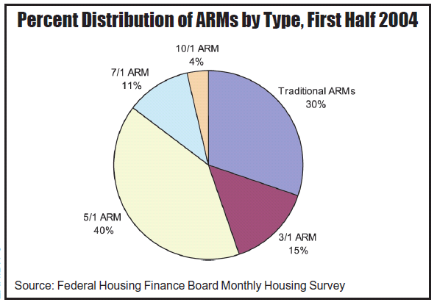
Some Stats

Slide 41
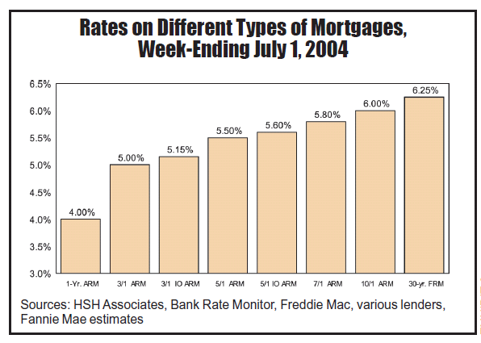
ARM Pricing Stats

Slide 42
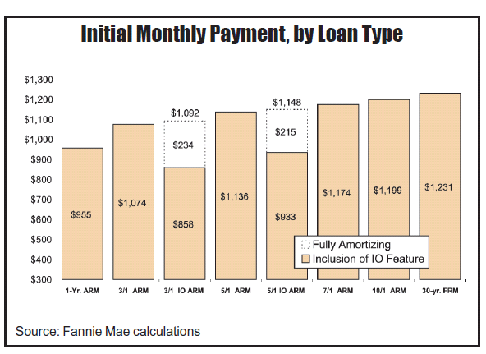
ARM Pricing Stats

Slide 43
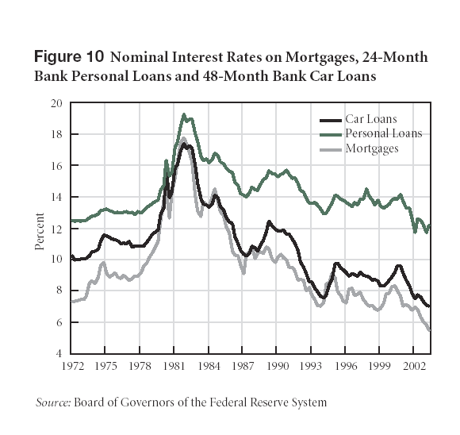
Popularity of ARMs in 80’s

Slide 44
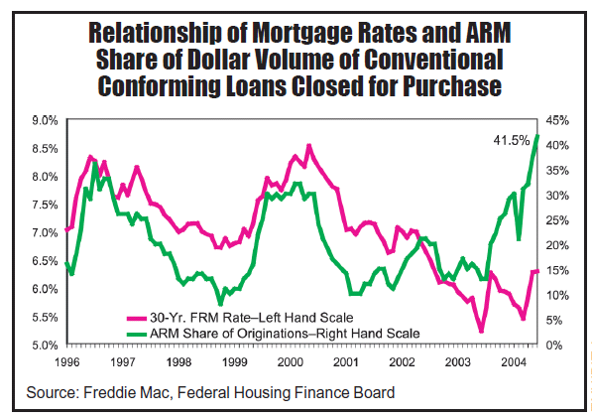
What Happened in 2003-04?

Slide 45
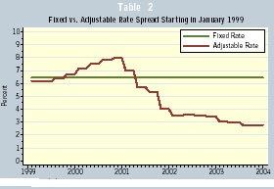
Past FRM & ARM Rates
Interest rates that would have been paid on FRM & ARM Loans over the 5-year period starting in January 1999

Slide 46
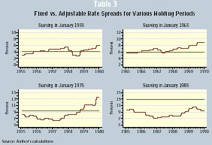
Past FRM & ARM Rates
Interest rates that would have been paid on FRM & ARM Loans over the 5-year period for different starting dates

Slide 47
30-Year FRM Rates
Source: Federal Reserve Bank of St Louis “FRED” database
This is why Greenspan said in back in 2005 that more people should have chosen ARMs in the previous 10 years!

Slide 48
Interest Rate Risk & ARM Popularity
Source: Mortgage Market Design by John Y. Campbell

Slide 49
FRM Maturities
Source: Mortgage Market Design by John Y. Campbell

Slide 50
Interest Rate Risk
An inaccurate prediction of interest rate due to inflation higher than expected would result in a loss for the lender.
Interest rate risk has probably the largest impact on profitability. Often though, the lender is better able to manage that risk than the borrower.
Assume a CPM mortgage contract involves i=10%, $600,000, 30 years, repaid after 10 years.
What is the loss to the lender would suffer if the market rate moves up to 12% shortly after closing?

Slide 51
Interest Rate Risk
PMT = $5,265 / month
Outstanding loan balance at the end of year 10 is $545,628
PV of the 120 monthly payments of $5,265 and the final payment of $545,628 discounted at 12% is $532,328
The lender’s loss is then:
$600,000 – $532,328 = $67,672
As with bonds, up and down interest rate changes do not have the same effect on value.
Rate decreases have a larger effect than rate increases due to price convexity.

Slide 52
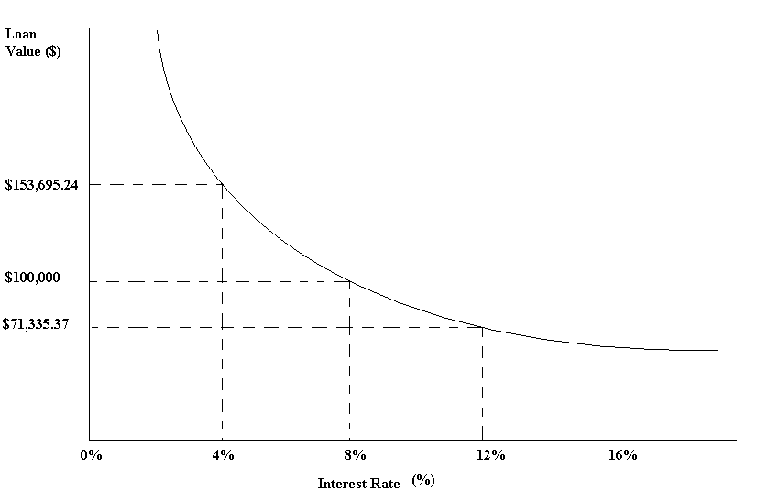
Impact of Interest Rate Changes on Loan Value
Assume a $100,000, 30-year, 8% mortgage. The impact on loan value if the interest rate changes right after origination (ignore prepayment or default): see the graph on the following slide.
How would changes in interest rate affect price if it were an ARM?

Slide 53
PLAMs and VTMs
Price level adjusted mortgages (PLAMs)
Variable term mortgages (VTMs)

Slide 54
PLAMs
Remember, the mortgage interest rates have three components:
i = r + p + f
Which of these three component of interest rate is more difficult to predict, even for ARMs?
Answer: Expected inflation (f)
PLAM payments are based on r and p with the loan balance adjusted for inflation at the end of each year using a price index, generally the CPI.

Slide 55
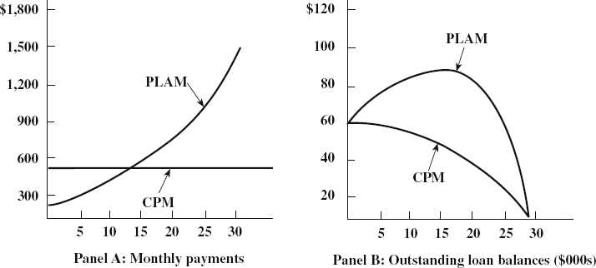
PLAMs
Payments and Loan Balance Patterns, $60,000 PLAM, 4% interest rate and 6% inflation per year, versus $60,000 CPM, 10% interest – all for 30 Years

Slide 56
PLAMs
Similar to ARMs, PLAMs
Shift interest rate risk from the lender to the borrower. But in this instance, the borrower bears all interest rate risk.
All else the same, interest rates on PLAMs should be lower than ARM rates.
Would also reduce the burden of the tilt effect discussed previously, which benefits the borrower.
For lenders, FRMs can lose substantial value if an unanticipated rise in inflation occurs after the mortgages have been made. The PLAM is designed to avoid the loss in value that would otherwise occur due to unanticipated inflation.

Slide 57
PLAMs
However, there are a number of problems associated with PLAMs.
Lenders may find themselves having to forecast both the index (CPI) and house prices in order to make sure the increase in loan balance is covered by the value of the property.
Property prices do not necessary increase at the rate of inflation!
If borrower’s income does not increase at CPI, this may limit the borrower’s ability to meet ever increasing monthly payments. The fact that the inflation adjustment is made ex-post may increase the burden on the borrower.
Again, the lender trades off interest rate risk for more default risk.

Slide 58
Variable-Term Mortgage
Variable-term mortgages (VTM) keep period payments constant by allowing the loan term to rise and fall with changes in interest rates.
Again, VTMs shift interest rate risk from the lender to the borrower.
Although default risk may be lower than for similar ARMs or PLAMs due to less payment uncertainty, this does not necessarily translate into a low interest rate because of the resulting longer loan term.

Slide 59
Next:
Mortgage Topics

