Slide 1
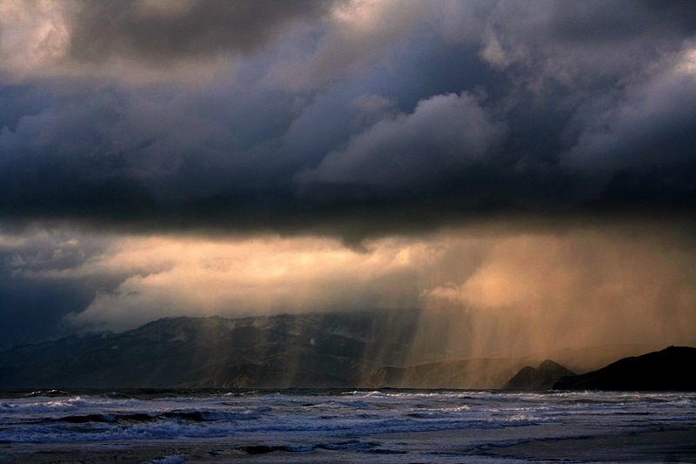
Measuring Precipitation from Satellite
Ralf Bennartz
Cooperative Institute for Meteorological Satellite Studies
University of Wisconsin – Madison

Slide 2
Outline
What is the impact of precipitation on radiation observed in the:
  Solar spectral range…
  Infrared spectral range…
  Microwave spectral range…
Active versus passive
Build your own rain retrieval
Recap

Slide 3
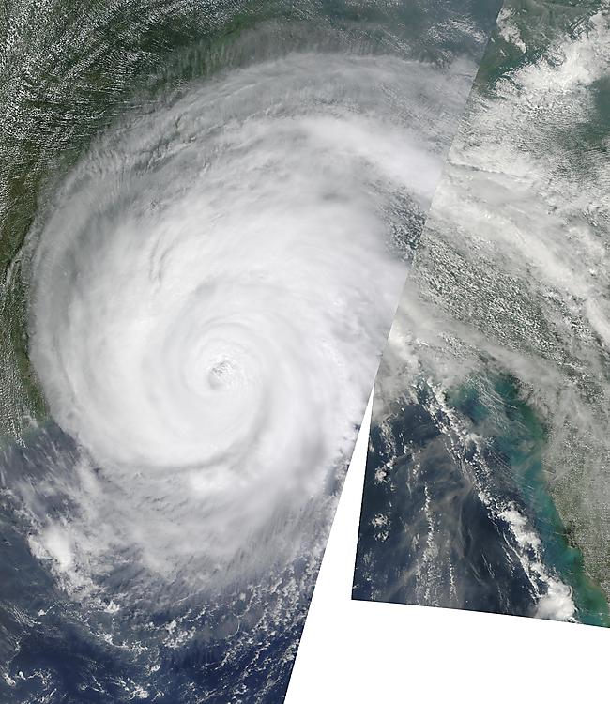
Solar spectral range

Slide 4
Solar spectral range
Cloud thickness
Cloud top effective radius
Do we actually see the rain from satellite?

Slide 5
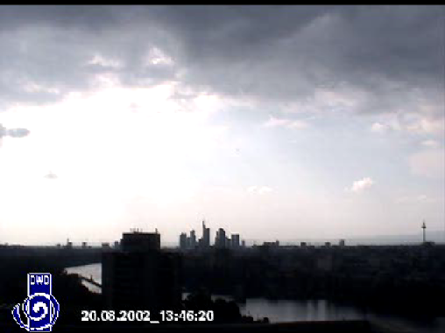

Slide 6
Solar spectral range
Cloud thickness
Cloud top effective radius
Do we actually see the rain from satellite?
Rain is very optically thin compared to clouds.
If it is underneath a cloud we cannot actually see it.
Thickness, particle size are correlated with precipitation

Slide 7
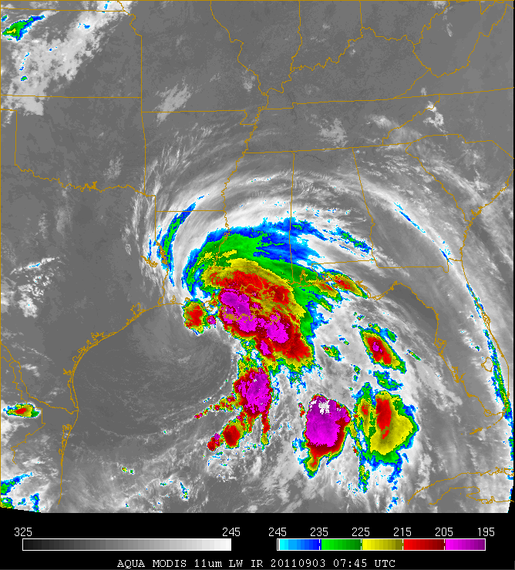
Infrared spectral range

Slide 8
Infrared spectral range

Slide 9
Infrared spectral range
We see the cloud top temperature
This information is correlated with precipitation (i.e. thick, cold clouds rain often).
However, we do not see the rain. (E.g. we cannot discriminate a thick anvil cloud from the core of a thunderstorm.)

Slide 10
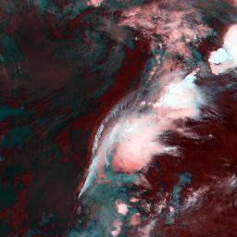
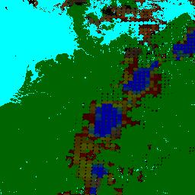
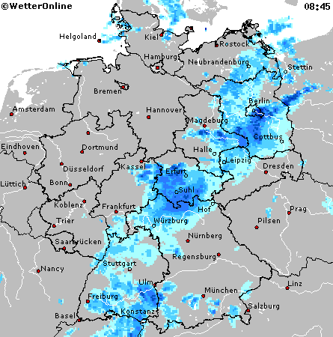
NOAA15 overpass 13 September 2000, 06:43 UTC
RGB AVHRR ch3,4,5
PC product RGB:
red: very light
green:light/moderate
blue:intense
Radar composite
different projection!

Slide 11
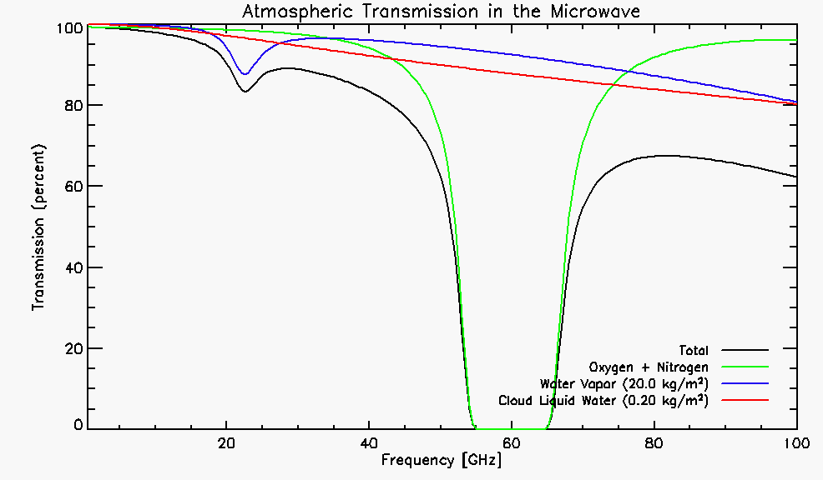
Cloud and water vapor absorption
19.4
22.2
37.0
Water Vapor Absorption
85.5
Liquid Water Absorption

Slide 12
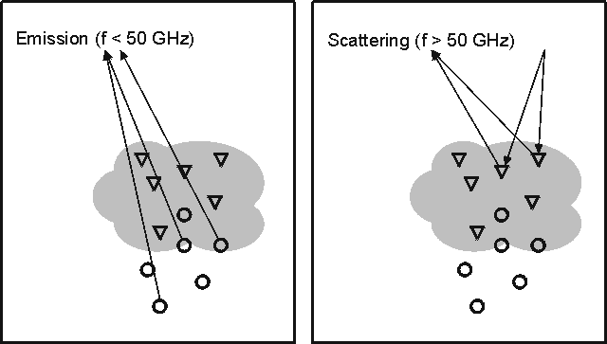
Let’s build our own rain retrieval!
Most directly linked to surface precipitation
Over cold (water) surfaces only
All types of surfaces
More indirect

Slide 13
Radar
Active sensor
Sends out energy and measures how much is scattered back
Allows to slice the atmosphere

Slide 14
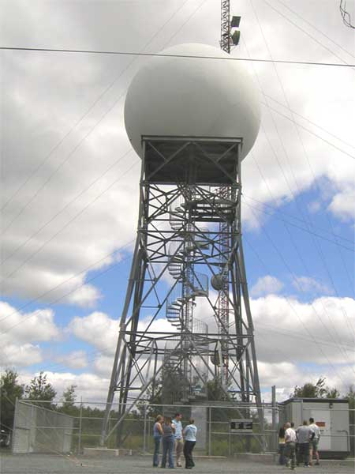
Weather radar tower

Slide 15
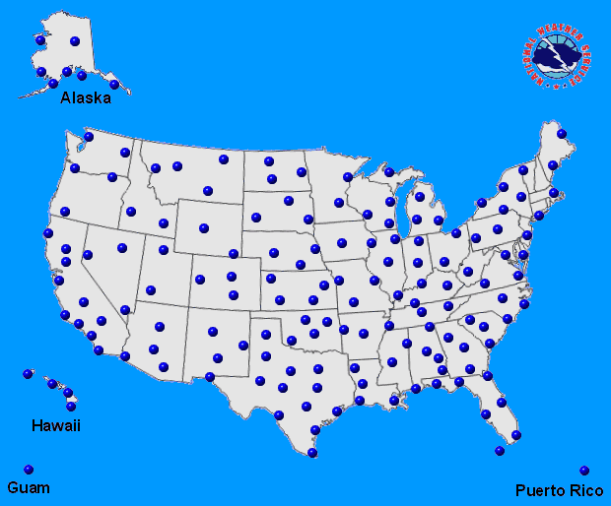
NEXRAD radar sites

Slide 16
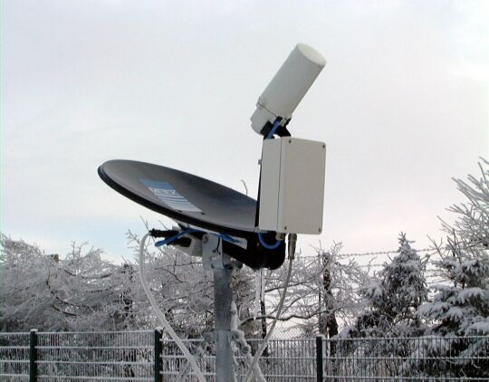
Inexpensive vertically looking ground radar

Slide 17
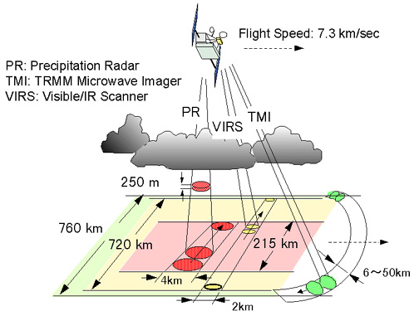
Spaceborne precipitation radar

Slide 18
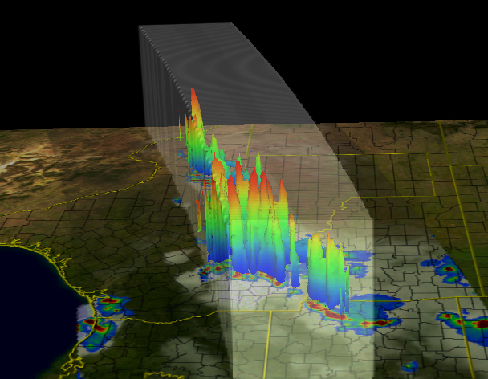

Slide 19
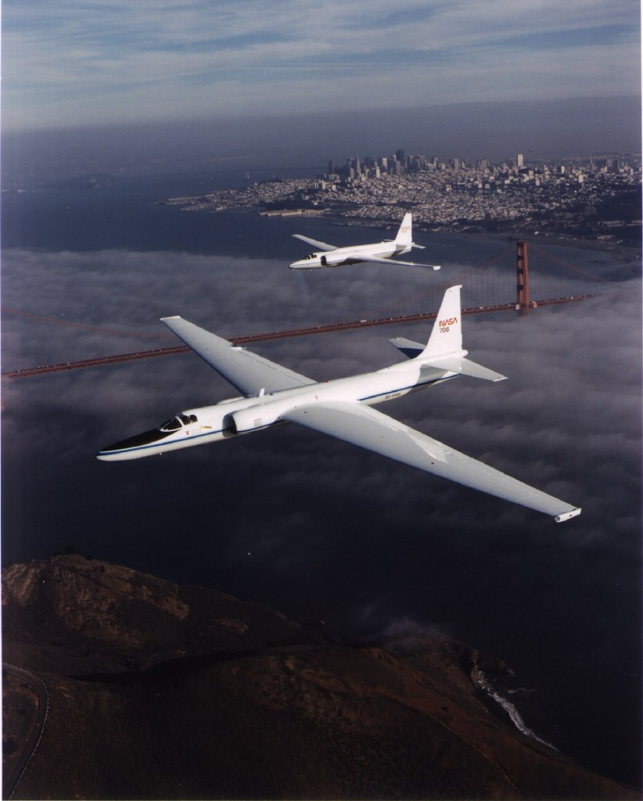

Slide 20
ER-2 EDOP Doppler Radar
Frequency / Wavelength: | 9.72 GHz / 3.07 cm
Peak Transmit Power | 20 kW
Pulse Repetition Frequency | 2.2 of 4.4 kHz
Pulse Widths/Range Resolution | 0.25, 1.0 micro-sec / 37.5, 150 m
Antenna Beam Widths | 2.9 deg

Slide 21
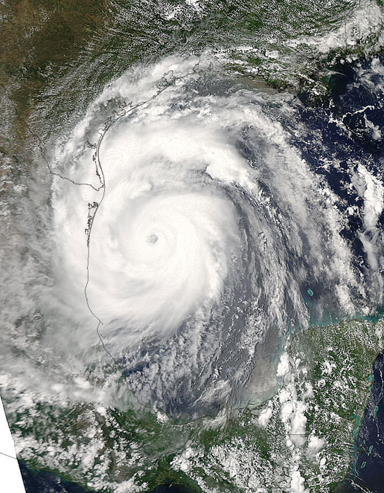

Slide 22
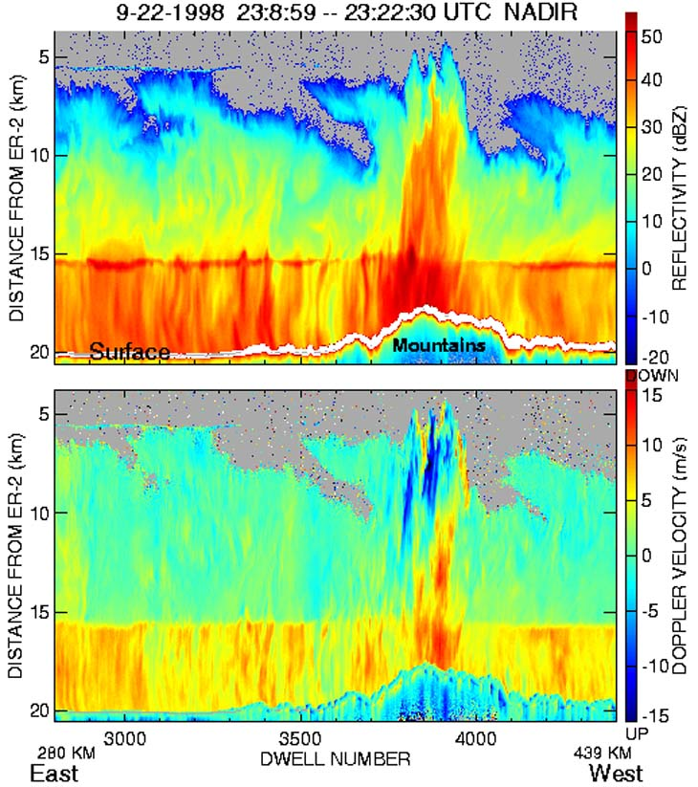

Slide 23
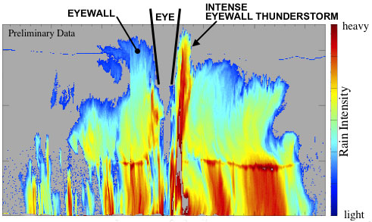

Slide 24
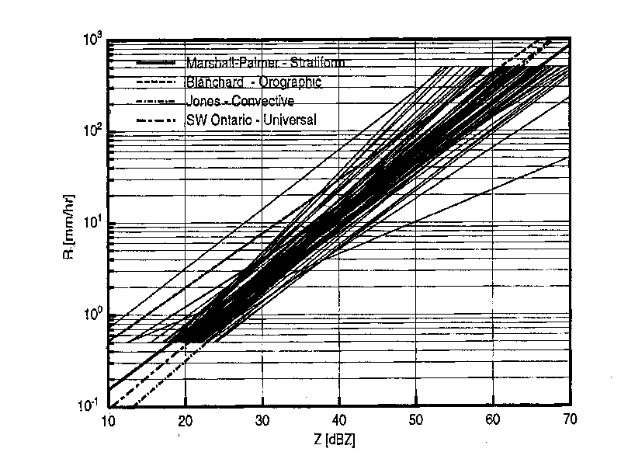
Z-R conversion radar
Marshall-Palmer (1948): Z=200 R^{1.6}
Sekhon-Srivastava (1970): Z=2000 R^{2.0}
(Figure from Battan, 1981)

Slide 25
Let’s build our own rain retrieval!
Most directly linked to surface precipitation
Over cold (water) surfaces only
All types of surfaces
More indirect

Slide 26
Precipitation
Most directly linked to surface precipitation
Over cold (water) surfaces only
All types of surfaces
More indirect

Slide 27
Rain retrieval

Slide 28
Rain retrieval

Slide 29
Rain retrieval

Slide 30
Rain retrieval
Freezing Level (Z_{F})

Slide 31
Rain retrieval

Slide 32
Rain retrieval

Slide 33
Rain retrieval
NOTES:
Real retrieval algorithms are a bit more complicated b/c they have to work everywhere
But, the basic principle is pretty much the same

Slide 34
Recap
Infrared sees cloud top. Solar sees cloud thickness, particle size. Both are correlated with rain but no direct signal.
Direct signal of precipitation only observed in the microwave.
Radars allow to derive much more information about precipitation (but much more expensive and have their own problems as well).

Slide 35
Precipitation processes

Slide 36
Precipitation processes
Autoconversion

Slide 37
Precipitation processes
Autoconversion
Accretion

Slide 38
Warm rain

Slide 39
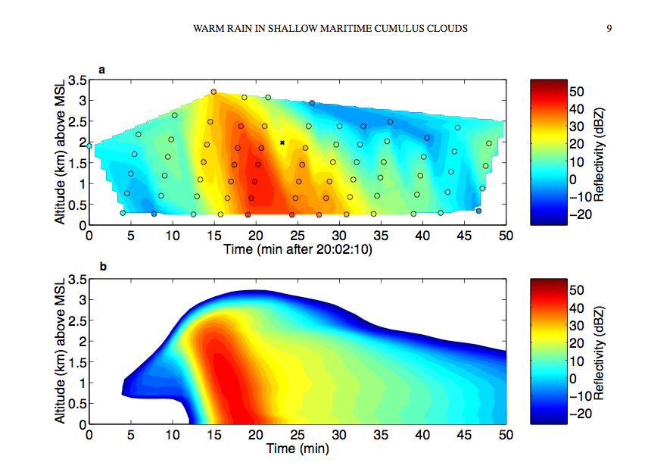
Warm rain
From Lowenstein et al., 2009, QJRMS

Slide 40
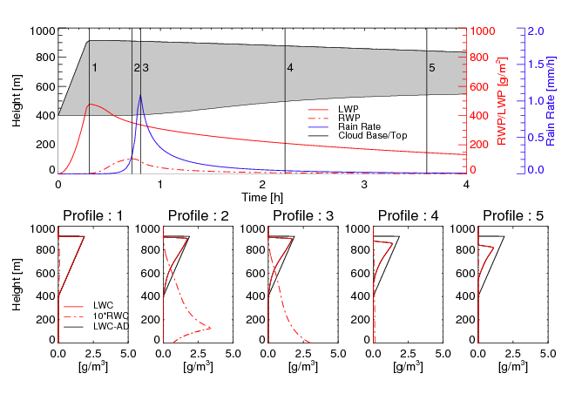

Slide 41
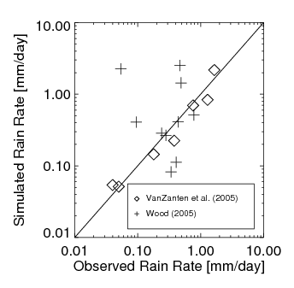
Comparison with observations

Slide 42
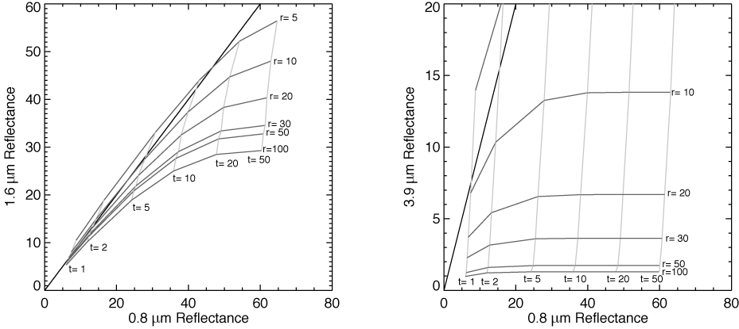
Nakajima-King retrieval

Slide 43
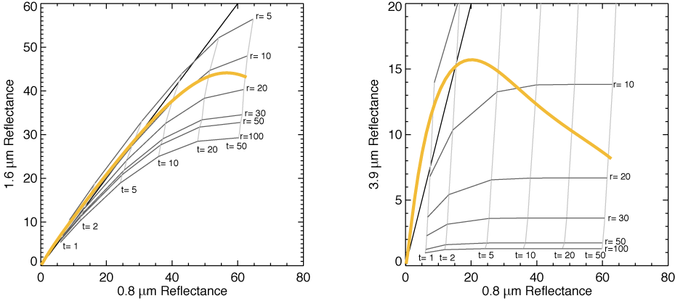
Adiabatic cloud

Slide 44
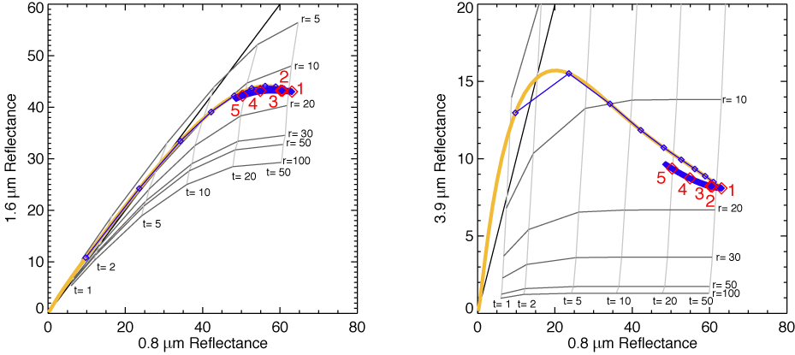
Simulated Sc cloud with rain

