Slide 1
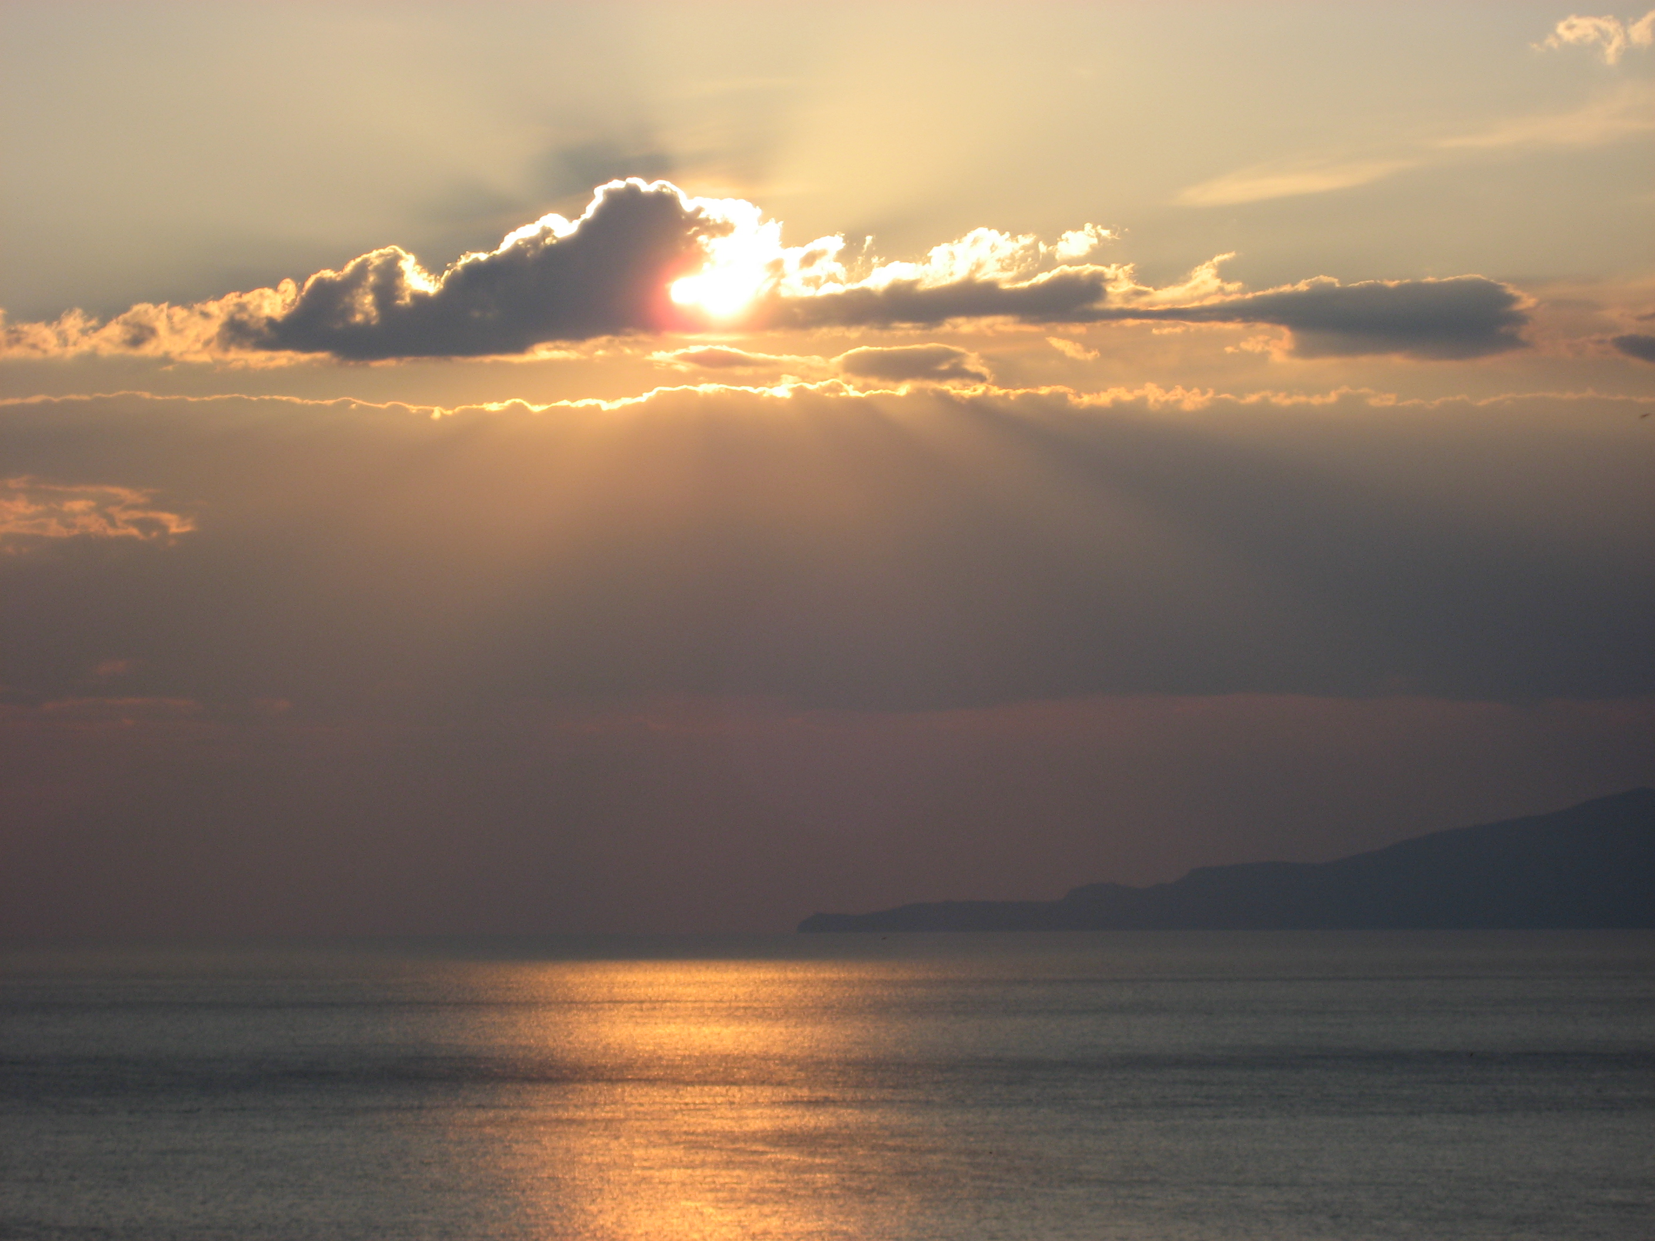
Suomi NPP
Ralf Bennartz
Cooperative Institute for Meteorological Satellite Studies
University of Wisconsin – Madison

Slide 2
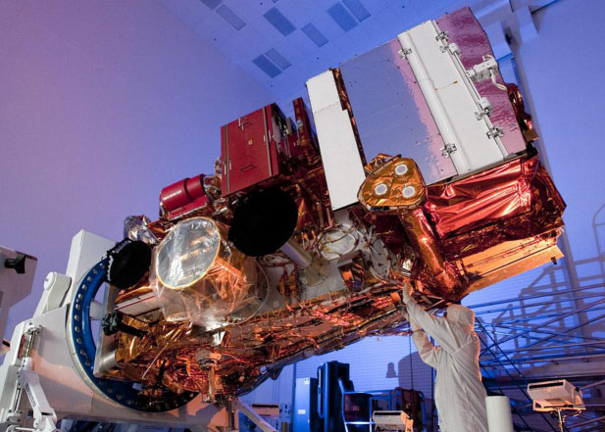
What we want to know and why we need it?
What does a satellite really observe (a.k.a. The radiative transfer equation)
Weighting functions
Recap: What is important?

Slide 3
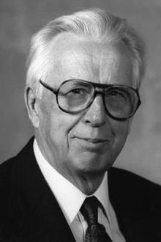
Overview
National Polar orbiting Partnership
Named after Verner Suomi, Professor at UW-Madison, father of satellite meteorology.

Slide 4
Blue Marble 2012

Slide 5
Satellite
5 year design life with redundant architecture
Orbit: 824 km, sun-synch (i=98.7 deg), 1:30 pm Ascending Node
Observatory Mass - 2132.8 kg
5 Instruments on board

Slide 6
Instruments
ATMS - Advanced Technology Microwave Sounder, a 22-channel passive microwave radiometer, to create global temperature and moisture profiles.
CrIS - Cross-track Infrared Sounder an infrared instrument for temperature and pressure sounding.
VIIRS – Visible Infared Imaging Radiometer Suite a 22-band radiometer similar to MODIS. It will collect data of wildfires, land changes, and ice movement and atmospheric and oceanic properties, including clouds and sea surface temperature.
OMPS – Ozone Mapping and Profiler Suite
CERES – Clouds and the Earth’s Radiation Budget. Broad-band instrument to measure radiative fluxes

Slide 7
VIIRS

Slide 8
What are the bright stripes?

Slide 9
What are the bright stripes?
Aurora Borealis in VIIRS D/N channel

Slide 10
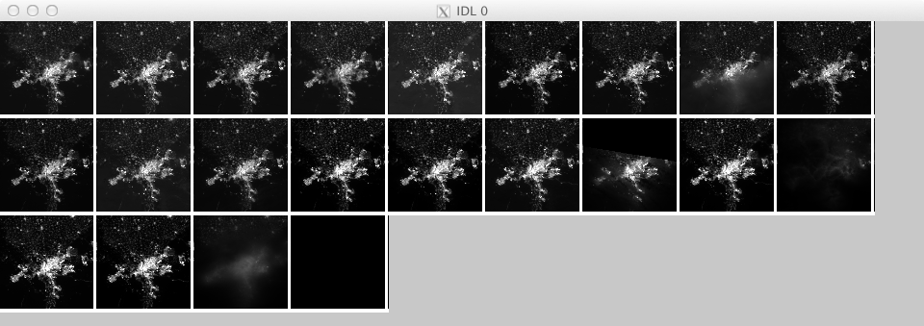
Cairo at night time from 870 km altitude on 22 days between Dec 2011 and June 2012

