Slide 1
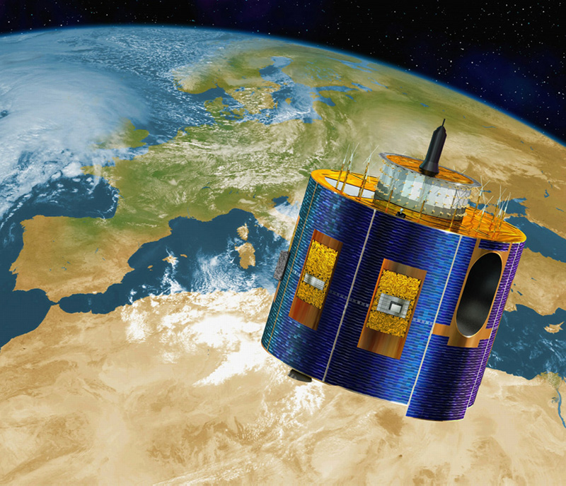
Satellites and Orbits Ralf Bennartz Cooperative Institute for Meteorological Satellite Studies University of Wisconsin – Madison

Slide 2
Outline
Kepler’s Laws
Meteorological Satellite Orbits
A Brief History of Satellite Remote Sensing
Instrumentation
Recap: What is important?

Slide 3
Kepler’s Laws
The orbit of every planet is an ellipse with the sun at one of the two foci
A line joining a planet and the sun sweeps out equal areas during equal interval times
The square of the orbital period of a planet is directly proportional to the cube of the semi-major axis of its orbit
Image source: http://onlinephys.com/keplerlaws.html

Slide 4
Orbits

Slide 5
Inclination
Inclination 0 degrees : On equator
Inclination 90 degrees: Directly over pole
Inclination < 90 degrees prograde orbit
Inclination > 90 degrees retrograde orbit
Image source: http://www.tpub.com/neets/book17/76.htm

Slide 6
Geostationary Orbit
Inclination 0 degrees : On equator
Speed: 1 rotation/24 hrs
Distance to surface ~ 36000 km
Image source: http://www.daviddarling.info/images/geostationary_orbit.jpg

Slide 7
Sun-synchronous Orbit
Inclination slightly retrograde
Speed: One rotation per 90-100 mins
Distance to surface ~ 600-800 km
Image source: http://spaceyuga.com/files/2010/04/orbital_plane.jpg

Slide 8
History of Satellite Remote Sensing
Menzel et al., 2009, (BAMS): The first successful meteorological experiment conducted from a satellite was launched on Explorer VII on 13 October 1959, 50 years ago this year. Explorer VII carried an early version of a radiometer designed to measure Earth's heat balance from a satellite. The thermal radiation experiment, devised by Verner E. Suomi, along with University of Wisconsin - Madison engineering professor Robert J. Parent, established Suomi as the "father of satellite meteorology.”’
Next 12 slides courtesy of Prof. F. House, Dept. Physics, Drexel University, Philadelphia, PA, UW-Madison graduate 1965.

Slide 9
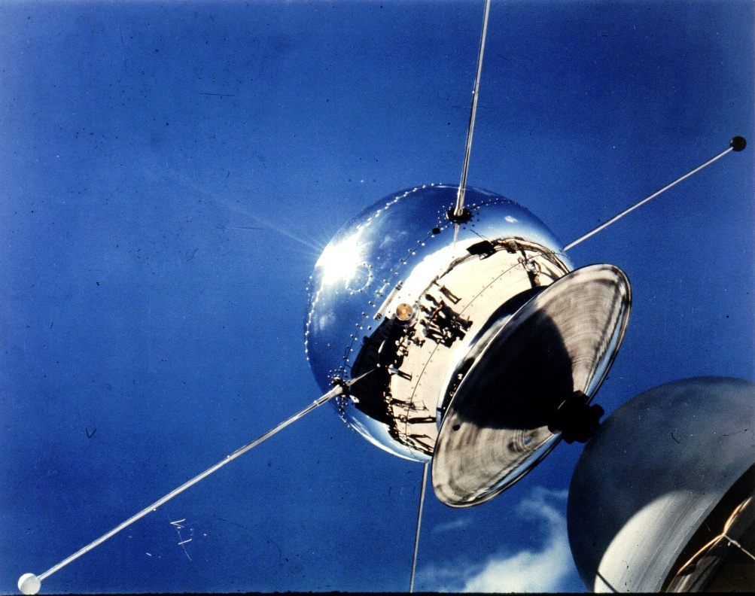
Vanguard Satellite at Launch Pad 1958

Slide 10
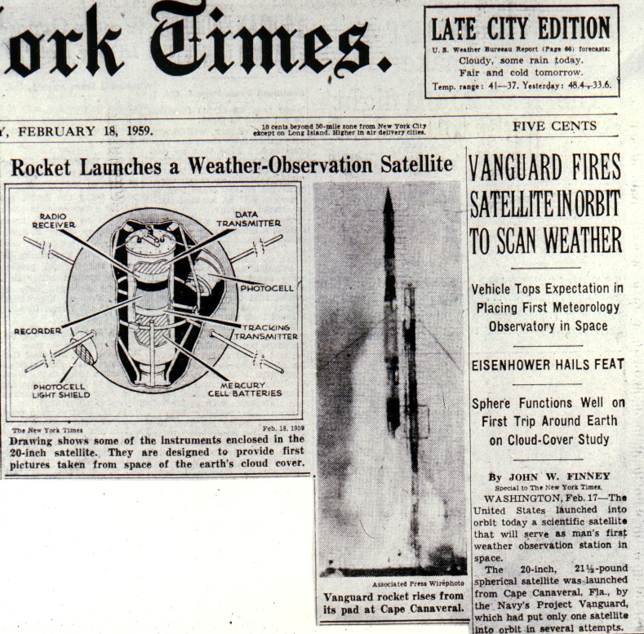

Slide 11
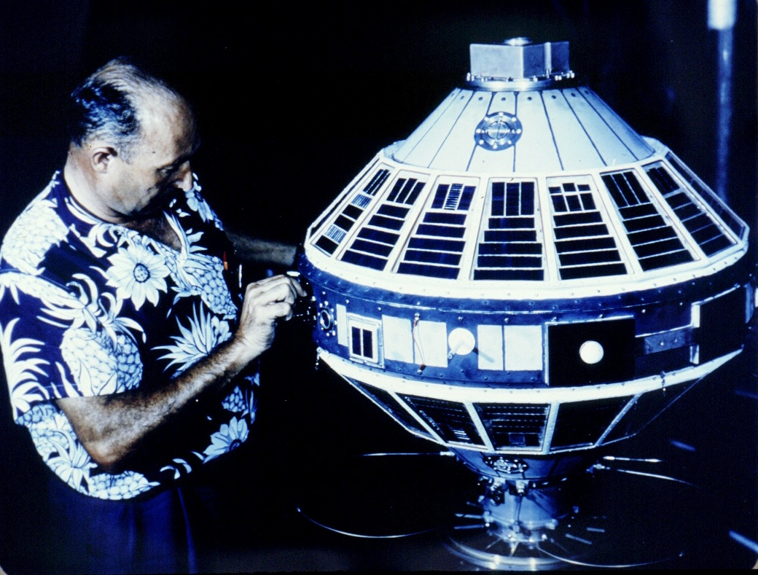
Preparing Explorer VII for Launch

Slide 12
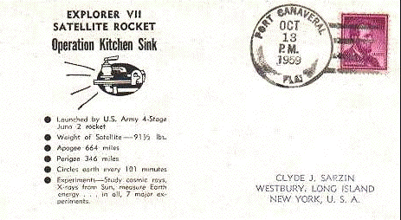
When It All Began

Slide 13
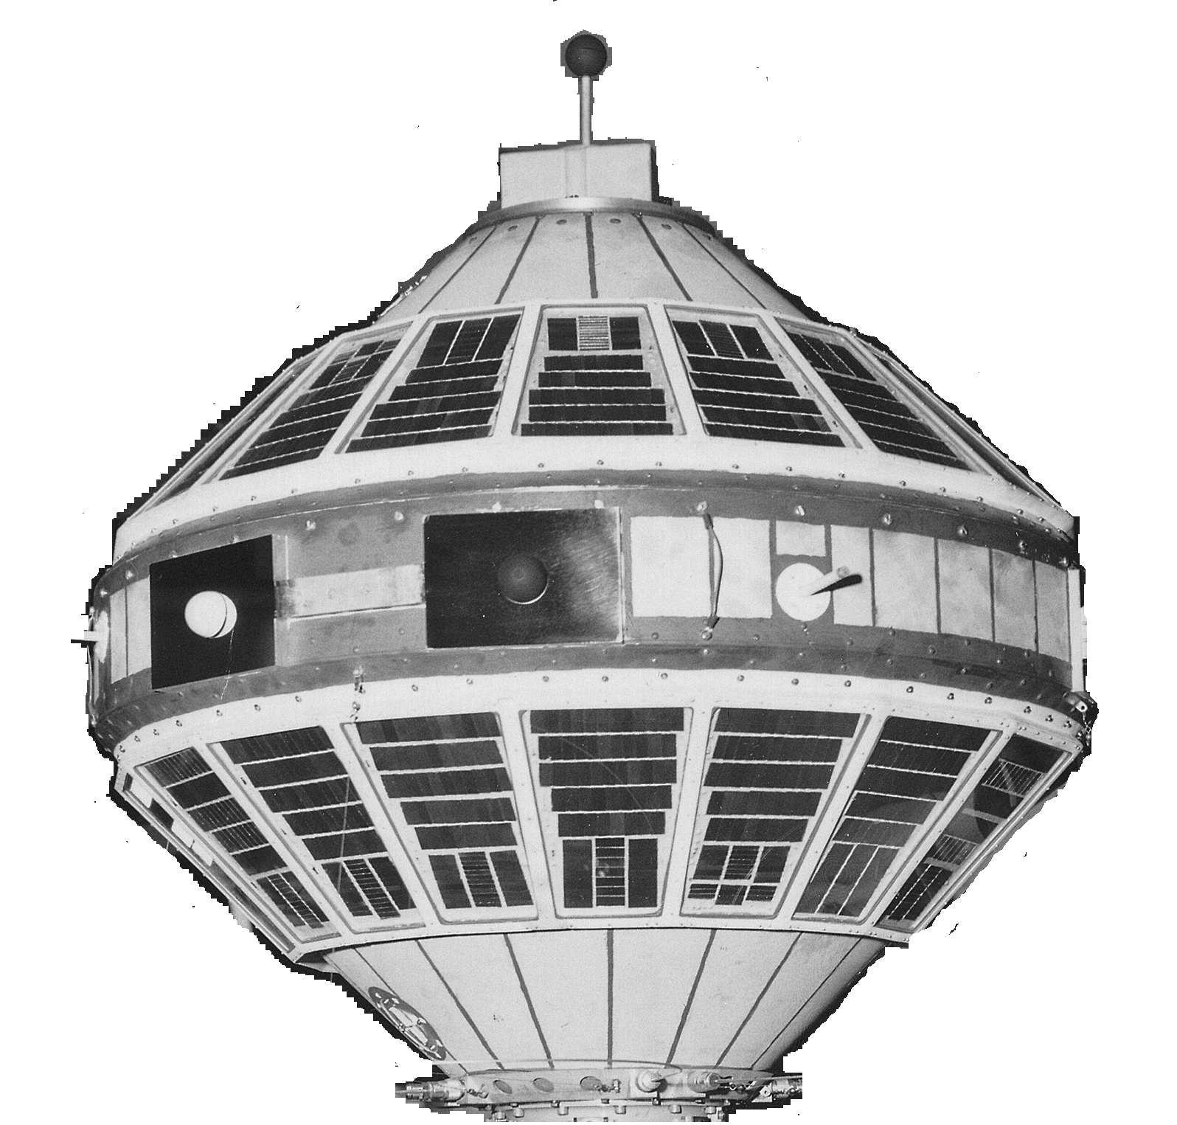
Explorer VII Satellite

Slide 14
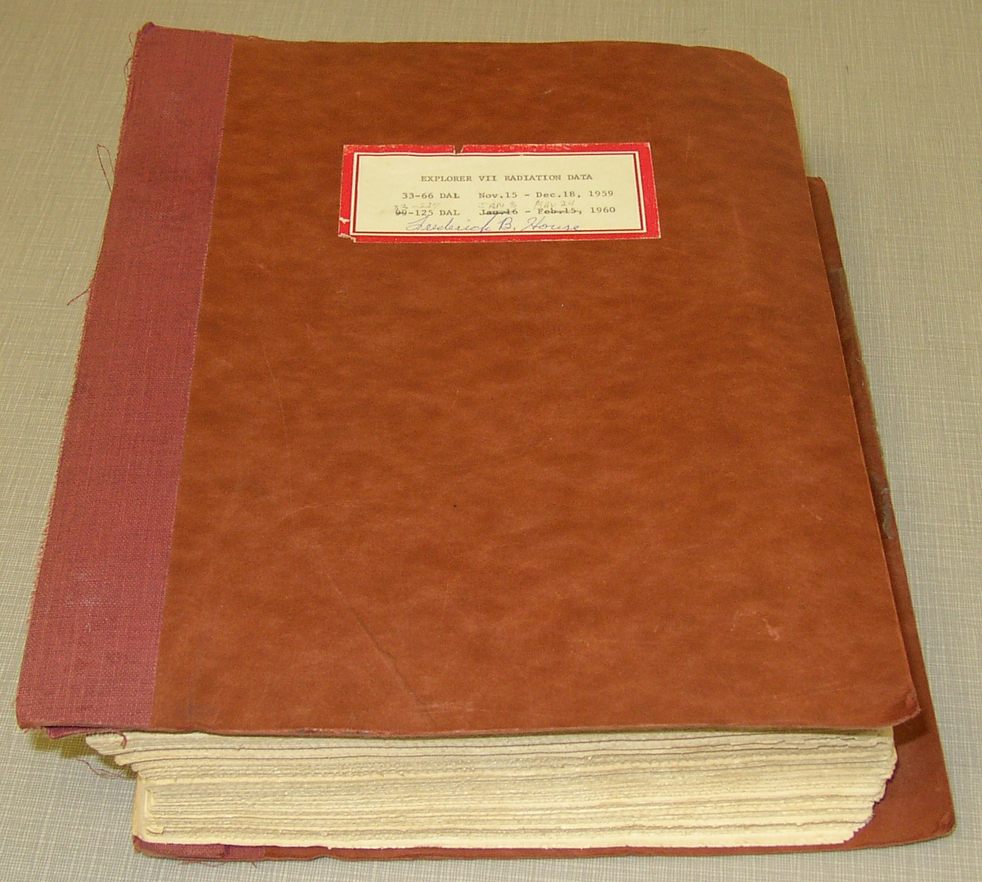

Slide 15
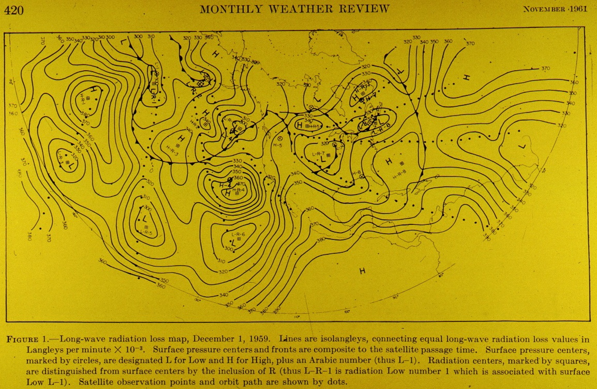
Weinstein and Suomi, 1961

Slide 16
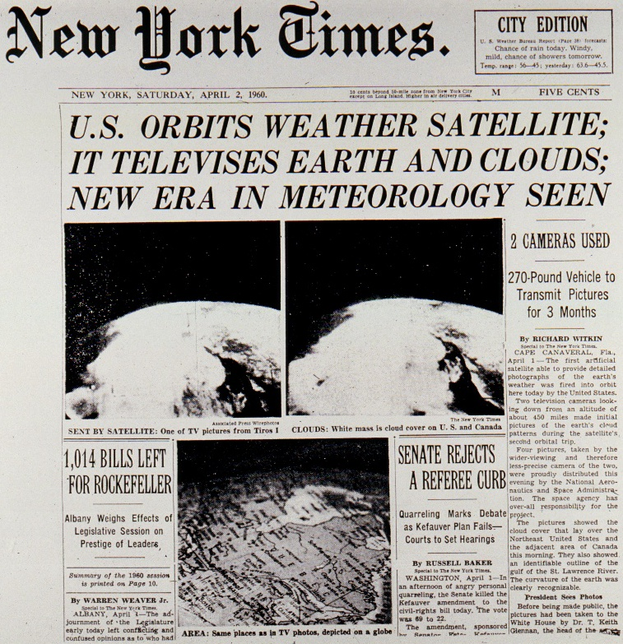
TIROS I Launch on April Fools Day, 1960

Slide 17
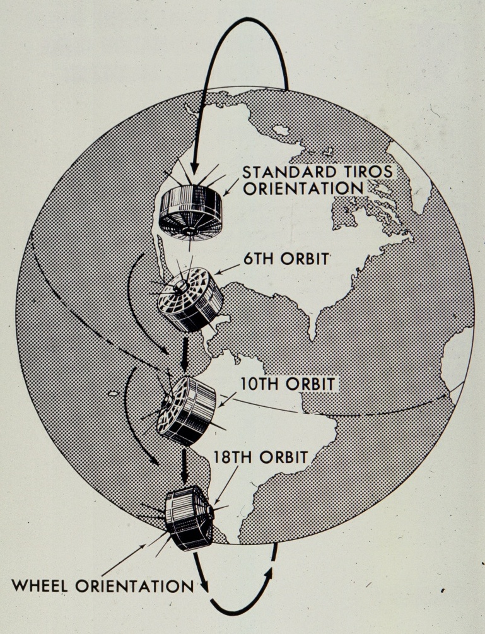
TIROS Satellite Transition to ESSA Cart-Wheel Orientation

Slide 18
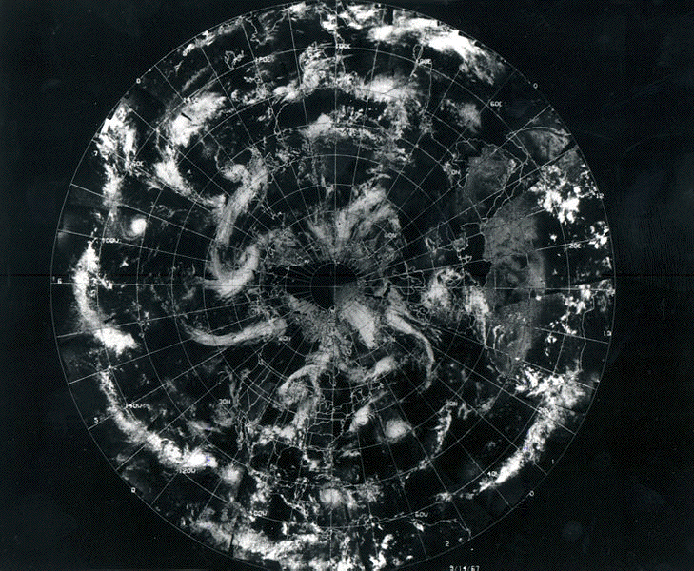
Composite Cloud Image - NH

Slide 19
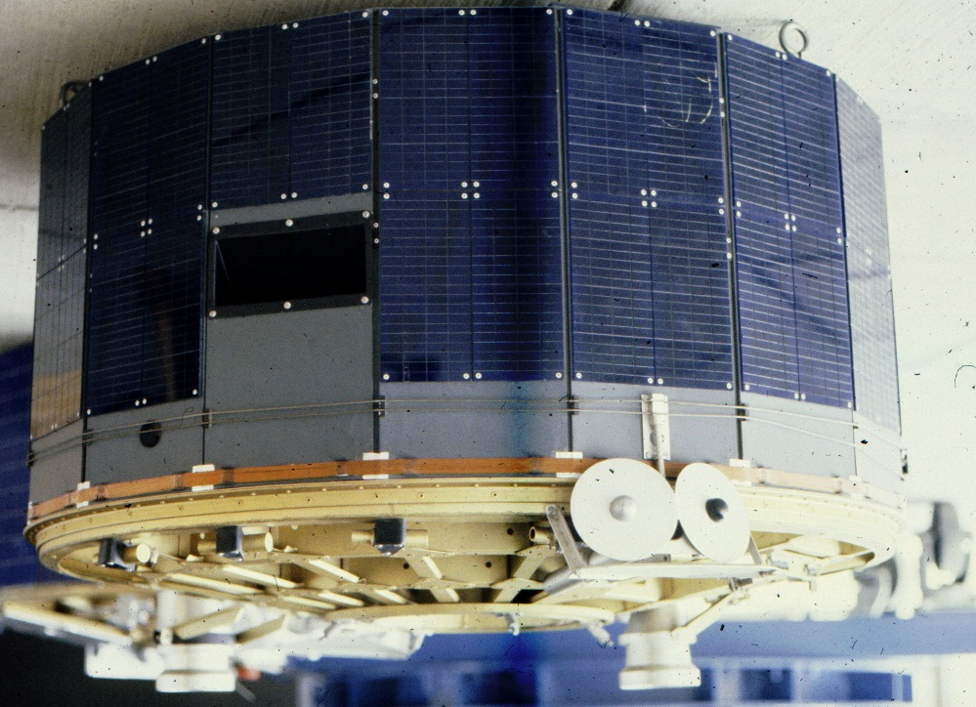
TIROS Satellite Model with Suomi Radiometers

Slide 20
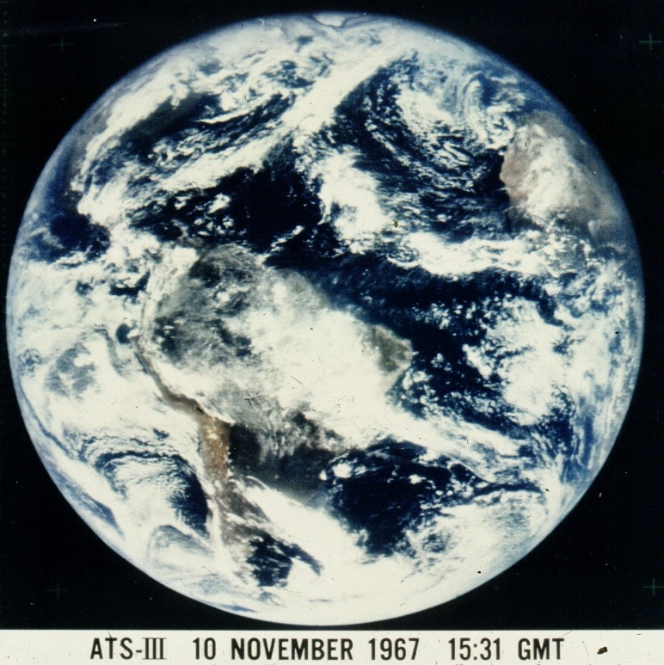

Slide 21
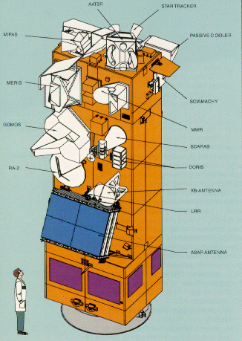
Explorer VII vs ESA’s ENVISAT

Slide 22
Remote Sensing Instruments
See talk by HP Roesli

