Slide 1

Cloud optical properties
Ralf Bennartz
Cooperative Institute for Meteorological Satellite Studies University of Wisconsin – Madison

Slide 2
Outline
How do cloud droplets and ice interact with radiation in the visible and near-infared?.
How can we distinguish ice from liquid?.
How can we retrieve cloud optical depth and droplet radius
Recap: What is important?

Slide 3
Scattering into line of sight: SOURCE
Scattering
Scattering out of line of sight: SINK
θ_{S}

Slide 4
Scattering/absorption by cloud droplets
Wavelength range 0.5-3.5 micron
Size maybe 10 – 100 microns
Mie Scattering
Figure from Petty (2006)

Slide 5
Scattering/absorption by cloud droplets
Wavelength range 0.5-3.5 micron
Size maybe 10 – 100 microns
Mie Scattering
Figure from Petty (2006)

Slide 6
What determines whether droplets scatter and/or absorb?
Complex index of refraction
Imaginary part determines absorption
See relation with radiation penetration depth in water
Slight difference between ice and water e.g. at 1.6 micron
Figure from Petty (2006)

Slide 7
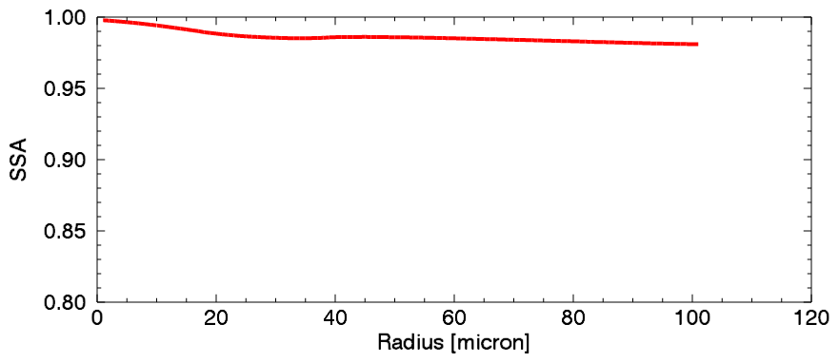
Cloud optical properties at 1.6 microns
Single scatter albedo of liquid drops depends on radius

Slide 8
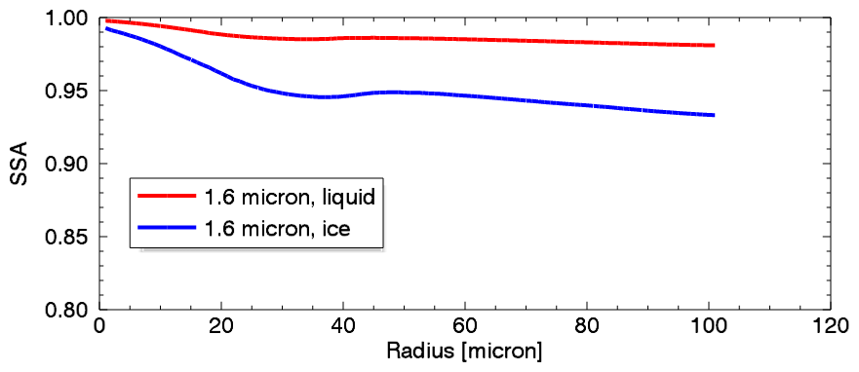
Cloud optical properties at 1.6 microns
Single scatter albedo of liquid drops depends on radius
Much lower for ice clouds

Slide 9
Why does the single scatter albedo matter?
Without absorption photons might get scattered 10s -100s of times before leaving the cloud
As the single scatter albedo increases, the likelihood of photons to get absorbed increases
Say, if N=20 scattering events occur and ssa=0.9 then the likelihood for a photon to ‘survive’ is 0.9²⁰= 0.12
Figure from Petty (2006)

Slide 10
Cloud optical properties at 1.6 microns
Single scatter albedo of liquid drops depends on radius
Much lower for ice clouds

Slide 11
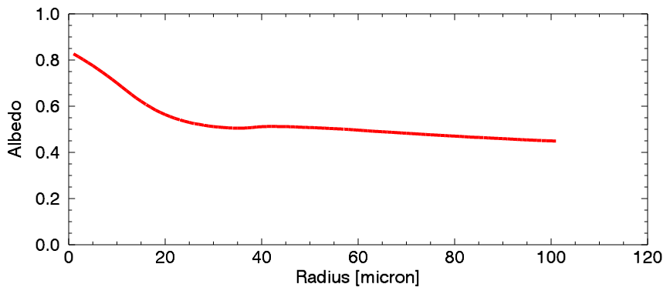
Cloud optical properties at 1.6 microns
Single scatter albedo of liquid drops depends on radius
Much lower for ice clouds
Albedo of thick cloud……

Slide 12
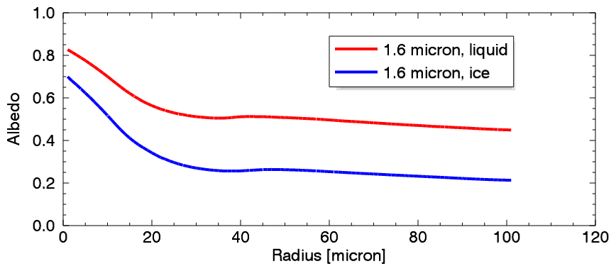
Cloud optical properties at 1.6 microns
Single scatter albedo of liquid drops depends on radius
Much lower for ice clouds
Albedo of thick cloud……
Much lower for ice cloud

Slide 13
Cloud optical properties at 1.6 microns
Typical range of liquid drop sizes
Typical range of ice particle sizes
So: If you plot the ratio 1.6/0.8 reflectance, ice clouds will have a very small ratio.
For liquid cloud the ratio will become smaller as drop size increases

Slide 14
Why can we not simply use cloud top temperature (11 micron Tb)?
Just see, if temperature is below, say, 273 K?
Well, there might be supercooled clouds….
Actually many of them
Those are important…..
Figure from Naud et al. (2006)

Slide 15
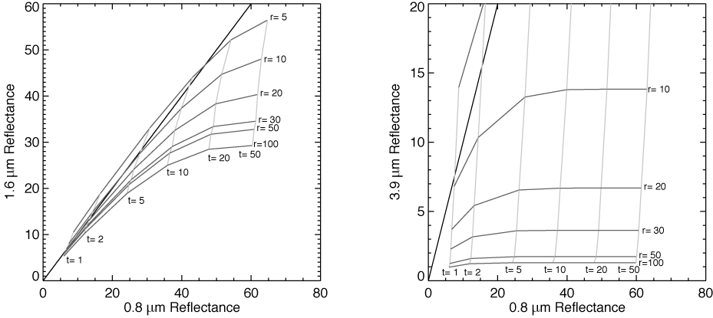
Nakajima-King retrieval

Slide 16
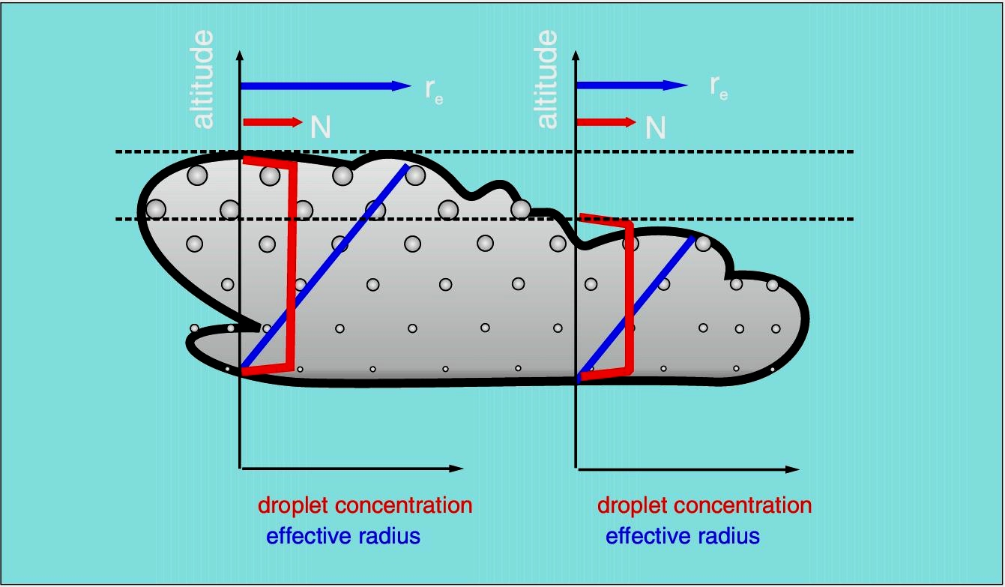
Example: Adiabatic Cloud
Qualitative description of BL clouds

Slide 17
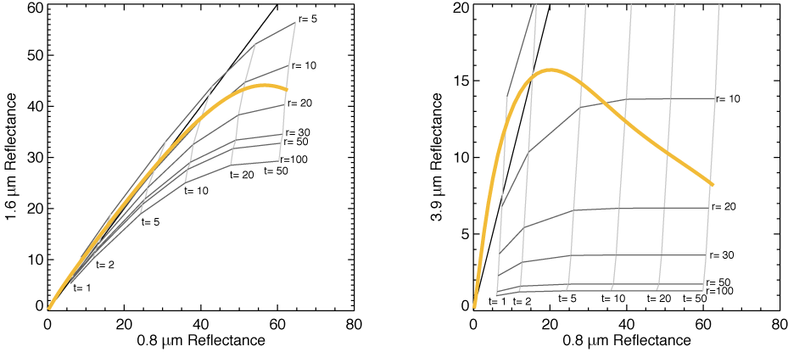
Nakajima-King retrieval

Slide 18
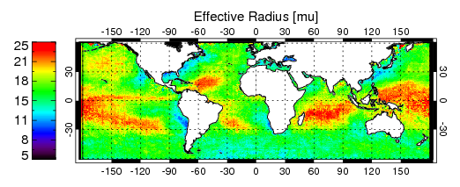
Global Effective Radius Retrieval from MODIS using N-K scheme (liquid only)

Slide 19
Recap
Liquid droplets and cloud ice have different optical properties in the visible/near infrared
Ice absorbs more strongly than liquid
This allows to distinguish ice from liquid phase
Also estimate particle radius using Nakajima-King technique
Infrared cloud top temperature is not such a good indicator for cloud ice, b/c of super cooled liquid water

