Slide 1
Aerosols, Clouds, and Climate Ralf Bennartz Cooperative Institute for Meteorological Satellite Studies University of Wisconsin – Madison

Slide 2
Outline
How do clouds again interact with radiation?
How do clouds modify the climate?
How does human activity modify clouds?
Recap: What is important?

Slide 3
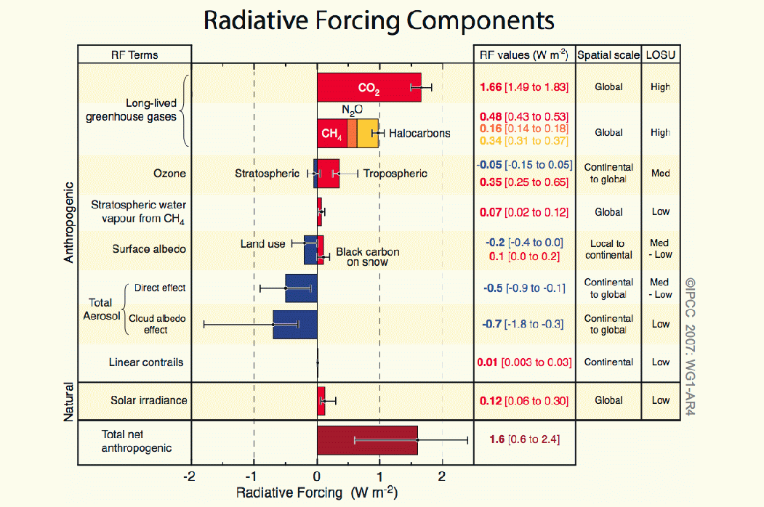
IPCC 2007

Slide 4
Clouds are the single-most important factor modulating climate sensitivity…..
… and we know very little about forcings and feedbacks

Slide 5
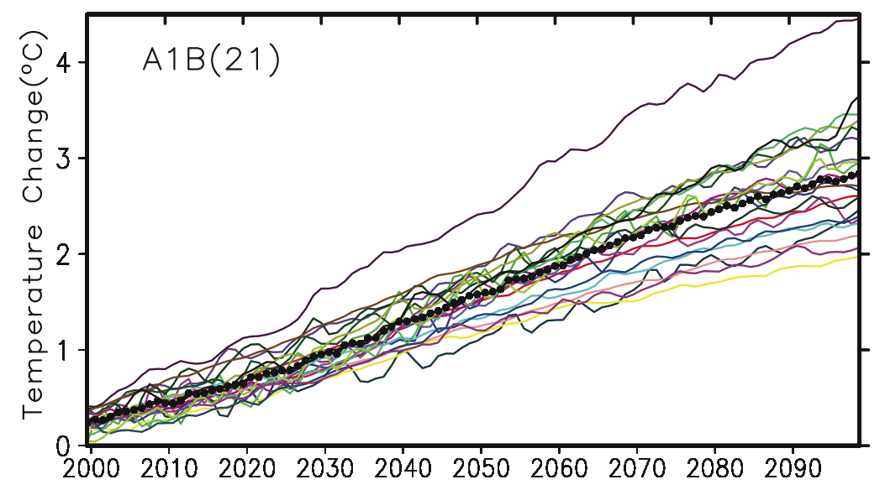
21 climate models- one scenario
IPCC 2007

Slide 6
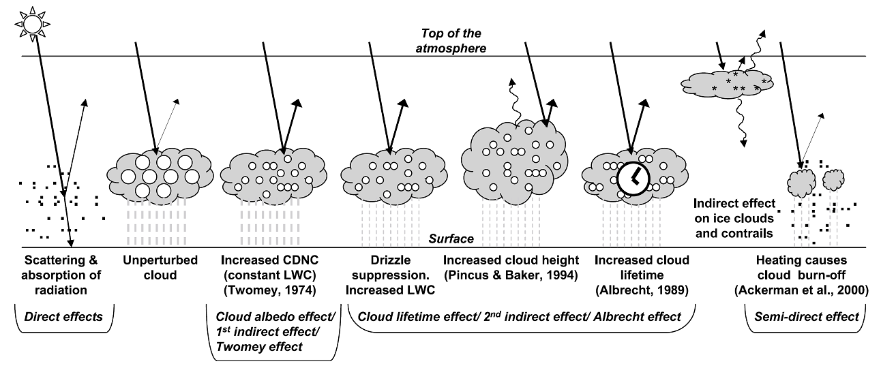
Clouds are the single-most important factor modulating climate sensitivity…..
… and we know very little about forcings and feedbacks
IPCC 2007

Slide 7
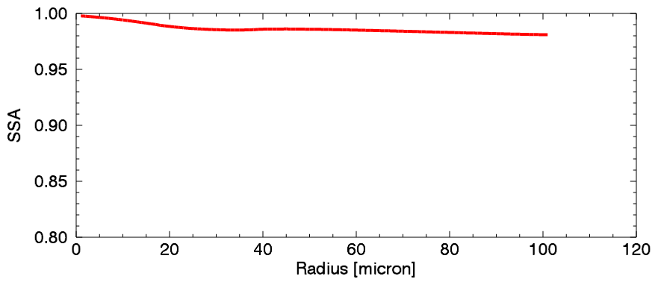
Cloud optical properties at 1.6 microns
Single scatter albedo of liquid drops depends on radius

Slide 8
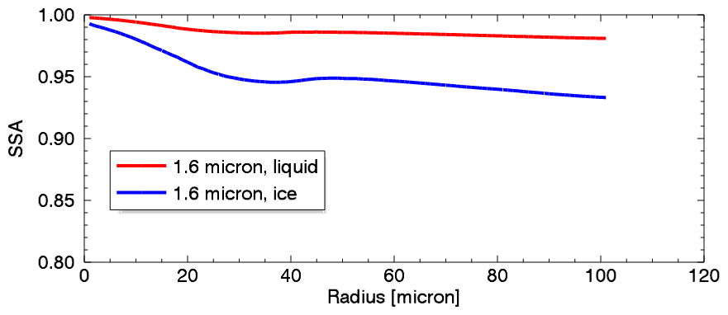
Cloud optical properties at 1.6 microns
Single scatter albedo of liquid drops depends on radius
Much lower for ice clouds

Slide 9
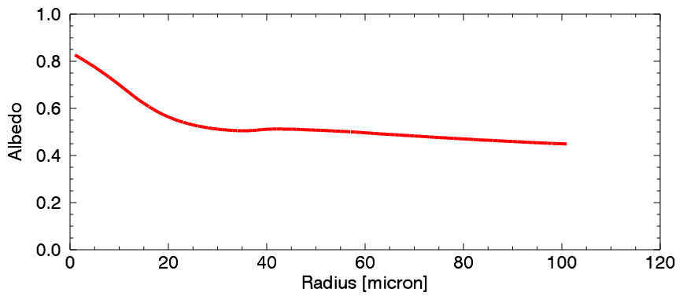
Cloud optical properties at 1.6 microns
Single scatter albedo of liquid drops depends on radius
Much lower for ice clouds
Albedo of thick cloud……

Slide 10
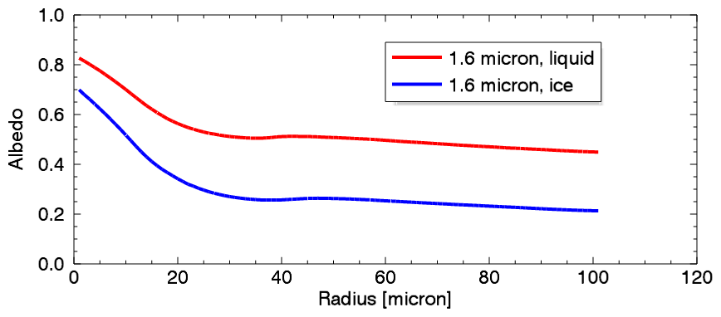
Cloud optical properties at 1.6 microns
Single scatter albedo of liquid drops depends on radius
Much lower for ice clouds
Albedo of thick cloud……
Much lower for ice cloud

Slide 11
Cloud optical properties at 1.6 microns
Typical range of liquid drop sizes
For liquid cloud the ratio will become smaller as drop size increases

Slide 12
Cloud albedo
Values for α, β derived from
a large set of full radiative
transfer simulations using 1D
adiabatic clouds

Slide 13
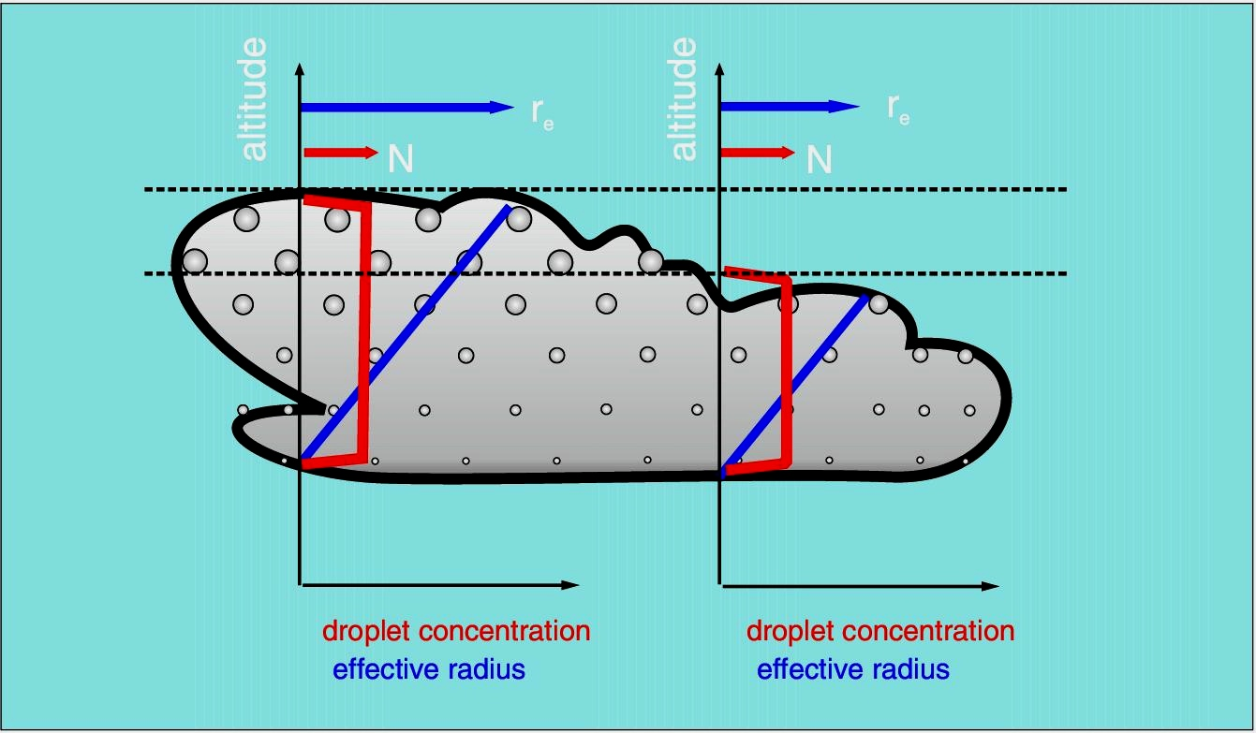
Example: Adiabatic Cloud
Qualitative description of BL clouds

Slide 14
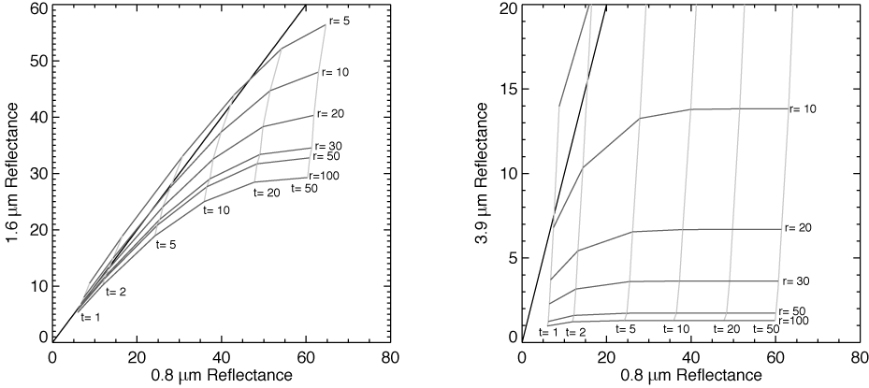
Nakajima-King retrieval

Slide 15
Example: Adiabatic Cloud
Qualitative description of BL clouds

Slide 16
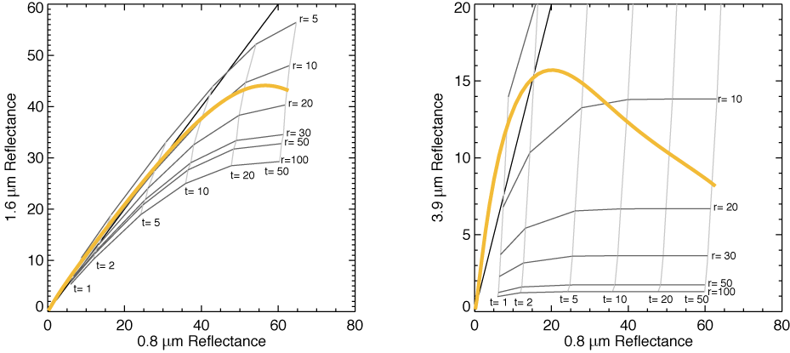
Nakajima-King retrieval

Slide 17
Global Effective Radius Retrieval from MODIS using N-K scheme (liquid only)

Slide 18
Cloud albedo
Values for α, β derived from
a large set of full radiative
transfer simulations using 1D
adiabatic clouds

Slide 19
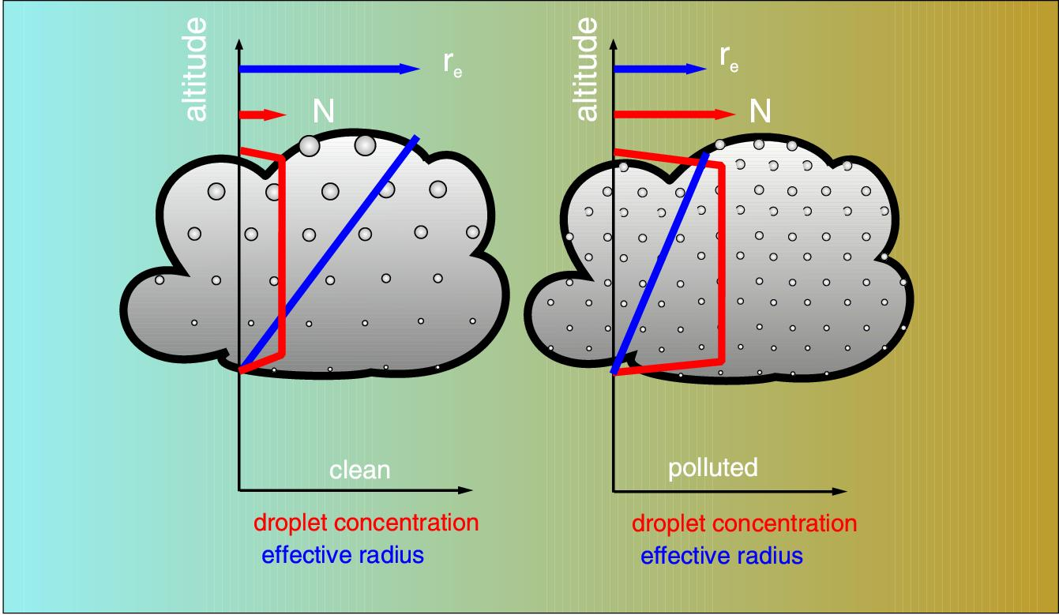
Cloud droplet number concentration
Figure from L. Schueller

Slide 20
Cloud droplet number concentration

Slide 21
Cloud droplet number concentration
Cloud droplet number concentration

Slide 22
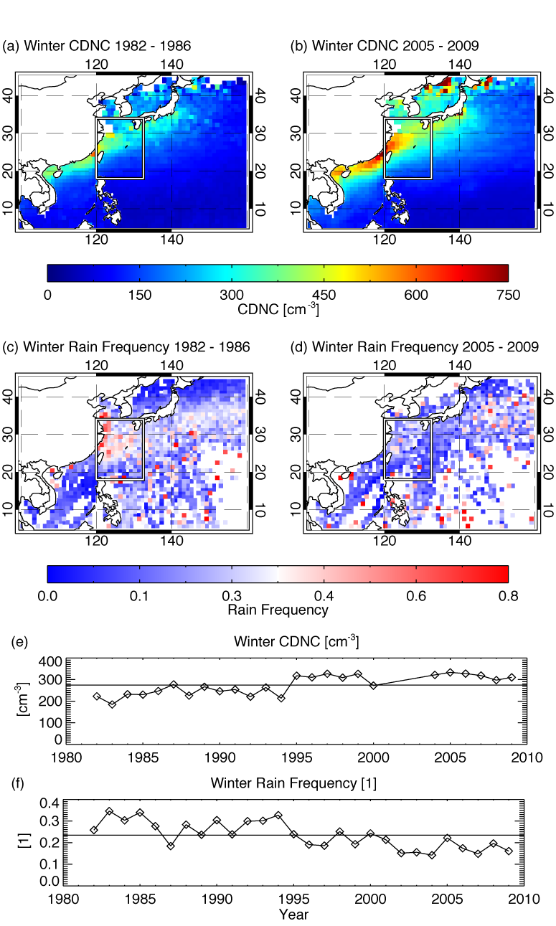
Cloud droplet number concentration

Slide 23
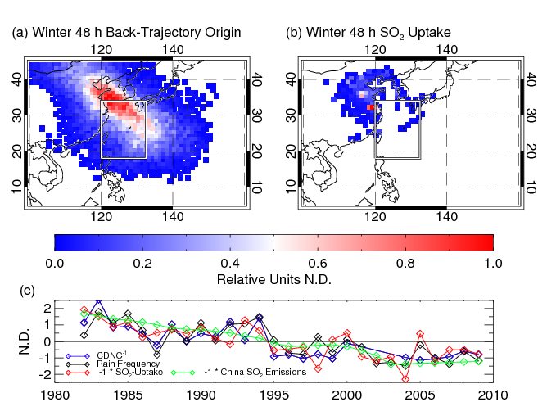
Cloud droplet number concentration
Cloud droplet number concentration

Slide 24
Recap
Clouds modulate climate very strongly.
Clouds are affected by aerosol in many ways. This changes their albedo, but also potentially their lifetime, precipitation efficiency, etc….
For many effects we do not know how important they are for climate change.
They constitute a large uncertainty in our predictions of future climate
Jochen Kerkmann lab…….

