Slide 1
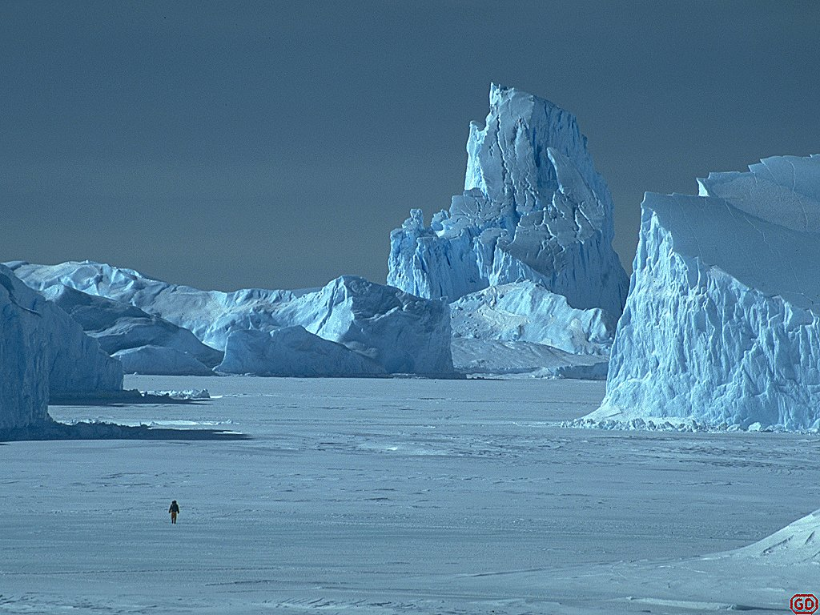
Monitoring Arctic Sea Ice Ralf Bennartz Cooperative Institute for Meteorological Satellite Studies University of Wisconsin – Madison

Slide 2
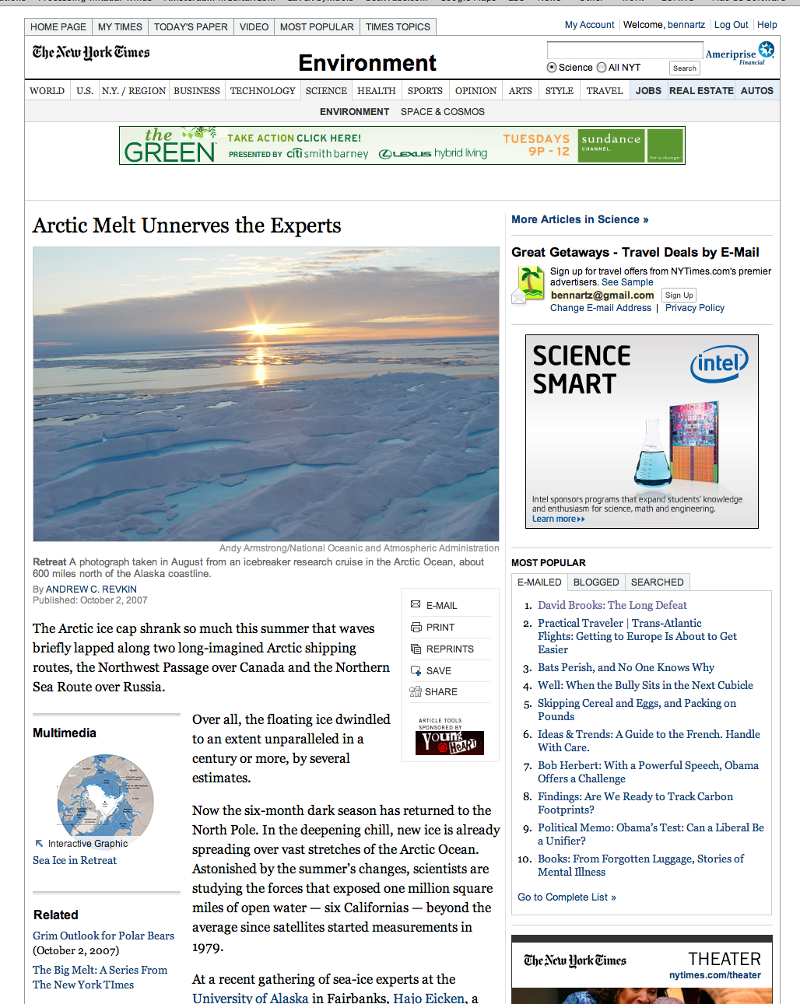
New York Times October 2007

Slide 3
September 2011

Slide 4
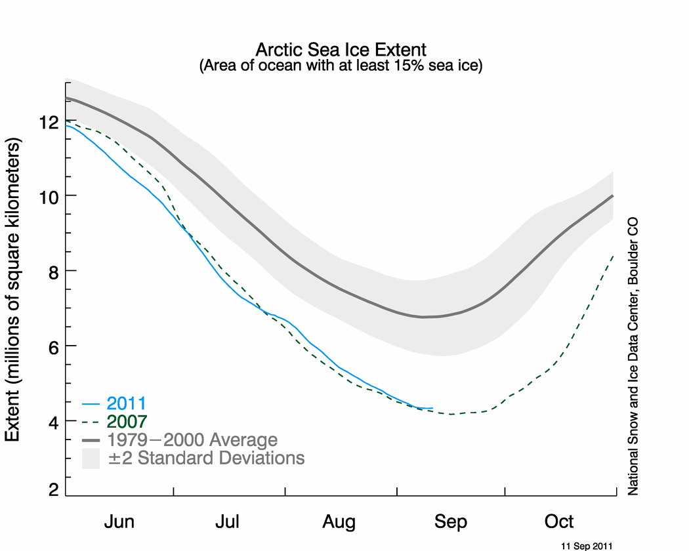
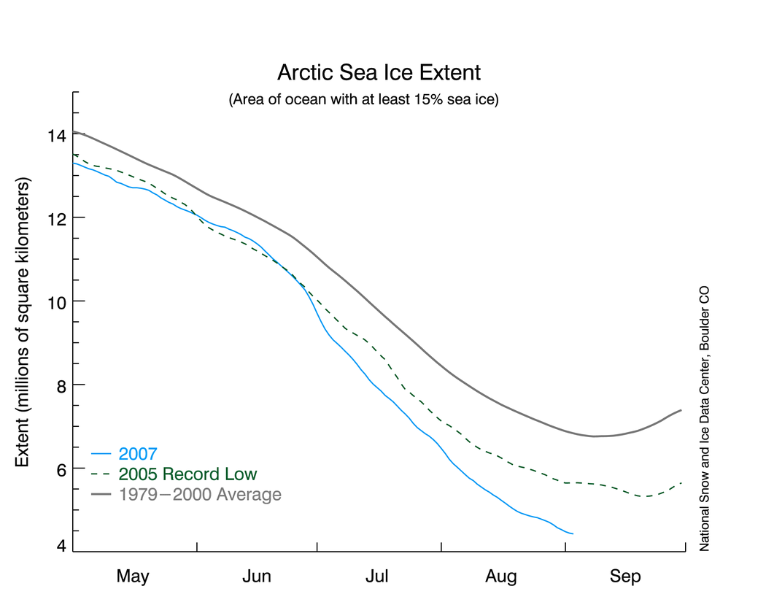
Source: National and Ice Data Center

Slide 5
Movie: Source NASA Goddard

Slide 6
Sea Ice Extend in the Baltic Area
Bennartz et al., 2009

Slide 7
Microwave Tb example (Just scaled linearly between lowest and highest Tb in image)

Slide 8
Sea Ice Extend in the Baltic Area
Bennartz et al., 2009

Slide 9
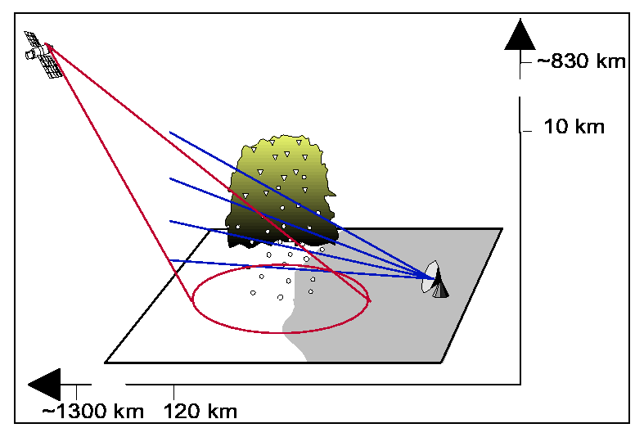
Microwave imaging instrument on AQUA
Advanced Microwave Scanning Radiometer (AMSR)
Conical scan geometry
Main dedication is integrated atmospheric properties, soil moisture, sea surface temperature, sea ice, and wind
6, 10, 18, 23, 37, 89 GHz
All channels dual polarization
Spatial resolution varies with frequency between 6 x 9 km and 70 x 50 km
Notes:
1.6% increase in global precipitation in the last 140 years
from rain gages that cover about 30% of land surfaces globally
Obvious need for remote sensing for both applications

Slide 10
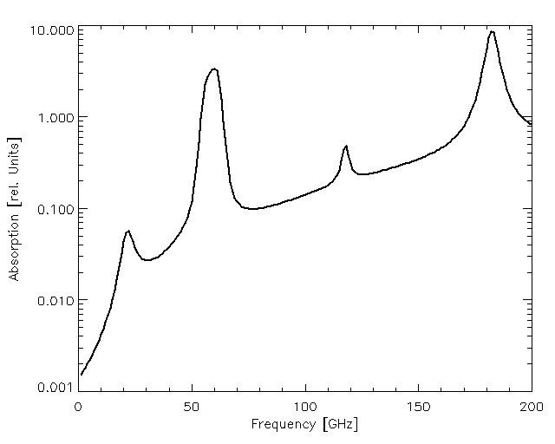
AMSR channels
O₂
H₂O
O₂
H₂O

Slide 11
AMSR channels
O₂
H₂O
O₂
H₂O

Slide 12
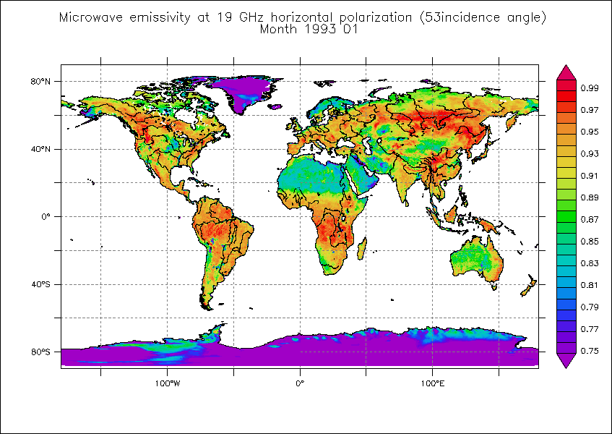
Microwave surface emissivity over land and ice (Source C. Prigent)

Slide 13
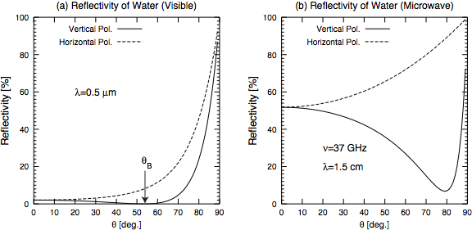
Microwave surface emissivity over water

Slide 14
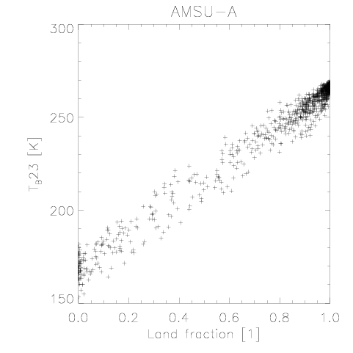
Linear dependence of brightness temperature on fraction of ice (or land) within field of view
Ice Fraction

Slide 15
Linear dependence of brightness temperature on fraction of ice (or land) within field of view
Ice Fraction

