Slide 1
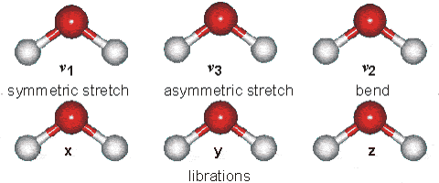
Weighting Functions and Atmospheric Soundings, Part II: Gas absorption
Ralf Bennartz
Cooperative Institute for Meteorological Satellite Studies
University of Wisconsin – Madison
Figure from http://www.lsbu.ac.uk/water/images/v1.gif

Slide 2
Outline
Why do gases absorb radiation?
Where do gases absorb radiation?
Relevance to remote sensing
Recap: What is important?

Slide 3
Absorption principles
Absorption of photons can change rotational/vibrational energy of molecules (infrared/microwave).
Absorption can also excite electrons into different orbits (near-infrared).
Absorption can also disrupt molecules (e.g. Ozone absorption in UV)
First three effects are quantized, i.e. they only occur at specific wavelengths dependent on molecule

Slide 4
Absorption principles
Absorption of photons can change rotational/vibrational energy of molecules (infrared/microwave).
Absorption can also excite electrons into different orbits (near-infrared).
Absorption can also disrupt molecules (e.g. Ozone absorption in UV)
First three effects are quantized, i.e. they only occur at specific wavelengths dependent on molecule

Slide 5
Absorption principles
Different molecules vibrate differently depending on their shape
The two major absorbers in the atmosphere are CO₂ and H₂O.
The three different vibrational modes of these gases are shown below
667 cm⁻¹
1366 cm⁻¹
2349 cm⁻¹
1595 cm⁻¹
3562 cm⁻¹
3756 cm⁻¹
Figure from Petty (2006)

Slide 6
Absorption in the infrared
O₃
H₂O Vib.
H₂O Rot.
CO₂
Emission spectrum observed from space over the tropical Pacific
Figure from Petty (2006)

Slide 7
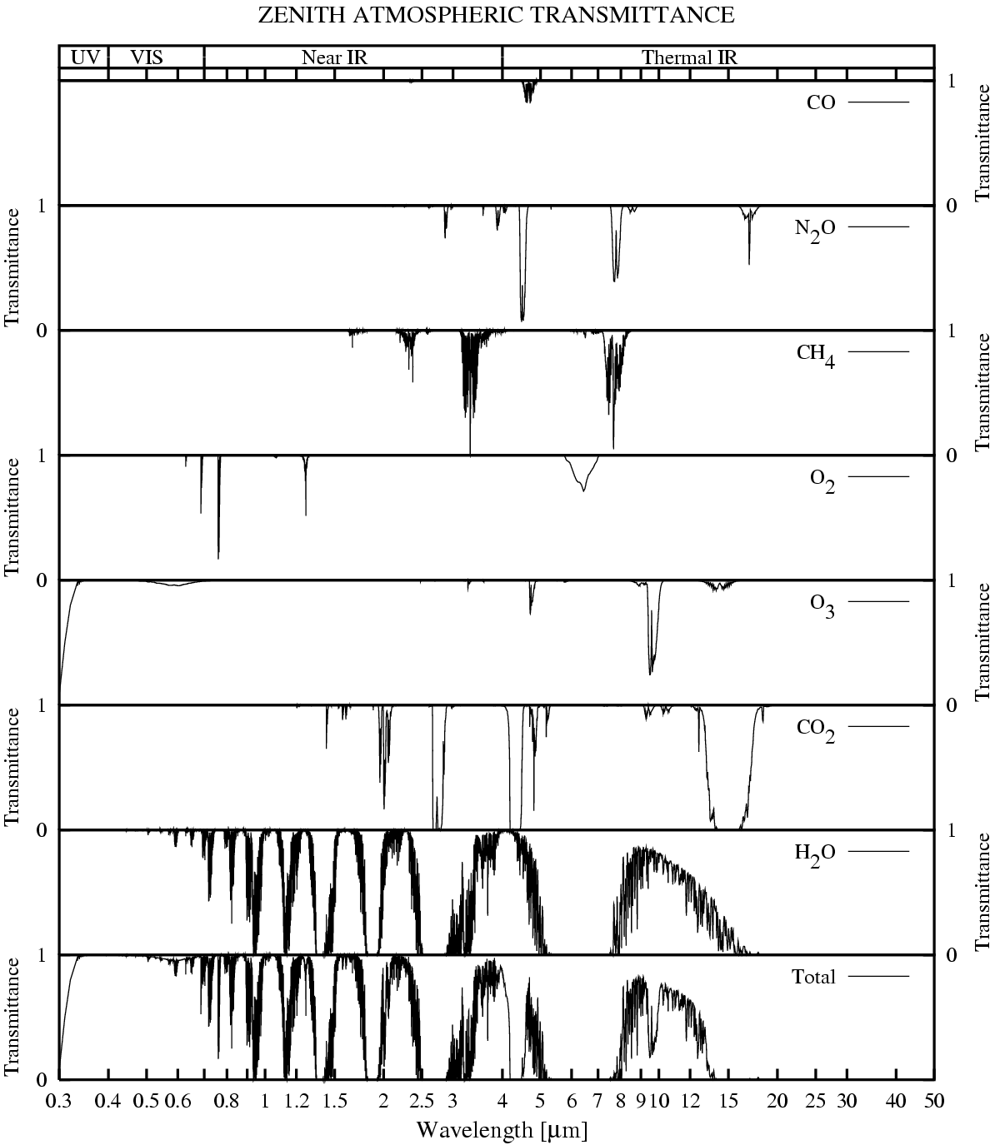
Absorption in the infrared
Figure from Petty (2006)

Slide 8
Absorption in the infrared
Where were those spectra taken?
Was the instrument looking up or down?
Identify the major absorption bands!
Figure from Petty (2006)

Slide 9
Recap
Different processes lead to absorption in the atmosphere.
In the infrared vibrational bands dominate at shorter wavelength, at longer wavelength rotational bands.
There are 100s of thousands of absorption lines for different isotope, combinations of rotational/vibrational modes, harmonics etc….
CO₂ and H₂O bands are particularly important in temperature/moisture profiling
Other gases, such as CH₄, CO, O₃ also have minor absorption bands in the infrared.

