Slide 1
Monitoring Vegetation and Land Features
Steve Ackerman
Director CIMSS
Prof. AOS

Slide 2
Objectives
Describe the capabilities, benefits, and limitations of land remote sensing
Define NDVI and NDSI
Describe applications that benefit from vegetation indices
Interpret features in NDVI and NSDI imagery

Slide 3
Satellite Observation (radiance, reflectance, brightness temperature)
Atmosphere Reflectance, Transmittance and Emission
Atmosphere Temperature and gas distribution
Cloud aerosol optical depth (how much), single scattering albedo (absorption) and phase function (where does scattered energy go)
Particle sizes, shapes and chemistry
Particle size is relative to the wavelength
Underlying surface

Slide 4
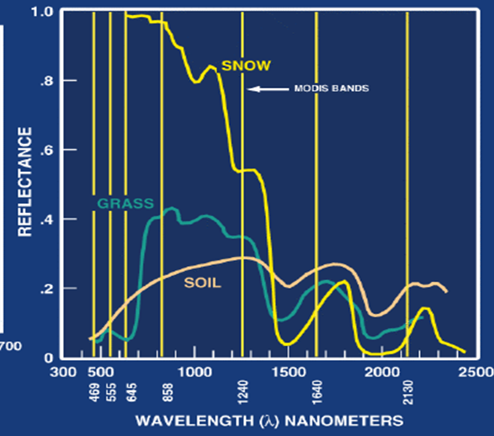
Reflectance properties of surfaces

Slide 5
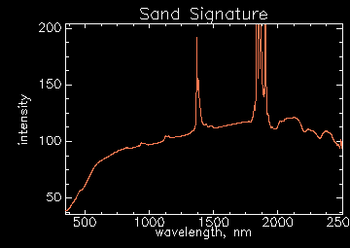
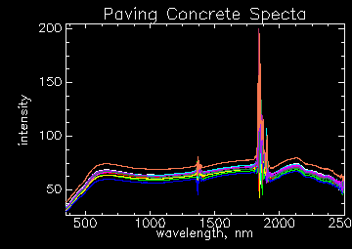
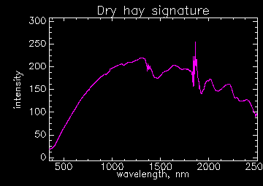
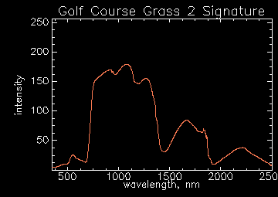

Slide 6
Vegetation Indices
Global vegetation indices are designed to provide consistent spatial and temporal comparisons of vegetation conditions. Blue, red, and near-infrared reflectances, centered at 469-nanometers, 645-nanometers, and 858-nanometers, respectively, are used to determine the daily vegetation indices.

Slide 7
MODIS
The Moderate Resolution Imaging Spectroradiometer (MODIS) measures radiances at 36 wavelengths including infrared and visible bands with spatial resolution of 250 m , 500m and 1 km.
It is a scanning instrument that yields ‘images’ at the different wavelengths.

Slide 8
MODIS Bands
Reflective Bands
1,2 0.645, 0.865 land/cld boundaries
3,4 0.470, 0.555 land/cld properties
5-7 1.24, 1.64, 2.13 “
8-10 0.415, 0.443, 0.490 ocean color/chlorophyll
11-13 0.531, 0.565, 0.653 “
14-16 0.681, 0.75, 0.865 “
17-19 0.905, 0.936, 0.940 atm water vapor
26 1.375 cirrus clouds

Slide 9
MODIS Bands
Emissive Bands
20-23 3.750(2), 3.959, 4.050 sfc/cld temp
24,25 4.465, 4.515 atm temperature
27,28 6.715, 7.325 water vapor
29 8.55 sfc/cld temp
30 9.73 ozone
31,32 11.03, 12.02 sfc/cld temp
33-34 13.335, 13.635 cld top properties
35-36 13.935, 14.235 cld top properties

Slide 11
Vegetation Index
Vegetation indices are optical measures of vegetation canopy “greenness,” a composite property of leaf chlorophyll, leaf area, canopy cover, and structure. VIs are not “intrinsic physical quantities” but are widely used as proxies to assess canopy biophysical/biochemical variables have improved in recent years, they still have limitations.

Slide 12
NDVI
The NOAA Advanced Very High Resolution Radiometer (AVHRR)-derived consistent global normalized difference vegetation index (NDVI) land record exists, which has contributed significantly to global biome, ecosystem, and agricultural studies.

Slide 13
NDVI
An advantage of the NDVI as a ratio, is its ability to normalize and produce stable values across large variations in incoming direct/diffuse irradiances. However, this also results in some disadvantages including the nonlinear nature of ratios, sensitivity to soil background, and saturation at moderate-to-high vegetation densities.
Should atmosphere correct the radiances.

Slide 14
NDVI
2004 – January - December
Notes:
MODIS Vegetation Indices
Alfredo Huete, Kamel Didan, Willem van Leeuwen, Tomoaki Miura, and Ed Glenn

Slide 15
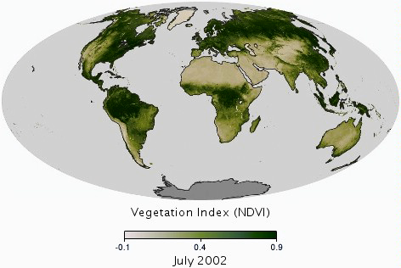
Global NDVI

Slide 16
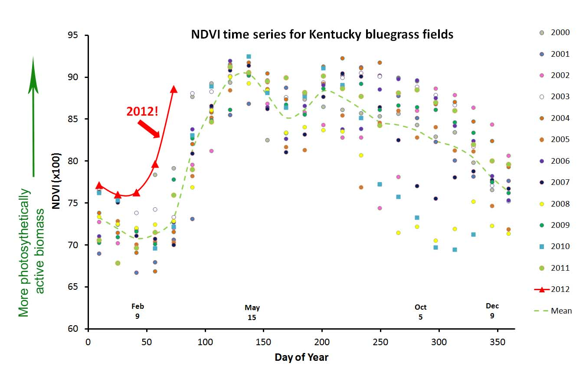
NDVI – long term
Notes:
http://publiclab.org/notes/cfastie/3-24-2012/grassroots-ndvi-time-series

Slide 17
NDVI
Negative values of NDVI (values approaching -1) correspond to water. Values close to zero (-0.1 to 0.1) generally correspond to barren areas of rock, sand, or snow. Lastly, low, positive values represent shrub and grassland (approximately 0.2 to 0.4), while high values indicate temperate and tropical rainforests (values approaching 1)

Slide 18
Enhanced Vegetation Index (EVI)
The blue band in the EVI is primarily used to stabilize aerosol influences in the
red band resulting from residual and aerosol miscorrection.
The EVI better depict biophysical canopy structural variations, and is less prone to saturate in high biomass areas.

Slide 19
Recap
Vegetation indices are good to monitor the variations of vegetation. Need to remove clouds and correct for scattering by the atmosphere and aerosols.
NDVI and EVI are two popular indices..

Slide 20
Snow Index?

Slide 21
Reflectance properties of surfaces
Choose two wavelengths

