Slide 1
Cloud: Detection Methods
Steve Ackerman
Prof AOS, Director CIMSS

Slide 2
Objectives
Identification of clouds in satellite images
Underlying physical principles
Developing a cloud detection method using solar and infrared channels

Slide 3
Why are clouds important to detect and quantify?

Slide 4
Different Perspectives on Satellite Observations of Clouds
Observations improve global-scale data base.
Observations improve the representation of clouds in models, both weather and climate.

Slide 5
What is a cloud?
Depends on detection objective….
What are three ways that we detect objects using our visual sensors (eyes and brain)?

Slide 6
Satellite Observation (radiance, reflectance, brightness temperature)
Atmosphere Reflectance, Transmittance and Emission
Atmosphere Temperature and gas distribution
Cloud aerosol optical depth (how much), single scattering albedo (absorption) and phase function (where does scattered energy go)
Particle sizes, shapes and chemistry
Particle size is relative to the wavelength
Underlying surface

Slide 7
What does a satellite observe?
Detects number of photons per exposure time at a given wavelength (or wvl range) traveling from viewing direction into detector
No. of photons, direction, per time → RADIANCE
We need to physically and quantitatively understand the relation between observed radiance and state of the atmosphere
Radiative Transfer Equation

Slide 8
Transmitted from surface and atmosphere below: SOURCE
Scattering
Scattering into line of sight: SOURCE
Scattering out of line of sight: SINK
θ_{S}
Absorbed by aerosol: SINK

Slide 9
Energy transmitted through aerosol: SOURCE
IR, broken down
Emission by aerosol layer along line of sight: SOURCE
Absorbed out of line of sight: SINK
θ_{S}

Slide 10
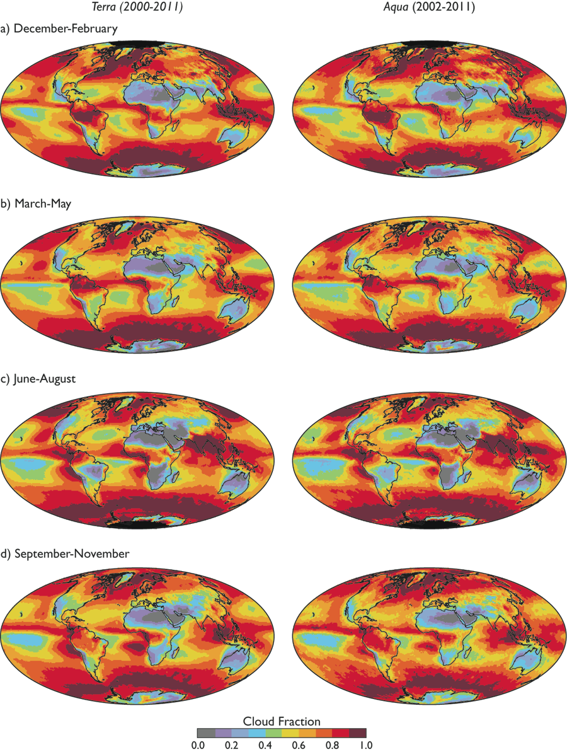
Global Cloud Cover from MODIS
Global Cloud cover from the two MODIS instruments.

Slide 11
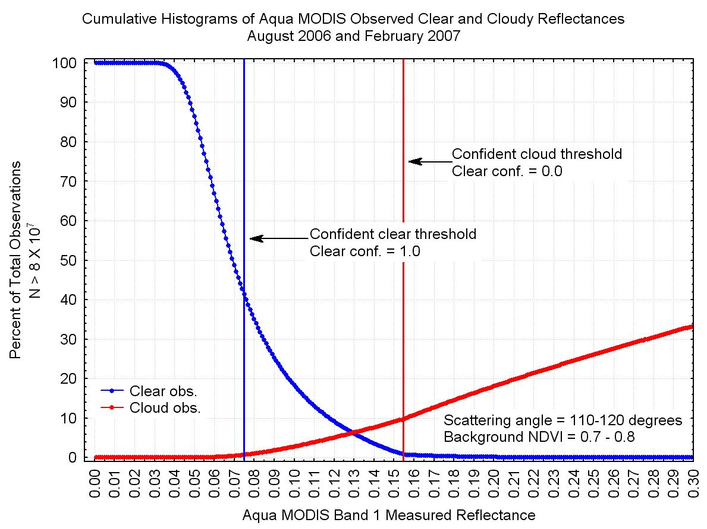
Deciding if a pixel contains a cloud….

Slide 12
The Lab
Data and Lab Instructions are in a Lab_Cloud_detection pdf document
Objective is to design a automated cloud algorithm by first setting thresholds of clear vs. cloud contaminated pixel.

Slide 13
Lab – IF … THEN CLEAR
Channel | Threshold for cloud over ocean | Threshold for cloud over land
Reflectance .86 micron
Reflectance .65 micron
Reflectance .46 micron
Reflectance .55 micron
Reflectance 1.2 micron
BT 11 micron
BT 13.9 micron
BT 12 micron
BT 8.5 micron
Your tests
BT difference between
Solar ratio test

Slide 14
Do lab

Slide 15
How do you handle different test results?

Slide 16
Quality Flags
Each test returns a confidence (F ) ranging from 0 to 1.
Similar tests are grouped and minimum confidence selected [min (F_{i} ) ]
Quality Flag is
Four values; 0, >.66, >.95 and >.99
Notes:
Quick overview

Slide 17
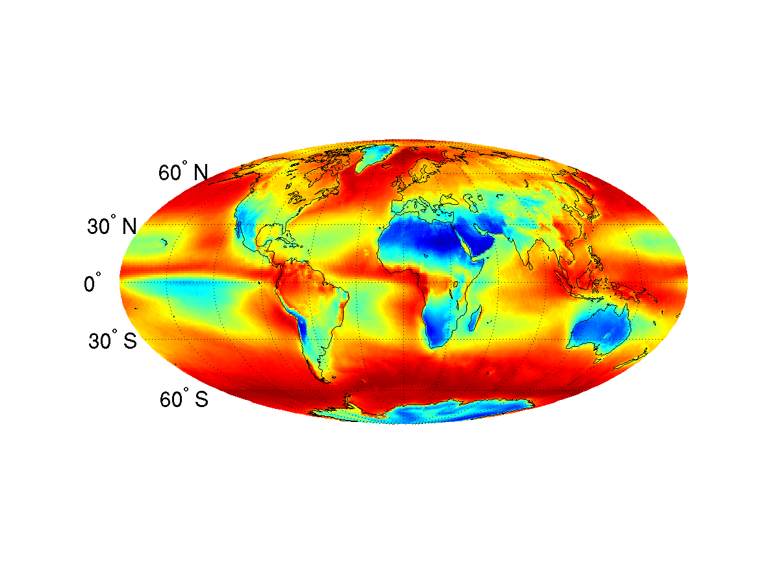
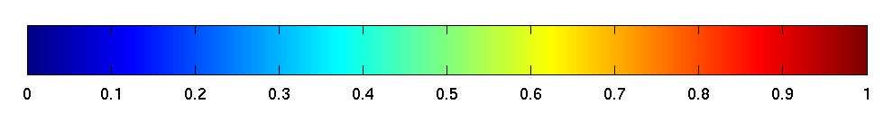
MODIS cloud amount
Terra – Annual Mean
0
Cloud fraction
1

Slide 18
Validation…. Assume a truth
How do we validate our cloud detection algorithm?
Compare with visual observations, lidar ground based observations, CALIOP, other satellites.

Slide 19
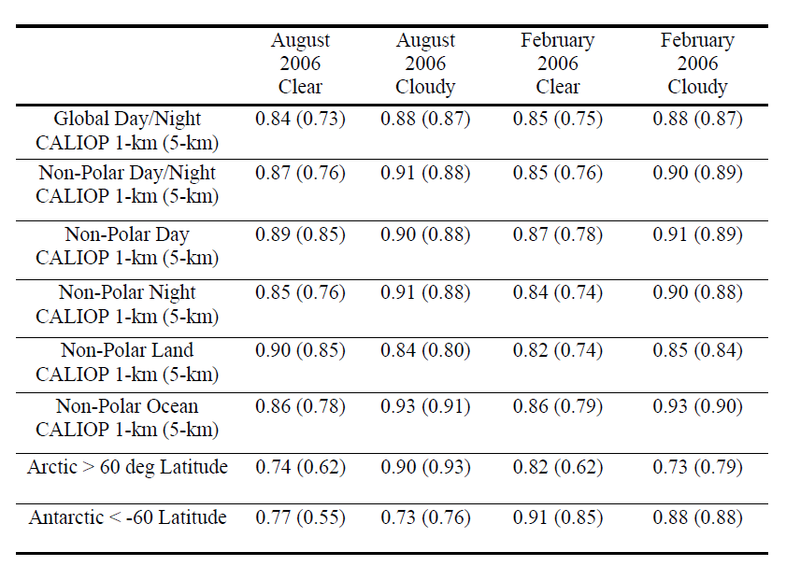
The global fractional agreement of cloud detection between MODIS and CALIOP for August 2006 and February 2007. The results are separated by CALIOP averaging amount, with the 5 km averaging results in parenthesis, as well as day, night and surface type. From Holz et al 2008.

Slide 20
Recap: Cloud Detection
?

Slide 21
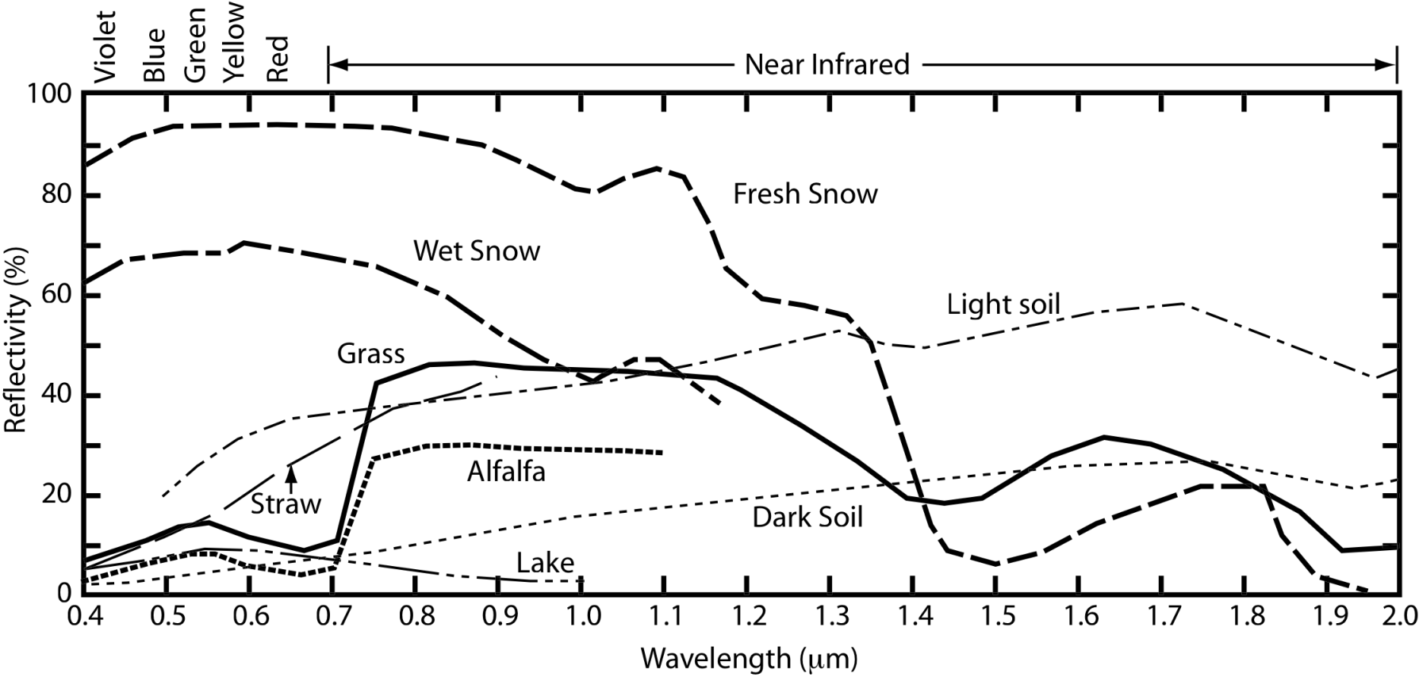
Typical Shortwave Reflectivity Spectra

