Slide 1
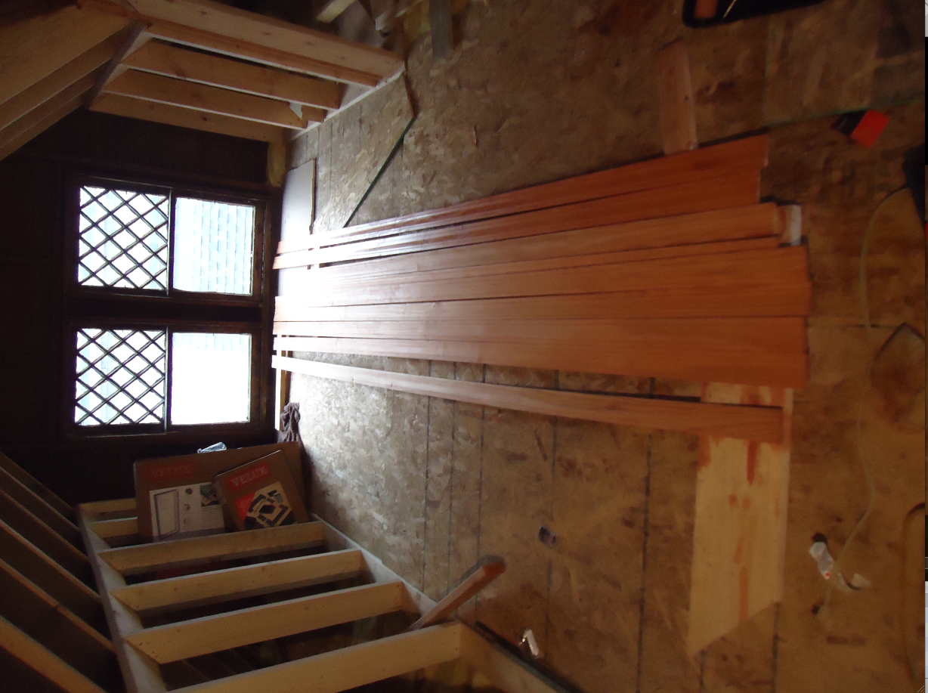
STAIN & POLISHING TRIM

Slide 2
SETING UP SHOP

Slide 3
WINDOWS DEAILS
WINDOWS REPLACEMENT ON SECOND FLOOR:
WE HAVE INSTALLED 8 WINDOWS SO FAR IN THE SECOND FLOOR AND HAVE 3 MORE TO GO. THE REST OF THE WINDOWS HAVE TO BE TEMPERED AND WE ARE AWAITING DELIVERY, SCHEDULED FOR JANUARY 9TH.
Note: we went with brand new construction windows. I added new jam extensions and new trim casing. Low-E 366, Argon, Tilt, Nail Fin, Fiberglass mesh

Slide 4
1st BEDROOM One old & one new

Slide 5
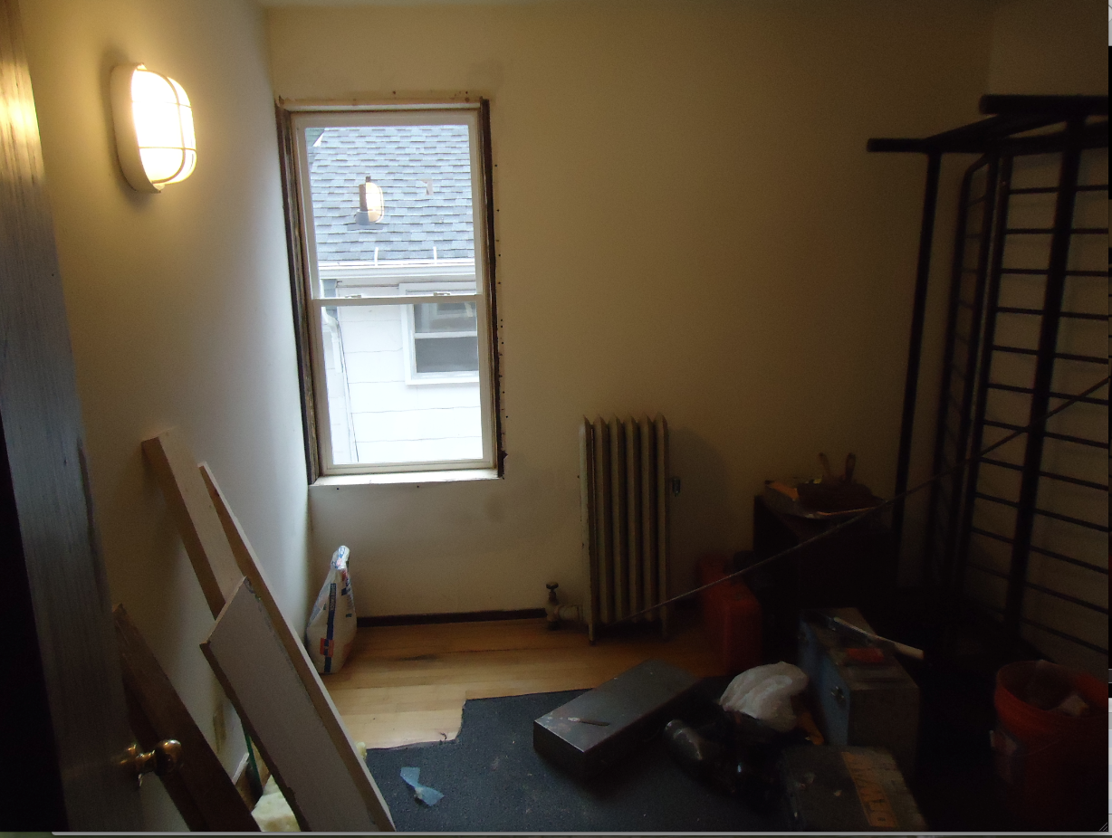
2ND BEDROOM

Slide 6
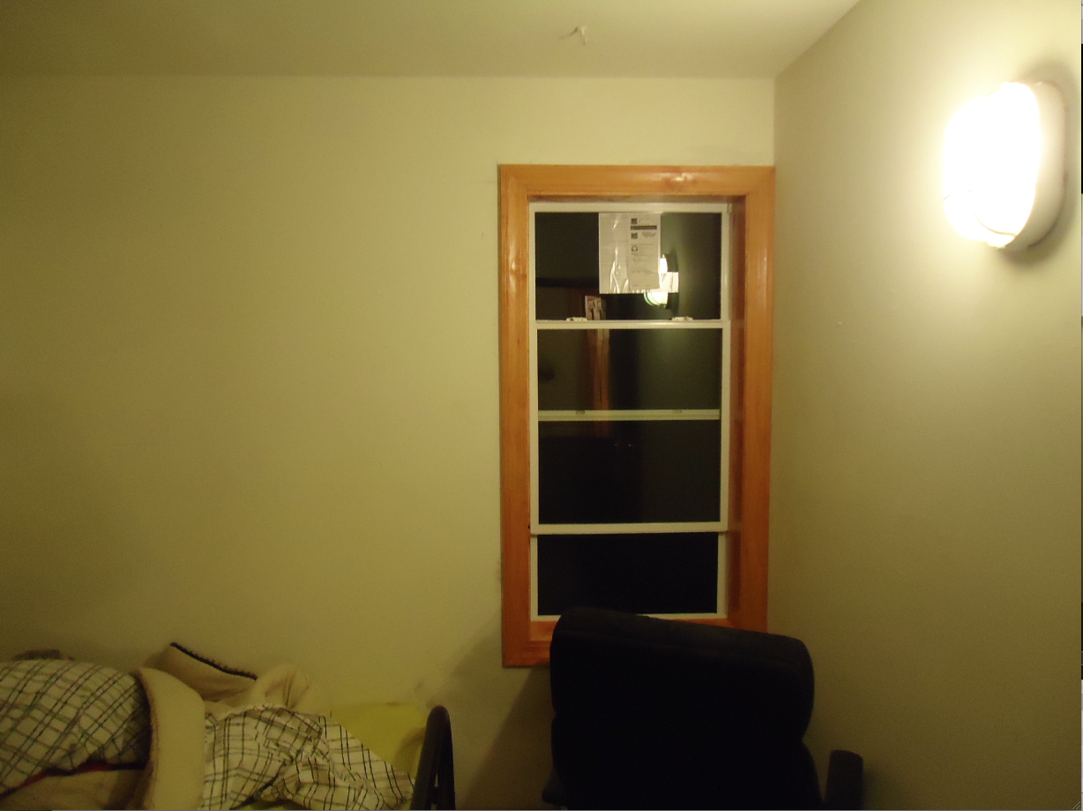
3rd BEDROOM

Slide 7
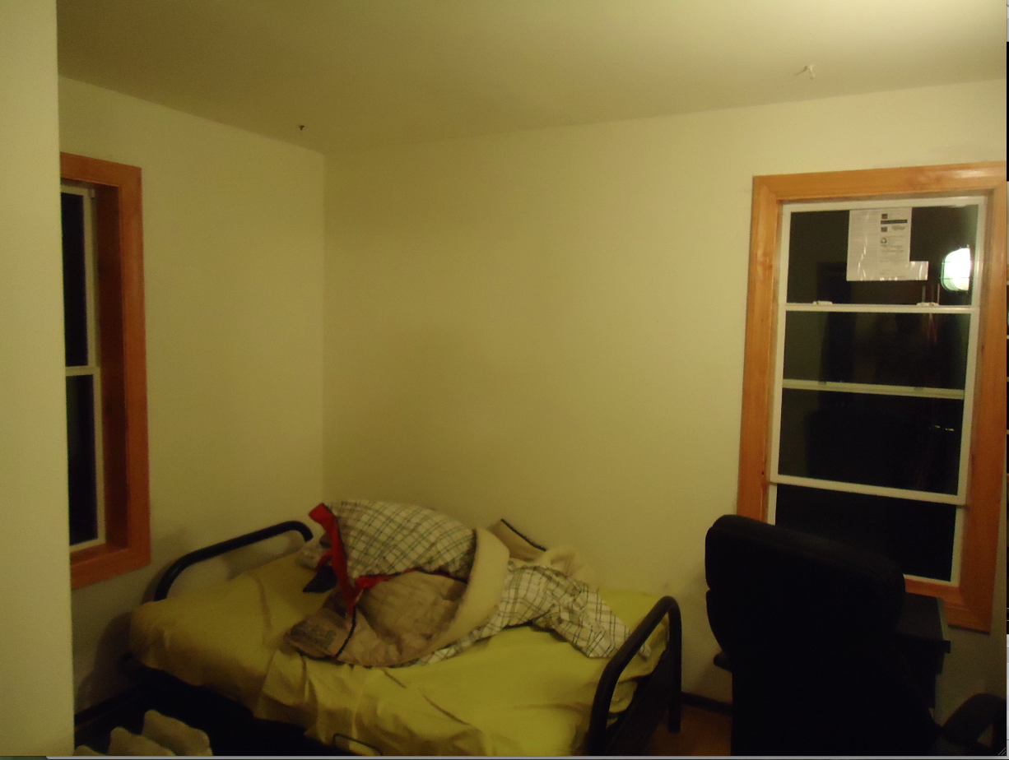
4th BED ROOM

Slide 8
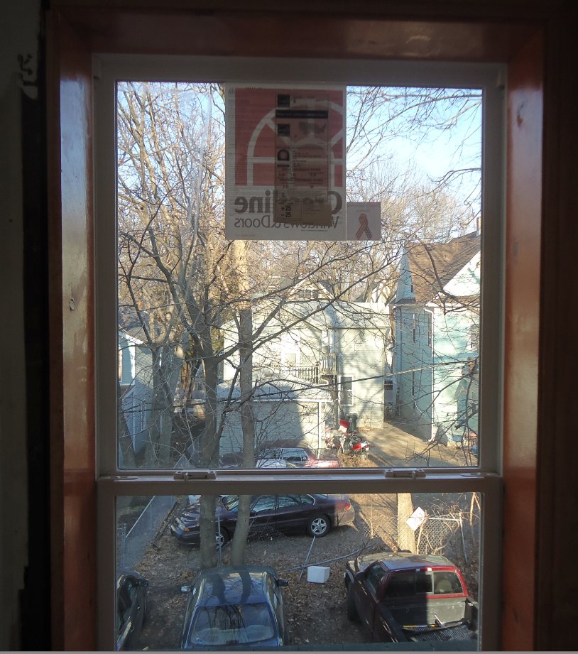
BACK STAIRS WINDOW

Slide 9
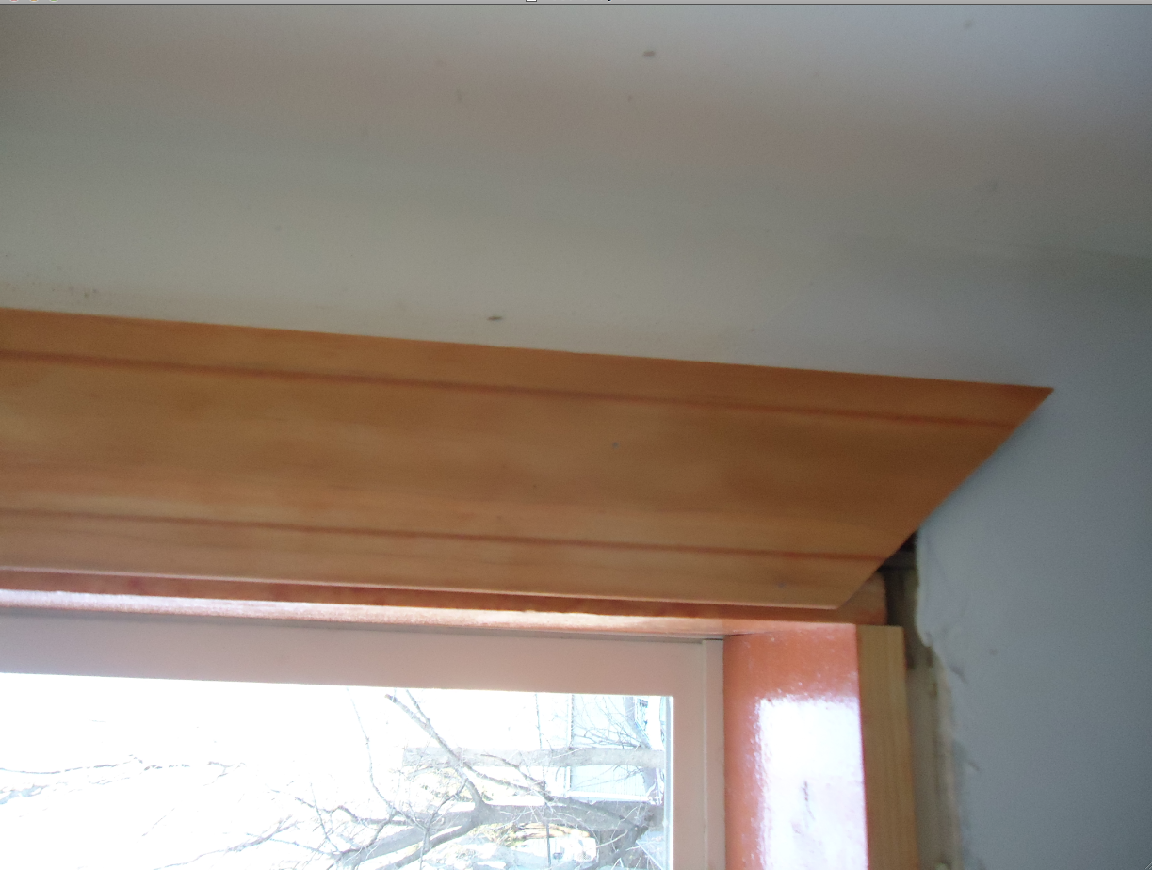
WINDOW ANOTONAMY

Slide 10
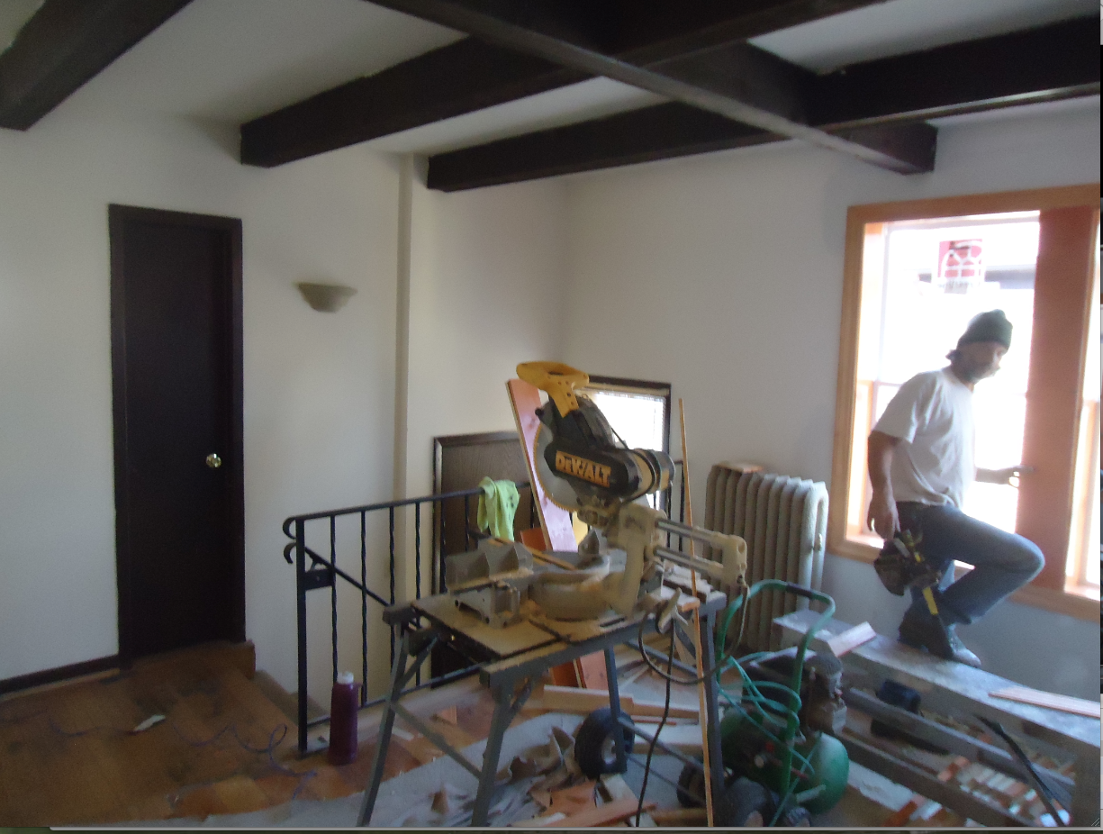
DOUBLE WINDOWS IN LIVING ROOM

Slide 11
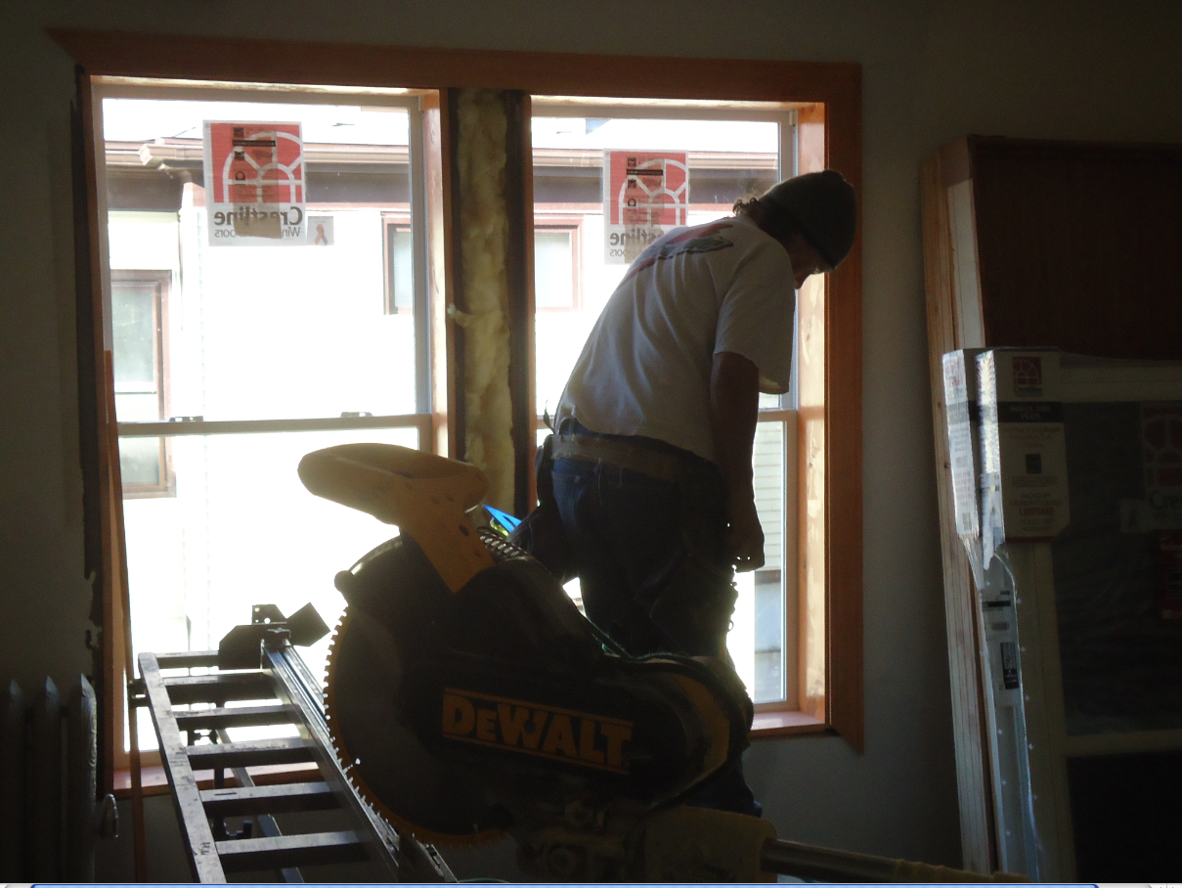
INSULATING AS WE GO

Slide 12
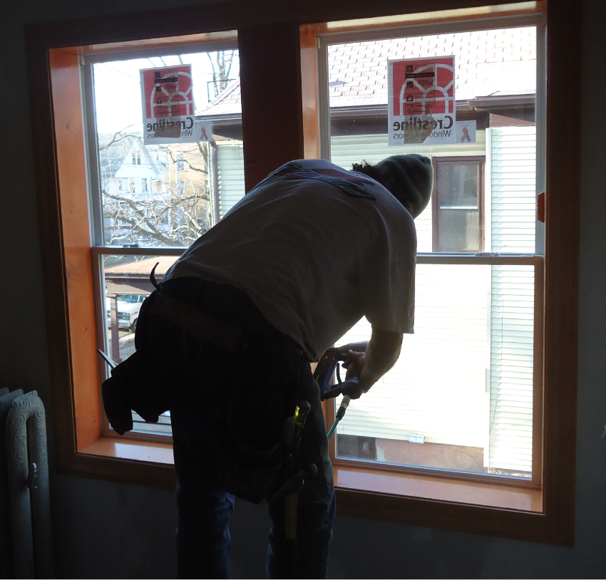
FINISHING LIVING ROOM

Slide 13
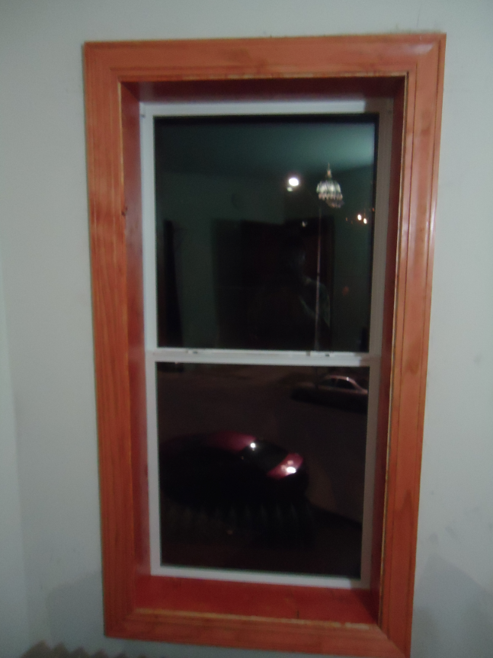
VIEW OF CAPITAL THROUGH WINDOW

Slide 14
ATTIC INSULATION

Slide 15
INSULATION DELIVERED

Slide 16
ATTIC FLOOR INSULATED @ R-50 ( 2 R-25)

Slide 17
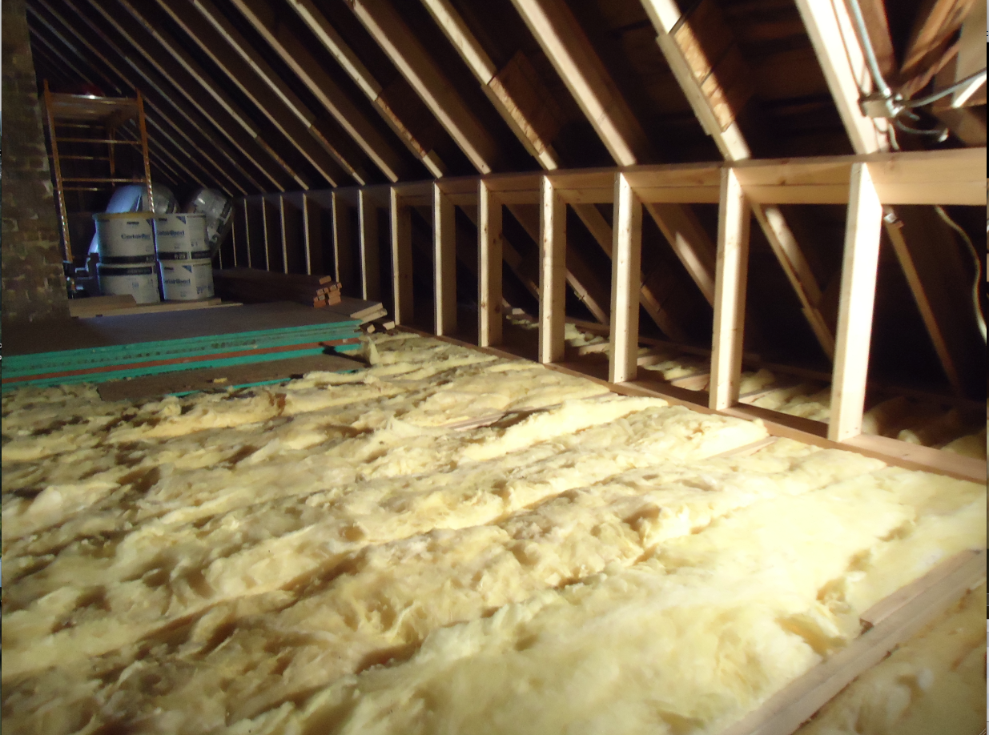
Whole attic insulated @ R-50

Slide 18
Temp floor with roofing steel

Slide 19
ATTIC BEFORE & AFTER

Slide 20
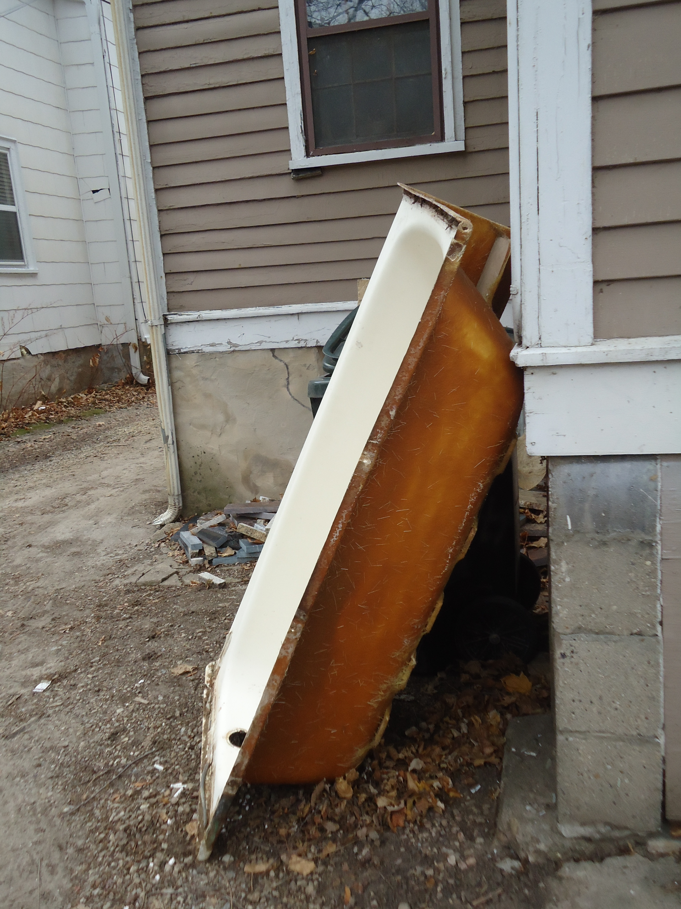
UPDATED 2ND FLOOR BATH ROOM.
Leaking old tub out.

Slide 21
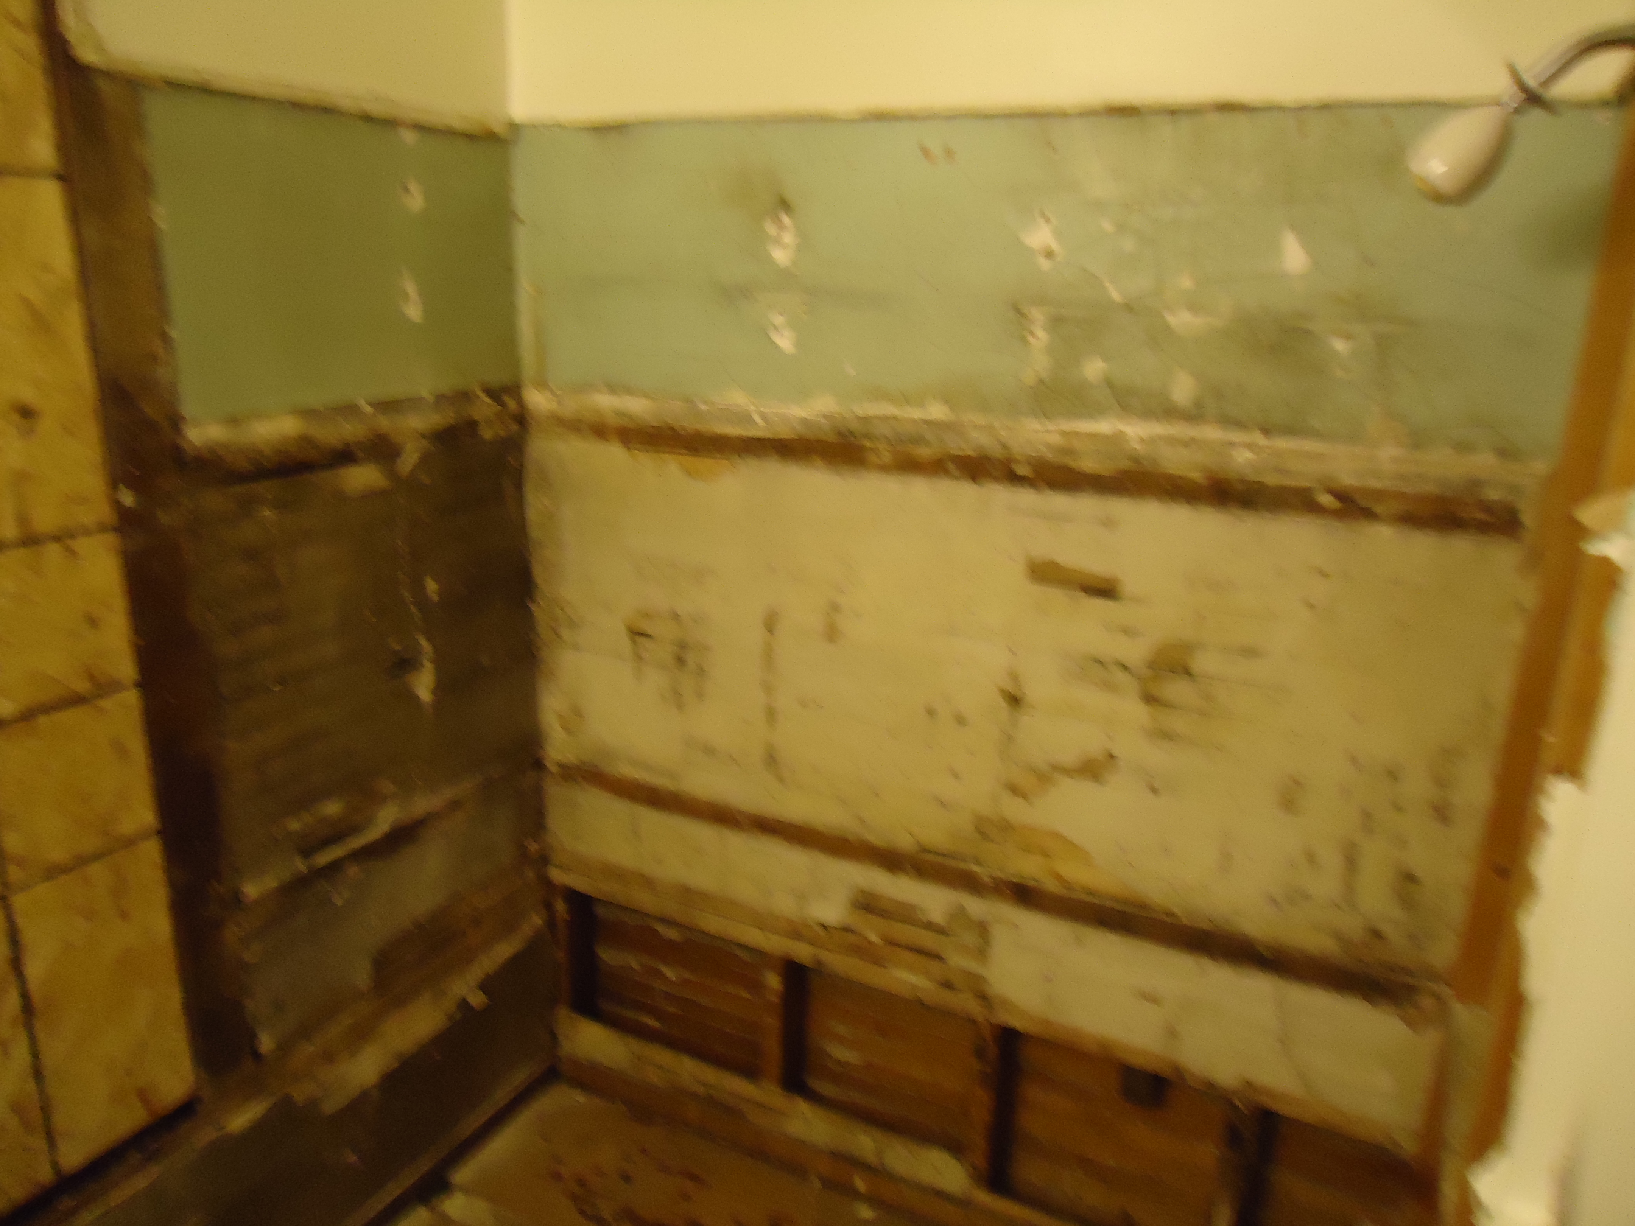
Messy wall behind old tub

Slide 22
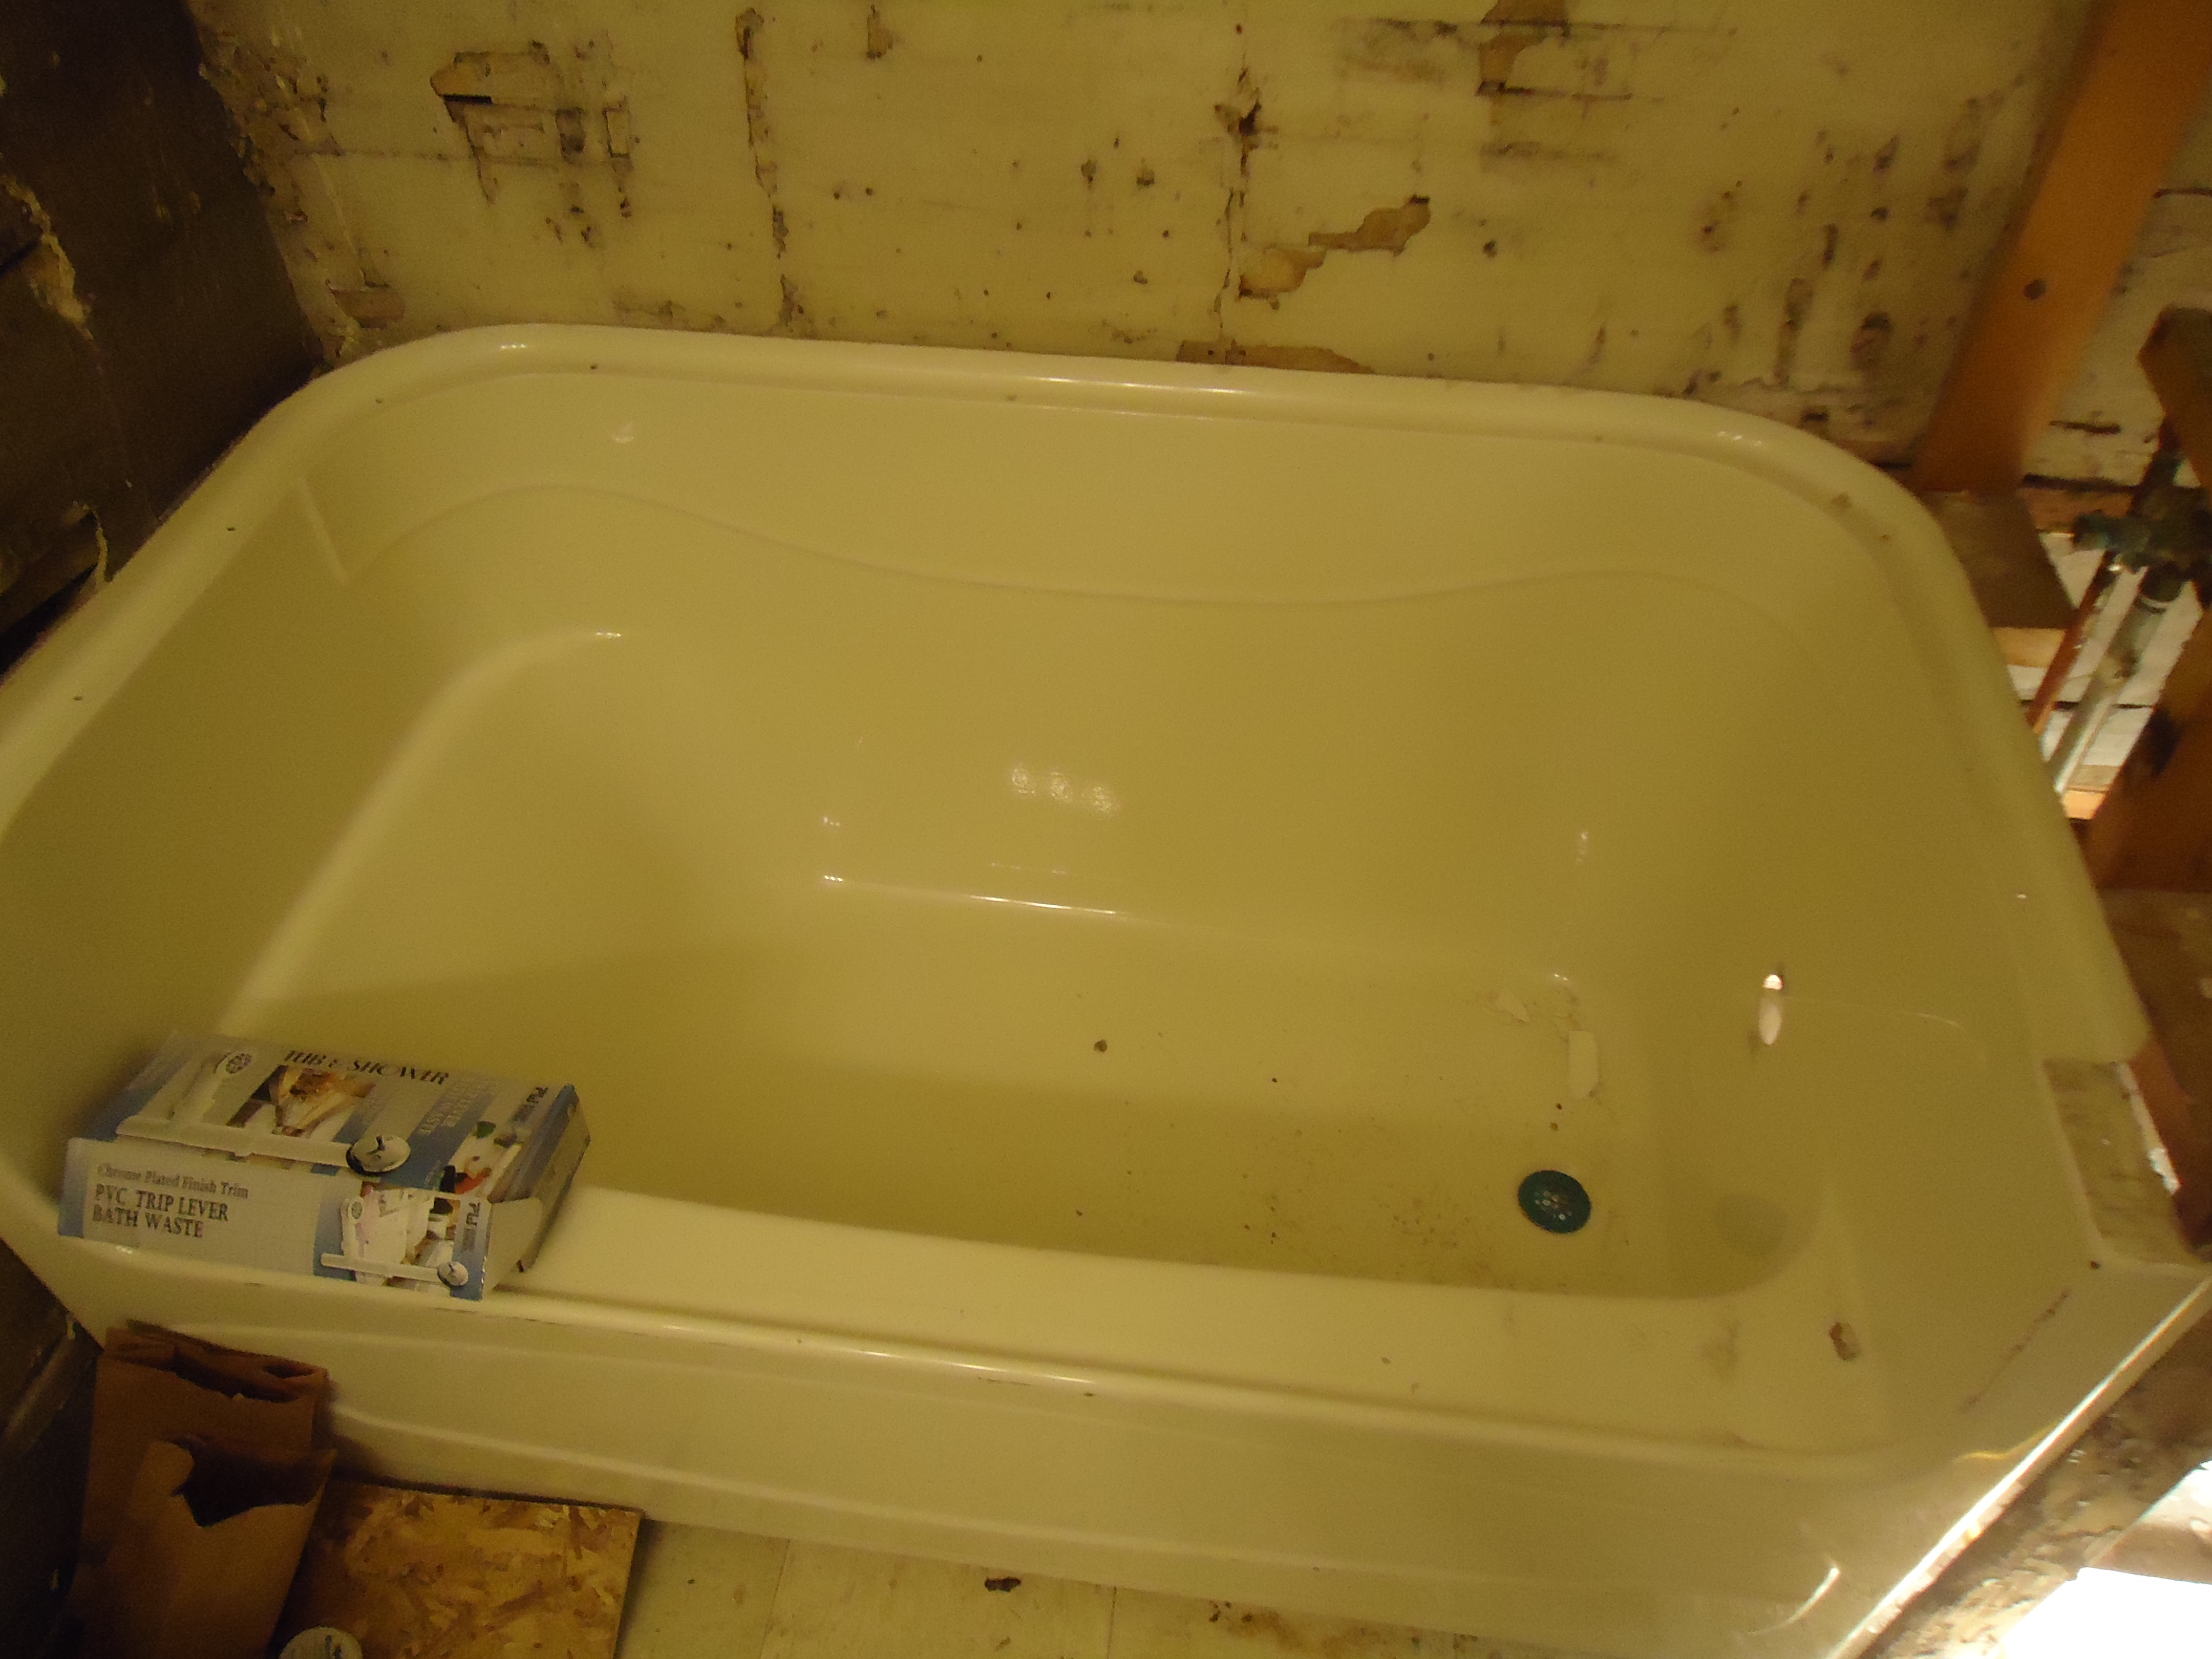
New 3 piece tub in

Slide 23
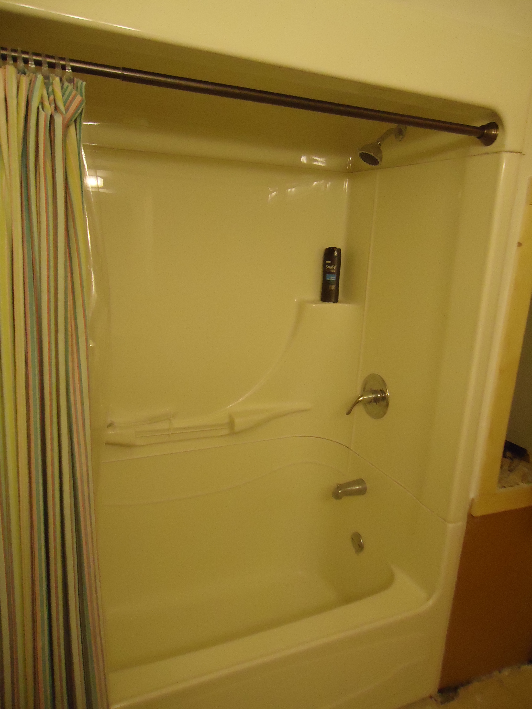
NEW TUB IN

Slide 24
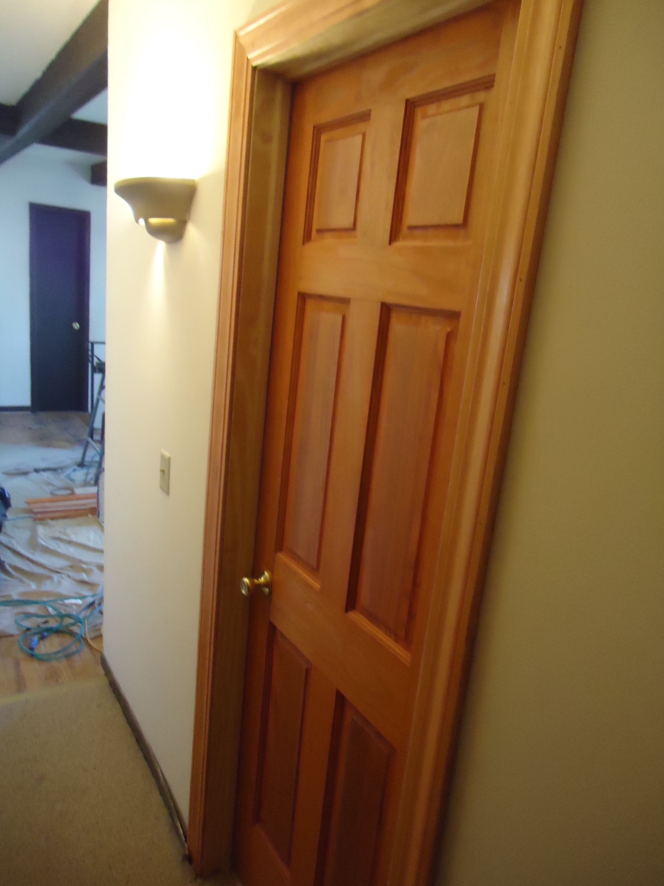
New bath room door

