Slide 1
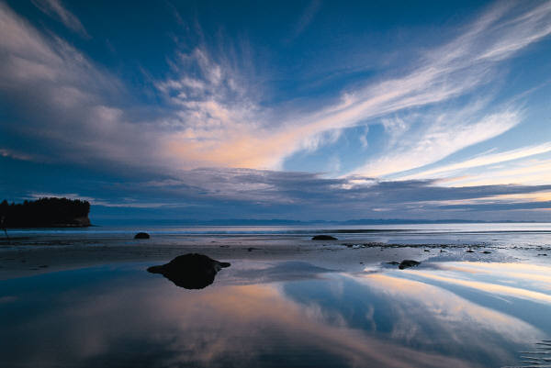
CIMSS GOES-16 ABI-RGB
NATURAL & TRUE COLOR
Presented by: Kaba Bah
Thanks to Tim Schmit, Mat Gunshor, Joleen Feltz, James P. Nelson III, Hong Zhang.

Slide 2
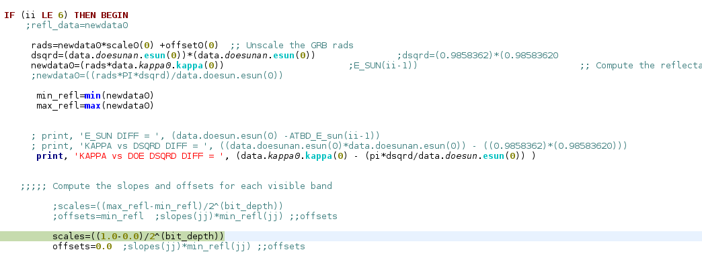
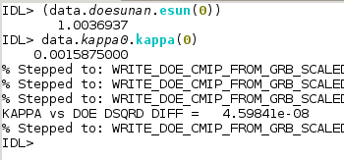

Slide 3
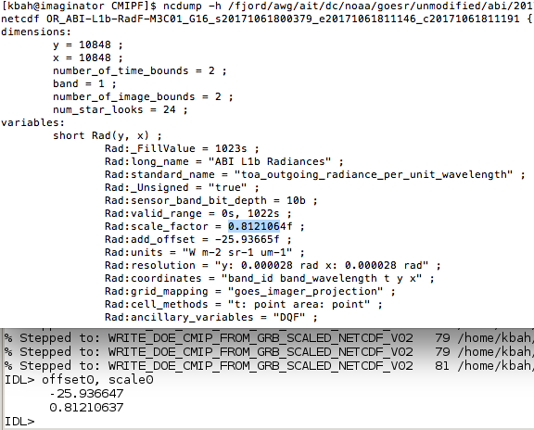
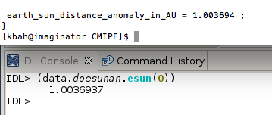

Slide 4
