Slide 1
CIMSS GOES-16 ABI-RGB
NATURAL & TRUE COLOR
Presented by: Kaba Bah
Thanks to Tim Schmit, Mat Gunshor, Joleen Feltz, James P. Nelson III, Hong Zhang.

Slide 2
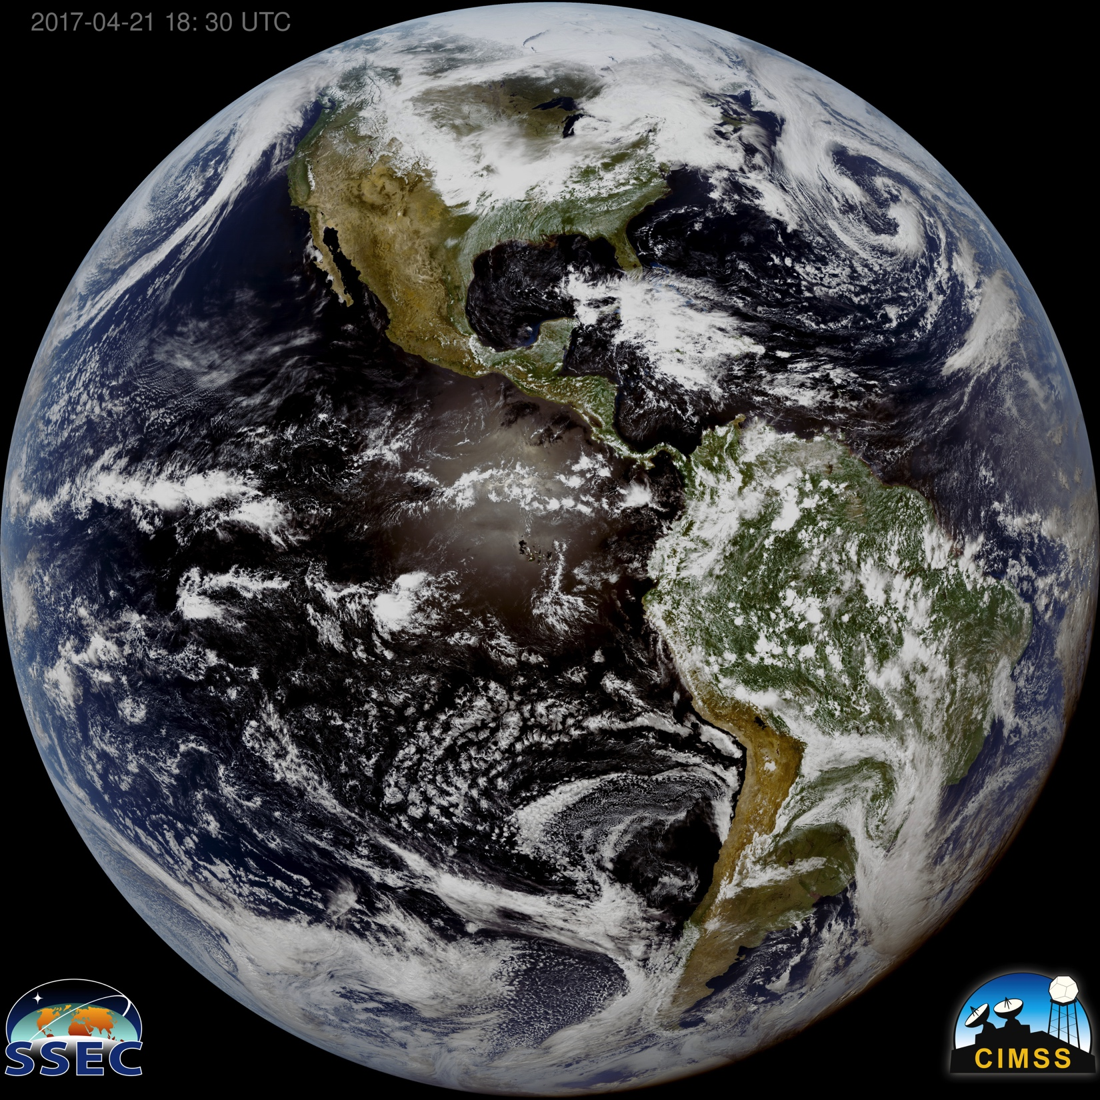

Slide 3
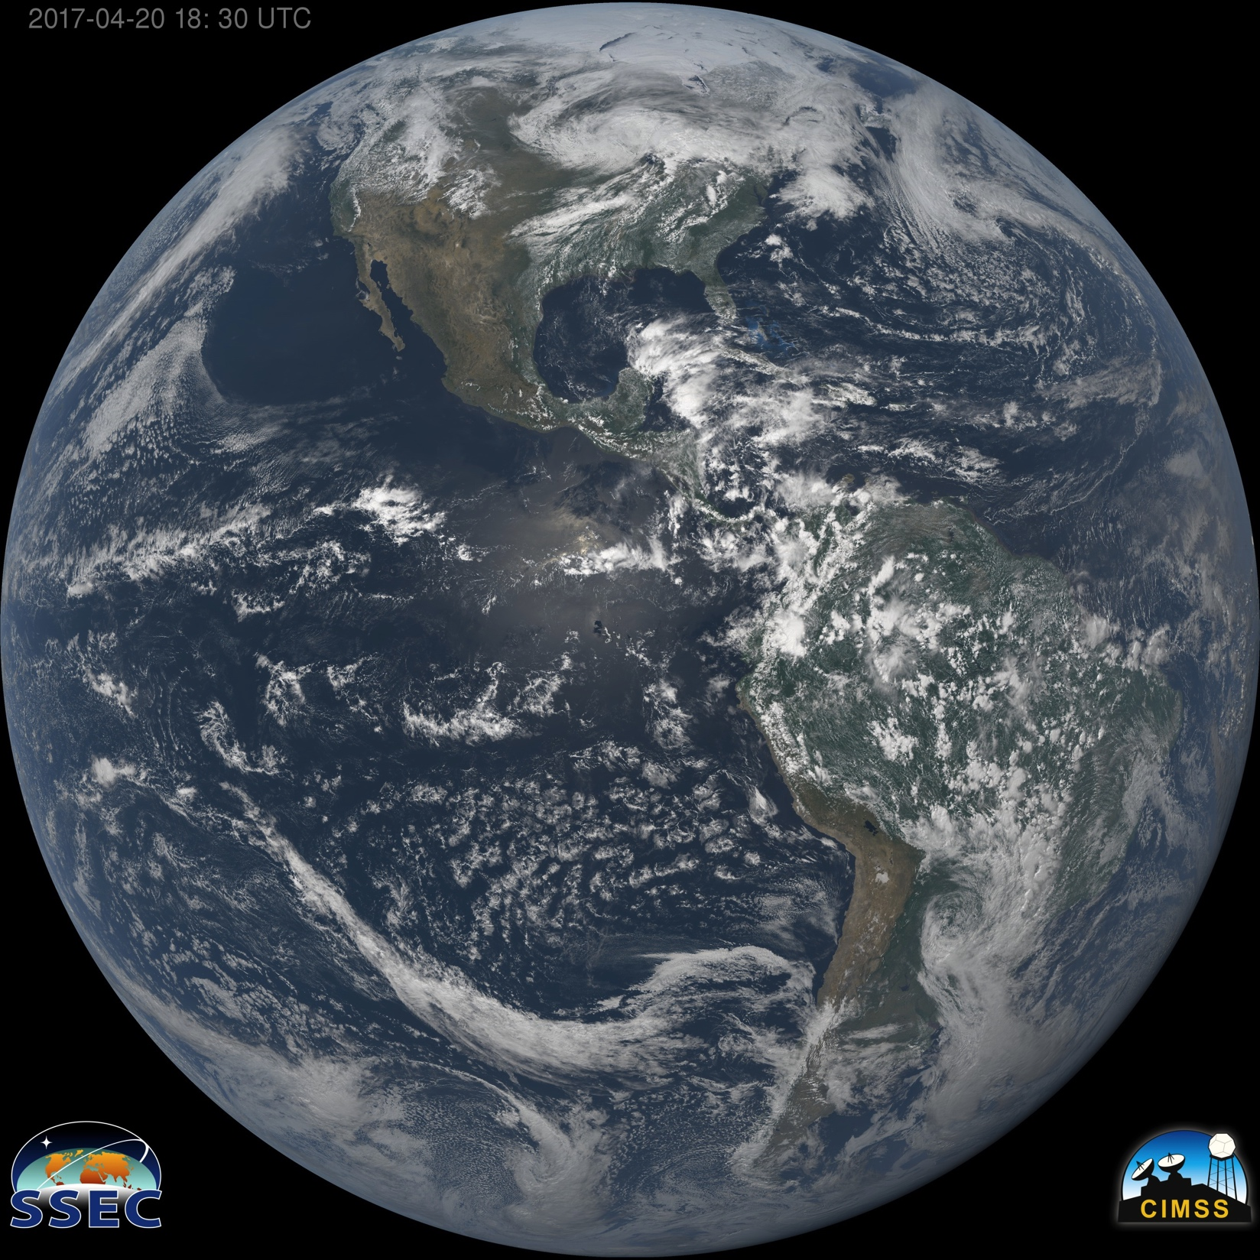

Slide 6
III: CIMSS VS EPIC TRUE COLOR 04-03, 17:15Z 04-03, 18:18Z

Slide 7
CIMSS VS EPIC NATURAL COLOR 04-03, 17:15Z 04-03, 18:18Z

