Slide 1
RGB Imagery meeting 10-18-2016
2016-06-01 200Z

Slide 2
orig

Slide 6
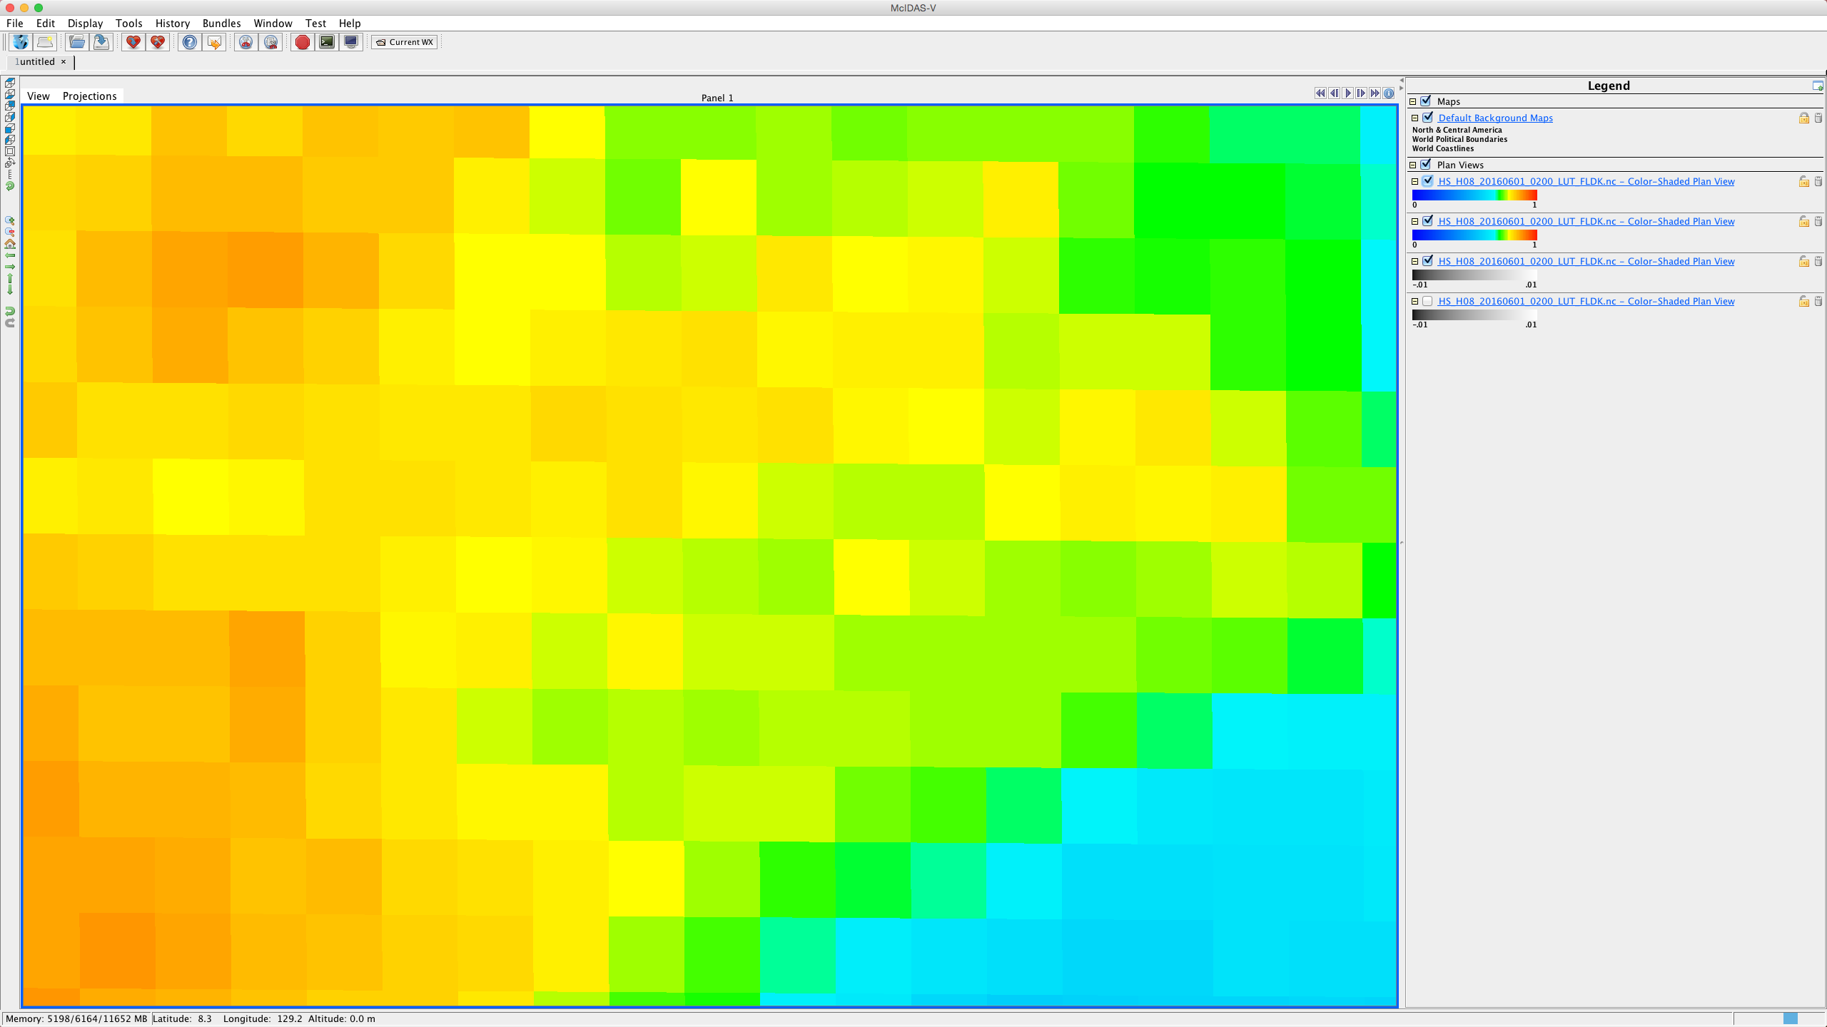

Slide 9
RGB issues
CONTRAST
SCATTERING
CIMSS OPTIONS
CADILLAC
SHCS

Slide 10
Distributions: key
CONTRAST
SCATTERING

Slide 11
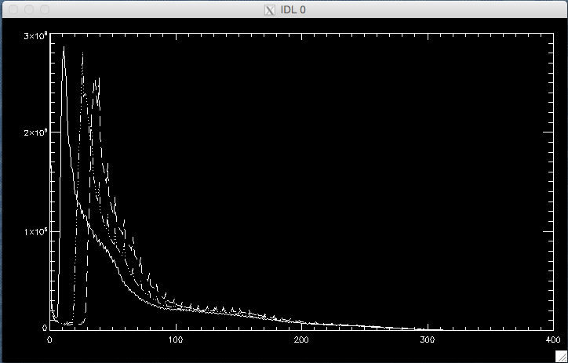

Slide 15
Equalize histogram Density distribution

Slide 16
Cadillac

Slide 17
SHCS

Slide 18
MIDDLE GROUND

Slide 20
