Slide 1
Molecular Atmospheric correction for AHI RGB image

Slide 2
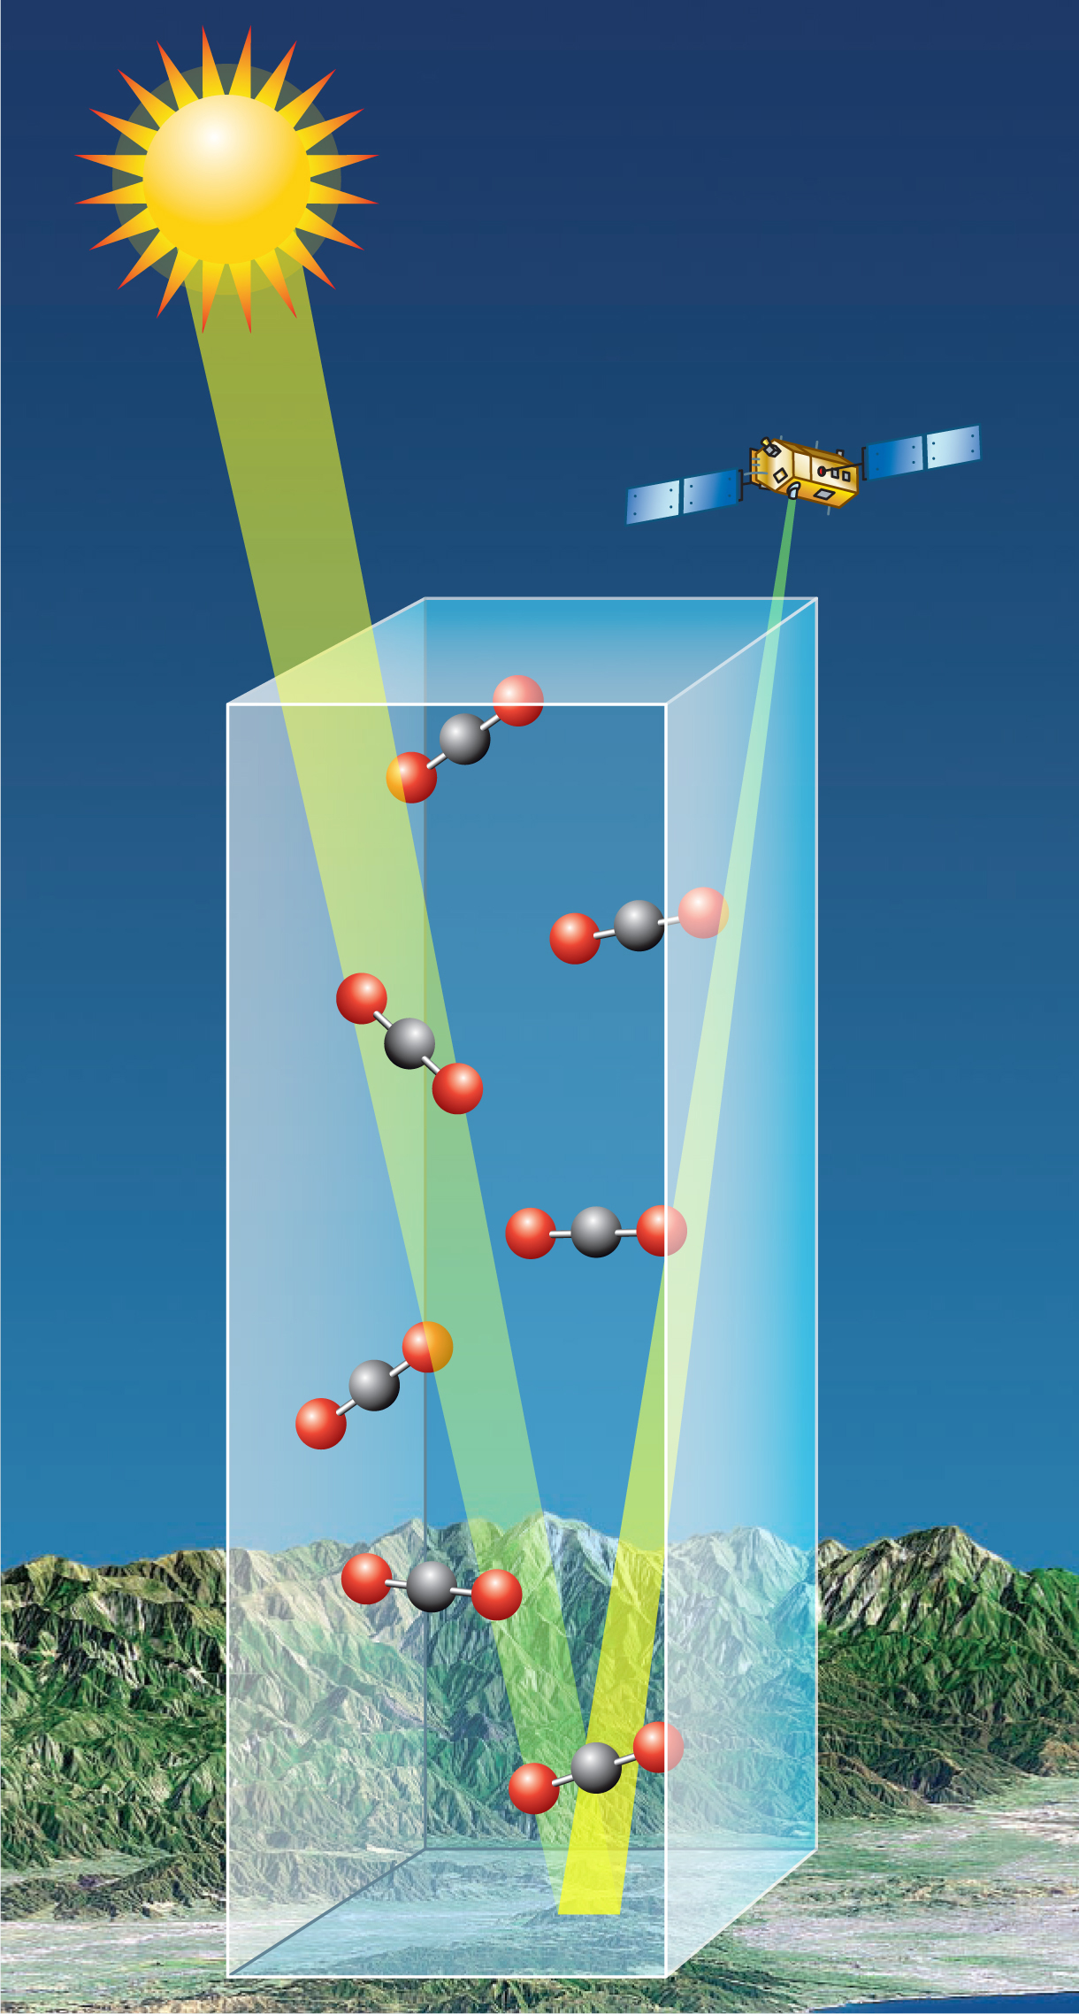
Satellite measured TOA reflectance atmospheric gases correction
“gas free” TOA reflectance is necessary to produce high quality RGB image.
Satellites sensors measured TOA reflectance (or radiance) required appropriate correction for atmospheric gases.
That includes both scattering (Rayleigh) and absorption/transmission of gas.

Slide 3
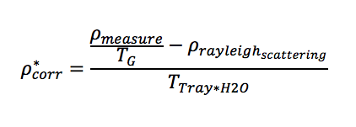
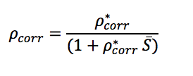
Radiative Transfer :
T(G) is the total transmission gas correction ( as a function of O3, Dry gas (CO, CO2, etc…) absorption)
T(G) = T(O3)T(Dry gas)= exp(-air_mass x tauO3) x exp (-air_mass x tau drygas)
Rayleigh reflectance is estimated from single scattering approximation as a function of Rayleigh Optical Depth for each bands
S is Atmospheric spherical albedo

Slide 4
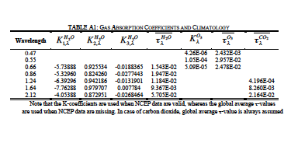
MODIS C005 Gas absorption correction of L1B reflectance

Slide 5
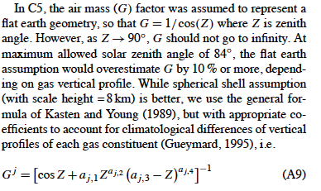
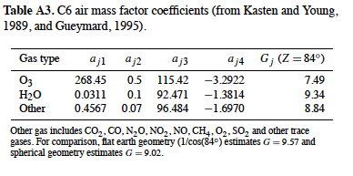
MODIS C006 air mass factor calculation is modified

Slide 6
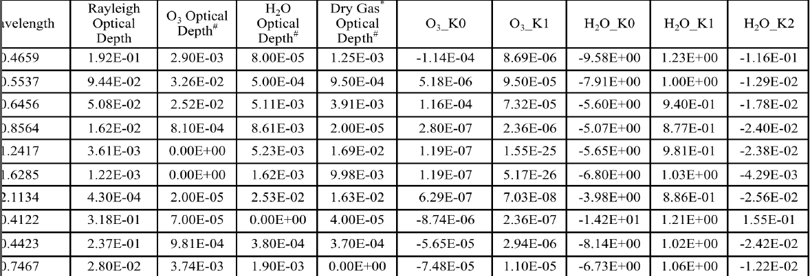
MODIS C006 Gas absorption table
Note that the K coefficients are used when NCEP data are valid, whereas the US1976 optical depths are used when NCEP data are missing.
For “Other” gases,
we took climatology to be the sum of all major gases that are
not H2 O and O3 . Thus in addition to CO2 , “other” gases include
CO, N2 O, NO2 , NO, CH4 , O2 , SO2 and other trace
gases.

Slide 7
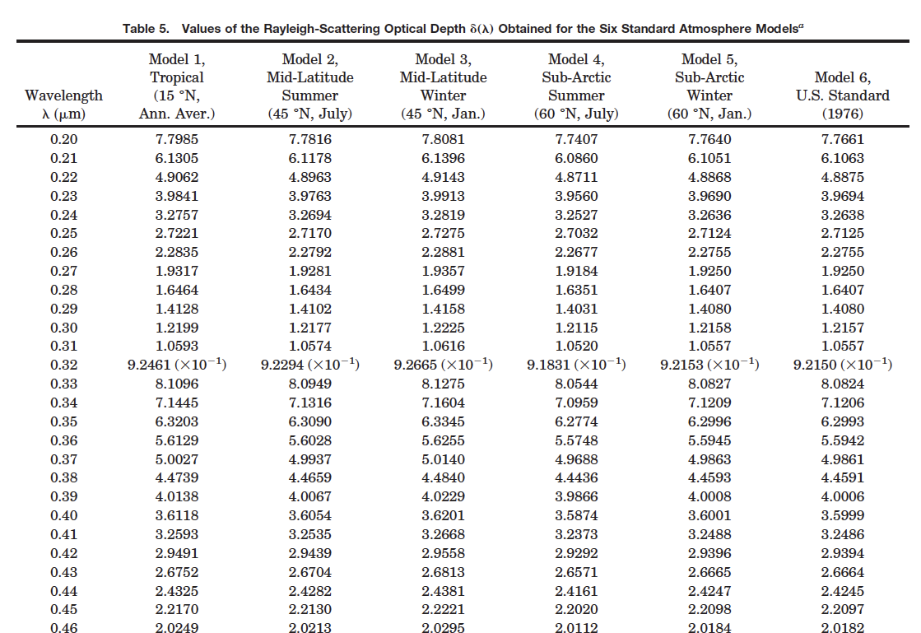
Values of the Rayleigh-Scattering Optical Depth Obtained for the Six Standard Atmosphere Model from 0.2 to 4 micro
(Tomasi et al., 2005)

Slide 8
C006, when NCEP data are valid

