Slide 1
CIMSS GOES-16 ABI-RGB
NATURAL & TRUE COLOR
Presented by: Kaba Bah
Thanks to Tim Schmit, Mat Gunshor, Joleen Feltz, James P. Nelson III, Hong Zhang.

Slide 2
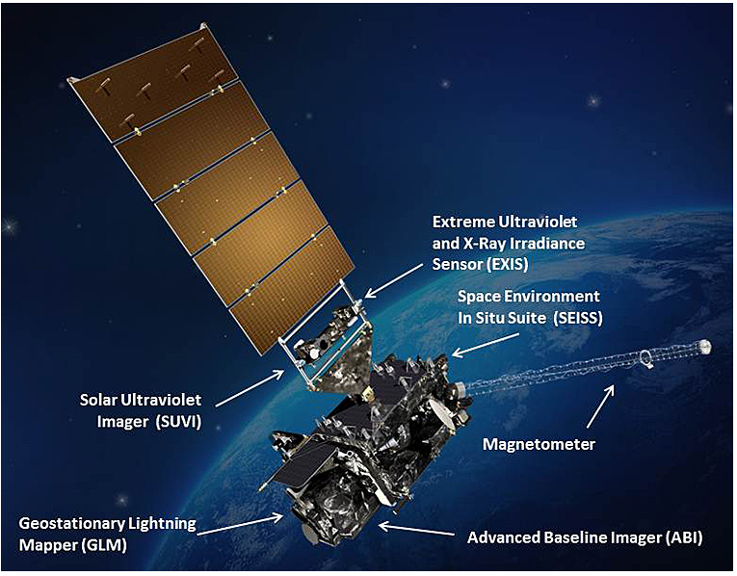

Slide 3
OUTLINE
GOES-16 BANDS => 0.47um, 0.64um, 0.86um.
Natural VS True color RGB.
Compare with EPIC: Natural & True.
Sample loops:
February 26th Eclipse.
March 30th Dust storm.
Cloud dynamics
CONUS LOOPS

Slide 4
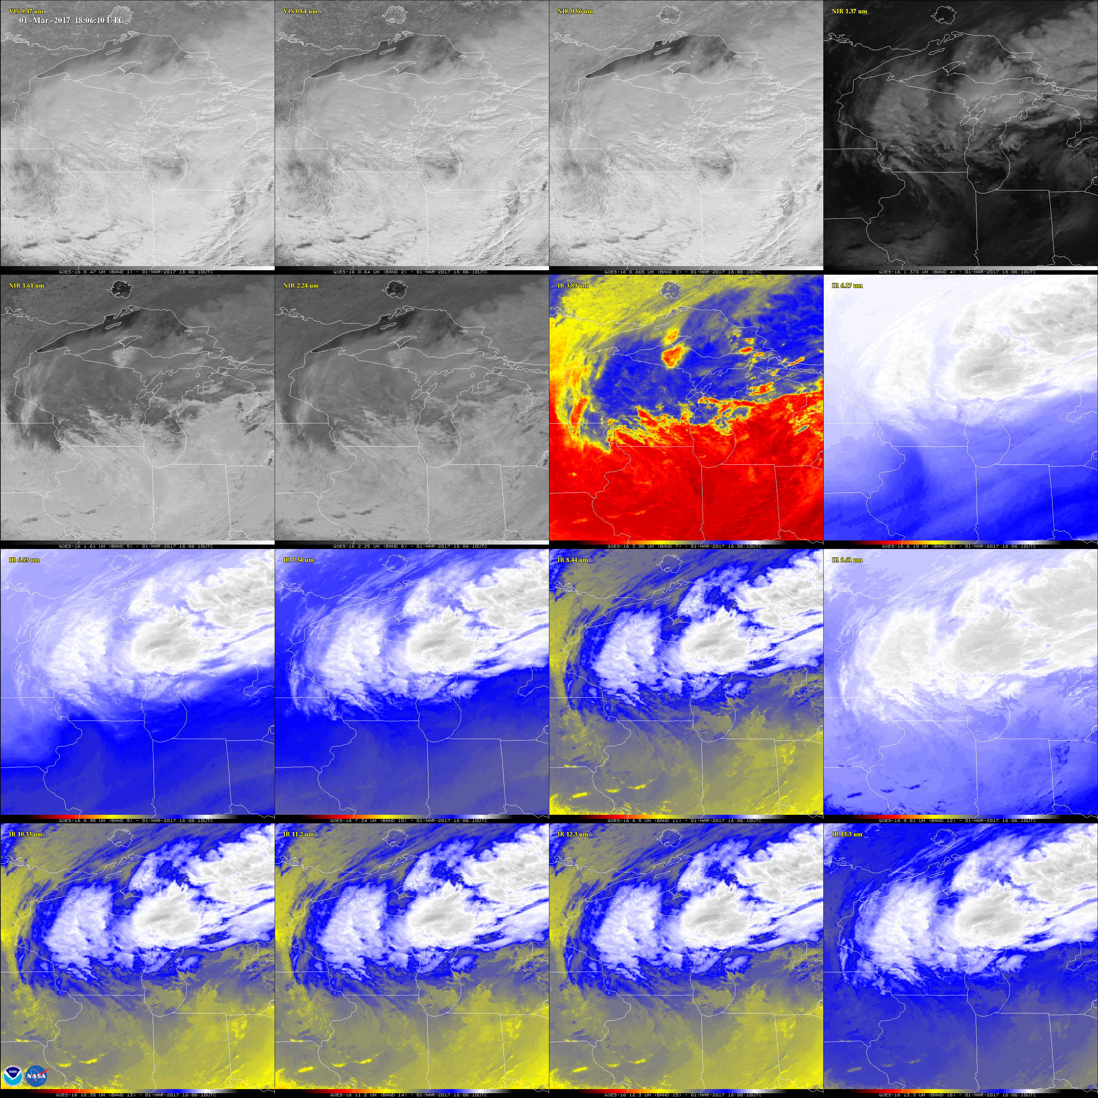
I: GOES-16 ABI BANDS: 03-0-2017, 18:06UTC

Slide 5
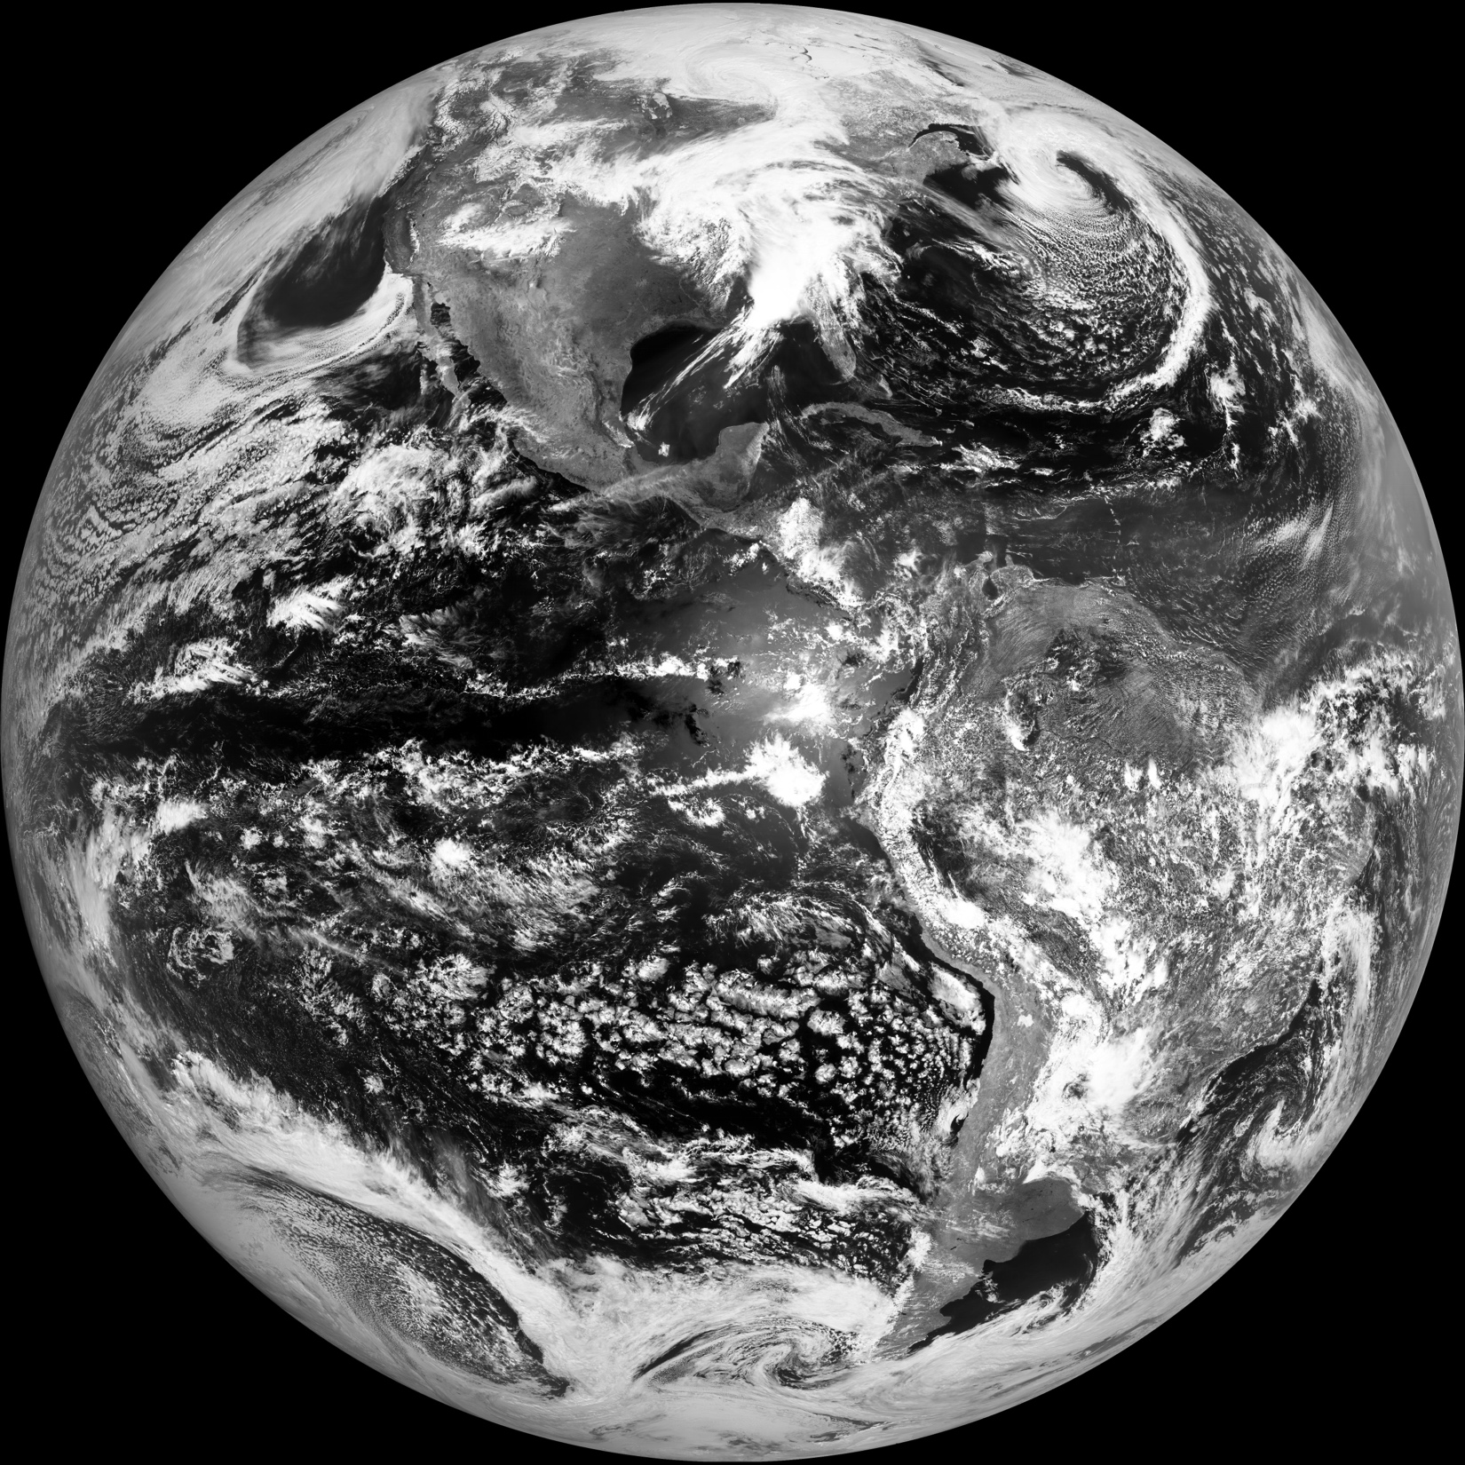
Red(0.64um), 04-03-2017, 17:15UTC

Slide 6
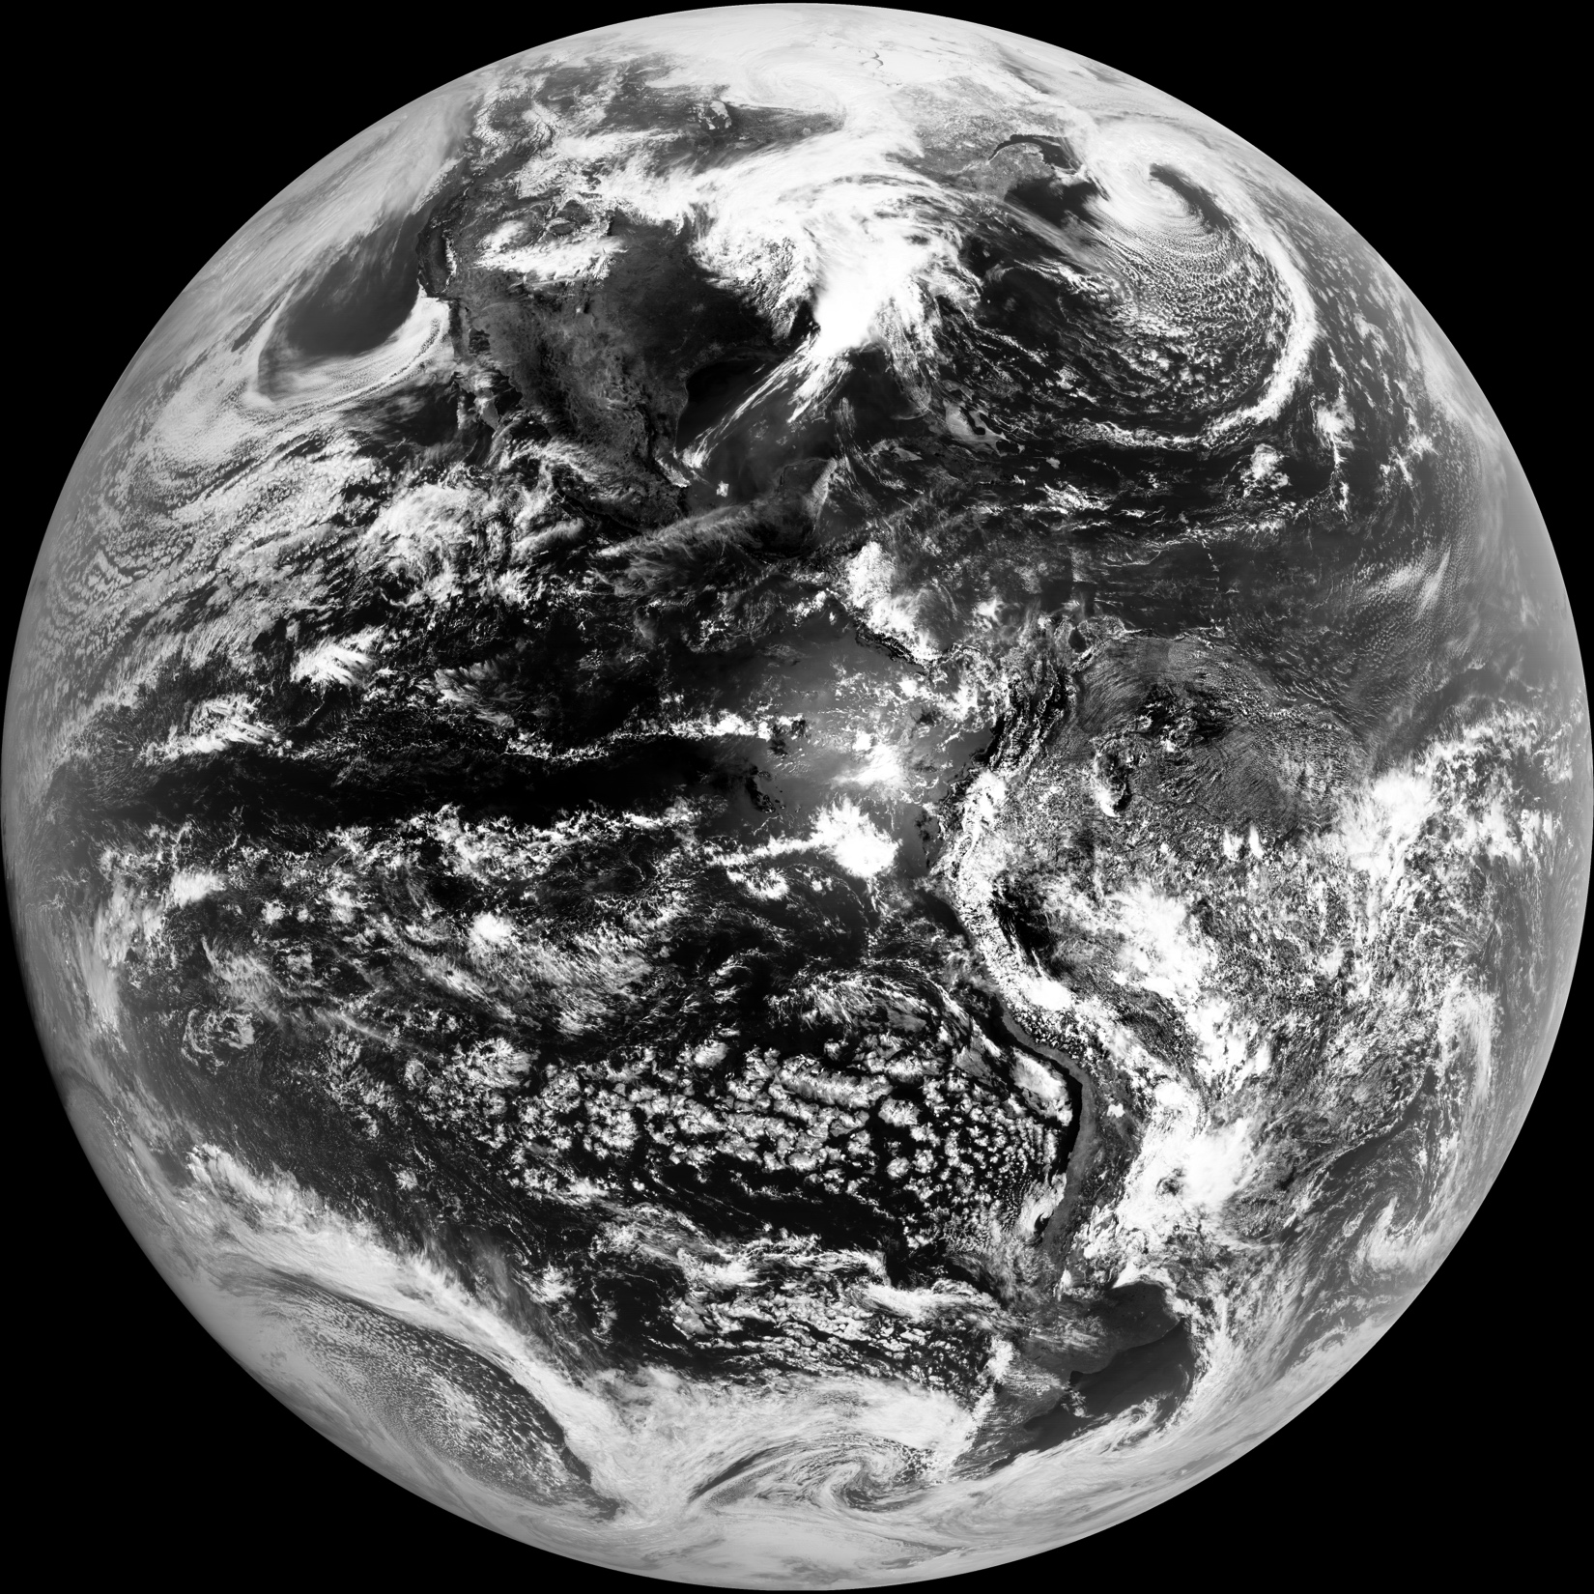
Blue(0.47um), 04-03-2017, 17:15UTC

Slide 7
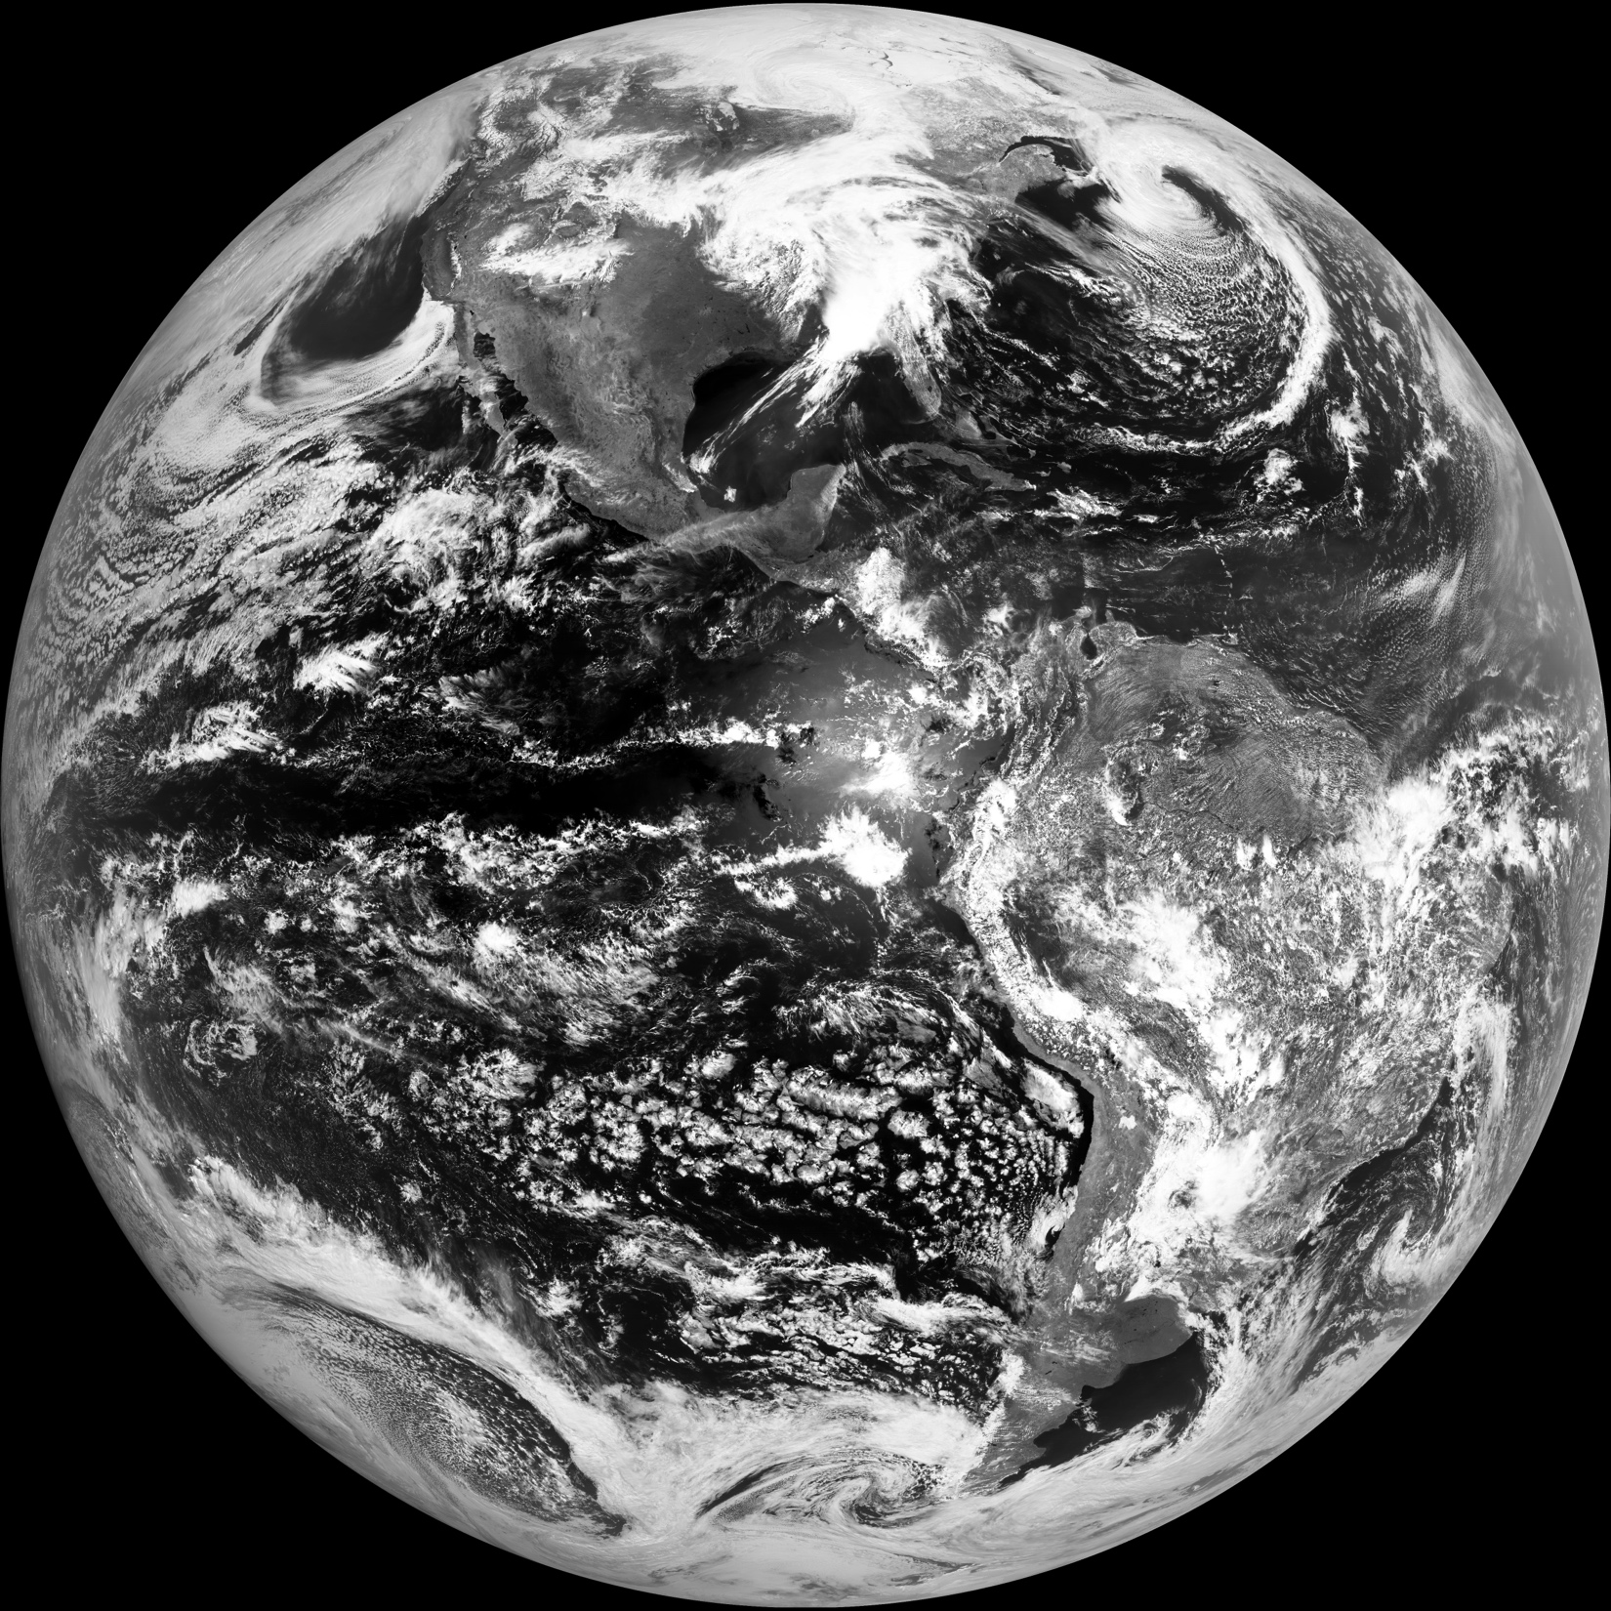
Green(0.55um), 04-03-2017, 17:15UTC

Slide 8
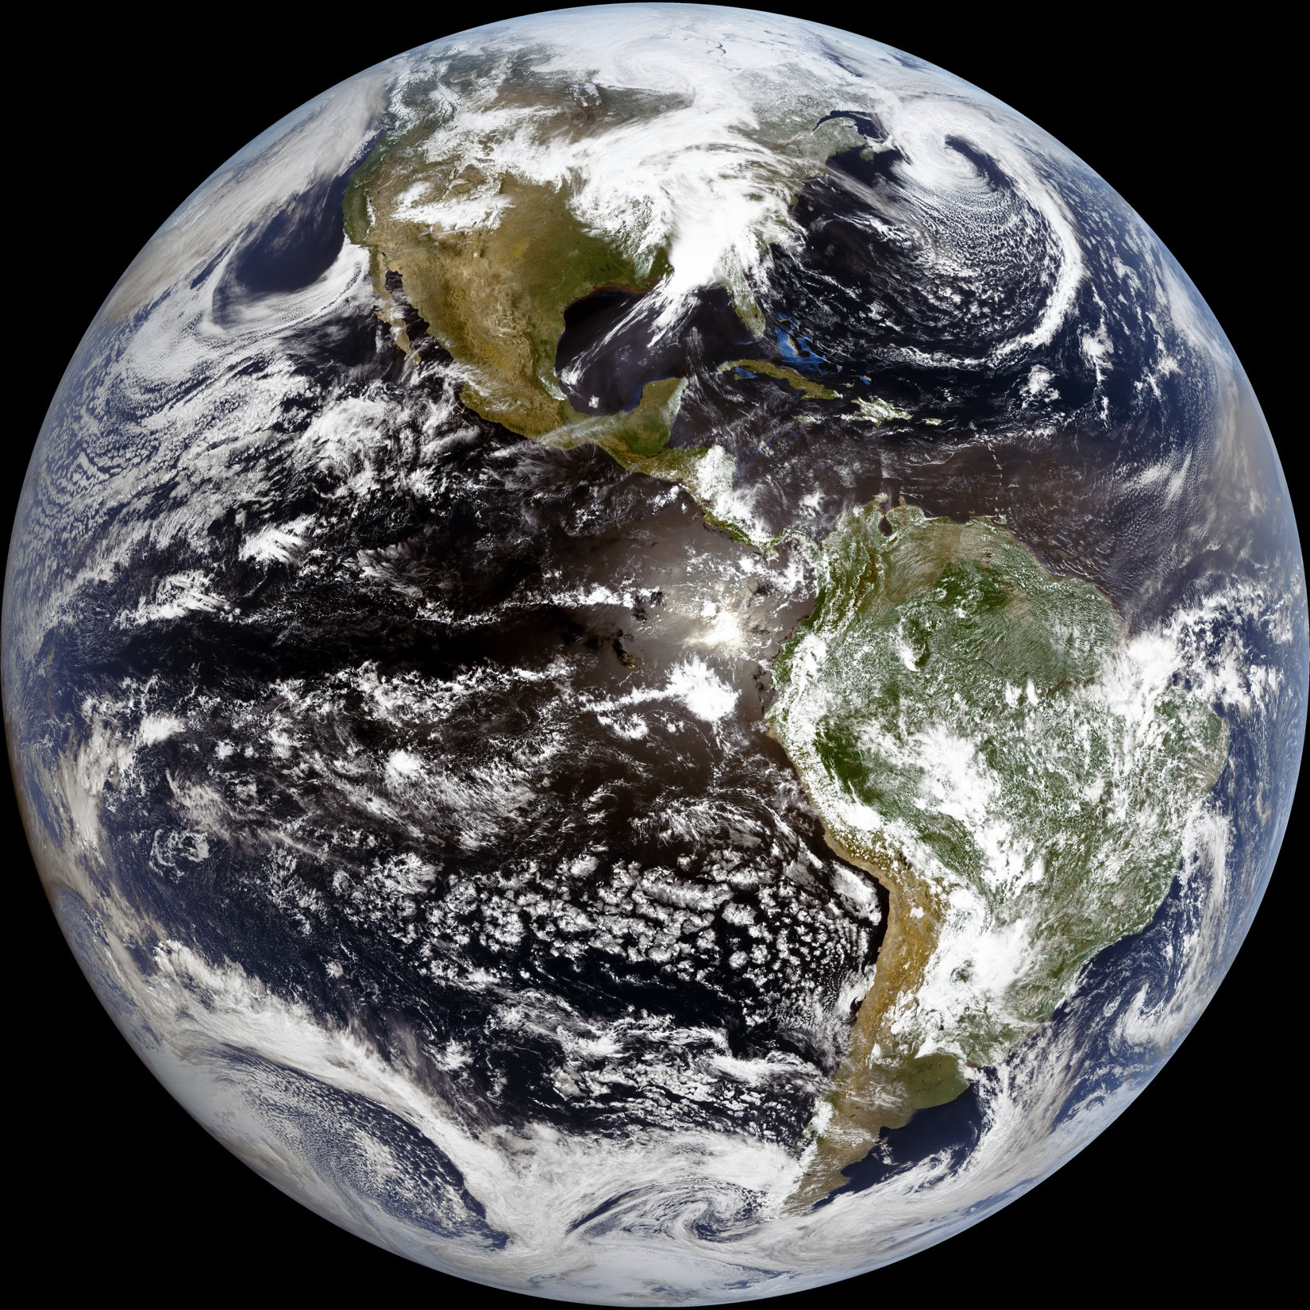
II: TRUE COLOR; 04-03-2017, 17:15UTC

Slide 9
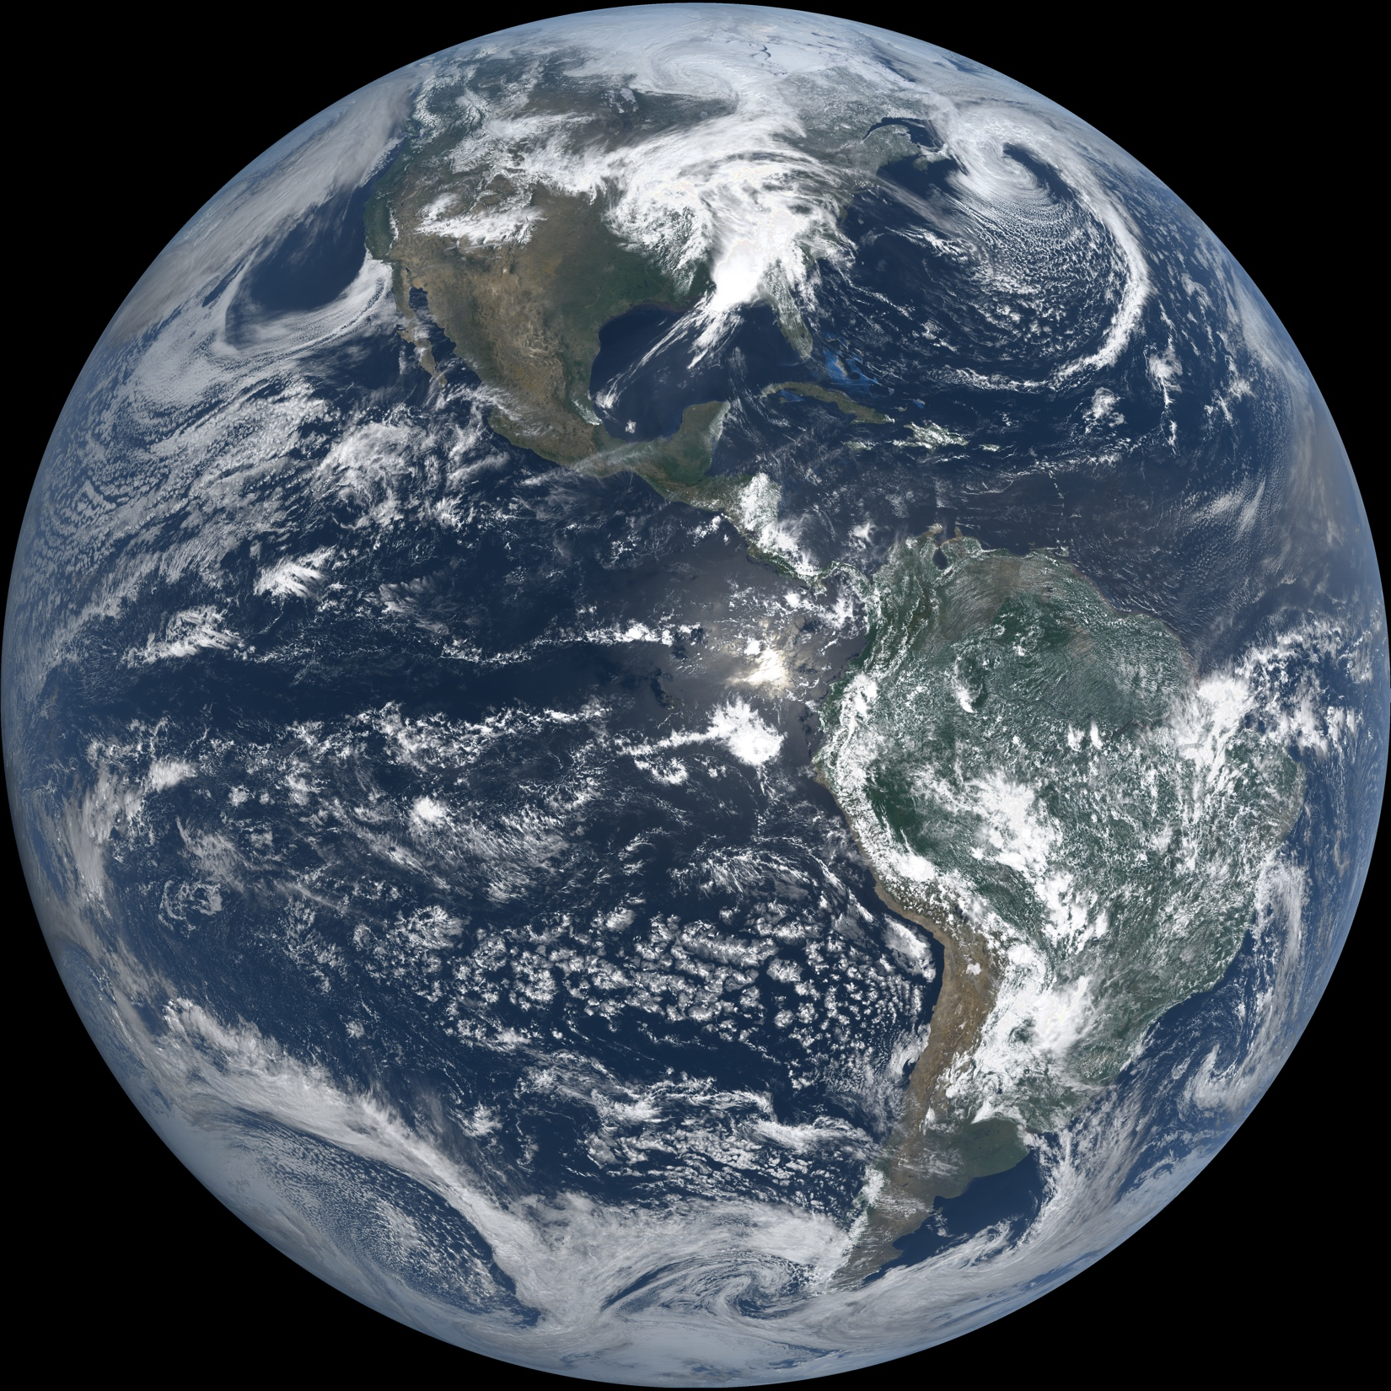
NATURAL COLOR: 04-03-2017, 17:15UTC

Slide 10
III: CIMSS VS EPIC TRUE COLOR 04-03, 17:15Z 04-03, 18:18Z

Slide 11
CIMSS VS EPIC NATURAL COLOR 04-03, 17:15Z 04-03, 18:18Z

Slide 12
IV: February 26th Eclipse

Slide 13
March-30th- Dust storm

Slide 14
03-25th Cloud Dynamics

Slide 15
True color

Slide 16
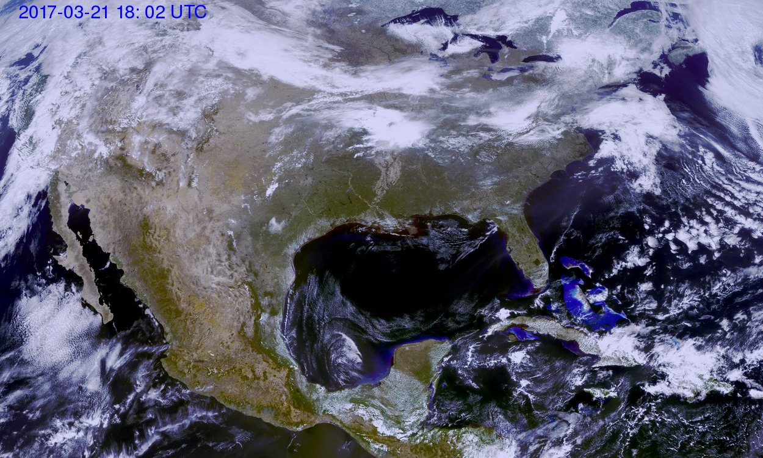
V: True color: CONUS: 03-18-2017, 16:52UTC

Slide 17
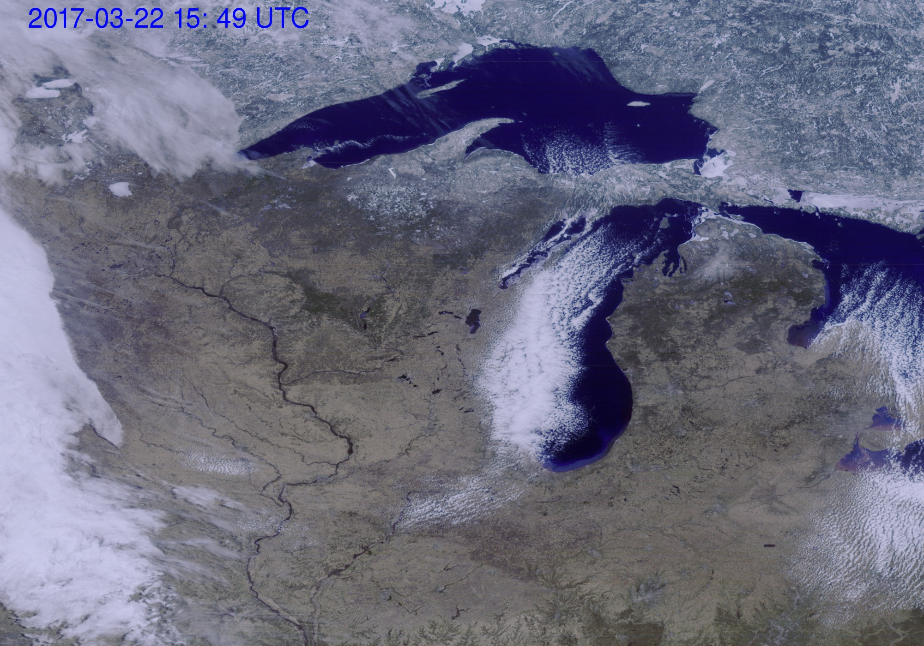
True color: MESO, 03-22-2017, 15:49 UTC

Slide 18
CONUS LOOP: 03-18-25th

Slide 19
MESO LOOP

Slide 20
What Next?
Continue improving algorithm.
Automate process.
Test other RGB products.

Slide 21
Thank you!.

