Slide 1
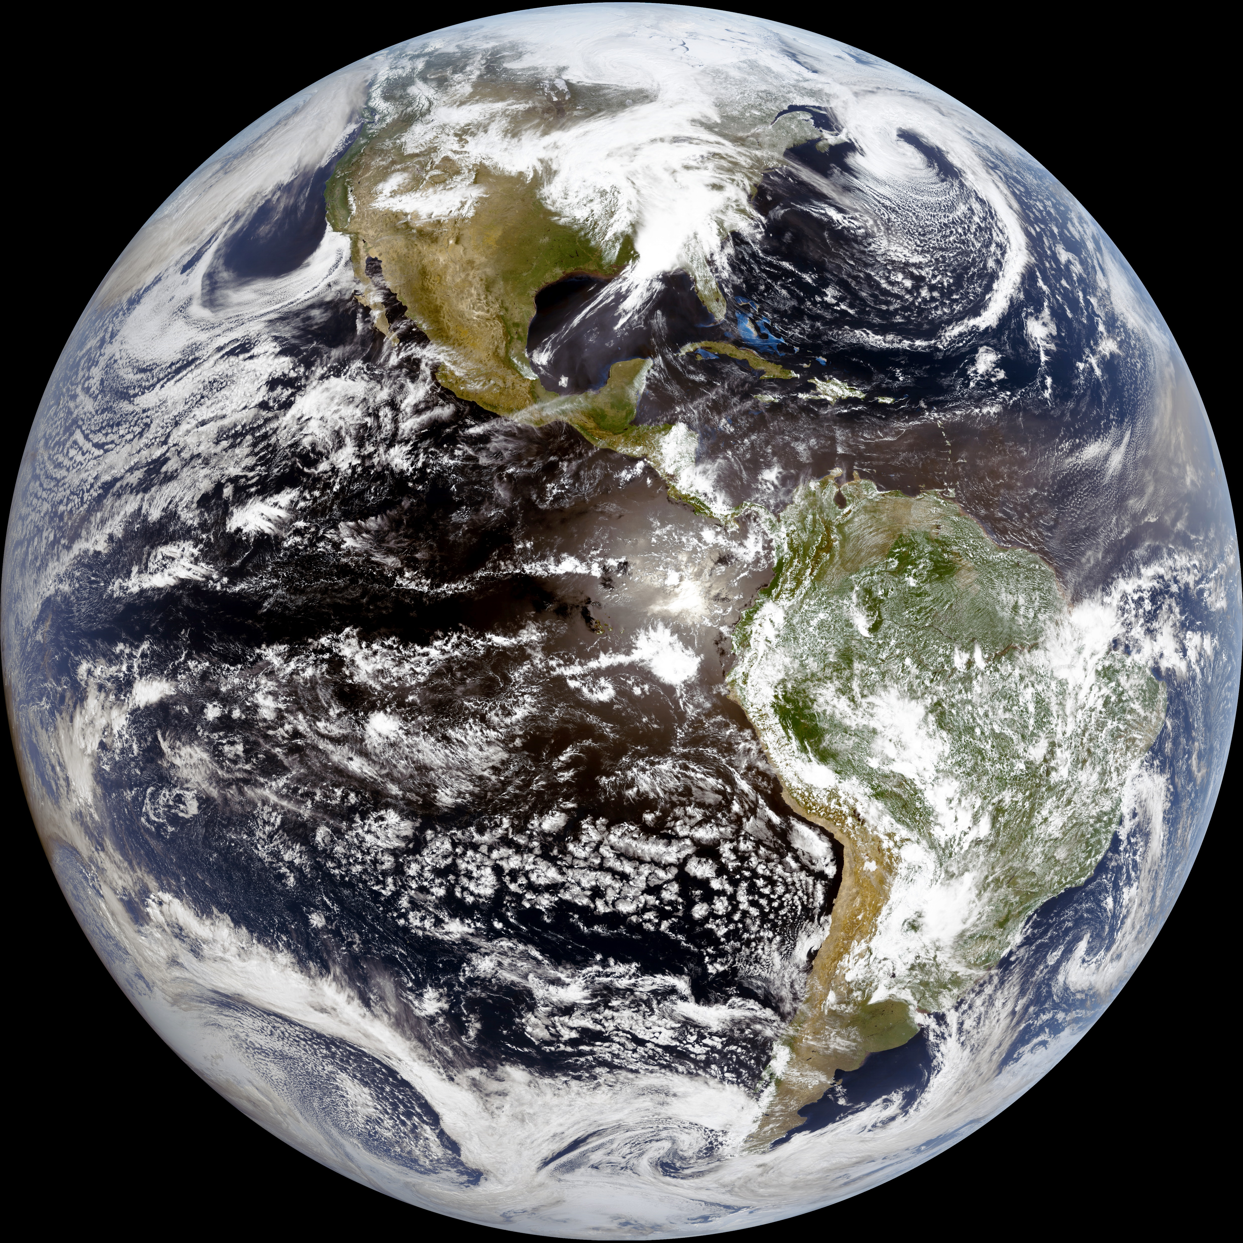
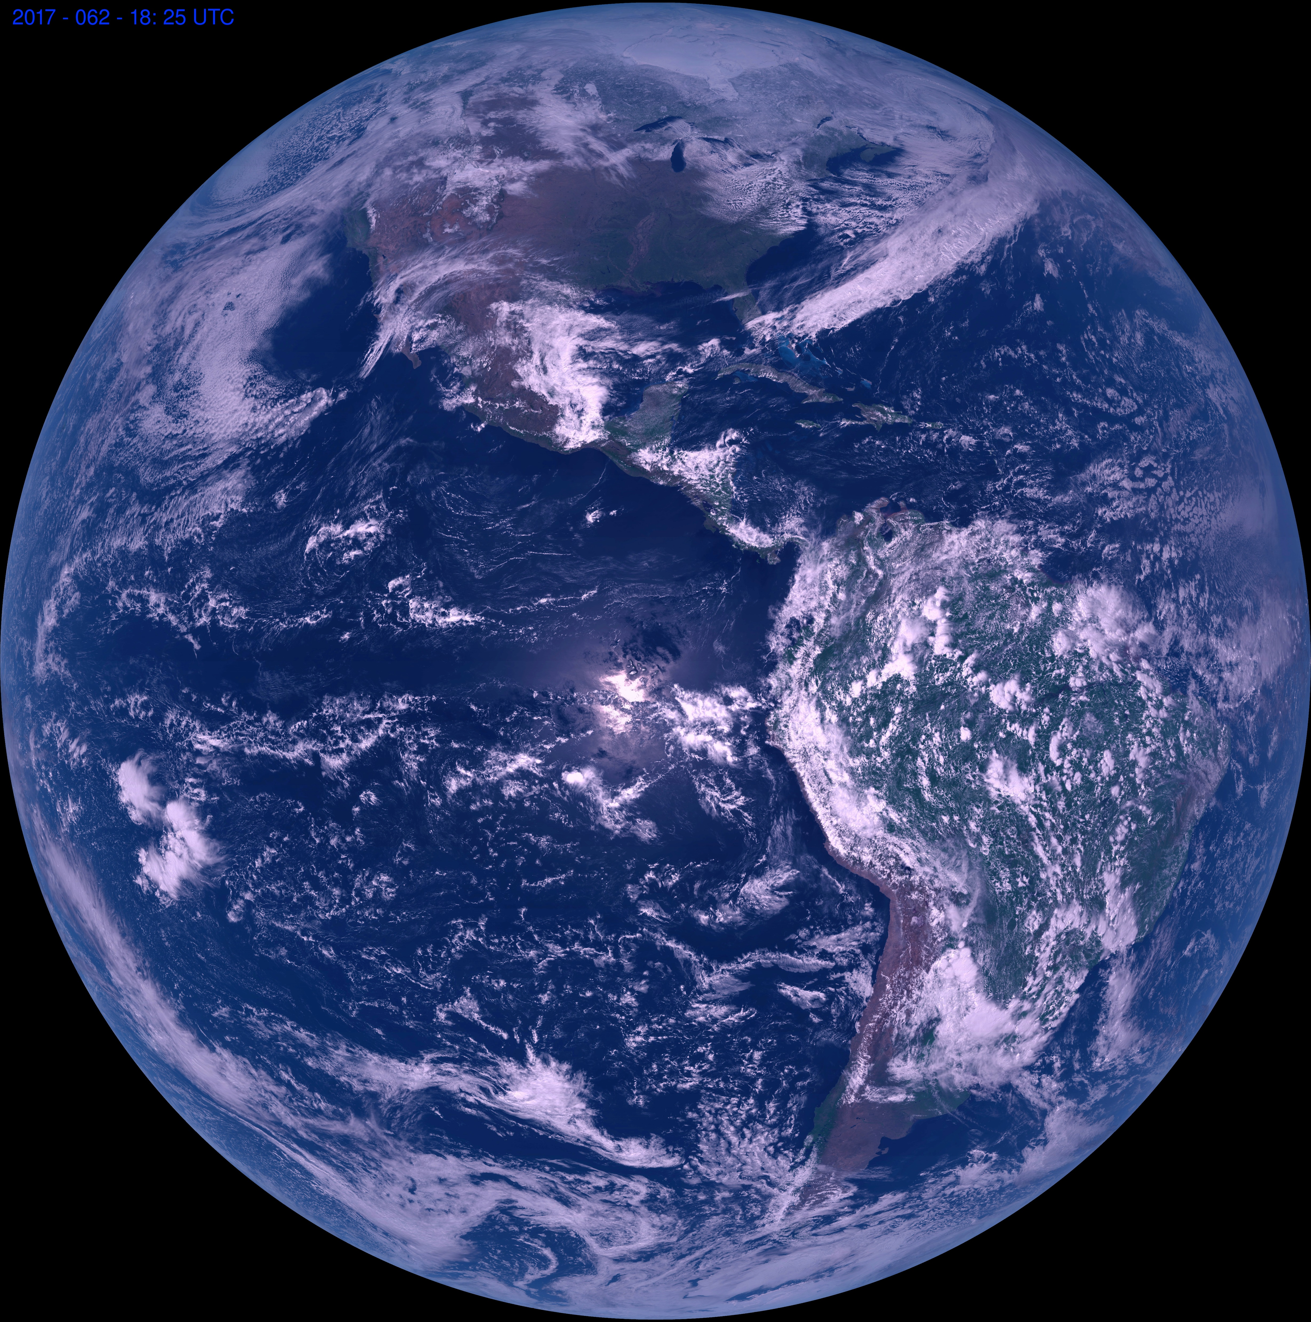
Preparation for use of the GOES-R/16 Advanced Baseline Imager (ABI)
Kaba Bah¹, Tim Schmit², Mat Gunshor¹ , Joleen Feltz¹, Hong Zhang¹, James P. Nelson III¹
¹Cooperative Institute for Meteorological Satellite Studies, University of Wisconsin - Madison, WI
²NOAA/NESDIS Center for Satellite Applications and Research - Madison, WI
These images are true and natural color RGB composites from the Advanced Baseline Imager (ABI) on board the new GOES-16. These images were generated by researchers at UW-Madison and show clouds and the Earth’s surface, including North and South America, as viewed from space for two different days. Since the ABI does not have the green band (0.55 µm), we leverage the correlation between the red (0.64 µm), blue (0.47 µm) and near-IR (0.866 µm) bands to generate a green band on the fly.
CIMSS GOES-16 ABI true color for April-03-2017, 17:15UTC
CIMSS GOES-16 ABI natural color for March-02-2017, 18:25UTC
Nate
Nate
06-04-2006 22:00Z
08-28-2005 19:45Z
These images were created by the GOES-16 imagery team using IDL.
GOES-16 ABI RGB: http://www.ssec.wisc.edu/news/articles/9836
GOES-16 official site: http://www.goes-r.gov
E-mail: kbah@ssec.wisc.edu

