Slide 1
CIMSS coral reeves before and after:
ENHANCED
NATURAL

Slide 2
NATURAL

Slide 3
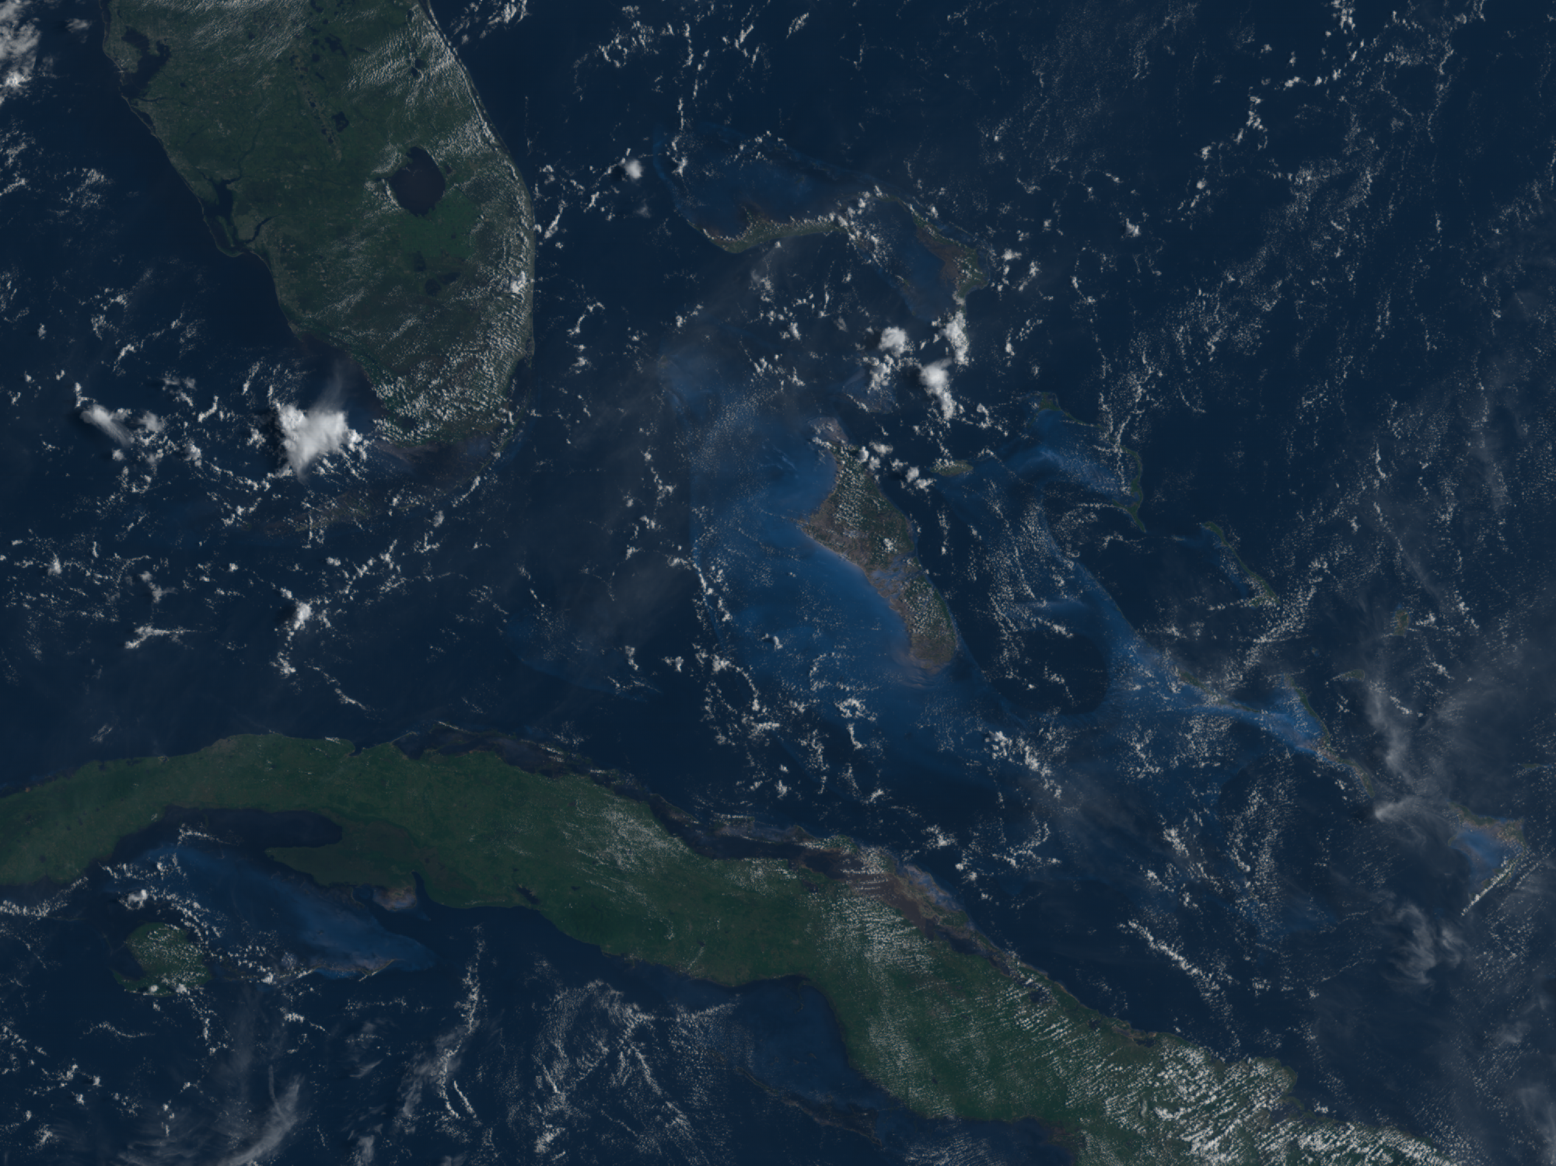

Slide 4
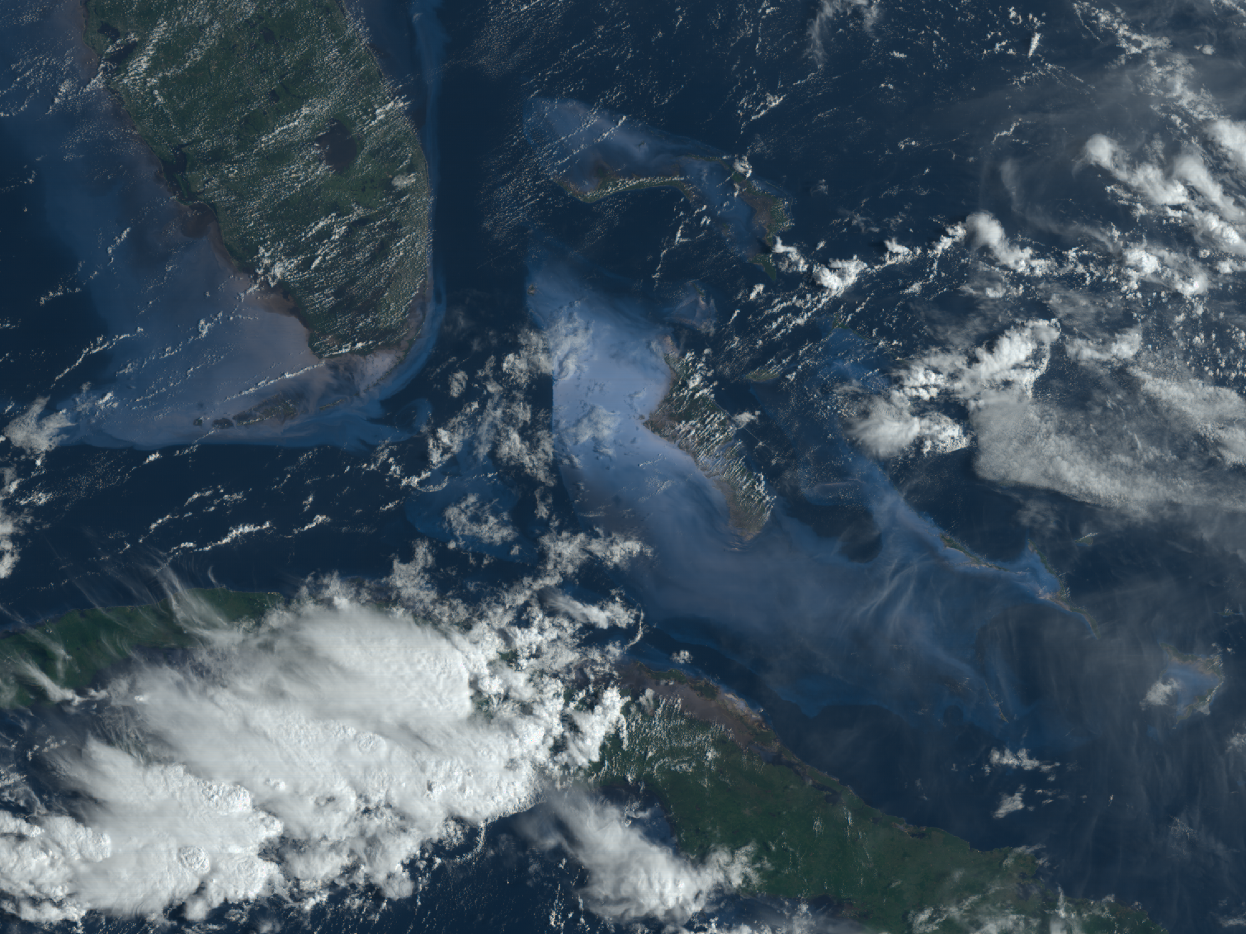

Slide 5
ENHANCED

Slide 6
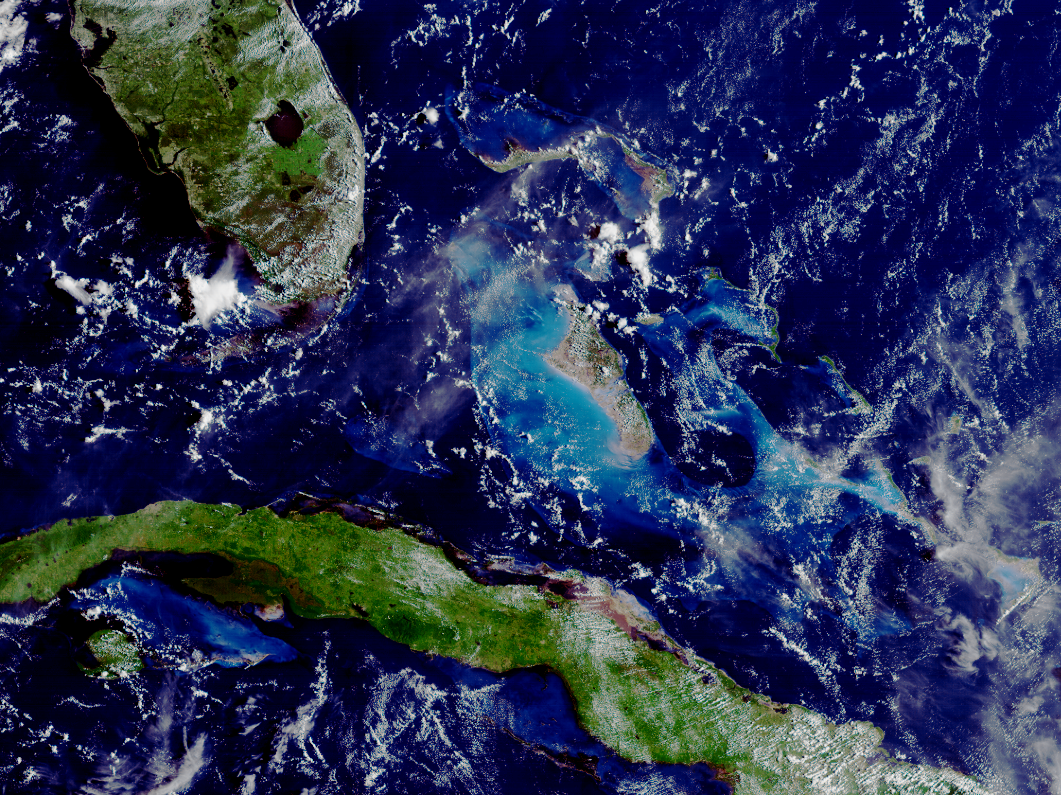

Slide 7
