Slide 1
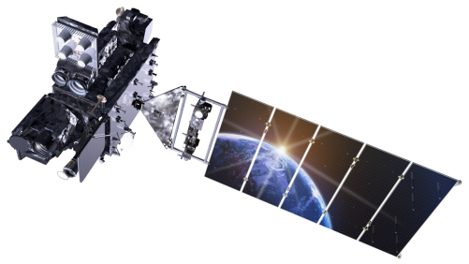
Outline
Current GOES Imager and Sounder
GOES-14/15
ABI (Advanced Baseline Imager)
Spatial
Spectral
Temporal
Summary
More information
Questions
Lockheed Martin

Slide 2
The Advanced Baseline Imager:
ABI Current
Spectral Coverage
16 bands 5 bands
Spatial resolution
0.64 μm Visible 0.5 km Approx. 1 km
Other Visible/near-IR 1.0 km n/a
Bands (>2 μm) 2 km Approx. 4 km
Spatial coverage
Full disk 4 per hour Scheduled (3 hrly)
CONUS 12 per hour ~4 per hour
Mesoscale Every 30 sec n/a
Visible (reflective bands)
On-orbit calibration Yes No

Slide 3
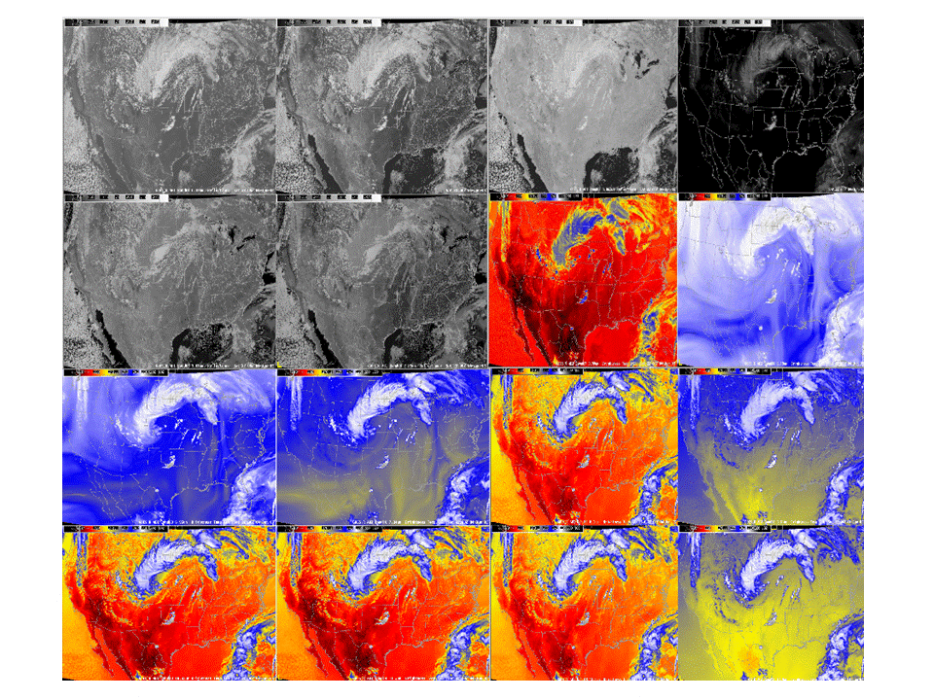
ABI band selection
0.47 μm
0.64 μm
0.86 μm
1.38 μm
1.61 μm
2.26 μm
3.9 μm
6.19 μm
6.95 μm
7.34 μm
8.5 μm
9.61 μm
10.35 μm
11.2 μm
12.3 μm
13.3 μm

Slide 4
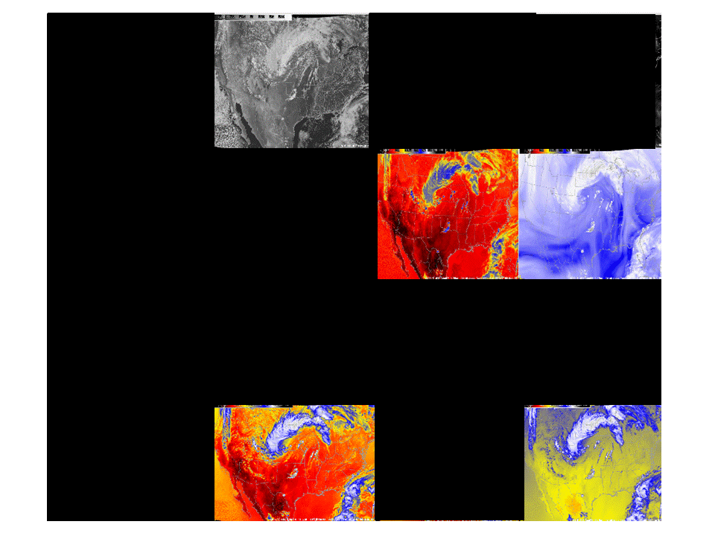
Current GOES band selection

Slide 5
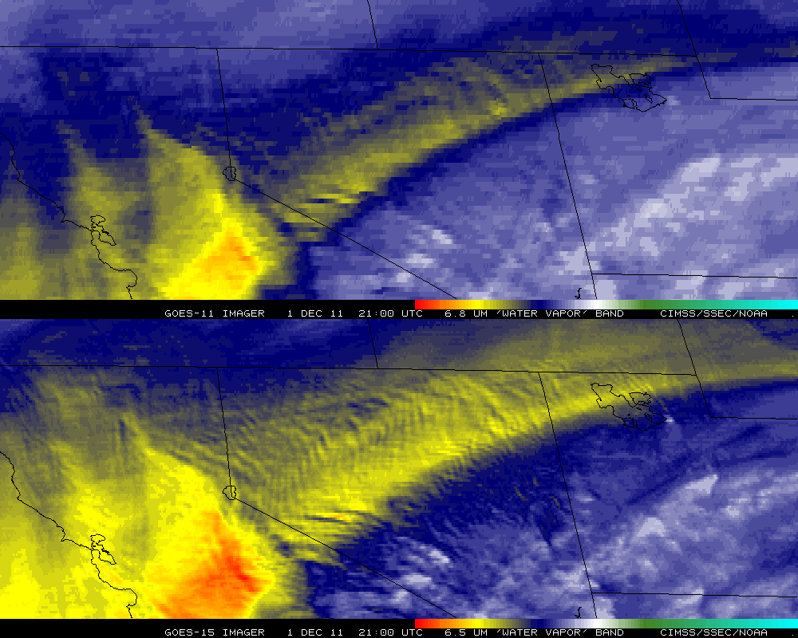
Improved GOES-15 WV imagery
GOES-11
GOES-15

Slide 6
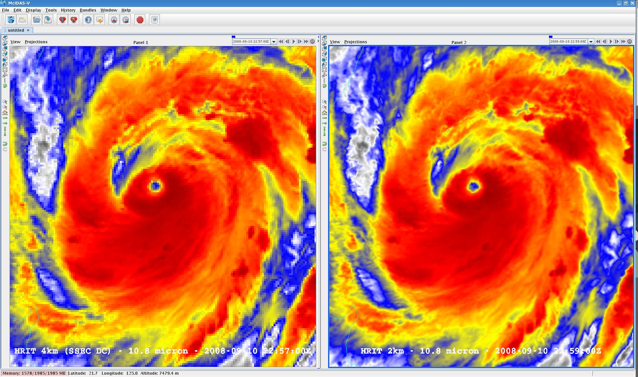
Visualization (2 km MTSAT; data from JMA)
SSEC

Slide 7
1-min imagery
Operational (GOES-13)
1-min mode (SRSOR from GOES-14)

