Slide 1
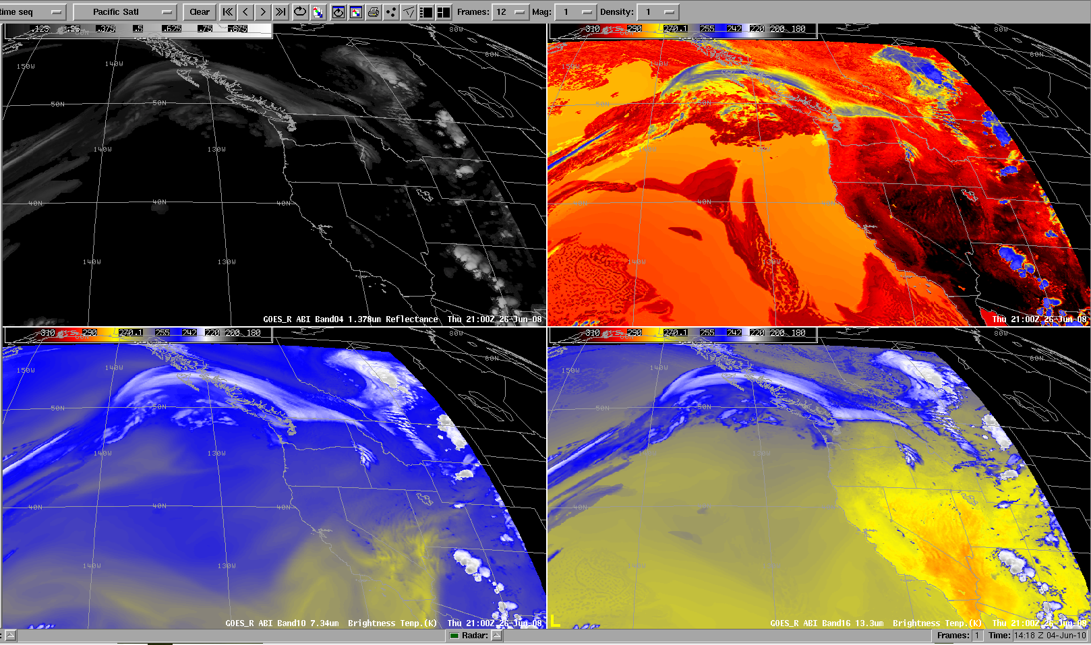
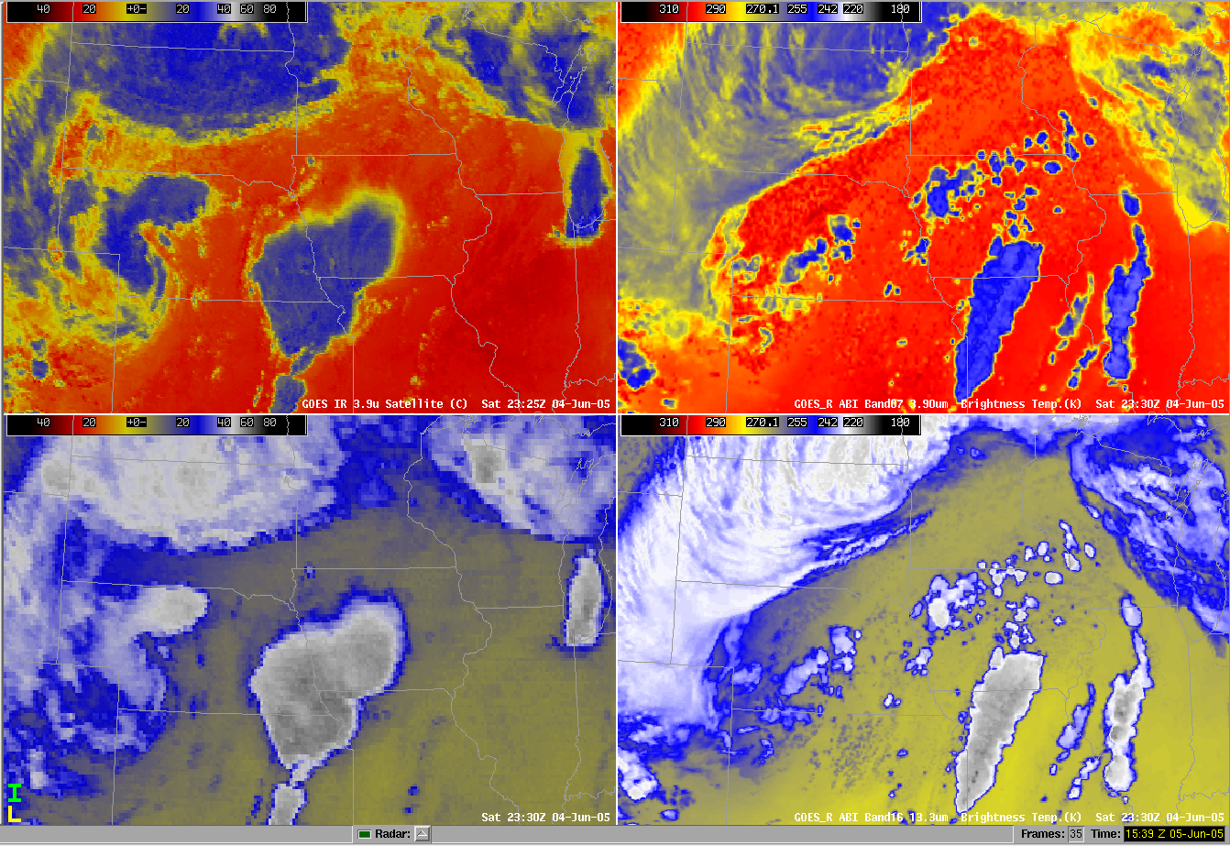
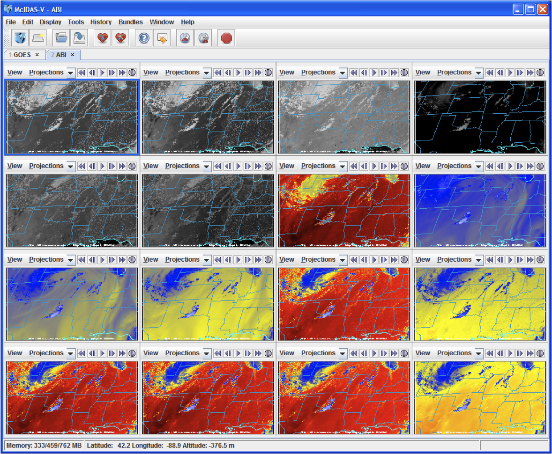
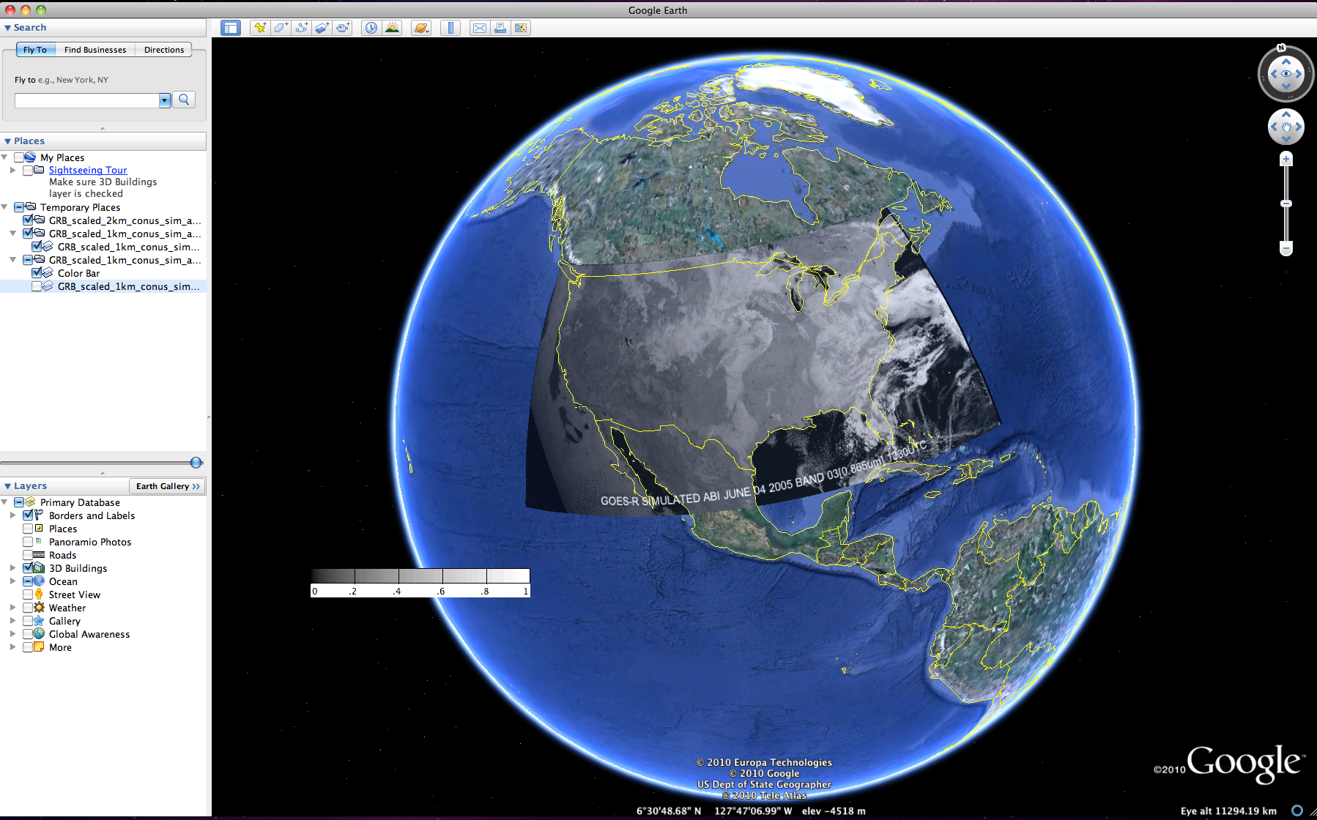
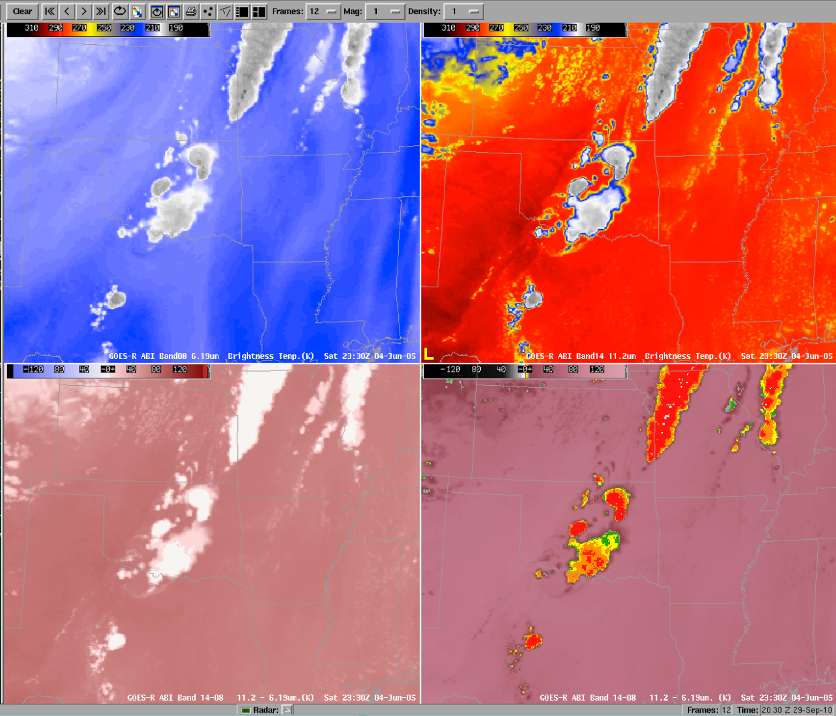
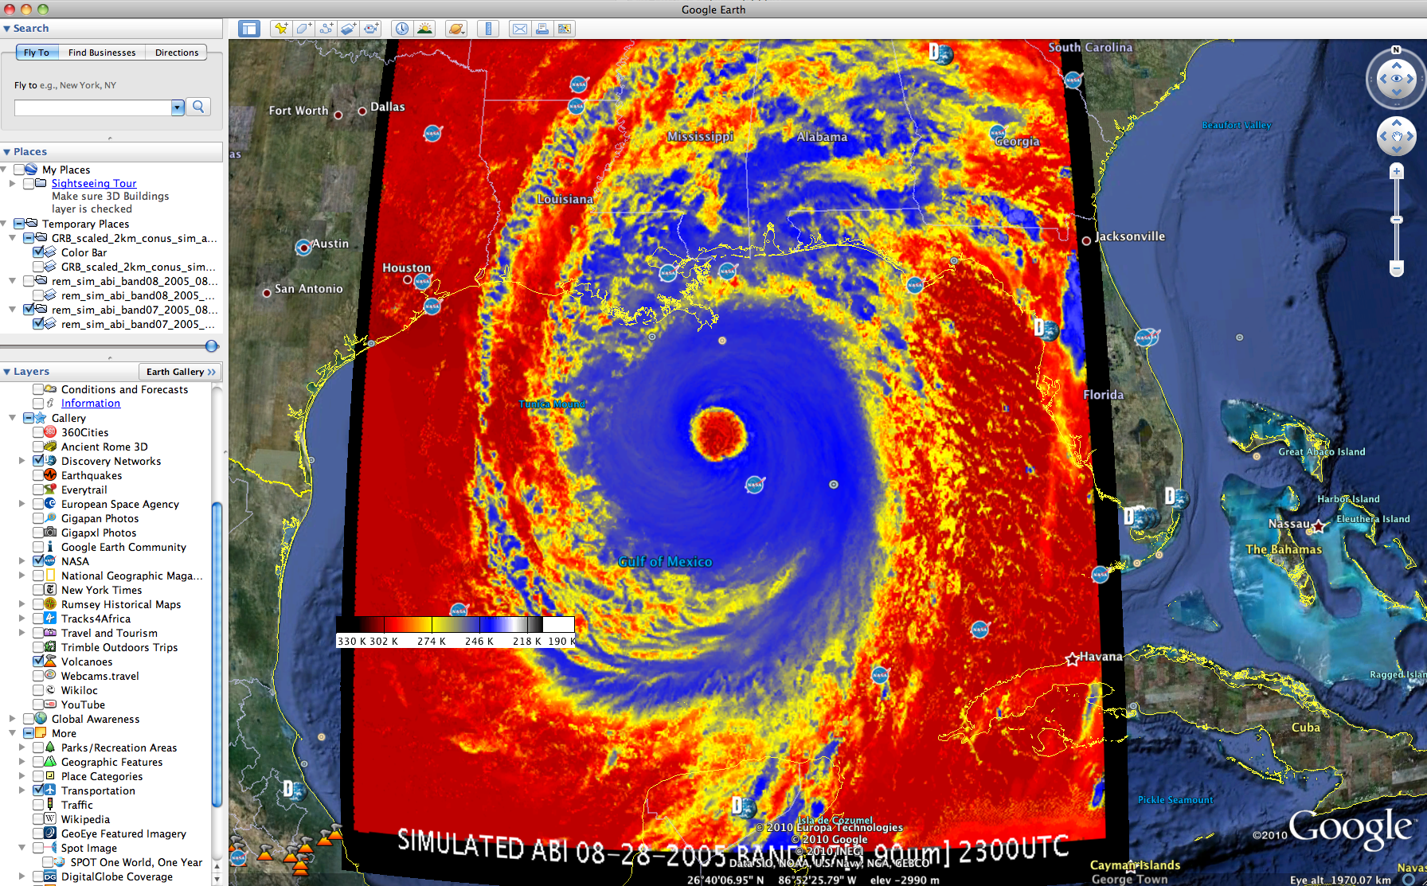
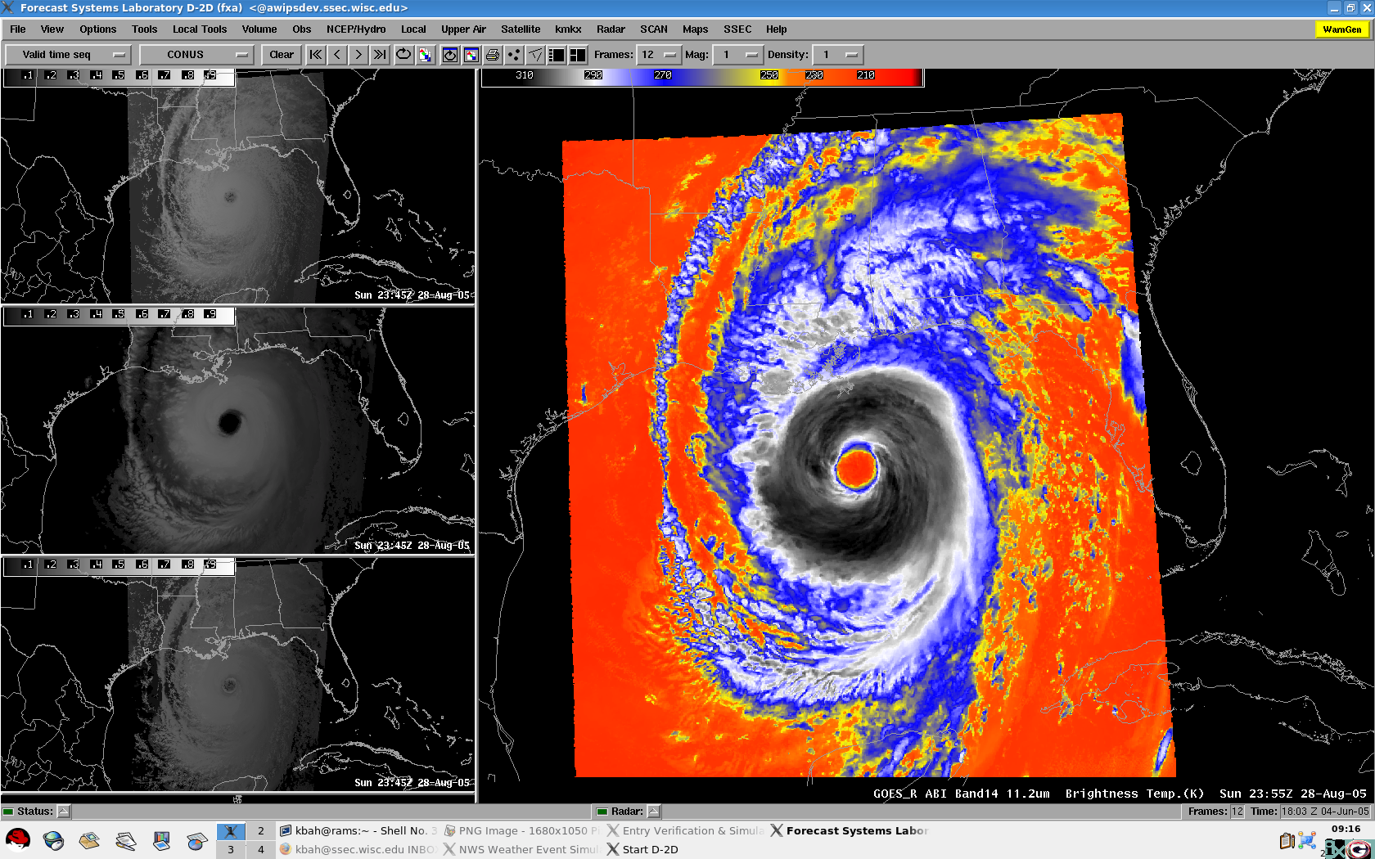
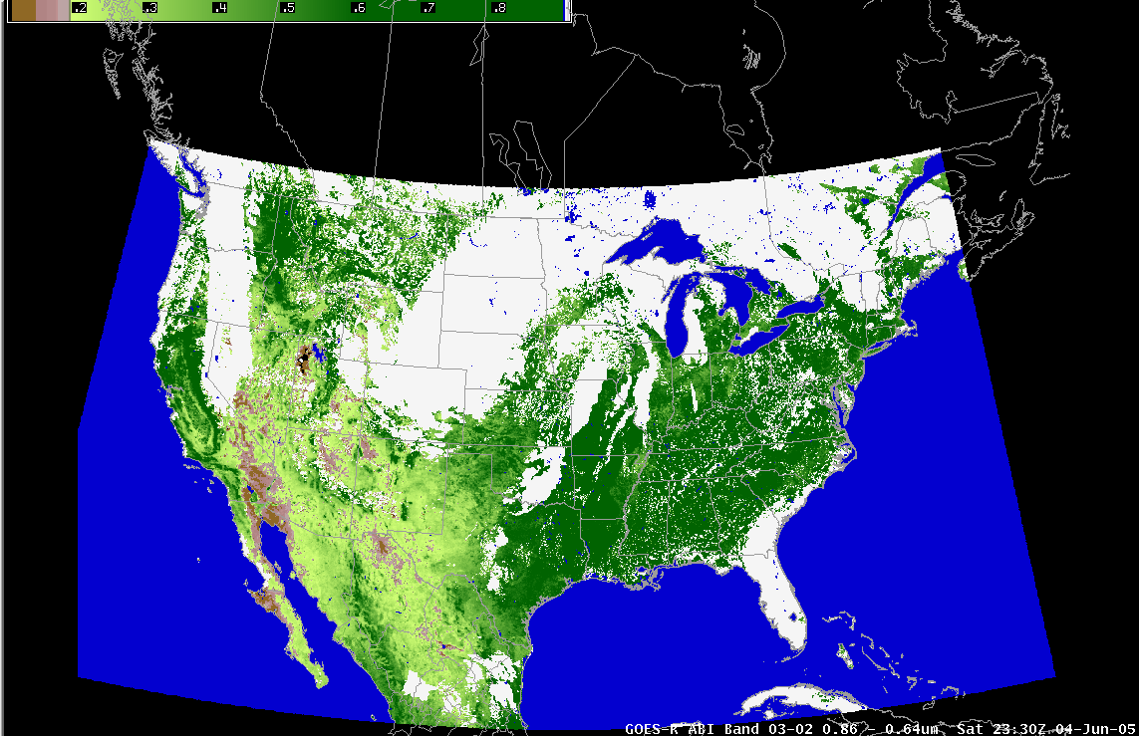
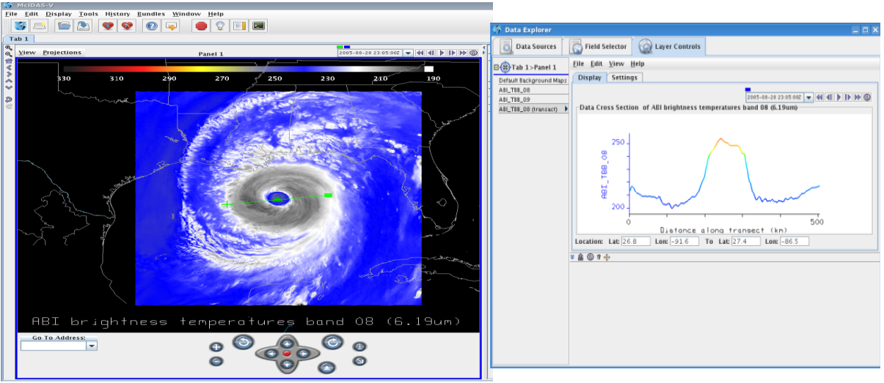
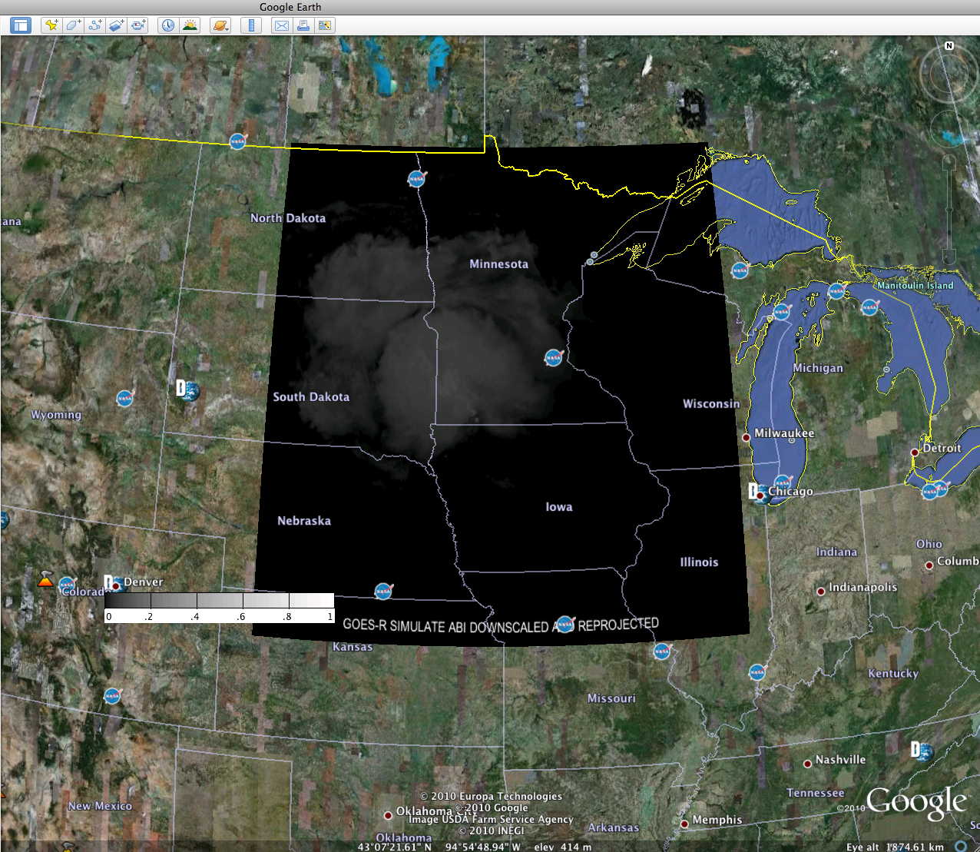
Preparation for use of the GOES-R Advanced Baseline Imager (ABI)
James Gurka², Kaba Bah¹, Tim Schmit², Tom Achtor¹,Justin Sieglaff¹, Jordan Gerth¹, Marcia Cronce³ , Joleen Feltz¹, Gary Wade², Jason Otkin¹
¹Cooperative Institute for Meteorological Satellite Studies, University of Wisconsin - Madison, WI
²NOAA/NESDIS Center for Satellite Applications and Research - Madison, WI, ³NWS Milwaukee/Sullivan- WI
The capabilities of the Advanced Baseline Imager (ABI) that will be on board the GOES-R satellite are being demonstrated by using AWIPS, McIDAS-V and Google earth to visualize and analyze simulated GOES-R ABI data. These simulated images were created by the GOES-R Algorithm Working Group (AWG) who used super computers to run high resolution numerical models, which were then input into the Cooperative Institute for Meteorological Satellite Studies (CIMSS) advanced radiative transfer models
Visualizing and analyzing different simulated GOES-R ABI cases in AWIPSI
Visualizing and Analyzing different simulated GOES-R ABI cases in McIDAS-V and Google earth
McIDAS-V
Google Earth
West Projection simulation of the ABI showing the pacific projection at 137°..
Comparing GOES-12 to simulated GOES-R spatial resolution for band 7 (3.90um) and band 16 (13.3um).
CONUS simulation of the 16 ABI bands displayed
In McIDAS-V for the June-05-2005 storm outbreak.
Band 03 (0.865um) (Daytime “Veggie” band) for June 05th 2005 at 13:30UTC, displayed in Google earth as a kmz file .
Band 04(1.378um) (Daytime “Cirrus” band) for 4th June 2005 at 22:00UTC. Detects very thin cirrus clouds during the day.
Band 08(6.19um) and band 14(11.2um) for 4th June 2005 at 23:30UTC. shown in the upper panels. Their full and and focused range band differences are shown at the bottom).
ABI water vapor bands highlighting the added layer information by plotting brightness temperature.
Band 08 (3.90um) (Shortwave IR window band) for June 04th 2005 at 22:00UTC, showing hurricane Katrina in the golf .
06-04-2006 22:00Z
Hurricane Katrina simulation of the ABI approaching the shore on August-29-2005.
NDVI computed using reflectance's from simulated ABI band 03 (0.865um) and band 02 (0.64um).
Data transect of simulated ABI band 08 (6.19um) through the eye of hurricane Katrina.
Band 01 (064um) (Daytime “blue” band) for June 04th 2005 at 10:00UTC, re projected in the Fix Grid Format and displayed in Google earth.
08-28-2005 19:45Z
All the above shown images were created by using McIDAS-V, AWIPS and Google earth.
For more information visit the websites below.
GOES-R ABI: http://cimss.ssec.wisc.edu/goes_r/proving-ground.html
McIDAS-V : http://www.ssec.wisc.edu/mcidas
AWIPS : Advance Weather Interactive Processing system
MIDAS-V: Man Computer Interactive Data Access System
E-mail: kbah@ssec.wisc.edu

