Slide 1
CIMSS/ASPB Metrics: Real-time ingest of CIMSS proxy RGB Air Mass product with quantitative overlay within NCWCP AWIPS environment and forecaster training sessions.
Brad Pierce & Kaba Bah
(CIMSS/UW-Madison)
AWIPSII VSP Meeting
College Park, MD
Sept- 15-18- 2014

Slide 2
Content
Introduction
Grib2 AWIPSII baseline plugin approach
Grib2 code path and sample images
New GOES-R ABI discipline 3 parameters
Ground based continuous integration approach
RaFTR-CIMSS-SIM samples through Joe Zajic
Summary

Slide 3
Introduction.
CIMSS/ASPB Metrics: Real-time ingest of CIMSS proxy RGB Air Mass product with quantitative overlay within NCWCP AWIPS environment and forecaster training sessions.
[1]: Display gridded products within AWIPS II via conversion to grib2 using the AWIPS II baseline plugin “unified grid de-coder”.
[2]: Leverage Joe Zajic’s support of "Continuous Integration" instance of AWIPS-II that is continuously ingesting and displaying the RaFTR-CIMSS-SIM data.

Slide 4
Grib2 AWIPSII baseline plugin approach
Approach #1: Display gridded products within AWIPS II via conversion to grib2 using the AWIPS II baseline plugin “unified grid de-coder”
Software (Code path) :
IDL routine to extract binary synthetic brightness temperatures from archived netcdf CRTM output files
Fortran routine to convert binary synthetic brightness temperatures to grib2 using standard Grib2 libraries (issues with JPEG2000 data representation)
AWIPS-II XML scripts to unscale (see issues) and rescale grib2 synthetic brightness temperatures for RGB guns
AWIPS-II GUI developed to allow interactive scaling of RGB guns
We used Grib2 Simulated Brightness Temperature for GOES 11 band 2,3,4,5 as test placeholders for the ABI bands that we are testing.

Slide 5
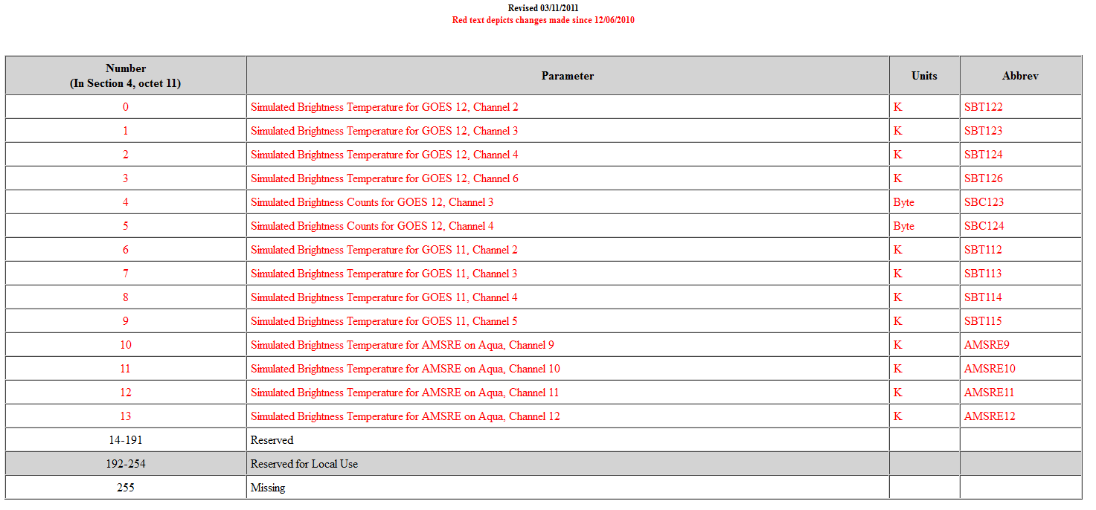
Previous Grib2 Capabilities for forecast satellite imagery
GRIB2 - TABLE 4.2-3-192
PARAMETERS FOR DISCIPLINE 3 CATEGORY 192
(Space products, Forecast Satellite Imagery category)
(http://www.nco.ncep.noaa.gov/pmb/docs/grib2/grib2_table4-2-3-192.shtml)

Slide 6
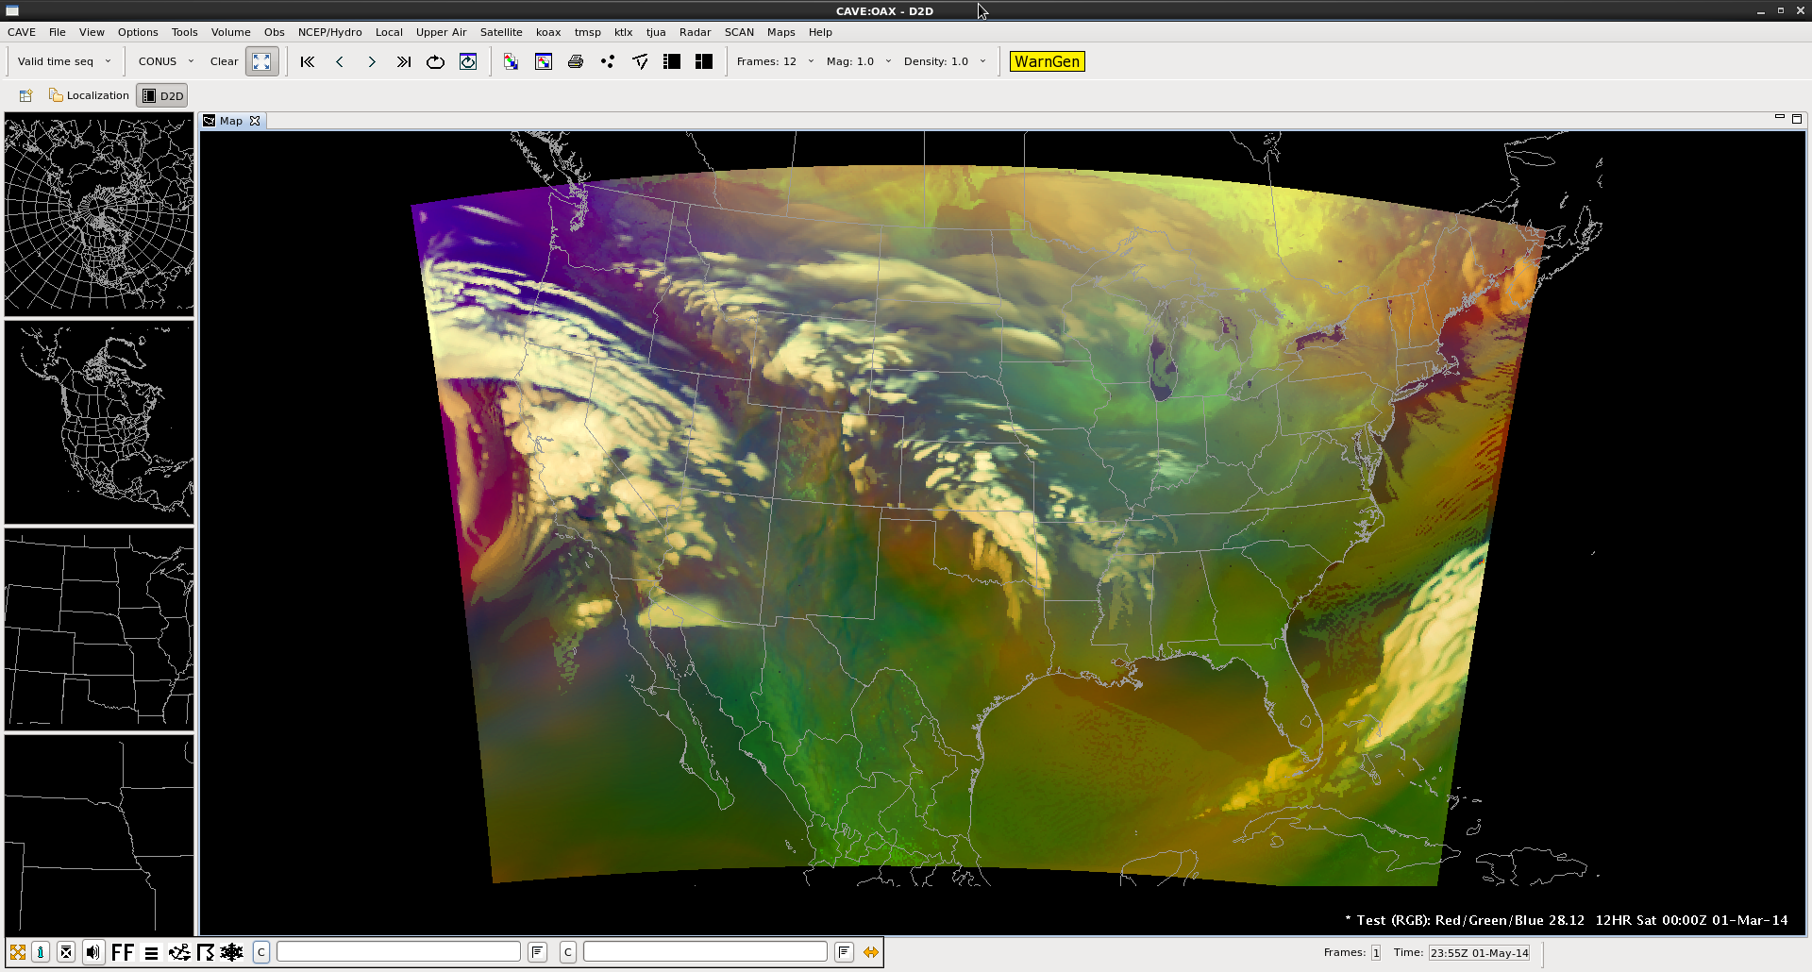
Sample images:
Results 00Z March 01, 2014

Slide 7
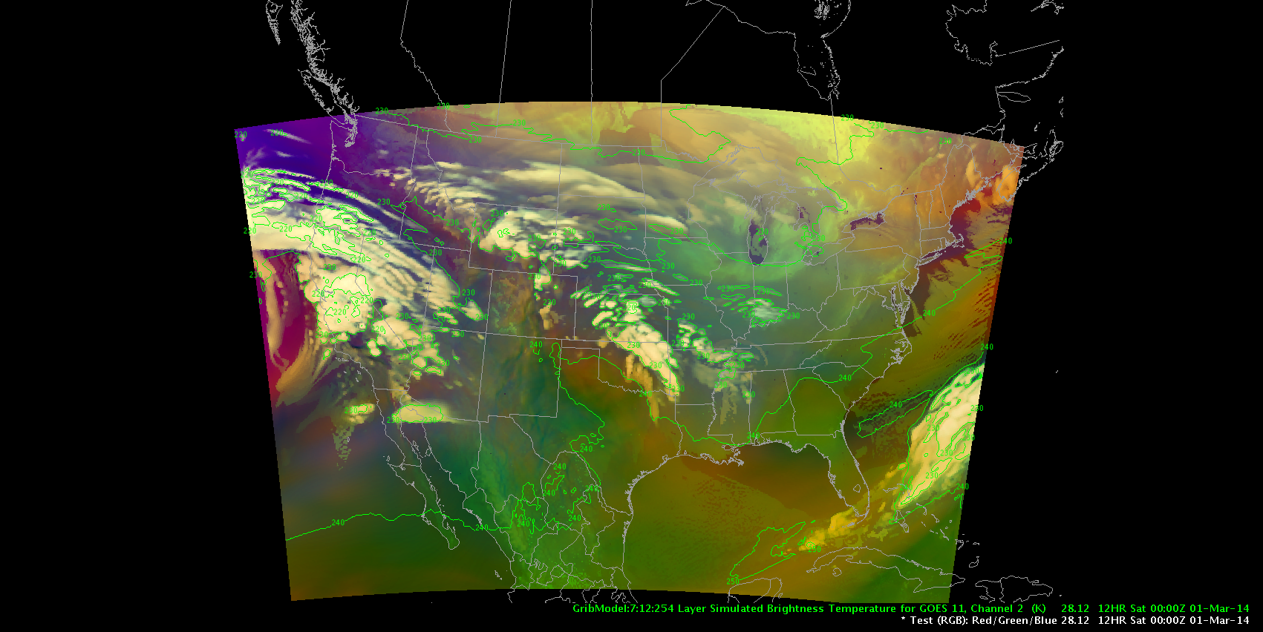
Results 00Z March 01, 2014:
(with ABI band 08 low density contour overlay)

Slide 8
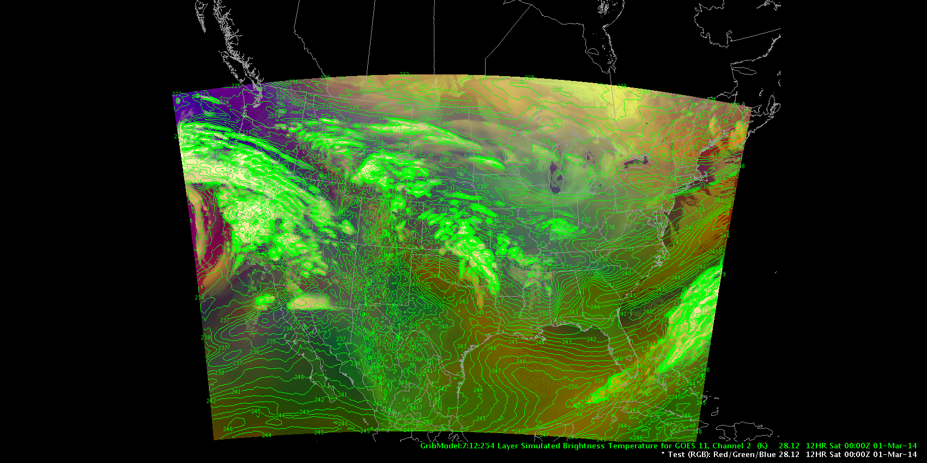
Results 00Z March 01, 2014:
(with ABI band 08 high density contour overlay)
Need to develop capabilities to better control contour levels within AWIPS-II so we can contour TB>240K (driest air)

Slide 9
Resolution:
New GOES-R parameters for Discipline 3 (Space Products) category 192 (forecast satellite imagery category) are now available for ABI through NCEP and we will be testing these next.
GOES 16 and 17 brightness temperature grib2 variables should now have valid ranges for the ABI bands
No need to scale ABI bands prior to putting them into grib2
AWIPS-II XML scripts do not have to un-scale ABI bands prior to generation of RGB guns
Now working on resolving how to get updated grib2 table into AWIPS-II (or local machine for testing)
Next:
Will use the "Analysis or forecast on a horizontal layer at a point in time for simulated (synthetic) satellite data" (http://www.nco.ncep.noaa.gov/pmb/docs/grib2/grib2_temp4-32.shtml) which has information regarding "Scale factor of central wave number of bands".

Slide 10
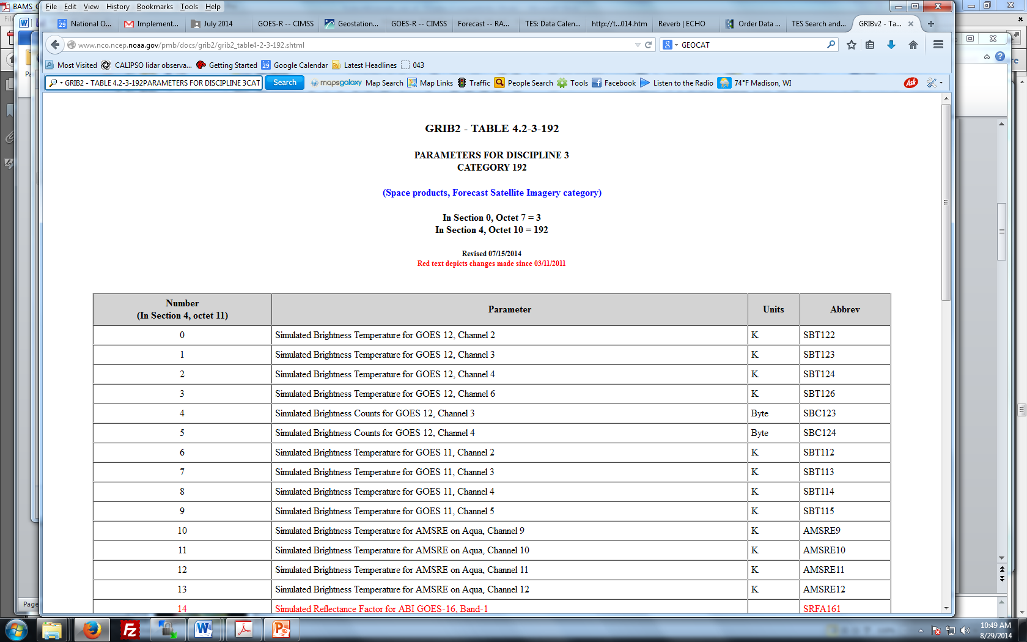
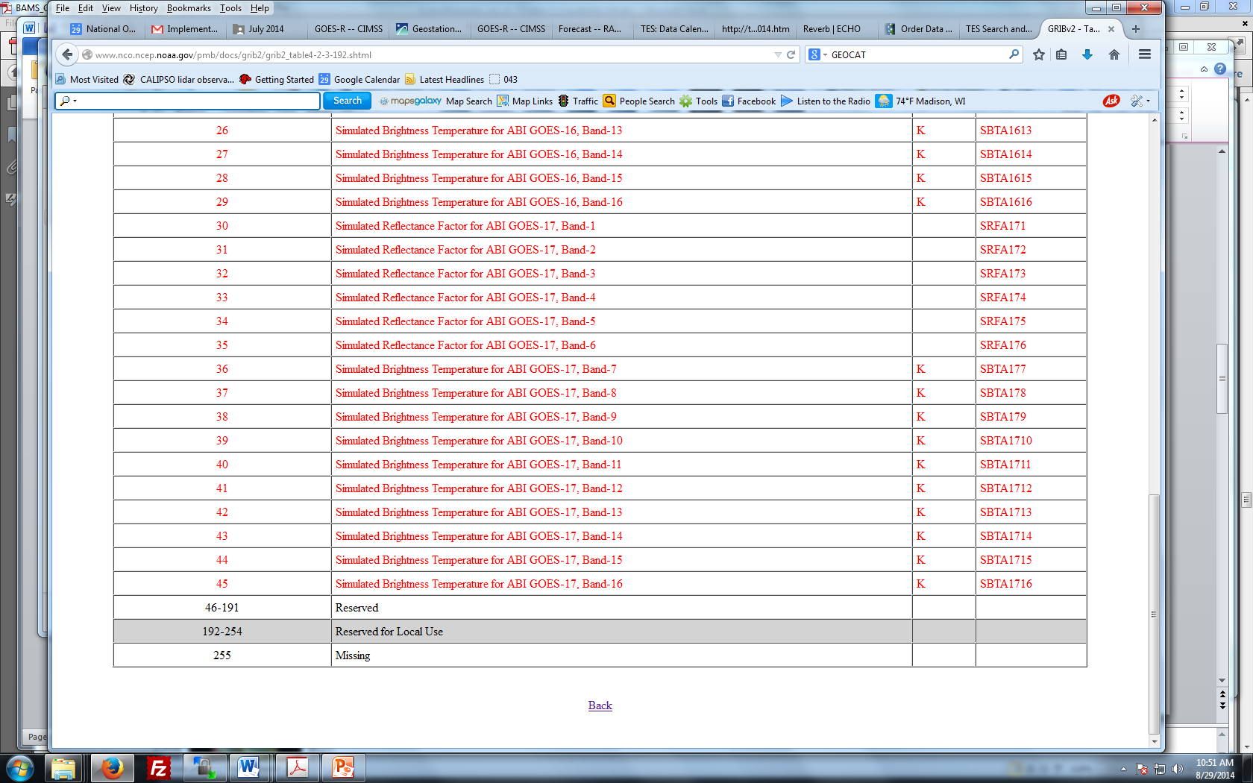
New GOES-R ABI discipline 3 parameters
New Grib2 Capabilities for forecast satellite imagery as of 07/15/2014
For visible/NIR Bands 1-6 the unit is "none" (range 0-1) and the parameter is "reflectance factor"
For IR Bands 7-16 the unit is "Kelvin" (range 180-400K with the low end for space and high end to account for band 7 fire detection) and the parameter is "brightness temperature"
All 16 of these parameters for ABI East (GOES-16) and ABI West (GOES-17)

Slide 11
New Grib2 Capabilities for forecast satellite imagery as of 07/15/2014
For visible/NIR Bands 1-6 the unit is "none" (range 0-1) and the parameter is "reflectance factor"
For IR Bands 7-16 the unit is "Kelvin" (range 180-400K with the low end for space and high end to account for band 7 fire detection) and the parameter is "brightness temperature"
All 16 of these parameters for ABI East (GOES-16) and ABI West (GOES-17)

Slide 12
Ground based continuous integration approach
Alternative approach for initial demonstration is to leverage Joe Zajic’s support of "Continuous Integration" instance of AWIPS-II that is continuously ingesting and displaying the RaFTR-CIMSS-SIM data.
NWS (Eric Guillot) will be using the data on a daily basis to develop AWIPS-II configurations for the various mission threads.

Slide 13
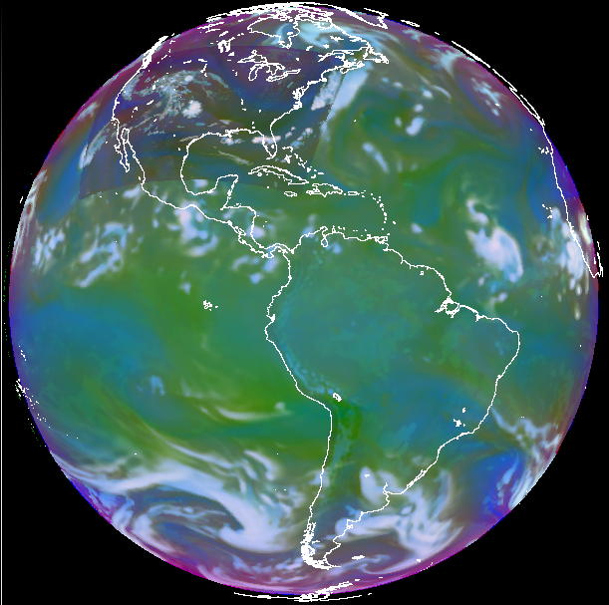
Airmass RGB image using RaFTR-CIMSS-SIM data (From Joe Zajic)
Airmass RGB
First Try
20140729 1800Z
R: 6.95um-7.34um
G: 9.61um-10.35um
B: 1/(6.95um)
Each input scaled to it’s range

Slide 14
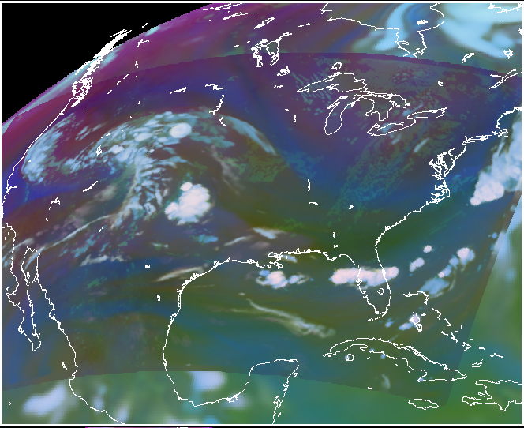
Airmass RGB image using RaFTR-CIMSS-SIM data (From Joe Zajic)
Airmass RGB
First Try
CONUS Detail

Slide 15
Airmass RGB image using RaFTR-CIMSS-SIM data (From Joe Zajic)
Airmass RGB
First Try
20140729 1800Z
R: 6.95um-7.34um
G: 9.61um-10.35um
B: 1/(6.95um)
Each input scaled to it’s range

Slide 16
Airmass RGB image using RaFTR-CIMSS-SIM data (From Joe Zajic)
Airmass RGB
First Try
CONUS Detail

Slide 17
Summary
Tested and verified methods to get sample simulated GOES-R ABI RGB data into AWIPSII.
Display gridded products within AWIPS II via conversion to grib2 using the AWIPS II baseline plugin “unified grid de-coder”.
Leverage Joe Zajic’s support of "Continuous Integration" instance of AWIPS-II that is continuously ingesting and displaying the RaFTR-CIMSS-SIM data.

