Slide 1
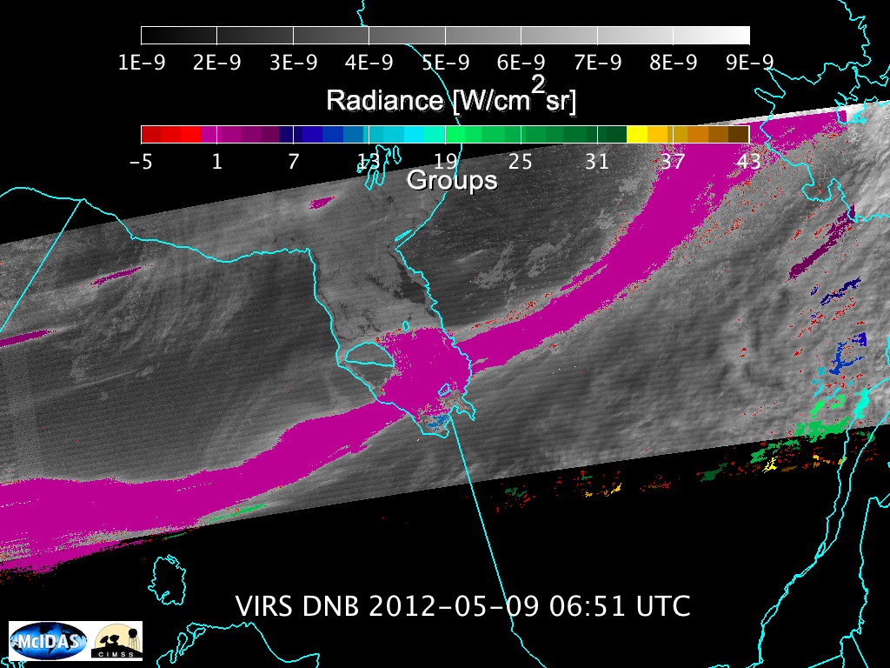
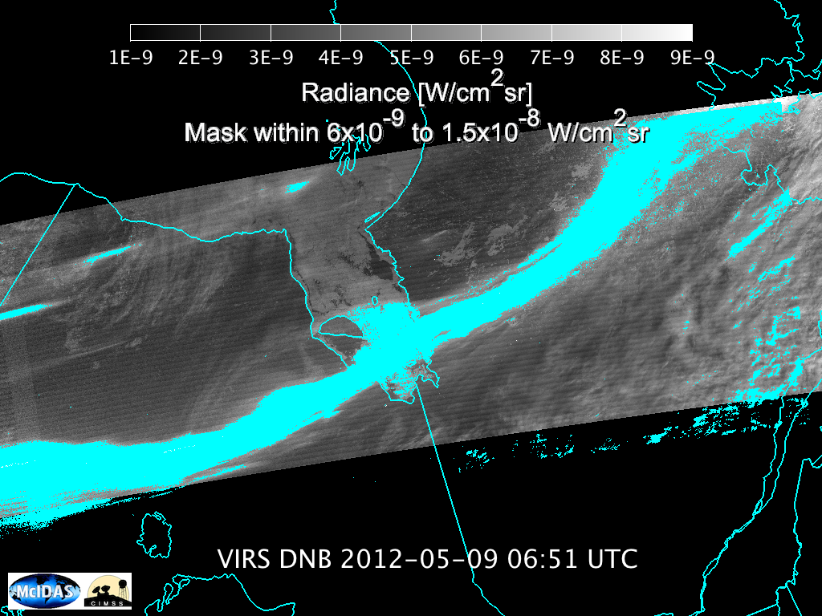
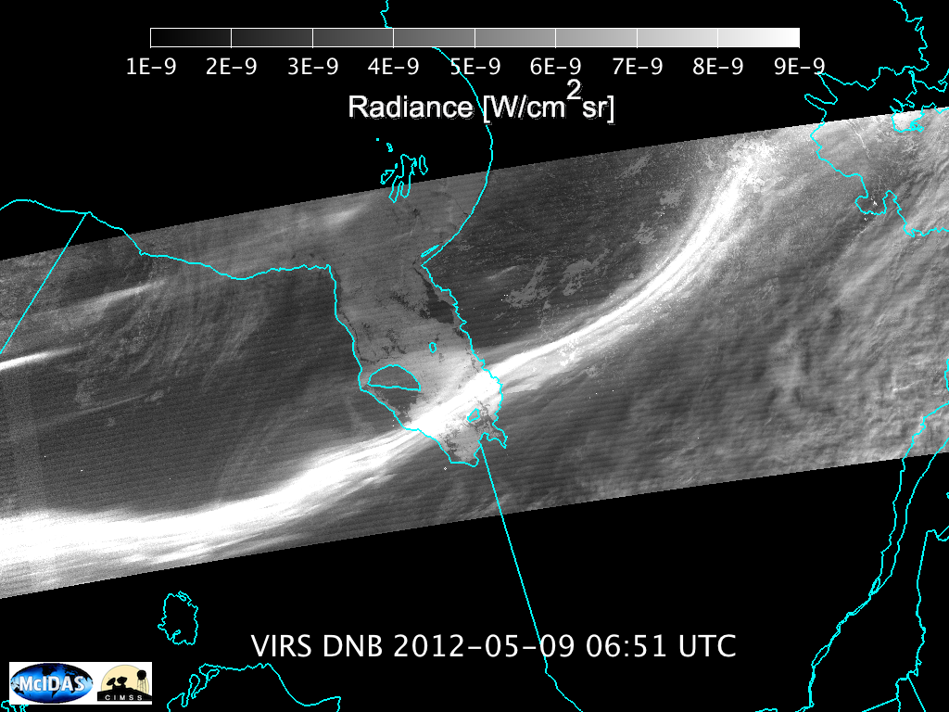
Eric Tobias: UW-Madison AOS Undergraduate Student
Supervisor: Steve Ackerman

Slide 2
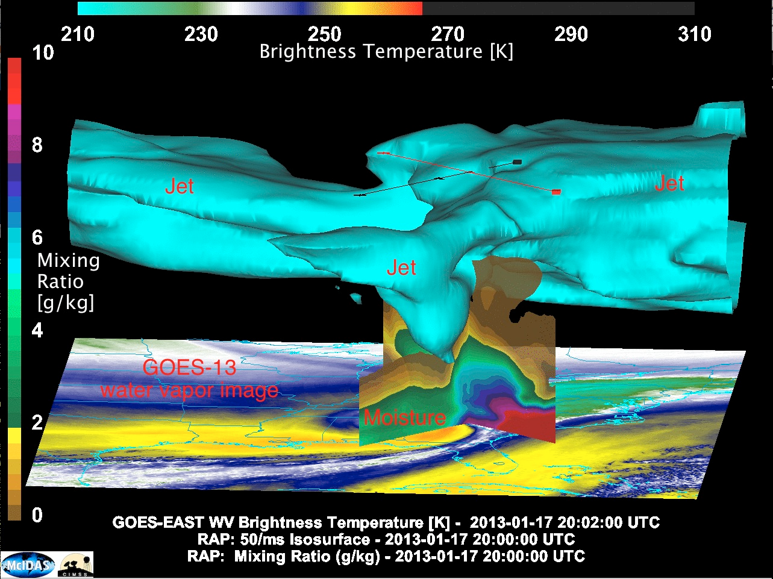
CIMSS Blog (Author: Scott Bachmeier)http://cimss.ssec.wisc.edu/goes/blog/archives/12149

Slide 4
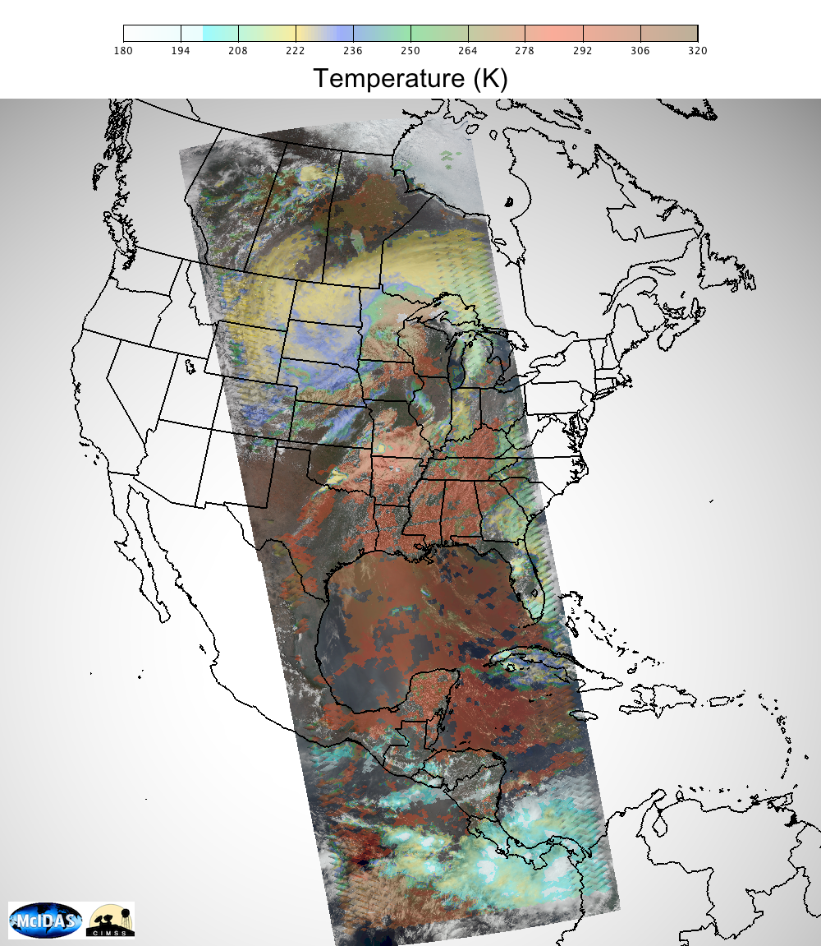
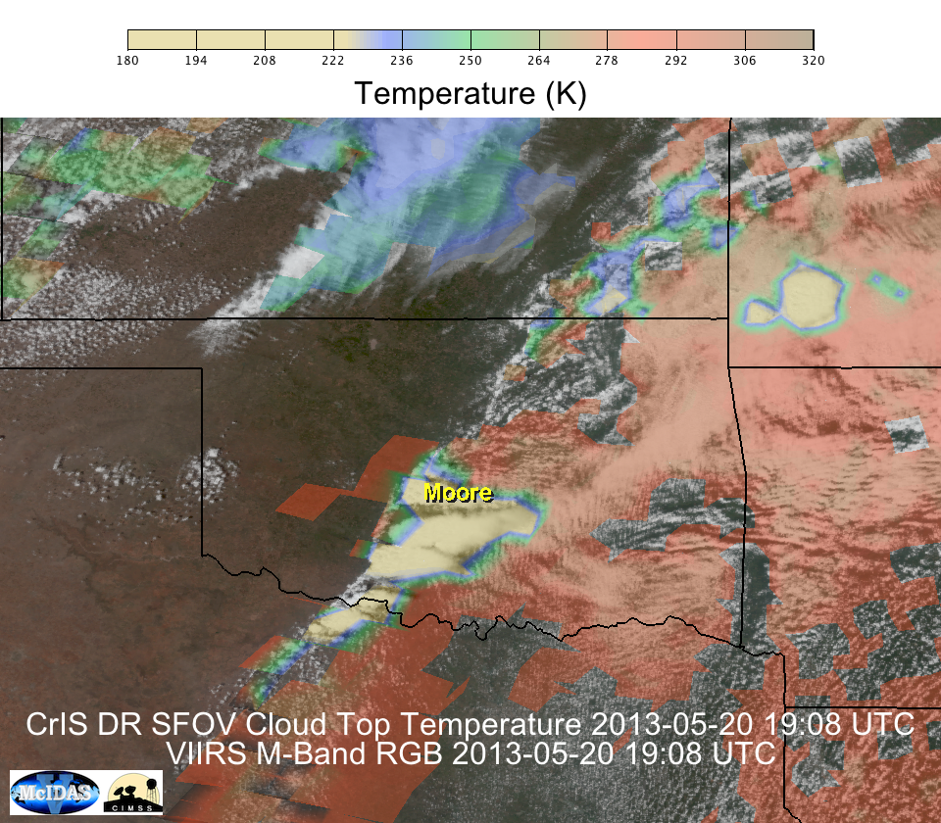
Suomi NPP CrIS RGB 18:59-1916 UTC and UW-SFOV Retrieval of Cloud Top Temperature

Slide 5
