Slide 1
Notes:
----- Meeting Notes (1/3/14 13:13) -----
This is the agenda, I won't go into detail. We may delay discussion of inquiries until the March meeting due to the number of other topics which should be discussed at this teleconference as well as the concern that we may not be holding a web conference for the next meeting, so I want to introduce a new Progressive Resolution Disclosure Display at this meeting. UNIDATA has requested that the MAC members provide early input so that development reflects user’s needs.

Slide 2
GOES-R SDI Testing, ADDE Server Development
Funding for a development and testing of GOES-R ADDE server was to arrive at SSEC in January 2014.
The data will be served in AREA format from the ADDE servers
Testing will determine if partial files can be obtained and converted to AREA to aid time latency requirements
1 to 1 pixel ratio will be preserved
SDIs support notification which provide a faster alternative to a schedule if firewalls support this type of notification

Slide 3
Suomi-NPP data in McIDAS-X
The ability to display raw (native projection) data is dependent on funding.
Updates, does McIDAS Administration intend to resubmit for funding?
Questions?

Slide 4
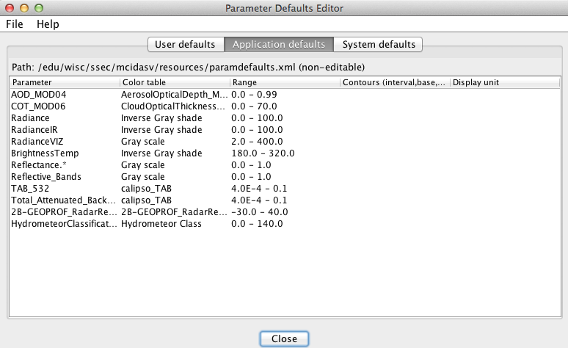
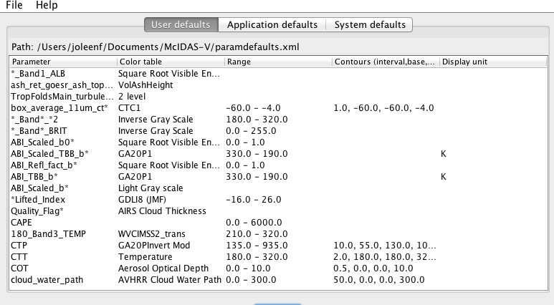
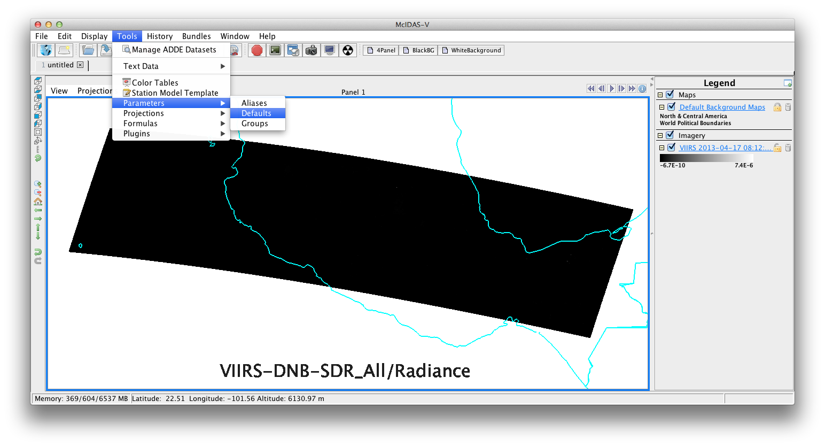
Parameter Defaults Background
Application Defaults – Preset
User Defaults – Unique for each user
Notes:
There are user defaults, which is set by each user. We are not discussing this.
Application Defaults are set by the McIDAS programming staff. I am not sure when some of these apply. I am not sure I have seen a RadianceVIZ shortname. The question is whether or not some of these defaults need adjustment.

Slide 5
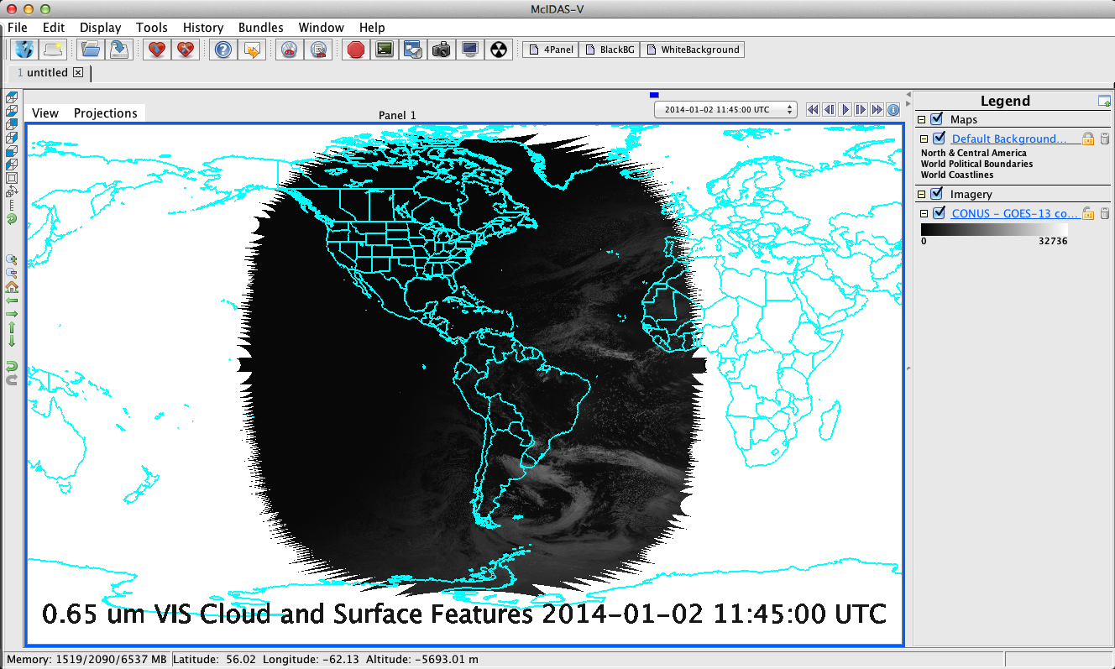
Parameter Defaults
Imagery Application Defaults may need modification
If any imagery is not displaying well, please post a complaint or suggestion to the forum.
Notes:
Generally, the min/max of the displayed data will be reflected in the range of the display unless a different default is set.

Slide 6
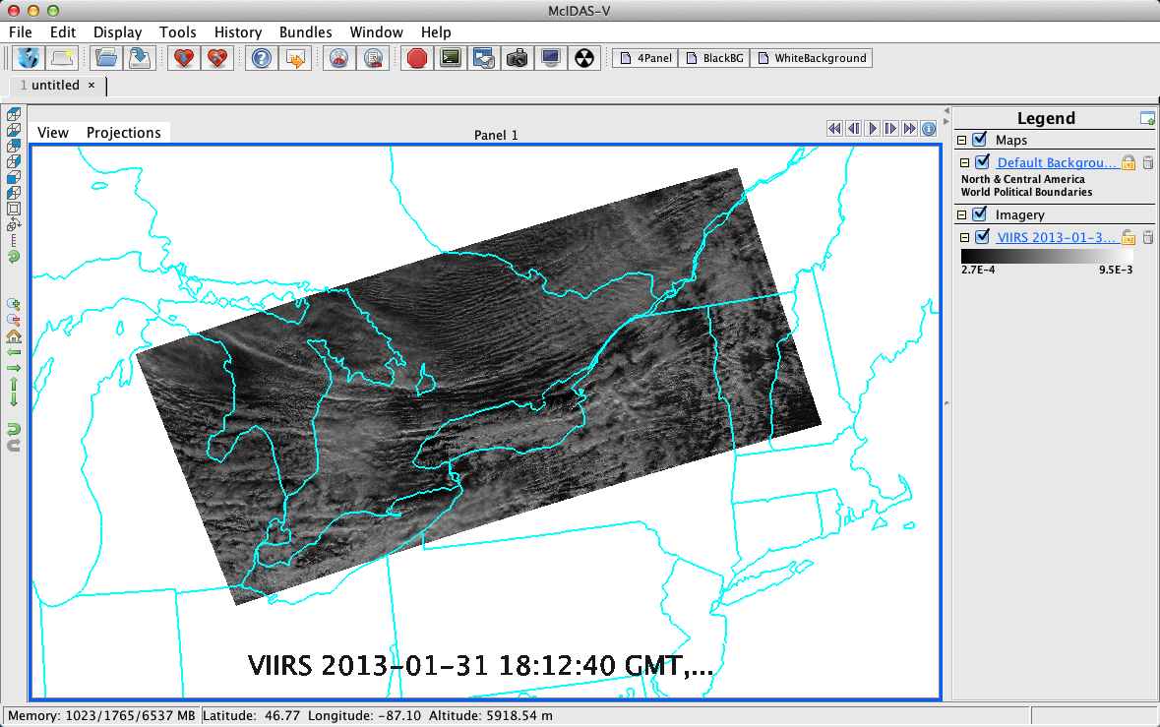
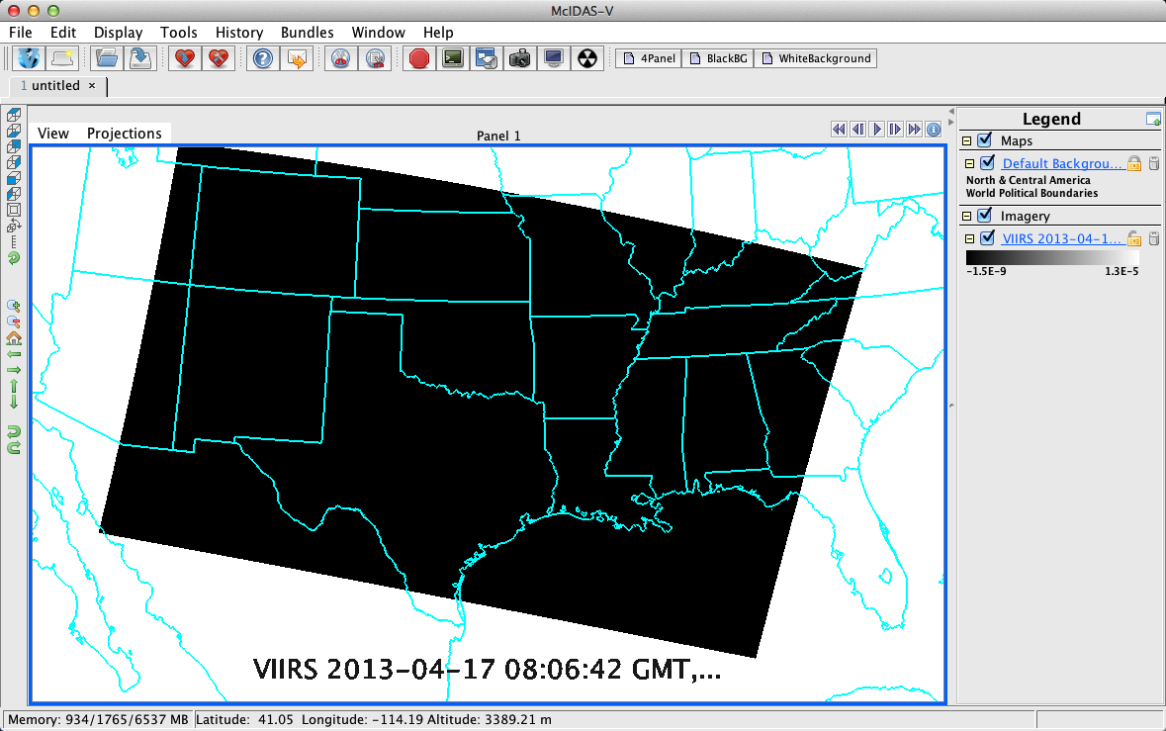
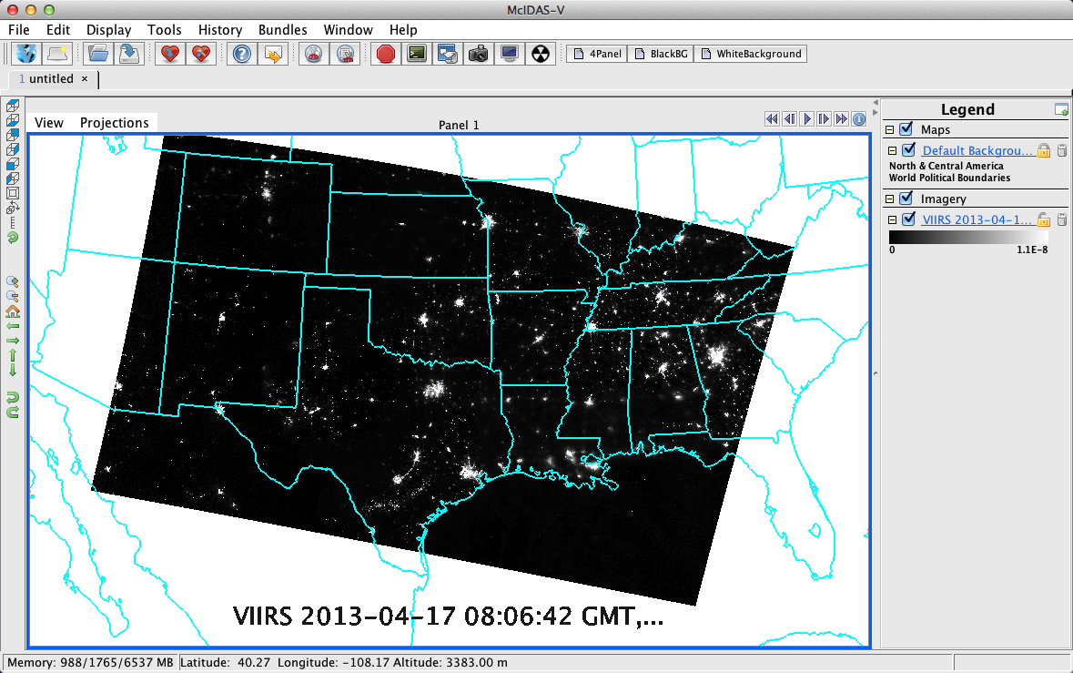
Suomi-NPP DNB? Day vs. Night Ranges
Notes:
The first image is illustrating the location of the parameter default settings in the main menu.
The default for nighttime (min and max of data) tends to be too broad to capture the scene features, but for daytime, it is relatively good.
Is there a good way to deal with this other than to rely on each user to set individual parameter defaults based on what they do most? Is that a problem?

Slide 7
Display Scales Vertical Labels CALIPSO Example

Slide 8
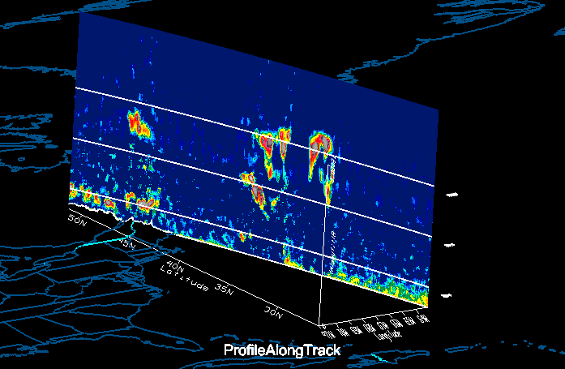
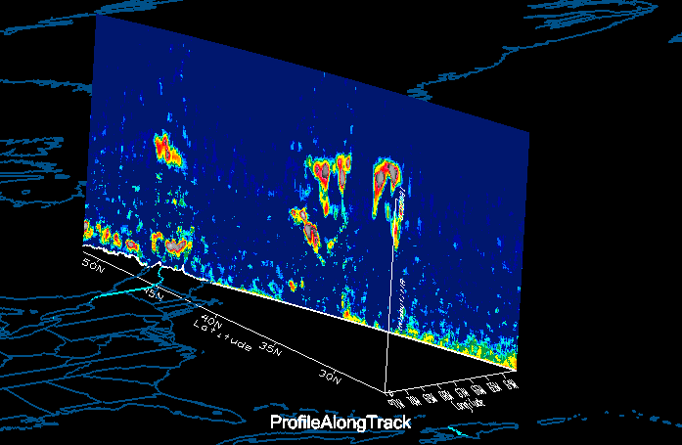
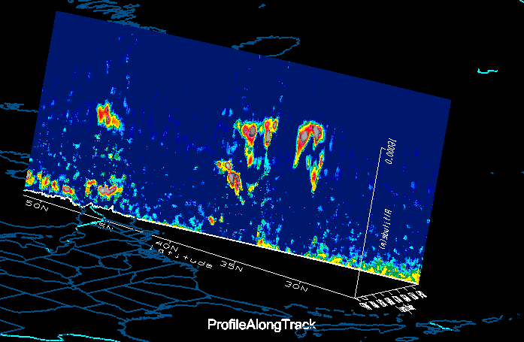
Publication Quality Graphics (#9 MAC Combined Priorities)
Notes:
Publication quality graphics: Adjustable data ranges, fonts, tick mark locations, axis labels, lat/lon labels, color bar labels on 2-D scatterplots/cross-sections/transects/histograms and within the primary 3-D display window (when applicable)
Needs (McV, IDV):
1.) Be Read what is there (Provide Control to rotate labels on vertical axis)
2.) Add Ticks for altitude labeling
3.) Ability to choose which corner of box the altitude line is displayed (provides clarity)
4.) Unfortunately a separate priority, not in the top 10, display pressure levels… (Question, McV internally converts between a standard atmosphere and pressure. Altitude it great for some displays, but pressure is ideal for most. Right now, it seems the altitude line could be labeled with a corresponding pressure, but the display is still linear. Would this be a desirable option while we wait for the capability to display a properly scaled pressure display?)
McV/ProfileAlongTrack specific
5.) Ideally choose what altitude meshlines and labales are placed as well as the label rotation. (ProfileAlongTrack control)
6.) Expose the meshline, labels, cross-hair visibility controls to the user. (See code linked to the CALIPSO example text in slide 7).

Slide 9
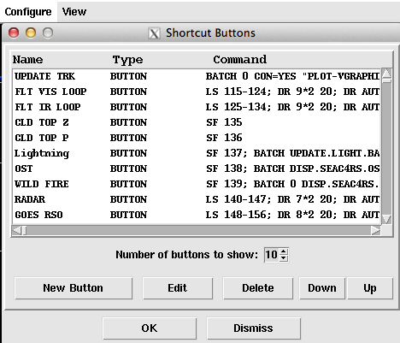
Highlights from MUG 2013 Talks GUI with GOES-13 Enhanced Channel 4 Image with Plane Tracks
*PATH, AIRPLANE
*BAR
*PC T, ZA
*SHOWVG
17:02 GMT Aug 23, 2013

Slide 10
Highlights from Talks
Support for Field Experiments
Current daily use in NOAA operations
McIDAS at Johnson Space Center: Support for 109 missions with 100% availability
McIDAS-X has provided efficiency and reliability.
Efficiency is #1 priority on the MAC McIDAS-V priority list.

Slide 11
Highlights from MUG 2013 Talks
McIDAS-X Buttons→Replicated with Tabs or Favorite Bundles in McIDAS-V
Could be replicated in tabs or favorite bundles if loading is efficient
Point data displays are not efficient, depending on the number of points, display can be slow.
MAC assessment of the Progressive resolution disclosure display will be requested at the next meeting. This approach improves initial display speeds.

Slide 12
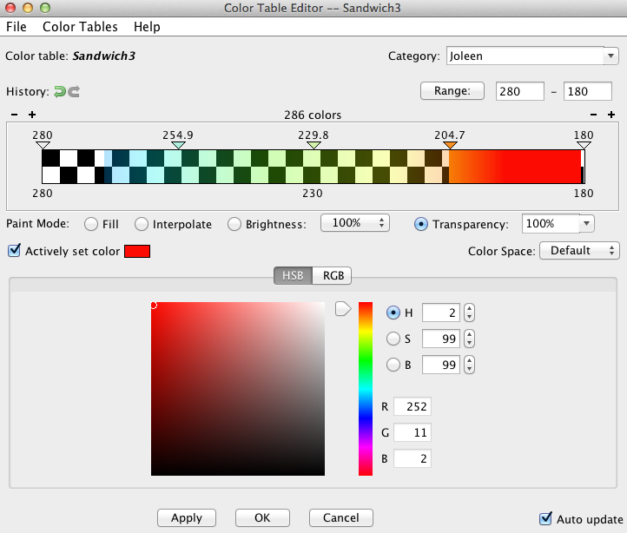
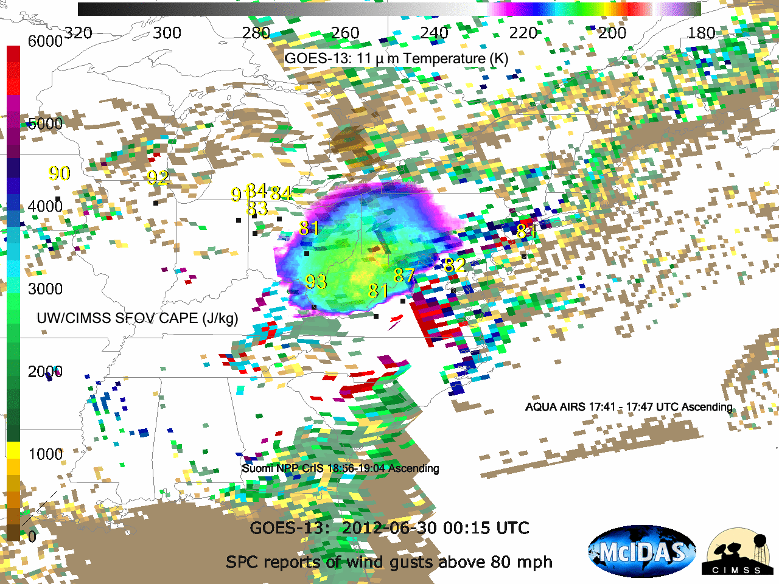
Color Tables/Layers Provide R,G,B,alpha and Independent Control
Notes:
Users have asked about color tables with a bit depth larger than 24 in McX or McV. Could independent layers as well as the rgb + transparency and brightness controls help? Once person mentioned that it would be nice to avoid split tables (McX), it seems that for these cases, McV is already equipped.

Slide 13
McIDAS-V Inquiries (Priority)
Quick: Request will take minimal (few days of) programmer time.
Critical: Request is funded, the program is throwing exceptions, output is incorrect or misleading. Program behavior is deemed excessively annoying.
High: Important, but does not meet critical criteria.
Medium: Nice, but not considered necessary functionality.
Low: Request applies to a very small subset of users.

Slide 14
McIDAS-V Inquiries (Status)
A number of definitions are not being discussed at this meeting. Please note the following definitions
Closed: The inquiry did not need programmer time.
Queued: Not assigned to a programmer.
Being Resolved: Assigned to a programmer.
Released: Included in the release.

Slide 15
Questions
Is anyone interested in seeing regular reporting of inquiries which are in testing or released?
Format? Could a standard search be provided on the inquiry page?

Slide 16
Current Inquiry Pages are Interactive
McIDAS-X Inquiry System: http://dcdbs.ssec.wisc.edu/inquiry-x/
McIDAS-V Inquiries: http://dcdbs.ssec.wisc.edu/inquiry-v/

Slide 17
Useful Information
“User Functions” forum added
UNIDATA example netCDF files are a good starting point for building netCDF files.
Standard Names should be used when possible for netCDF variables. The standard names table is a nice reference.

