Slide 1
Preparing for GOES-R: Imagery and Validation
Presenters: Joleen Feltz and James P. Nelson*
Tim Schmit**, Mat Gunshor*, Kaba Bah*, Hong Zhang*
*Cooperative Institute for Meteorological Satellite Studies/ Space Science and Engineering Center (SSEC/CIMSS) University of Wisconsin-Madison
**NOAA/NESDIS/Satellite Applications and Research Advanced Satellite Products Branch (ASPB)

Slide 2
Notes:
In preparation for GOES-R, in particular, the mesoscale scans, scientists at CIMSS as well as other cooperative institutes and Proving Ground Partners, have been visualizing 1-min SRSOR data. This practice not only helps to prepare us for handling imagery at a higher rate, but also reveals more interesting features in satellite imagery in a more timely manner for forecasting. In this image, we have Martin Setvak’s Sandwich RGB overlaid on a visible image. This RGB is popular in Europe along with the Storm RGB in forecasting of severe storms. The use of the sandwich is increasingly being used here as well. The advantage of this method is that the IR brightness temperatures with rapid cooling can be viewed simultaneously with the texture of the visible image. This helps the viewer zero in on important features evolving within the clouds.

Slide 3
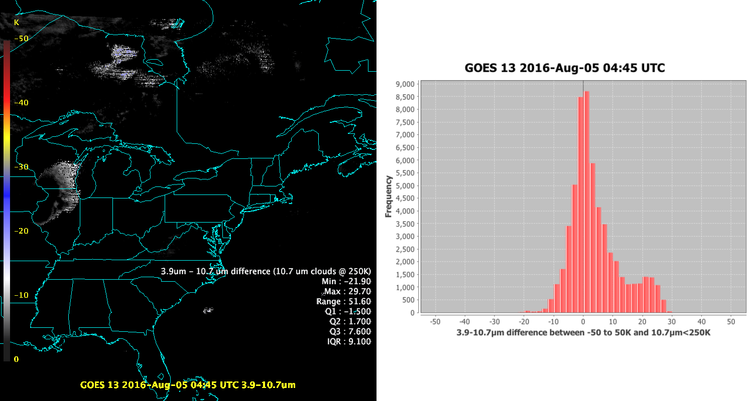
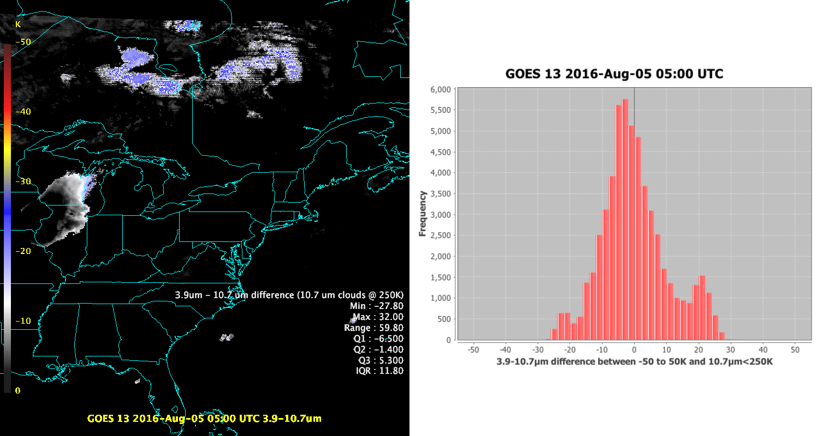
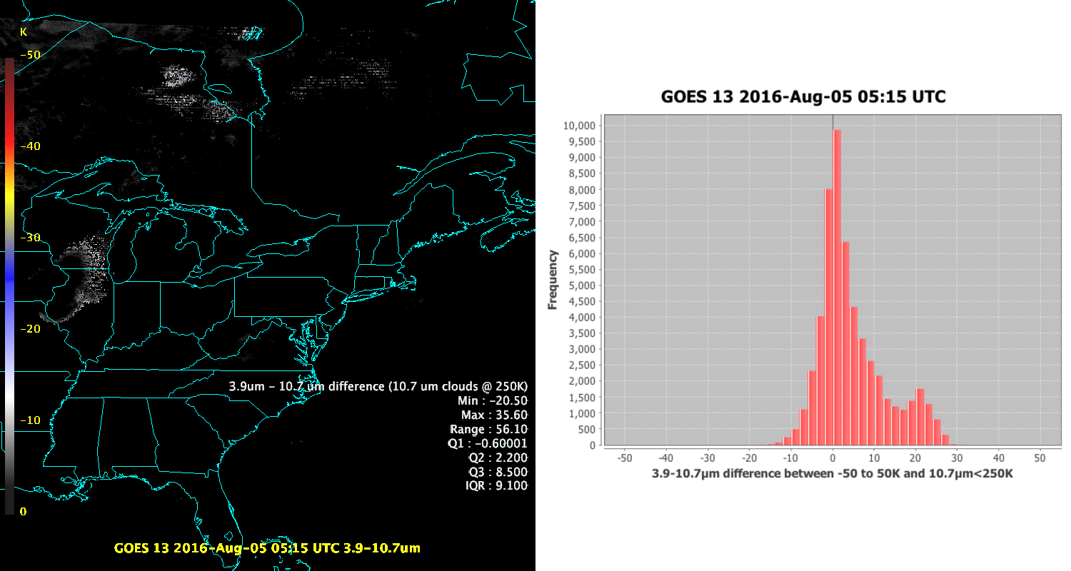
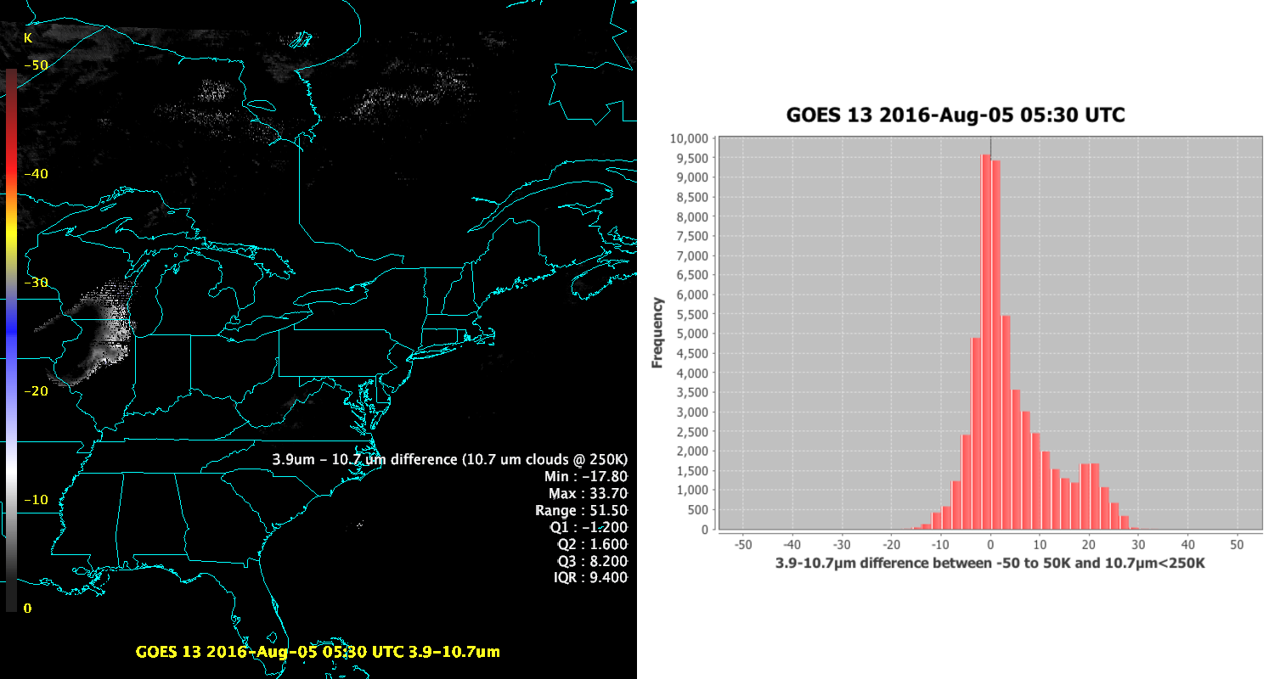
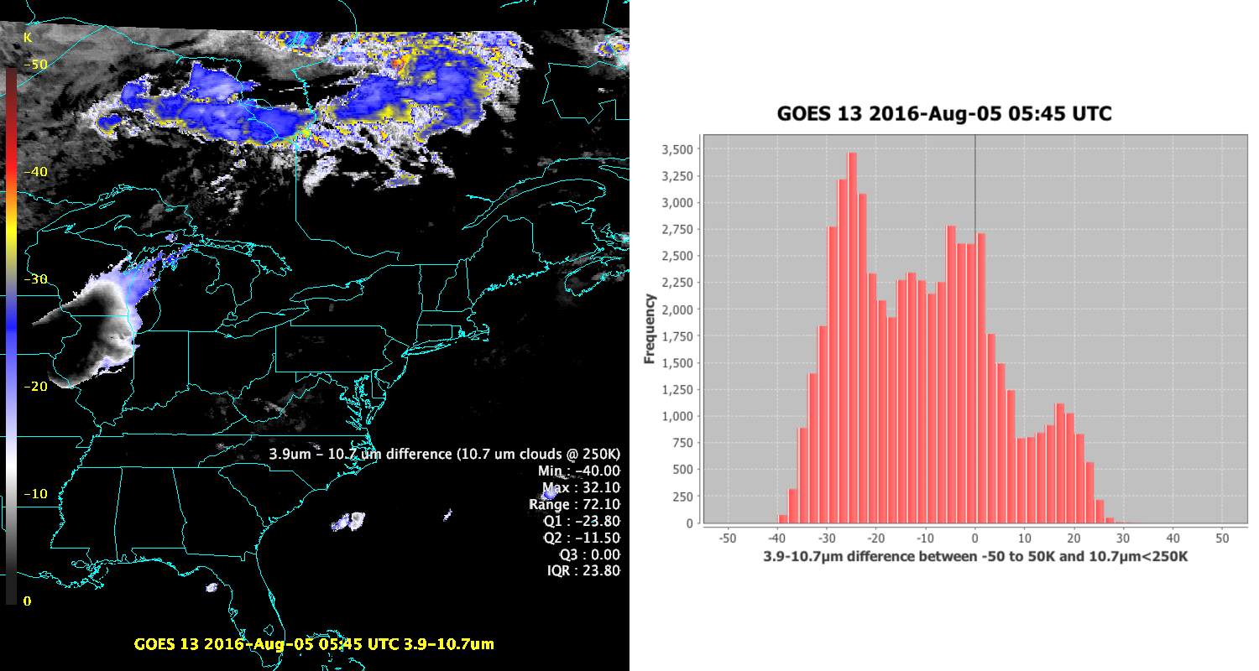
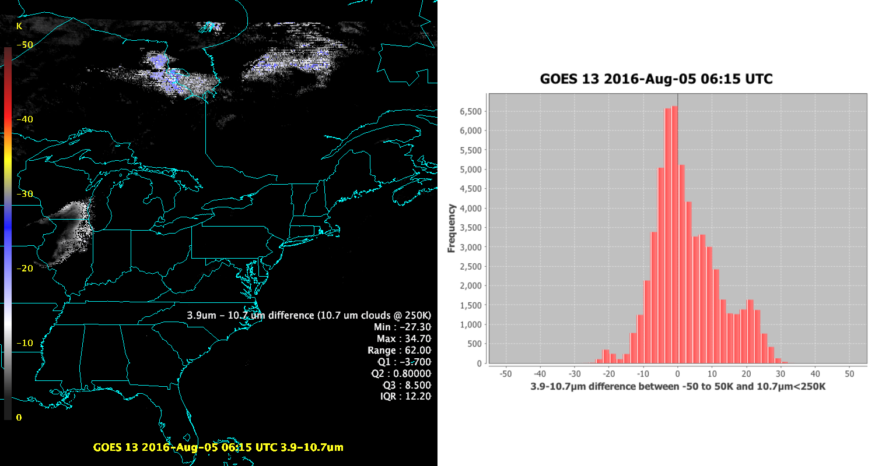
Notes:
For a few years we have been looking at how to capture stray light affected space scans. Tim S. had noted a leftward shift in the sw-lw band difference over clouds (where LW < 250K). This can be seen in this set of images. Starting with a relatively well calibrated image, the histogram centers closer to zero with few points below zero in the early morning hours. As we continue, we see a shift of the histogram and in this case a spreading of the values. This is what we are looking for, but our goal is to have a quick look web page for image quality and this is not an efficent way of looking at the data in the long run.

Slide 4
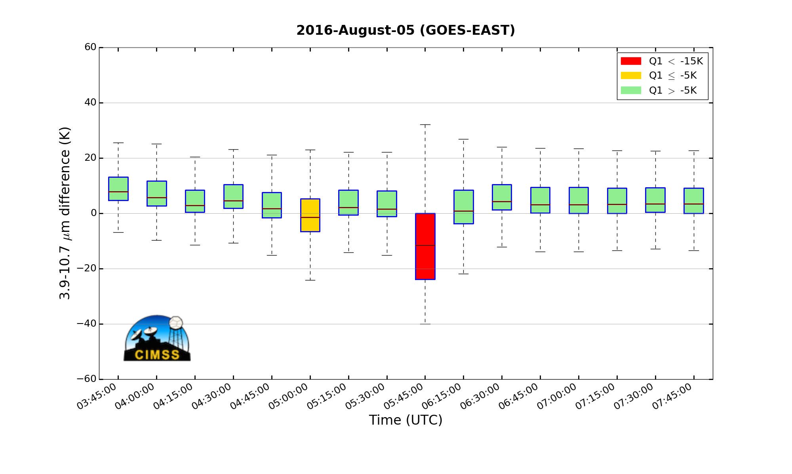
Notes:
The statistics are running, they have also been tested on DOE-4 data. We hope to have a web page they will display time series such as these and be flexible in how these series are displayed. In this instance, we have chosen from observation to mark any image with the first quartile below -15 K as severely affected by stray light calibration issues and these stand out clearly in the series. Not only do they stand out here, but….
In this plot:
The lines in the center of the boxes are the median. This represents the position where equal portions of the data lie above and below the line.
The first quartile (25%) is the location in the data which is located halfway between the median and the lower extreme of the data. (Bottom line of box)
The third quartile (75%) is the location in the data which is located haflway between the median and the upper extreme of the data. (Top line of box)
The IQR ( or spread), which is the extent of the box from top to bottom (Q3-Q1) describes the range of the center 50% of the data.

Slide 5
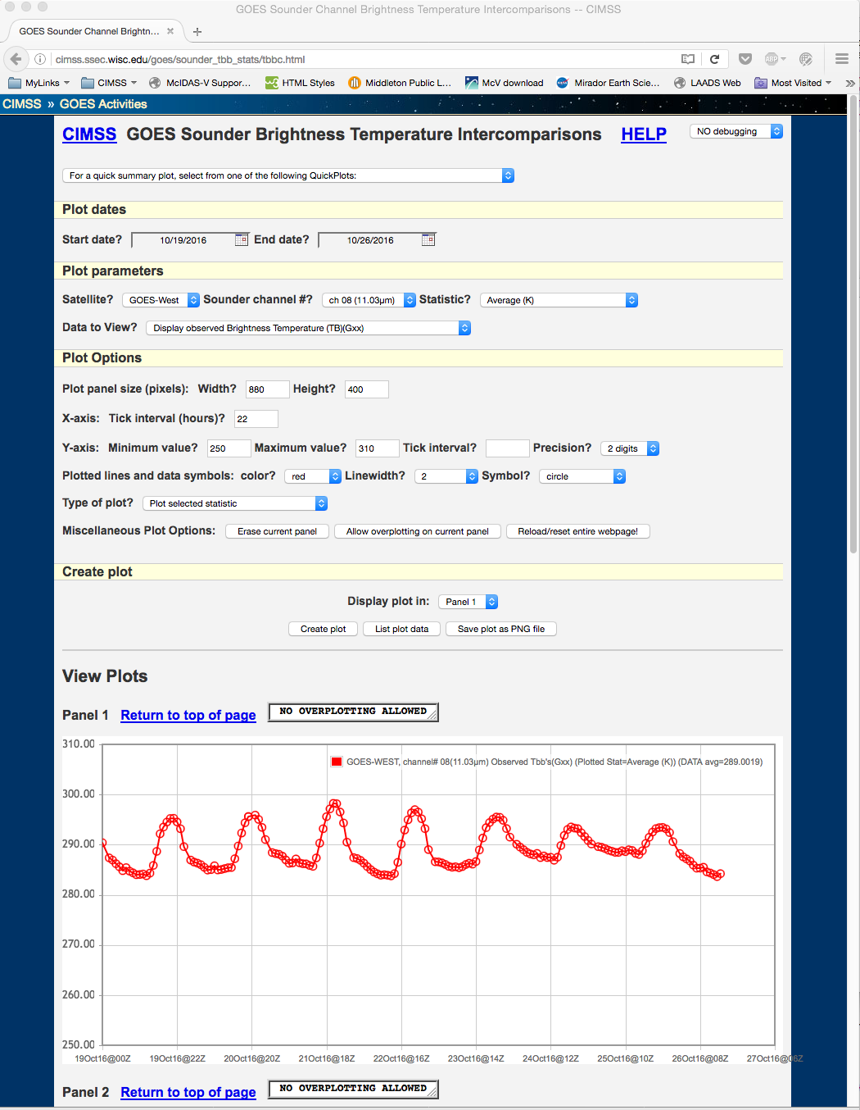
GOES Sounder Brightness Temperature Intercomparison:
http://cimss.ssec.wisc.edu/goes/sounder_tbb_stats/tbbc.html

Slide 6
Notes:
Simulated imagery from all 16 ABI (Advanced Baseline Imager) channels from the DOE (Data Operations Exercise)-4 period, “valid” 060019UTC 30Jul2016. This type of imagery from GOES-R
will be generated automatically and displayed on the Web. McIDAS-X and UNIX ksh shell scripts were used to produce this multi-panel image.

Slide 7
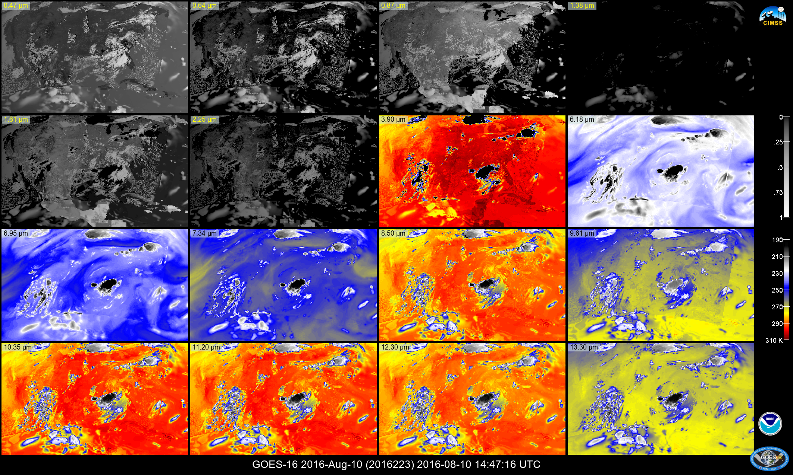
Notes:
16 panels are being created in both McX and McV. Bilinear stretch color table conversation????

Slide 9
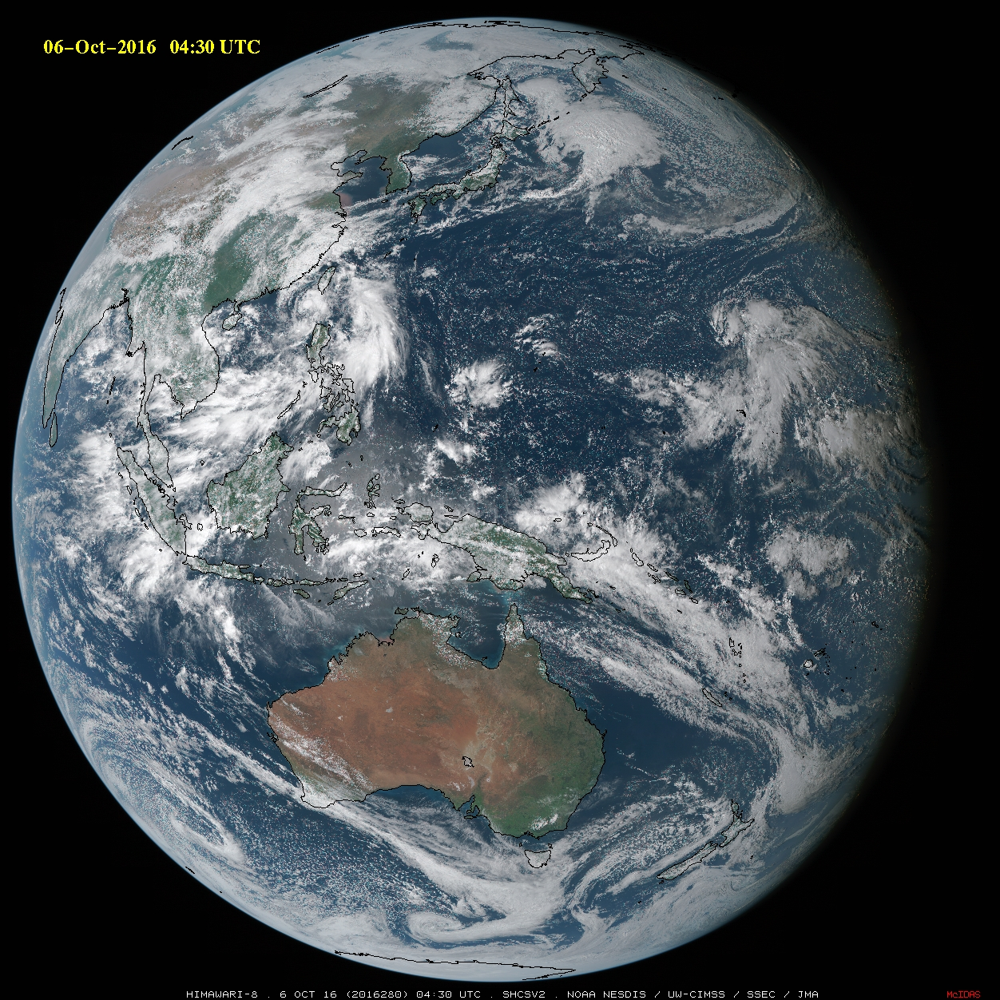
Notes:
Also being created in McIDAS-X is a Simple Hybrid Contrast Stretch RGB. This is done by using a boosted green channel which is a combination of two visible channels. Then, the R,G,B components are scaled in such a way that stretches the middle part of the 0-255 color range, and compresses the ends of the range before the r,g,b, components are combined. I don’t think it would be too difficult to replicate this in McIDAS-V. There are a few factors to consider. 1.) I never have to display this in McIDAS-V, so I could choose to use as little resources as possible and run the algorithm in the jython shell without opening the entire display package. Whether or not I run in the jython shell or choose to run a display in the background, I would not only want to save an image, but I probably want to save at least my combined rgb data object. There is not official way to save either a netCDF (preferable) or an AREA. However, we can use the java netCDF writers. Is there a way to incorporate this into the McIDAS-V scripting API?

