Slide 1


GOES-R Proving Ground Aviation Weather Products Displayed in McIDAS-V
Joleen Feltz, Tim Schmit*, Kaba Bah,
Tom Rink, Tom Whittaker, Tommy Jasmin, Tom Achtor
Cooperative Institute for Meteorlogical Satellite Studies (CIMSS) University of Wisconsin-Madison
*NOAA/NESDIS/Satellite Applications and Research Advanced Satellite Products Branch (ASPB)

Slide 2
McIDAS-V
McIDAS-X → VisAD + IDV + HYDRA = McIDAS-V
Integration of Geophysical Data
Remote and Local Data Access
3D Visualization
HYDRA: analysis tools for hyper-spectral data
Simple re-projection of data and sharing of projections between data displays

Slide 3
McIDAS-V Features
Software Package: Open source, free, adaptable, community driven
Portable: developed in Java
Bundles: users easily share displays and analysis
Jython based user computation

Slide 4
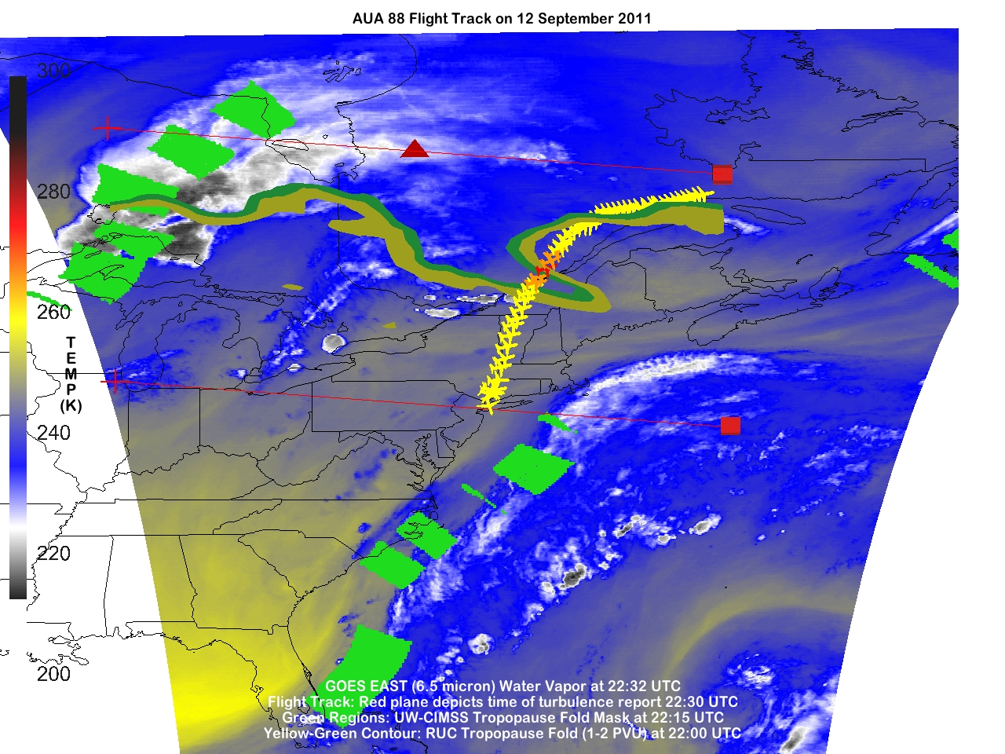
Tropopause Fold Turbulence Product: Anthony Wimmers (CIMSS)
Notes:
The tropopause fold product uses gradients in the GOES water vapor channel to refine possible locations of the tropopause fold. The underlying image is a color-enhanced water vapor image. The tropopause fold product is displayed with green boxes. The tropopause fold as analyzed by the RUC is displayed in the yellow and green contours. The location where the plane experienced turbulence is shown with a red plane.

Slide 5
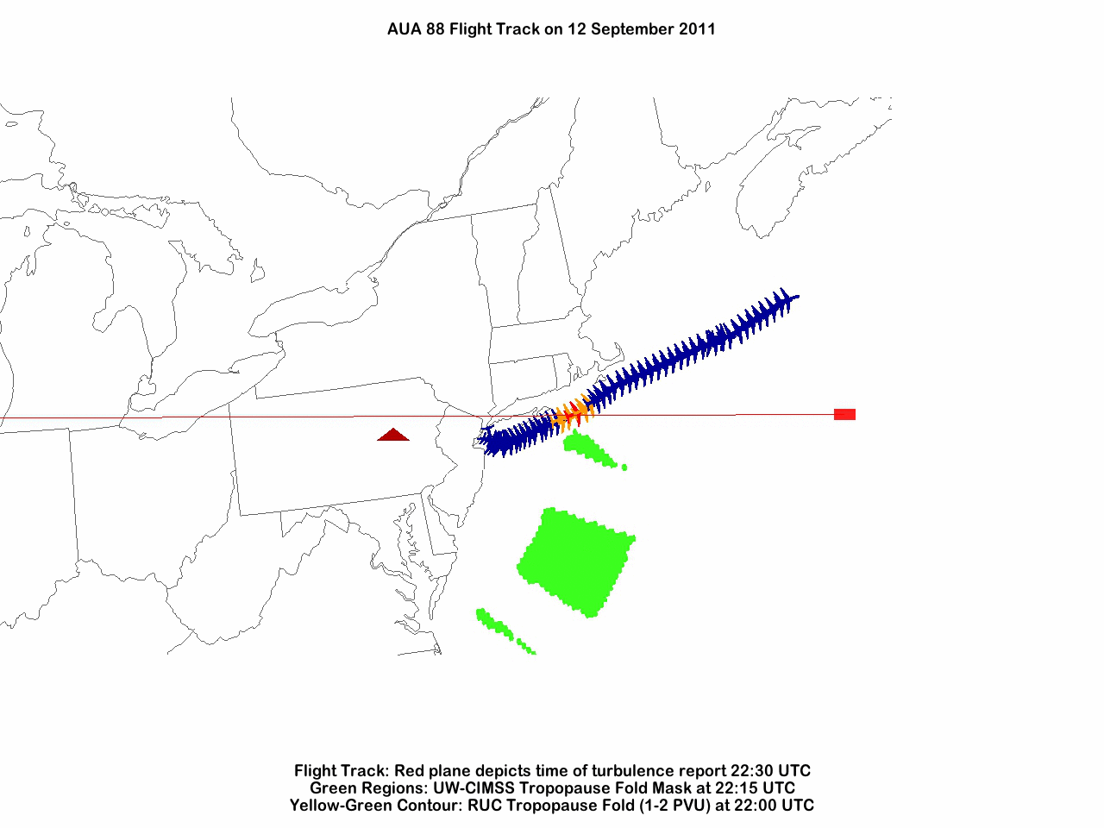
Tropopause Fold Turbulence Product: Anthony Wimmers (CIMSS)
Notes:
A bundle was used to create a rotating movie from a script. McIDAS-V provides a robust means to analyze data with the 3D interactive display.

Slide 6
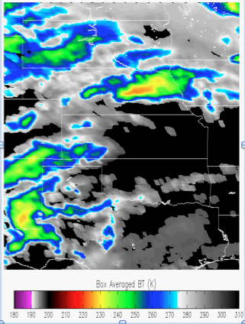
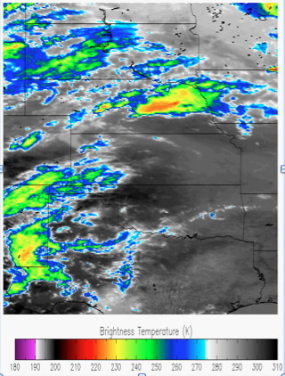
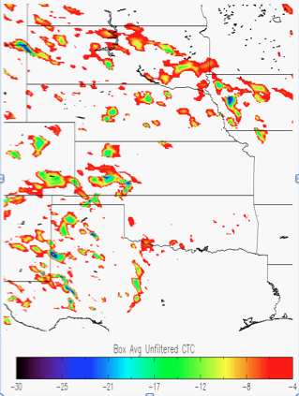
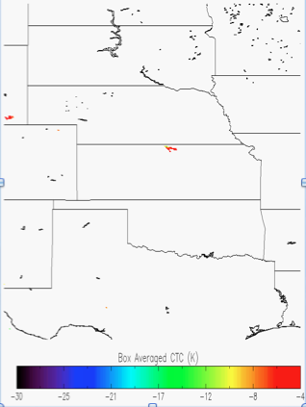
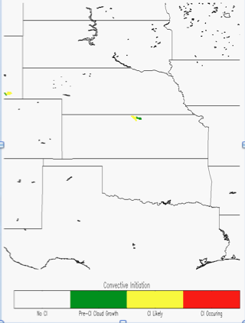
UW Convective Initiation / Cloud Top Cooling (UWCI/CTC) Algorithm
High-level algorithm overview
Compute box-averaged 11 micron brightness temperature (BT) for current time and previous time, using specific categories from GOES Cloud Typing product
Unfiltered Cloud Top Cooling (CTC) Rate is calculated by differencing box average 11 micron BT for current time from previous time
Large/small box approach eliminates most of false CTC due to cloud motion (and additional checks reduce false cooling further)
Combine cloud-top cooling information with cloud-top microphysical (phase/cloud type) transitions for convective initiation nowcasts
Reference: Sieglaff et al., 2011
6
Notes:
this is the same region that later results will be validated within

Slide 7
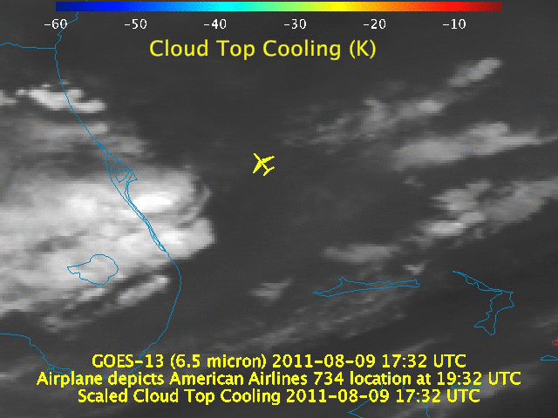
Justin Sieglaff , Lee Cronce, Dan Hartung, Wayne Feltz (CIMSS)
Notes:
This movie displays a GOES-R Scaled Cloud Top cooling product. The location where the plane experience turbulence is depicted by the yellow plane. In the hour before the plane crossed the region where turublence was reported, rapid cloud top cooling was signaled by the product indicating a rapidly developing storm. The pilot possibly turned into a region where a storm was decaying.

Slide 8
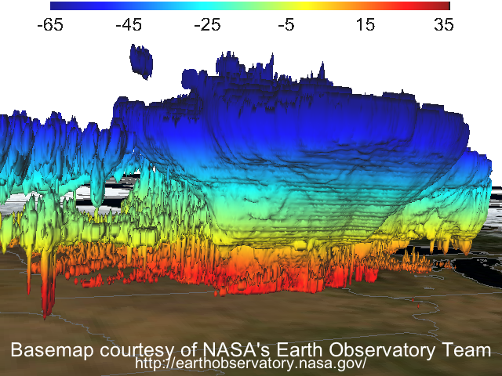
Temperature (°C)
NSSL WRF Simulation of Thunderstorm Complex: Jason Otkin (CIMSS)

Slide 9
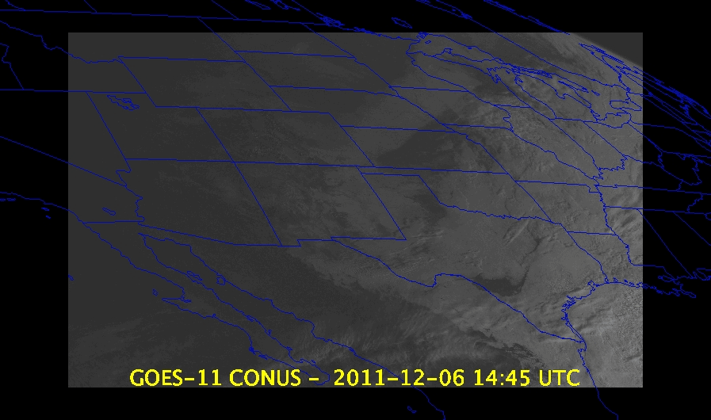
Notes:
Bundles are a nice way to save work, and with a few additions, can be manipulated from a script.

Slide 10
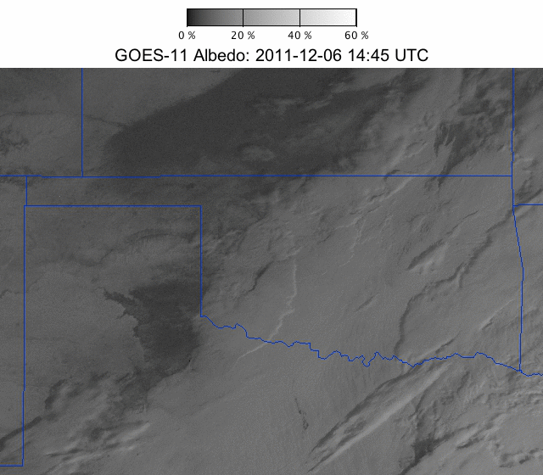
Notes:
An image created from same bundle in the previous slide after a script loaded the bundle, changed the display window size, re-projected to a zoomed view of Oklahoma, labels and colorbar was added.

Slide 11
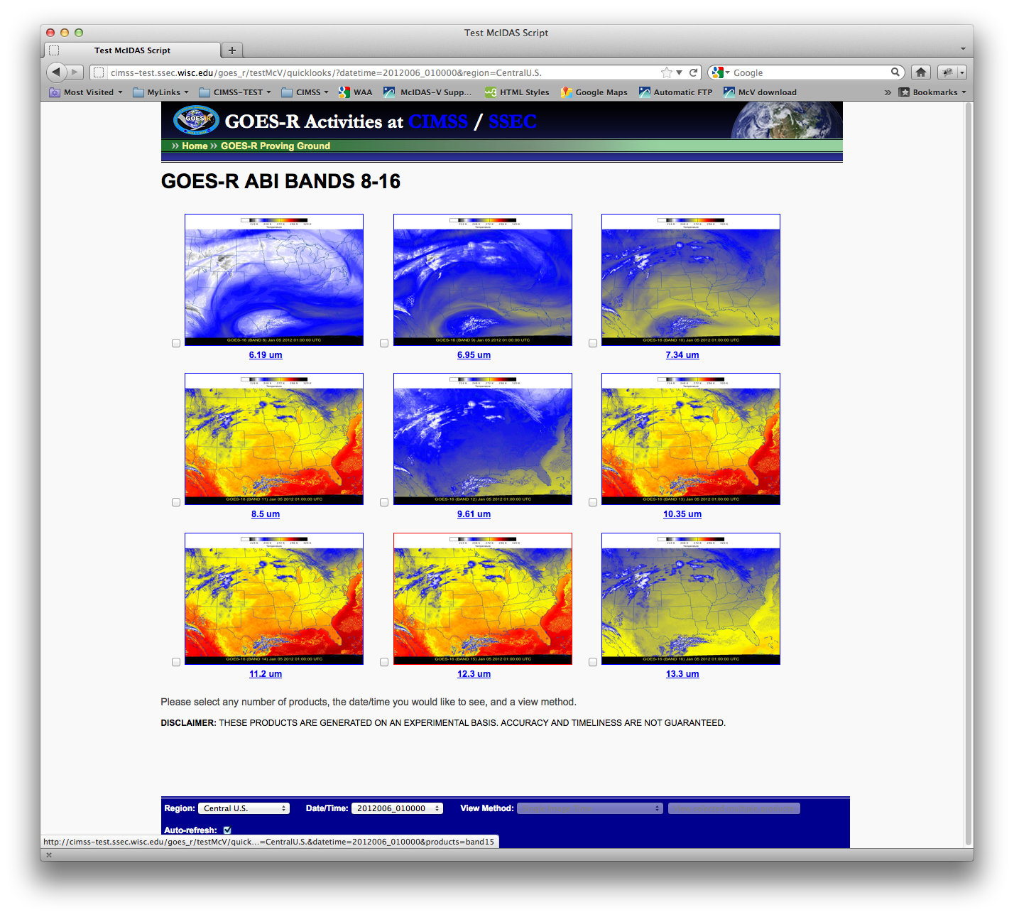
Notes:
Demonstration of scripting for operational use

Slide 12
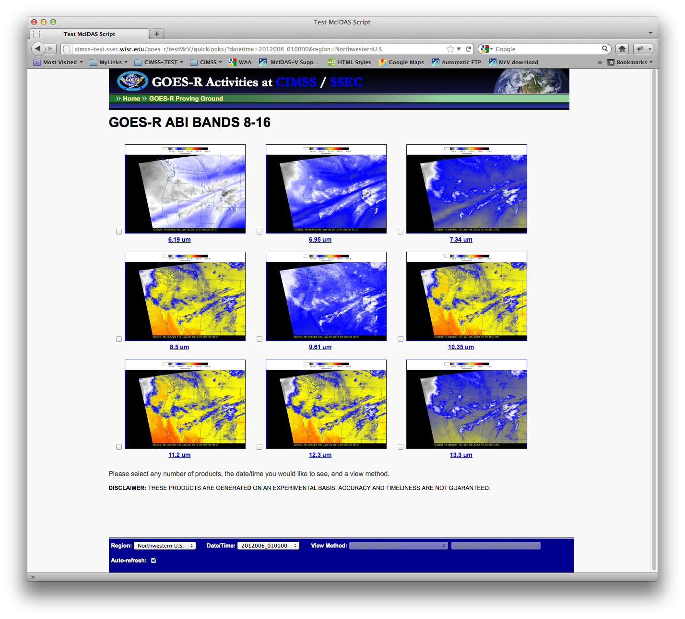
Notes:
The script generated multiple bands and projections

Slide 13
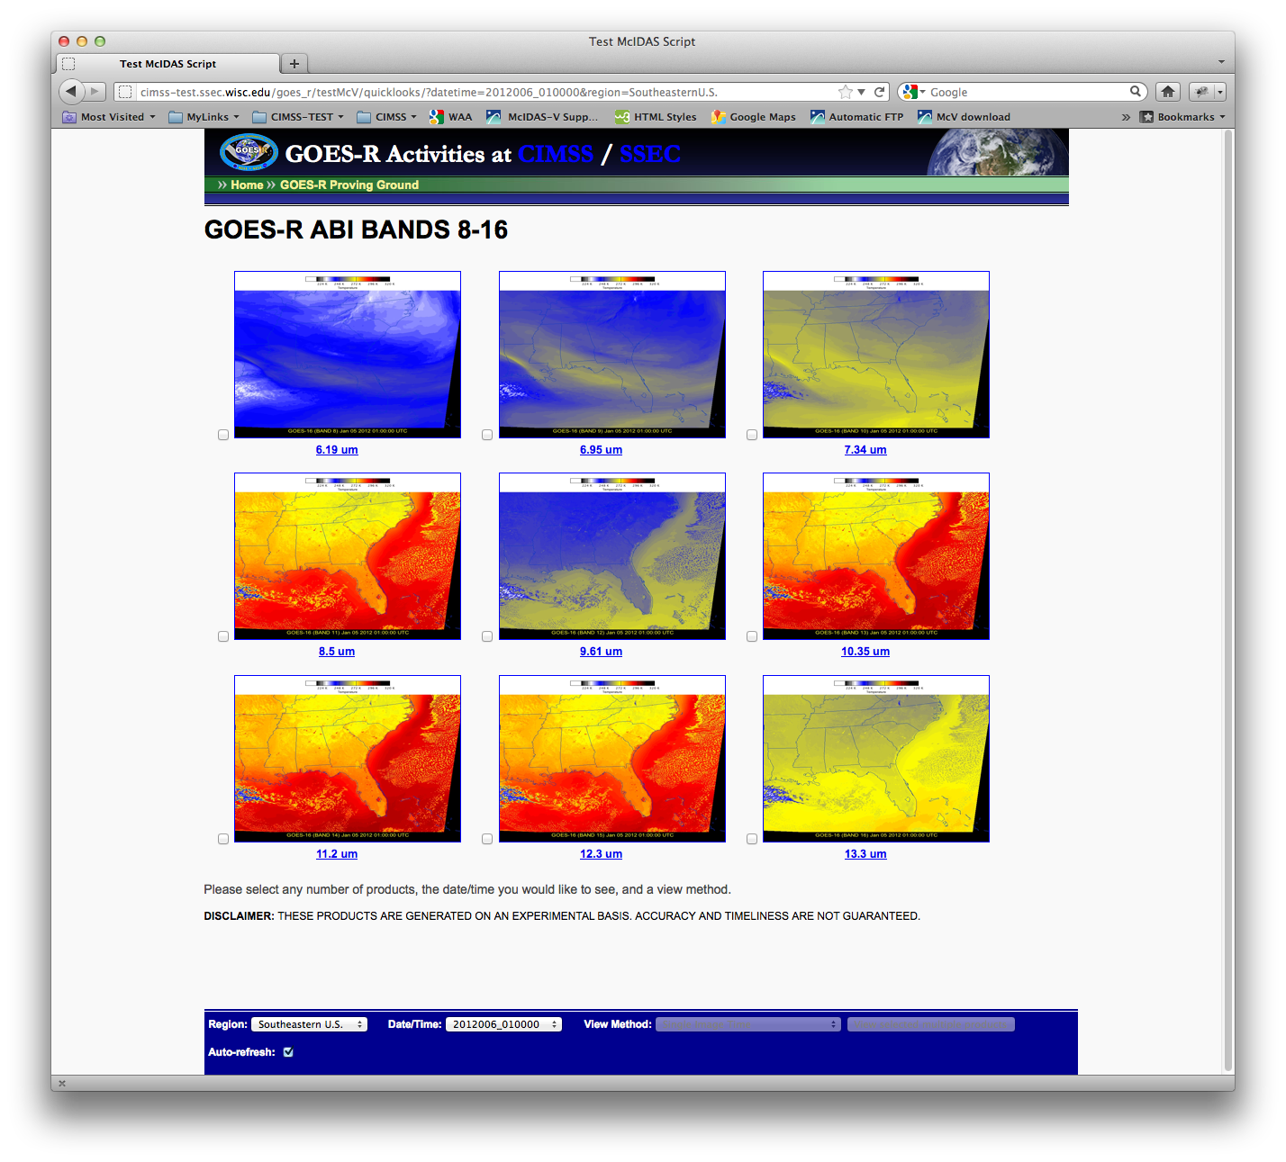
Notes:
Another projection

Slide 14
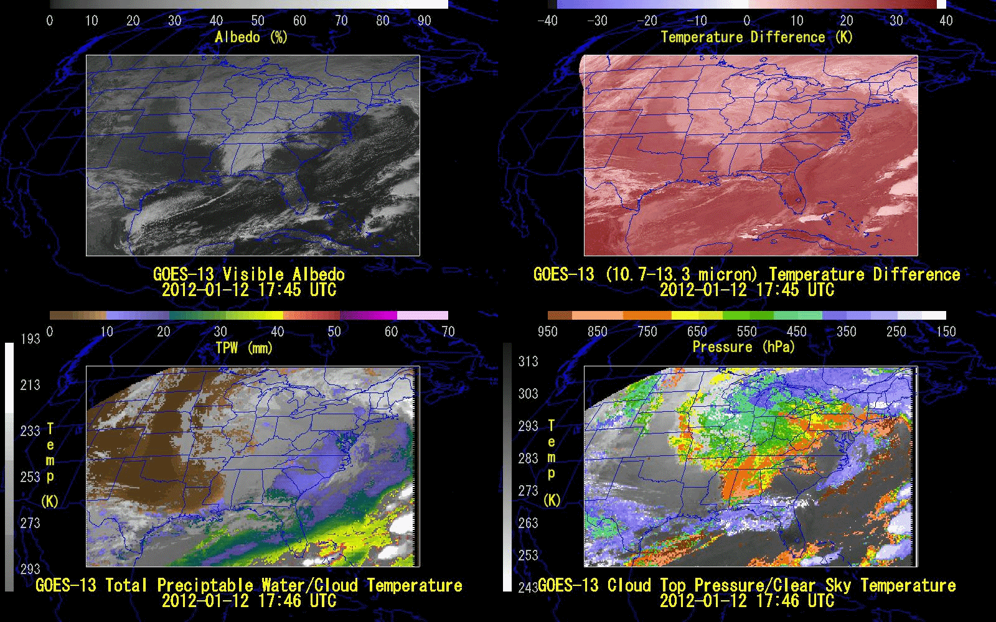
GOES Sounder DPI: Gary Wade, Tim Schmit, Tony Schreiner
Notes:
An example of shared views, multiple colorbars

Slide 15
CIMSS Proving Ground Website
http://cimss.ssec.wisc.edu/goes_r/proving-ground.html
More Information about McIDAS-Vhttp://www.ssec.wisc.edu/mcidas/software/v/download.html

