Slide 1
Using McIDAS-V with the Next Generation of Satellite Sensors
Presenter: Joleen Feltz*
T. Schmit**, M. Gunshor*, R.M. Rabin, M. Hiley+
*Cooperative Institute for Meteorological Satellite Studies/Space Science and Engineering Center (SSEC/CIMSS) University of Wisconsin-Madison
**NOAA/NESDIS/Satellite Applications and Research Advanced Satellite Products Branch (ASPB)
+NOAA/OAR/National Severe Storms Laboratory (NSSL)
Acknowledgments to:
Kris Bedka (NASA Langley Research Center)
Martin Setvák (Czech Hydormeteorlogical Institute)
12 January, 2016: Visualization Techniques for Climatology and Meteorology
96th American Meteorological Society Annual Meeting

Slide 2
What is McIDAS-V?
Freely distributed open source software package for displaying and interrogating meteorological and meteorological satellite data (including hyper-spectral satellites)
McIDAS-V → VisAD + IDV + HYDRA
Interactive or scripting options
The scripting API provides the ability to access ADDE data, load netCDF/hdf files, control display layers, capture movies/images using the Jython language. (Java-Implementation of Python)
New features are driven by user need.

Slide 3
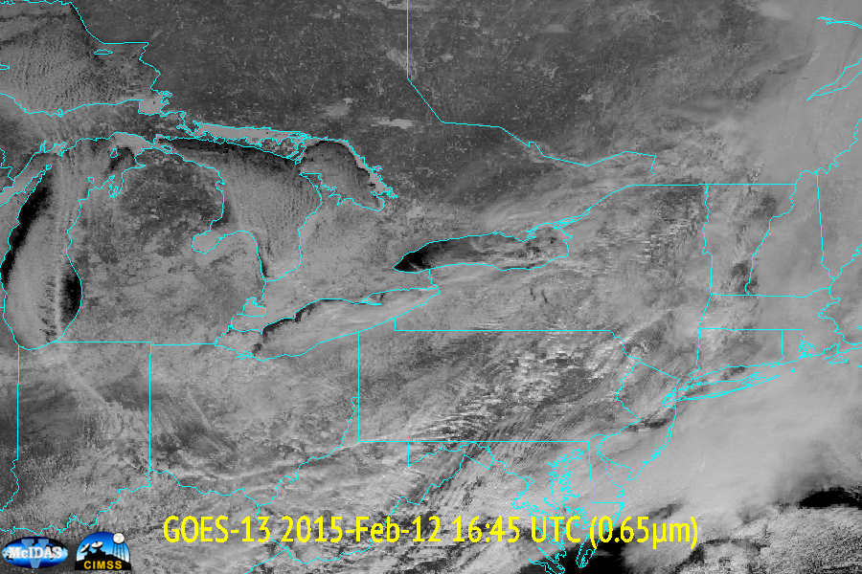
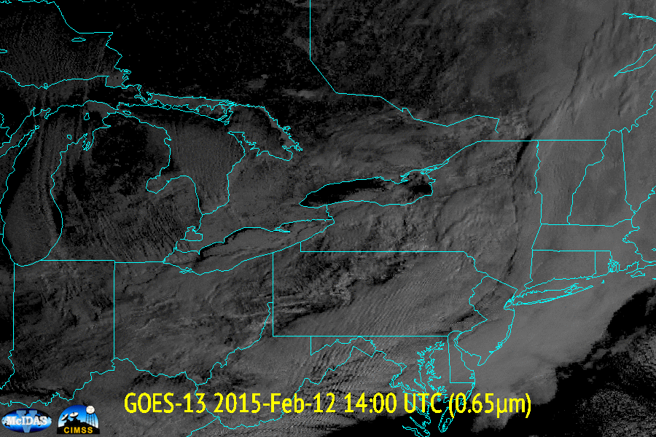
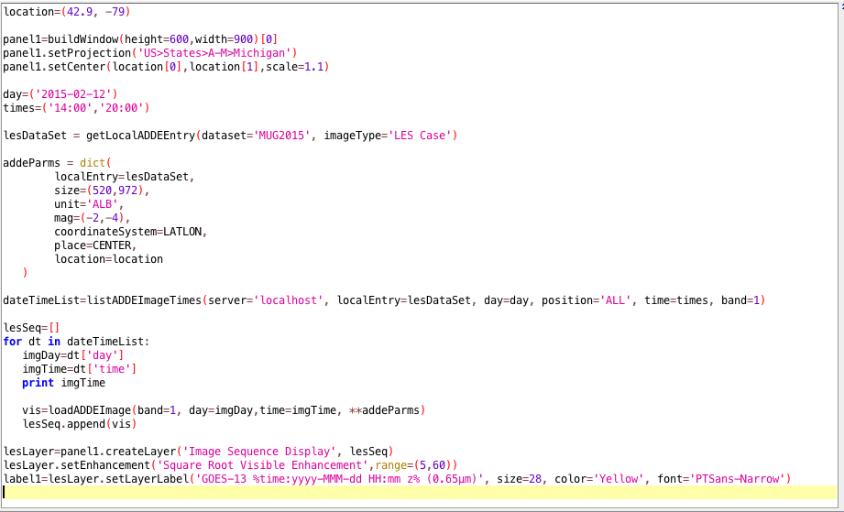
Simple Animation of Satellite Imagery

Slide 4
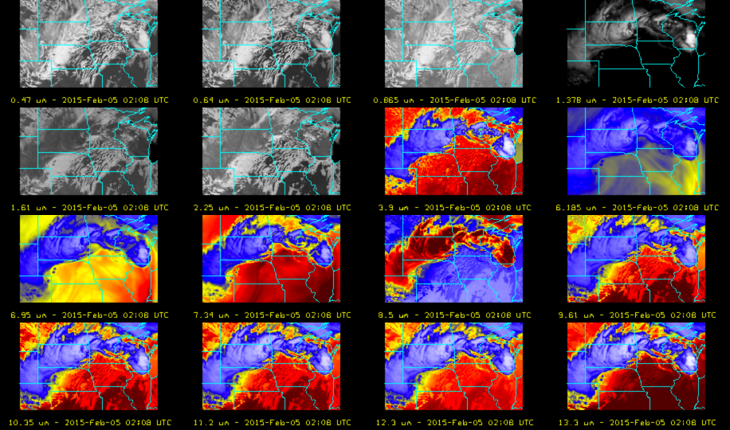
Simulated GOES-R Data in McIDAS-V
Notes:
Flex mode 1 minute mesoscale, 5 minute CONUS and 15 minute full disk.

Slide 5
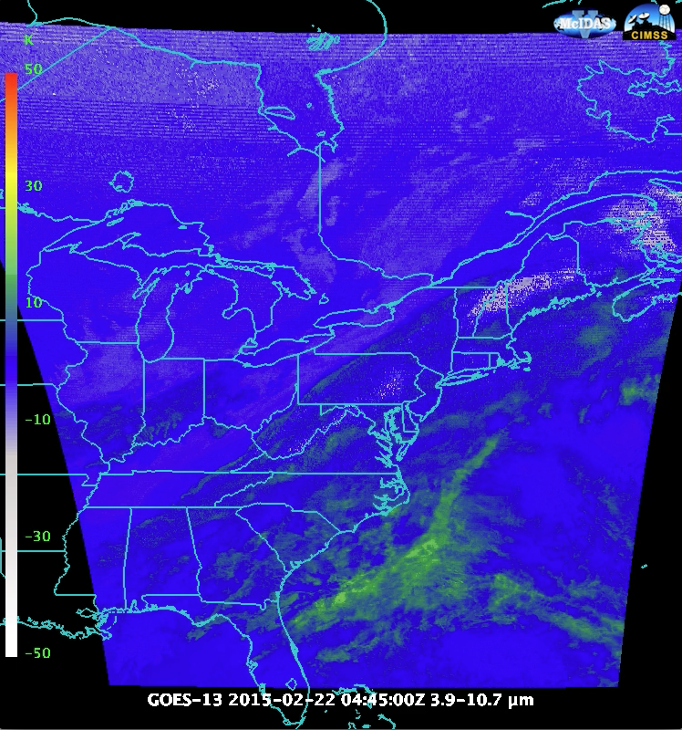
Stray light Contamination

Slide 6
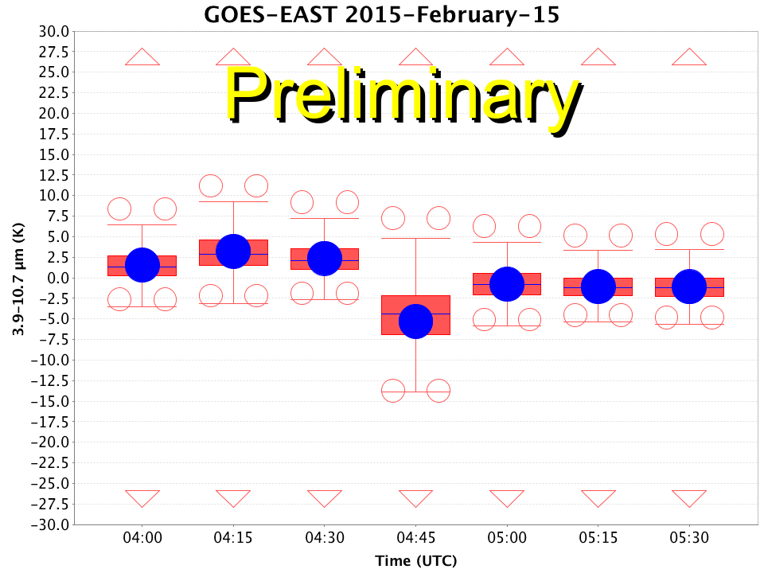
Stray light statistics calculated daily

Slide 7
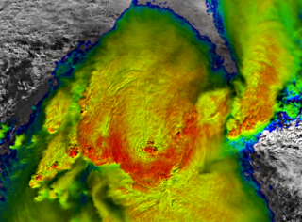
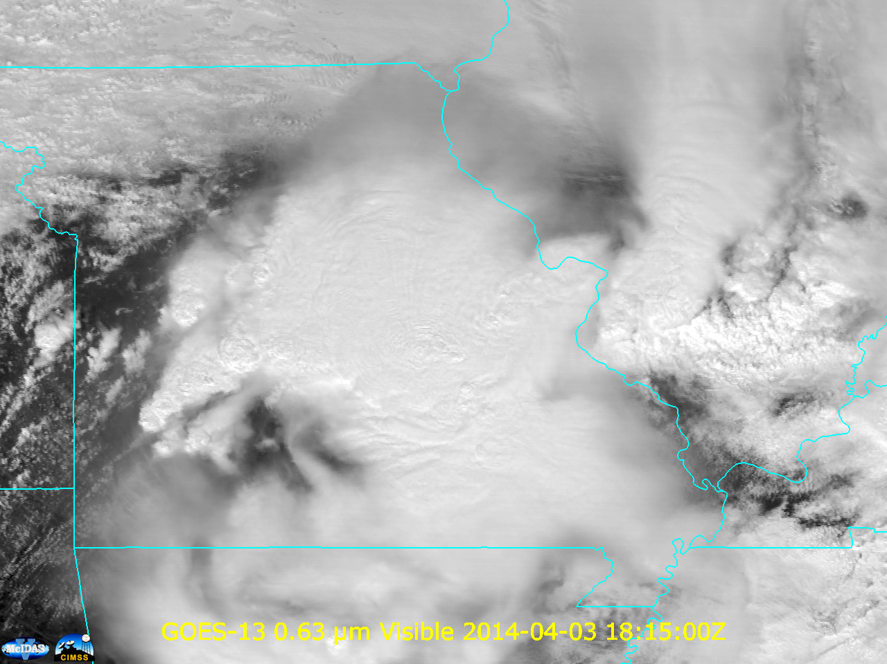
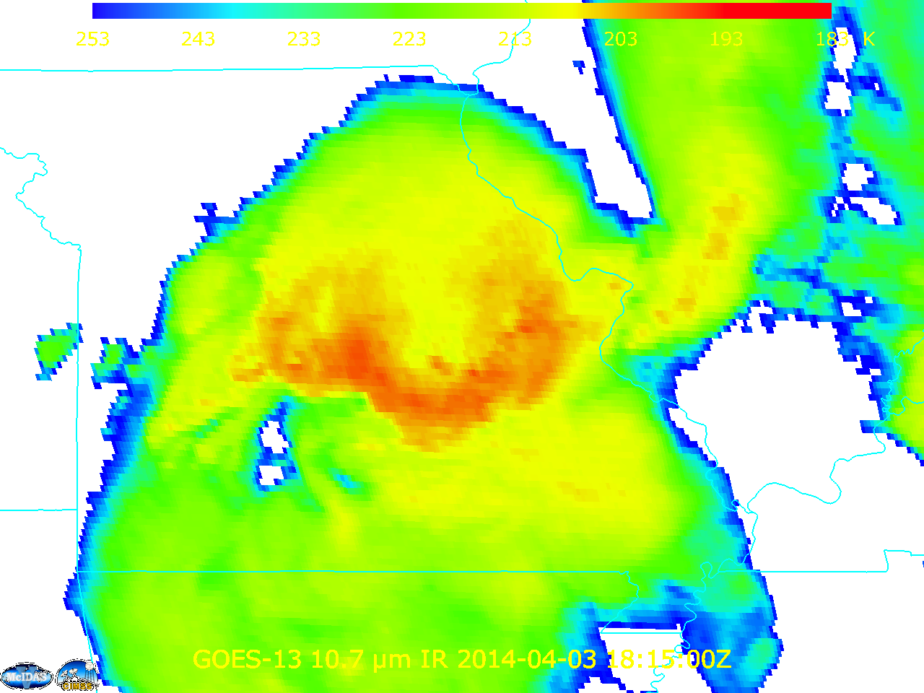
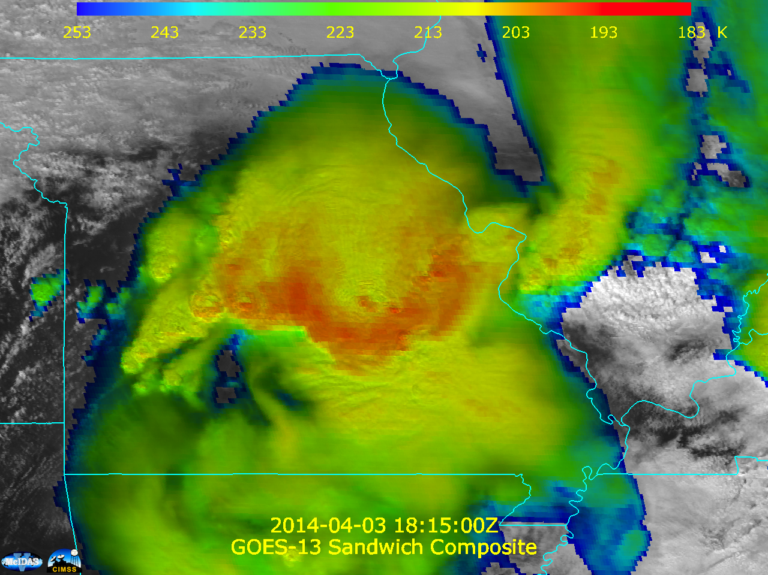
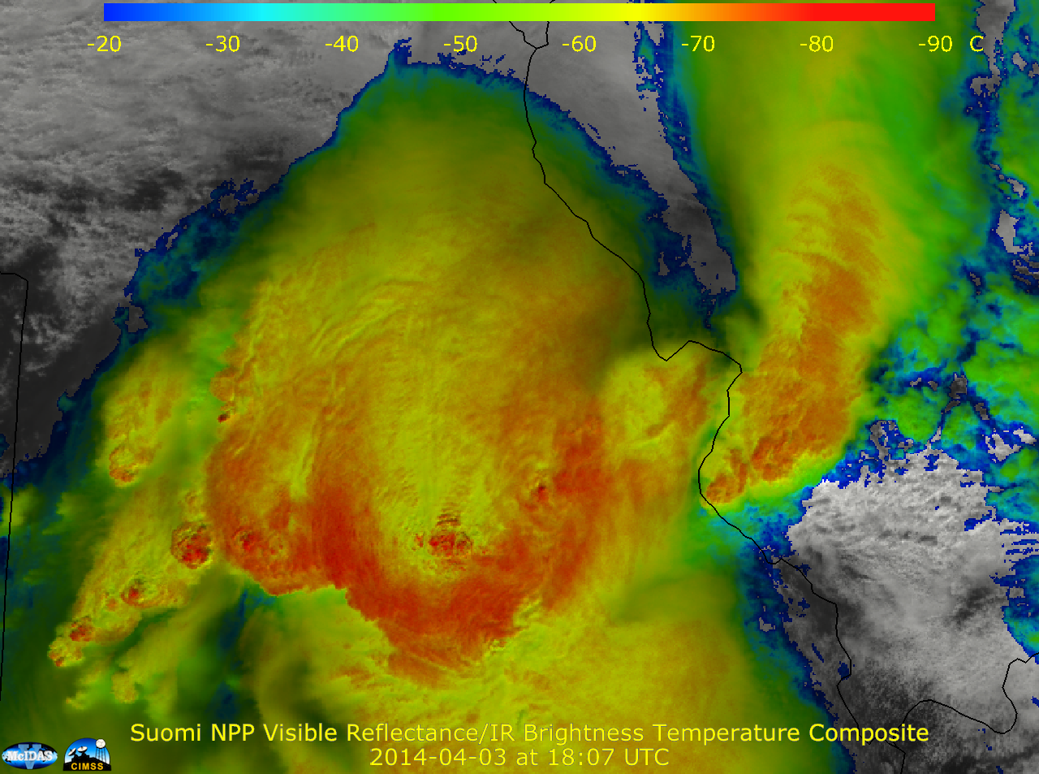
Sandwich Product scripted in McIDAS-V:
Blends Thermal and Visible Channels
Notes:
Usually this done by blending satellite layers in an image editing package.

Slide 8
Visualization Examples
Sandwich Product
Blends Thermal and Visible Channels
Sandwich Product by Martin Setvák (Czech Hydormeteorlogical Institute)
Convection Working Group: http://essl.org/cwg/?p=417
Notes:
Usually this done by blending satellite layers in an image editing package.

Slide 9
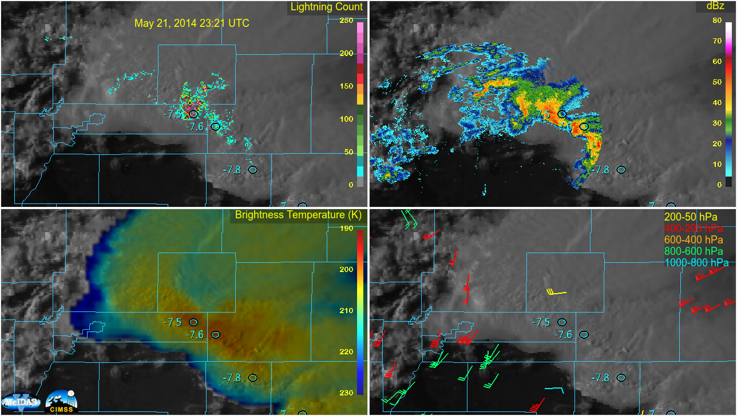
GOES SRSO (May 21, 2014)

Slide 10
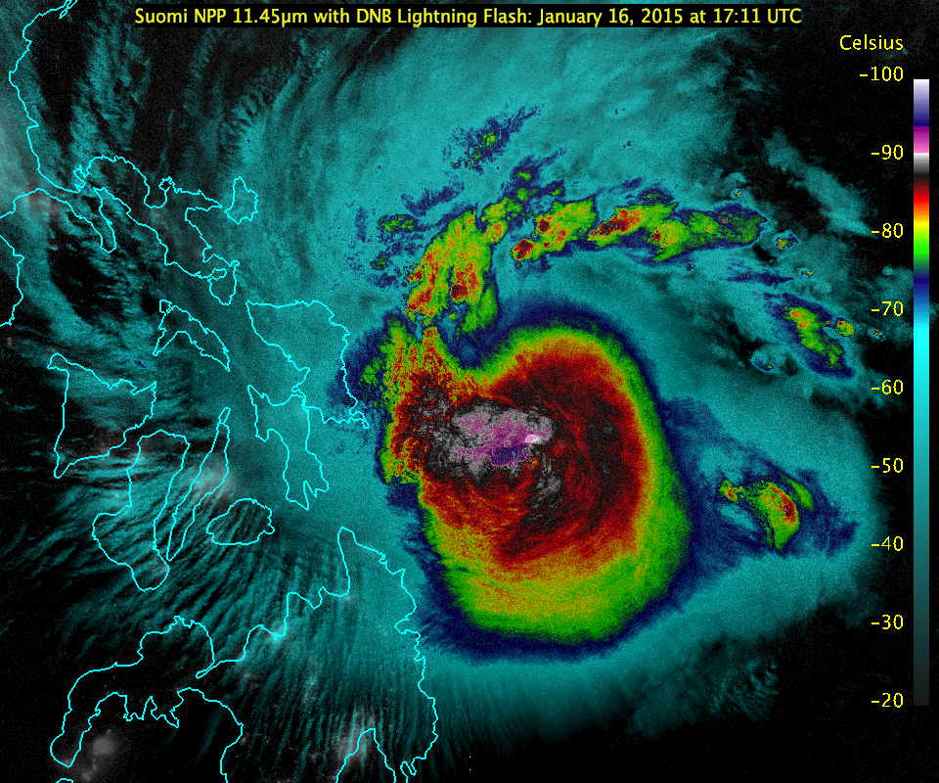

Slide 11
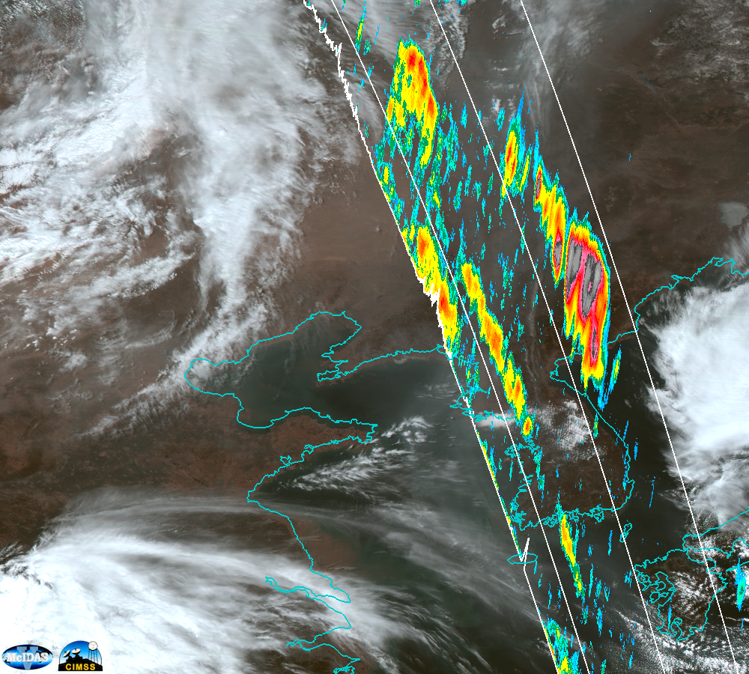
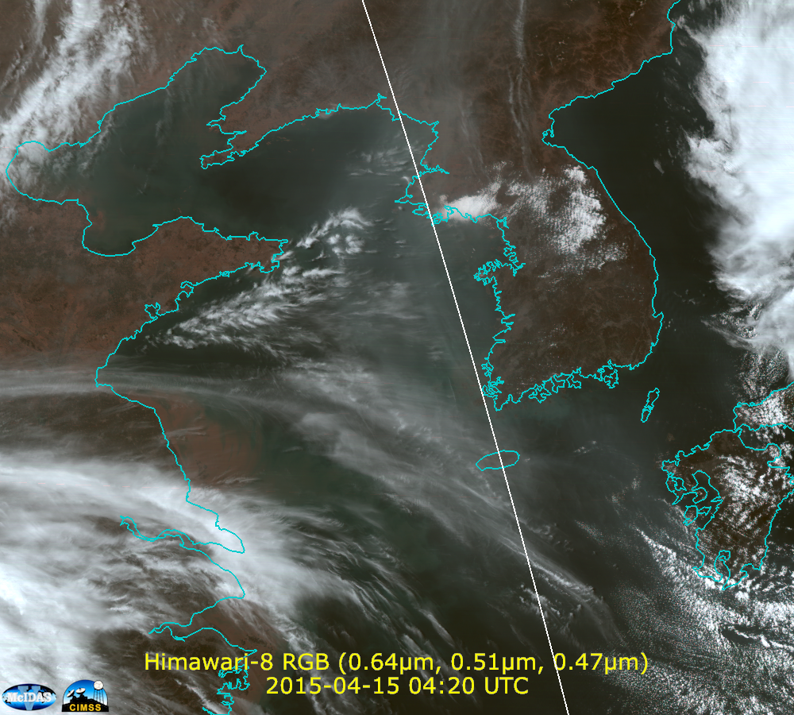
Himawari-8
(0.64, 0.51, 0.47 µm) RGB on April 15, 2015
4:20 UTC/4:26 UTC CALIPSO Overpass

Slide 12
For more examples, documentation or to download the software
McIDAS-V Website http://www.ssec.wisc.edu/mcidas/software/v
Visit the SSEC booth
Questions about this talk: joleen.feltz@ssec.wisc.edu

