Slide 1
Displaying Imagery and CIMSS Science Products in McIDAS-V
Joleen Feltz, Will Straka, Kaba Bah
In cooperation with CIMSS Scientist and McIDAS Programmers
Notes:
Thank-you Will and Kaba for stepping in

Slide 2
Acknowledgements
McIDAS Imagery and Visualization: Tom Whittaker, Tom Rink and Tommy Jasmin
CIMSS Scientist: Anthony Wimmers, Justin Sieglaff, William Straka, Jason Otkin, Tony Schreiner, Kaba Bah, Elizabeth Weisz, Wayne Feltz, Tom Achtor, Robert Knuteson
NOAA/NESDIS Satellite Applications Branch: Tim Schmit, Ralph Peterson, Gary Wade
Notes:
A number of scientists generously provided their data, expertise and programming knowledge.

Slide 3
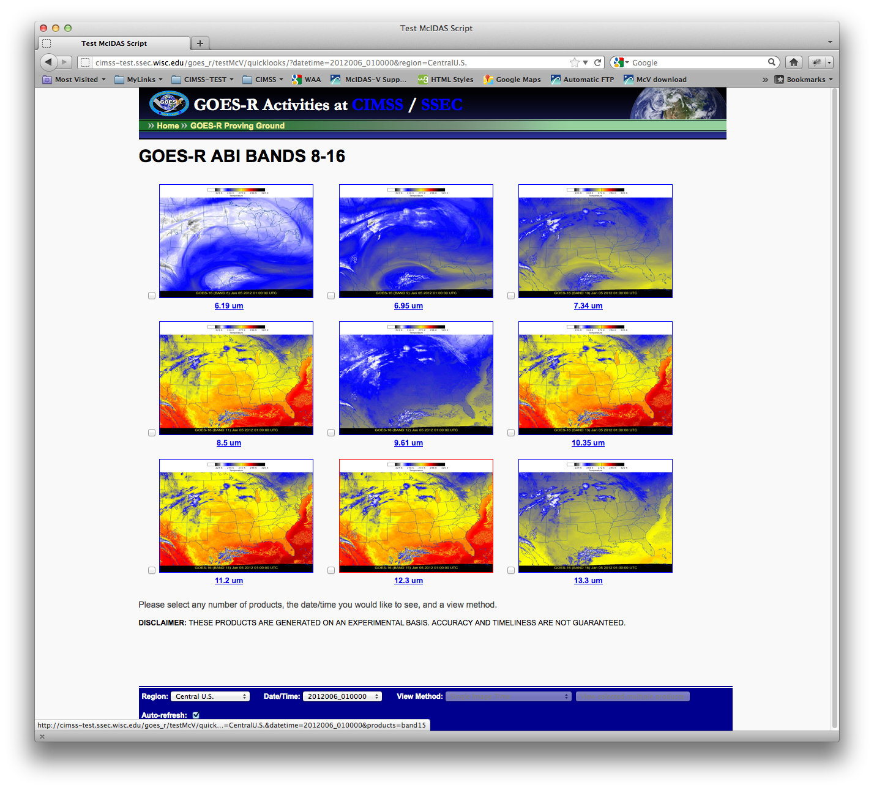
Notes:
One of the first major tasks using scientific data in McIDAS-V was a proof of concept that McIDAS-V could be run in the background using line by line code instead of a bundle.
Since this website was a proof a concept, it is not currently being updated.
Could McIDAS-V run in background to produce images from multiple bands, and change projections. Give control of color scale.

Slide 4
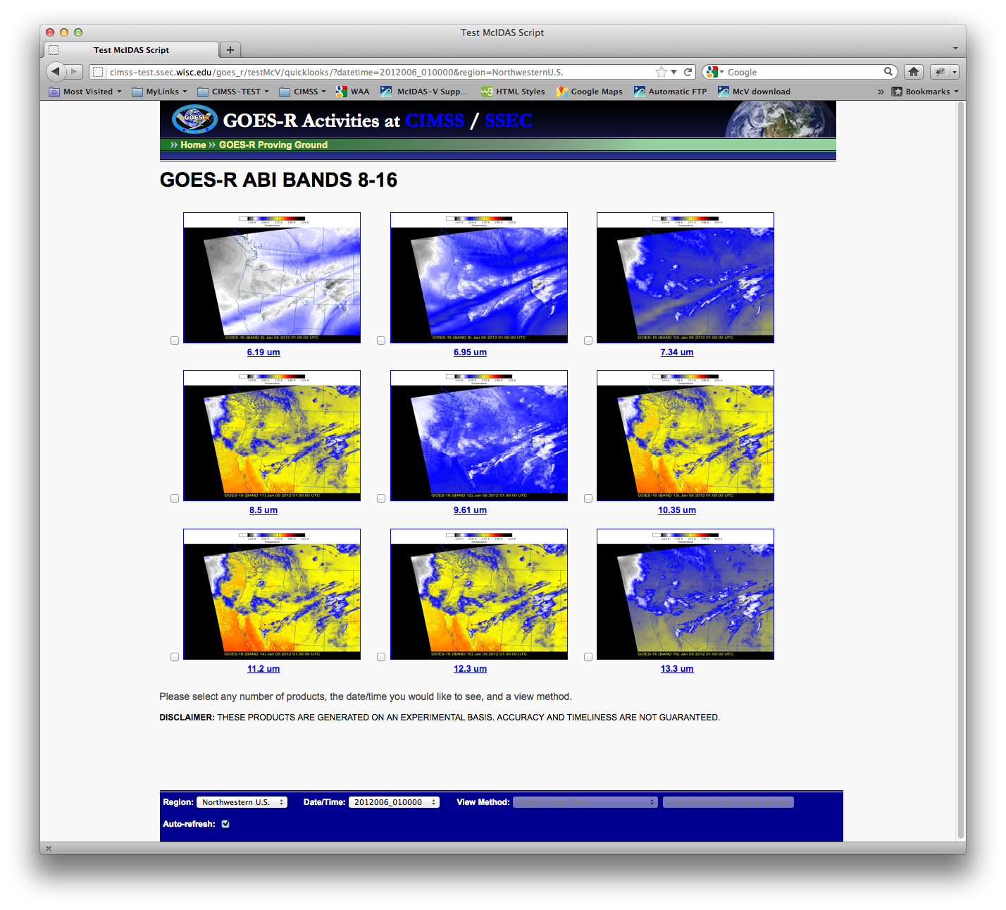
Notes:
The script generated multiple bands and projections, the user could select which region, and even construct a time-series. McIDAS-V supplied the images, php code handled the user requests for looping.

Slide 5
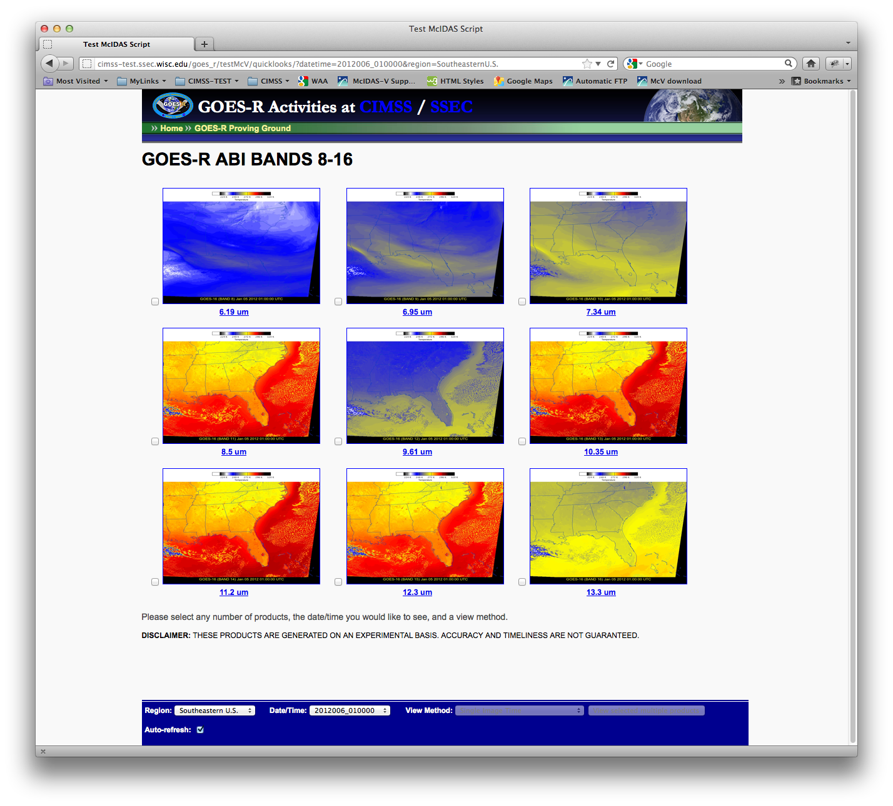
Notes:
Another projection. This is an example of the programmers working very closely with the needs of a user. Tom Whittaker helped point me in the right direction for the code. He also was a great mentor, teaching as he passed code along.
Most importantly from this project, the need for easier scripting methods were identified and programmers have begun to develop tools for everyone to do this in a more straightforward and stable manner.

Slide 6
Bundles:
Reckless but useful bundle tricks
When an ID is used:
  Change or turn off layer labels
  Access multiple panels in a bundle
Zoom, change projection/change centering
Change color scale (enhancement) and range
Step through an animation, get timestamp information
Replace data within the bundle
Notes:
At one time, I disliked bundles, I thought I was bound to whatever was in the bundle, making it useless for background processing. <user click> I have found this is not the case. I call this reckless bundle tricks because I am not sure how much of this would be endorsed by those who must support McIDAS-V, but it illustrates that bundles can be a powerful tool. <user clicks, go through list>

Slide 7
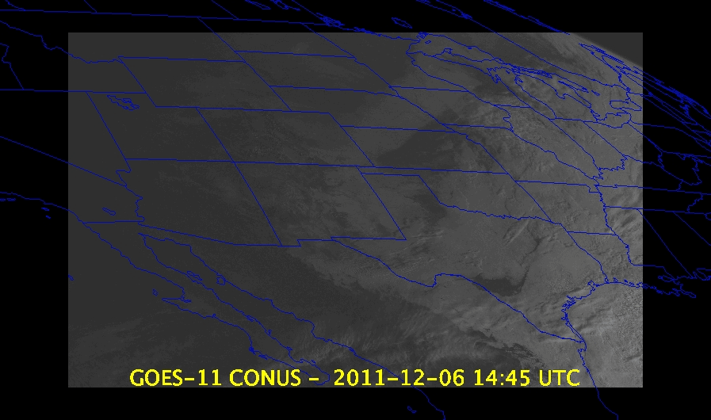
Notes:
Bundles are a nice way to save work, and with a few additions, can be manipulated from a script. Here is a rough example. The image is made rough to illustrate the point. This is a loop that was saved in a bundle.

Slide 8
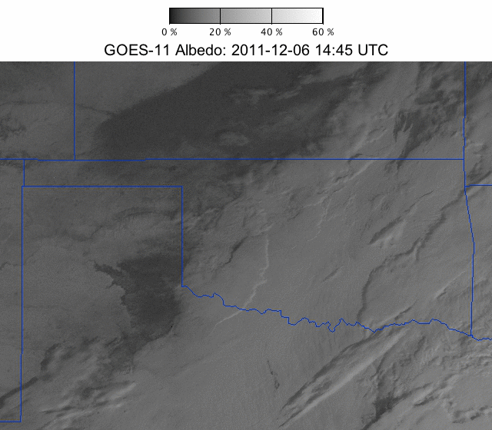
Notes:
An image created from same bundle in the previous slide after a script loaded the bundle, changed the display window size, re-projected to a zoomed view of Oklahoma, labels and colorbar was added.

Slide 9
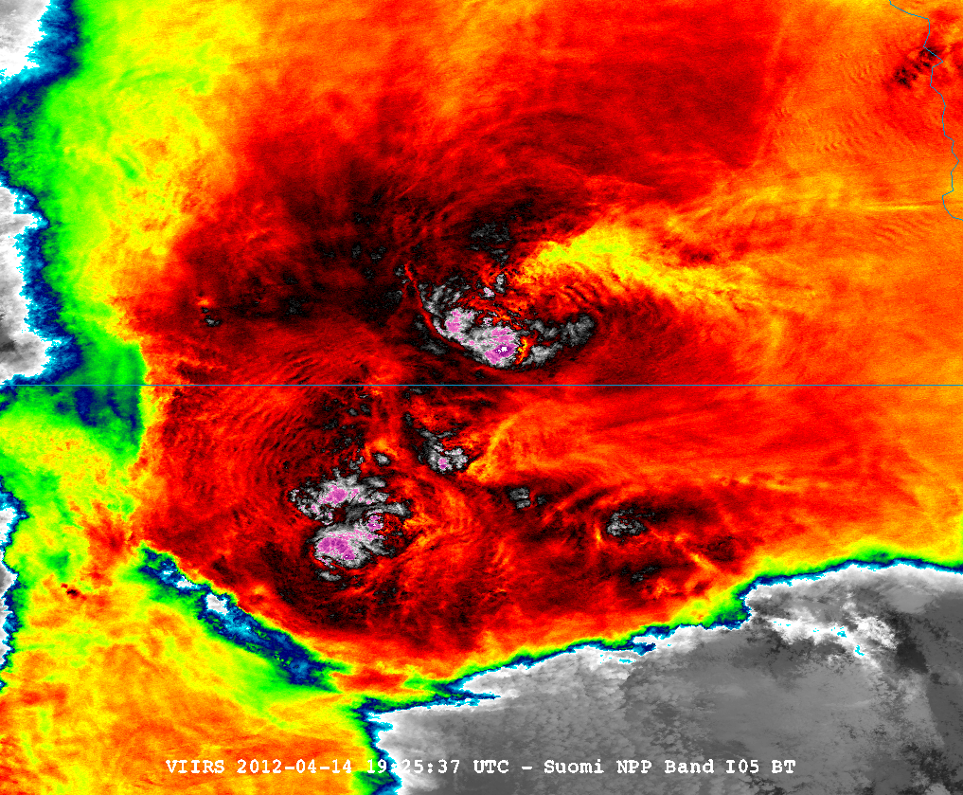
VIIRS Band I05 (11 um), 4/14/2012, 1925Z
BT = 188.8K
Norman, OK Storm Case Study
CIMSS/SSEC
Notes:
McIDAS-V is one of few applications which can display VIIRS data easily. Will Straka provided this example of an overshooting top with an enhanced-v signature.

Slide 10
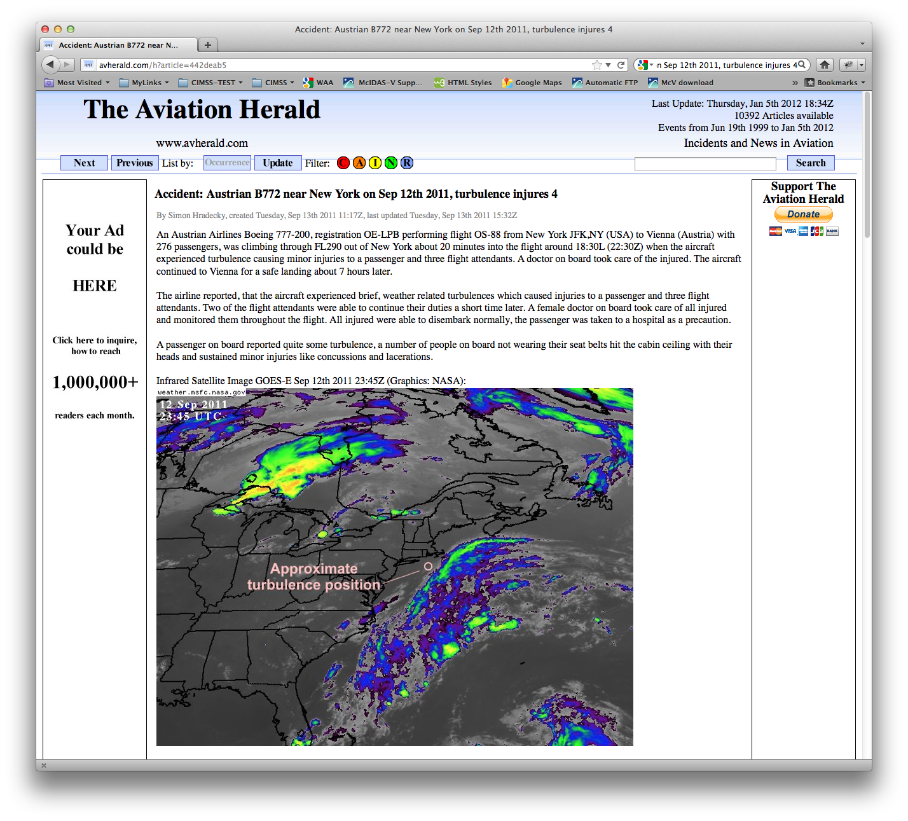
Notes:
GOES-R risk reduction and the GOES-R proving ground are two projects where it is an advantage to have a tool such as McIDAS-V. Interest in products which can predict turbulence risk between model times or over ocean is not only a meteorological questions, but also of concern to the airline industry and the general public. While a 2D satellite image can provide enough information to make decisions, the 3D capabilities can enhance the understanding of the meteorological situation.
<SPEAKER CLICK> Austrian Air flight 88 experienced brief turbulence, causing injury to passengers and flight attendants. Using McIDAS-V, CIMSS scientists developed a case study highlighting the Tropopause Fold Product.

Slide 11
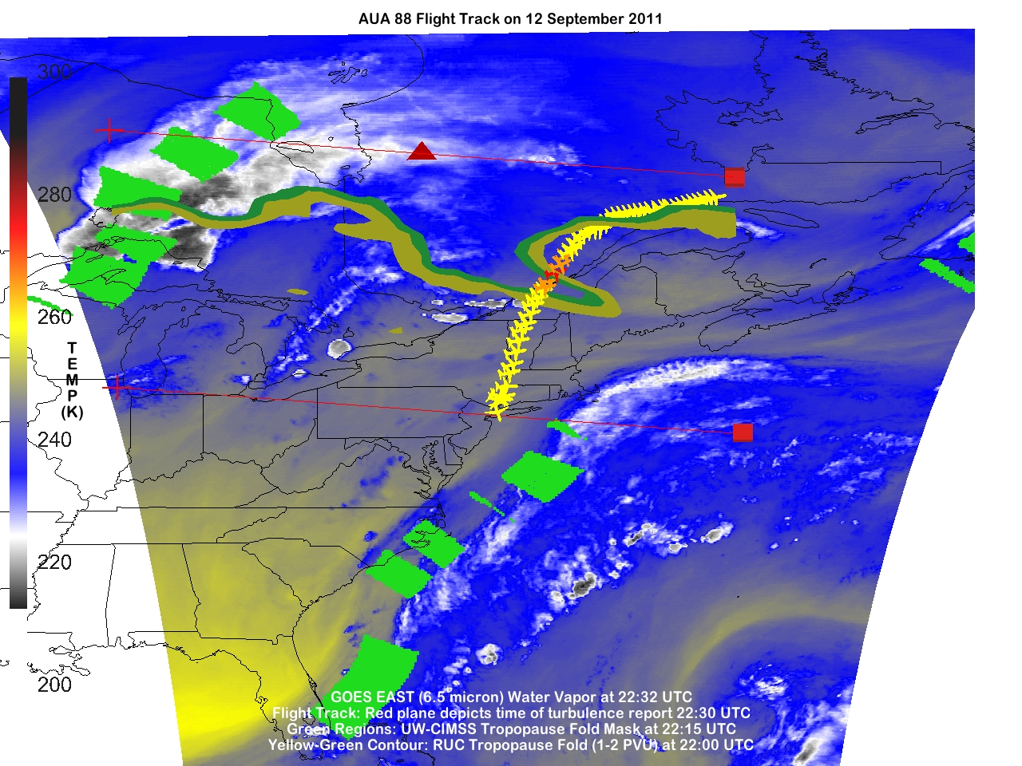
Tropopause Fold Turbulence Product: Anthony Wimmers (CIMSS)
Notes:
The tropopause fold product uses gradients in the GOES water vapor channel to refine possible locations of the tropopause fold. The underlying image is a color-enhanced water vapor image which helps to emphasize where the gradients in water vapor exists. Regions where the product indicated an increased probability of folding are displayed with green boxes. The tropopause fold as analyzed by the RUC is displayed in the yellow and green contours. The location where the plane experienced turbulence is shown by the a red plane. This image alone, shows that the plane experienced turbulence as it flew through a tropopause fold.

Slide 12
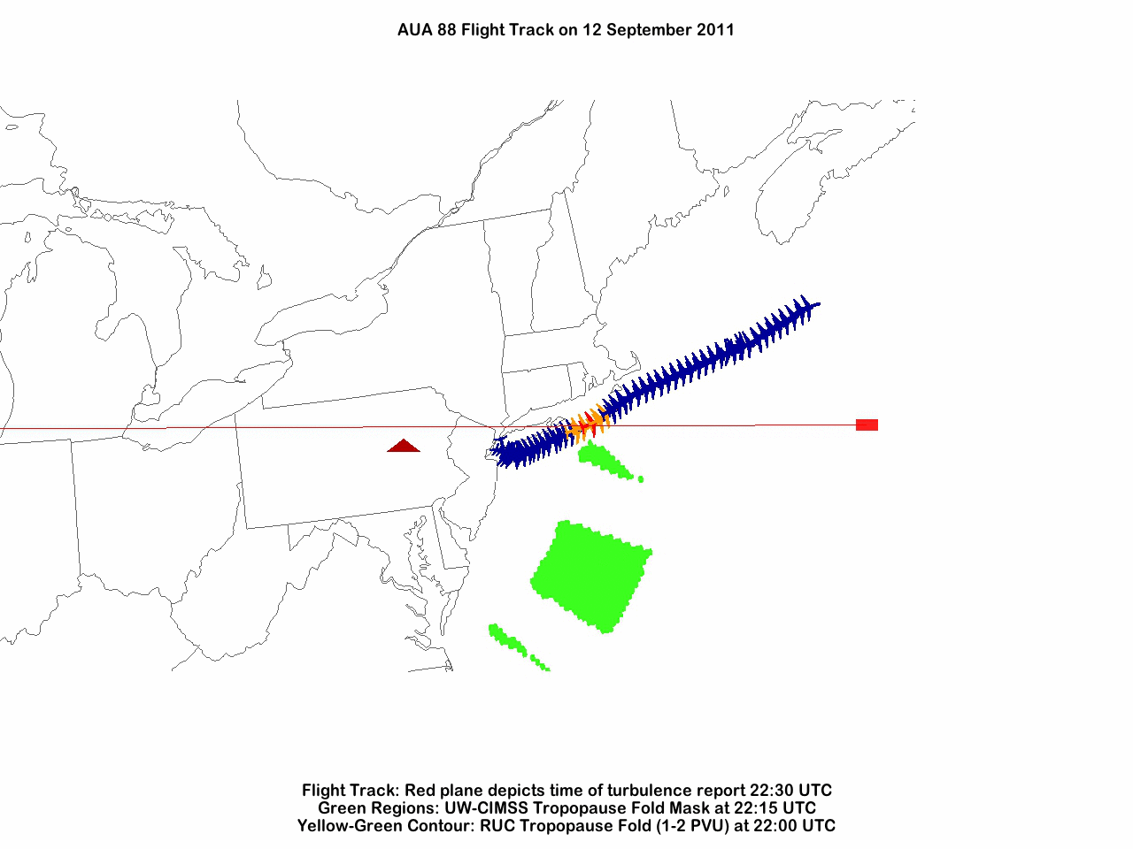
Tropopause Fold Turbulence Product: Anthony Wimmers (CIMSS)
Notes:
A bundle was used to create a rotating movie from a script. McIDAS-V provides a robust means to analyze data with the 3D interactive display. This loop was very useful in demonstrating the capability of this product to the general public.

Slide 13
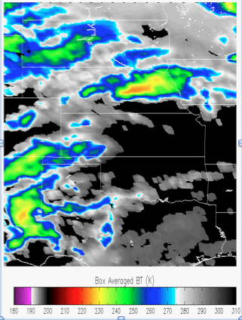
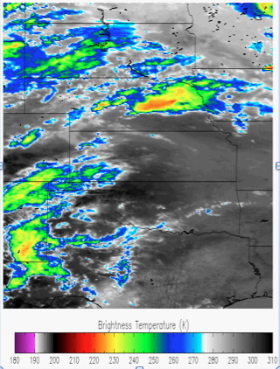
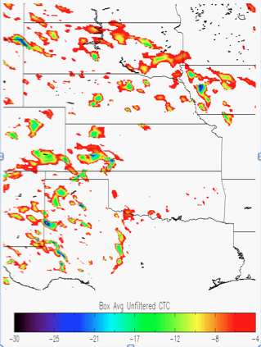
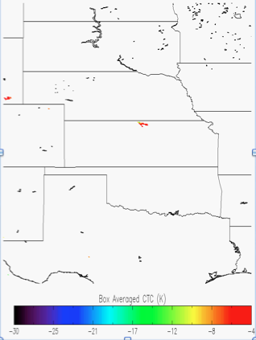
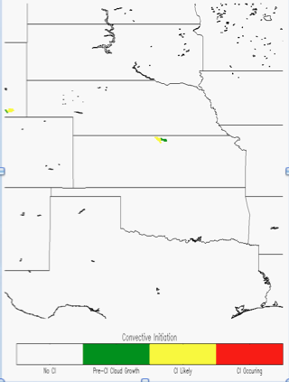
UW Convective Initiation / Cloud Top Cooling (UWCI/CTC) Algorithm
High-level algorithm overview
Compute box-averaged 11 micron brightness temperature (BT) for current time and previous time, using specific categories from GOES Cloud Typing product
Unfiltered Cloud Top Cooling (CTC) Rate is calculated by differencing box average 11 micron BT for current time from previous time
Large/small box approach eliminates most of false CTC due to cloud motion (and additional checks reduce false cooling further)
Combine cloud-top cooling information with cloud-top microphysical (phase/cloud type) transitions for convective initiation nowcasts
Reference: Sieglaff et al., 2011
13
Notes:
The UW Convective Initiation Product is a successful real-time tool to assess the risk of a convective storm. Rapidly cooling storms are often rapidly growing storms. This product was developed by Kris Bedka while working at CIMSS, Justin Sieglaff has taken over the project at CIMSS and continues to develop the work. A brief algorithm overview.
In the next slide, the results of the cloud top cooling portion of the algorithm are used.

Slide 14
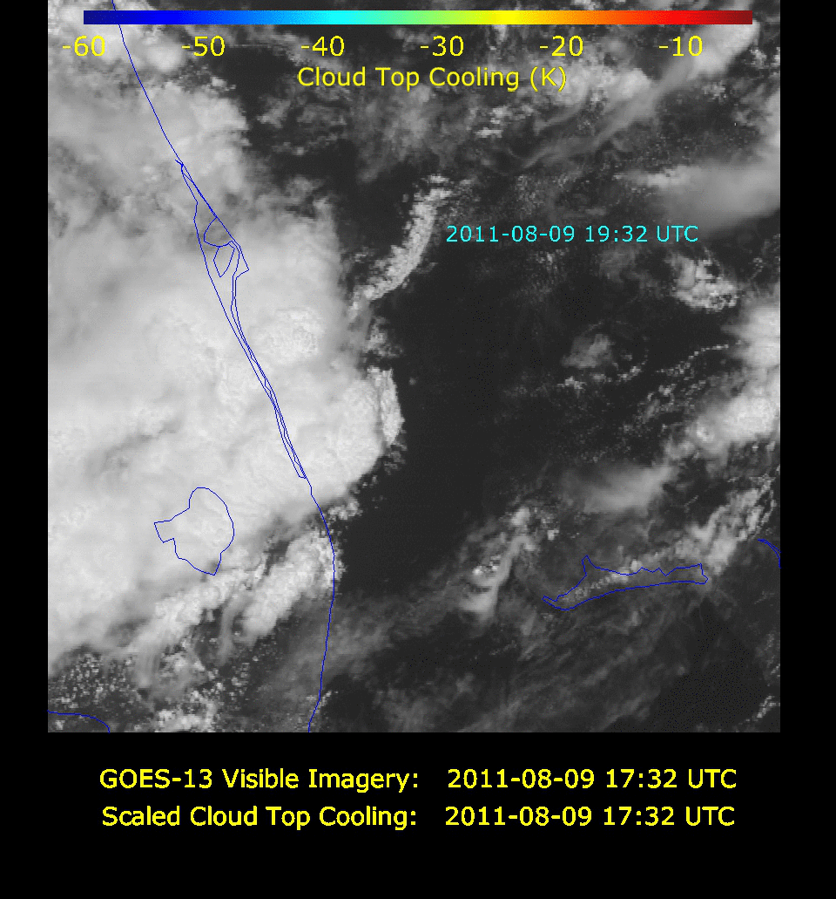
Justin Sieglaff , Lee Cronce, Dan Hartung, Wayne Feltz (CIMSS)
Notes:
This movie displays a GOES-R Scaled Cloud Top cooling product. The location where the plane experience turbulence is shown by the blue text (the top of the “2” is the pixel location). In the hour before the plane crossed the region where turbulence was reported, rapid cloud top cooling was signaled by the product indicating a rapidly developing storm (18:32 UTC). Looking at the flight track around the storm in the satellite imagery, the pilot tried to avoid the major cloud shield, but turned into a line of storms which had developed rapidly and were still turbulent. It may have been difficult to avoid turbulence in this situation.

Slide 15
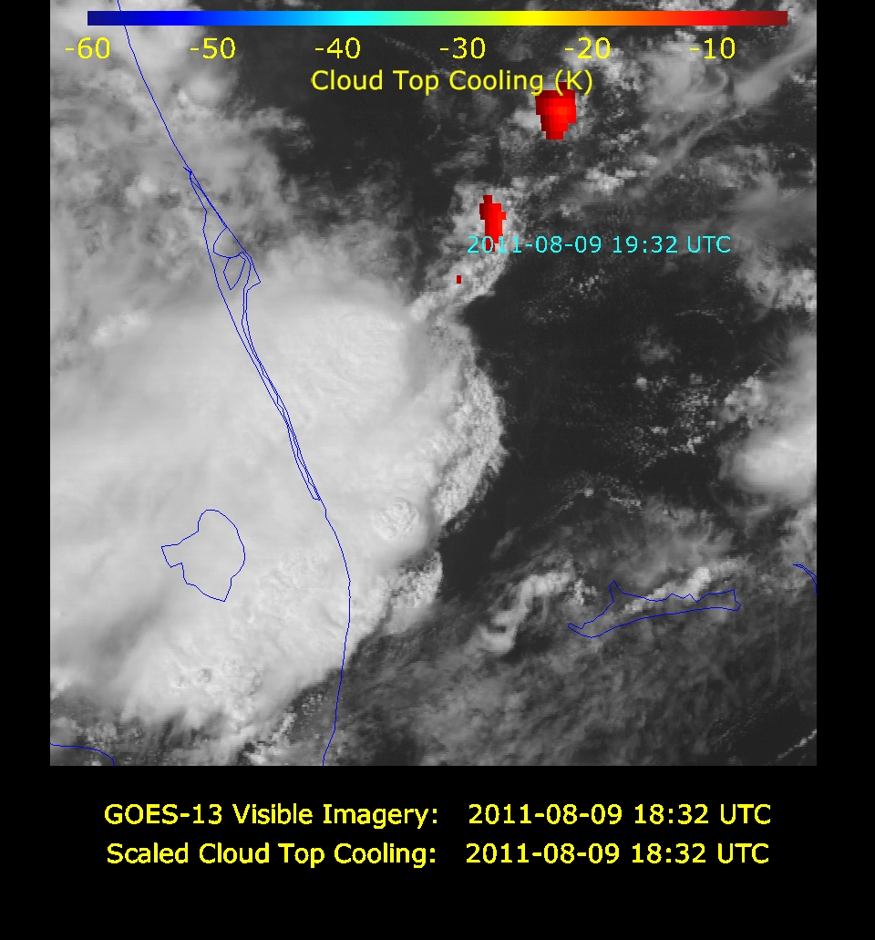
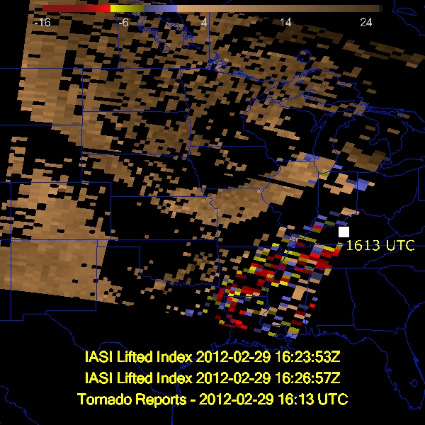
Files without time as a dimension
Time information in metadata and filename.
NCML allows the user to assign time information to the grids.
Grids must share same dimensions and navigation.
Data without a time dimension can be useful:
Show multiple polar orbiting granules in one frame
When comparing with data that does not share a timestamp (e.g. comparison of geostationary to polar oribiting imagery)
Notes:
Make a point. McIDAS-V requires that time is supplied as a dimension in order to create a time series. The Cloud Top Cooling product contains this information only in the metadata and the filename. While NCML makes it easier to load this data and assign a time to each grid, this works only on grids with the same dimensions and navigation. There are times when it may be easier to compare data when the time dimension is omitted. For example: a comparison of a geostationary loop and a polar oribiting product., but many times, it is inconvenient to have no simple way to use the metadata or filename to obtain time information.

Slide 16
It is possible to create a time series of polar oribiting data
Tom Rink wrote a formula which allows the user to supply a list of flat fields and a list of times from which an image sequence is created
Have only used it in the jython shell because an array of grids and times is used.
Could this easier?
Allow the user to assign a time either manually, automatically from the metadata, or filename pattern matching
Allow user to assign a time to a single image/grid
Make this available from the field selector
Should it be easier?
Notes:
It is possible to create an image sequence of polar orbiting data, but is it easy enough for a new user to McIDAS-V. Tom’s formula is not distributed with the McIDAS-V build.
Many datasets that don’t have time as a dimension, a number of polar orbiting products and GOES-R products contain time only in the meta data. This causes unexpected problems. Could this process can be made more uniform for all image data types.
Finally, what is the interest in this problem? Should the programmer’s spend time on this?

Slide 17
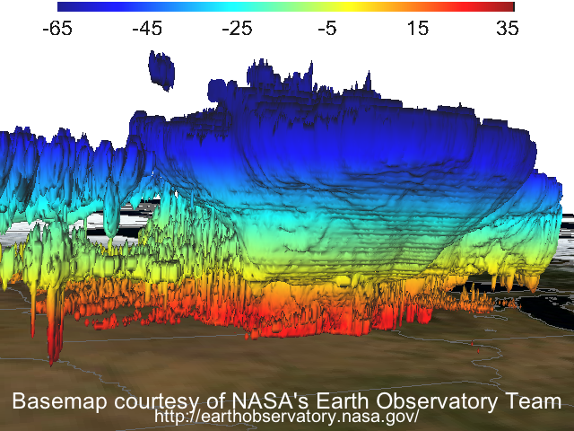
Public Outreach
Temperature (°C)
NSSL WRF Simulation of Thunderstorm Complex: Jason Otkin (CIMSS)
Notes:
NSSL WRF model is being used as proxy data for the GOES-R proving ground. Last summer, the work of the center was highlighted at the Madison Airport. This was an opportunity to convey the importance of our work to the public. This same model field could have been shown as a series of 2D images, which while conveying similar information, would have been more difficult to capture the attention of the general public. The 3D display of McIDAS-V provides of more tangible way to display complex concepts. This is an mixing ratio colored by temperature.

Slide 18
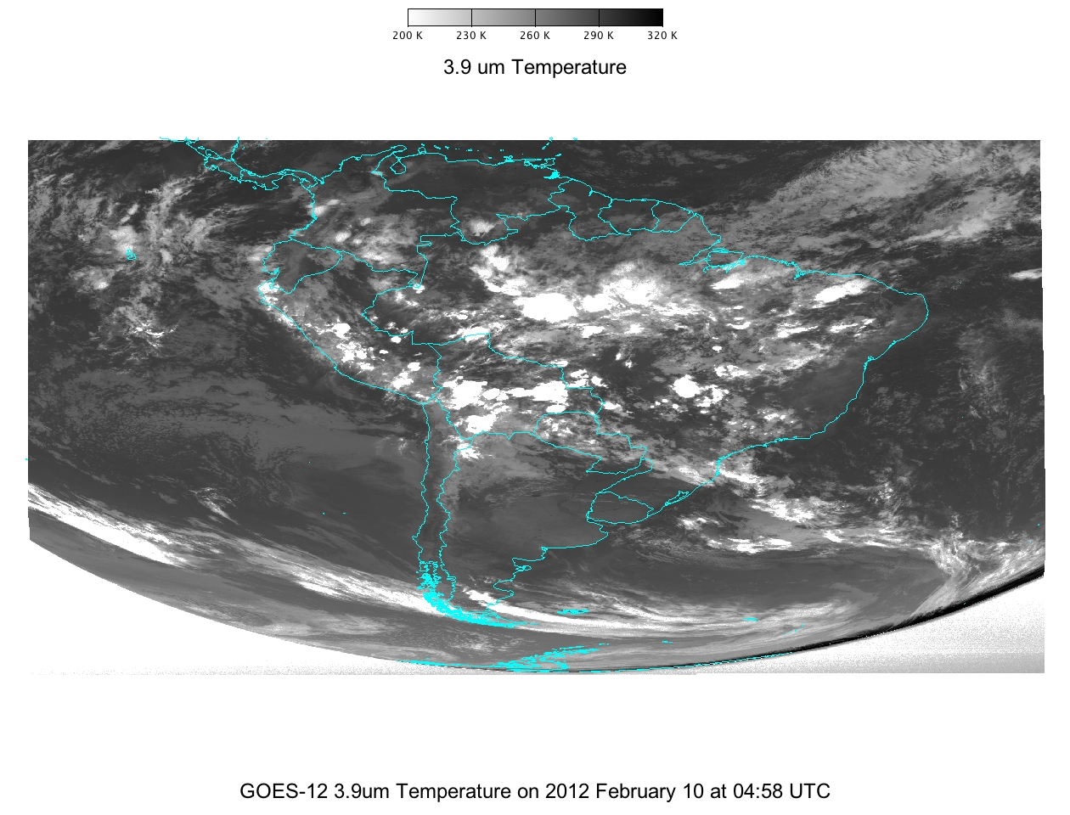
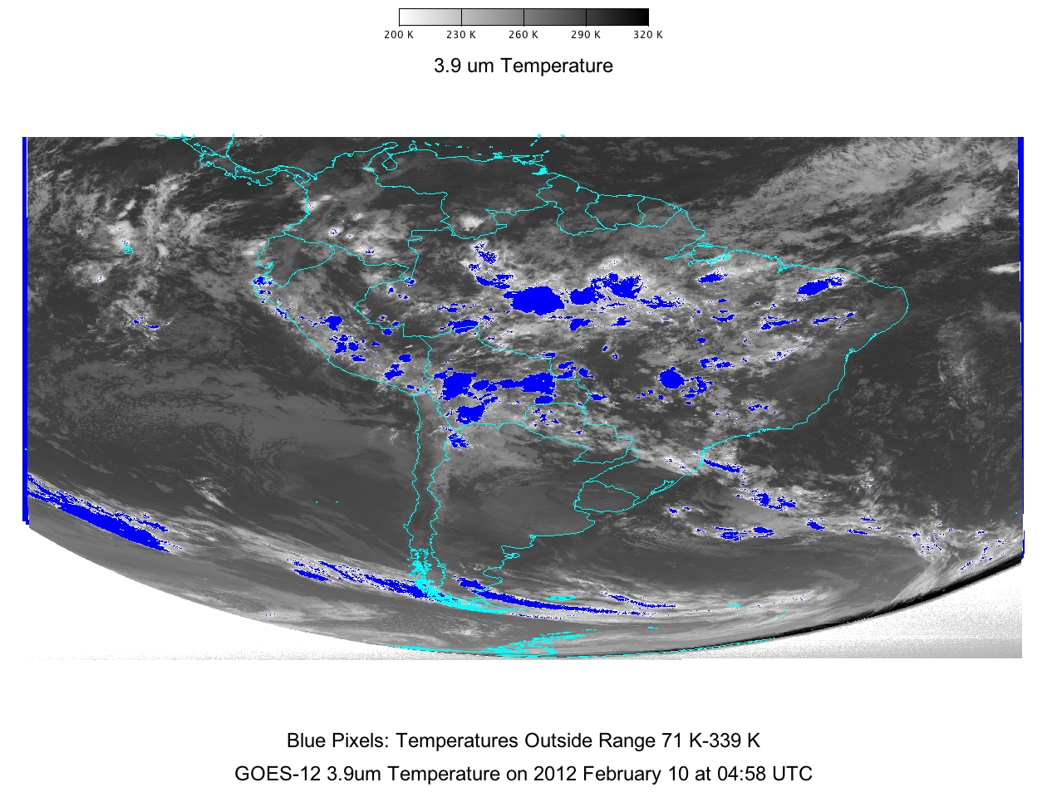
Calibration/Validation
findWithinRange
createAreaField
computeSum
maskWithinRange
Notes:
There is a wrap around issue with very hot pixels in GOES-12. Pixels which exceed saturation temperature will either be returned as very hot (values at or near saturation) or too cold (physically unrealistic values). CIMSS scientist wish to automate the detection of these pixels and determine the size of the areas affected in any image. To help achieve this goal, programmers refined the existing mask and find methods to allow the scientist to the indices of pixels within a specified range. This information can be used in combination with the recently developed methods of createAreaField(returns the area of any given pixel in the field) and computeSum (sums the values) to provide the information needed. This new functionality occurred because of a close collaboration between scientists and developers.
Just a note: I need to group the regions so that I can classify size of region by grouping and remove the detects due to the satellite edge (when necessary).

Slide 19
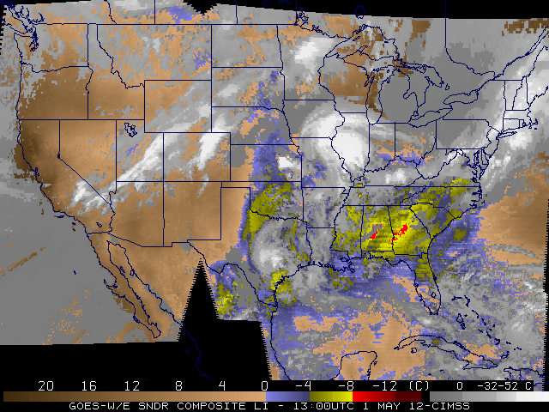
McIDAS-X Products in McIDAS-V
GOES Sounder DPI: Lifted Index/ Cloud Top Temperature
Notes:
The GOES Sounder DPI products are routinely made in McIDAS-X. In these areas, two fields are contained: in this case it is the lifted index and the cloud top temperature. In McIDAS-X, a stretch table is applied to provide the correct scale for the two products on one color bar.

Slide 20
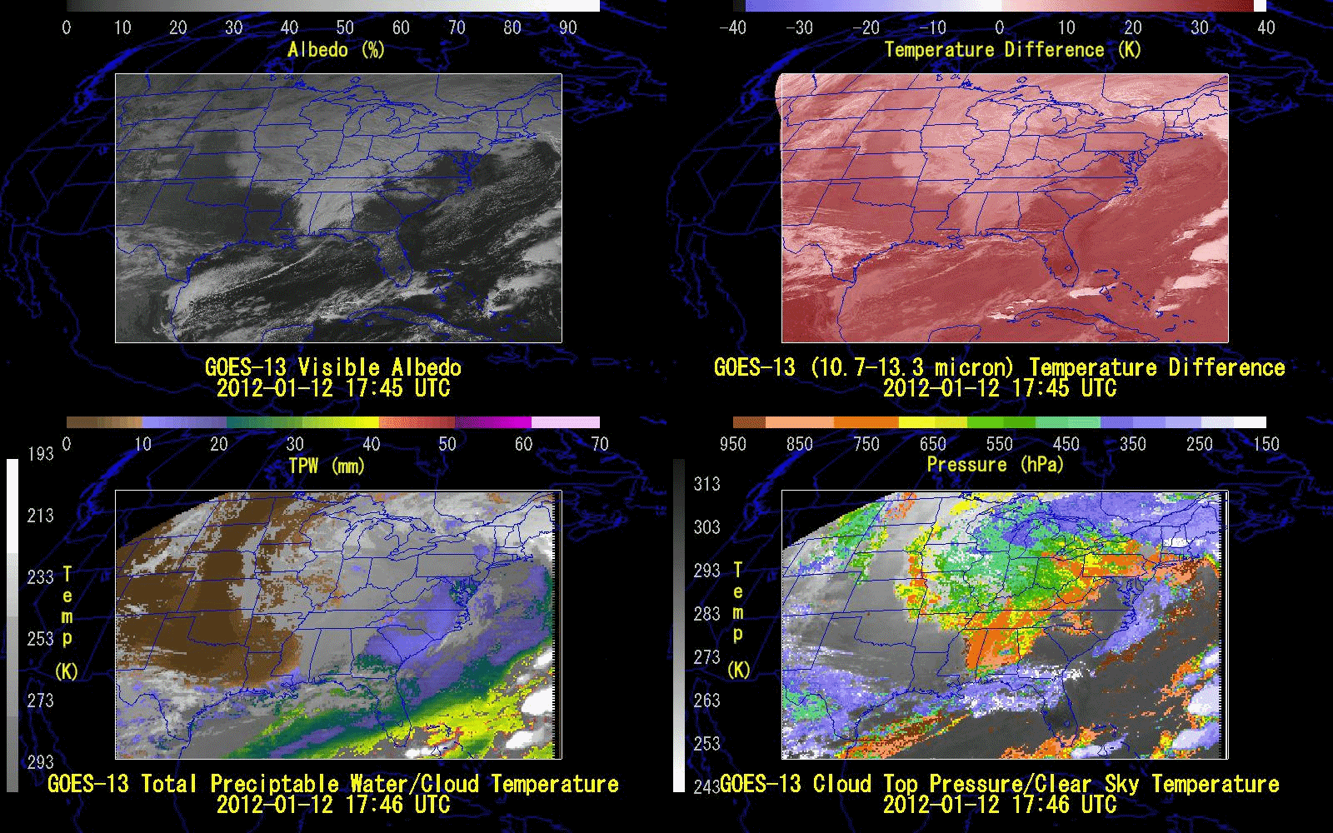
GOES Sounder DPI: Gary Wade, Tim Schmit, Tony Schreiner
Notes:
Traditional Data in traditional form, displayed with the capability of McIDAS-V. The mask function now allows the user to redefine a values set to signify missing data to NaN. This provides an easy way to display the GOES Sounder DPI products which contain both a product value and a clear sky/or cloudy temperature in one McIDAS-V area. In McIDAS-V, the two layers provide more flexibility for adding color bars and each layer can have a full and independent color bar.

Slide 21
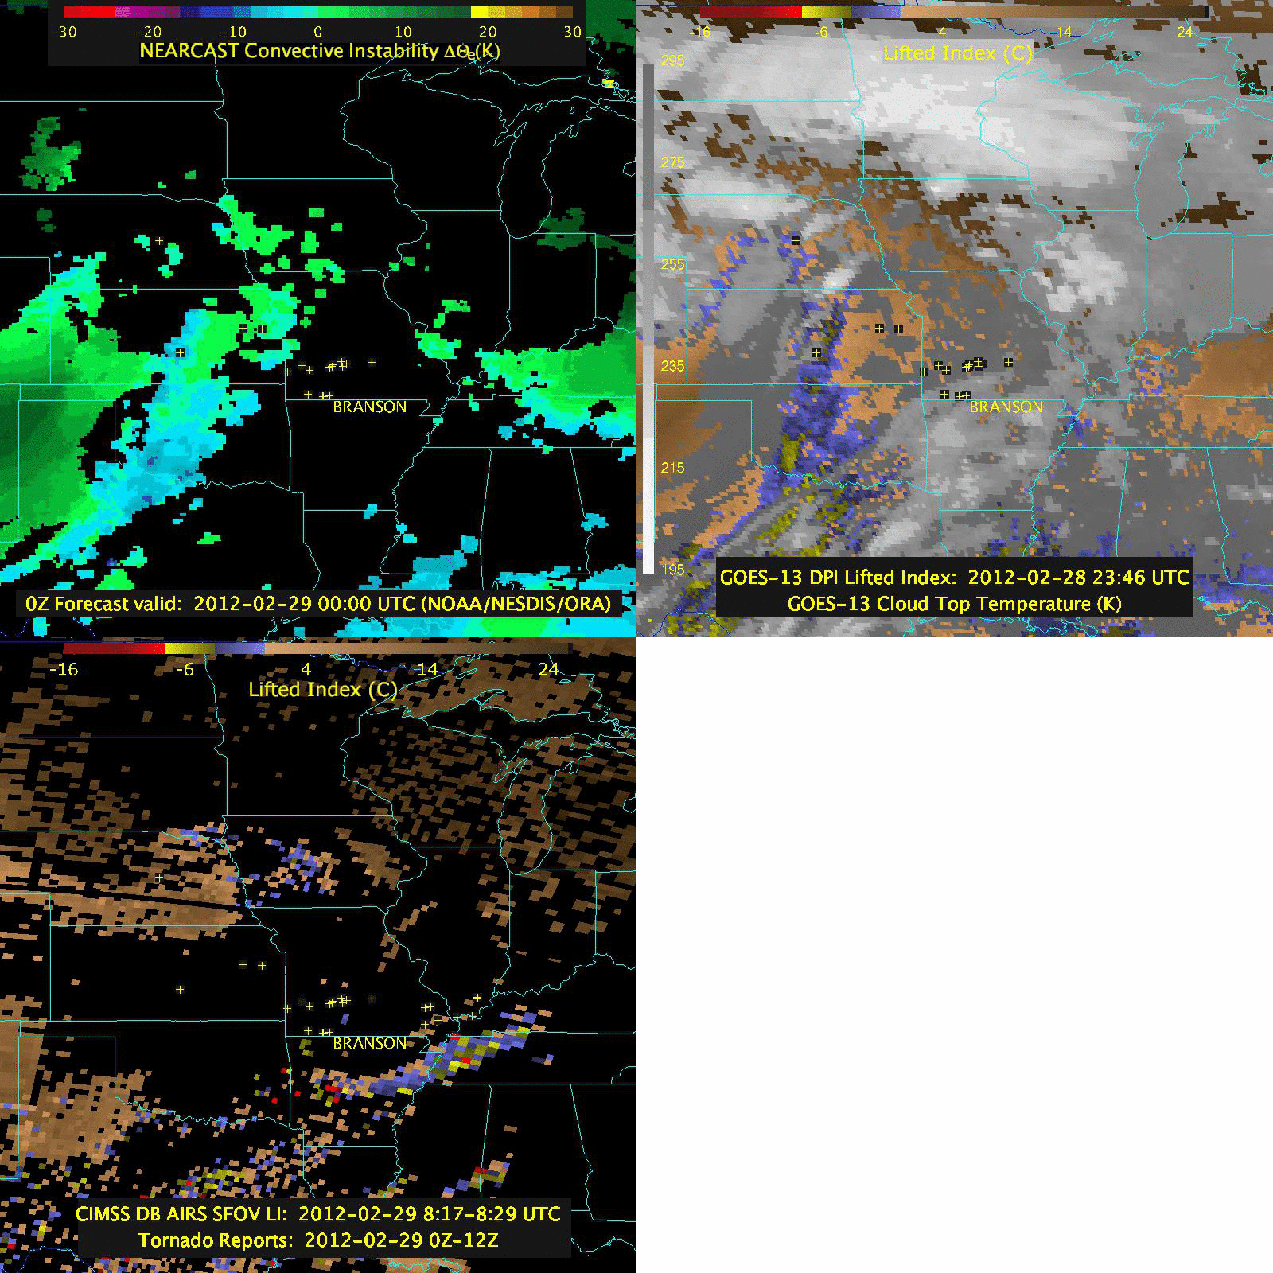
NEARCAST Convective Instability: Ralph Peterson
UWAIRS Dual Regression Algorithm: Elizabeth Weisz
Notes:
On February 29th, 2012, a tornado formed and tracked through Branson, Missouri after midnight. The NEARCAST convective instability product predicted rapid destabilization in the immediate region of Branson at the time of the severe weather. The major input to the NEARCAST product are derived from the GOES sounder, similar to the DPI. This image is a comparison between the product results of the NEARCAST convective instability, the GOES sounder lifted index derived product imagery and the AIRS Dual Regression Lifted Index from an overpass near to the reported tornado formation. Crosses indicate other reported tornadoes in a 12 hour period beginning on Feburary 28th, 2012 at 0 UTC and ending on February 29th, 2012 at 12 UTC. This image demonstrates the ability of McIDAS-V to display multiple data formats, hdf, grib, McIDAS AREA format and point data. In addition, comparison between polar orbiting and geostationary satellites is made easier by the sharing of displays and automatic remapping of data.

Slide 22
McIDAS-V Forums
http://dcdbs.ssec.wisc.edu/mcidasv/forums/
CIMSS Proving Ground Website
http://cimss.ssec.wisc.edu/goes_r/proving-ground.html
GOES Sounder DPI
http://cimss.ssec.wisc.edu/goes/rt/sounder-dpi.php
International MODIS/AIRS Processing Package
http://cimss.ssec.wisc.edu/imapp/
Notes:
The GOES Sounder DPI products are still being displayed in McIDAS-X. (The stretch table, one color scale version).

