Slide 1


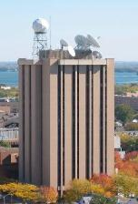
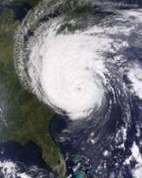


NWP opportunities with the Advanced Baseline Imager (ABI)
on the GOES-R series
  Timothy J. Schmit (tim.j.schmit@noaa.gov)
NOAA/NESDIS/Satellite Applications and Research
Advanced Satellite Products Branch (ASPB)
World Weather Building
Science Center
5200 Auth Road, Room 707
Camp Springs, MD 20746
JCSDA Seminar
14 December 2011
UW-Madison
Notes:
Version of Dec 6th, 2011

Slide 2

Thanks to…
The JCSDA for the invitation.
Shobha Kondragunta, Brad Pierce, Kaba Bah, Mathew M. Gunshor, Jun Li, Scott Bachmeier, Steve Ackerman, Bob Aune, Don Hillger, Paul Menzel, Steve Ackerman, Tony Schreiner, Jason Otkin, Justin Sieglaff, Jim Jung, Elaine Prins, Joleen Feltz, Wayne Feltz, Jean Phillips, Gary Wade, Don Hillger, Jinlong Li, Jing Zheng, William Straka, Allen Huang, Bob Rabin, the SSEC data center, Mike Pavolonis, Jaime Daniels, ASPB, STAR, NESDIS, NSSL, Steve Weygandt, Haidao Lee, Mark DeMaria, and many others!
GOES-R Program Office (Steve Goodman, Jim Gurka, etc.), NASA, ITT Industries, other industry partners, etc.
You.

Slide 3
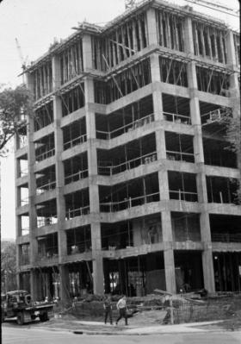
Outline
History
Current GOES Imager and Sounder
  GOES-14/15
ABI (Advanced Baseline Imager)
  Temporal
  Spatial
  Spectral
Select Products
High Spectral resolution
Summary
  More information
  Questions

Slide 4
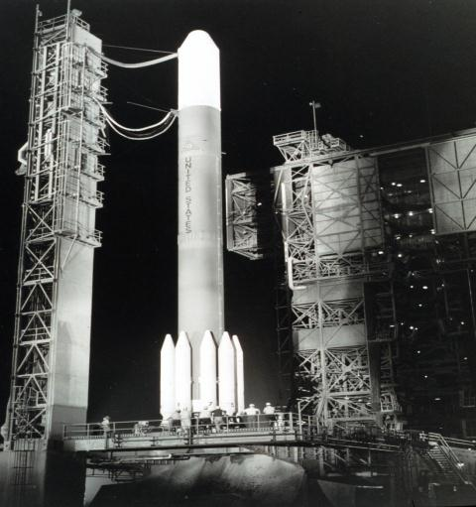
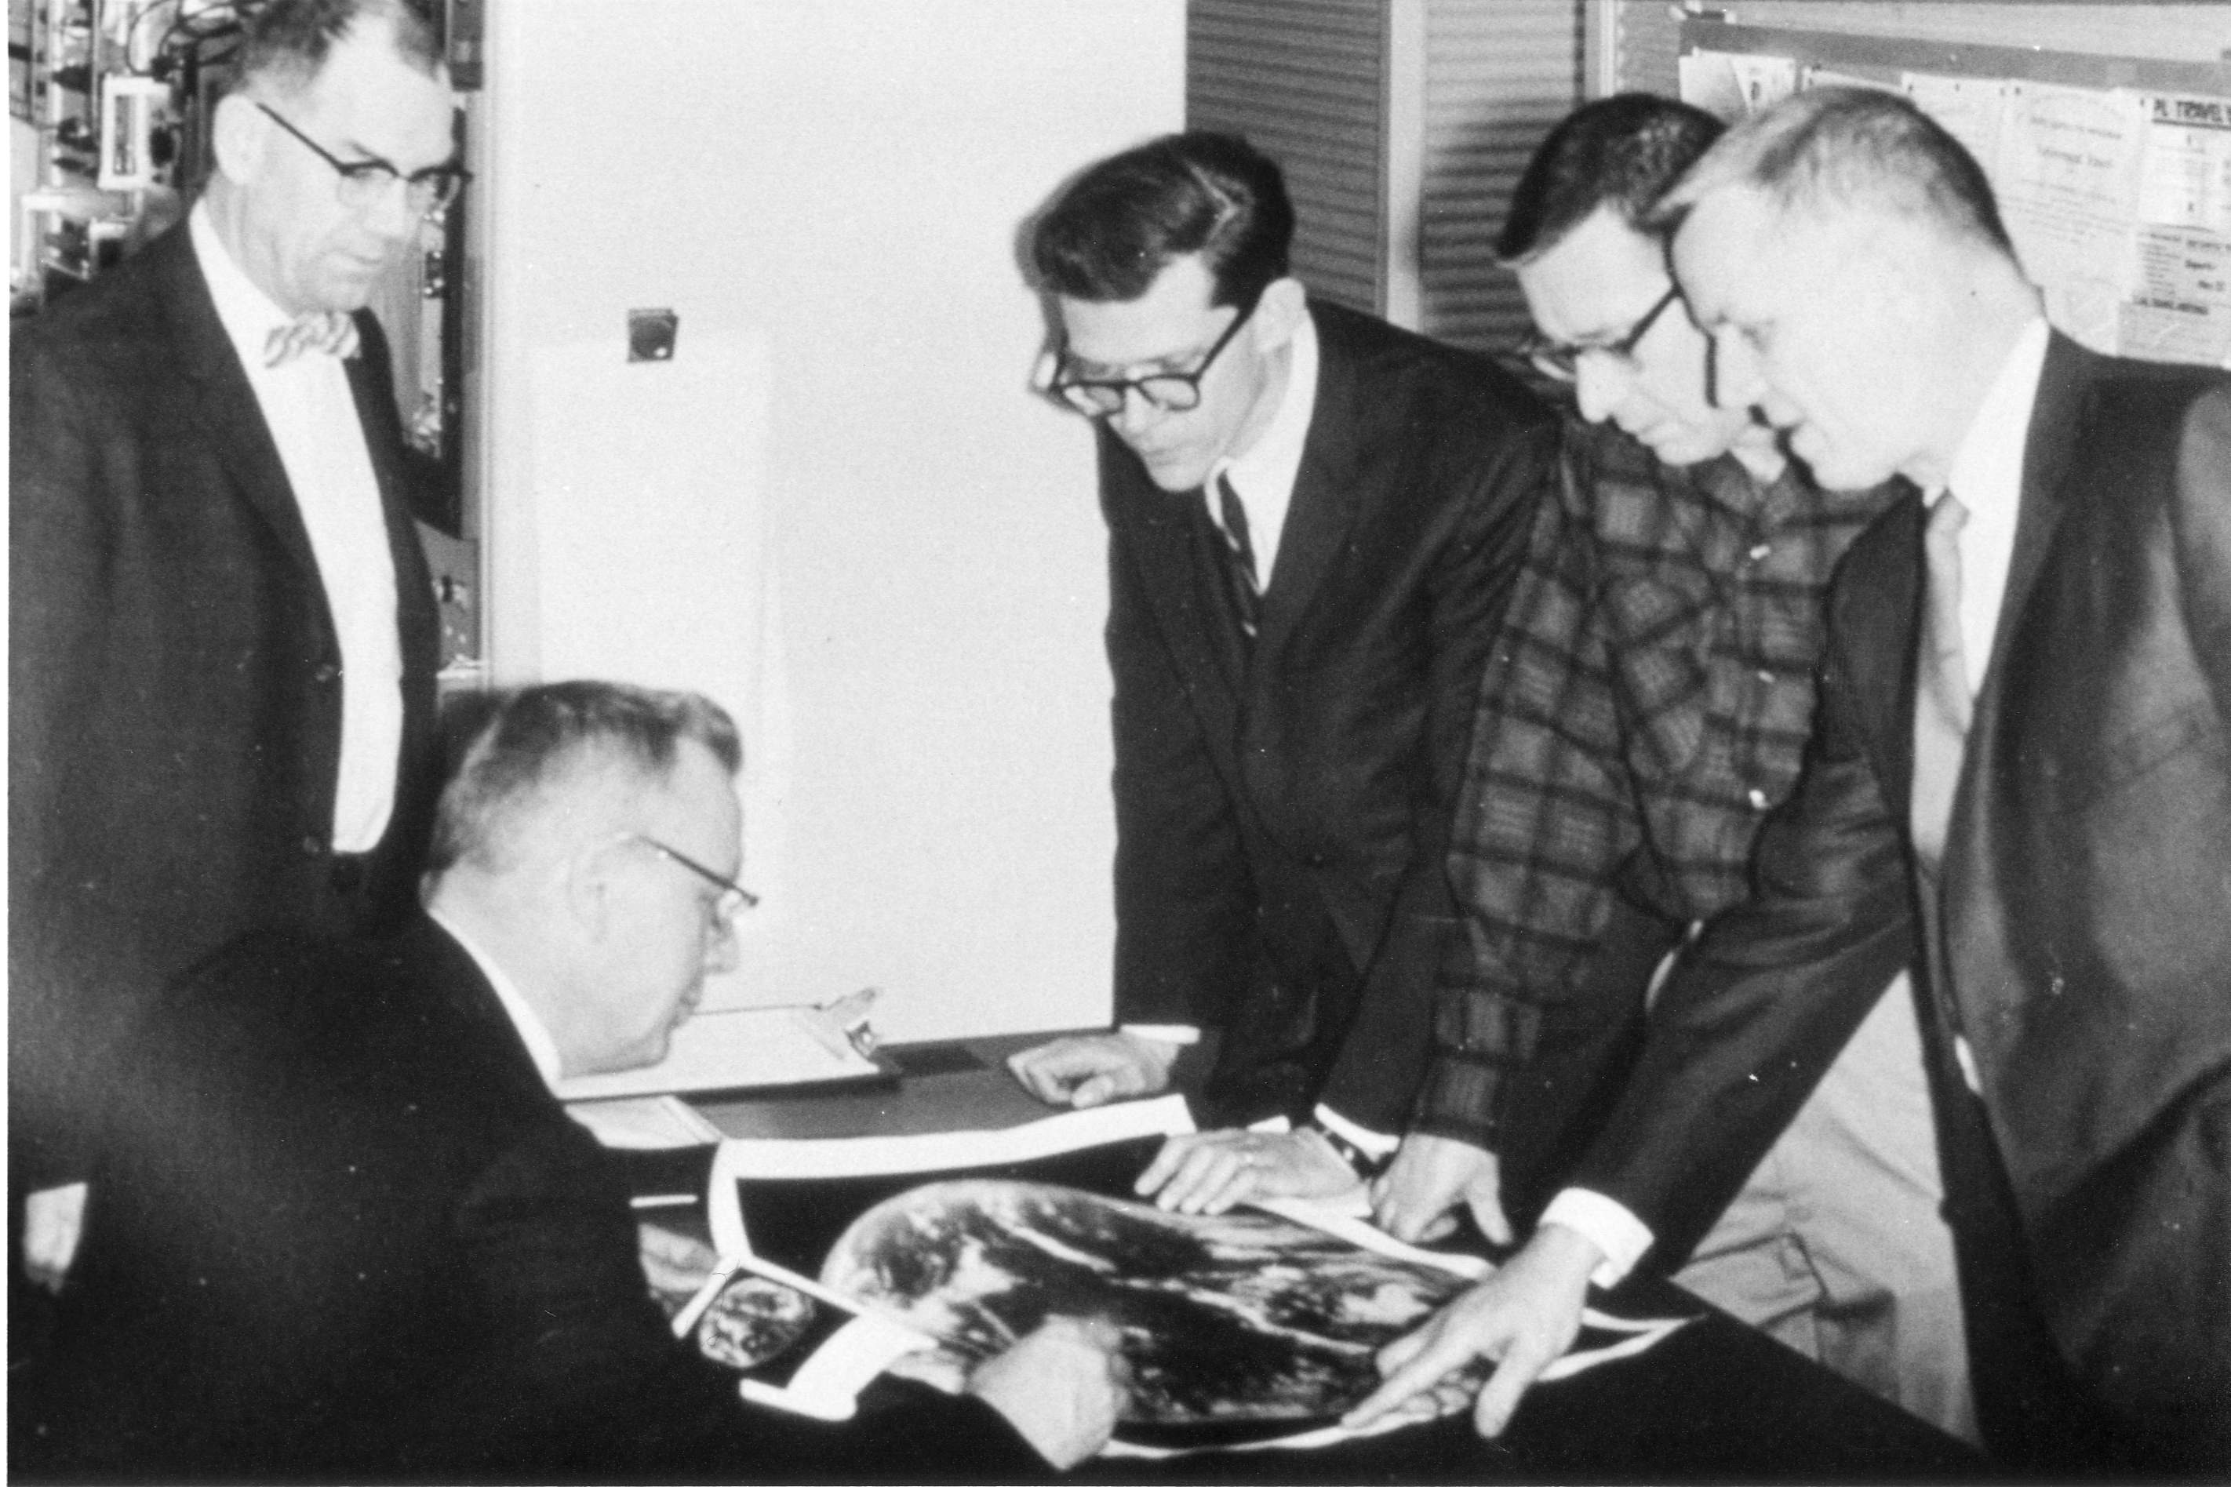
On 6 December 1966 the Applications Technology Satellite (ATS-1) was launched. We have had the benefit of the geostationary perspective for 45 years!
ATS-1's spin scan cloud camera (UW’s Suomi and Parent 1968) provided full disk visible images of the earth and its cloud cover every 20 minutes. The spin scan camera on ATS-1 occurred because of an extraordinary effort by Verner Suomi and Homer Newell, when the satellite was already well into its fabrication.

Slide 5
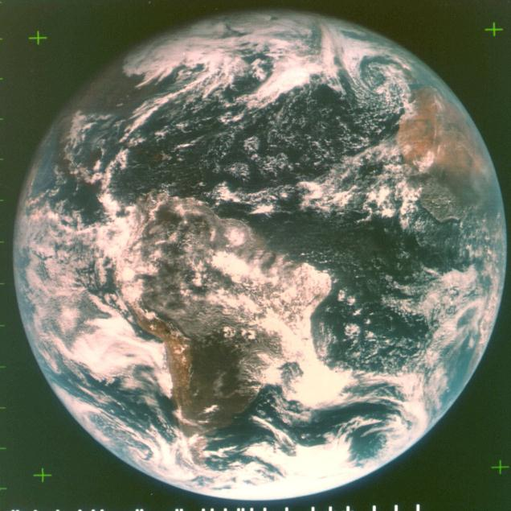
ATS-III 18Nov1967 15UTC

Slide 6
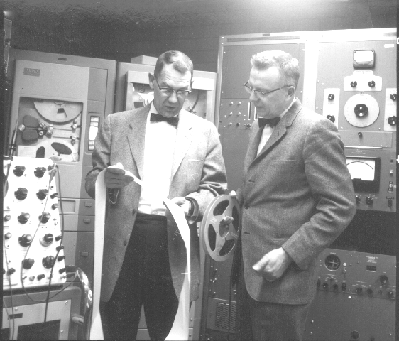
Verner E. Suomi and Robert J. Parent

Slide 7
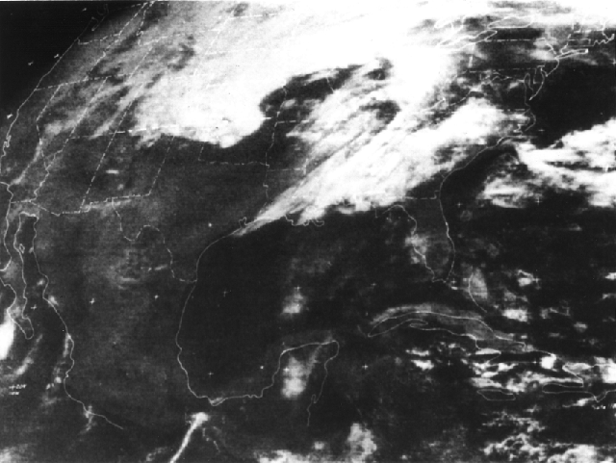
ATS-3: Visible (3 April 1974)
ATS -3

Slide 8
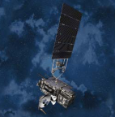
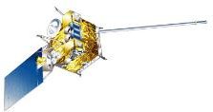

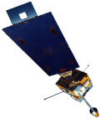
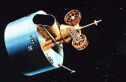
GOES History
GOES-1/3
Launched
1975
1977
1978
One visible and one infrared .
Operational.
GOES-4/7
Launched
1980
1981
1983
1987
VISSR–VAS visible, 12 IR. MSI (visible, IRW, and 2 additional IR channels)
GOES-8/12
Launched
1994
1995
1997
2000
2001
3-axis stabilized.
Imager Bands: 4 IR; 1 visible.
Operational Sounder
(18 IR bands)
GOES-13/14/15
Launched
2005
2009
2010
Better navigation and calibration.
No eclipse outages.
Better spatial resolutions for the 6.5 um on GOES-12+ and the 13.3 um band on GOES-14/15.
Operational Sounder
GOES-R/S+
Planned Launch
2015
2017
2020
2025
Faster coverage.
16 Imager Bands.
Improved spatial.
No sounder.
GLM
Notes:
The circles represent an estimate of the impact of GOES on regional scale numerical models.

Slide 9
Impact Study of RAOB, GOES, and POES data on Eta Data Assimilation System
RAOBs, GOES and POES all contribute unique information!
Zapotocny, T. H., W. P. Menzel, J. A. Jung, and J. P. Nelson III, 2005: A four season impact study of rawinsonde, GOES and POES data in the Eta Data Assimilation System. Part I: The total contribution. Wea. Forecasting, 20, 161-177.
Zapotocny, T. H., W. P. Menzel, J. A. Jung, and J. P. Nelson III, 2005: A four season impact study of rawinsonde, GOES and POES data in the Eta Data Assimilation System. Part II: Contribution of the components. Wea. Forecasting, 20, 178-198.
Zapotocny, T. H., W. P. Menzel, J. P. Nelson III, and J. A. Jung, 2002: Impact Study of Five Satellite Data Types in the Eta Data Assimilation System in Three Seasons. Weather and Forecasting, 17, 263-285.

Slide 10
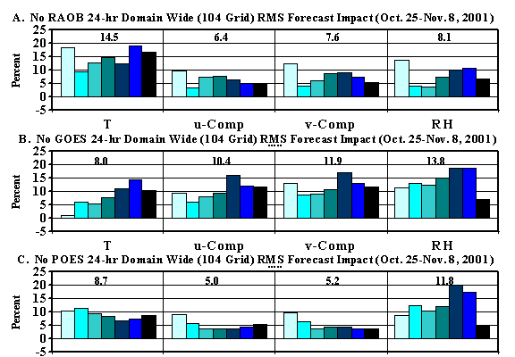
Oct 2001 forecast impact (%) for T, u, v, RH fields
after 24-hrs of Eta model integration
Zapotocny, 2005
Notes:
Time averaged forecast impact (%) results for four standard meteorological fields after 24-hrs of Eta model integration for the No RAOB (A), No GOES (B) and No POES (C) experiments. Results for the 104 grid are shown. The time period examined utilizes a 32 km EDAS for both the assimilation and forecast and extends from 0000 UTC 25 October 2001 through 1200 UTC 08 November 2001.
Raob impact decreases %5 in summer versus winter

Slide 11
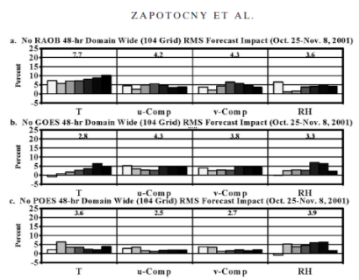
Positive Impact still at 48-hours
Regional forecast impact at 48 h
Overall, the forecast impact from virtually every parameter, data type, and level decreased from 24 to 48 h.
Some impacts decreased by as much as a factor of 3, while others decreased by substantially less.
A drop in forecast impact from 24 to 48 h is not surprising, considering the regional nature of the EDAS and the ever-growing importance of the lateral boundary conditions as the integration proceeds.
Finally, there is limited evidence that global models exhibit the opposite trend, with the importance of some remotely sensed data sources increasing as the length of the integration proceeds (T. J. Schmit, 2003, personal communication).
Zapotocny, 2005
Notes:
Zapotocny, T. H., W. P. Menzel, J. A. Jung, and J. P. Nelson III, 2005: A four season impact study of rawinsonde, GOES and POES data in the Eta Data Assimilation System. Part I: The total contribution. Wea. Forecasting, 20, 161-177.

Slide 12


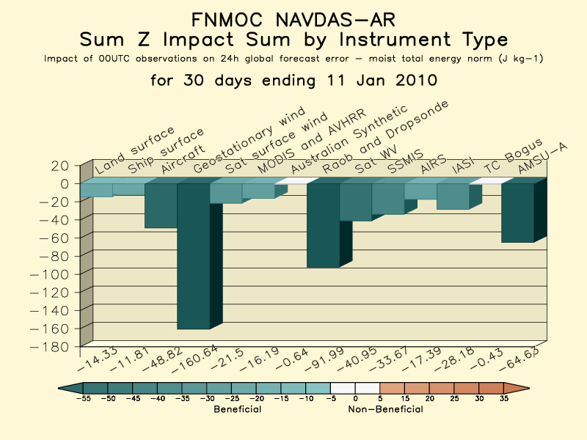
Importance of Satellite Data in NWP http://www.nrlmry.navy.mil/obsens/
Satellite Data has become the single most important component
of the global observing network for NWP
00, 06, 12, 18 UTC Observation Impact Sum
all
1
Nancy Baker, NRL
2
1
6
Negative value denotes improved forecast
Σ Sat Winds = -198.3
Σ Conv = -168.0
Σ Sat Radiances = -143.9

Slide 13
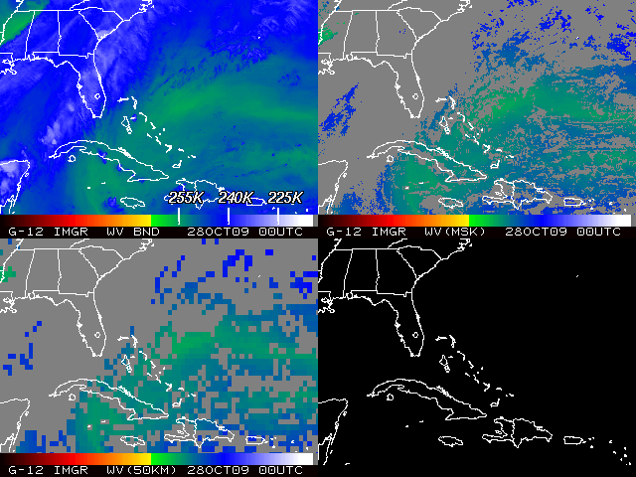
Satellite Data Assimilation
The challenge (from satellite imagery to NWP)!

Slide 14
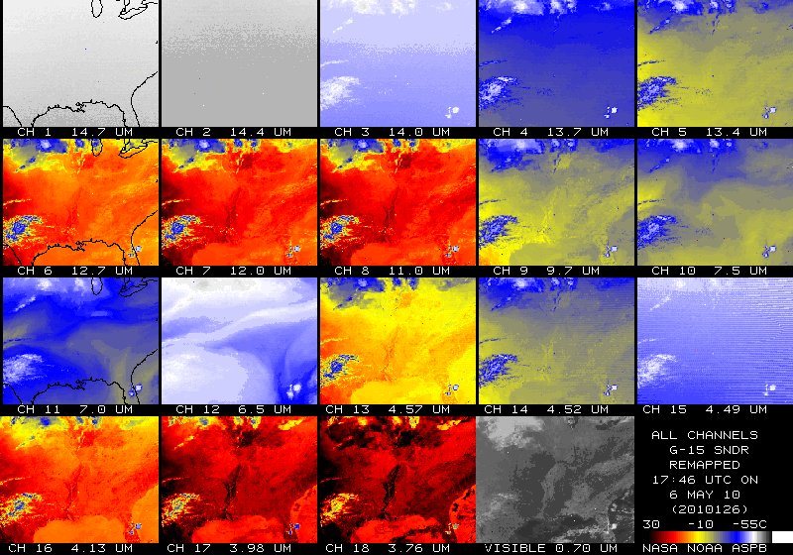
Outline
History
Current GOES Imager and Sounder
  GOES-14/15
ABI (Advanced Baseline Imager)
  Temporal
  Spatial
  Spectral
Select Products
High Spectral resolution
Summary
  More information
  Questions

Slide 15
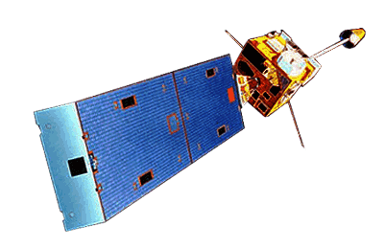
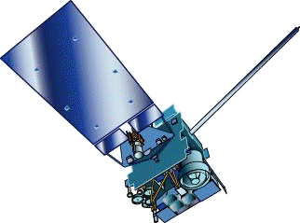
GOES-15
GOES-13/14/15 have similar instruments to GOES-8-12, but on a different spacecraft bus.
Spring and fall eclipse outages will be avoided by larger onboard batteries.
Improved navigation
Improved radiometrics
Similar stray light to GOES-13/14
Operational on Dec 6th, 2011
GOES-8/12
GOES-13/14/15

Slide 16
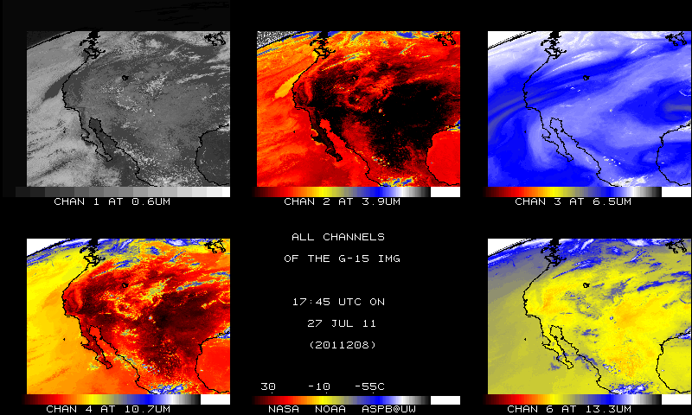
GOES-15 (Imager)
Native projection
From NOAA ASPB

Slide 17
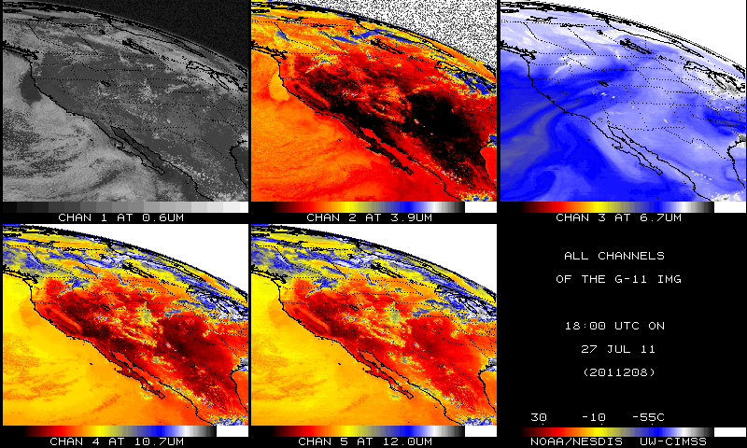
GOES-11 (Imager)
Native projection
From NOAA ASPB

Slide 18
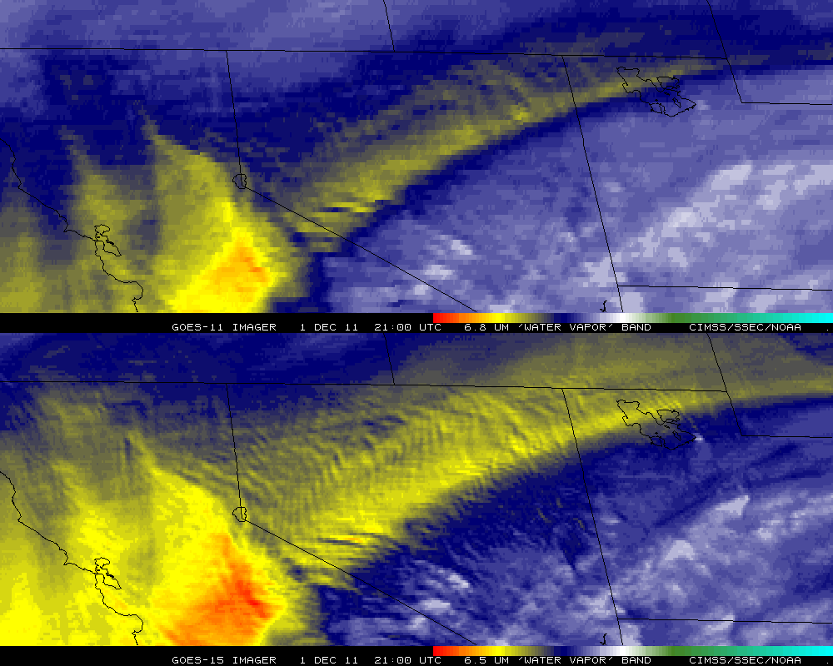
GOES-11 vs GOES-15 (WV)

Slide 19
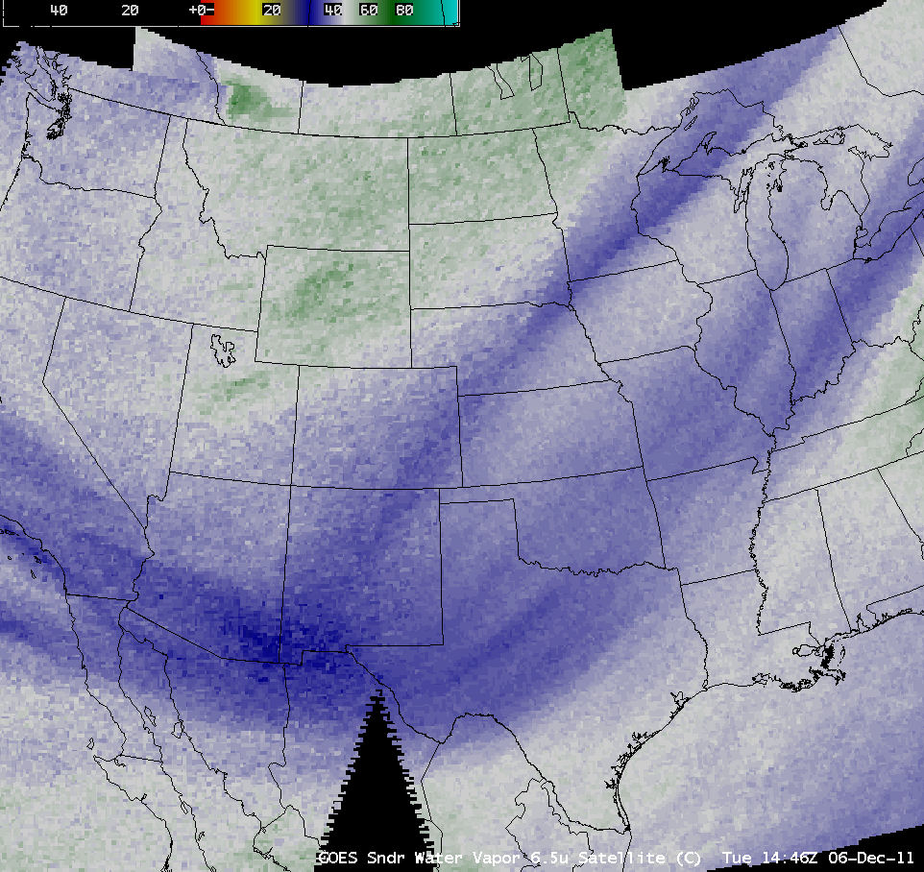
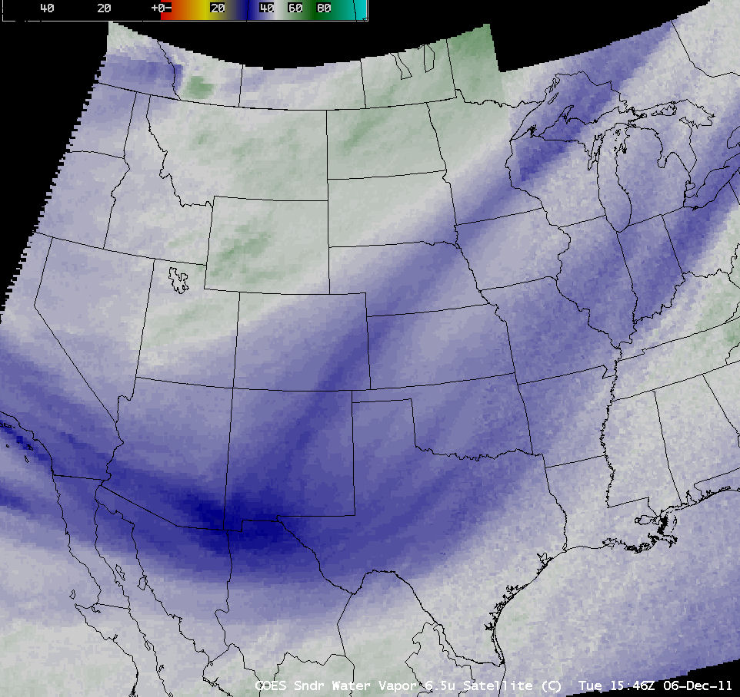
GOES-11 vs GOES-15 (Sounder)
GOES-11
GOES-15
AWIPS – Sounder band 12; 6.5 micrometers

Slide 20
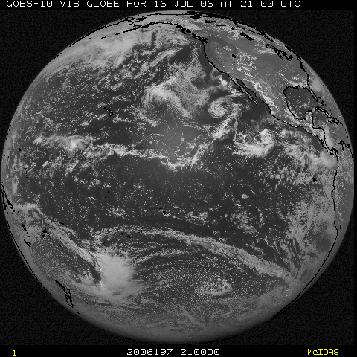
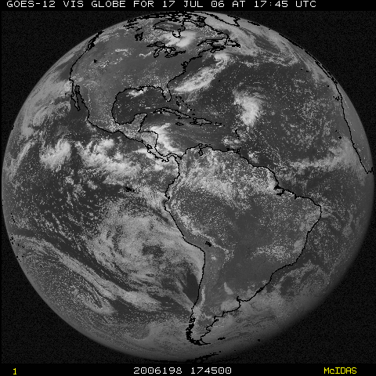
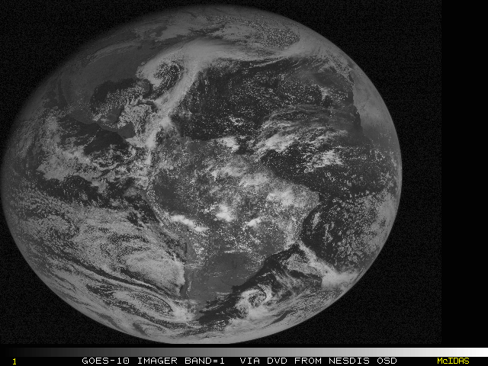
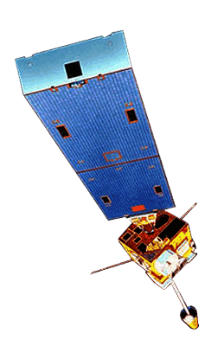
NOAA GOES Constellation
GOES-15
(135W)
GOES-13
(75W)
GOES-14
(105W)
Storage
(spinning)
GOES-12
(60W)
South America

Slide 21
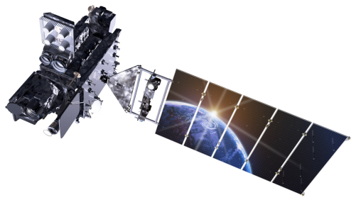
Outline
History
Current GOES Imager and Sounder
  GOES-14/15
ABI (Advanced Baseline Imager)
  Temporal
  Spatial
  Spectral
Select Products
High Spectral resolution
Summary
  More information
  Questions
Lockheed Martin

Slide 22
GOES-R Overview
Advanced Baseline Imager (ABI)
No dedicated Sounder
Geostationary Lightning Mapper (GLM)
Space Weather
  Space Environmental In-Situ Suite (SEISS)
  Solar Ultra Violet Imager (SUVI)
  Extreme Ultra Violet/X-Ray Irradiance Sensor (EXIS)
  Magnetometer
Communications
  GOES Rebroadcast (GRB)
  Low Rate Information Transmissions (LRIT)
  Emergency Managers Weather Information Network (EMWIN)
  Search and Rescue (SAR)
  Data Collection System (DCS)
Notes:
Advanced Baseline Imager (ABI) Earth-viewing
Geostationary Lightning Mapper (GLM) Earth-viewing
Solar Ultra-Violet Imager (SUVI) Sun-viewing
EUVS and XRS Irradiance Sensors (EXIS) Sun-viewing
Space Environment In-Situ Suite (SEISS) Space-viewing
Magnetometer (MAG) Space-viewing

Slide 23
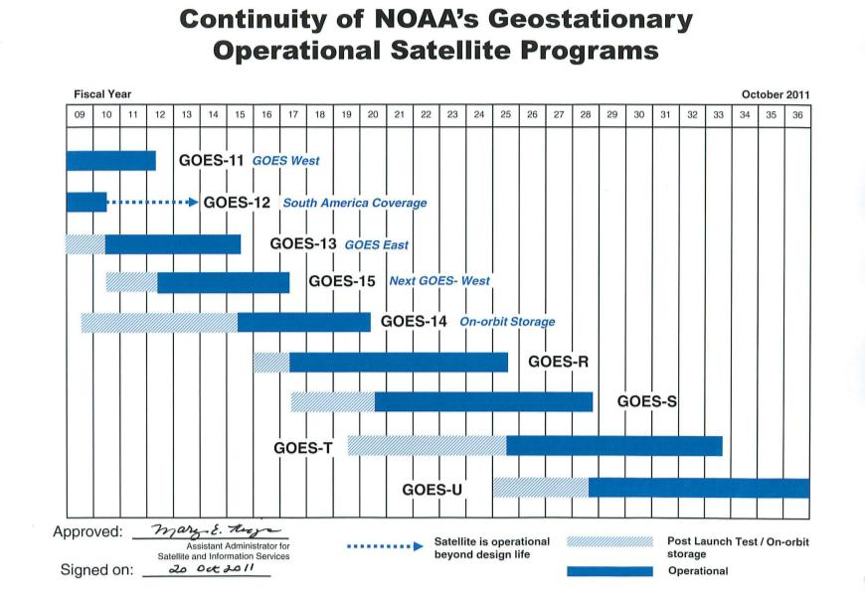
GOES Fly-out
Current plans call for GOES-R to be at 137West
Notes:
Advanced Baseline Imager (ABI) Earth-viewing
Geostationary Lightning Mapper (GLM) Earth-viewing
Solar Ultra-Violet Imager (SUVI) Sun-viewing
EUVS and XRS Irradiance Sensors (EXIS) Sun-viewing
Space Environment In-Situ Suite (SEISS) Space-viewing
Magnetometer (MAG) Space-viewing

Slide 24
The Advanced Baseline Imager:
ABI Current
Spectral Coverage
16 bands 5 bands
Spatial resolution
0.64 μm Visible 0.5 km Approx. 1 km
Other Visible/near-IR 1.0 km n/a
Bands (>2 μm) 2 km Approx. 4 km
Spatial coverage
Full disk 4 per hour Scheduled (3 hrly)
CONUS 12 per hour ~4 per hour
Mesoscale Every 30 sec n/a
Visible (reflective bands)
On-orbit calibration Yes No

Slide 25
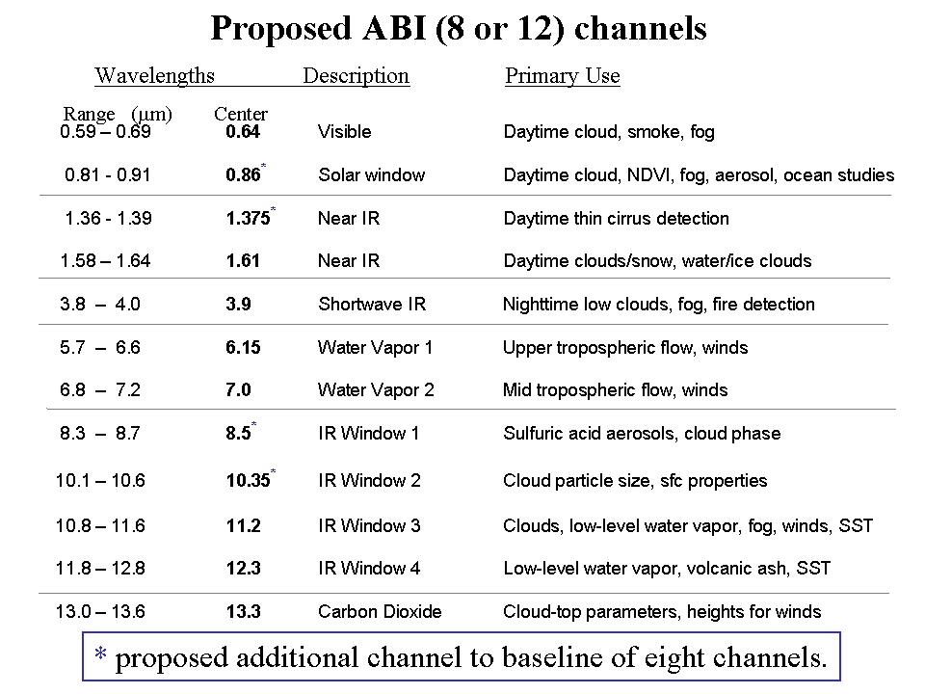
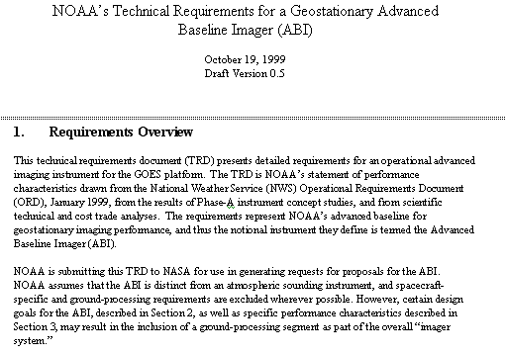
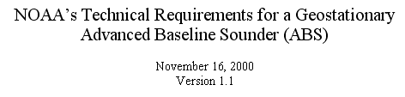
Mission Planning
STAR very involved during the early GOES-R series development. This includes: formulation studies for both ABI and advanced geostationary sounder, ABI band selection and modification, Technical Requirement Documents, Performance and Operational Requirements Document, etc.
ABI/ABS Requirements.
circa 1999/2000
Originally ABI was only 8 spectral bands, now it is 16. All ABI bands were modified with input from STAR and it’s Cooperative Institutes.
Notes:
Significant remaining scientific challenges for the specific science topic
Next step(s)
Instruments (current/future), techniques, testbed, transition, …
Path into applications/operations
Who will use it and how
How will it get out to the real world

Slide 26
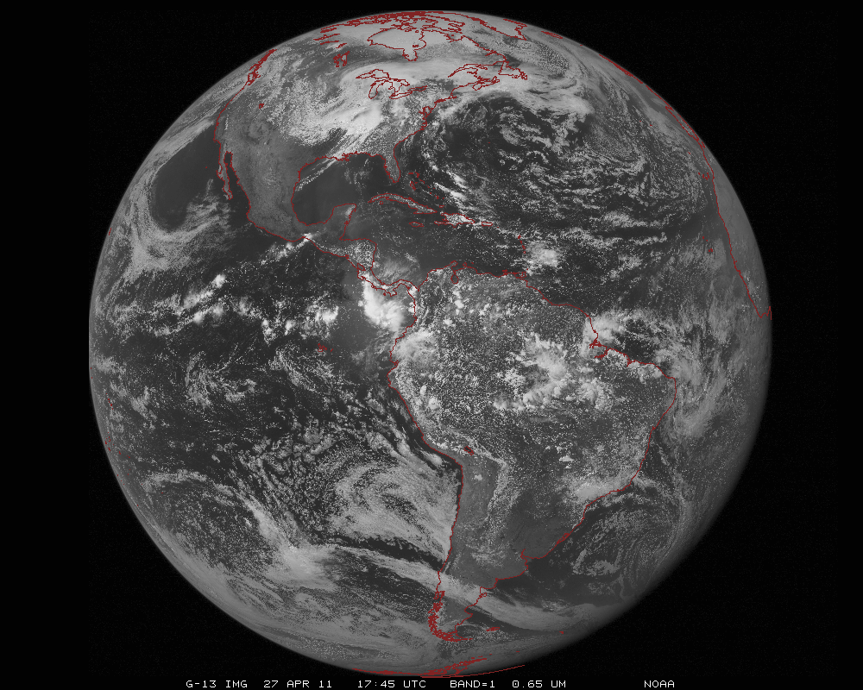
ABI scans about 5 times faster
than the current GOES imager
There are two anticipated scan modes for the ABI:
- Full disk images every 15 minutes + 5 min CONUS images + mesoscale.
or - Full disk every 5 minutes.

Slide 27
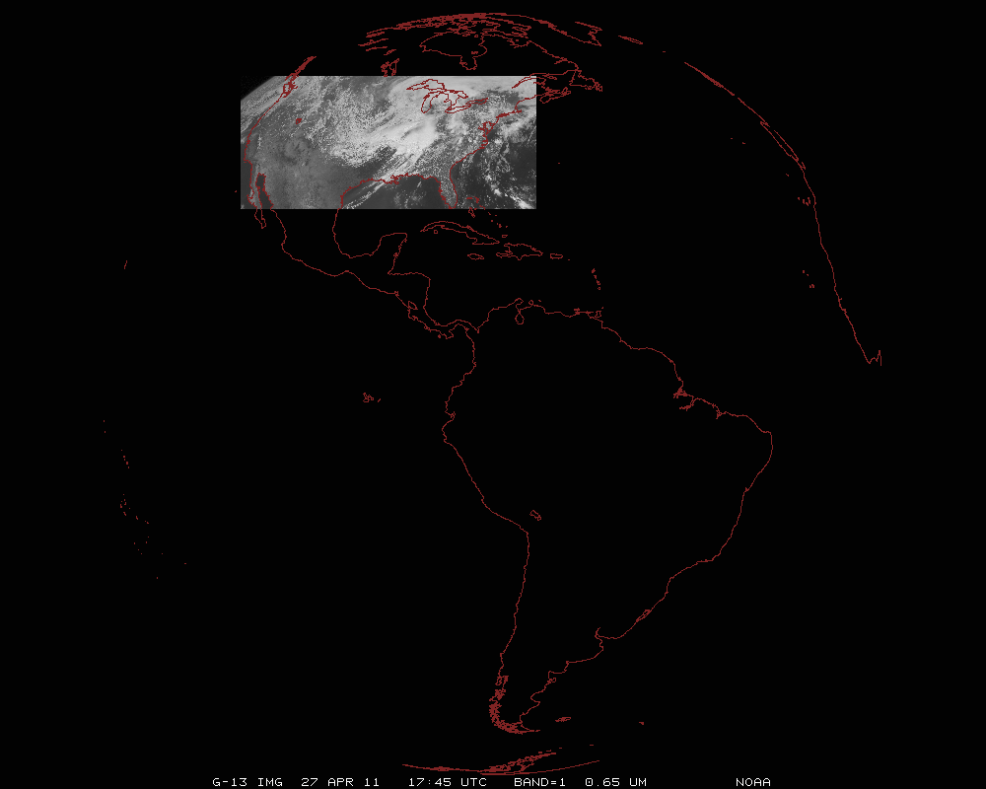
ABI can offer Continental US images every 5 minutes for routine monitoring of a wide range of events (storms, dust, clouds, fires, winds, etc).
This is every 15 or 30 minutes with the current GOES in routine mode.
Notes:
Approx. size of CONUS

Slide 28
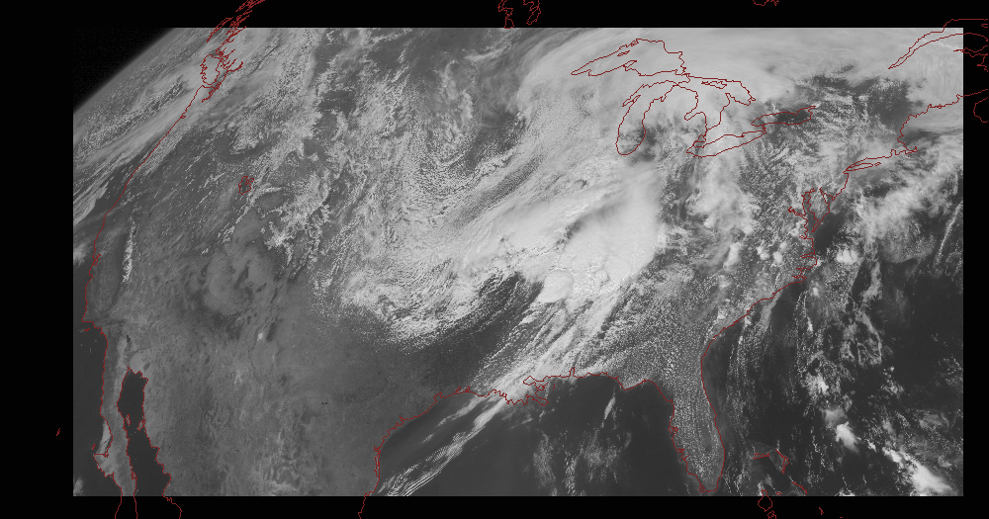
Notes:
Approx. size of CONUS

Slide 29
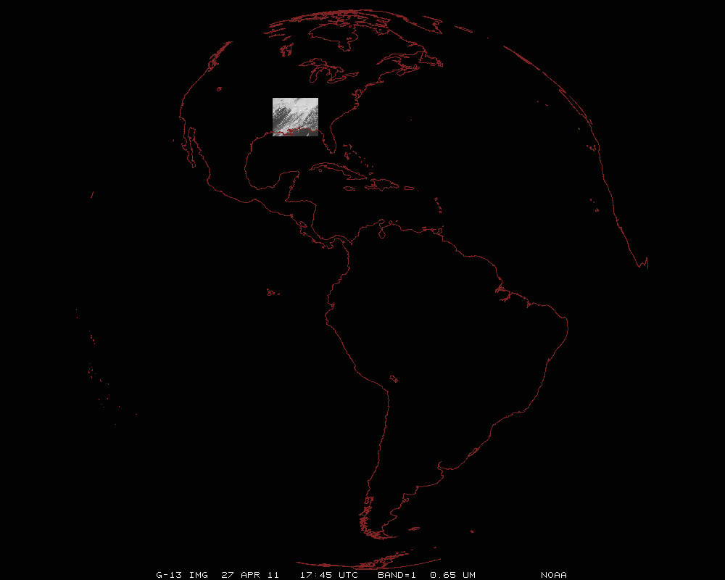
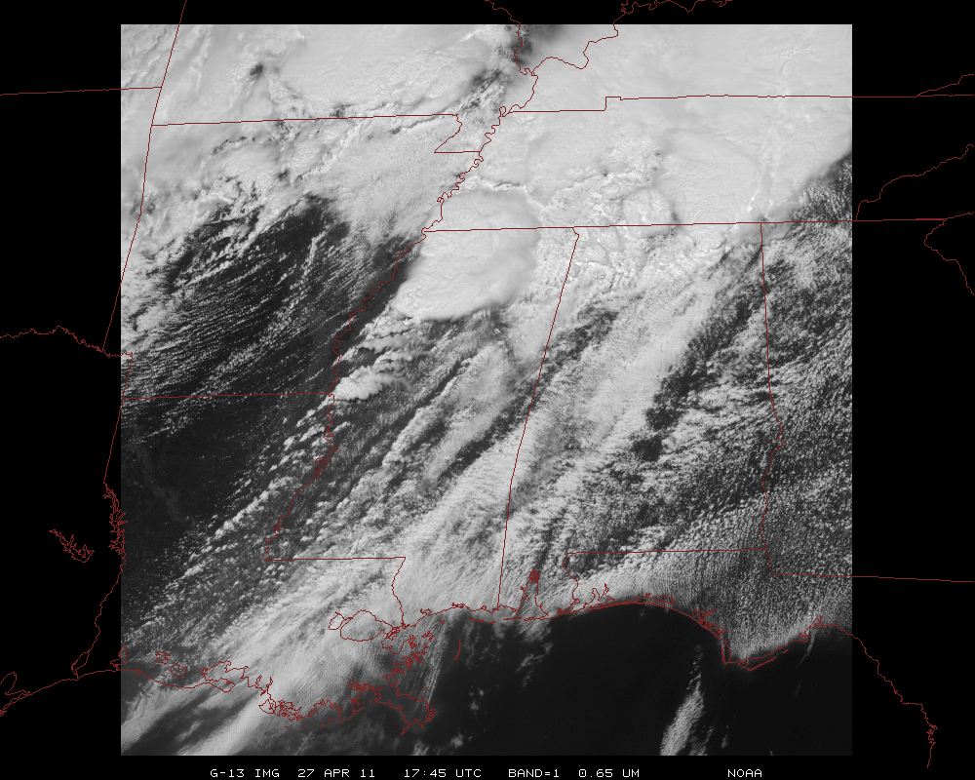
Mesoscale images every 30 seconds for rapidly changing phenomena
(thunderstorms, hurricanes, fires, etc). Or two regions every 60 seconds.
Notes:
Approx. size of meso-scale showing “Franklin”.

Slide 30
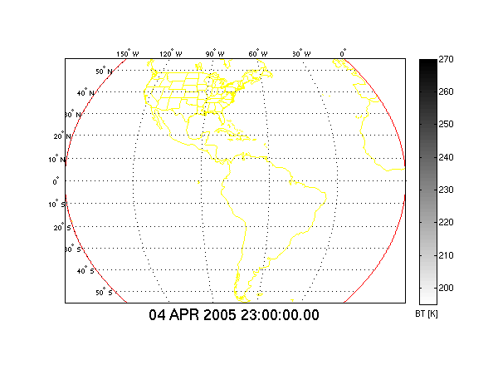
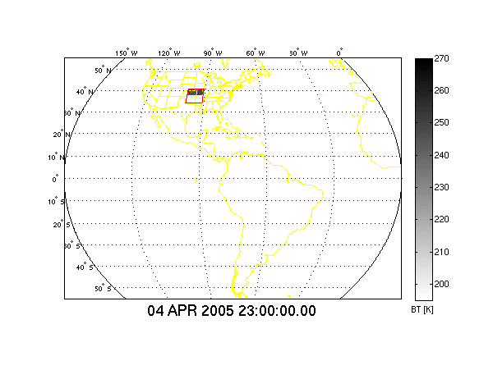
In 15 Minutes
Current GOES Imager can scan:
Most (3/5) of a Full Disk Image
Current GOES Imager scan coverage within 15 minutes
In 15 Minutes
ABI (“Flex Mode”) will scan:
30 Mesoscale Images
3 CONUS Images
1 Full Disk Image
GOES-R ABI scan coverage within 15 minutes
CIMSS
Notes:
From Jun Li and Chian-Yi Liu (CIMSS). Water vapor Image. Data from AWG Proxy Teams.

Slide 31
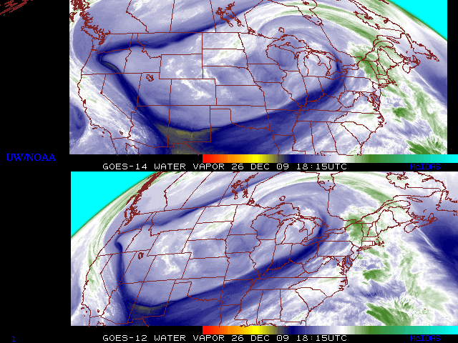
GOES-14: Sample “5-min” imagery
GOES-14
GOES-12
“Water vapor” data from the GOES-14 NOAA Science Test, lead by Hillger and Schmit
Notes:
Note the comma head is forming in the dry slot as a vort max swings around. This is not obvious from the 15 min.

Slide 32
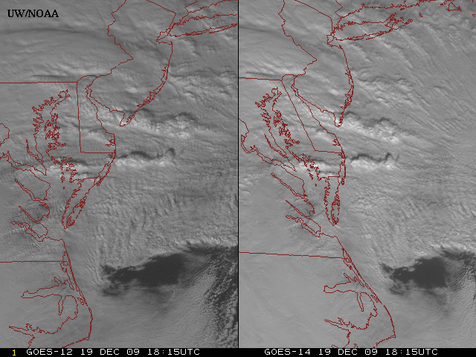
GOES-14: Sample “1-min” imagery
GOES-12
GOES-14
- Visible data from the GOES-14 NOAA Science Test, lead by Hillger and Schmit
- Can these type loops validate meso-scale models?
Notes:
Note the number of different levels of motion you can see (the cyclonic low level circulation over the ocean through the breaks in the higher clouds)... and you can't distinguish those on the GOES-12 loop.

Slide 33
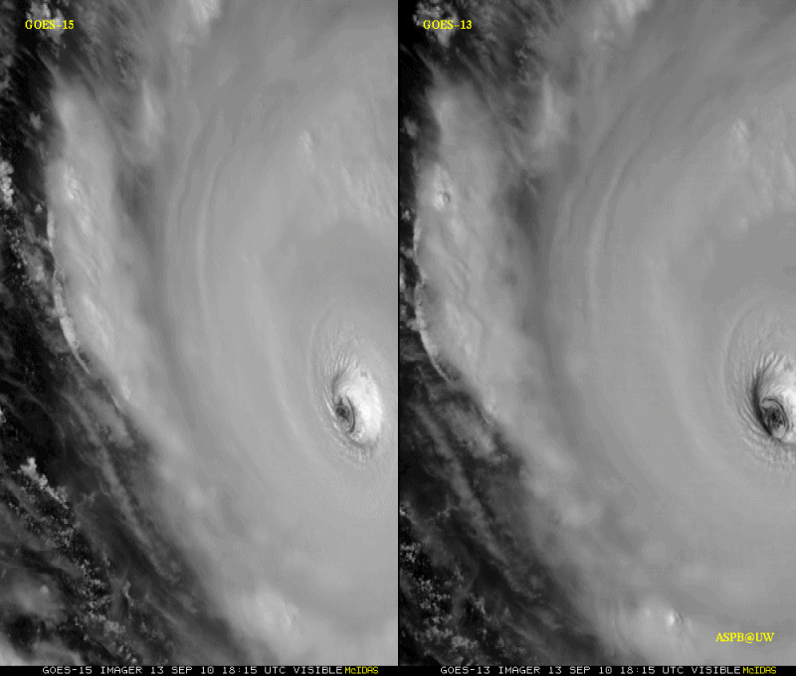
GOES-15: Sample “1-min” imagery
1-min
30-min
Visible data from the GOES-15 NOAA Science Test, lead by Hillger and Schmit
Notes:
Igor

Slide 34
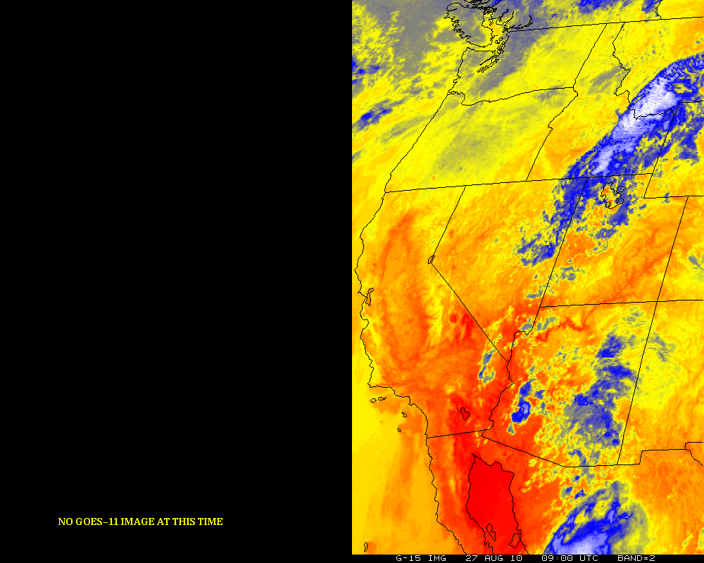
GOES-12/15 (Around eclipse period)
GOES-11 GOES-15
Notes:
http://cimss.ssec.wisc.edu/goes/blog/archives/date/2006/08

Slide 35
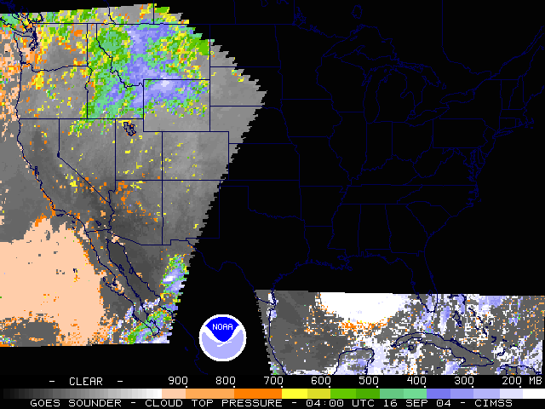
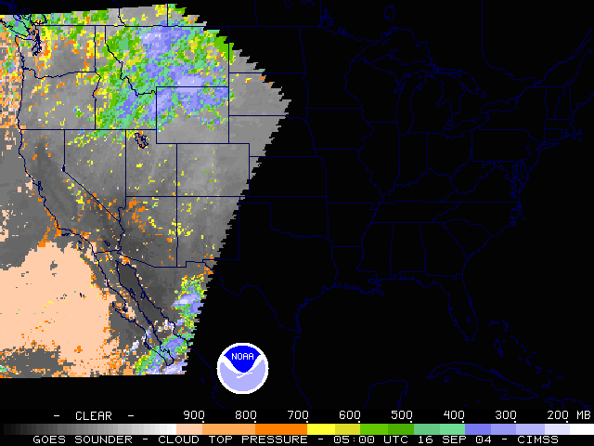
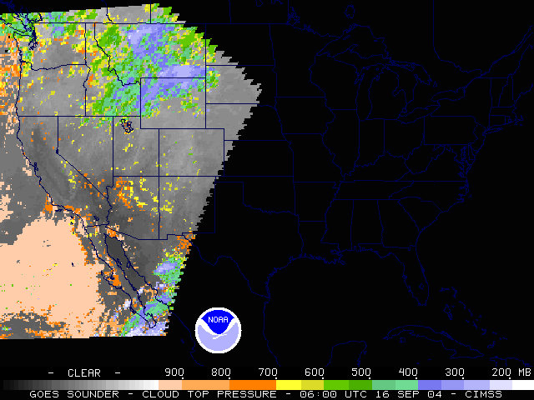
GOES Outages
-- approximate hours/year
Satellite Series | KOZ, Eclipse and Stray Light (spring and fall) | Housekeeping, SEM calibration, Maneuvers and Yaw-flip
GOES-8 thru -12 | 420 | 211
GOES-13/14/15 (may be reduced) | 220 | 107
GOES-R ABI | ~6 - 40 | ~2 - 6
Improved stray light performance with the ABI.
0400 UTC
0500 UTC
0600 UTC
Outage
during
landfall
Hurricane
Ivan
Notes:
2004, Hurricane Ivan.

Slide 36
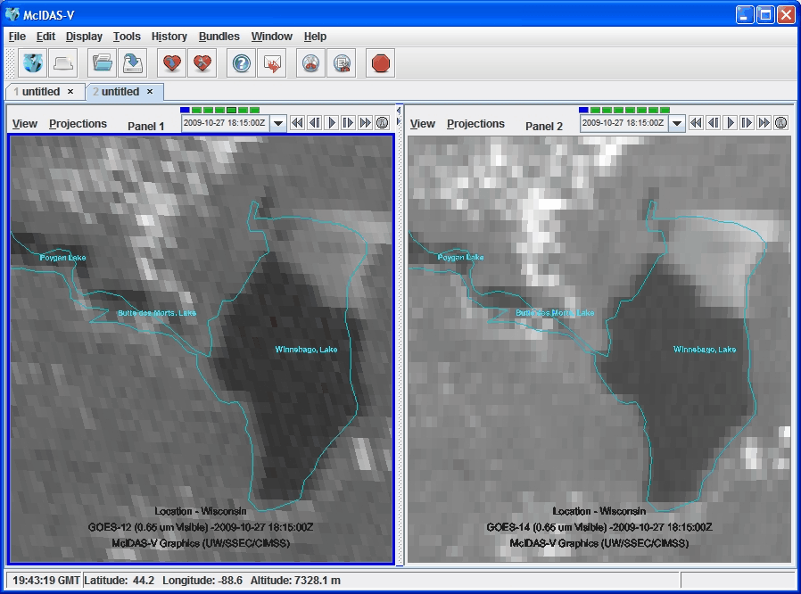
Improved Image Navigation and Registration

Slide 37
ABI to Imager Noise Comparison
* From ITT at GUC7
ABI |  |  |  | GOES |  |  | -12 | -15
# | Freq. (um) | Spec | Worst Case Estimate* | # | Freq (um) | Spec | Measured (PLT) | Measured (PLT)
7 | 3.9 | 0.1 | 0.10 | 2 | 3.9 | 1.4 | 0.130 | 0.063
8 | 6.185 | 0.1 | 0.06
9 | 6.95 | 0.1 | 0.09 | 3 | 6.x | 1.0 | 0.15 | 0.17
10 | 7.34 | 0.1 | 0.11
11 | 8.5 | 0.1 | 0.04
12 | 9.61 | 0.1 | 0.04
13 | 10.35 | 0.1 | 0.05
14 | 11.2 | 0.1 | 0.04 | 4 | 10.7 | 0.35 | 0.11 | 0.06
15 | 12.3 | 0.1 | 0.05 | 5 | 12.0 | 0.35 | - | -
16 | 13.3 | 0.3 | 0.14 | 6 | 13.3 | 0.32 | 0.19 | 0.13
Similar instrument noise, even with 4-16 times finer spatial resolutions!
Notes:
NEdT is 300K for all bands, but the Water vapor bands are 240K for ABI and 230K for GOES!

Slide 38
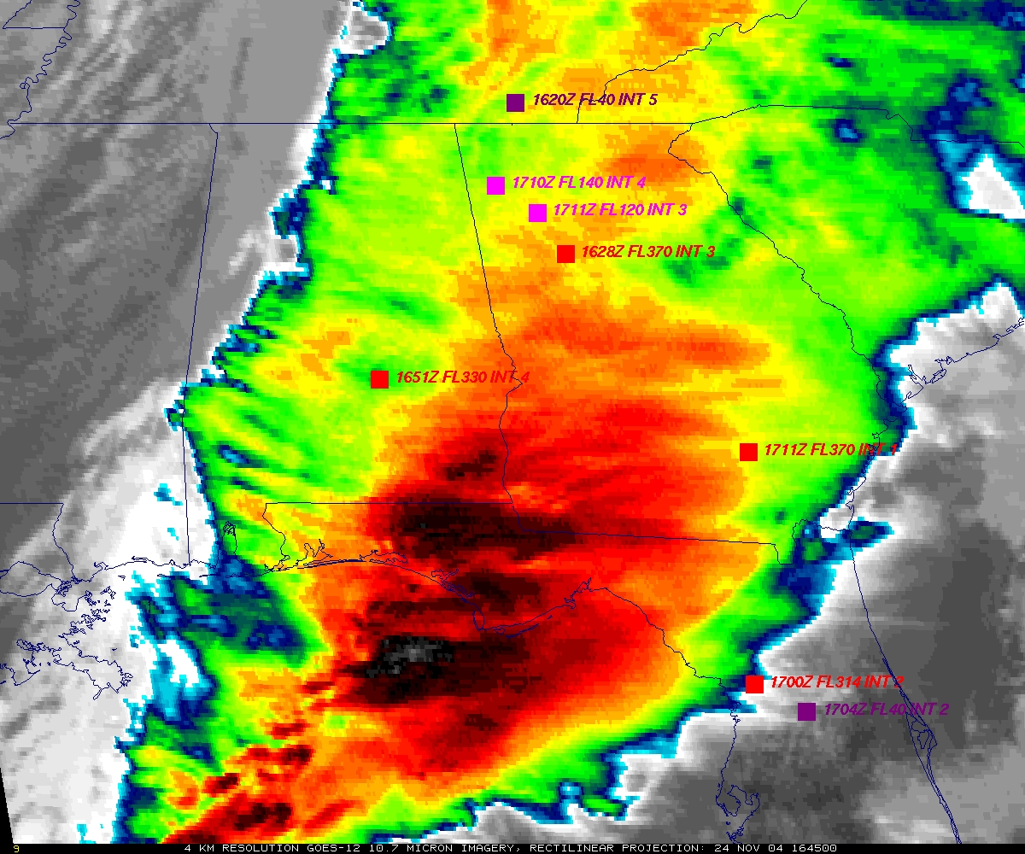
GOES: Cannot monitor waves
GOES
Aircraft turbulence reports plotted (squares).
Figure courtesy of K. Bedka and W. Feltz

Slide 39
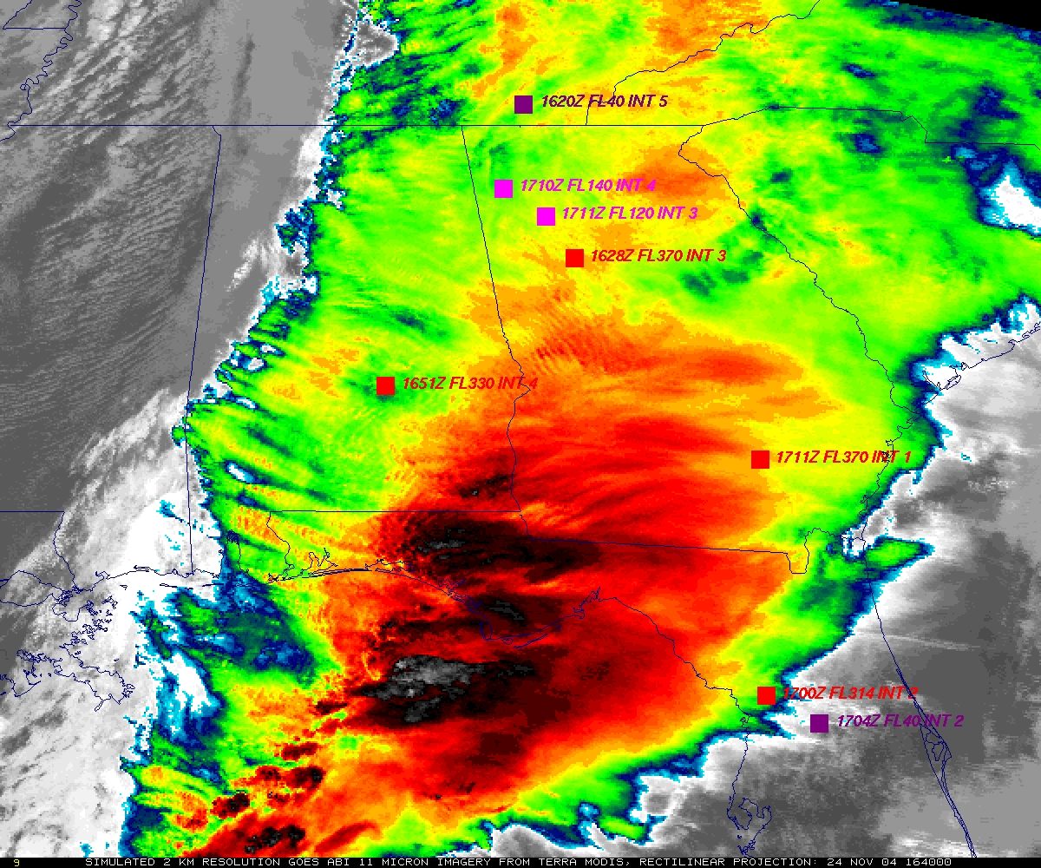
ABI: Can monitor waves
“ABI” from MODIS
Aircraft turbulence reports plotted (squares).
Figure courtesy of K. Bedka and W. Feltz

Slide 40

ABI Visible/Near-IR Bands
Schmit et al, 2005
Notes:
Schmit, T. J., M. M. Gunshor, W. P. Menzel, J. J. Gurka, J. Li, and A. S. Bachmeier, 2005: Introducing the next-generation Advanced Baseline Imager on GOES-R. Bull. Amer. Meteor. Soc., 86, 1079-1096.

Slide 41

Visible and near-IR channels on the ABI
Aerosols, Insolation
Clouds, Snow
Vegetation, Imagery
Cloud mask, Suspended matter
Snow, Phase
Cloud Particle size
Sample use only, many other uses
The ABI visible and near-IR bands have many uses.
Notes:
Schmit, T. J., M. M. Gunshor, W. P. Menzel, J. J. Gurka, J. Li, and A. S. Bachmeier, 2005: Introducing the next-generation Advanced Baseline Imager on GOES-R. Bull. Amer. Meteor. Soc., 86, 1079-1096.

Slide 42

ABI IR Bands
Schmit et al, 2005
Notes:
Schmit, T. J., M. M. Gunshor, W. P. Menzel, J. J. Gurka, J. Li, and A. S. Bachmeier, 2005: Introducing the next-generation Advanced Baseline Imager on GOES-R. Bull. Amer. Meteor. Soc., 86, 1079-1096.

Slide 43

ABI IR Weighting Functions
Clear-sky

Slide 44

The IR channels on the ABI
Clouds, Stability Indices
SST, Fires, Radiances
Ozone, Downward Radiation
Rainfall, Aerosol
Hurricane, Imagery
Cloud Phase, SST
Sample use only, many other uses
SO2, Radiances
Winds, WV profiling
TPW, Rainfall rate
Fires, Fog
ABI has many more bands than the current operational GOES imagers.
Notes:
Schmit, T. J., M. M. Gunshor, W. P. Menzel, J. J. Gurka, J. Li, and A. S. Bachmeier, 2005: Introducing the next-generation Advanced Baseline Imager on GOES-R. Bull. Amer. Meteor. Soc., 86, 1079-1096.

Slide 45

These NWP model simulations were performed on the 'cobalt' supercomputer at the National Center for Supercomputing Applications at the University of Illinois.
Band 1: Daytime “Blue” band – aerosols, solar insolation, snow cover
Notes:
Otkin, J. A., T. J. Greenwald, J. Sieglaff, and H.-L. Huang, 2009: Validation of a large-scale simulated brightness temperature dataset using SEVIRI satellite observations. J. Appl. Meteor. Climatol., 48, 1613-1626.
Feltz, W. F., K. M. Bedka, J. A. Otkin, T. Greenwald, and S. A. Ackerman, 2009: Understanding satellite-observed mountain wave signatures using high-resolution numerical model data. Wea. Forecasting, 24, 76-86.
Otkin, J. A., and T. J. Greenwald, 2008: Comparison of WRF model-simulated and MODIS-derived cloud data. Mon. Wea. Rev., 136, 1957-1970.

Slide 46

Band 2: Daytime “Red” band – clouds, cloud-mask, optical depth, winds, etc.

Slide 47

Band 3: Daytime “Veggie” band – NDVI, solar insolation, snow cover

Slide 48

Band 4: Daytime “Cirrus” band – cloud mask, aerosol detection

Slide 49

Band 5: Daytime “Snow” band – snow cover, cloud mask, etc.

Slide 50

Band 6: Daytime “Cloud-top phase” band – cloud particle size, snow cover

Slide 51

Band 7: Shortwave IR window band - fog, fires, winds, SST, etc.

Slide 52

Band 8: Upper-level tropospheric water vapor band – moisture, flow, winds

Slide 53

Band 9: Upper/mid-level tropospheric water vapor band – moisture, flow, winds

Slide 54

Band 10: Lower mid-level tropospheric water vapor band– moisture, flow, winds

Slide 55

Band 11: “Cloud-top phase” band – SO₂, dust, SST, stability indices, etc.

Slide 56

Band 12: “Ozone” band

Slide 57

Band 13: “Clean” IR longwave window band – imagery, TPW, etc.

Slide 58

Band 14: IR longwave window band – many cloud parameters, SST, snow cover

Slide 59

Band 15: “Dirty” IR longwave window band – many cloud parameters, TPW

Slide 60

Band 16: “CO2” longwave IR band – cloud height/pressure, stability indices

Slide 61

ABI in AWIPS (via netCDF)
J. Oktin et al., CIMSS
Simulated Advanced Baseline Imager (ABI) bands shown; in the legacy AWIPS.
Notes:
http://cimss.ssec.wisc.edu/goes/abi/

Slide 62

Visualization
(“decision aid”)
“True Color” with “synthetic” green from ABI simulated data (from CIMSS); image from Don Hillger, RAMMB.

Slide 63

Simulated ABI band – NSSL WRF
- Run in near-realtime each day.
- Future plans call for all ABI bands to be simulated, currently only 8 or 9 are being generated.
http://cimss.ssec.wisc.edu/goes_r/proving-ground/nssl_abi/nssl_wrf_goes.html

Slide 64


WRF Model-Derived Proxy Radiance Datasets
(UW CIMSS)
Which is which – Proxy/Observed or Observed/Proxy SEVIRI 10.8 μm Tb?
J. Oktin et al., CIMSS
Notes:
Data from this high-resolution simulation has been extensively used by two validation studies, with results shown in the next slide. To the best of our knowledge, this was the largest model simulation (in terms of memory) ever performed at the time and was only surpassed by an even larger simulation late last year. Real image is on the right.

Slide 65

Real, Simulated
Notes:
Both remapped to 10km. Real image is on the top.

Slide 66

Real, Simulated
Notes:
Both remapped to 10km. Real image is on the top.

Slide 67

One is from a McIDAS AREA, while the other (simulated image) is from a netCDF.

Slide 68

Outline
History
Current GOES Imager and Sounder
  GOES-14/15
ABI (Advanced Baseline Imager)
  Temporal
  Spatial
  Spectral
Select Products
High Spectral res.
Summary
  More information
  Questions
Photo courtesy of ITT Geospatial Systems

Slide 69
GOES-R Products
Baseline Products
Future Capabilities
Advanced Baseline Imager (ABI)
Aerosol Detection (Including Smoke and Dust) Aerosol Optical Depth (AOD) Clear Sky Masks Cloud and Moisture Imagery Cloud Optical Depth Cloud Particle Size Distribution Cloud Top Height Cloud Top Phase Cloud Top Pressure Cloud Top Temperature Derived Motion Winds Derived Stability Indices Downward Shortwave Radiation: Surface Fire/Hot Spot Characterization Hurricane Intensity Estimation Land Surface Temperature (Skin) Legacy Vertical Moisture Profile Legacy Vertical Temperature Profile Radiances Rainfall Rate/QPE Reflected Shortwave Radiation: TOA Sea Surface Temperature (Skin) Snow Cover Total Precipitable Water Volcanic Ash: Detection and Height
Geostationary Lightning Mapper (GLM)
Lightning Detection: Events, Groups & Flashes
Space Environment In-Situ Suite (SEISS)
Energetic Heavy Ions Magnetospheric Electrons & Protons: Low Energy Magnetospheric Electrons: Med & High Energy Magnetospheric Protons: Med & High Energy Solar and Galactic Protons
Magnetometer (MAG)
Geomagnetic Field
Extreme Ultraviolet and X-ray Irradiance Suite (EXIS)
Solar Flux: EUV Solar Flux: X-ray Irradiance
Solar Ultraviolet Imager (SUVI)
Solar EUV Imagery
Advanced Baseline Imager (ABI)
Absorbed Shortwave Radiation: Surface Aerosol Particle Size Aircraft Icing Threat Cloud Ice Water Path Cloud Layers/Heights Cloud Liquid Water Cloud Type Convective Initiation Currents Currents: Offshore Downward Longwave Radiation: Surface Enhanced “V”/Overshooting Top Detection Flood/Standing Water Ice Cover Low Cloud and Fog Ozone Total Probability of Rainfall Rainfall Potential Sea and Lake Ice: Age Sea and Lake Ice: Concentration Sea and Lake Ice: Motion Snow Depth (Over Plains) SO₂ Detection Surface Albedo Surface Emissivity Tropopause Folding Turbulence Prediction Upward Longwave Radiation: Surface Upward Longwave Radiation: TOA Vegetation Fraction: Green Vegetation Index Visibility

Slide 70

Imagery
Imagery for nowcasting
  Clouds
  Input for products
  Channel differences
  RGB
  General Users
  Etc.
Radiances for NWP
  Clear-sky
  Cloudy-sky
  Validations
  Monitoring
  Etc.

Slide 71
Clear Sky Mask
(“Cloud Detection”)
Automatic Cloud Mask (ACM)
Algorithm Highlights
  Designed to maximize flexibility and use
  Mask built with multiple individual tests that could be turned on and off by the downstream applications.
  Uses new ABI Bands (1.38um, 1.6um)
  Design allows for additional of new tests easily as warranted.
  Determination of test thresholds accomplished through the use and analysis of CALIPSO data.
Operational Applications
  Used extensively by downstream level-2 product algorithms
  Identifies clear pixel radiances for NWP data assimilation
71
71
A. Heidinger, ASPB
71
Notes:
71
71
71
71
71

Slide 72

Inter-satellite
ACM Comparison
The EUMETSAT Meteorological Product Extraction Facility (MPEF) Cloud Mask cloud mask provides a well-characterized mask designed for the imagery used as proxy
The animation on the right shows a comparison of the ACM run on data from SEVIRI as compared to the EUMETSAT cloud mask from that scene.
Inter-satellite comparisons of cloud mask (and other products) can provide insight as to deficiencies and improvement in both products (next slide)
A. Heidinger, ASPB

Slide 73


Cloud Phase
Algorithm Highlights
  An Infrared only algorithm that exploits the rich IR information (7.4, 8.5, 11.2, and 12.3 μm) provided by the ABI
  Algorithm determines the cloud top (layer that the radiometer senses) thermodynamic phase of the highest cloud layer
  Exploits recent improvements in fast clear-sky radiative transfer models and ancillary data (land cover, surface emissivity
  Makes advanced use of spatial information
Operational Applications
  Prerequisite for other cloud property retrievals (height, temp)
  Climate prediction
  Aviation forecasting (Aircraft icing)
M. Pavolonis
73
73
73
73
73
Water, Supercooled Water, Mixed Phase, Ice
Notes:
73
73
73
73
73
This ABI Cloud Phase Algorithm determines the cloud top (layer that the radiometer senses) thermodynamic phase of the highest cloud layer.
The cloud phase output is a subset of a more detailed cloud classification produced by the GOES-R Cloud Type Algorithm
A unique infrared cloud classification scheme is used to determine the cloud type
ABI channels used: 10, 11, 14, and 15
Effective absorption optical depth ratios (β-ratios) are used to determine cloud type (liquid water, supercooled liquid water, mixed phase, opaque ice, semi-transparent ice, and multilayered clouds).
The cloud phase (liquid water, supercooled liquid water, mixed phase, and ice) is determined from the cloud type output (ice = opaque ice, semi-transparent ice, and multilayered clouds).

Slide 74


The “Future Capabilities” Fog Product
GOES
GOES-R alg.
M. Pavolonis
Notes:
What Is Fog and Low Stratus?
Fog is defined as a stratus cloud that has a cloud base at or close to the surface that reduces the surface visibility to less than 1 km. Even if the base of a stratus cloud is not in contact with the surface, however, it can be a hazard to aviation. The GOES-R Fog/Low Cloud Detection product is designed to quantitatively identify clouds that produce IFR or Low Instrument Flight Rules (LIFR) conditions.
The fog probability is based on textual and spectral information, as well as the difference between the cloud radiative temperature and surface temperature.
The current GOES fog products are limited to a qualitative brightness temperature difference approach (3.9μm - 11μm), available at 15 or 30-minute intervals, that can only be used at night. The GOES-R algorithm will produce a quantitative analysis of the probability that fog or low stratus is present, both day and night.
The GOES-R fog product can much more accurately capture hazardous valley fog events like this one on the east coast of the U.S., compared to current GOES

Slide 75




Fog – Dec. 1, 2011
MODIS: TBB Diff.
GOES: TBB Diff.
Bachmeier, CIMSS
GOES: Low cloud
GOES: Visible
Notes:
From Scott Bachmeier, CIMSS

Slide 76

Derived Motion Winds
Algorithm Highlights
  Heritage in targeting, tracking, and QC algorithms lie with current NESDIS operational winds algorithms
  New nested tracking algorithm introduced that makes use of a two-dimensional clustering algorithm to capture the dominant motion in each target scene
  Utilizes clear sky mask product
  Wind height assignment will rely on utilization of pixel level cloud heights generated upstream via algorithms delivered by AWG cloud application team
  Leverages ABI’s higher spatial and temporal resolution data
Operational Applications
  Weather Forecasting
  Assimilation into mesoscale and global NWP models
  Aviation (flight routing)
Cloud-drift Winds derived from a Full Disk Meteosat-8 SEVERI 10.8 µm image triplet centered at 1200 UTC 01 February 2007
High Level 100-399 mb
Mid-Level 400–699 mb
Low-Level >700 mb
76
76
76
76
76
Courtesy J. Daniels: NOAA-STAR
Notes:
76
76
76
76
76

Slide 77

Volcanic Ash
Algorithm Highlights
  Detects volcanic ash and estimates its height and mass loading
  Leverages the new ABI 8.5 μm band, The 8.5 μm, 11.2 μm, and 12.3,11.2 μm channel pairs are used to detect volcanic ash
  An optimal estimation approach is used to estimate ash cloud temperature, emissivity and microphysical index.
  Ash cloud height determined from NWP profiles.
  Mass loading estimated from computed optical depth and effective particle size
  Leverages ABI’s new 8.5 μm channel, along with 11.2 μm and 12.3 μm for sensitivity to cloud microphysics (including composition)
Operational Applications
  Aviation safety
  Health safety
  Climate studies
Iceland's Eyjafjallajökull Volcano
False Color
Imagery
Mass
Loading
Ash
Height
Effective
Particle
Radius
77
77
77
77
M. Pavolonis
77
Notes:
77
77
77
77
77
Grand Comore Island, Comoros (11.75 S, 43.38 E)
summit elevation 2361 m
shield volcano
Karthala volcano is located on Grande Comore, the most westerly of four volcanic islands comprising the Comores Archipelago, between northern Madagascar and Mozambique. Karthala occupies the southern half of Grand Comore Island.

Slide 78




Geostationary Total Column Ozone (TCO) Assimilation
CalNex Ozonesonde
GOES TCO Assimilation
(GFS UT/LS and background errors)
The National Air Quality Forecasting Capability (NAQFC) uses the Community Multi-scale Air Quality (CMAQ) to provide air quality forecast guidance. Capabilities to assimilate Geostationary Sounder TCO within CMAQ are currently under development at JCSDA
Ozone mixing ratio
Significant improvement in upper troposphere
Improved Cloud free sampling
Continuous day/night sampling
Brad Pierce (NESDIS/STAR)

Slide 79


Improved Aerosol Predictions with Satellite Data Assimilation
Assimilation (Cressman analysis) of GOES Aerosol Optical Depth (AOD) in a NOAA-EPA Weather and Research (WRF)/Community Multiscale Air Quality (CMAQ) model shows improved aerosol predictions for an east coast pollution episode
Observed vs Predicted Surface PM2.5 (µg/m³) Concentrations
Assimilation
No Assimilation
AOD
Shobha Kondragunta, STAR
Notes:
The movie loops show WRF-CMAQ simulations for one day beginning at 00z. This was a regional-scale industrial haze/pollution episode. Top left panel shows 24-hr forecast without assimilation and the bottom left panel shows 24-hr forecast with GOES AOD (aerosol optical depth) assimilation. AOD can be viewed as a proxy to particulate matter (PM2.5) pollution. PM2.5 stands for particulate matter in ug/m3 for particles smaller than 2.5 microns. These particles are the most harmful because they can make it through your respiratory system and cause health problems. As evident by the scatterplot of predicted PM2.5 concentrations and observed concentrations, simulations with assimilation correlate better with observations than the forecast runs without assimilation.

Slide 80


Aerosol Transport Model Assimilation of the Wildfire ABBA Fire Product Using the Navy Aerosol Analysis and Prediction System
GOES-8 Wildfire ABBA fire product
for the Pacific Northwest
Date: August 17, 2001
Time: 2200 UTC
FIRES
Smoke
NAAPS Model Aerosol Analysis
for the continental U.S.
Date: August 18, 2001
Time: 1200 UTC
Elaine Prins, formerly of STAR
Notes:
Over the past 2 years, D. Westphal at the Naval Research Laboratory (NRL) in Monterey, California has been assimilating half-hourly Geostationary Operational Environmental Satellite (GOES) Wildfire Automated Biomass Burning Algorithm (ABBA) fire products into the Navy Aerosol Analysis and Prediction System (NAAPS) in real time to analyze and predict aerosol extent, loading, and transport regimes. In August 2001 the NAAPS successfully documented the transport of smoke associated with wildfires burning in the western U.S. On August 18, the NAAPS analyzed a large smoke pall that extended north into Canada and south over the plains of Montana. This effort is part of a joint collaboration funded by the National Aeronautics and Space Administration (NASA) under the Earth Systems Enterprise (ESE) modeling and data analysis research program.

Slide 81


GOES data was used to develop improved moist physics in CRAS
SATELLITE VALIDATION
CRAS generates forecast 11um and 6.5um satellite images and are validated using actual GOES imagery.
CRAS 24hr forecast 6.7um satellite image at 40km resolution (clear sky)
CRAS 12hr forecast 6.7um satellite image at 40km resolution (clear sky)
CRAS 18hr forecast 11um image at 20km resolution
CRAS 06hr forecast 11um image at 20km resolution
6.7 um water vapor image from GOES-10 valid 00UTC, October 12, 2004
11um image from GOES-12 valid 18UTC August 9, 2004
Images courtesy of G. Wade

Slide 82

Simulated WV imagery in AWIPS (since 2006)
000
FXUS63 KMKX 301935
AFDMKX
AREA FORECAST DISCUSSION
NATIONAL WEATHER SERVICE MILWAUKEE/SULLIVAN WI
230 PM CDT WED AUG 30 2006
.DISCUSSION...FORECAST FOCUS ON LINGERING UPPER LOW AND STRONGER
UPPER LOW FOR NEXT WEEK.
IN THE NEAR TERM FIRST LOOK AT CRAS MODEL SATELLITE IMAGERY IS VERY
IMPRESSIVE. SO MUCH MODEL INFORMATION IS BEING PRESENTED IN ONE
IMAGE THAT CAN BE EASILY DIGESTED. ESPECIALLY WITH SAY 700MB NAM
HEIGHT OVERLAYED. CLOUD COVER AND CLOUD HEIGHTS...EASILY
IDENTIFIED STRATOCUMULUS SHIELDS. ALSO EASY TO CONVERT TO
CONCEPTUAL MODEL OF SYSTEM TYPE. …
Notes:
Thanks to Bob Aune (ASPB) and crew.

Slide 83

Cloud Errors After Last Assimilation Cycle
Total cloud condensate (QALL) errors over the entire model domain after the last assimilation cycle
Overall, the cloud analysis was greatly improved when 8.5 micrometer brightness temperatures were assimilated simultaneously with the conventional observations.
Clear observations may be more representative of larger scales whereas cloudy observations are more representative of smaller scale features.
Jason Otkin, CIMSS
Notes:
The accuracy of the final cloud analysis obtained after 12 hours of assimilation is shown on this slide. This slide shows vertical profiles of bias and root mean square error for the total cloud hydrometeor mixing ratio (sum of cloud water, rain water, ice, snow and graupel) computed with respect to the clear and cloudy grid points in the truth simulation and valid after the last assimilation cycle. Overall, the cloud analysis was greatly improved when 8.5 micron brightness temperatures were assimilated simultaneously with the conventional observations. The largest error reductions occurred in the middle and upper troposphere for both clear and cloudy sky grid points. Comparison of the brightness temperature assimilation cases reveals that similar errors occurred for the clear sky grid points during each case, however, the errors consistently decreased with decreasing localization radius for the cloudy sky grid points. This behavior suggests that it may be necessary to use different localization radii for clear and cloudy observations to account for differences in their representative scale. In other words, clear observations may be more representative of larger scales whereas cloudy observations are more representative of smaller scale features.
Similar errors occurred for the clear sky grid points
Errors consistently decreased with decreasing localization radius for the cloudy grid points
Suggests different horiz. localization radii should be used for clear and cloudy observations

Slide 84






Training and Education
COMET
Notes:
Image obscures template footer Resized.

Slide 85

Outline
History
Current GOES Imager and Sounder
  GOES-14/15
ABI (Advanced Baseline Imager)
  Temporal
  Spatial
  Spectral
Select Products
High Spectral res.
Summary
  More information
  Questions

Slide 86
Operational ECMWF system
Averaged over all model layers and entire global atmosphere. % contribution of different observations to reduction in forecast error.
Courtesy: Carla Cardinali
and Sean Healy, ECMWF
Forecast error contribution (%)
Infrared High Spectral resolution Sounders reduce forecast error the most (for a given instrument)
Notes:
86
September to December 2008
86

Slide 87
High-Spectral, combined with High-Temporal Resolution is the key
Water Vapor and Carbon Dioxide absorption lines within the infrared window are sensitive to changes in the lower tropospheric thermodynamic state
  current GOES sounders are spectrally too broad to resolve these lines
High-time information obtained from a high spectral resolution IR GEO sounder would be very useful for monitoring pre-convective clear sky regions
GOES-R previously had an advanced sounder (HES), which was removed in 2006
  requirements remain unmet

Slide 88


Need to monitor rapidly evolving situations

Slide 89

Evolution of the Vertical Moisture is the Key!
Simulated Relative humidity cross-section at 20 UTC 12 June 2002
“Truth”
“GEO advanced IR sounder ”
“ABI”
“RUC”
Li et. al.
Notes:
Warning information in pre-convection environment from geostationary advanced infrared sounding system – a simulation study using the IHOP case
Jun Li, Jinlong Li, Jason Otkin, Timothy J. Schmit, Chian-Yi, LiuJournal of Applied Meteorology and Climatology

Slide 90







A Hyper-Spectral Geo-Sounder Could Near-cast Severe Weather
An Observing System Simulation Experiment
Simulated ABI
Robert Aune (NESDIS)
Simulated HES
Weak gradients of low-level Theta-E are indicated by ABI which has only two water vapor channels.
A WRF model simulation of the June 12, 2002 IHOP case was used to generate simulated radiances from a GOES-R Advanced Baseline Imager (ABI) and a geostationary Hyper-spectral Environmental Sounder (HES). Simulated radar reflectivity was also generated
Temperature and moisture profiles were retrieved from the simulated radiance datasets and assimilated by the CIMSS Near-casting Model and compared.
Strong low-level Theta-E gradients are indicated by HES which has the ability to detect low-level moisture.
5-hour NearCast for 2000 UTC
Low level Theta-E
5-hour NearCast for 2000 UTC
Low level Theta-E
Negative vertical Theta-E differences indicate where convection is likely.
Negative vertical Theta-E differences indicate where convection is likely.
Simulated composite reflectivity indication the formation of convection.
5-hour NearCast for 2000 UTC
Low to Mid level Theta-E Differences
Rapid Development of Convection over Texas and Nebraska between 2000 and 2100 UTC 12 June 2002
5-hour NearCast for 2000 UTC
Low to Mid level Theta-E Differences
Notes:
Precipitation products from NWP models tend to show patterns that are quite board and much smoother than observed. In addition, the source of moisture for the precipitation is often misrepresented – i.e., the precipitation forms for the wrong reason and/or the precipitation patterns become driven by the convective parameterizations themselves, not by details in the observed local moisture and wind fields.
In the case shown, the rapid convection developed only in the area where the 6 hour NearCasts showed strong signatures of Convective Instability in far NW IA – a fact that was lost to forecasters using the NWP guidance lone. It should also be noted that no GOES observations were available here after the convection began, although the destabilization shown in the NearCasts proper predicted the subsequent movement of the MCS.
It should also be noted that NWP models typically ‘limit’ the amount of convective instability that can be present in the models. In fact, the role of the ‘convective parameterizations’ is not be produce realistic thunderstorms, but rather to remove excessive thermal instabilities and ‘vertically misplaced latent heating’ which could adversely affect the model during an extended prediction. For example, the ECMWF readily recognizes the it’s convective schemes cause rainfall to occur too early during daytime over land in the tropics (they detect instability and try to remove it to quickly) and that the rainfall is unrealistic in that it ‘starts and stops’ much to often during the afternoon (due to repeated cycles of stabilization, followed by surface heating and destabilization). In addition, once the convective parameterization has been active for a period of time (even if incorrectly), boundary layer flows produced as a result of the parameterization often become dominant in the area around the storms, leading to further forecast errors.

Slide 91
Various Infrared spectral resolutions
Standard Atmosphere:
0.2 cm⁻¹ (NAST-I-like)
0.6 cm⁻¹ (HS from polar-like)
1.2 cm⁻¹ (HS from polar-like)
4.8 cm⁻¹
19.2 cm⁻¹ (current sounder-like)
38.4 cm⁻¹ (imager-like)
Jun Li, Mat Gunshor and Allen Huang
Notes:
On the web at: http://cimss.ssec.wisc.edu/goes/hes/res/

Slide 92

Longwave window region

Slide 93

Longwave window region

Slide 94

Longwave window region

Slide 95

Longwave window region

Slide 96

Longwave window region

Slide 97

Longwave window region

Slide 98

Longwave window region

Slide 99

Why do we need a high spectral resolution sounder?
Analysis courtesy of Justin Sieglaff, CIMSS.
GOES-12 Sounder Bands
Smooth over required absorption lines
Compared to broadband sounders, observing absorption lines is mandatory to meeting requirements for temperature and moisture structure needed to improve weather forecasting
Many papers document science value of high spectral resolution sounder that support weather forecast needs.
Notes:
These are calculated spectra, showing important features dealing with temperature and moisture are in the high-spectral data, but are smoothed over in the broad-band data. Figure courtesy of J. Sieglaff, CIMSS.
I’m not sure it is useful to show an entire spectrum. Rather I prefer to show the above and indicate that it is these little wiggles that make the HES so valuable and that the current GOES smears out.

Slide 100
Other Satellite-related DA work
(Funded by GOES-RRR or other sources)
High-Impact Weather
  Jun Li (etc), CIMSS
Warn-on-Forecast
  Thomas Jones (CIMMS)
AIRS in the Rapid Refresh
  Haidao Lin
  Steve Weygandt
  Ming Hu
Ensemble Simulation of GOES-R Proxy Radiance Data from CONUS Storm-Scale Ensemble Forecasts, Product Demonstration and Assessment at the Hazardous Weather Testbed GOES-R Proving Ground
  Prof. Ming Xue, Center for Analysis and Prediction of Storms (CAPS )

Slide 101

Improving tropical cyclone forecasts with advanced IR soundings
WRF/3DVAR forecasting and assimilation system is used.
Assimilation is done every 6 hours. 0-h is from analysis, others are forecasts.
Notes:
AIRS single FOV soundings in clear skies are used. WRF/3DVAR forecasting and assimilation system is used. Assimilation is done every 6 hours. 0-h is from analysis, others are forecasts.

Slide 102
Improving precipitation forecasts with advanced IR soundings
Jun Li, Jinlong Li (CIMSS), Bin Wang, Bing Lu (IAP)
OBS
CTRL
24-hour Precipitation Forecast
AIRS Run
24-hour precipitation (00 UTC 22 – 00 UTC 23 July 2009) forecast.
Two AIRS overpass times: 06 UTC and 18 UTC 21 July 2009.
CTRL run uses the NCEP analysis as initial, AIRS run uses soundings of both 06 UTC and 18 UTC.
The regional NWP model is Advanced Regional Eta-coordinate Model (AREM) with 37 km resolution. A collaborative work between CIMSS and Institute of Atmospheric Physics in Beijing.

Slide 103




Warn-on-Forecast
Current Projects:
  Use hyperspectral sounder data (AIRS)
    To improve 0-3 hour forecasts of a severe
    weather event (May 10, 2010).
  Temperature and dewpoint profiles
    improve mid-tropospheric characterization
    of the atmosphere
  Increases forecast convection compared to
    not assimilating these data.
Future Projects:
  Assimilate satellite derived cloud products
  Examples include:
    Cloud top pressure and temperature
    Cloud coverage
    Cloud liquid and ice water contents
  All products to be retrieved from GOES-R ABI radiances
  Testing of satellite-derived cloud products will utilize MODIS (and similar) data as will as OSSE experiments to prepare for GOES-R coming online in 2015-16.
Increases forecast convection
Better match to WSR-88D
GOES Cloud Cover
Thomas Jones

Slide 104




Assimilation of AIRS SFOV retrievals and
radiance Data in the Rapid Refresh
Rapid Refresh domain
Haidao Lin
Steve Weygandt
Ming Hu
Stan Benjamin
Assimilation and Modeling Branch
Global Systems Division
Cooperative Institute for
Research in the Atmosphere
Colorado State Univerisity
Collaborators:
Tim Schmit – NOAA NESDIS
Jun Li, Jinlong Li – CIMSS, University of Wisconsin
AIRS 500-mb retrieved temperature,
grey-scaled RR cloud-top analysis
Supporting slides for oral summary presentation,
GOES-R Science week, Huntsville, AL 22 Sept. 2011

Slide 105


24-h (2 X 12h) CPC Precipitation Verification
CSI by precip threshold
(avg. over 8 24h periods)
Control run (CNTL)
  3-h cycle 9 day retro run (May 8 2010 – May 16 2010)
  Conventional data
AIRS experiment one (AIRS Ex. 1)
  CNTL + AIRS radiance data (60 km thinning in GSI)
  Setting the mass bias coefficients to be zero at the very first cycle, cycle the bias coefficients
AIRS experiment two (AIRS Ex. 2)
  CNTL + AIRS radiance data (60 km thinning in GSI)
  Using the bias coefficients from the last cycle of Ex.1 as the initial coefficients
CNTL (no AIRS)
AIRS Ex. 1
AIRS Ex. 2
0.01 0.10 0.25 0.5 1.00 1.5 2.0 3.0 (in)
Slight improvement for heavy precipitation thresholds from AIRS radiance data

Slide 106
Summary and Future Work
Progress in 2010-2011
  Set up RR retrospective systems for May 2010 period
  Processed SFOV data, append them to std. prepbufr files
  Evaluated the SFOV profiles with matched raob profiles
  Conducted / analyzed several RR AIRS SFOV retro expts.
  Produced AIRS radiance data files for 3-h cycle RR runs
  Conducted/ analyzed RR AIRS radiance retro experiments
Ongoing and future work for 2011-2012
  Further evaluation of impact from SFOV moisture profiles
  More detailed analysis of SFOV assimilation results (O-B statistics, spatial distribution of analysis and forecast differences, possible HRRR runs from RR w/ and w/o SFOV)
  Test impact from additional SFOV QC procedures and bias correction schemes for temperature and moisture
  Jacobian and adjoint sensitivity study for AIRS channels
  AIRS radiance assimilation in RR with evaluation of channel selection strategies and cycled bias coefficients

Slide 107





































Realtime Convection-Permitting Ensemble and Convection-Resolving Deterministic Forecasts of CAPS for the Hazardous Weather Testbed (HWT) Spring Experiments
CAPS 2011 SSEF:
51 4-km, one 1 km, 36h CONUS forecasts
8 microphysics, 4 PBL, 2 LSM schemes, assimilating WSR-88D data
ARPS – CN
ARW – C0
NMM – CN
NMM – C0
ARPS – CN
ARPS – C0
June 14, 2010 – OKC Flooding Case, 14 h fcst
18 hr Forecast - 1 km “Radar”
1 km model forecast reflectivity
Observed reflectivity
Observed Radar Reflectivity
Max=125mm
Max=71%
20 members from 2008
Support Probabilistic Forecasts
PM ensemble hourly precip
probability of hourly
precipitation >0.5 inch
Notes:
107

Slide 108
Proposed Work
Principal Investigator: Prof. Ming Xue, Center for Analysis and Prediction of Storms (CAPS ) and School of Meteorology, University of Oklahoma
Ensemble Simulation of GOES-R Proxy Radiance Data from CONUS Storm-Scale Ensemble Forecasts, Product Demonstration and Assessment at the Hazardous Weather Testbed GOES-R Proving Ground
Ensemble of ABI imagery using NESDIS CRTM, CIMSS and CIRA simulation packages, from CAPS’s Storm-Scale ensemble in realtime.
Probabilistic products in terms of satellite observables.
Adapt the simulation packages to work with various microphysics schemes, including two-moment schemes
Simulations for at least 5 bands (6.185, 7.35, 6.95, 10.35 and 12.3 mm), comparison with GOES observations
Require ~3000-4000 CPU cores using three packages for ~ 30 members, need to run on NICS
Send the products to HWT/GOES-R Proving Ground for realtime assessment during Spring Experiments

Slide 109

Outline
History
Current GOES Imager and Sounder
  GOES-14/15
ABI (Advanced Baseline Imager)
  Temporal
  Spatial
  Spectral
Select Products
High Spectral res.
Summary
  More information
  Questions

Slide 110
Approximate spectral and spatial resolutions of US GOES Imagers
~ Band Center (um) | GOES-6/7 | GOES-8/11 | GOES-12/N | GOES-O/P | GOES-R+
0.47
0.64
0.86
1.6
1.38
2.2
3.9
6.2
6.5/6.7/7 | 14km
7.3
8.5
9.7
10.35
11.2
12.3
13.3
Visible
Near-IR
Box size represents pixel size
8
4
2
“MSI mode”
Infrared
Notes:
0.40 inches = 4km; 0.80 inches = 8km
MSI is Multi-Spectral Imaging Mode (dashed boxes)
This does not show other improvements: SNR, MTF, bit-depth, navigation, coverage rates, etc.

Slide 111

Summary
The ABI on GOES-R will improve over the current instrument, including improved image navigation and registration and radiometer performance (colder patch temperatures, etc).
These improvements will greatly assist a host of data assimilation and NWP applications, especially on the regional and
meso-scales via both direct assimilation and in-direct validations.
Need to start with current geostationary data and products to best prepare for the ABI
Still need the vertical resolution of high-spectral, high-temporal observations!

Slide 112
Summary
There’s so much more information from the GOES-R instruments (ABI, GLM, etc), that the best way for the forecaster and others to quickly gain benefit is if the information is assimilated into the appropriately-scaled numerical weather prediction models.
  Need to use both clear and cloudy radiances
  May need to continue to use select products
  Upcoming Warn-on-Forecast/High Impact Weather Workshop. Feb. 8-9 in Norman, OK [POC: S. Goodman]
That said, the direct use of imagery and products will continue, for model comparisons, rapidly changing phenomena, etc.

Slide 113


More information
GOES-R:
  http://www.goes-r.gov
  http://www.meted.ucar.edu/index.htm
  http://cimss.ssec.wisc.edu/goes_r/proving-ground.html
GOES and NASA:
  http://goespoes.gsfc.nasa.gov/goes/index.html
  http://goes.gsfc.nasa.gov/text/goes.databookn.html
UW/SSEC/CIMSS/ASPB:
  http://cimss.ssec.wisc.edu/goes_r/proving-ground/nssl_abi/nssl_abi_rt.html
  http://cimss.ssec.wisc.edu/goes_r/awg/proxy/nwp/
  http://cimss.ssec.wisc.edu/goes/abi/
  http://cimss.ssec.wisc.edu/goes/abi/wf
  http://cimss.ssec.wisc.edu/goes/blog/
  http://www.ssec.wisc.edu/data/geo/
AMS BAMS Article on the ABI (Aug. 2005)

Slide 114
Questions
Ready for GOES-15 (e.g., December)?
Ready for GOES-14?
GOES-13 radiances operational? Hourly?
Read netCDF for radiances and cloud mask (GOES-R ABI)
Ready to exploit the high temporal data from the ABI? Current GOES radiances and products?
Are the systems set-up for the in-direct validations?

Slide 115
Questions
Are there ‘future capability’ products that may be of use, either directly or in-directly?
  Cloud Type - Convective Initiation
  Turbulence - Low Cloud and Fog
  Overshooting Top - SO₂ Detections
  Visibility - Upward LW Radiation
  Total Ozone - Aerosol Particle Size
  Surface Emissivity/Albedo - Vegetation Index
Using current GOES to better tune?
Interested in any of the GOES-R training material?
Ready for assimilating GLM information?

Slide 116


Acknowledgements
The authors would like to thank the entire GOES-R team (especially the GOES-R Program Office); within the government, industry and academia.
The views, opinions, and findings contained in this presentation are those of the author and should not be construed as an official National Oceanic and Atmospheric Administration or U.S. Government position, policy, or decision.

Slide 117


Progress!

Slide 118


Back-up
More high-resolution IR spectra
AOD assimilations
ABI Weighting Functions
Select Products
Possible GOES-R at 137W scan strategy

Slide 119



Select High-Spectral References
Schmit, T. J., J. Li, S. A. Ackerman, and J. J. Gurka, 2009: High spectral and temporal resolution infrared measurements from geostationary orbit, Journal of Atmospheric and Oceanic Technology, 26, 2273 - 2292.
(a.k.a., why we need an advanced sounder)
Sieglaff, J., M., T. J. Schmit, W. P. Menzel, S. A. Ackerman, 2009: Inferring Convective Weather Characteristics with Geostationary High Spectral Resolution IR Window Measurements: A Look into the Future. J. Atmos. Oceanic Technol., 26, 1527–1541.
(a.k.a., potential now-casting applications)
Schmit, T. J., J. Li, J. J. Gurka, M. D. Goldberg, K. Schrab, J. Li, W. Feltz, 2008: The GOES-R ABI (Advanced Baseline Imager) and the continuation of current sounder products. J. of Appl. Meteor., 47, 2696–2711.
(a.k.a., the ABI isn’t an advanced sounder)

Slide 120


Slide 121


Slide 122


Slide 123


Slide 124


Slide 125


Slide 126


Slide 127

Water vapor region

Slide 128

Water vapor region

Slide 129

Water vapor region

Slide 130

Water vapor region

Slide 131

Water vapor region

Slide 132

Water vapor region

Slide 133

Water vapor region

Slide 134
The relative vertical number of independent pieces of information is shown. Note that the moisture content is similar between the ABI and the current GOES Sounder. The Sounder does show more temperature information than the ABI. Caveat: Even if two systems have the same number of pieces of information, they may represent different vertical levels. This information content analysis does not account for any spatial or temporal differences.

Slide 135


GOES AOD Assimilation
Time Series of PM2.5 concentrations
MODIS AOD Assimilation
WRF-CMAQ assimilation runs are reinitialized every 24 hours with satellite AOD observations. GOES has a 10-hr observational window during which hourly mini-cycling is used.
Both GOES and MODIS assimilation improve surface PM2.5 predictions. GOES has a bigger impact than MODIS due to hourly cycling.
Loss of information around 18 UTC in base case as well as assimilation run was determined to be due to boundary layer dynamics
Shobha Kondragunta, STAR

Slide 136



AIRS 700 hPa T (upper left);
WRF 700 hPa T (lower left);
Difference between AIRS and WRF
Future work:
Assimilate the GOES Sounder high temporal resolution precipitable water (PW) between 300 and 700 hPa;
Combined AIRS and MODIS/GOES Sounder for hurricane forecast in order to prepare the application of combined GOES-R/JPSS atmospheric profiles in high impact weather applications;
AIRS run with WRF/3DVAR uses clear-skies from 3 granules g066/067/068, assimilate T/q profiles between 200 - 700hPa in the experiments for next 48 hour Hurricane Ike (2008) track forecast
GTS: Conventional and other Sat data
A1T27: GTS+AIRS 200 – 700 hPa T
A1Q27: GTS+AIRS 200 – 700 hPa Q
A1TQ27: GTS+AIRS 200 – 700 hPa TQ
Zheng and Li 2011

Slide 137

CIMSS Real-time WF and ABI web page
http://cimss.ssec.wisc.edu/goes/wf/
http://cimss.ssec.wisc.edu/goes/wf/ABI/

Slide 138

ABI Weighting Functions
As a function of….
  View angle

Slide 139

Fire/Hot Spot Characterization
Algorithm Highlights
  Heritage lies with the GOES operational Wildfire Automated Biomass Burning Algorithm (WF_ABBA)
  Dynamic, multi-spectral, thresholding contextual algorithm
  Utilizes the 0.64, 3.9, 11.2 and 12.3 μm channels
  Leverages ABI’s higher spatial and temporal resolution data
Operational Applications
  Fire weather forecasting
  Air quality forecasting
139
139
139
139
139
Courtesy C. Schmidt: CIMSS
Notes:
139
139
139
139
139

Slide 140




GOES-12 and GOES-R ABI
Simulation of Grand Prix Fire/Southern California
GOES-12
GOES-R ABI
GOES-12
GOES-R ABI
J. Feltz
Notes:
Here are two different fires. What we can see is a more defined peak in the higher resolution data and it is easier to pick out individual hotspots. In addition, the higher saturation tempearture of the ABI allows us to see that the fire is around 370K.

Slide 141

Current GOES Imager scans: PACUS and CONUS (note that PACUS is one-third larger). These regions are sub-selected for AWIPS.

Slide 142

Proposed –Shifted “5 min PACUS”
“5 min PACUS”
Proposed “shifted” “PACUS” would give a 5 min scan of southern AK and western CONUS. This would mean that Hawaii could be covered with one of the meso-scales (and 15 min FD); if in ‘flex mode (3)’. Note that the positions are approximate.

Slide 143

Visualization
(“decision aid”)
“RGB Color” (VIS 0.6, VIS 0.8, and NearIR 1.6 um) with ABI simulated data (from CIMSS); image from William Straka, CIMSS and using the EUMETSAT enhancement.

Slide 144
Algorithm Working Group (AWG)
Develop algorithms for the Level 2 products
(Both ‘Baseline’ and ‘Future Capability’ products)
Cloud Layer/Heights
Cloud Ice Water Path
Cloud Liquid Water
Cloud Type
Convective Initiation
Turbulence
Low Cloud and Fog
Enhanced “V”/Overshooting Top
Aircraft Icing Threat
SO₂ Detections (Volcanoes)
Visibility
Upward Longwave Radiation (TOA)
Downward Longwave Radiation (SFC)
Upward Longwave Radiation (SFC)
Total Ozone
Aerosol Particle Size
Surface Emissivity
Surface Albedo
Vegetation Index
Vegetation Fraction
Flood Standing Water
Rainfall probability and potential
Snow Depth
Ice Cover
Sea & Lake Ice Concentration, Age, Extent, Motion
Ocean Currents, Currents: Offshore
Clouds and Moisture Imagery (KPP)
Clear Sky Mask
Cloud Top Pressure and Height
Cloud Top Phase
Cloud Top Temperature
Cloud Particle Size Distribution
Cloud Optical Path
Temperature and Moisture Profiles
Total Precipitable Water
Stability Parameters (Lifted Index, etc.)
Aerosol Detection
Aerosols Optical Depth
Derived Motion Winds
Hurricane Intensity
Fire/Hot Spot Characterization
Land and Sea Surface Temperature
Volcanic Ash
Rainfall Rate
Snow Cover
Downward Solar Insolation: Surface
Reflected Solar Insolation: TOA
Lightning Detection
Advanced Baseline Imager (ABI)
GLM

Slide 145
ABI “Baseline” Products
Wavelength Micrometers | 0.47 | 0.64 | 0.865 | 1.378 | 1.61 | 2.25 | 3.90 | 6.185 | 6.95 | 7.34 | 8.5 | 9.61 | 10.35 | 11.2 | 12.3 | 13.3
Channel ID | 1 | 2 | 3 | 4 | 5 | 6 | 7 | 8 | 9 | 10 | 11 | 12 | 13 | 14 | 15 | 16
Baseline Products
Aerosol Detection | X | X | X | X | X | X | X |  |  |  |  |  |  | X | X
Suspended Matter/OD | X | X | X |  | X | X
Clear Sky Masks |  | X |  | X | X |  | X |  | X | X | X |  |  | X | X
Cloud & Moisture Imagery | X | X | X | X | X | X | X | X | X | X | X | X | X | X | X | X
Cloud Optical Depth |  | X |  |  |  | X | X |  |  |  |  |  |  | X | X
Cloud Particle Size |  | X |  |  |  | X | X |  |  |  |  |  |  | X | X
Cloud Top Phase |  |  |  |  |  |  |  |  |  | X | X |  |  | X | X
Cloud Top Height |  |  |  |  |  |  |  |  |  |  |  |  |  | X | X | X
Cloud Top Pressure |  |  |  |  |  |  |  |  |  |  |  |  |  | X | X | X
Cloud Top Temperature |  |  |  |  |  |  |  |  |  |  |  |  |  | X | X | X
Hurricane Intensity |  |  |  |  |  |  |  |  |  |  |  |  | X
Rainfall Rate/QPE |  |  |  |  |  |  |  | X |  | X | X |  |  | X | X
Legacy Vertical Moisture Profile |  |  |  |  |  |  |  | X | X | X | X | X | X | X | X | X
Legacy Vertical Temp Profile |  |  |  |  |  |  |  | X | X | X | X | X | X | X | X | X
Derived Stability Indices |  |  |  |  |  |  |  | X | X | X | X | X | X | X | X | X
Total Precipitable Water |  |  |  |  |  |  |  | X | X | X | X | X | X | X | X | X
Downward Solar Insolation Surf | X | X | X |  | X | X
Reflected Solar Insolation TOA | X | X | X |  | X | X
Derived Motion Winds |  | X |  |  |  |  | X | X | X | X |  |  |  | X
Fire Hot Spot Characterization |  | X |  |  |  |  | X |  |  |  |  |  |  | X | X
Land Surface Temperature |  |  |  |  |  |  |  |  |  |  |  |  |  | X | X
Snow Cover | X | X | X |  | X | X | X |  |  |  |  |  | X
Sea Surface Temps |  |  |  |  |  |  | X |  |  |  | X |  | X | X | X
Bands may also be used by needed “upstream” products, such as the cloud mask.

Slide 146
ABI “Option 2” Products
Wavelength Micrometers | 0.47 | 0.64 | 0.865 | 1.378 | 1.61 | 2.25 | 3.90 | 6.185 | 6.95 | 7.34 | 8.5 | 9.61 | 10.35 | 11.2 | 12.3 | 13.3
Channel ID | 1 | 2 | 3 | 4 | 5 | 6 | 7 | 8 | 9 | 10 | 11 | 12 | 13 | 14 | 15 | 16
Option 2 Products
Cloud Layer/Heights |  |  |  |  |  |  |  |  |  |  |  |  |  | X | X | X
Cloud Ice Water Path |  |  |  |  |  |  | X |  |  |  |  |  |  | X | X
Cloud Liquid Water |  | X |  |  |  | X |  |  |  |  | X
Cloud Type |  |  |  |  |  |  |  |  |  | X | X |  |  | X | X
Convective Initiation |  |  |  |  |  |  |  | X | X | X | X | X |  | X | X | X
Turbulence |  |  |  |  |  |  |  | X
Low Cloud and Fog |  | X |  |  |  |  | X
Enhanced-V/Overshooting Top |  |  |  |  |  |  |  |  |  |  |  |  |  | X
Aircraft Icing Threat |  | X |  |  |  | X | X |  |  | X | X |  |  | X | X | X
SO₂ Detection |  |  |  |  |  |  |  | X |  | X | X |  |  | X | X
Visibility (no direct use of ABI bands)
Upward Longwave Radiation (TOA) |  |  |  |  |  |  |  | X |  | X | X |  | X |  |  | X
Downward Longwave Radiation (SFC) |  |  |  |  |  |  |  |  | X | X | X | X | X | X | X | X
Upward Longwave Radiation (SFC) |  |  |  |  |  |  |  |  |  |  | X |  | X | X | X
Total Ozone |  |  |  |  |  |  |  | X | X | X |  | X | X | X | X | X
Aerosol Particle Size | X | X | X |  | X | X
Surface Emissivity |  |  |  |  |  |  |  | X | X | X | X | X | X | X | X | X
Surface Albedo | X | X | X |  | X | X
Vegetation Index |  | X | X
Vegetation Green Fraction |  | X | X
Flood/Standing Water |  | X | X |  | X |  |  |  |  |  |  |  |  | X | X
Rainfall Potential (no direct use of ABI bands) |  |  |  |  |  |  |  | X |  | X | X |  |  | X | X
Rainfall Probability (no direct use of ABI bands) |  |  |  |  |  |  |  | X |  | X | X |  |  | X | X
Snow Depth (no direct use of ABI bands) | X | X | X |  | X | X | X |  |  |  |  |  | X
Sea & Lake Ice: Age (no direct use of ABI bands) |  | X | X |  | X |  |  |  |  |  |  |  |  | X | X
Sea & Lake Ice: Concentration |  | X | X |  | X |  |  |  |  |  |  |  |  | X | X
Sea & Lake Ice: Motion |  |  |  |  |  |  |  |  |  |  |  |  |  | X
Ocean Currents |  |  |  |  |  |  |  |  |  |  |  |  |  | X
Ocean Currents: Offshore |  |  |  |  |  |  |  |  |  |  |  |  |  | X

