Slide 1


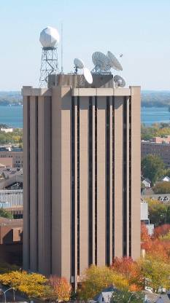
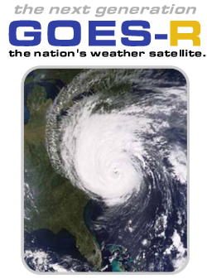

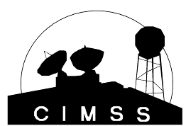
NWP opportunities with the Advanced Baseline Imager (ABI) on the GOES-R series
  Timothy J. Schmit (tim.j.schmit@noaa.gov)
NOAA/NESDIS/Satellite Applications and Research
Advanced Satellite Products Branch (ASPB)
JCSDA Seminar
16 November 2011
UW-Madison

Slide 2
Thanks to…
Shobha Kondragunta, Brad Pierce, Kaba Bah, Mathew M. Gunshor, Jun Li, Scott Bachmeier, Steve Ackerman, Bob Aune, Don Hillger, Paul Menzel, Tony Schreiner, Jason Otkin, Jim Jung and many others
GOES-R Program Office, NASA, ITT Industries, other industry partners, etc.

Slide 3
Overview
History
Current GOES Imager and Sounder
  GOES-14/15
ABI (Advanced Baseline Imager)
  Temporal
  Spatial
  Spectral
Select Products
High Spectral resolution
Summary
  More information
  Questions

Slide 4
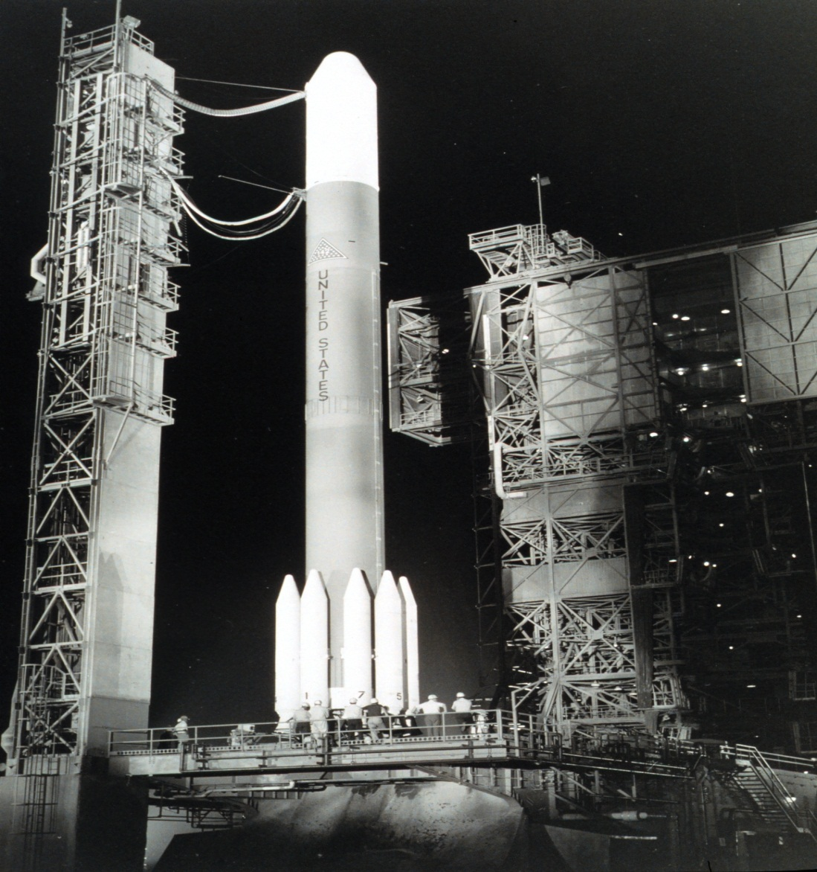
On 6 December 1966 the Applications Technology Satellite (ATS-1) was launched. We have had the benefit of the geostationary perspective for 40 years!
ATS-1's spin scan cloud camera (UW’s Suomi and Parent 1968) provided full disk visible images of the earth and its cloud cover every 20 minutes. The spin scan camera on ATS-1 occurred because of an extraordinary effort by Verner Suomi and Homer Newell, when the satellite was already well into its fabrication.

Slide 5
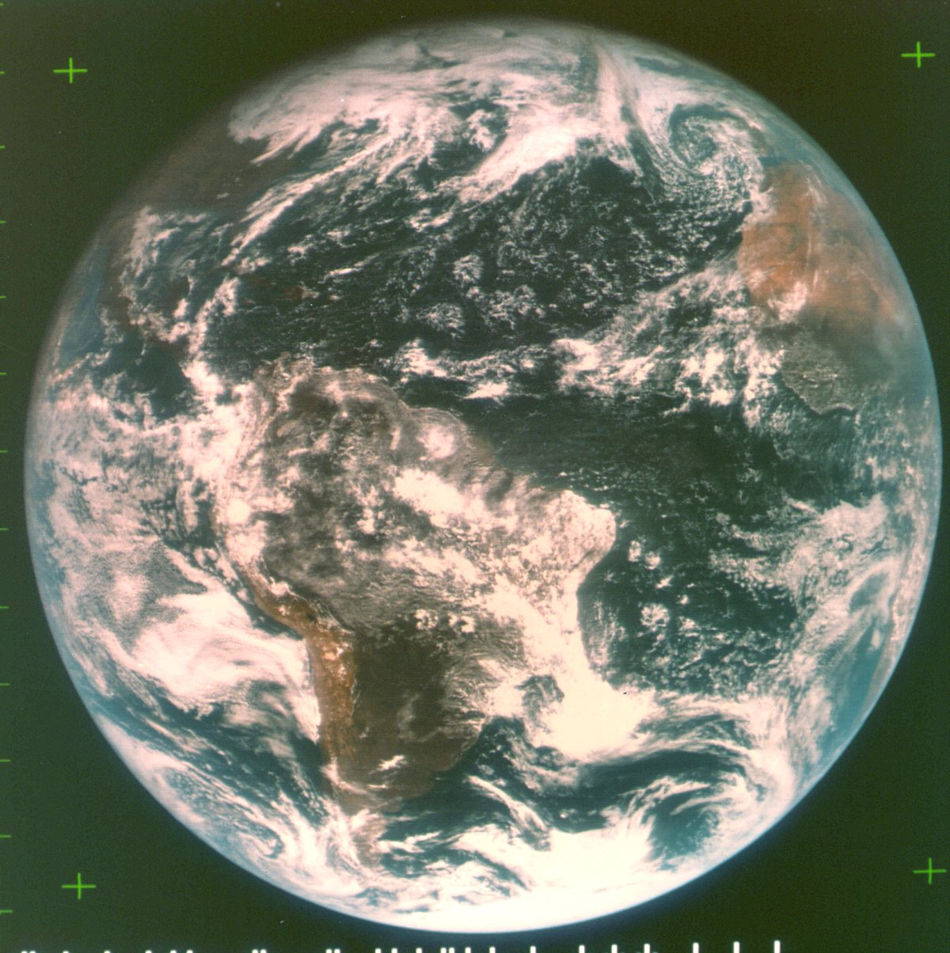
ATS-III 18Nov1967 15:03Z

Slide 6
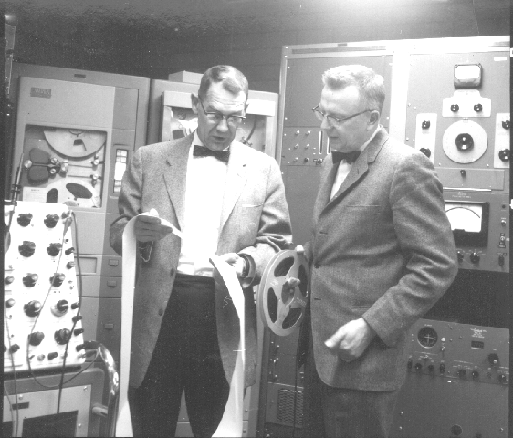
Verner E. Suomi and Robert J. Parent

Slide 7
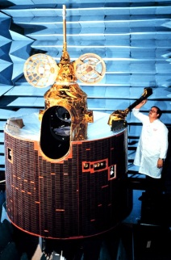

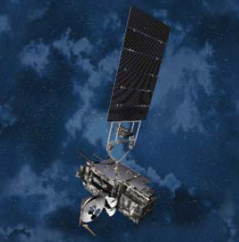
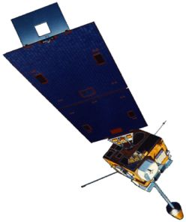
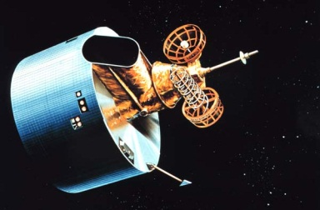
GOES History
GOES-1/3
Launched
1975
1977
1978
One visible and one infrared
GOES-4/7
Launched
1980
1981
1983
1987
VISSR–VAS visible, 12 IR MSI (visible, IRW, and 2 additional IR channels)
GOES-8/12
Launched
1994
1995
1997
2000
2001
Imager Bands: 4 IR; 1 visible
Operational Sounder
(18 IR bands)
GOES-13/14/15
Launched
2005
2009
2010
Better navigation and calibration
No eclipse outages
Better spatial resolutions for the 6.5 um on GOES-12+ and the 13.3 um band on GOES-14/15
Operational Sounder
GOES-R/S+
Planned Launch
2015
2017
2020
2025
Faster coverage
16 Imager Bands
Improved spatial
No sounder
GLM

Slide 8
Impact Study of RAOB, GOES, and POES data on Eta Data Assimilation System
RAOBs, GOES and POES all contribute unique information!
Zapotocny, T. H., W. P. Menzel, J. A. Jung, and J. P. Nelson III, 2005: A four season impact study of rawinsonde, GOES and POES data in the Eta Data Assimilation System. Part I: The total contribution. Wea. Forecasting, 20, 161-177.
Zapotocny, T. H., W. P. Menzel, J. A. Jung, and J. P. Nelson III, 2005: A four season impact study of rawinsonde, GOES and POES data in the Eta Data Assimilation System. Part II: Contribution of the components. Wea. Forecasting, 20, 178-198.
Zapotocny, T. H., W. P. Menzel, J. P. Nelson III, and J. A. Jung, 2002: Impact Study of Five Satellite Data Types in the Eta Data Assimilation System in Three Seasons. Weather and Forecasting, 17, 263-285.

Slide 9
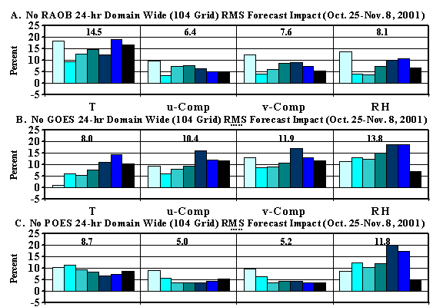
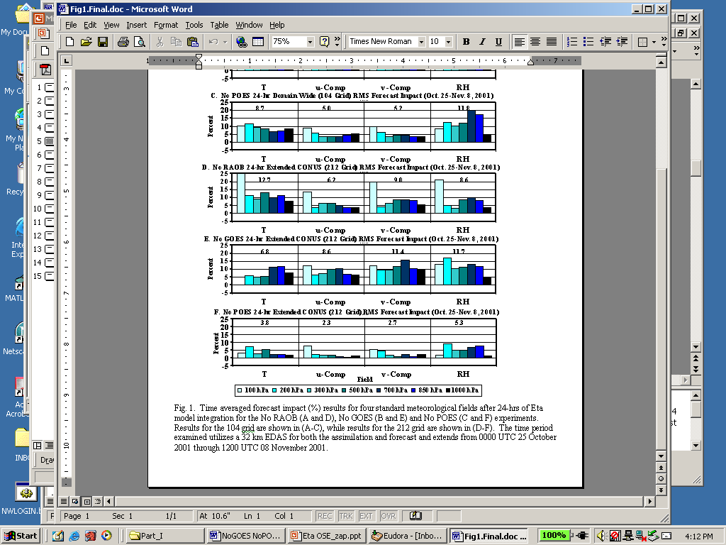
Oct 2001 forecast impact (%) for T, u, v, RH fields
after 24-hrs of Eta model integration
Zapotocny, 2005
Notes:
Time averaged forecast impact (%) results for four standard meteorological fields after 24-hrs of Eta model integration for the No RAOB (A), No GOES (B) and No POES (C) experiments. Results for the 104 grid are shown. The time period examined utilizes a 32 km EDAS for both the assimilation and forecast and extends from 0000 UTC 25 October 2001 through 1200 UTC 08 November 2001.
Raob impact decreases %5 in summer versus winter

Slide 10
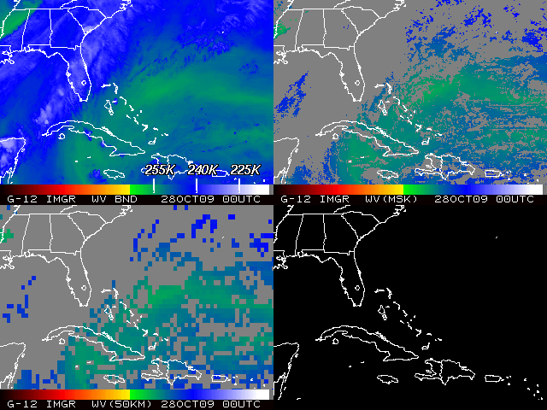
Satellite Data Assimilation

Slide 11
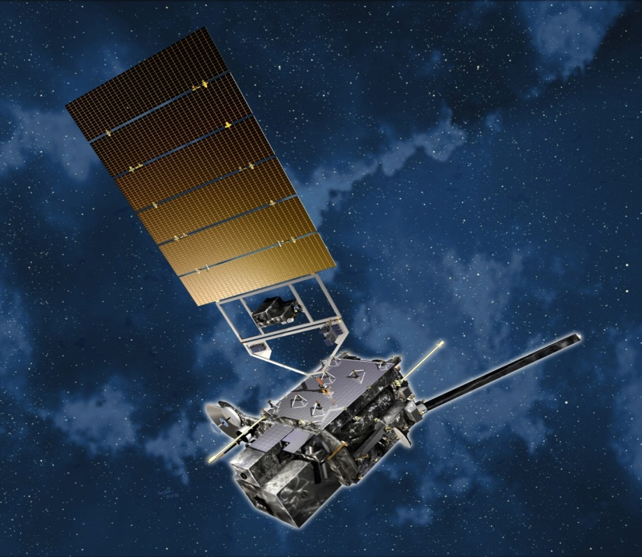
Overview
History
Current GOES Imager and Sounder
  GOES-14/15
ABI (Advanced Baseline Imager)
  Temporal
  Spatial
  Spectral
Select Products
High Spectral resolution
Summary
  More information
  Questions
Lockheed Martin

Slide 12
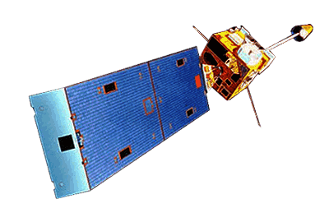
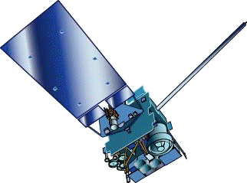
GOES-15
GOES-13/14/15 have similar instruments to GOES-8-12, but on a different spacecraft bus.
Spring and fall eclipse outages will be avoided by larger onboard batteries.
Improved navigation
Improved radiometrics
Similar stray light to GOES-13/14
GOES-8/12
GOES-13/14/15

Slide 13
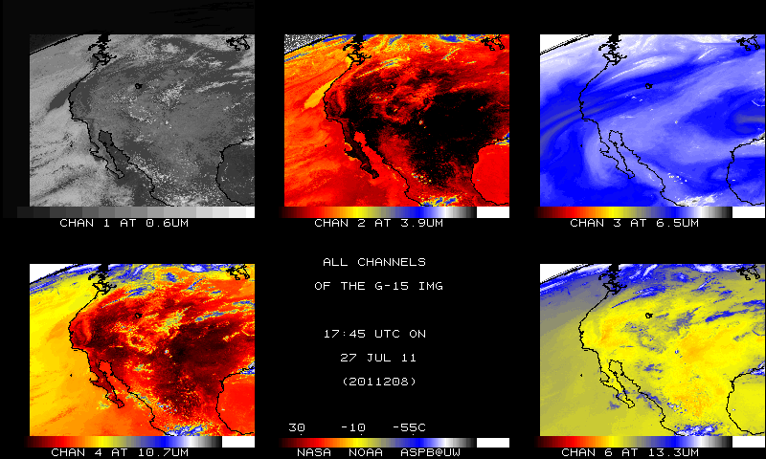
GOES-15
Native projection
From NOAA ASPB

Slide 14
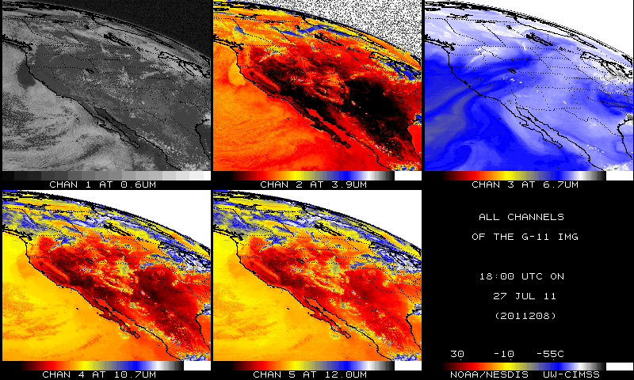
GOES-11
Native projection
From NOAA ASPB

Slide 15
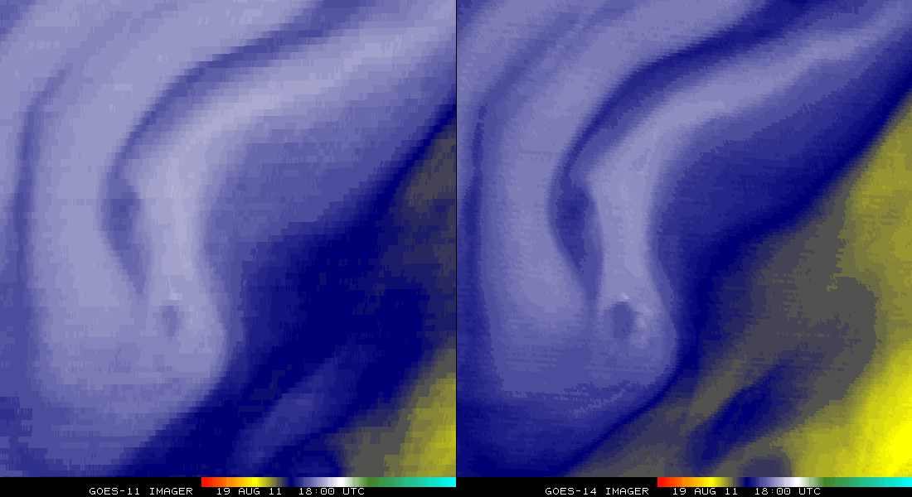
GOES-11 vs GOES-14 (WV)
Remapped into a projection

Slide 16
Overview
History
Current GOES Imager and Sounder
  GOES-14/15
ABI (Advanced Baseline Imager)
  Temporal
  Spatial
  Spectral
Select Products
High Spectral resolution
Summary
  More information
  Questions
Lockheed Martin

Slide 17
GOES-R Overview
Advanced Baseline Imager (ABI)
No dedicated Sounder
Geostationary Lightning Mapper (GLM)
Space Weather
  Space Environmental In-Situ Suite (SEISS)
  Solar Ultra Violet Imager (SUVI)
  Extreme Ultra Violet/X-Ray Irradiance Sensor (EXIS)
  Magnetometer
Communications
  GOES Rebroadcast (GRB)
  Low Rate Information Transmissions (LRIT)
  Emergency Managers Weather Information Network (EMWIN)
  Search and Rescue (SAR)
  Data Collection System (DCS)
Notes:
Advanced Baseline Imager (ABI) Earth-viewing
Geostationary Lightning Mapper (GLM) Earth-viewing
Solar Ultra-Violet Imager (SUVI) Sun-viewing
EUVS and XRS Irradiance Sensors (EXIS) Sun-viewing
Space Environment In-Situ Suite (SEISS) Space-viewing
Magnetometer (MAG) Space-viewing

Slide 18
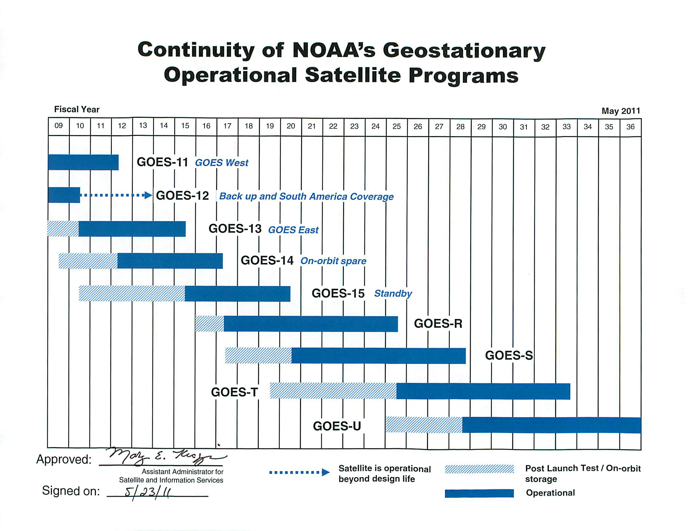
GOES Fly-out
Notes:
Advanced Baseline Imager (ABI) Earth-viewing
Geostationary Lightning Mapper (GLM) Earth-viewing
Solar Ultra-Violet Imager (SUVI) Sun-viewing
EUVS and XRS Irradiance Sensors (EXIS) Sun-viewing
Space Environment In-Situ Suite (SEISS) Space-viewing
Magnetometer (MAG) Space-viewing

Slide 19
The Advanced Baseline Imager:
ABI Current
Spectral Coverage
16 bands 5 bands
Spatial resolution
0.64 μm Visible 0.5 km Approx. 1 km
Other Visible/near-IR 1.0 km n/a
Bands (>2 μm) 2 km Approx. 4 km
Spatial coverage
Full disk 4 per hour Scheduled (3 hrly)
CONUS 12 per hour ~4 per hour
Mesoscale Every 30 sec n/a
Visible (reflective bands)
On-orbit calibration Yes No

Slide 20
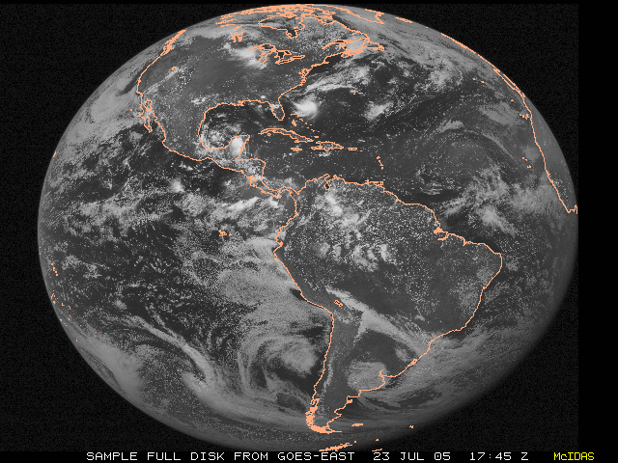
ABI scans about 5 times faster
than the current GOES imager
There are two anticipated scan modes for the ABI:
- Full disk images every 15 minutes + 5 min CONUS images + mesoscale.
or - Full disk every 5 minutes.

Slide 21
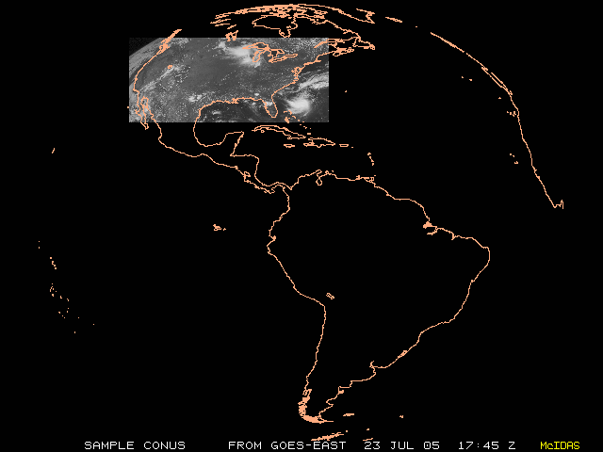
ABI can offer Continental US images every 5 minutes for routine monitoring of a wide range of events (storms, dust, clouds, fires, winds, etc).
This is every 15 or 30 minutes with the current GOES in routine mode.
Notes:
Approx. size of CONUS

Slide 22
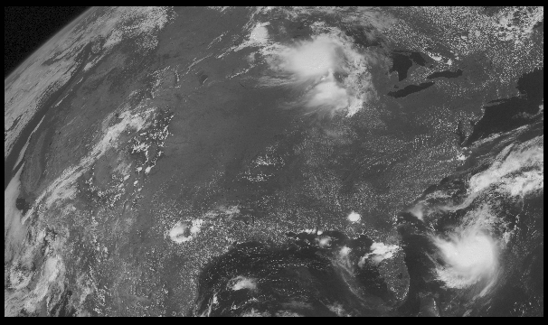
Notes:
Approx. size of CONUS

Slide 23
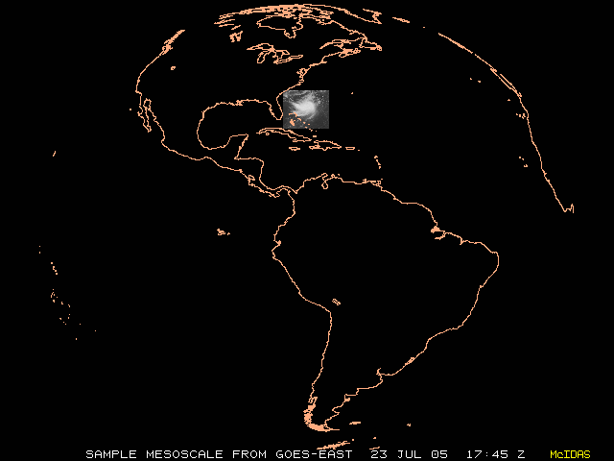
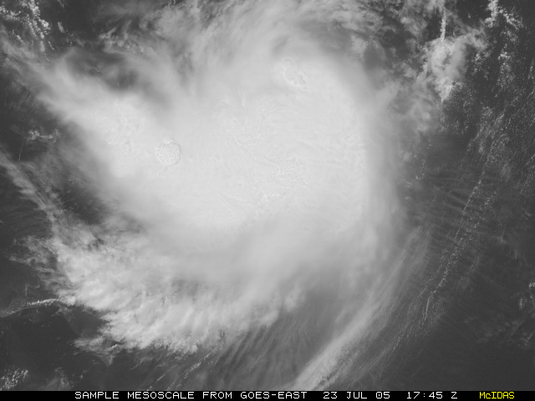
“Franklin”
Mesoscale images every 30 seconds for rapidly changing phenomena (thunderstorms, hurricanes, fires, etc). Current GOES can not offer these rapid scans while still scanning other important regions
Notes:
Approx. size of meso-scale showing “Franklin”.

Slide 24
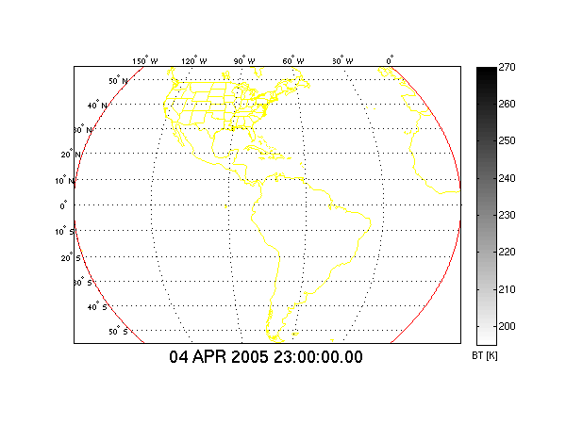
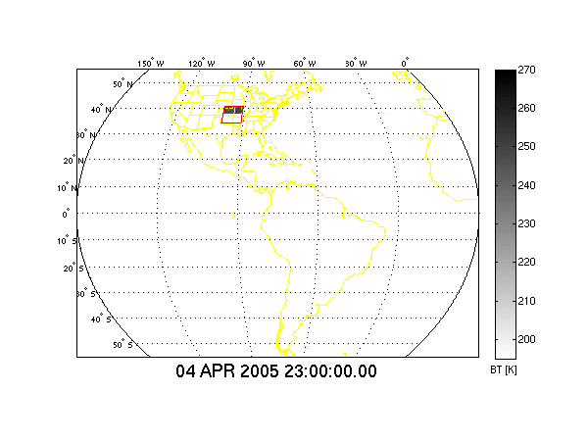
In 15 Minutes
Current GOES Imager can scan:
Most (3/5) of a Full Disk Image
Current GOES Imager scan coverage within 15 minutes
In 15 Minutes
ABI (“Flex Mode”) will scan:
30 Mesoscale Images
3 CONUS Images
1 Full Disk Image
GOES-R ABI scan coverage within 15 minutes
CIMSS
Notes:
From Jun Li and Chian-Yi Liu (CIMSS). Water vapor Image. Data from AWG Proxy Teams.

Slide 25
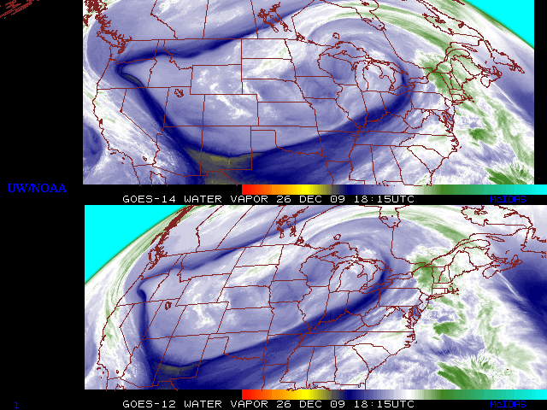
GOES-14: Sample “5-min” imagery
GOES-14
GOES-12
“Water vapor” data from the GOES-14 NOAA Science Test, lead by Hillger and Schmit
Notes:
Note the comma head is forming in the dry slot as a vort max swings around. This is not obvious from the 15 min.

Slide 26
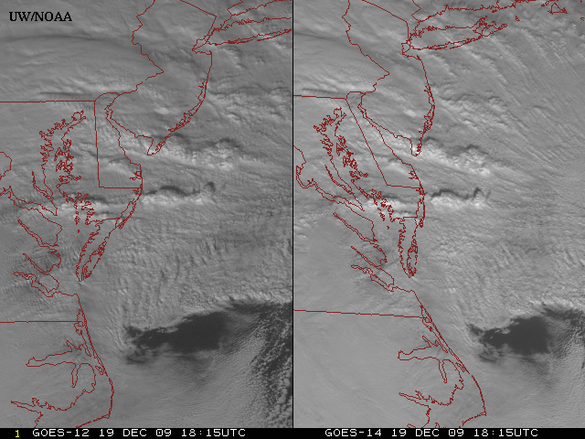
GOES-14: Sample “1-min” imagery
GOES-12
GOES-14
Visible data from the GOES-14 NOAA Science Test, lead by Hillger and Schmit
Notes:
Note the number of different levels of motion you can see (the cyclonic low level circulation over the ocean through the breaks in the higher clouds)... and you can't distinguish those on the GOES-12 loop.

Slide 27
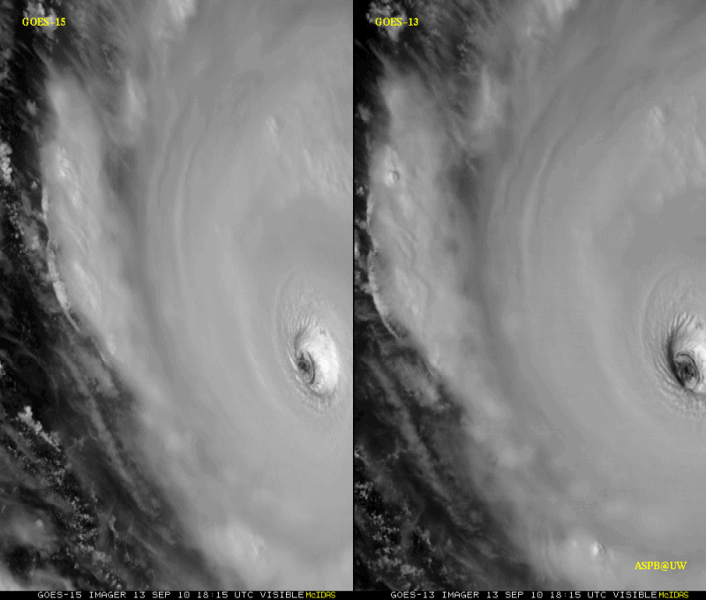
GOES-15: Sample “1-min” imagery
1-min
30-min
Visible data from the GOES-15 NOAA Science Test, lead by Hillger and Schmit
Notes:
Igor

Slide 28
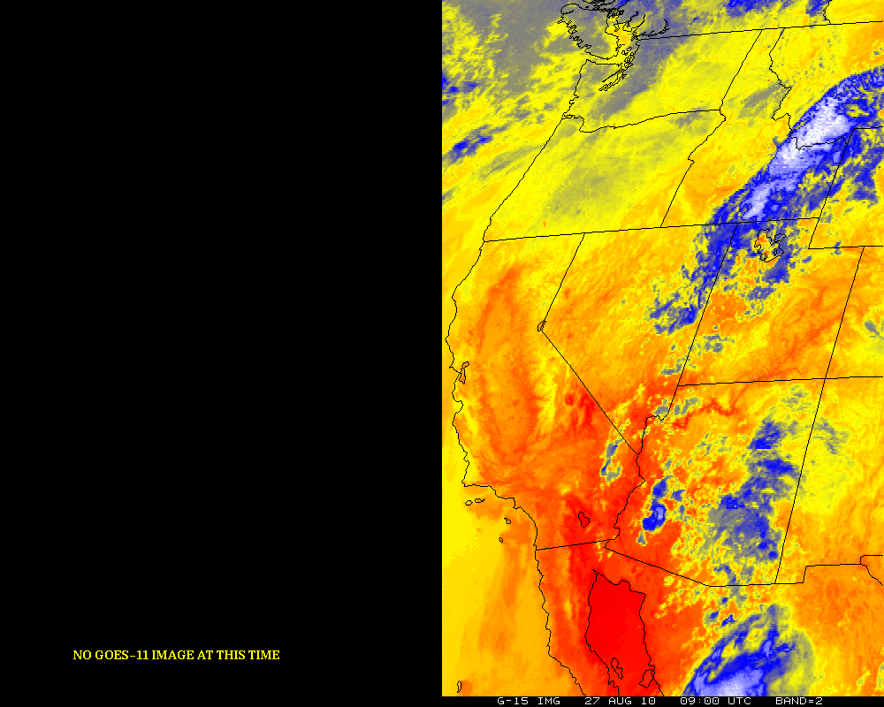
GOES-12/15 (Around eclipse period)
GOES-11 GOES-15
Notes:
http://cimss.ssec.wisc.edu/goes/blog/archives/date/2006/08

Slide 29
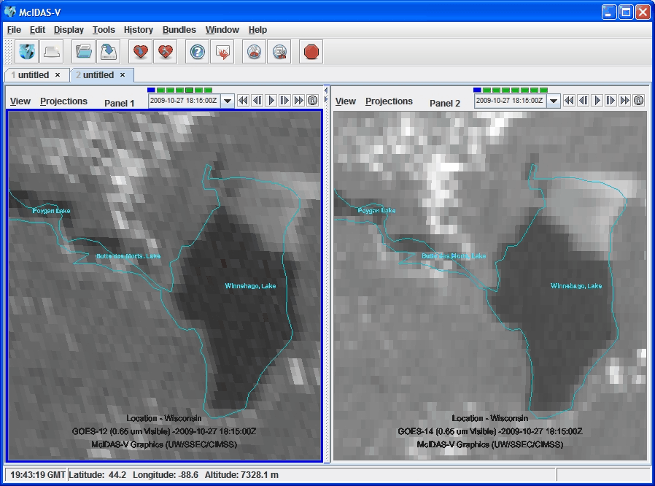
Improved INR

Slide 30
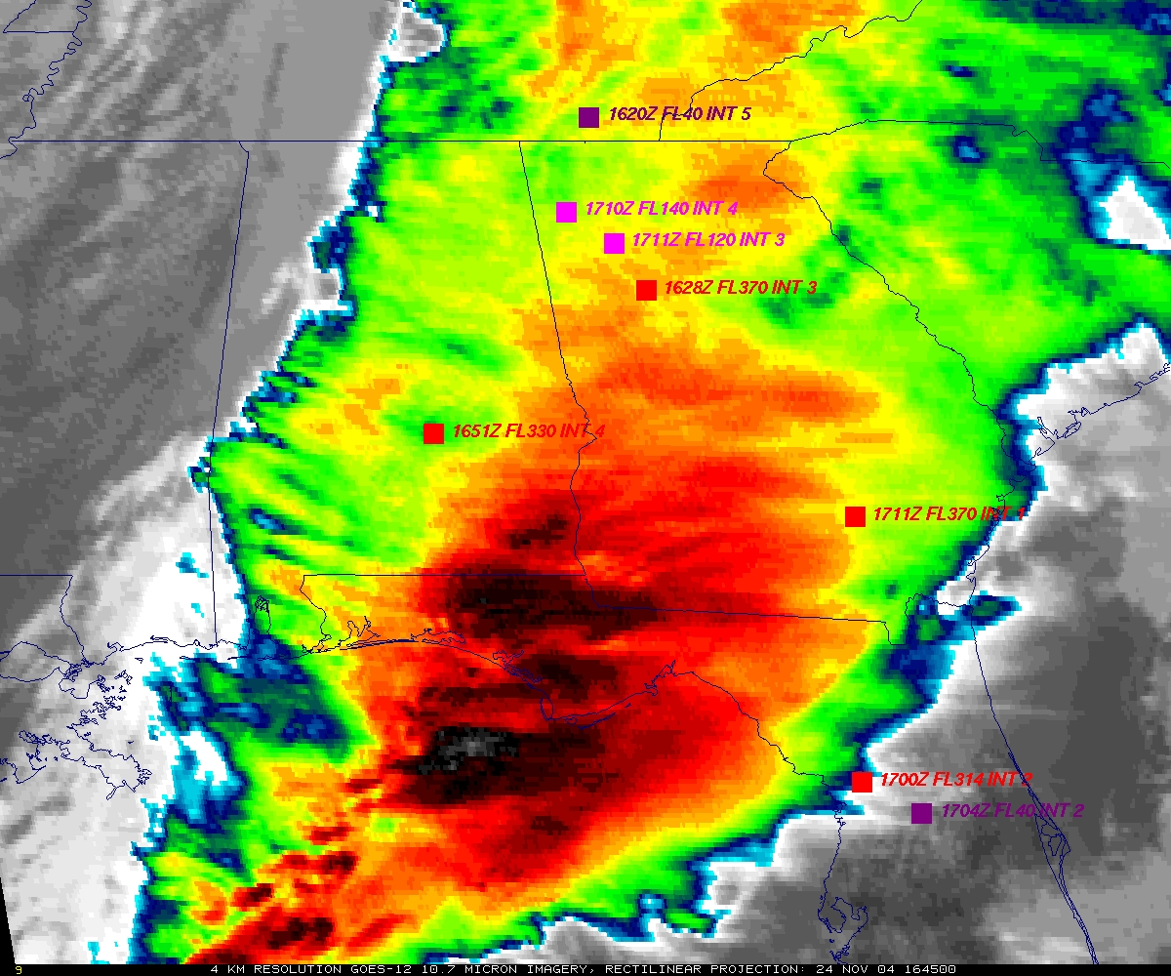
GOES
Figure courtesy of K. Bedka and W. Feltz

Slide 31
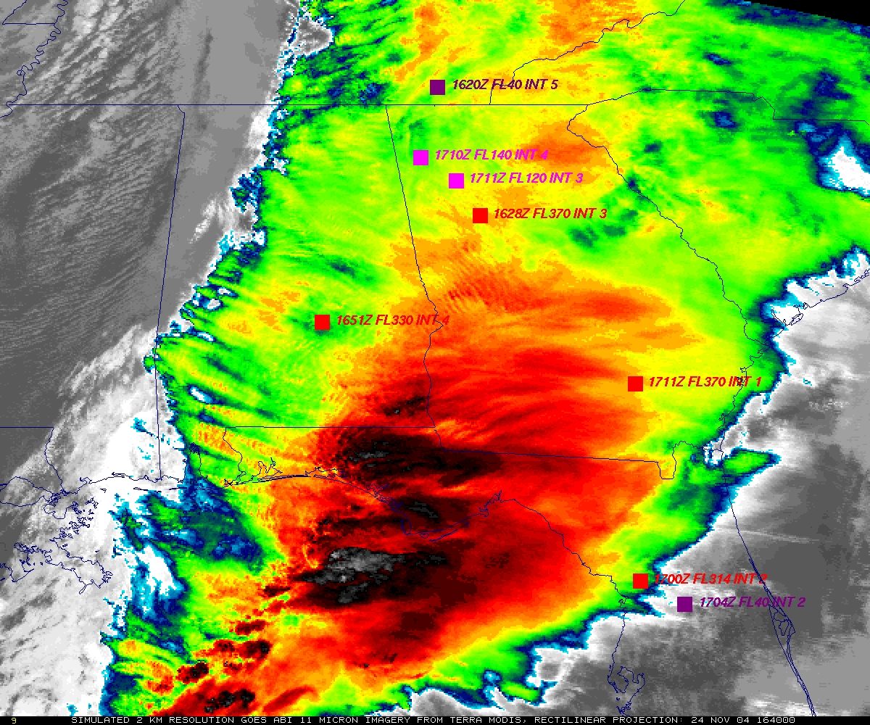
“ABI”
Figure courtesy of K. Bedka and W. Feltz

Slide 32
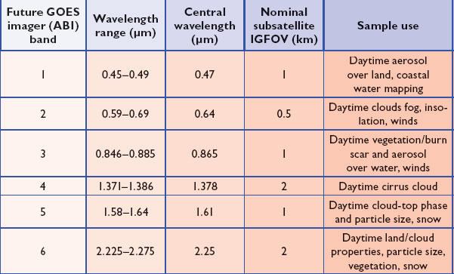
ABI Visible/Near-IR Bands
Schmit et al, 2005
Notes:
Schmit, T. J., M. M. Gunshor, W. P. Menzel, J. J. Gurka, J. Li, and A. S. Bachmeier, 2005: Introducing the next-generation Advanced Baseline Imager on GOES-R. Bull. Amer. Meteor. Soc., 86, 1079-1096.

Slide 33
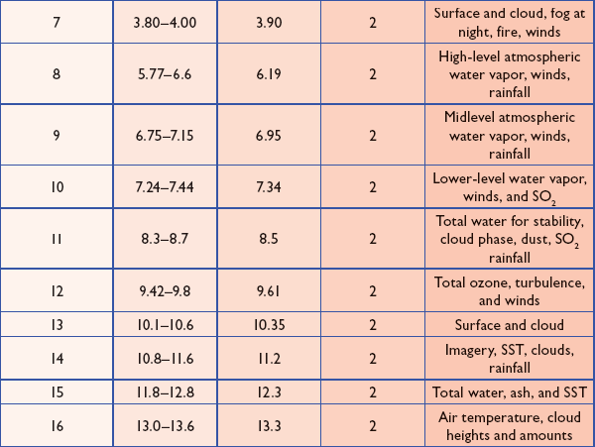
ABI IR Bands
Schmit et al, 2005
Notes:
Schmit, T. J., M. M. Gunshor, W. P. Menzel, J. J. Gurka, J. Li, and A. S. Bachmeier, 2005: Introducing the next-generation Advanced Baseline Imager on GOES-R. Bull. Amer. Meteor. Soc., 86, 1079-1096.

Slide 34
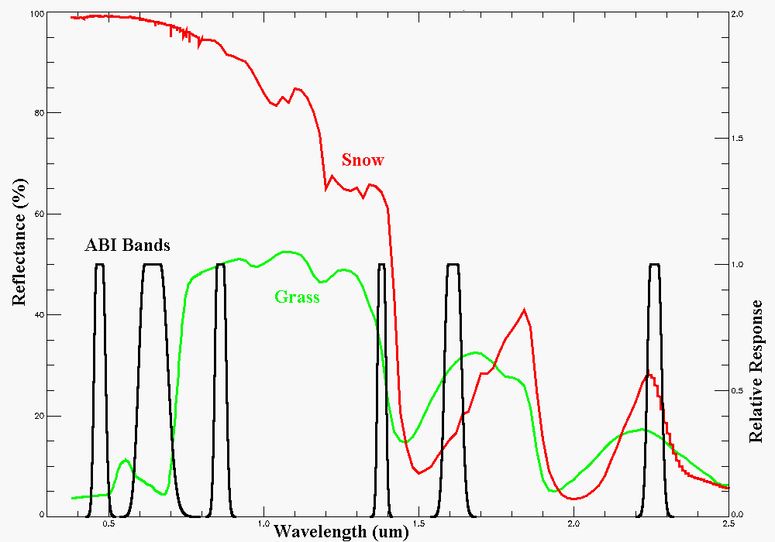
Visible and near-IR channels on the ABI
Snow, Phase
Part. size
Cirrus
Haze
Clouds
Veg.
The ABI visible and near-IR bands have many uses.
Notes:
Schmit, T. J., M. M. Gunshor, W. P. Menzel, J. J. Gurka, J. Li, and A. S. Bachmeier, 2005: Introducing the next-generation Advanced Baseline Imager on GOES-R. Bull. Amer. Meteor. Soc., 86, 1079-1096.

Slide 35
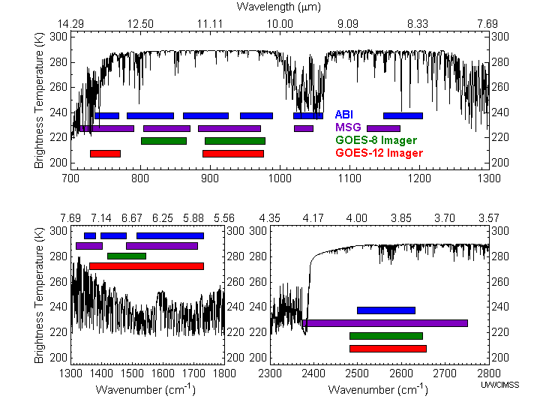
Similarities and differences for the spectral bands on Meteosat Second Generation (MSG), current GOES, and the Advanced Baseline Imager (ABI).
ABI has many more bands than the current operational GOES imagers.
Notes:
Schmit, T. J., M. M. Gunshor, W. P. Menzel, J. J. Gurka, J. Li, and A. S. Bachmeier, 2005: Introducing the next-generation Advanced Baseline Imager on GOES-R. Bull. Amer. Meteor. Soc., 86, 1079-1096.

Slide 36
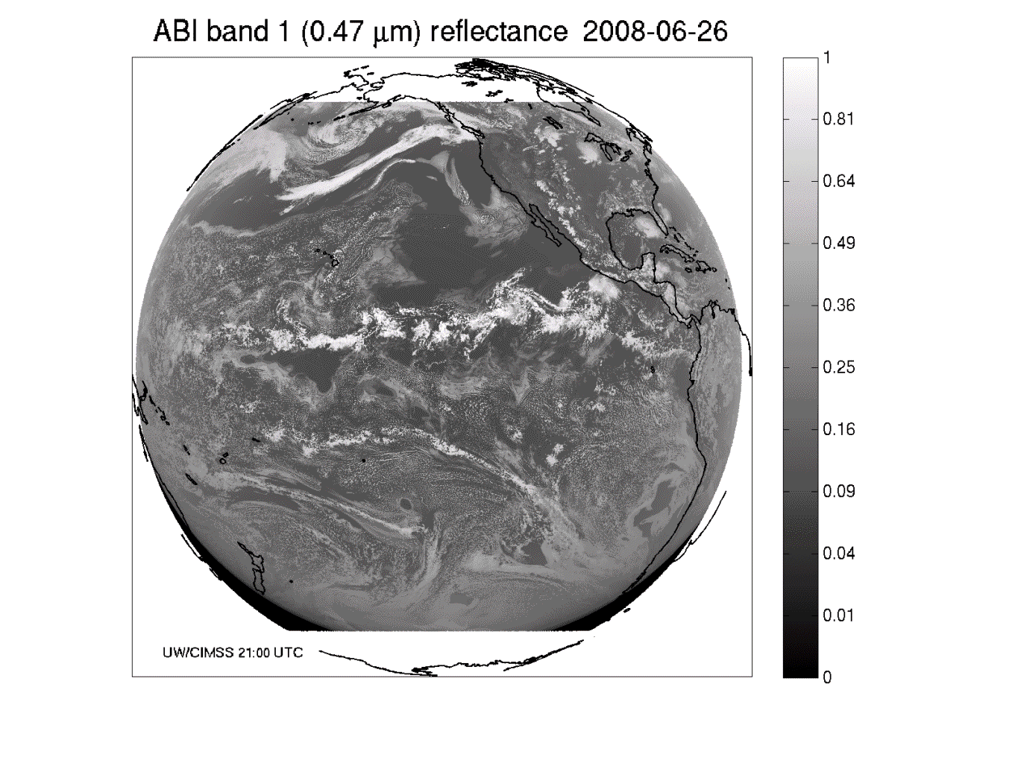
These NWP model simulations were performed on the 'cobalt' supercomputer at the National Center for Supercomputing Applications at the University of Illinois.
Band 1: Daytime “Blue” band -- aerosols

Slide 37
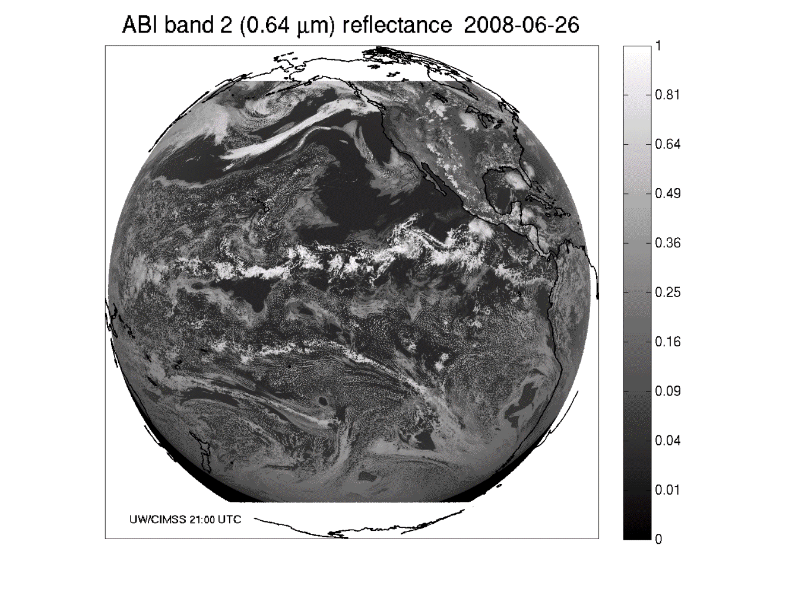
Band 2: Daytime “Red” band – clouds, etc.

Slide 38
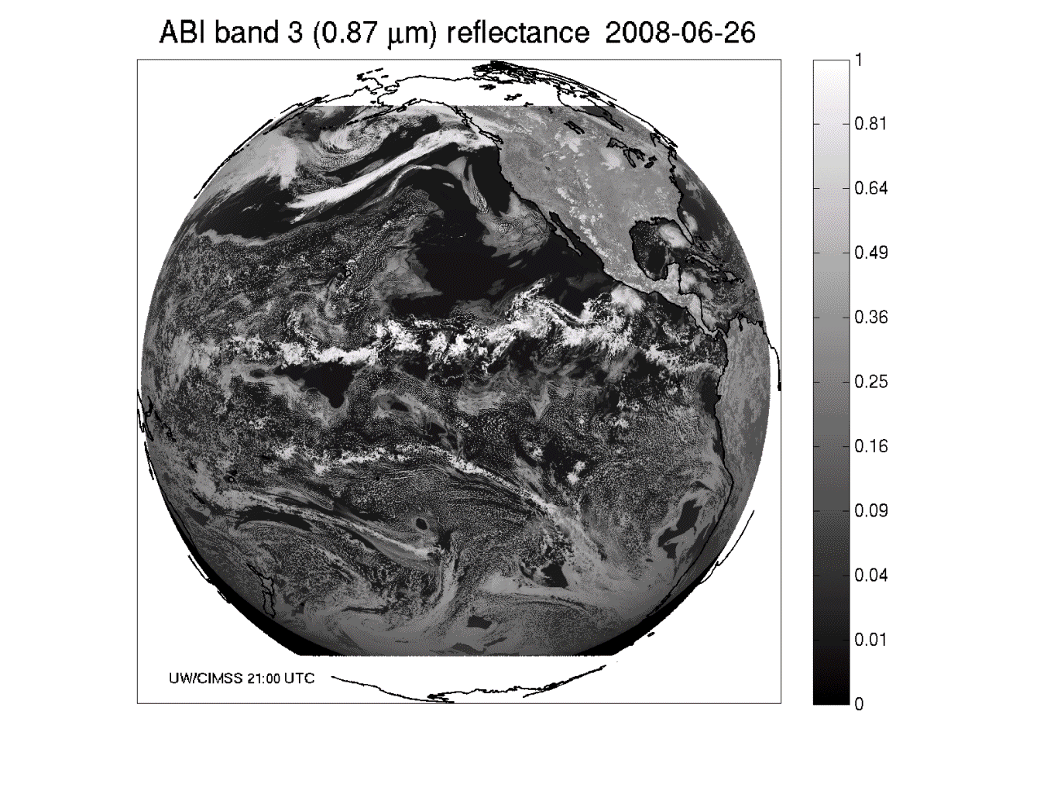
Band 3: Daytime “Veggie” band

Slide 39
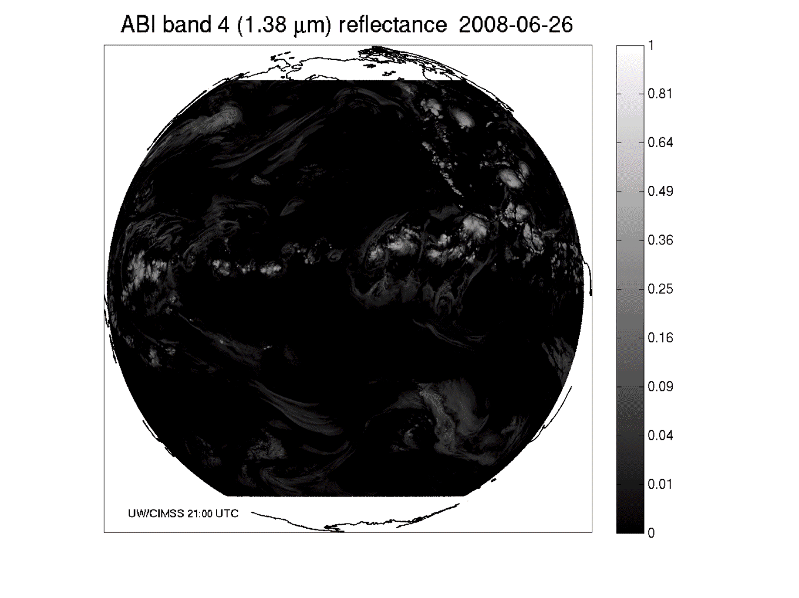
Band 4: Daytime “Cirrus” band

Slide 40
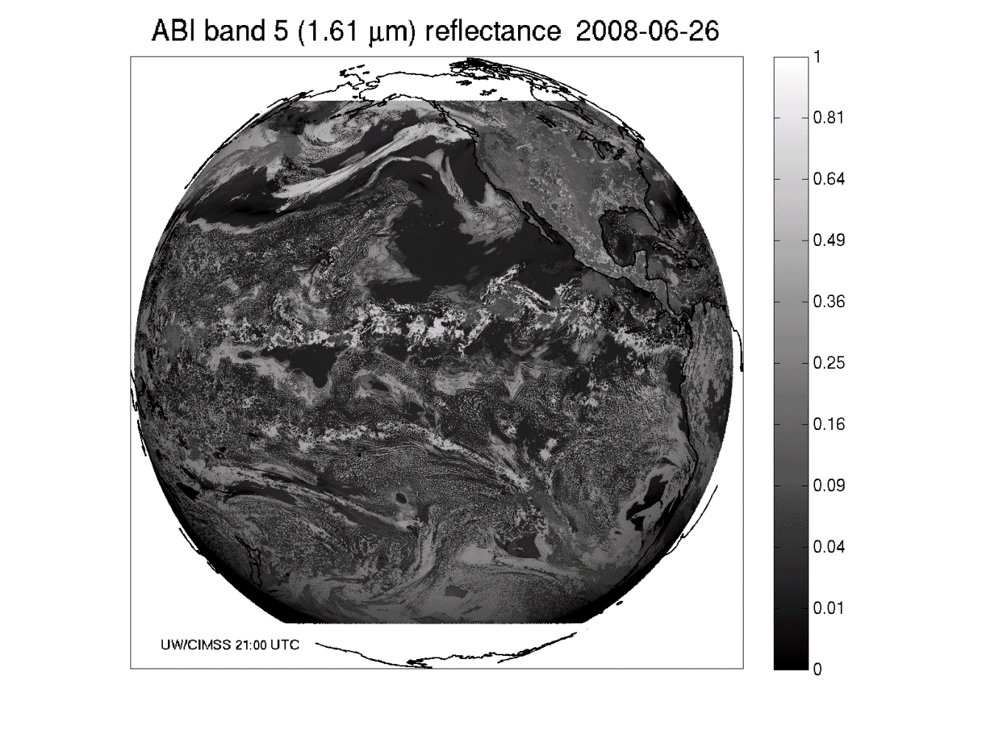
Band 5: Daytime “Snow” band

Slide 41
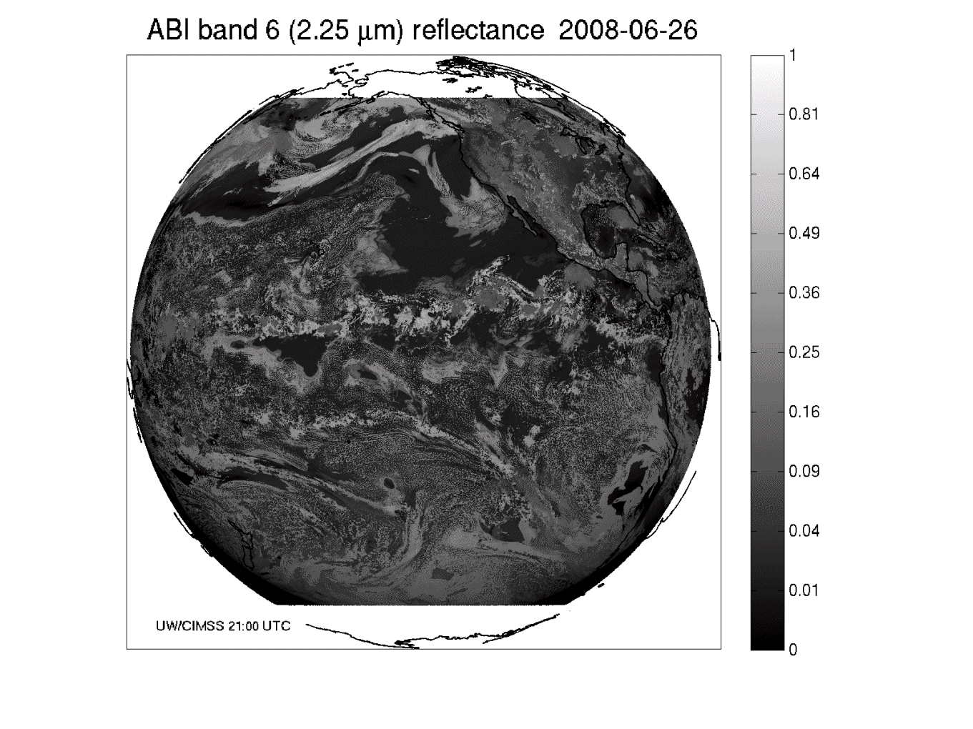
Band 6: Daytime “Cloud-top phase” band

Slide 42
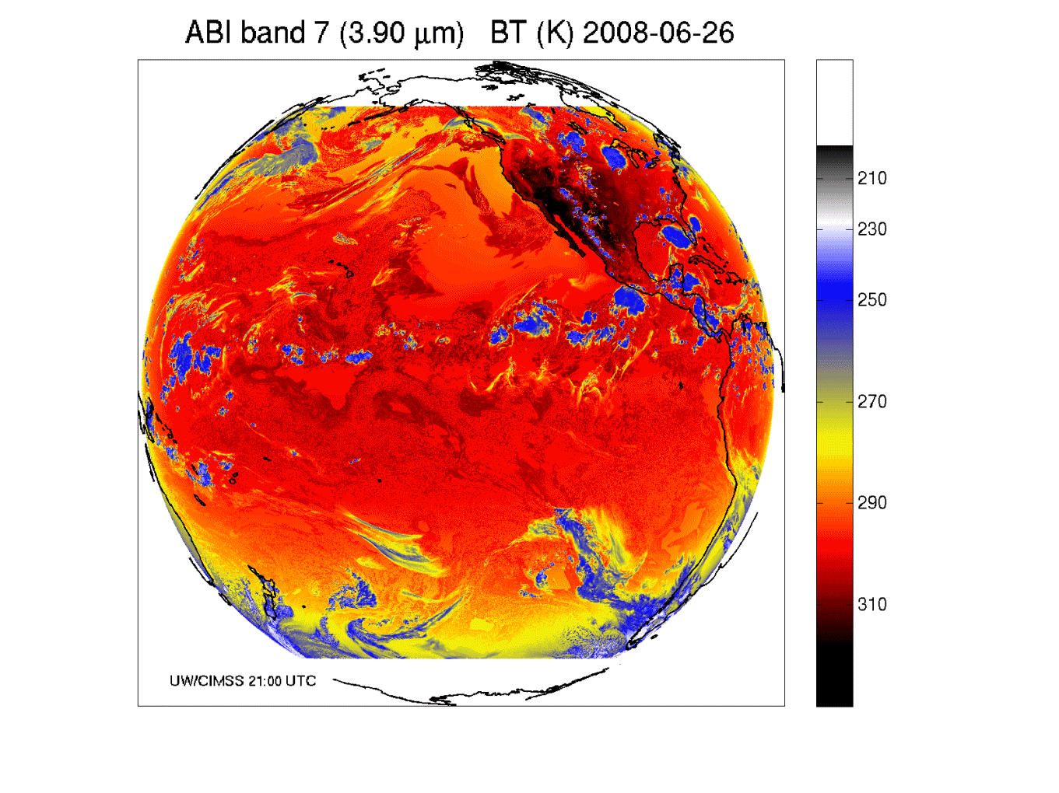
Band 7: Shortwave IR window band - fog, fires, etc.

Slide 43
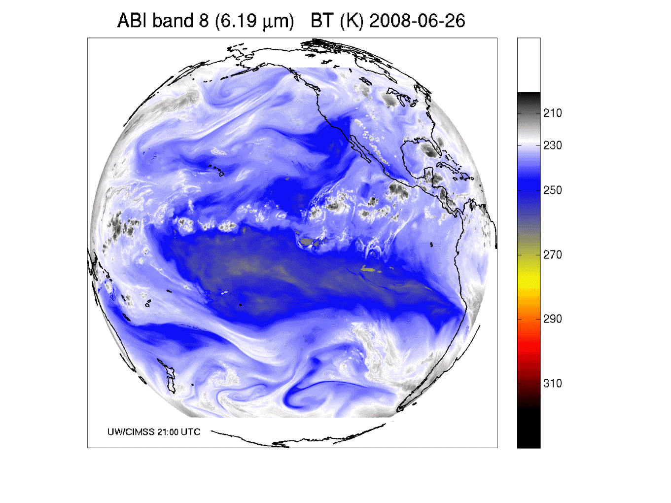
Band 8: Upper-level tropospheric water vapor band

Slide 44
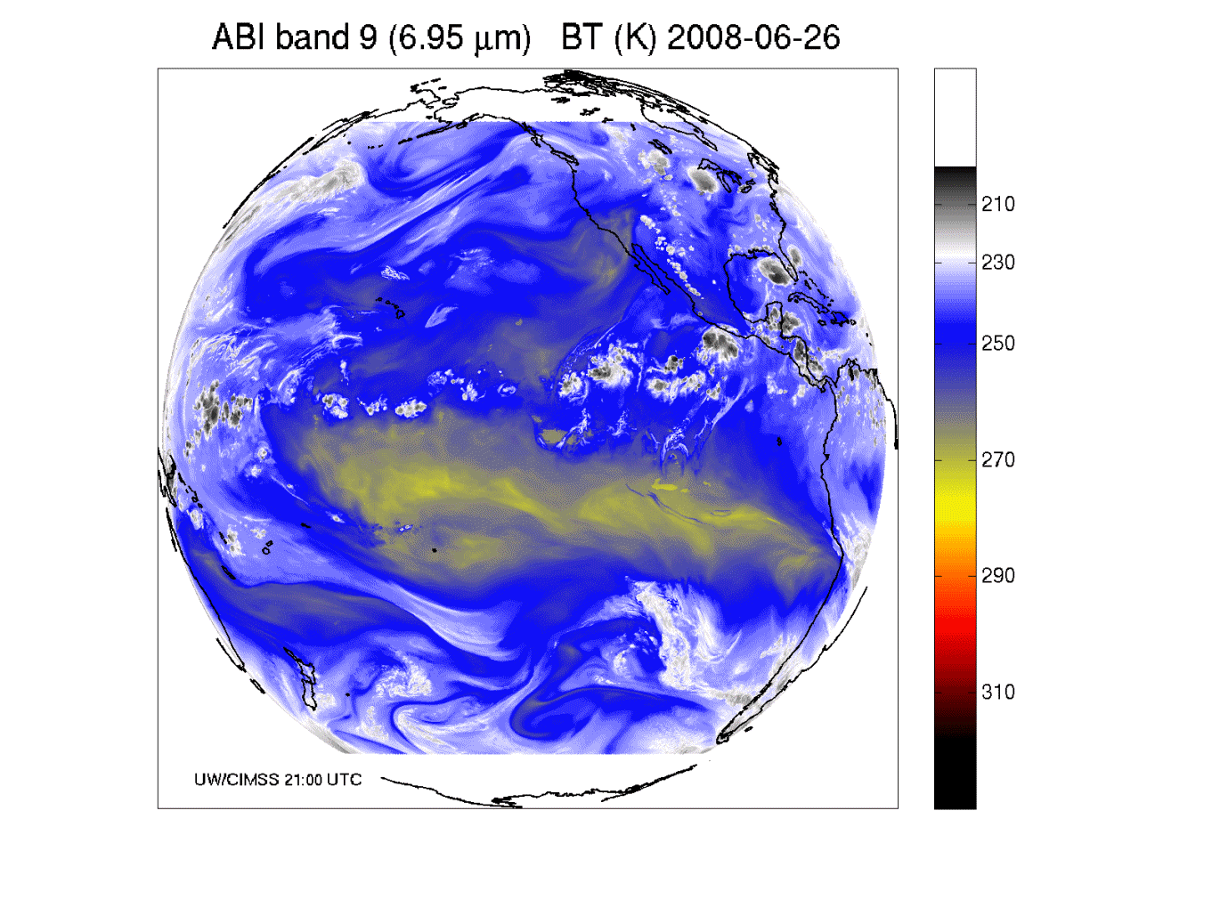
Band 9: Upper/mid-level tropospheric water vapor band

Slide 45
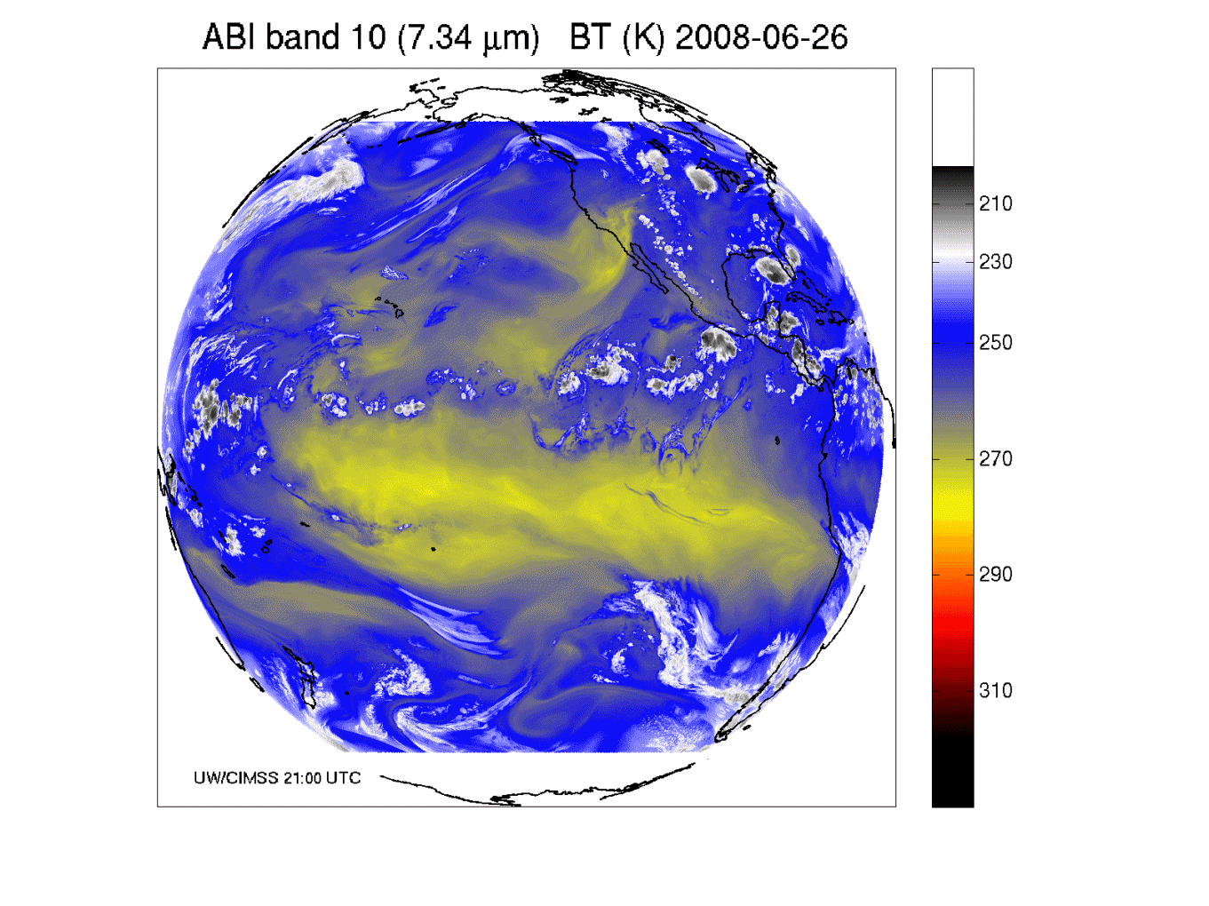
Band 10: Lower mid-level tropospheric water vapor band

Slide 46
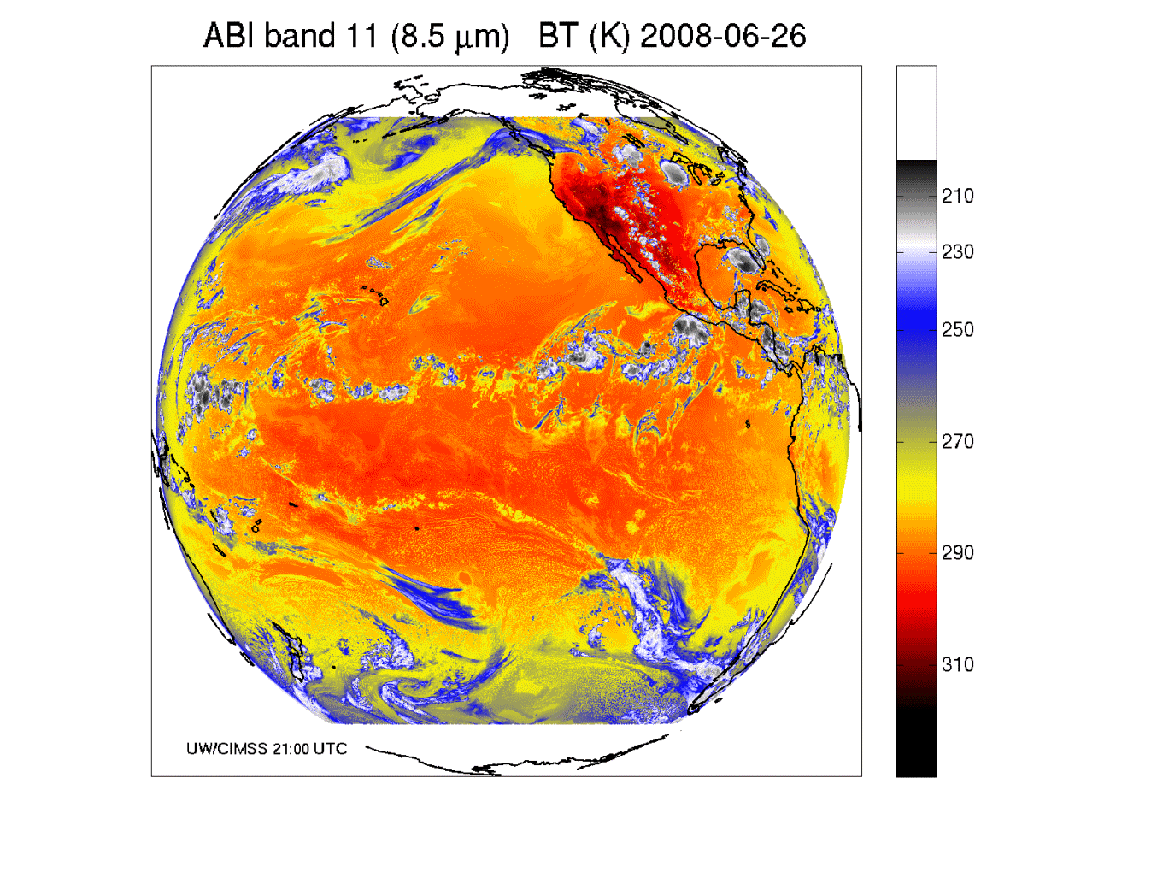
Band 11: “Cloud-top phase” band

Slide 47
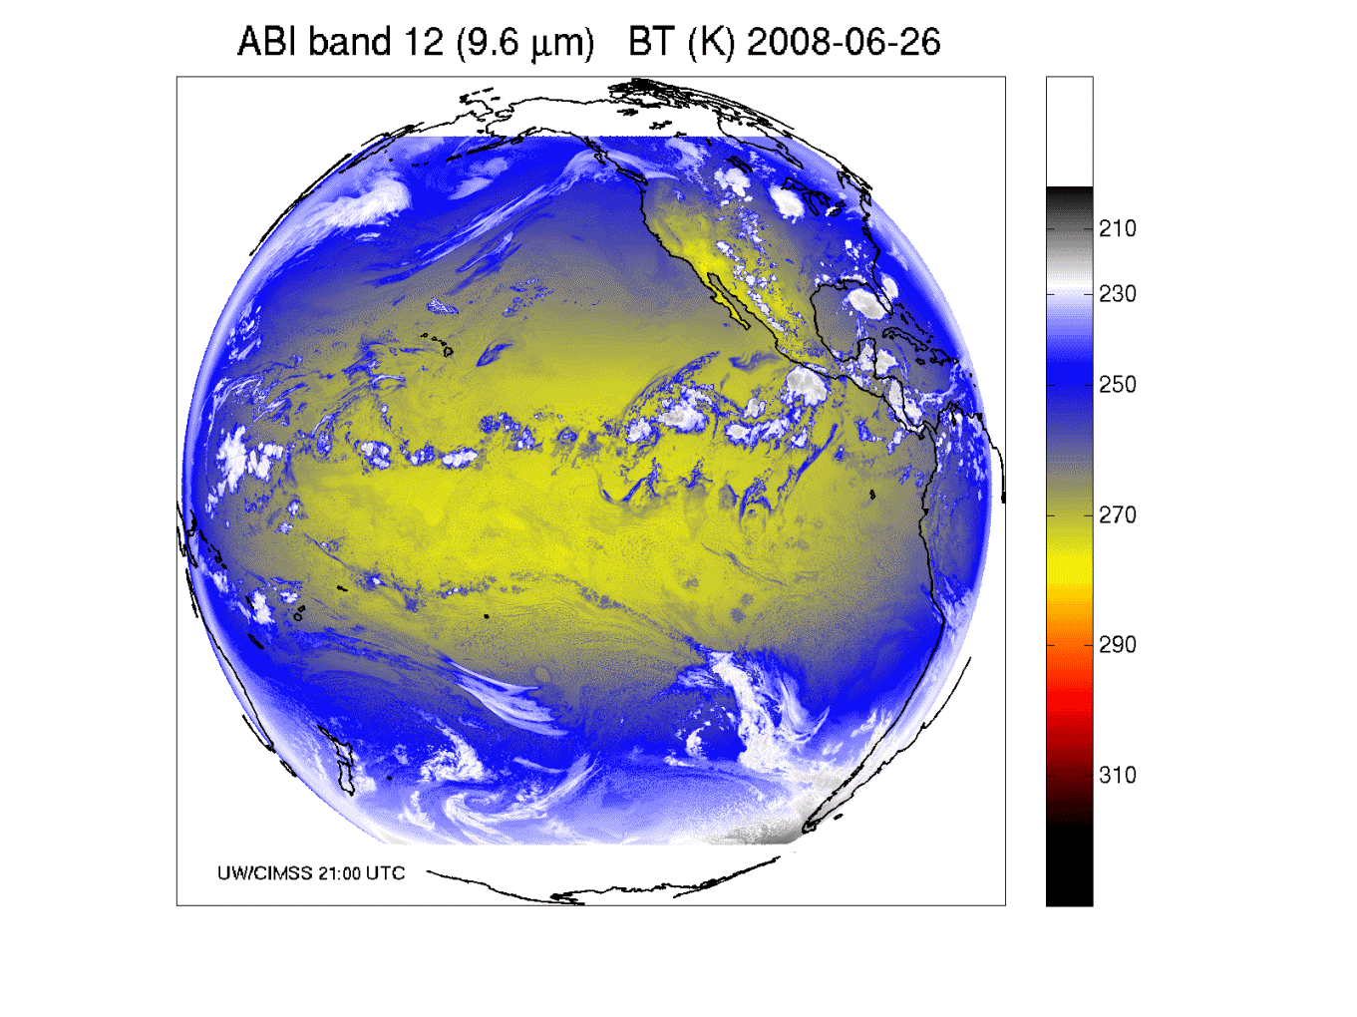
Band 12: “Ozone” band

Slide 48

Band 13: “Clean” IR longwave window band

Slide 49

Band 14: IR longwave window band

Slide 50

Band 15: “Dirty” IR longwave window band

Slide 51

Band 16: “CO2” longwave IR band

Slide 52

ABI in AWIPS (via netCDF)
J. Oktin et al., CIMSS
Simulated Advanced Baseline Imager (ABI) bands shown; in the legacy AWIPS.
Notes:
http://cimss.ssec.wisc.edu/goes/abi/

Slide 53

Visualization
(“decision aid”)
“True Color” with “synthetic” green from ABI simulated data (from CIMSS); image from Don Hillger, RAMMB.

Slide 54

Visualization
(“decision aid”)
“RGB Color” (VIS 0.6, VIS 0.8, and NearIR 1.6 um) with ABI simulated data (from CIMSS); image from William Straka, CIMSS and using the EUMETSAT enhancement.

Slide 55

Simulated ABI band – NSSL WRF
http://cimss.ssec.wisc.edu/goes_r/proving-ground/nssl_abi/nssl_wrf_goes.html

Slide 56


WRF Model-Derived Proxy Radiance Datasets
(UW CIMSS)
Proxy SEVIRI 10.8 μm Tb
Observed SEVIRI 10.8 μm Tb
Notes:
Data from this high-resolution simulation has been extensively used by two validation studies, with results shown in the next slide. To the best of our knowledge, this was the largest model simulation (in terms of memory) ever performed at the time and was only surpassed by an even larger simulation late last year.

Slide 57

Real, Simulated
Notes:
Both remapped to 10km

Slide 58

Real, Simulated
Notes:
Both remapped to 10km

Slide 59

GOES Imager
GOES-R ABI
One is from a McIDAS AREA, while the other (simulated image) is from a netCDF.

Slide 60

Overview
History
Current GOES Imager and Sounder
  GOES-14/15
ABI (Advanced Baseline Imager)
  Temporal
  Spatial
  Spectral
Select Products
High Spectral res.
Summary
  More information
  Questions
Photo courtesy of ITT Geospatial Systems

Slide 61
AWG Algorithm Development Scope
Develop algorithms for the following L2 products…
Cloud Layer/Heights
Cloud Ice Water Path
Cloud Liquid Water
Cloud Type
Convective Initiation
Turbulence
Low Cloud and Fog
Enhanced “V”/Overshooting Top
Aircraft Icing Threat
SO₂ Detections (Volcanoes)
Visibility
Upward Longwave Radiation (TOA)
Downward Longwave Radiation (SFC)
Upward Longwave Radiation (SFC)
Total Ozone
Aerosol Particle Size
Surface Emissivity
Surface Albedo
Vegetation Index
Vegetation Fraction
Flood Standing Water
Rainfall probability and potential
Snow Depth
Ice Cover
Sea & Lake Ice Concentration, Age, Extent, Motion
Ocean Currents, Currents: Offshore
Clouds and Moisture Imagery (KPP)
Clear Sky Mask
Cloud Top Pressure and Height
Cloud Top Phase
Cloud Top Temperature
Cloud Particle Size Distribution
Cloud Optical Path
Temperature and Moisture Profiles
Total Precipitable Water
Stability Parameters (Lifted Index, etc.)
Aerosol Detection
Aerosols Optical Depth
Derived Motion Winds
Hurricane Intensity
Fire/Hot Spot Characterization
Land and Sea Surface Temperature
Volcanic Ash
Rainfall Rate
Snow Cover
Downward Solar Insolation: Surface
Reflected Solar Insolation: TOA
Lightning Detection
Advanced Baseline Imager (ABI)
GLM

Slide 62

Imagery
Imagery for nowcasting
  Clouds
  Input for products
  Channel differences
  RGB
  General Users
  Etc.
Radiances for NWP
  Clear-sky
  Cloudy-sky
  Validations
  Monitoring
  Etc.

Slide 63


Cloud Phase
Algorithm Highlights
  An Infrared only algorithm that exploits the rich IR information (7.4, 8.5, 11.2, and 12.3 μm) provided by the ABI
  Algorithm determines the cloud top (layer that the radiometer senses) thermodynamic phase of the highest cloud layer
  Exploits recent improvements in fast clear-sky radiative transfer models and ancillary data (land cover, surface emissivity
  Makes advanced use of spatial information
Operational Applications
  Prerequisite for other cloud property retrievals (height, temp)
  Climate prediction
  Aviation forecasting (Aircraft icing)
M. Pavolonis
63
63
63
63
63
Water, Supercooled Water, Mixed Phase, Ice
Notes:
63
63
63
63
63
This ABI Cloud Phase Algorithm determines the cloud top (layer that the radiometer senses) thermodynamic phase of the highest cloud layer.
The cloud phase output is a subset of a more detailed cloud classification produced by the GOES-R Cloud Type Algorithm
A unique infrared cloud classification scheme is used to determine the cloud type
ABI channels used: 10, 11, 14, and 15
Effective absorption optical depth ratios (β-ratios) are used to determine cloud type (liquid water, supercooled liquid water, mixed phase, opaque ice, semi-transparent ice, and multilayered clouds).
The cloud phase (liquid water, supercooled liquid water, mixed phase, and ice) is determined from the cloud type output (ice = opaque ice, semi-transparent ice, and multilayered clouds).

Slide 64


The GOES-R Fog Product
GOES
GOES-R
M. Pavolonis
Notes:
What Is Fog and Low Stratus?
Fog is defined as a stratus cloud that has a cloud base at or close to the surface that reduces the surface visibility to less than 1 km. Even if the base of a stratus cloud is not in contact with the surface, however, it can be a hazard to aviation. The GOES-R Fog/Low Cloud Detection product is designed to quantitatively identify clouds that produce IFR or Low Instrument Flight Rules (LIFR) conditions.
The fog probability is based on textual and spectral information, as well as the difference between the cloud radiative temperature and surface temperature.
The current GOES fog products are limited to a qualitative brightness temperature difference approach (3.9μm - 11μm), available at 15 or 30-minute intervals, that can only be used at night. The GOES-R algorithm will produce a quantitative analysis of the probability that fog or low stratus is present, both day and night.
The GOES-R fog product can much more accurately capture hazardous valley fog events like this one on the east coast of the U.S., compared to current GOES

Slide 65

Derived Motion Winds
Algorithm Highlights
  Heritage in targeting, tracking, and QC algorithms lie with current NESDIS operational winds algorithms
  New nested tracking algorithm introduced that makes use of a two-dimensional clustering algorithm to capture the dominant motion in each target scene
  Utilizes clear sky mask product
  Wind height assignment will rely on utilization of pixel level cloud heights generated upstream via algorithms delivered by AWG cloud application team
  Leverages ABI’s higher spatial and temporal resolution data
Operational Applications
  Weather Forecasting
  Assimilation into mesoscale and global NWP models
  Aviation (flight routing)
Cloud-drift Winds derived from a Full Disk Meteosat-8 SEVERI 10.8 µm image triplet centered at 1200 UTC 01 February 2007
High Level 100-399 mb
Mid-Level 400–699 mb
Low-Level >700 mb
65
65
65
65
65
Courtesy J. Daniels: NOAA-STAR
Notes:
65
65
65
65
65

Slide 66

Fire/Hot Spot Characterization
Algorithm Highlights
  Heritage lies with the GOES operational Wildfire Automated Biomass Burning Algorithm (WF_ABBA)
  Dynamic, multi-spectral, thresholding contextual algorithm
  Utilizes the 0.64, 3.9, 11.2 and 12.3 μm channels
  Leverages ABI’s higher spatial and temporal resolution data
Operational Applications
  Fire weather forecasting
  Air quality forecasting
66
66
66
66
66
Courtesy C. Schmidt: CIMSS
Notes:
66
66
66
66
66

Slide 67




GOES-12 and GOES-R ABI
Simulation of Grand Prix Fire/Southern California
GOES-12
GOES-R ABI
GOES-12
GOES-R ABI
J. Feltz
Notes:
Here are two different fires. What we can see is a more defined peak in the higher resolution data and it is easier to pick out individual hotspots. In addition, the higher saturation tempearture of the ABI allows us to see that the fire is around 370K.

Slide 68

Volcanic Ash
Algorithm Highlights
  Detects volcanic ash and estimates its height and mass loading
  Leverages the new ABI 8.5 μm band, The 8.5 μm, 11.2 μm, and 12.3,11.2 μm channel pairs are used to detect volcanic ash
  An optimal estimation approach is used to estimate ash cloud temperature, emissivity and microphysical index.
  Ash cloud height determined from NWP profiles.
  Mass loading estimated from computed optical depth and effective particle size
  Leverages ABI’s new 8.5 μm channel, along with 11.2 μm and 12.3 μm for sensitivity to cloud microphysics (including composition)
Operational Applications
  Aviation safety
  Health safety
  Climate studies
Iceland's Eyjafjallajökull Volcano
False Color
Imagery
Mass
Loading
Ash
Height
Effective
Particle
Radius
68
68
68
68
M. Pavolonis
68
Notes:
68
68
68
68
68
Grand Comore Island, Comoros (11.75 S, 43.38 E)
summit elevation 2361 m
shield volcano
Karthala volcano is located on Grande Comore, the most westerly of four volcanic islands comprising the Comores Archipelago, between northern Madagascar and Mozambique. Karthala occupies the southern half of Grand Comore Island.

Slide 69

Temperature & Moisture Soundings, Precipitable Water, Atmospheric Stability Products
TPW
(mm)
Algorithm Highlights
  1D-variational physical retrieval algorithm that has heritage with MODIS and current operational GOES sounder physical retrieval algorithms
  Regression-based initial guess T/Q profiles
  Utilizes NWP forecast T/Q profiles
  Utilizes the 6.15, 7.0, 7.4, 8.5, 9.7, 10.35, 11.2, 12.3, and 13.3 μm bands)
  Exploits recent improvements in fast clear-sky radiative transfer models and ancillary data (surface emissivity)
Operational Applications
  Nowcasting
  Gulf of Mexico return flow
  Southwest US monsoon
  QPF (heavy rain, flash flooding)
  Convective potential and morphology
  Fog potential
  Situational awareness in pre-convective environments for potential watch/warning scenarios
  NWP
  Assimilation into regional and mesoscale NWP models (TPW)
69
69
69
69
69
J. LI, CIMSS
Notes:
69
69
69
69
69

Slide 70




Geostationary Total Column Ozone (TCO) Assimilation
CalNex Ozonesonde
GOES TCO Assimilation
(GFS UT/LS and background errors)
The National Air Quality Forecasting Capability (NAQFC) uses the Community Multi-scale Air Quality (CMAQ) to provide air quality forecast guidance. Capabilities to assimilate Geostationary Sounder TCO within CMAQ are currently under development at JCSDA
Ozone mixing ratio
Significant improvement in upper troposphere
Improved Cloud free sampling
Continuous day/night sampling
Brad Pierce (NESDIS/STAR)

Slide 71


Improved Aerosol Predictions with Satellite Data Assimilation
Assimilation (Cressman analysis) of GOES Aerosol Optical Depth (AOD) in a NOAA-EPA Weather and Research (WRF)/Community Multiscale Air Quality (CMAQ) model shows improved aerosol predictions for an east coast pollution episode
Observed vs Predicted Surface PM2.5 (µg/m³) Concentrations
Assimilation
No Assimilation
AOD
Shobha Kondragunta, STAR
Notes:
The movie loops show WRF-CMAQ simulations for one day beginning at 00z. This was a regional-scale industrial haze/pollution episode. Top left panel shows 24-hr forecast without assimilation and the bottom left panel shows 24-hr forecast with GOES AOD (aerosol optical depth) assimilation. AOD can be viewed as a proxy to particulate matter (PM2.5) pollution. PM2.5 stands for particulate matter in ug/m3 for particles smaller than 2.5 microns. These particles are the most harmful because they can make it through your respiratory system and cause health problems. As evident by the scatterplot of predicted PM2.5 concentrations and observed concentrations, simulations with assimilation correlate better with observations than the forecast runs without assimilation.

Slide 72


GOES AOD Assimilation
Time Series of PM2.5 concentrations
MODIS AOD Assimilation
WRF-CMAQ assimilation runs are reinitialized every 24 hours with satellite AOD observations. GOES has a 10-hr observational window during which hourly mini-cycling is used.
Both GOES and MODIS assimilation improve surface PM2.5 predictions. GOES has a bigger impact than MODIS due to hourly cycling.
Loss of information around 18 UTC in base case as well as assimilation run was determined to be due to boundary layer dynamics
Shobha Kondragunta, STAR

Slide 73

Overview
History
Current GOES Imager and Sounder
  GOES-14/15
ABI (Advanced Baseline Imager)
  Temporal
  Spatial
  Spectral
Select Products
High Spectral res.
Summary
  More information
  Questions

Slide 74
Approximate spectral and spatial resolutions of US GOES Imagers
~ Band Center (um) | GOES-6/7 | GOES-8/11 | GOES-12/N | GOES-O/P | GOES-R+
0.47
0.64
0.86
1.6
1.38
2.2
3.9
6.2
6.5/6.7/7 | 14km
7.3
8.5
9.7
10.35
11.2
12.3
13.3
Visible
Near-IR
Box size represents pixel size
8
4
2
“MSI mode”
Infrared
Notes:
0.40 inches = 4km; 0.80 inches = 8km
MSI is Multi-Spectral Imaging Mode (dashed boxes)
This does not show other improvements: SNR, MTF, bit-depth, navigation, coverage rates, etc.

Slide 75
High-Spectral, combined with High-Temporal Resolution is the key
Water Vapor and Carbon Dioxide absorption lines within the infrared window are sensitive to changes in the lower tropospheric thermodynamic state
Current GOES sounders are spectrally too broad to resolve these lines
High-time information obtained from a high spectral resolution IR GEO sounder would be very useful for monitoring pre-convective clear sky regions

Slide 76


Need to monitor rapidly evolving situations

Slide 77

Evolution of the Vertical Moisture is the Key!
Simulated Relative humidity cross-section at 20 UTC 12 June 2002
“Truth”
“GEO advanced IR sounder ”
“ABI”
“RUC”
Li et. al.
Notes:
Warning information in pre-convection environment from geostationary advanced infrared sounding system – a simulation study using the IHOP case
Jun Li, Jinlong Li, Jason Otkin, Timothy J. Schmit, Chian-Yi, LiuJournal of Applied Meteorology and Climatology

Slide 78
Various Infrared spectral resolutions
Standard Atmosphere:
0.2 cm⁻¹ (NAST-I-like)
0.6 cm⁻¹ (HS from polar-like)
1.2 cm⁻¹ (HS from polar-like)
4.8 cm⁻¹
19.2 cm⁻¹ (current sounder-like)
38.4 cm⁻¹ (imager-like)
Jun Li, Mat Gunshor and Allen Huang
Notes:
On the web at: http://cimss.ssec.wisc.edu/goes/hes/res/

Slide 79


Slide 80


Slide 81


Slide 82


Slide 83


Slide 84


Slide 85


Slide 86

Longwave window region

Slide 87

Longwave window region

Slide 88

Longwave window region

Slide 89

Longwave window region

Slide 90

Longwave window region

Slide 91

Longwave window region

Slide 92

Longwave window region

Slide 93

Water vapor region

Slide 94

Water vapor region

Slide 95

Water vapor region

Slide 96

Water vapor region

Slide 97

Water vapor region

Slide 98

Water vapor region

Slide 99

Water vapor region

Slide 100

Why do we need a high spectral resolution sounder?
Analysis courtesy of Justin Sieglaff, CIMSS.
GOES-12 Sounder Bands
Smooth over required absorption lines
Compared to broadband sounders, observing absorption lines is mandatory to meeting requirements for temperature and moisture structure needed to improve weather forecasting
Many papers document science value of high spectral resolution sounder that support weather forecast needs.
Notes:
These are calculated spectra, showing important features dealing with temperature and moisture are in the high-spectral data, but are smoothed over in the broad-band data. Figure courtesy of J. Sieglaff, CIMSS.
I’m not sure it is useful to show an entire spectrum. Rather I prefer to show the above and indicate that it is these little wiggles that make the HES so valuable and that the current GOES smears out.

Slide 101
The relative vertical number of independent pieces of information is shown. Note that the moisture content is similar between the ABI and the current GOES Sounder. The Sounder does show more temperature information than the ABI. Caveat: Even if two systems have the same number of pieces of information, they may represent different vertical levels. This information content analysis does not account for any spatial or temporal differences.

Slide 102

Overview
History
Current GOES Imager and Sounder
  GOES-14/15
ABI (Advanced Baseline Imager)
  Temporal
  Spatial
  Spectral
Select Products
High Spectral res.
Summary
  More information
  Questions

Slide 103
Summary
The ABI on GOES-R will improve over the current instrument in many aspects, plus improved image navigation and registration and radiometer performance.
These improvements will greatly assist a host of data assimilation and NWP applications, especially on the regional and
meso-scales via both direct assimilation and in-direct validations.
Need to start with current geostationary data and products to best prepare for the ABI
Still need the vertical resolution of highs-spectral, high-temporal observations!

Slide 104

More information
GOES-R:
  http://www.goes-r.gov
  http://www.meted.ucar.edu/index.htm
  http://cimss.ssec.wisc.edu/goes_r/proving-ground.html
GOES and NASA:
  http://goespoes.gsfc.nasa.gov/goes/index.html
  http://goes.gsfc.nasa.gov/text/goes.databookn.html
UW/SSEC/CIMSS/ASPB:
  http://cimss.ssec.wisc.edu/goes_r/proving-ground/nssl_abi/nssl_abi_rt.html
  http://cimss.ssec.wisc.edu/goes_r/awg/proxy/nwp/
  http://cimss.ssec.wisc.edu/goes/abi/
  http://cimss.ssec.wisc.edu/goes/abi/wf
  http://cimss.ssec.wisc.edu/goes/blog/
  http://www.ssec.wisc.edu/data/geo/
AMS BAMS Article on the ABI (Aug. 2005)

Slide 105



Select High-Spectral References
Schmit, T. J., J. Li, S. A. Ackerman, and J. J. Gurka, 2009: High spectral and temporal resolution infrared measurements from geostationary orbit, Journal of Atmospheric and Oceanic Technology, 26, 2273 - 2292.
(a.k.a., why we need an advanced sounder)
Sieglaff, J., M., T. J. Schmit, W. P. Menzel, S. A. Ackerman, 2009: Inferring Convective Weather Characteristics with Geostationary High Spectral Resolution IR Window Measurements: A Look into the Future. J. Atmos. Oceanic Technol., 26, 1527–1541.
(a.k.a., potential now-casting applications)
Schmit, T. J., J. Li, J. J. Gurka, M. D. Goldberg, K. Schrab, J. Li, W. Feltz, 2008: The GOES-R ABI (Advanced Baseline Imager) and the continuation of current sounder products. J. of Appl. Meteor., 47, 2696–2711.
(a.k.a., the ABI isn’t an advanced sounder)

Slide 106
Questions
Ready for GOES-15 (e.g., December)?
Ready for GOES-14?
Read netCDF for radiances and cloud mask (GOES-R ABI)
Ready to exploit the high temporal data from the ABI? Current GOES radiances and products?
Are the systems set-up for the in-direct validations?

Slide 107


Acknowledgements
The authors would like to thank the entire GOES-R team (especially the GOES-R Program Office); within the government, industry and academia.
The views, opinions, and findings contained in this presentation are those of the author and should not be construed as an official National Oceanic and Atmospheric Administration or U.S. Government position, policy, or decision.

