Slide 1
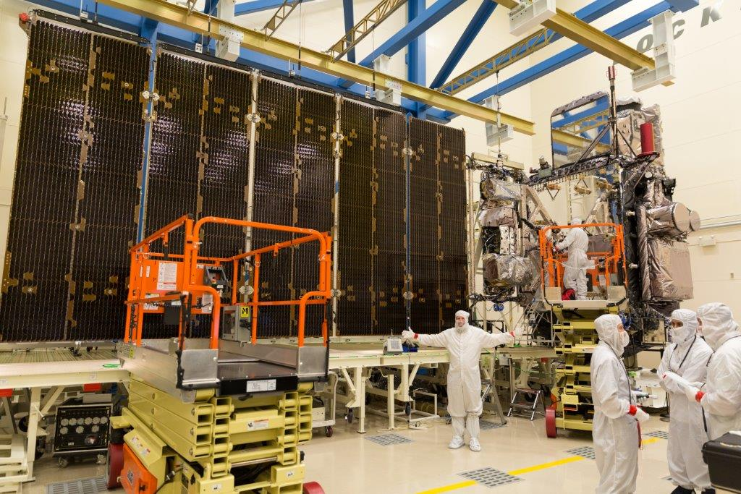
GOES-R Advanced Baseline Imager (ABI)
Spectral
Improved!
Spatial
Improved!
Temporal
Improved!
Calibration
Improved!
Lockheed Martin

Slide 2
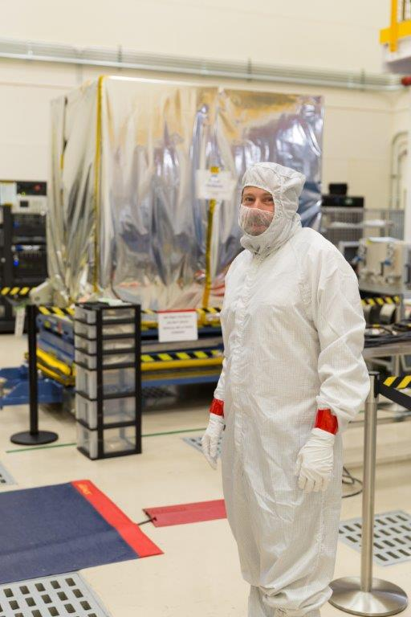
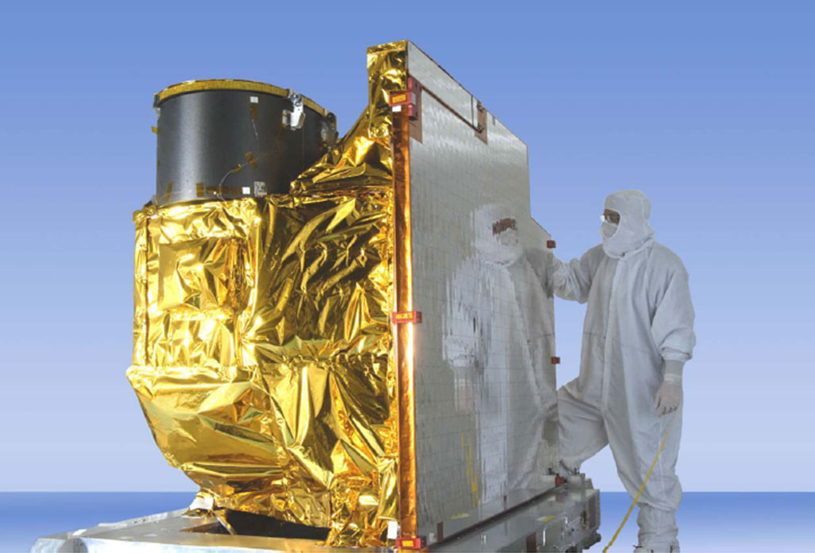
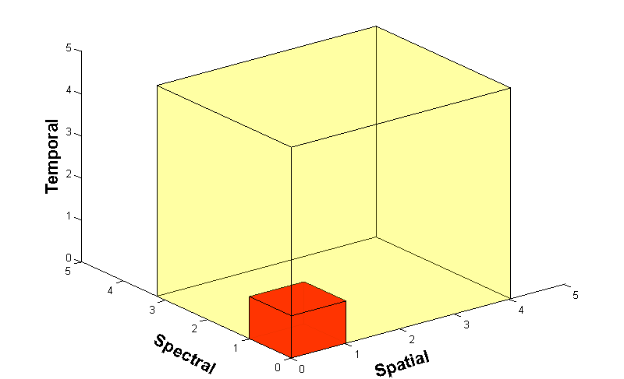
Advanced Baseline Imager (ABI)
ABI on GOES-S
5
4
3
X
Faster coverage (5-minute full disk vs. 25-minute)
X
Improved spatial resolution
(2 km IR vs. 4 km)
X
More spectral bands (16 on ABI vs. 5 on the current imager)
Plus improved radiometrics and higher bit depths, etc.
Notes:
Slide from J. Gerth, CIMSS.

Slide 3
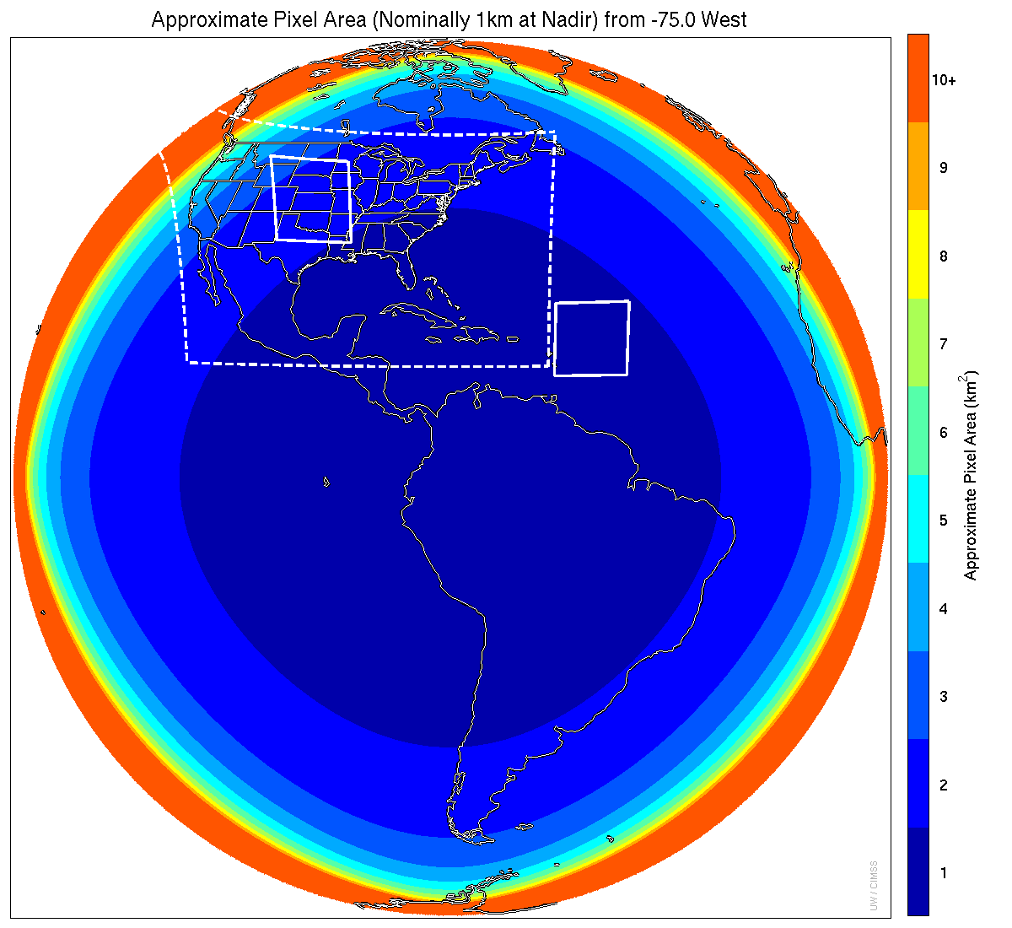
Meso-scale box locations are movable
1 min
5 min
1 min
15 min
Scan mode (3) or ‘flex mode’ for the ABI:
Full disk every 15 min
+ 5 min CONUS
+ 1-min mesoscale (2 locations).
Mat Gunshor, CIMSS
Notes:
1-km² spatial resolution at satellite nadir. Pixel Areas are approximate. Each bin is rounded to the nearest 1km² until we get to 9.5km² and then all are binned into the red 10+ area. So the first, dark blue, ring covers pixel areas from 1 to 1.49km² and is labeled “1”, above 1.5 to below 2.5km² goes into the next ring and is called “2”, etc. GOES-East location. Proposed CONUS sector, approved by the NWS NOAT. Two meso-scale image sectors shown; these are selectable. The same central lat/lon used for these mesoscales produces a different sized and shaped area for different satellite locations.

Slide 4
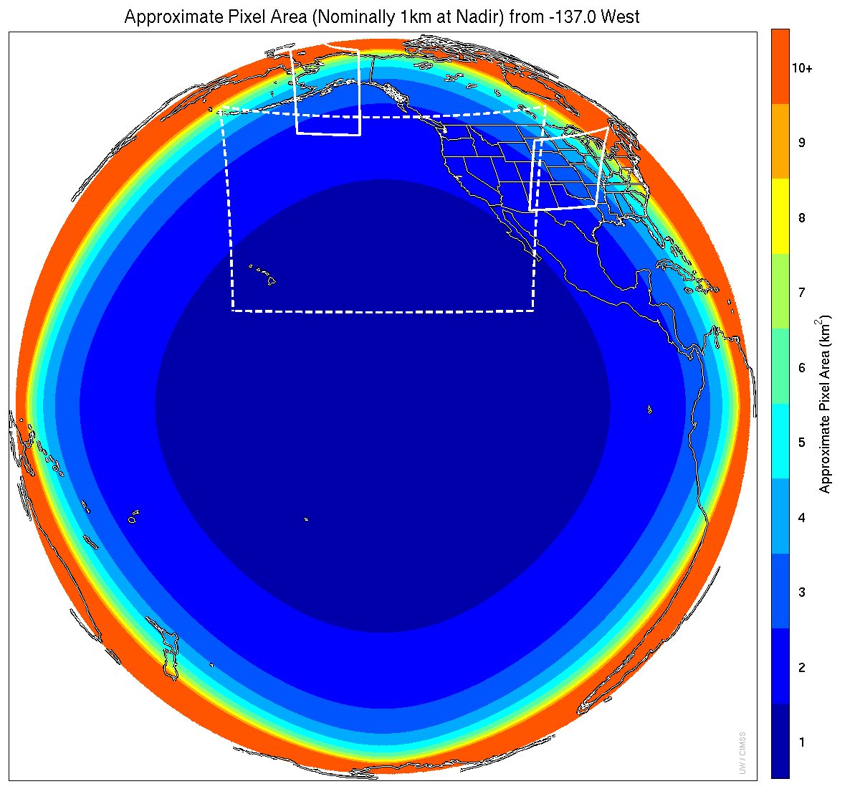
Meso-scale box locations are movable
1 min
1 min
5 min
15 min
Scan mode (3) or ‘flex mode’ for the ABI:
Full disk every 15 min
+ 5 min CONUS
+ 1-min mesoscale (2 locations).
Mat Gunshor, CIMSS
Notes:
1-km² spatial resolution at satellite nadir. Pixel Areas are approximate. Each bin is rounded to the nearest 1km² until we get to 9.5km² and then all are binned into the red 10+ area. So the first, dark blue, ring covers pixel areas from 1 to 1.49km² and is labeled “1”, above 1.5 to below 2.5km² goes into the next ring and is called “2”, etc. GOES-West location. Proposed CONUS sector, approved by the NWS NOAT. Two meso-scale image sectors shown; these are selectable. The same central lat/lon used for these mesoscales produces a different sized and shaped area for different satellite locations.

Slide 5
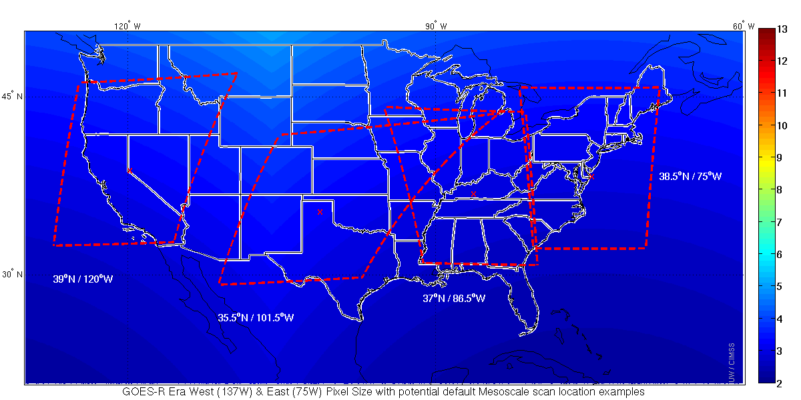
Default Meso Locations
Two meso from GOES-West and two from GOES-East
Mat Gunshor, CIMSS

Slide 6
ABI Sectors
Joleen Feltz, CIMSS

Slide 7
GOES-16 vs GOES-13

Slide 8
ABI vs GOES-13

Slide 9
ABI vs GOES-13

Slide 10
GOES-16 vs -13

Slide 11
Harvey

Slide 12
Many critical derived quantities
http://www.goes-r.gov

Slide 13
GOES-16 Products
ABI L1b Product
Radiances
ABI L2+ Products (con’t)
Downward S/W Radiation: Surface
Fire/Hot Spot Characterization
Hurricane Intensity Estimation
Land Surface Temperature
Legacy Vertical Moisture Profile
Legacy Vertical Temperature Profile
Rainfall Rate/QPE
Reflected S/W Radiation: TOA
Sea Surface Temperature
Snow Cover
Total Perceptible Water
Volcanic Ash: Detection and Height
GLM L2 Product
Lightning: Events, Groups, Flashes
SEISS L1b Products
Energetic Heavy Ions
Magnetospheric e⁻/p⁺: Low Energy
Magnetospheric e⁻/p⁺: High Energy
Solar & Galactic Protons
EXIS L1b Product
Solar Flux: EUV
Solar Flux: X-ray Irradiance
SUVI L1b Product
Solar EUV Imagery
MAG L1b Product
Geomagnetic Field
ABI L2+ Products
Cloud and Moisture Imagery (KPP)
Aerosol Detection (Smoke & Dust)
Aerosol Optical Depth (AOD)
Clear Sky Mask
Cloud Particle Size Distribution
Cloud Top Height
Cloud Top Phase
Cloud Top Pressure
Cloud Top Temperature
Derived Motion Winds
Derived Stability Indices
Plus from the ABI (Pathfinders)
Aerosol Particle Size Cloud Layers/Heights Ice Thickness Low Cloud and Fog Ice: Concentration Ice: Motion

Slide 14
Approximate spectral and spatial resolutions of US GOES Imagers
~ Band Center (um) | GOES-1/3 | GOES-4/7 | GOES-8/11 | GOES-12/13 | GOES-13/15 | GOES-R+
0.47
0.64
0.86
1.6
1.38
2.2
3.9
6.2
~6.7 |  | 14km
7.3
8.5
9.7
10.3
11.2
12.3
13.3
Visible
Box size represents pixel size,
smaller is better
Near-IR
8
4
2
“MSI mode”
Infrared
Notes:
0.40 inches = 4km; 0.80 inches = 8km
MSI is Multi-Spectral Imaging Mode (dashed boxes)
This does not show other improvements: SNR, MTF, bit-depth, navigation, coverage rates, etc.
ATS and SMS not shown.

Slide 15
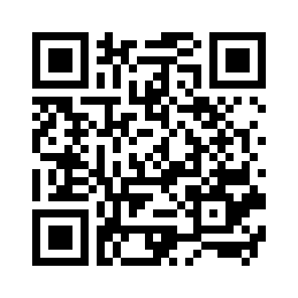
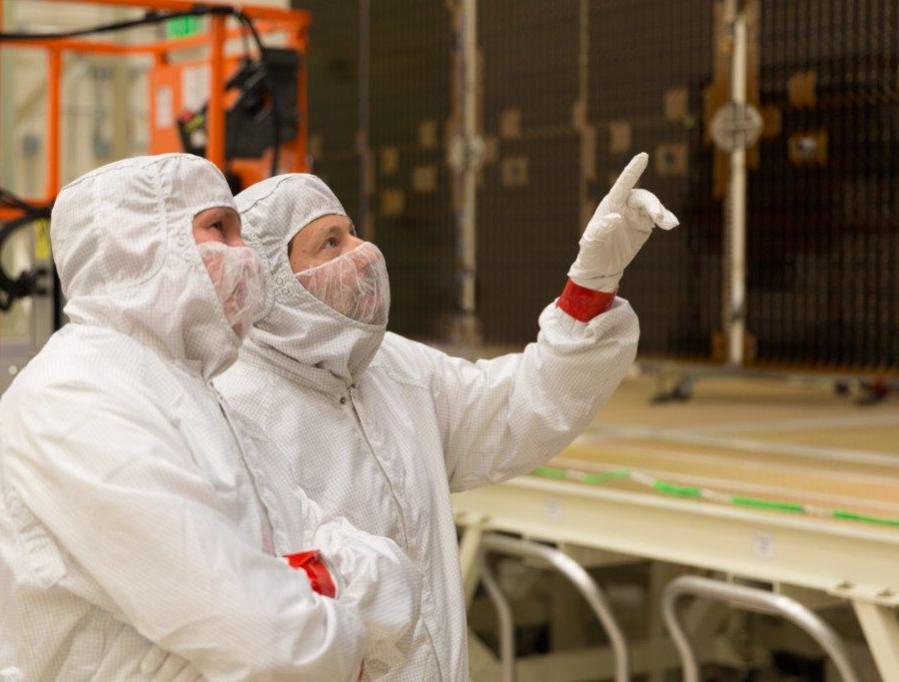
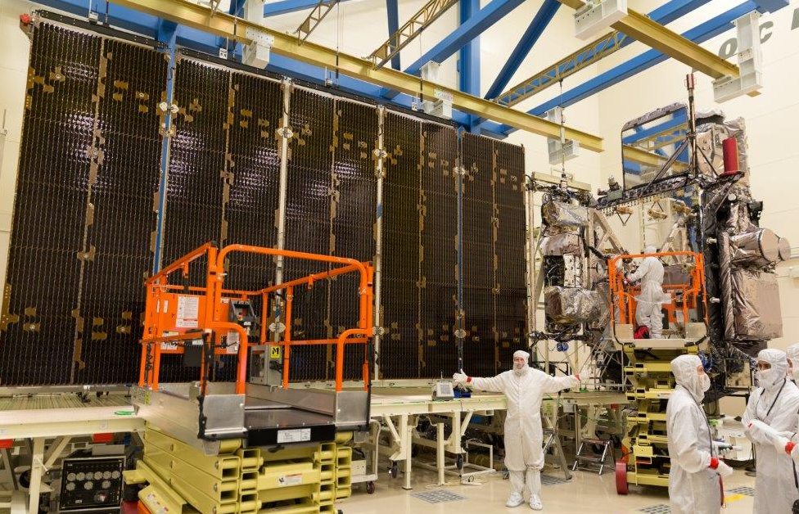
GOES-R Series web sites
http://www.goes-r.gov
http://cimss.ssec.wisc.edu/goes/goesdata.html
*Lockheed Martin

