Slide 1
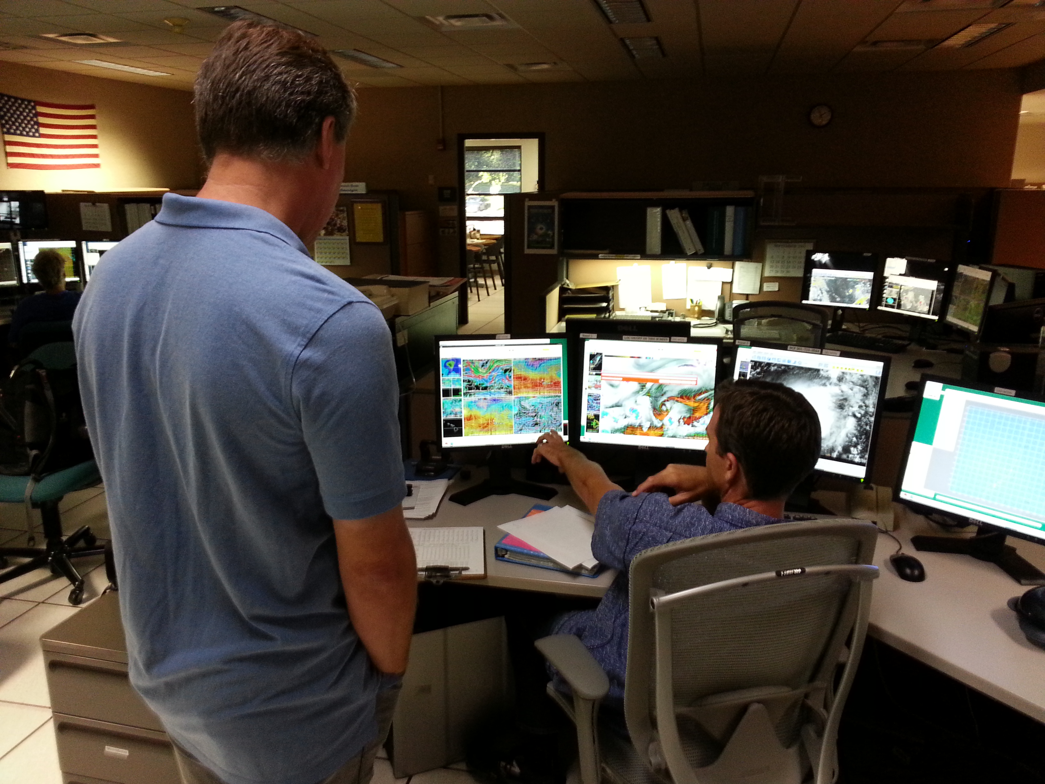
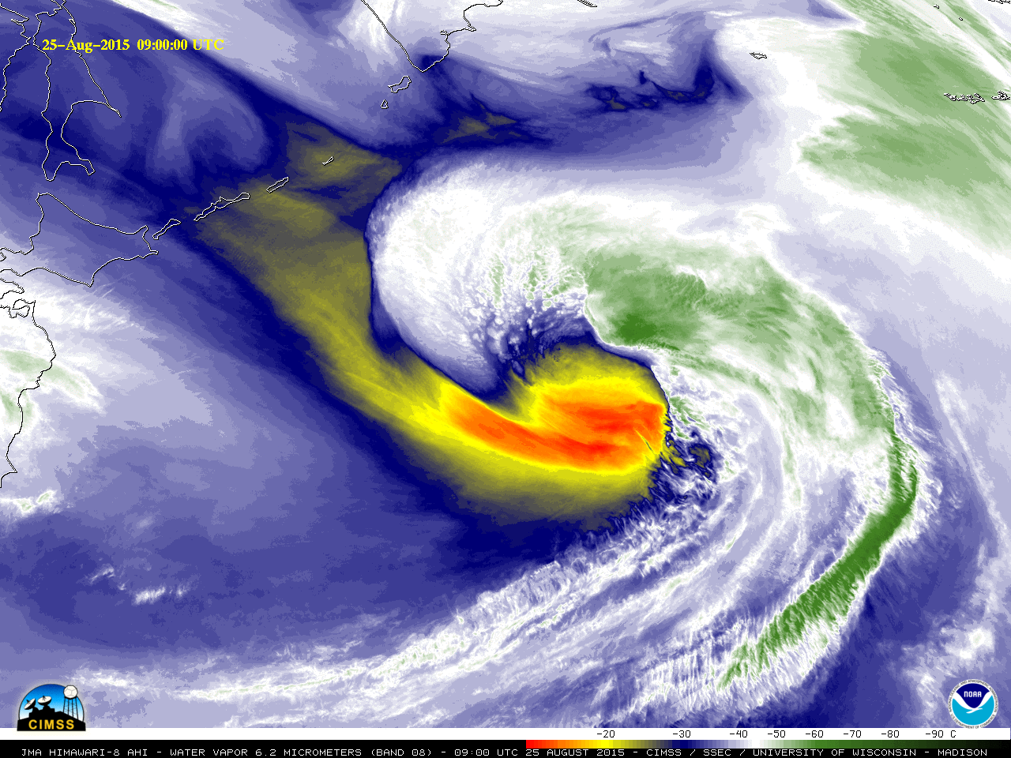
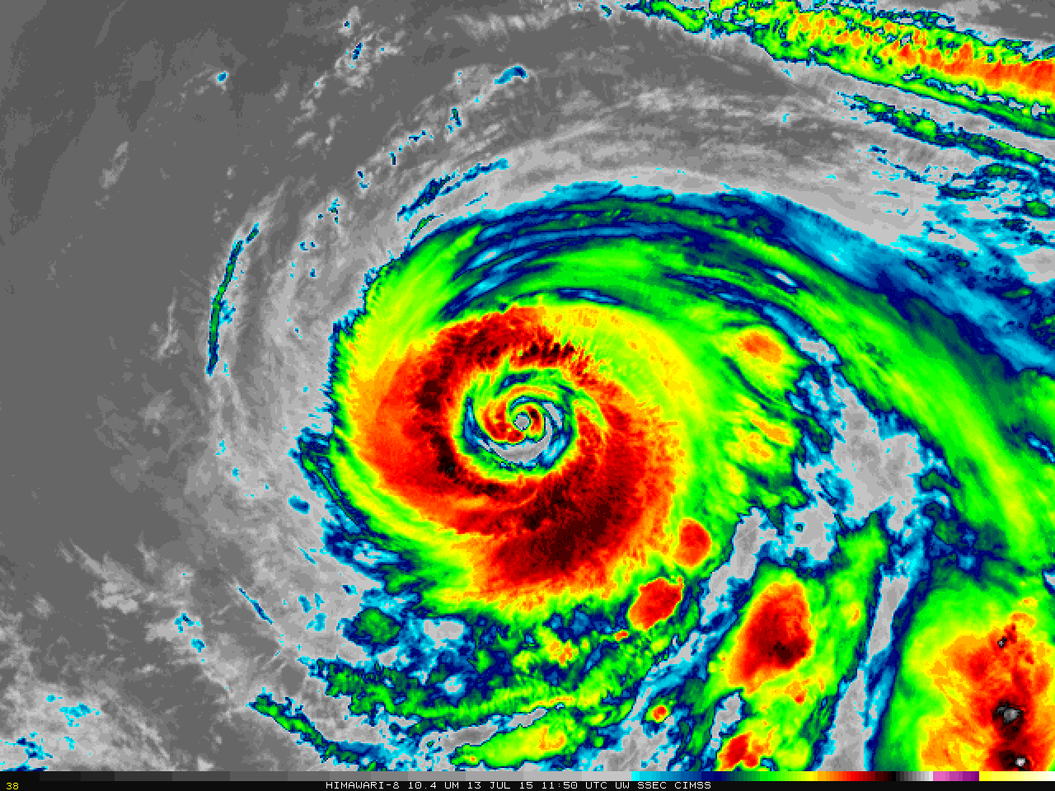
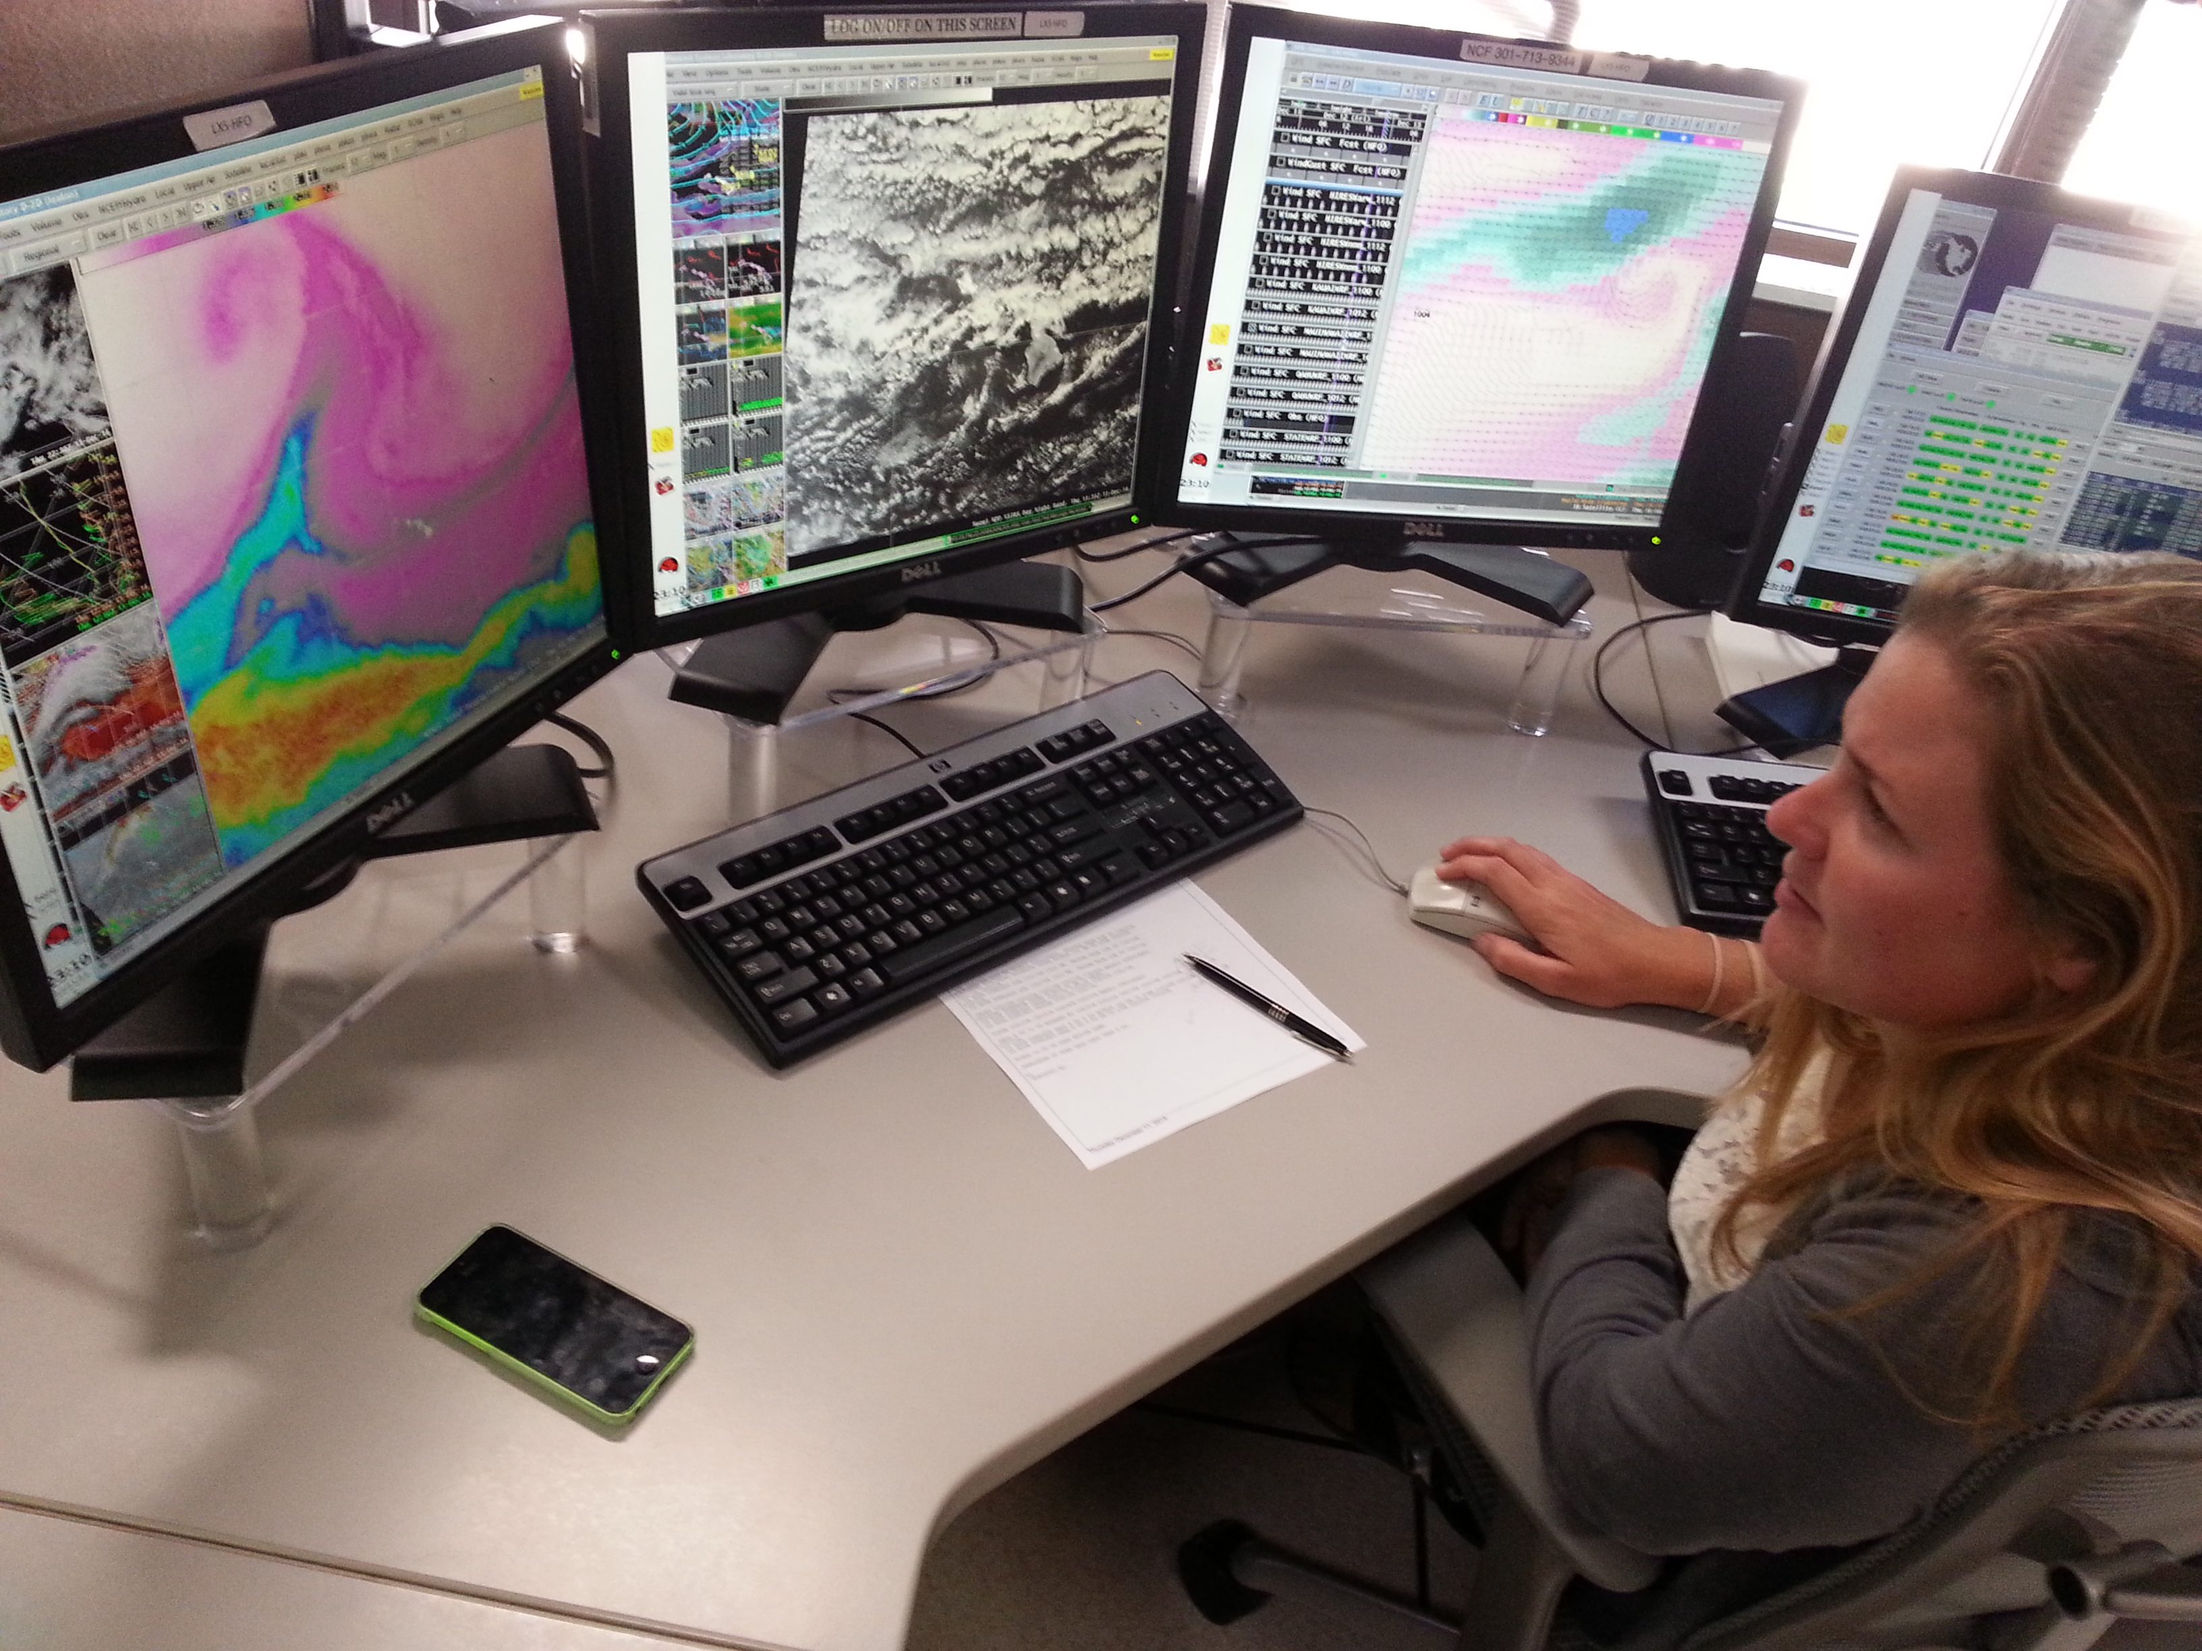
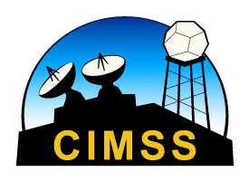
Himawari Training Workshop: Water Vapor Imagery from AHI
Scott Lindstrom
Cooperative Institute for Meteorological Satellite Studies (CIMSS), University of Wisconsin
Barrigada, Guam
16 and 18 November 2015

Slide 2
Improvements!
AHI: 3 Water Vapor Channels : 6.2 μm ; 6.9 μm ; 7.3 μm
Current GOES-15 : One water vapor channel
6.5 μm
Current MTSAT-2: One water vapor channel
6.75 μm
AHI: 2-km resolution*
Current GOES-15/MTSAT-2: 4-km resolution*
AHI: 10-minutes for a full disk scan
Current GOES-15/MTSAT-2: ~25 minutes for a full disk scan
* Nominal at sub-satellite point

Slide 3
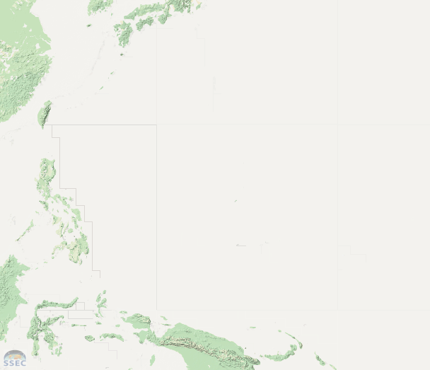
What does 3 Water Vapor channels get you?
Next 3 images cover this domain

Slide 4
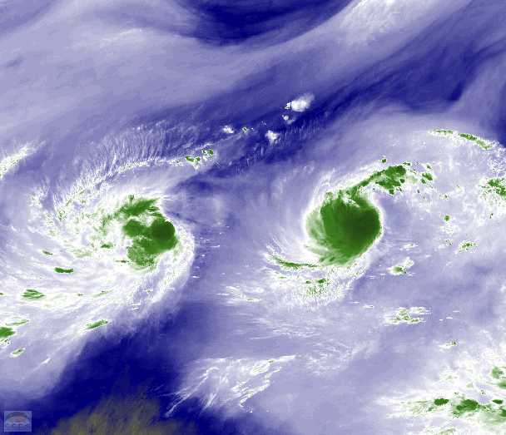
What does 3 Water Vapor channels get you?
6.2 μm
Cirrus clouds show up well, low-level clouds not visible.

Slide 5
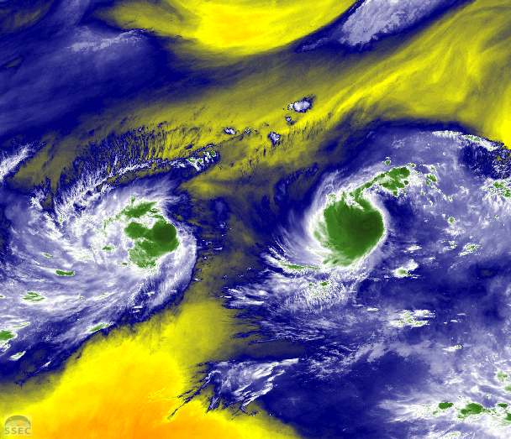
What does 3 Water Vapor channels get you?
6.9 μm

Slide 6
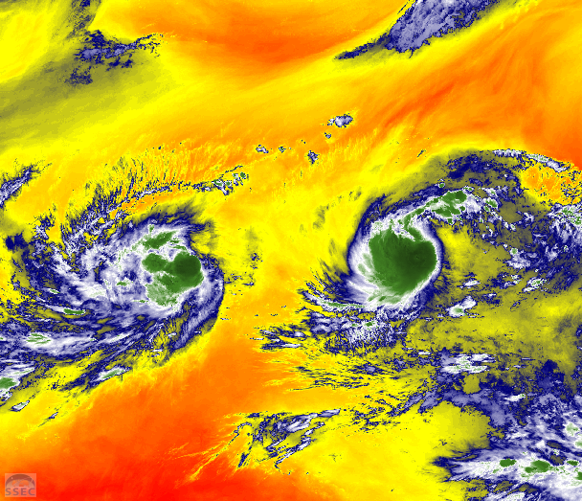
What does 3 Water Vapor channels get you?
7.3 μm
Cirrus clouds not visible, low-level clouds show up well.

Slide 7
How do you know what layer the radiative energy that is sensed by the satellite is originating from?

Slide 8
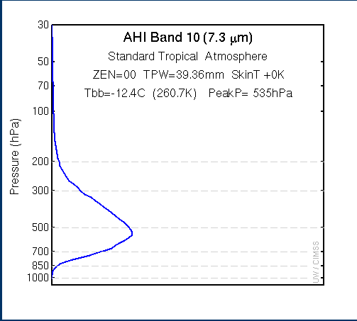
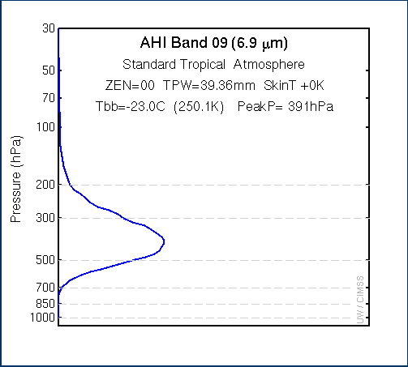
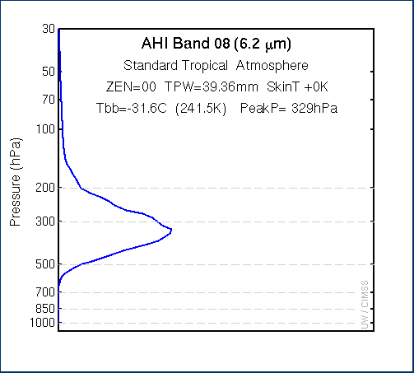
Weighting Functions: Tell you the layer that is emitting the energy
Longer Wavelength has a peak farther down in the atmosphere.
Why? This tells you something about radiative properties of the atmosphere
Graphs above from this site: (Bookmark it!)
http://cimss.ssec.wisc.edu/goes/wf/AHI/

Slide 9
What does 3 Water Vapor channels get you?
Three dimensions (Four, if you animate!)
Water Vapor Imagery shows the top of a moist layer, and where that top is a function of wavelength: longer wavelengths are detecting energy from farther down into the moist layer
Why? Water Vapor more readily absorbs energy at 6.2 μm vs. 6.9 μm vs. 7.3 μm
Temperature Difference
Proportional to absorption
6.2 μm
7.3 μm
6.9 μm

Slide 10
Levels change with wavelength
Because the level changes: the Brightness Temperature Changes too!

Slide 11
Levels change with wavelength
Because the level changes: the Brightness Temperature Changes too!

Slide 12
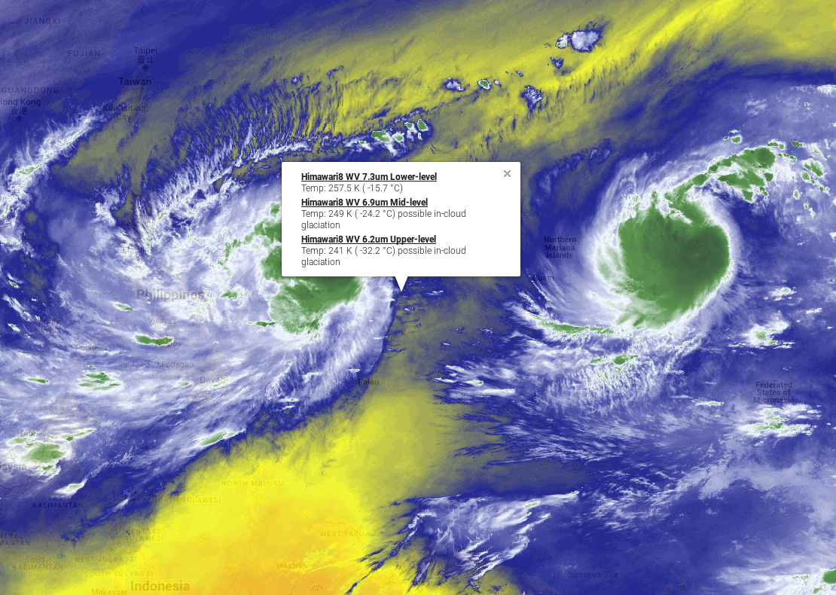

Slide 13
6.2 μm

Slide 14
6.9 μm

Slide 15
7.3 μm

Slide 16
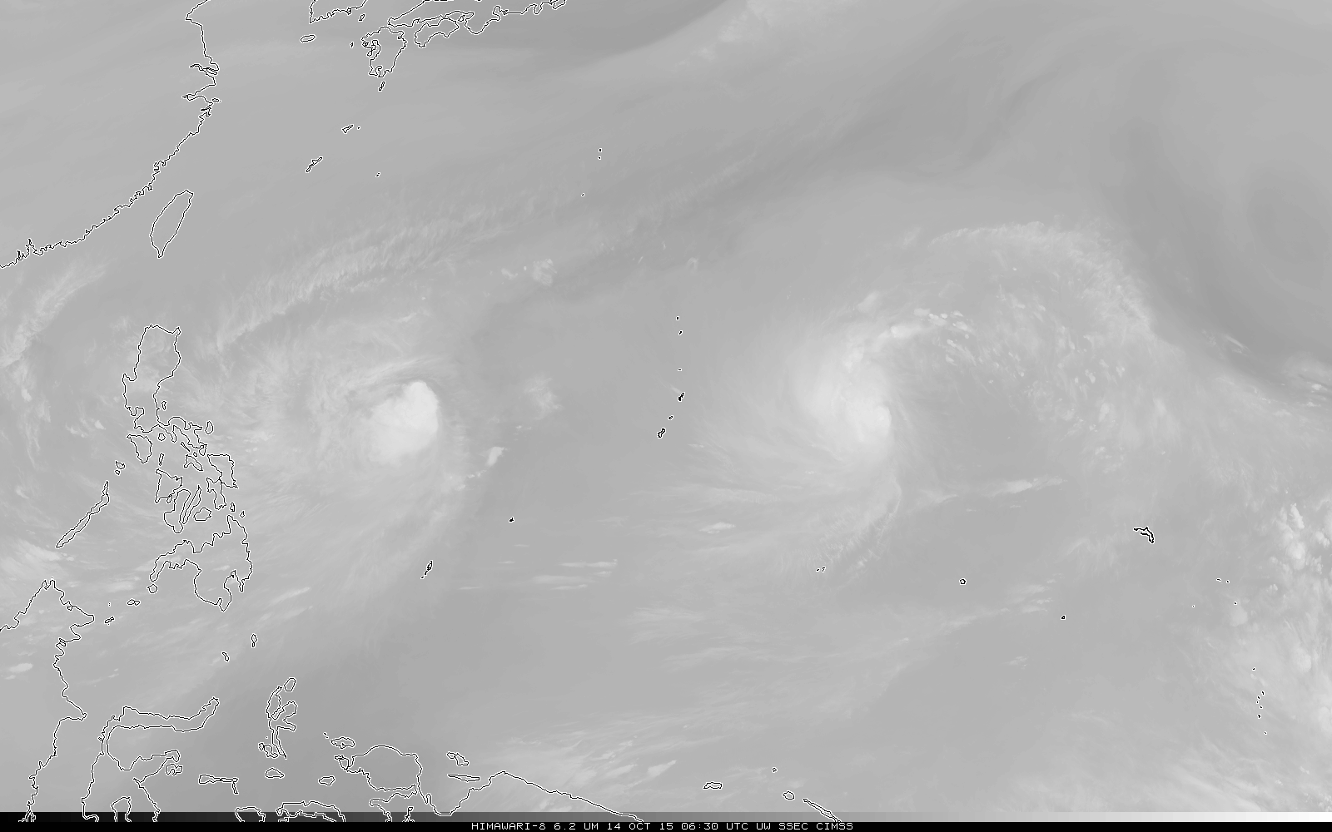
6.2μm – 6.75μm – 6.9μm – 7.3μm --- from coldest to warmest in this greyscale

Slide 17
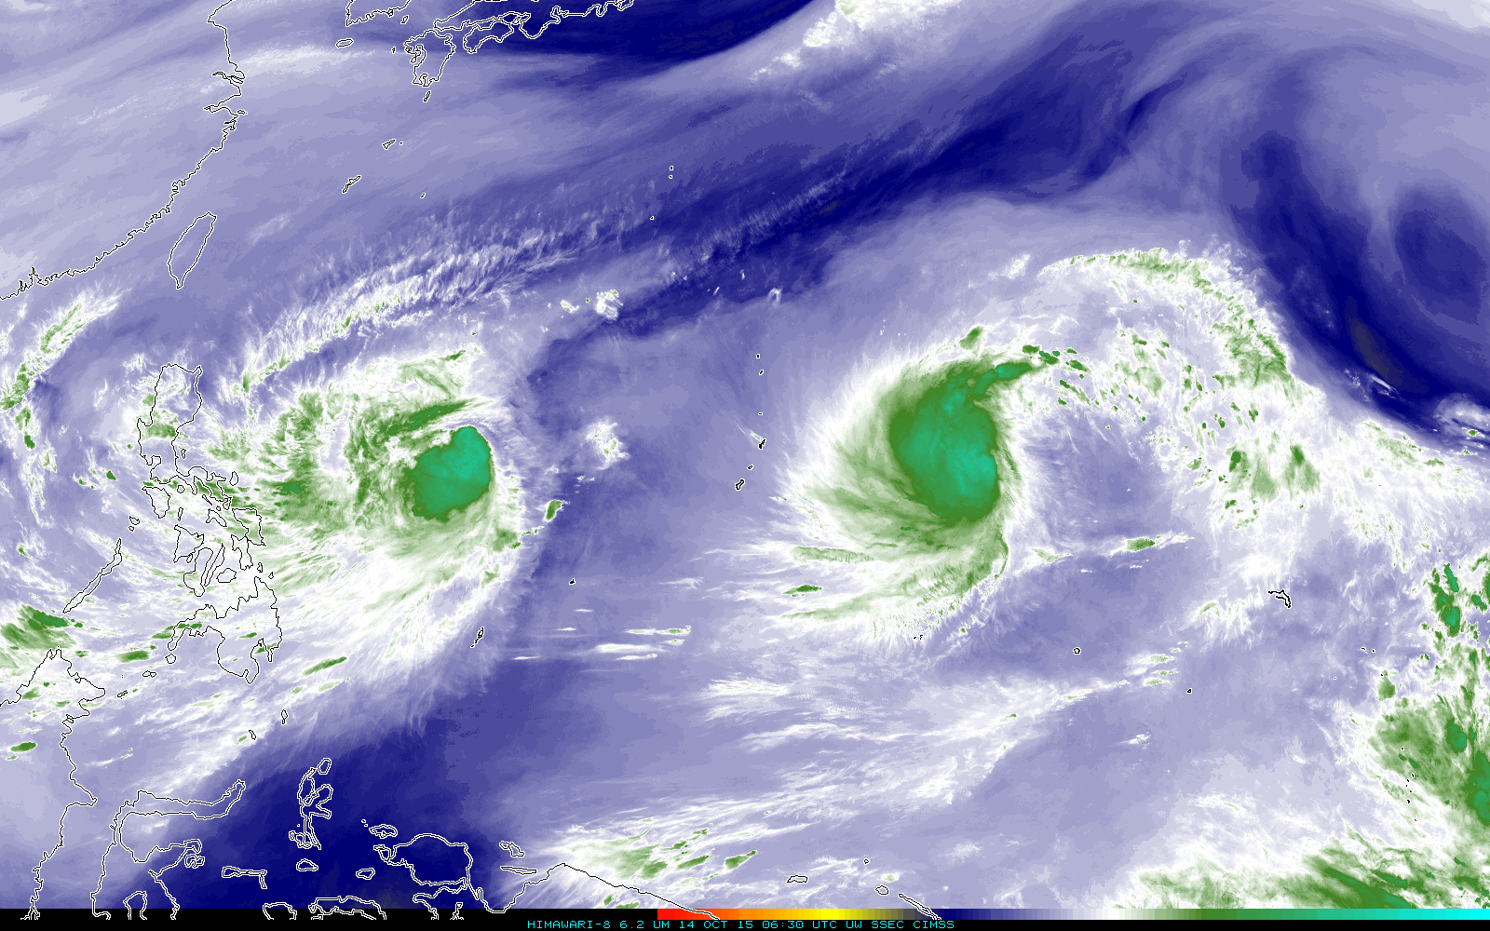
6.2μm – 6.75μm – 6.9μm – 7.3μm --- from coldest to warmest in this color-enhanced imagery

Slide 18
What does changing the Zenith Angle do?
Zenith Angle is 0º

Slide 19
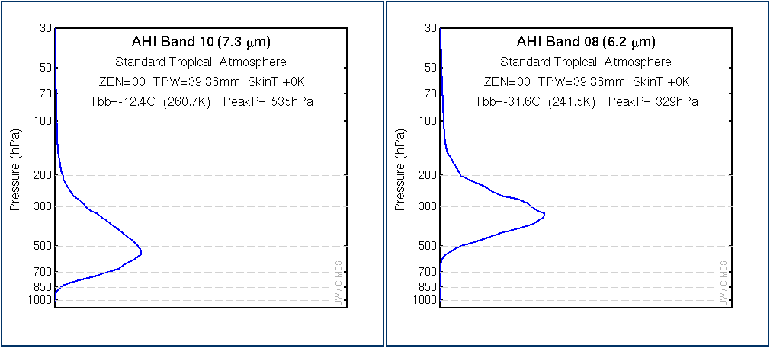
Brightness Temperature (and emitting layer height) changes with Zenith Angle
Zenith Angle ranges between 0º and 70º

Slide 20
What does changing the column moisture do?

Slide 21
Brightness Temperature (and emitting layer height) changes with column moisture
Column moisture: 100%, 70%, 40%, 10%
A dryer pixel is usually a warmer pixel – because
you see farther down into the atmosphere

Slide 22
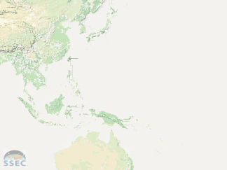
Does the Water Vapor Channel Give you
Information about total Precipitable Water?

Slide 23
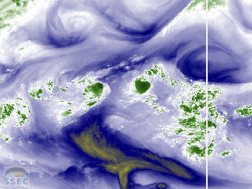
Is this also the distribution of total
Precipitable Water?

Slide 24
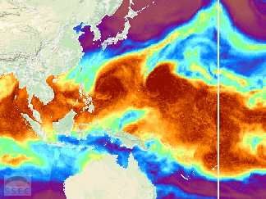
Compare this distribution to the
water vapor distribution

Slide 25
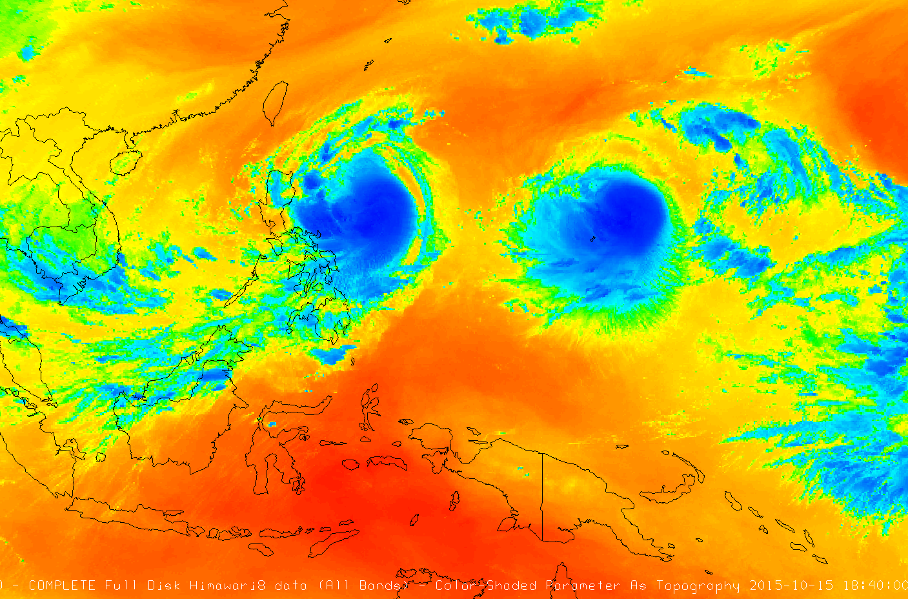
How Many Dimensions do you see?

Slide 26
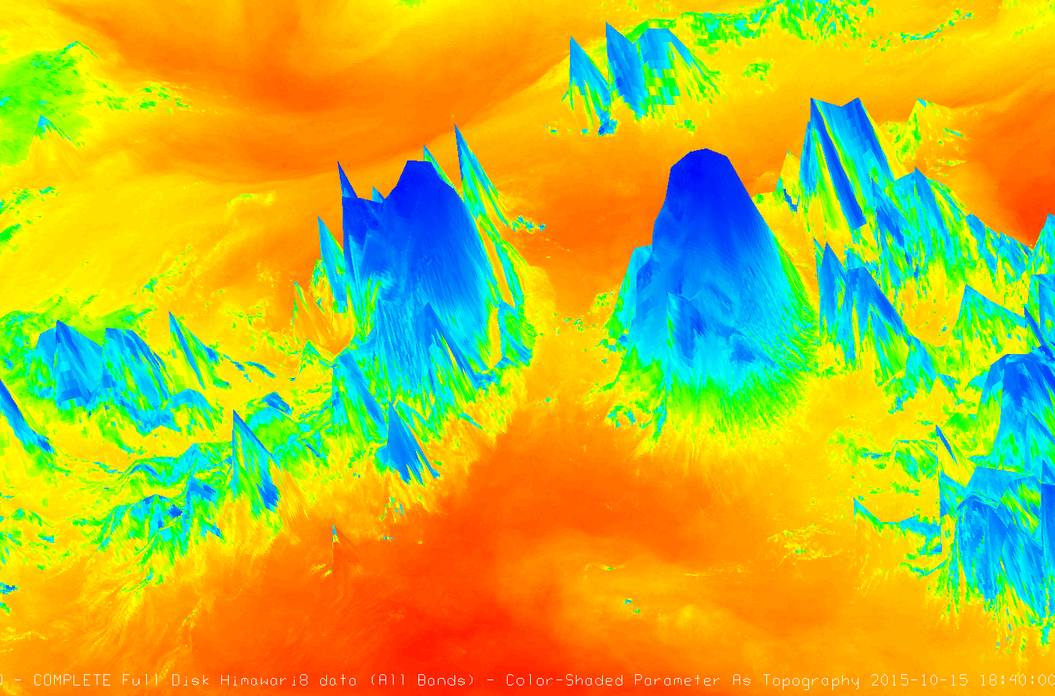
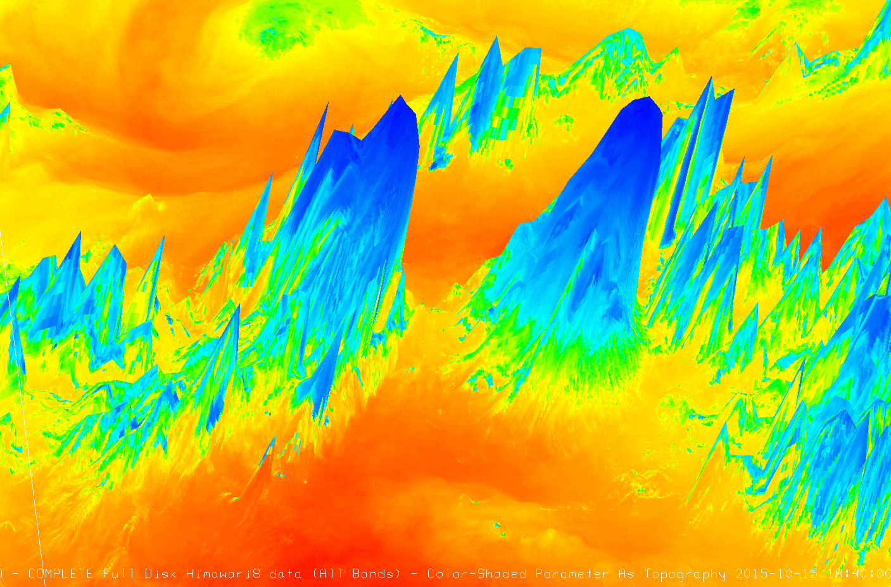
Water Vapor Imagery depicts
a surface! Treat it that way

Slide 27
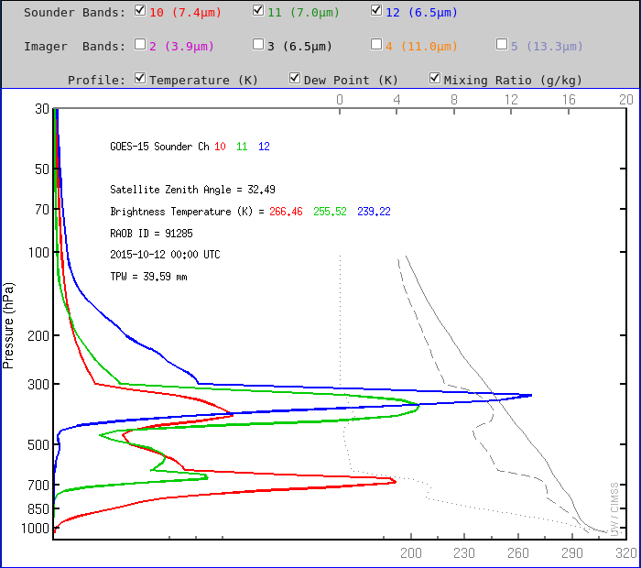
Weighting Functions change by day, depending on the weather

Slide 28
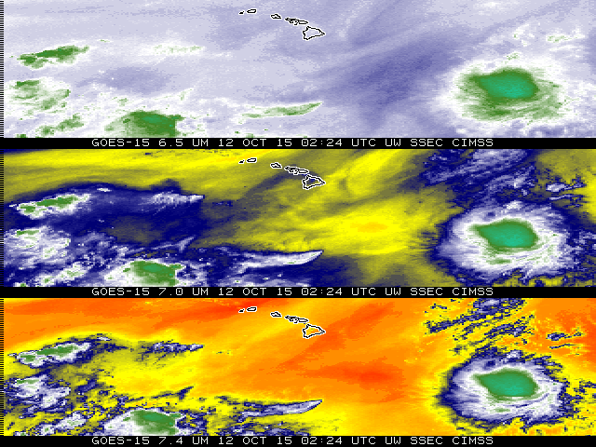

Slide 29
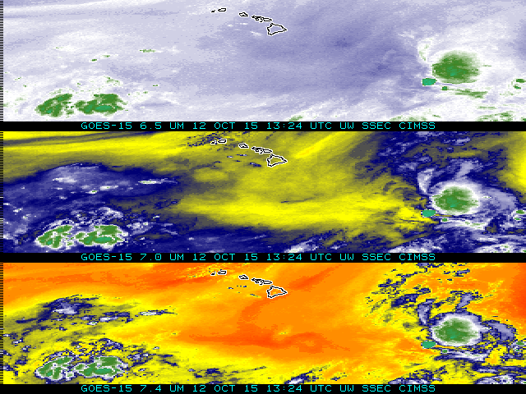
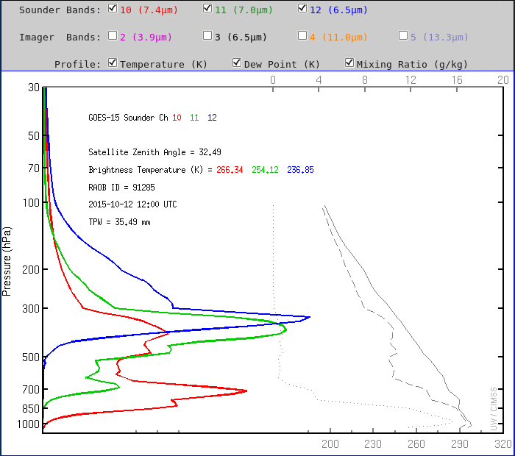

Slide 30
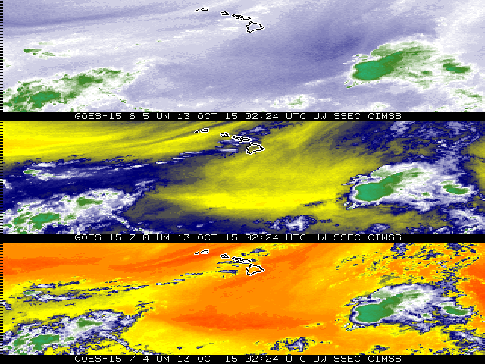
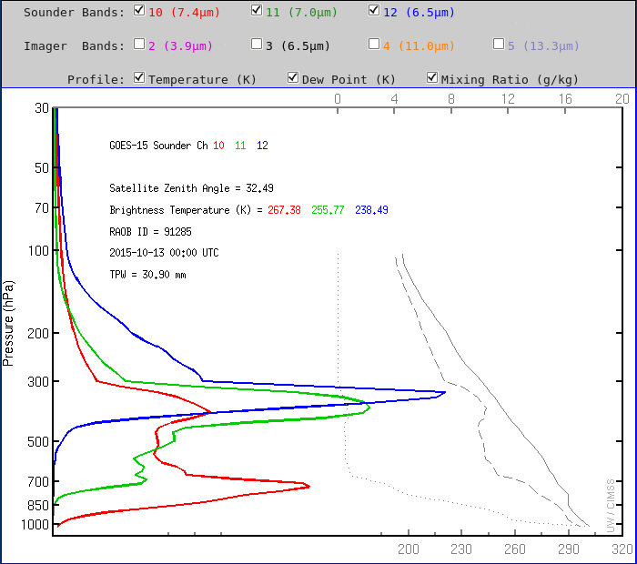

Slide 31
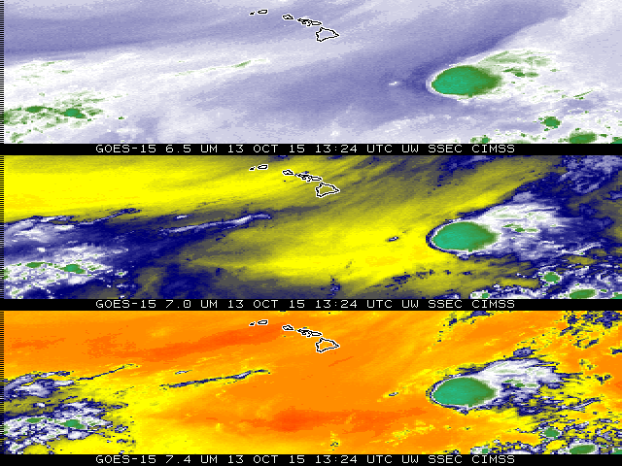
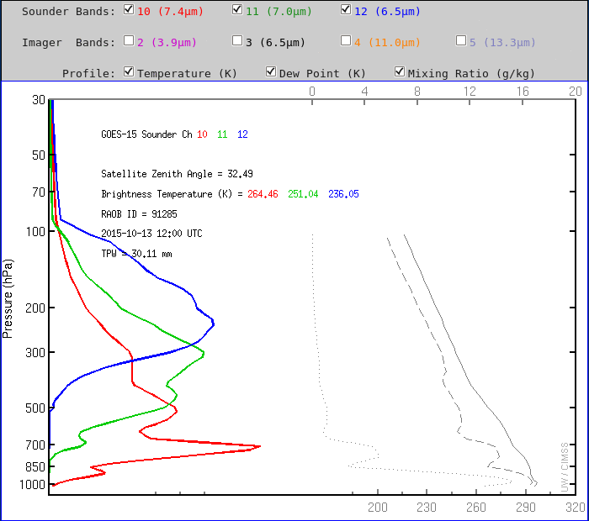

Slide 32
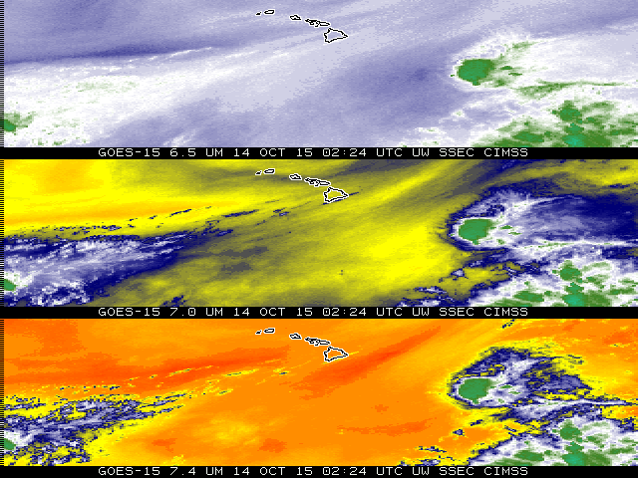
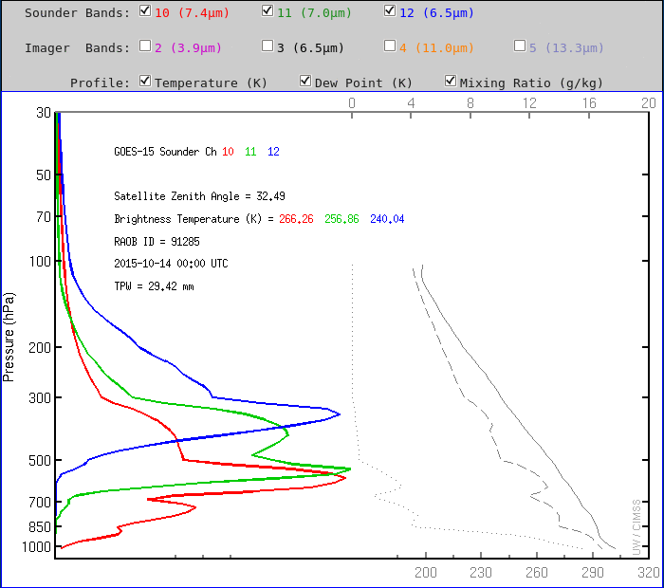

Slide 33
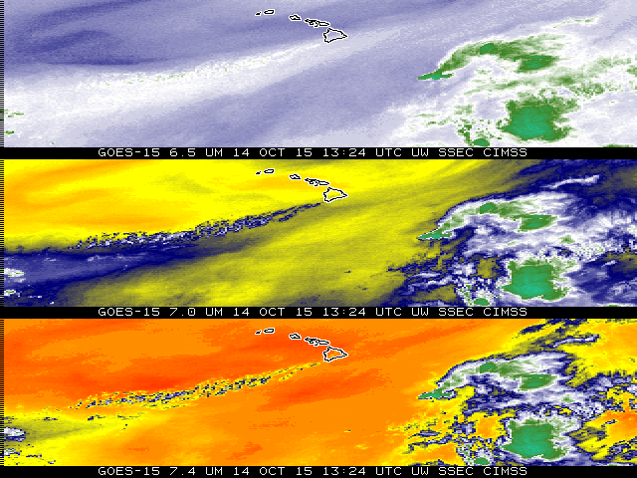
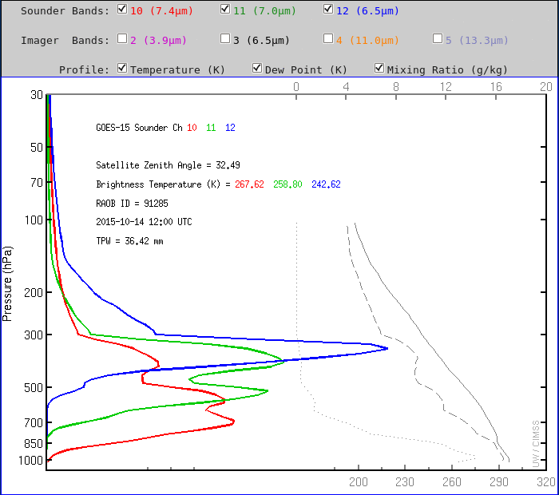

Slide 34
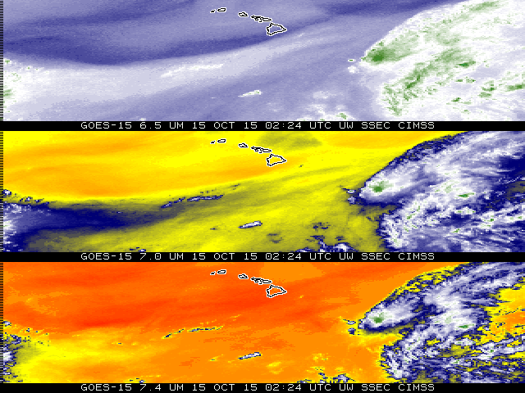
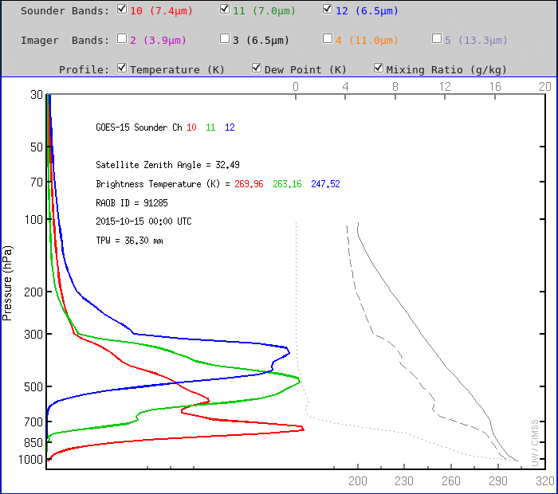

Slide 35
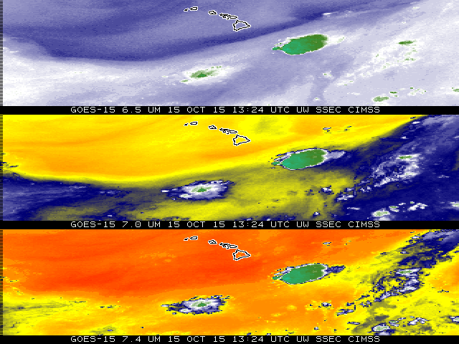
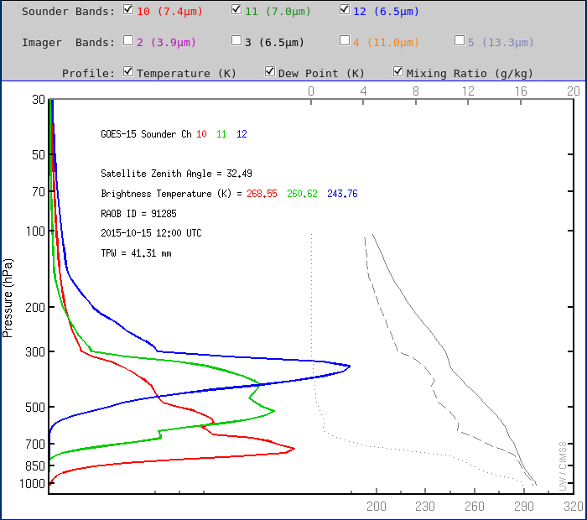

Slide 36
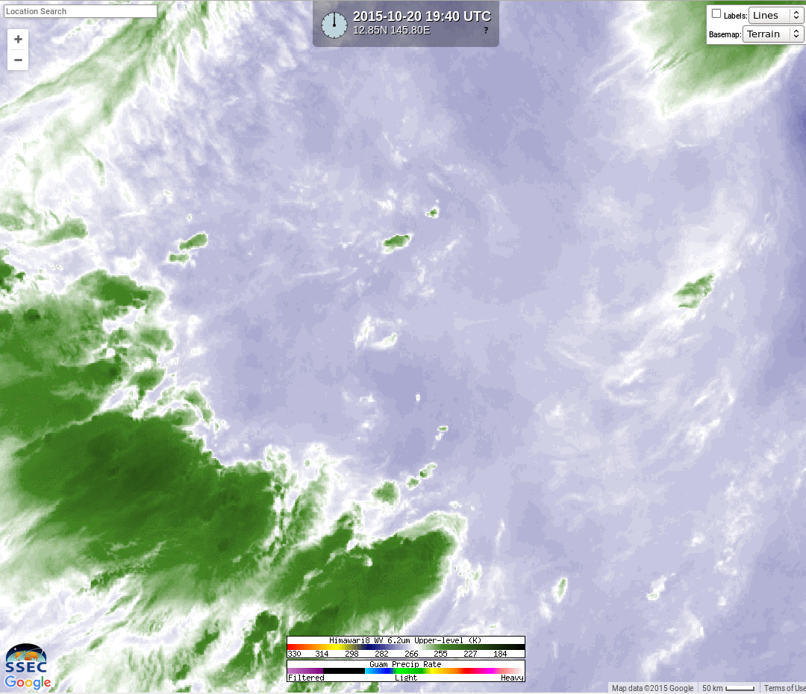
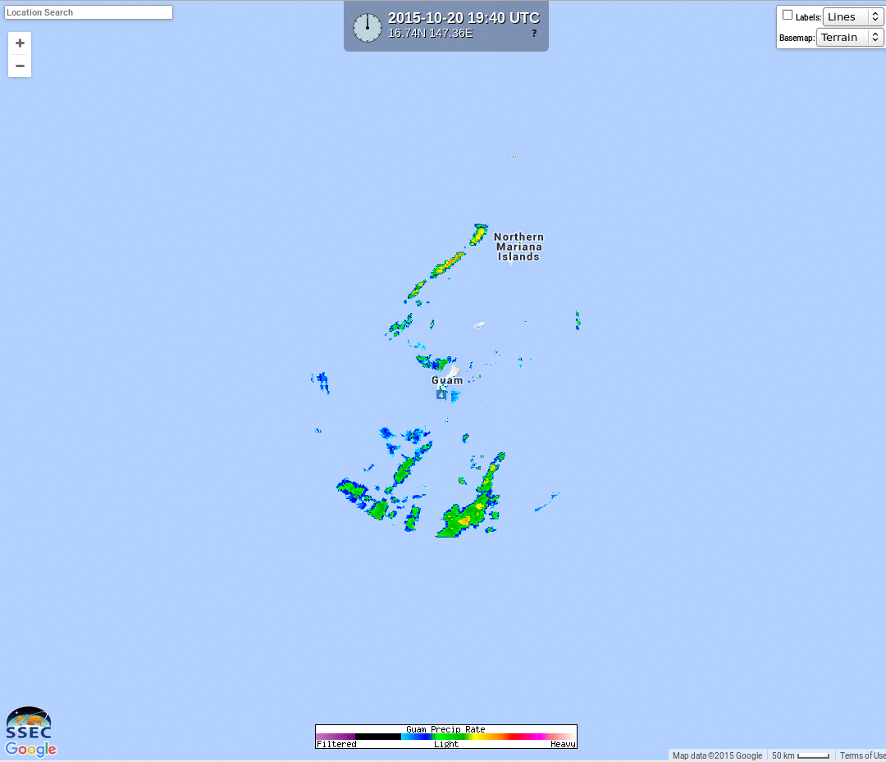
6.2 μm and Radar
If moisture overlays the developing shower, 6.2 may not see it

Slide 37
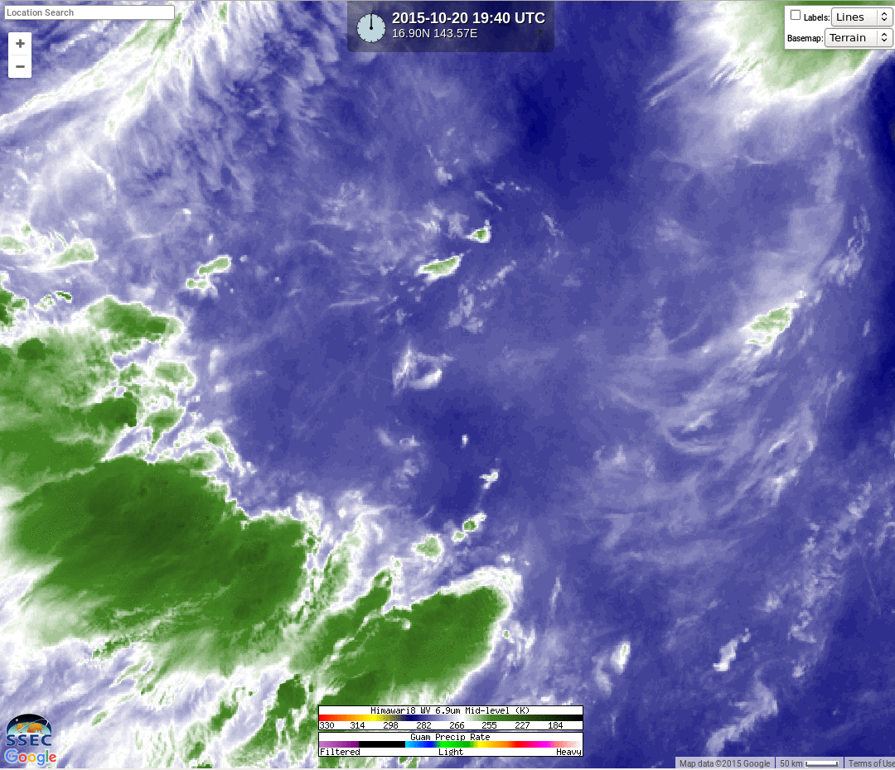
6.9 μm and Radar
If moisture overlays the developing shower, 6.9 may not see it

Slide 38
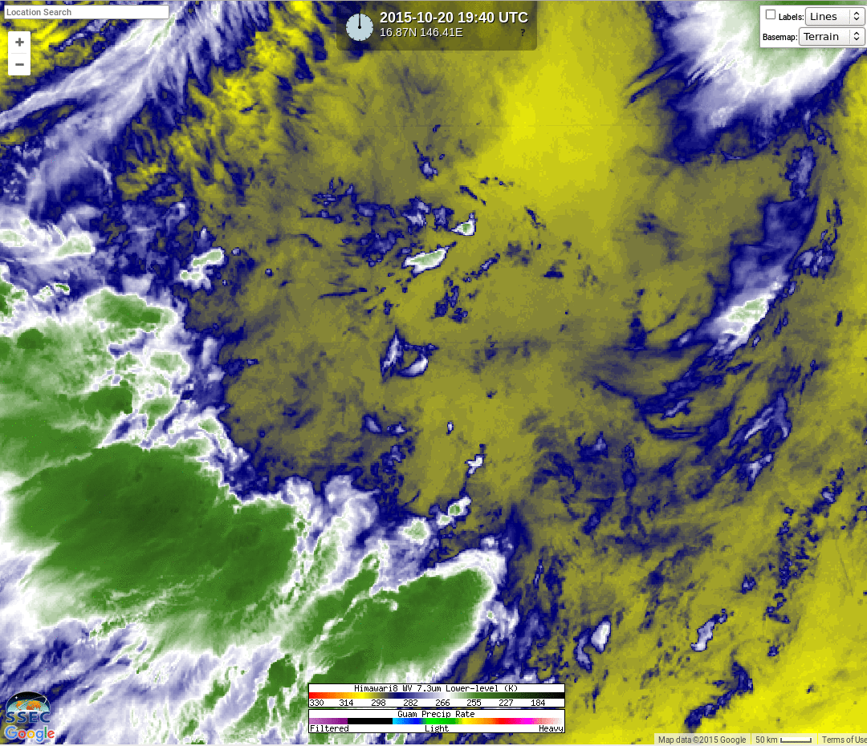
7.3 μm and Radar
If moisture overlays the developing shower, 7.3 may not see it

Slide 39
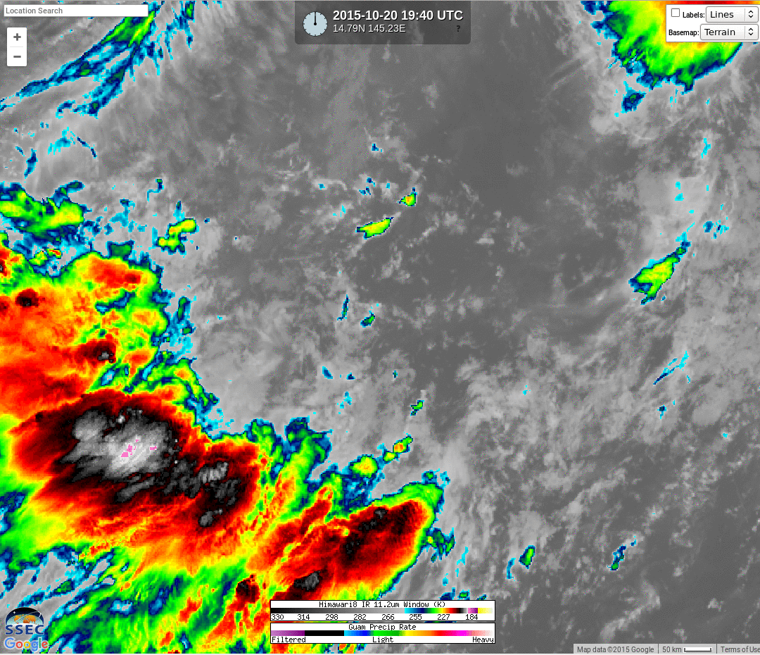
11.2 μm and Radar

Slide 40
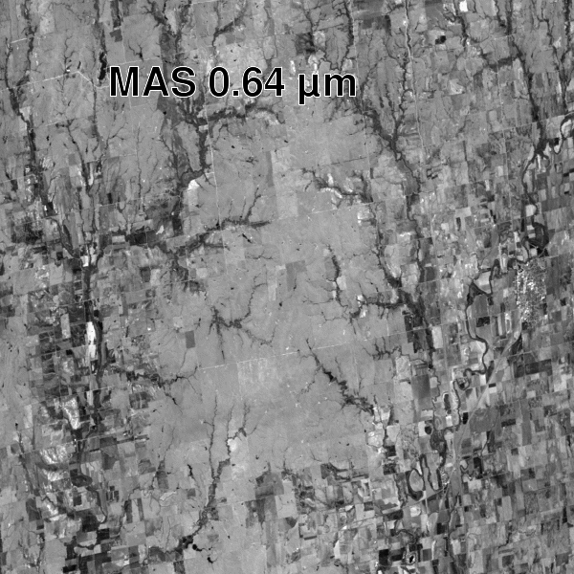
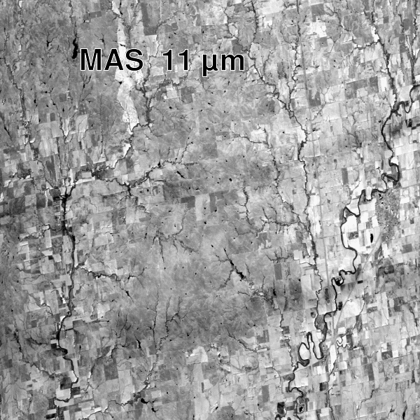
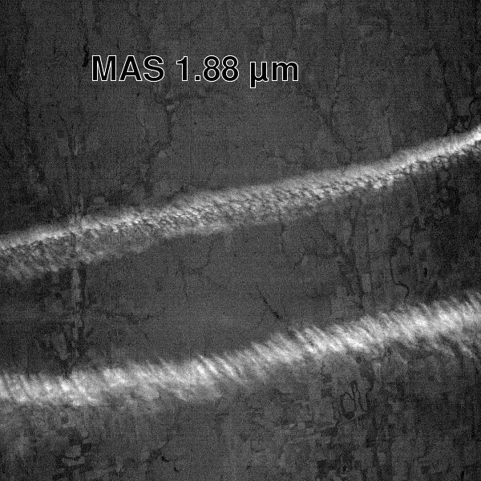
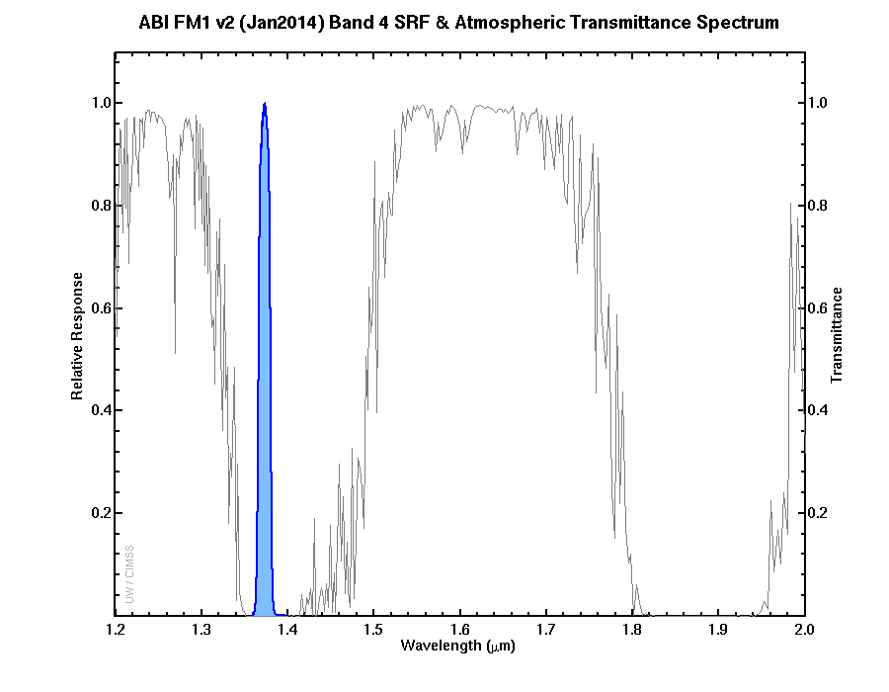
1.88 μm (or 1.38 μm): Band on ABI, and AMI not AHI
(GOES-R)
(Himawari)
(AMI – Korean satellite ~2019)

Slide 41
Water Vapor Channels
1.38 μm : Cirrus Channel, detects high cirrus, low dust (in a dry atmosphere)
6.2 μm : Water Vapor Channel, upper levels
6.9 μm : Water Vapor Channel, mid-levels
7.4 μm : Water Vapor Channel, lower levels
A warmer pixel can be warmer or dryer (or both)

Slide 42
SIFT and Himawari Data
Band 8: 6.2 μm
Band 9: 6.9 μm
Band 10: 7.3 μm

Slide 43
Spare Slides

Slide 44
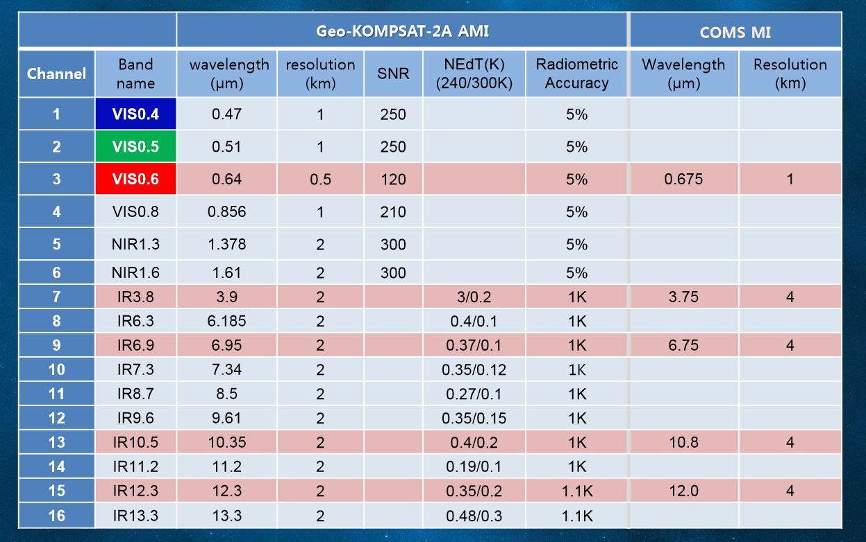
AMI (Advanced Meteorological Imager)
From KMA (NSC-2015)
Notes:
http://satelliteconferences.noaa.gov/2015/doc/presentation/1.9_NSC2015_Session_1.9_Lyu.pdf

Slide 45
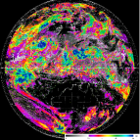
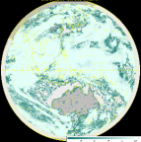
4.3 COMS & GEO-KOMPSAT-2A
resolution 4times upgrade
channel 3times increase
products 3.5 times increase
COMS
Geo-KOMPSAT-2A
COMS
Geo-KOMPSAT-2A
COMS
VIS 1km
IR 4km
Geo-KOMPSAT-2A
VIS 0.5~1km
IR 2km
1
(Black and white)
4
(color image)
Cloud/pre. : 5
Cloud/pre. :19
VIS
Observation frequency 4 times
Aerosol : 5
Aerosol : 16
1hr
2
SW IR
O
Full disk : 1
Full disk : 4
AMV : 3
AMV : 6
4
10
NH : 2
NH : 10
IR
Land sfc. : 3
Land sfc. : 11
…....
KP : every 15min
KP : every 2min
5 channel
16 channel
Total : 16
Total : 52

