Slide 1
20-September-2015 (263)

Slide 2
20-September-2015 (263)
Load all AHI bands for one time (02:30 UTC)
Step through each band
Use the up/down arrows on the keypad
Which bands ‘sees’ over-shooting tops, circulations, etc.
Is the circulation low or high level?
What’s the maximum value observed in the visible / near infrared bands?

Slide 3
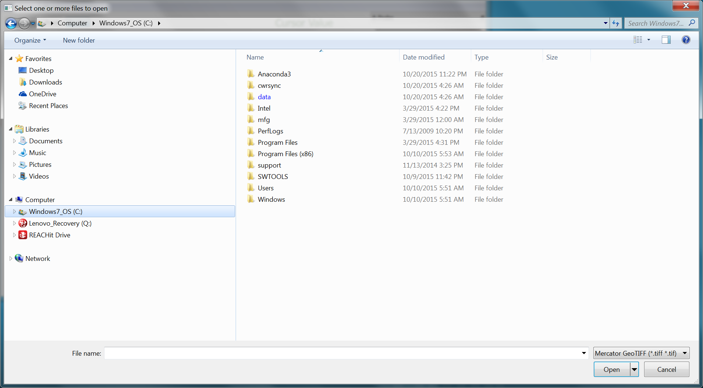

Slide 4
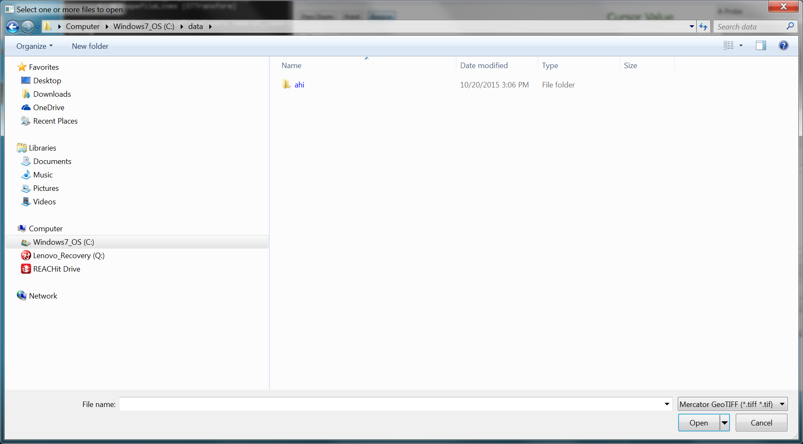

Slide 5
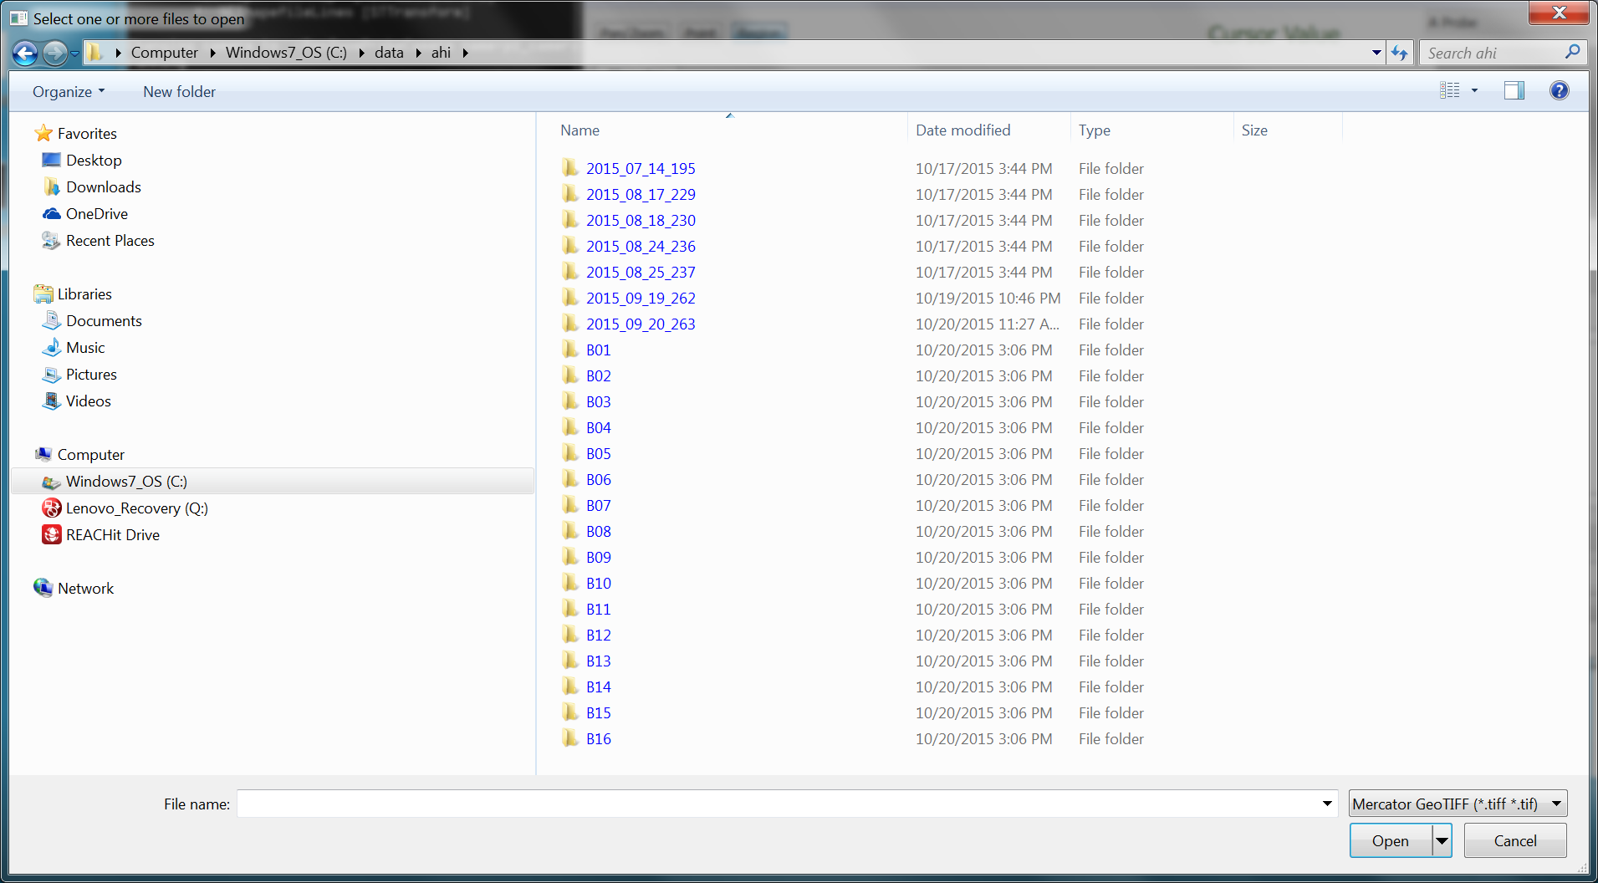

Slide 6
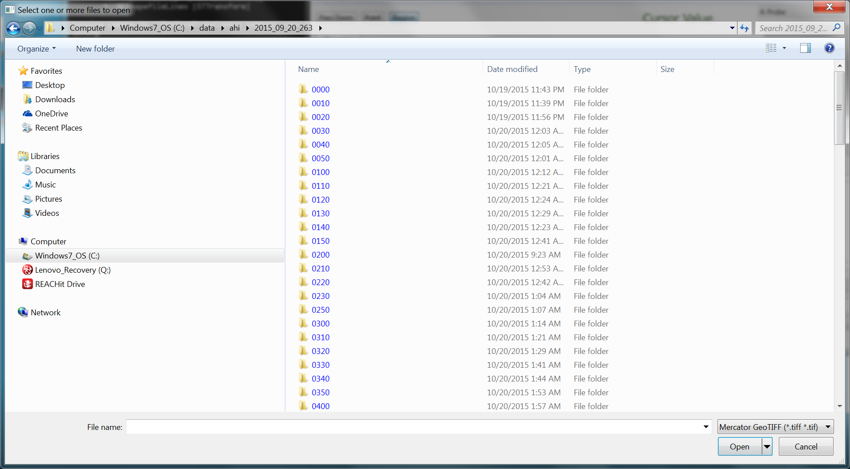

Slide 7
Select all bands to load

Slide 8
20-September-2015 (263)
Define a box over a small region
Right click with shift.
Make sure the graph window is large enough
Investigate band relationships
Band 3 vs 4, over a clear area; over the land
Band 3 vs 5, over a cloudy region
Band 13 vs 14, over a clear area

Slide 9
20-September-2015 (263)
Load a loop of AHI band 3 (0.6 micrometer) from 02 to 03 UTC)
(This may take a few minutes.)
Zoom over Guam
Note the changes in over-shooting tops, circulations, etc.
Try another enhancement (ZA or linear) (under ‘visible’)
Is the circulation east of Guam low or high level?
Roam to over Yap Island

Slide 10
Select time period from day 263: 02 to 03 UTC

Slide 11
20-September-2015 (263)
Repeat with other spectral bands
Near infrared (band 5)
Which clouds are liquid vs ice?
Short wave window (band 7)
What’s the maximum brightness temperature?
Water vapor (band 10)
Infrared window (band 14)
Increase time window
01:30 to 3:30 UTC

Slide 12
Select time period from day 263: 02 to 03 UTC

Slide 13
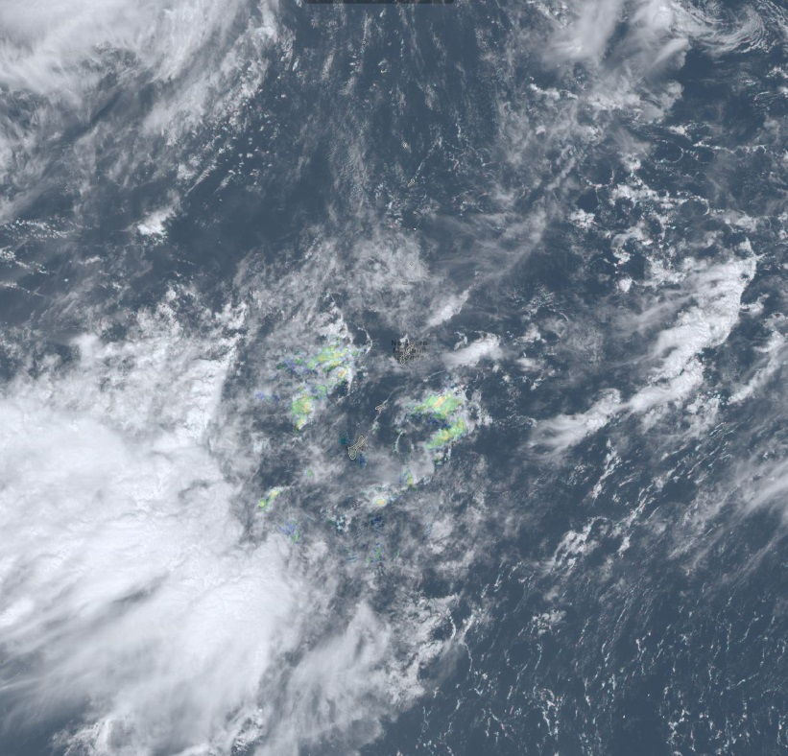
20-September-2015 (263)
Thought experiments
How far can the radar detect echoes
Can the satellite data be used to monitor NWP forecast quality? (location, timing, etc.)

Slide 14
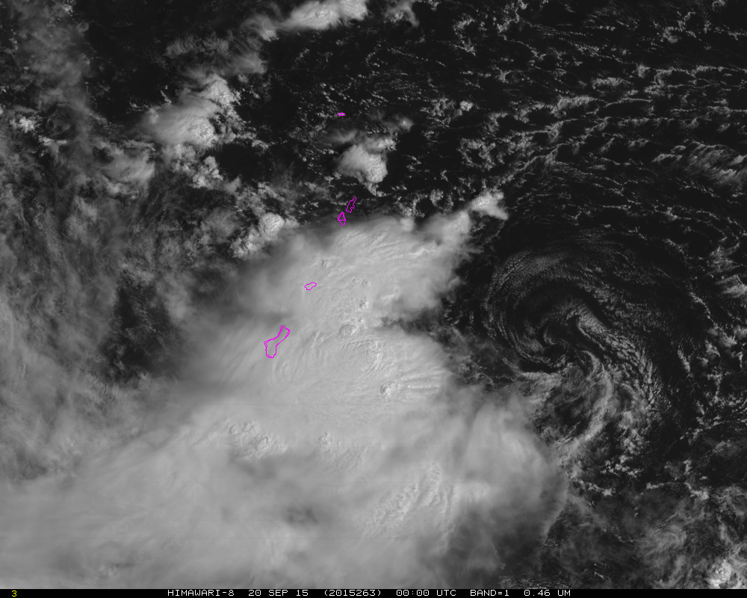
What follows are several GFS forecasts, valid at the same time (and the time of the image)

Slide 15
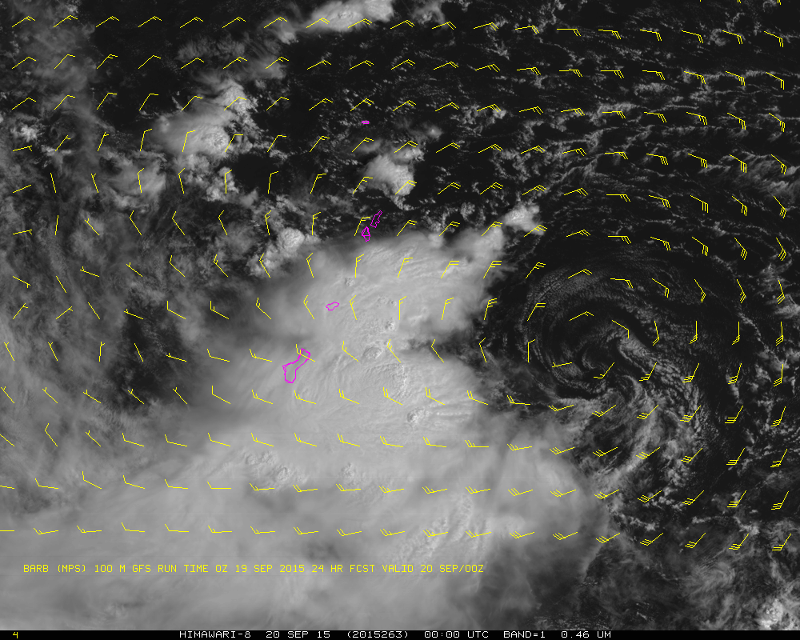

Slide 16
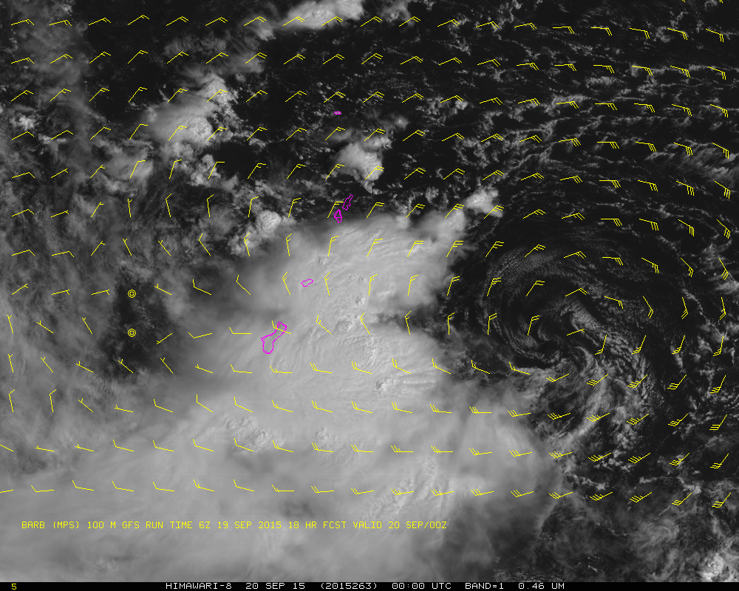

Slide 17
