Slide 1
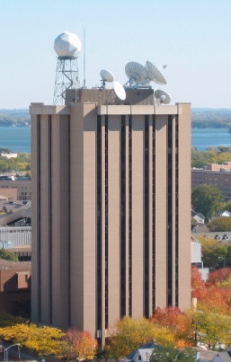
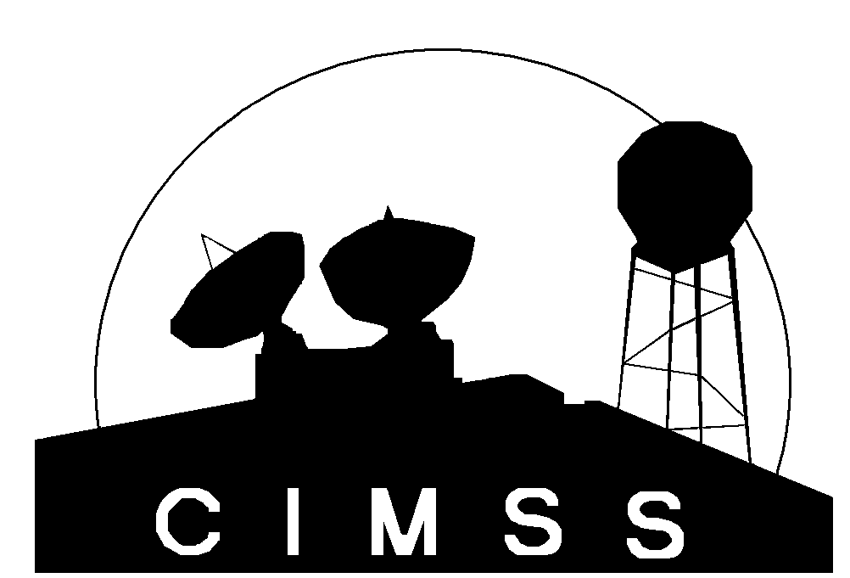
AHI Weighting Function Lab
T. Schmit
NOAA/NESDIS
M. Gunshor, J. Gerth
CIMSS
And Others
Guam
November 2015
UW-Madison

Slide 2
Weighting Functions
How the transmittance varies with height
The layer of the atmosphere observed by a given spectral band
Depends on the band, input temperature, moisture, ozone profiles, skin temperature, surface emissivity, plus the view (zenith) angle.
Clear-sky fast forward calculations
A surface emissivity value of 1 is used for each band.

Slide 3
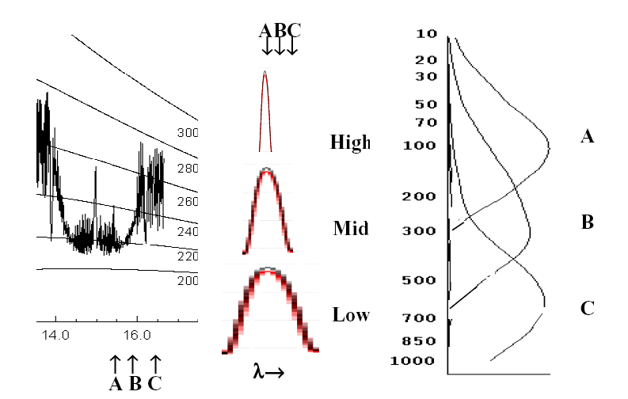
Location of three spectral bands in the CO2 absorption band at 15 um (left), pressure broadening of the absorption line from high to low in the atmosphere with the spectral band locations indicated (center), and vertical distribution of the weighting functions for the three spectral bands (right).
From W. P. Menzel --http://cimss.ssec.wisc.edu/rss/SatelliteNotes/app_metsat_2006_color.pdf

Slide 4
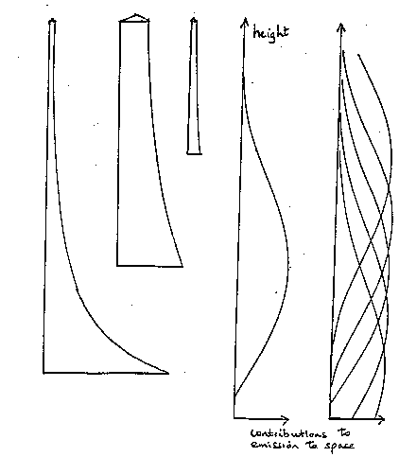
Rsfc R1 R2
top of the atmosphere
τ2 = transmittance of upper layer of atm
τ1= transmittance of lower layer of atm
blackbody earth surface.
R_{obs} =
R_{sfc} τ1 τ2 + R1 (1-τ1) τ2 + R2 (1- τ2)
From W. P. Menzel
Notes:
From W. P. Menzel

Slide 5
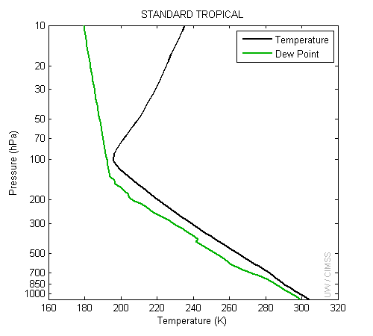
Temperature and moisture profiles

Slide 6
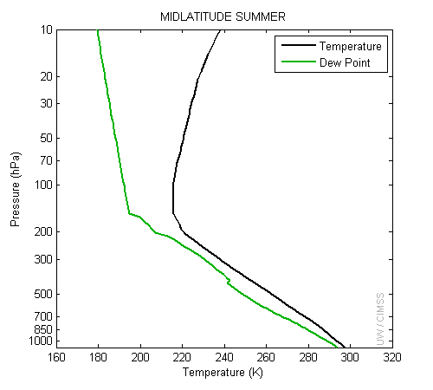
Temperature and moisture profiles

Slide 7
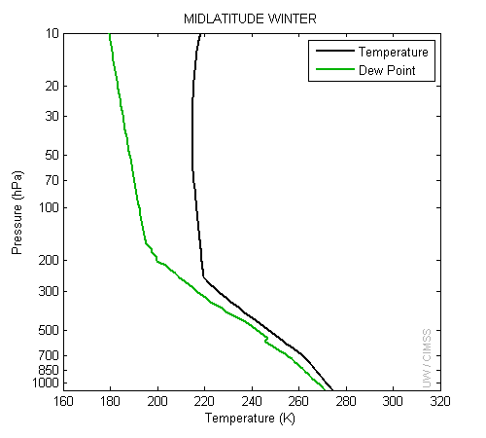
Temperature and moisture profiles

Slide 8
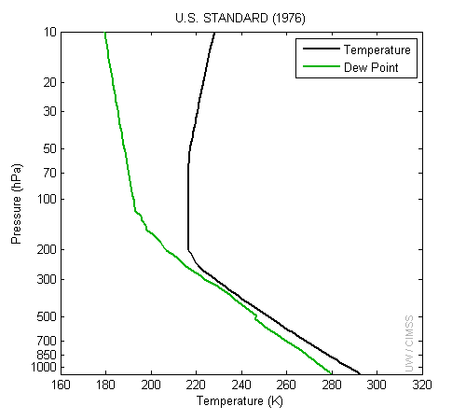
Temperature and moisture profiles

Slide 9
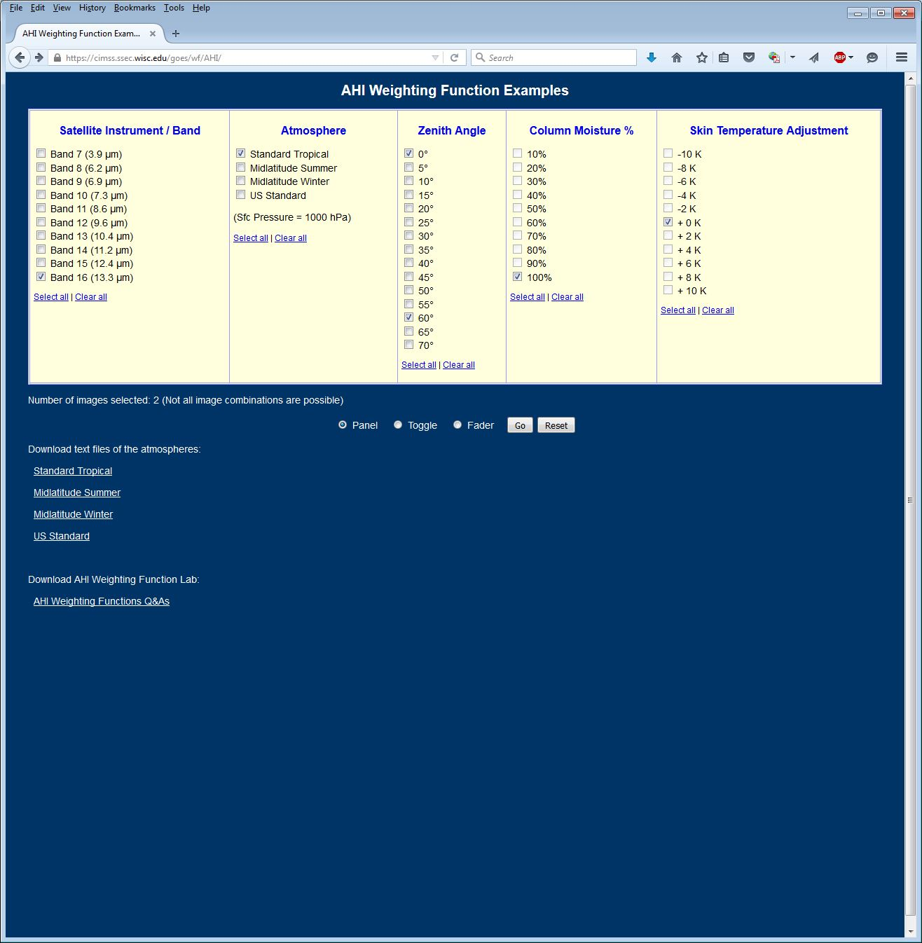
AHI Clear-sky Weighting Functions

Slide 10
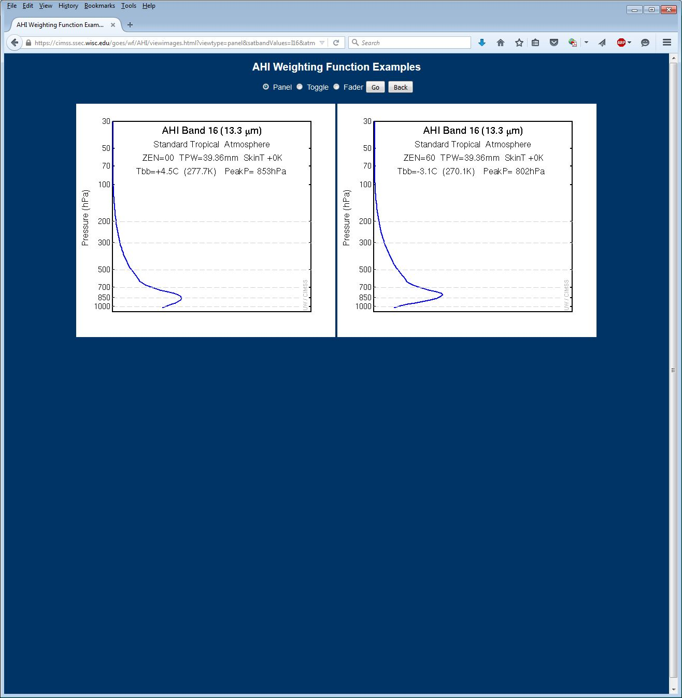
http://cimss.ssec.wisc.edu/goes/wf/AHI/

Slide 11
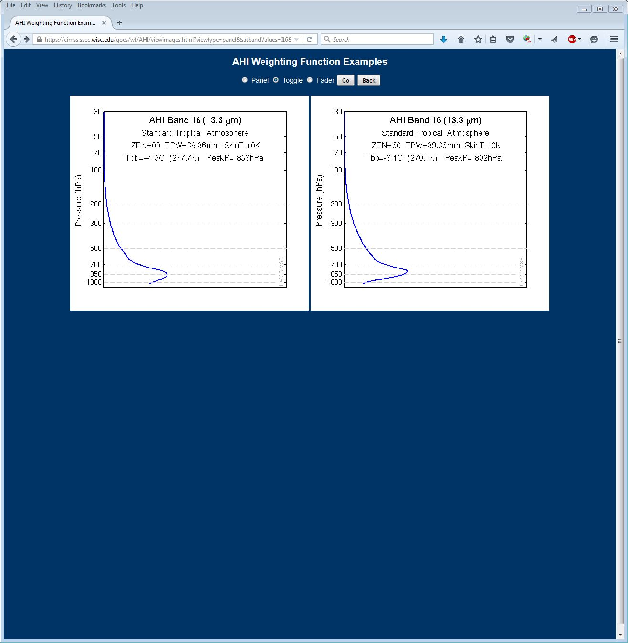

Slide 12
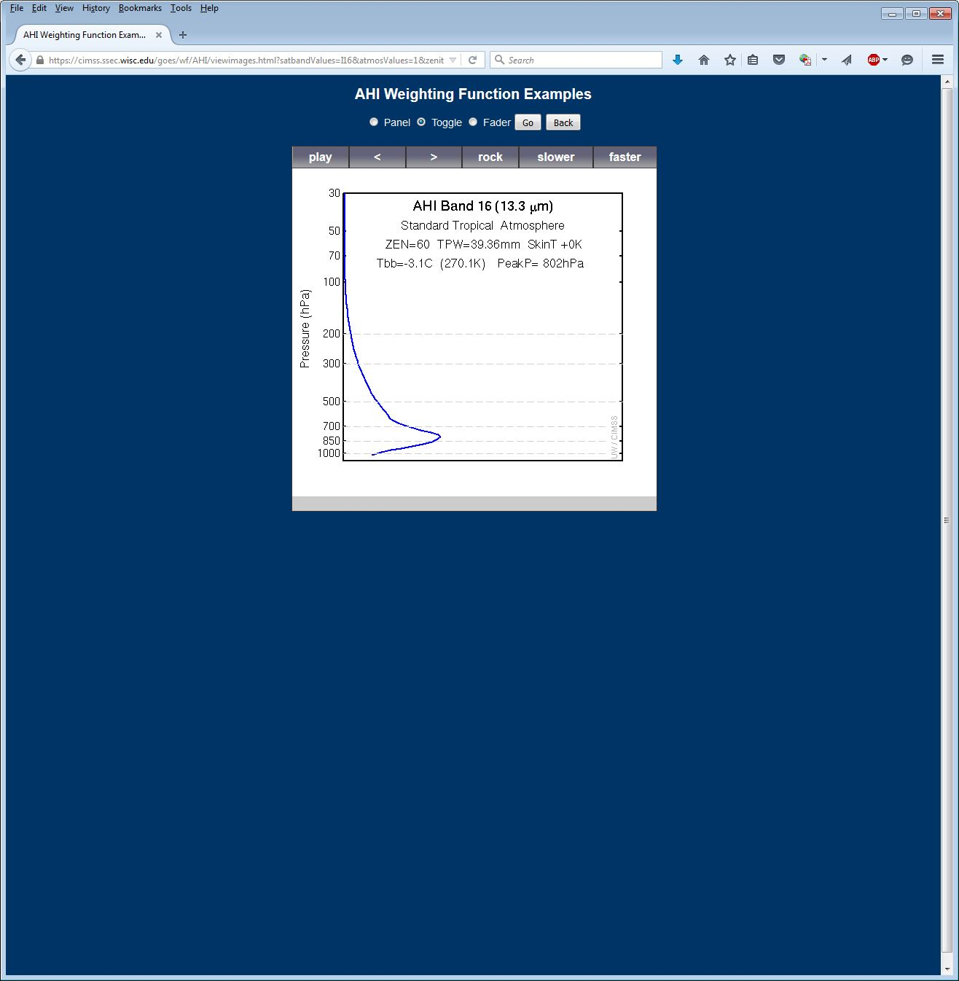

Slide 13
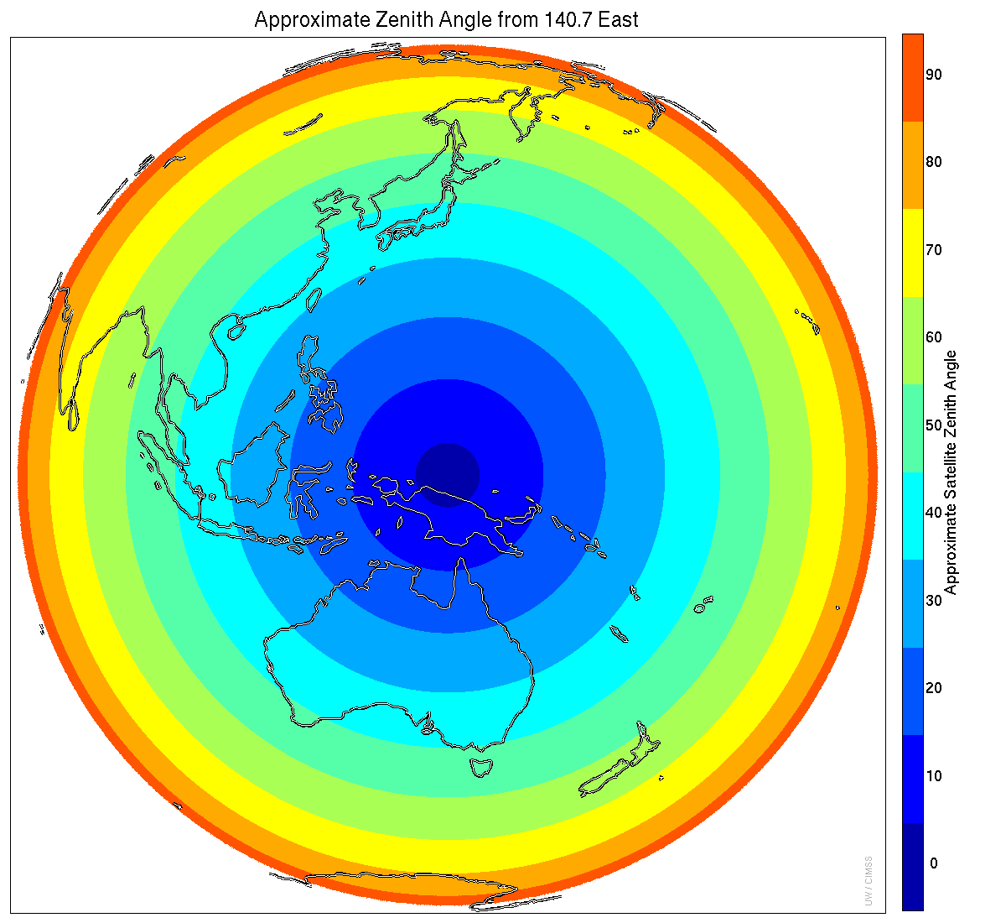
Notes:
Approximate zenith angle, rounded to the nearest 10. So the first, dark blue, ring covers zenith angles from 0 to 4.9 and called “0” on the scale; zenith angles above 5 and below 15 go into the next ring and are labeled as “10”, etc. Himawari-8 operational location.

Slide 14
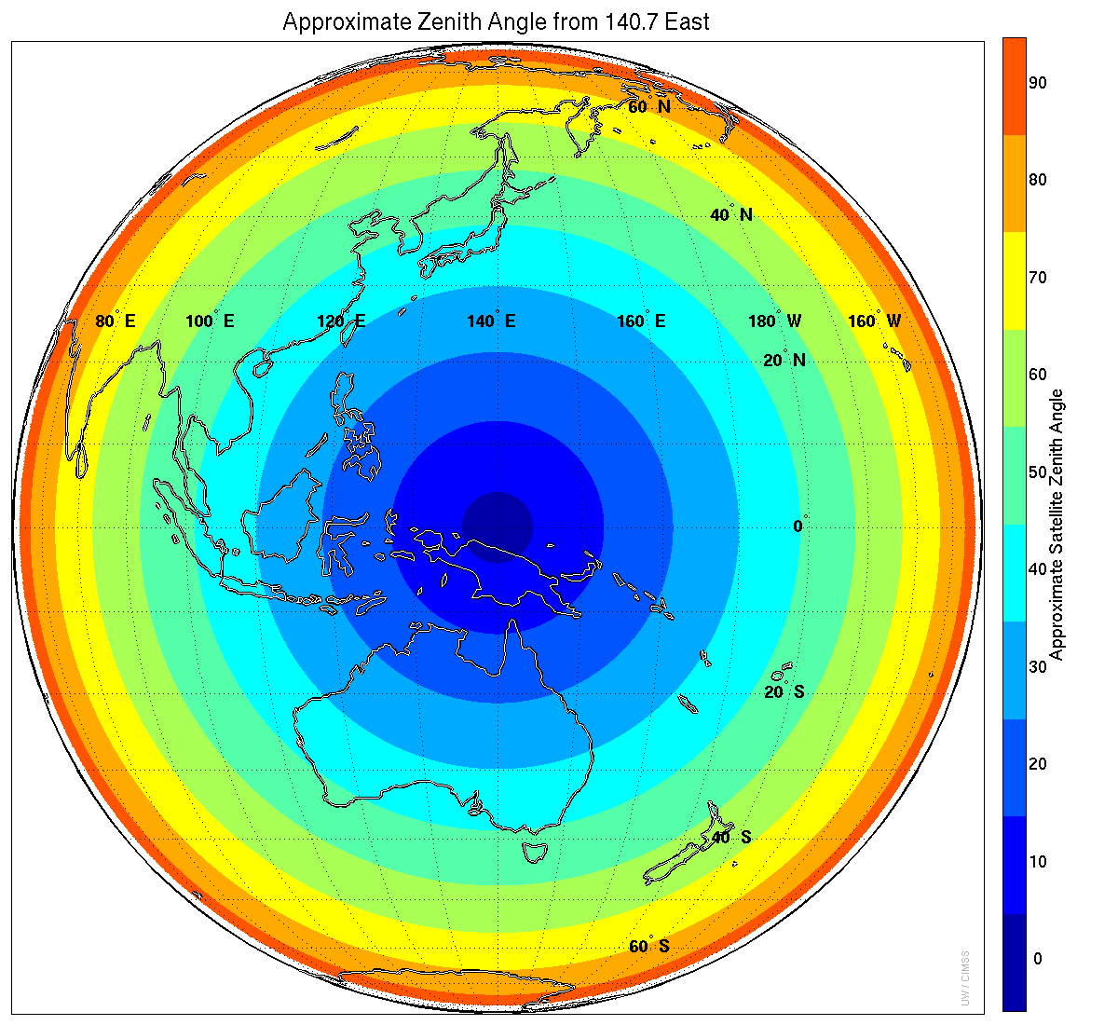
Notes:
Approximate zenith angle, rounded to the nearest 10. So the first, dark blue, ring covers zenith angles from 0 to 4.9 and called “0” on the scale; zenith angles above 5 and below 15 go into the next ring and are labeled as “10”, etc. Himawari-8 operational location.

Slide 15
“Ozone” Band Weighting Functions
by Mat Gunshor
October 30, 2015

Slide 16
Standard Tropical Atmosphere
PFAAST Forward Model used to generate weighting functions for AHI band 12 (9.6um).
Surface Pressure set to 1013hPa
Without modification, the total column ozone for this profile is 283 Dobson Units (DU).
Without modification, the brightness temperature for this profile is 272.6 K (-0.6C) for this band.
The following slides show a gradation of total ozone amounts of 10% to 180% of the unmodified amount.
Note changes in both brightness temperature and total ozone for this band.

Slide 17
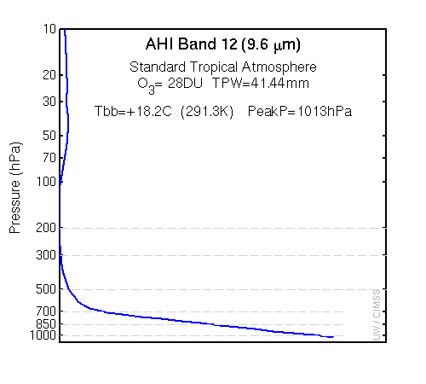

Slide 18
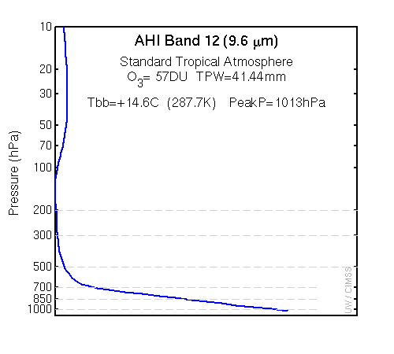

Slide 19
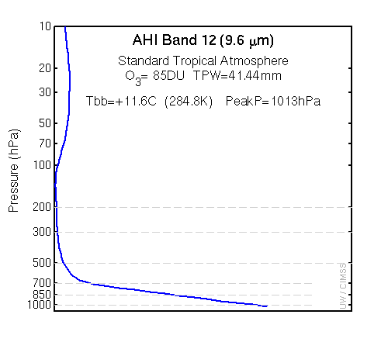

Slide 20
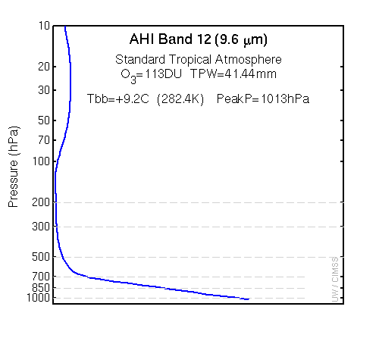

Slide 21
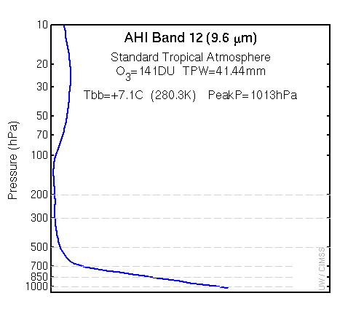

Slide 22
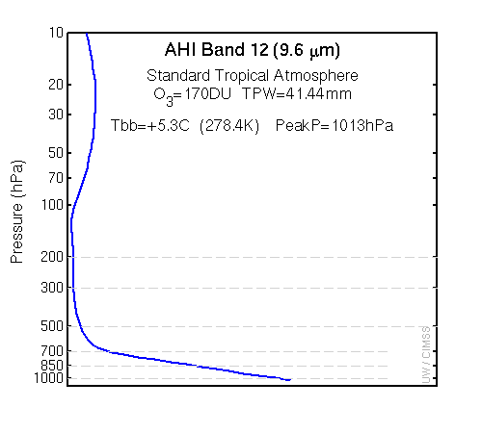

Slide 23
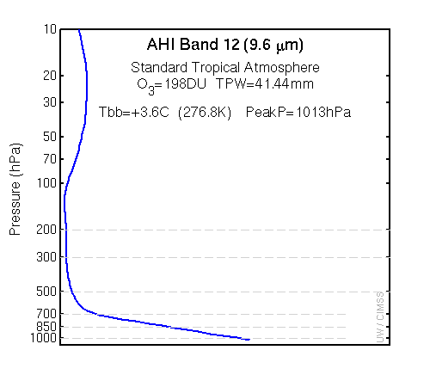

Slide 24
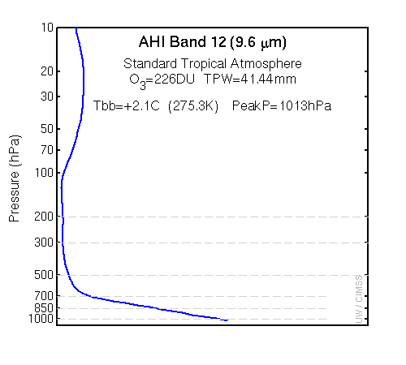

Slide 26
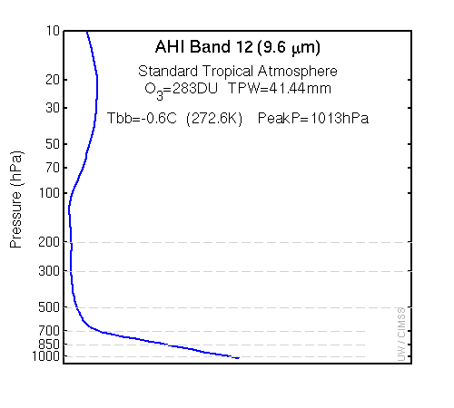

Slide 27
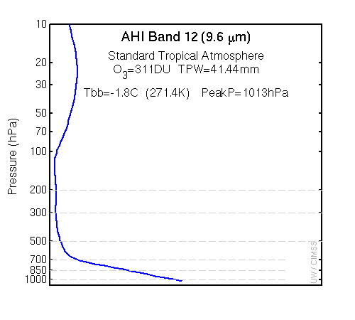

Slide 28
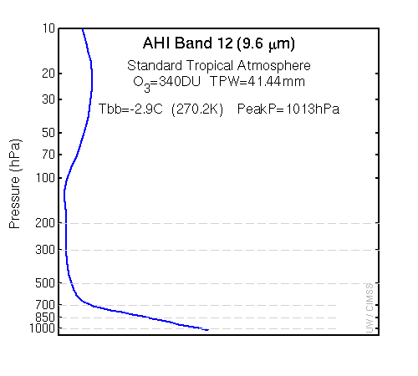

Slide 32
