Slide 1
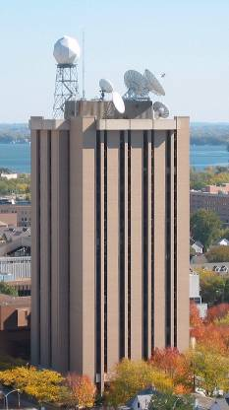
GOES-15 Imager and Sounder
Timothy J. Schmit
NOAA/NESDIS/Satellite Applications and Research
Advanced Satellite Products Branch (ASPB)
Mathew M. Gunshor, Tony Schreiner, Scott Bachmeier, Joleen Feltz, Steve Wanzong, SSEC Data Center, etc.
CIMSS/SSEC, Madison, WI
Don Hillger and Tim Schmit co-lead the NOAA Science Test
Notes:
T. Schmit

Slide 2
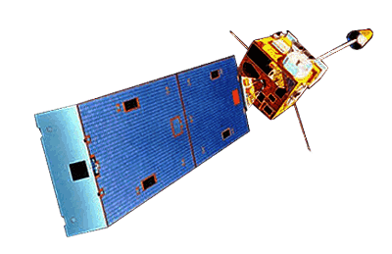
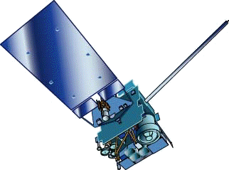
GOES-15
GOES-13/14/15 have similar instruments to GOES-8-12, but on a different spacecraft bus.
Spring and fall eclipse outages will be avoided by larger onboard batteries.
Improved navigation
Improved radiometrics
Similar stray light to GOES-13/14
GOES-8/12
GOES-13/14/15

Slide 3
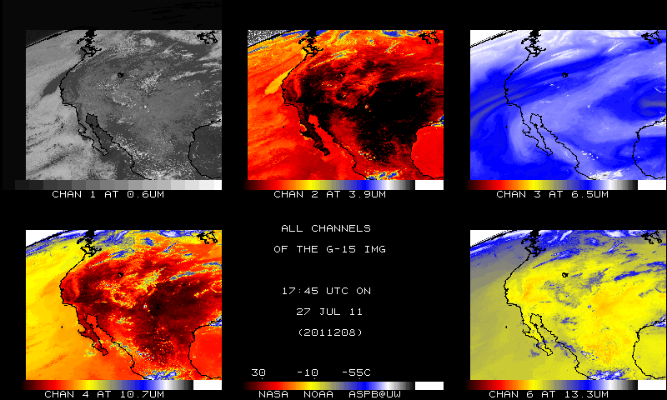
GOES-15
Native projection
From NOAA ASPB

Slide 4
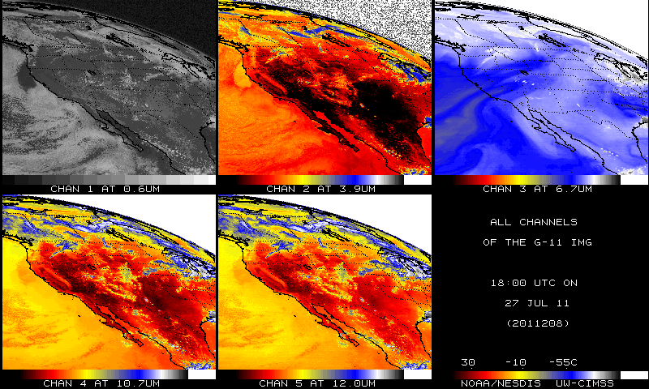
GOES-11
Native projection
From NOAA ASPB

Slide 5
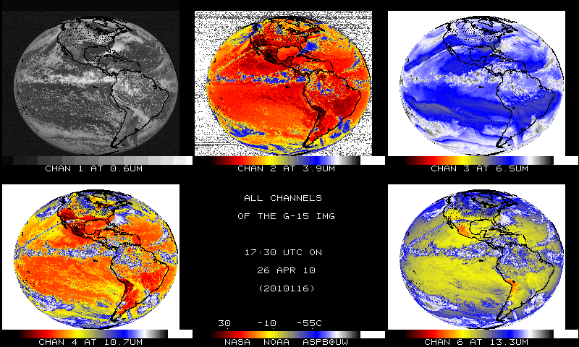
First GOES-15 Images (sub-sampled)
Native projection
From NOAA ASPB

Slide 6
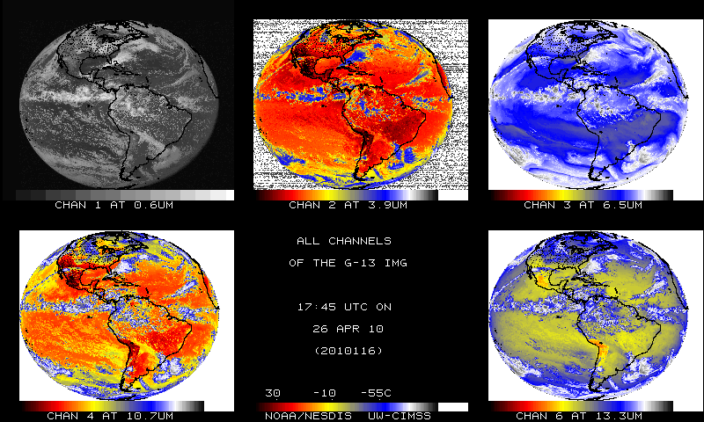
GOES-13 Images (sub-sampled)
Native projection
From NOAA ASPB

Slide 7
GOES-11 vs GOES-14 (WV)
Remapped into a projection

Slide 8
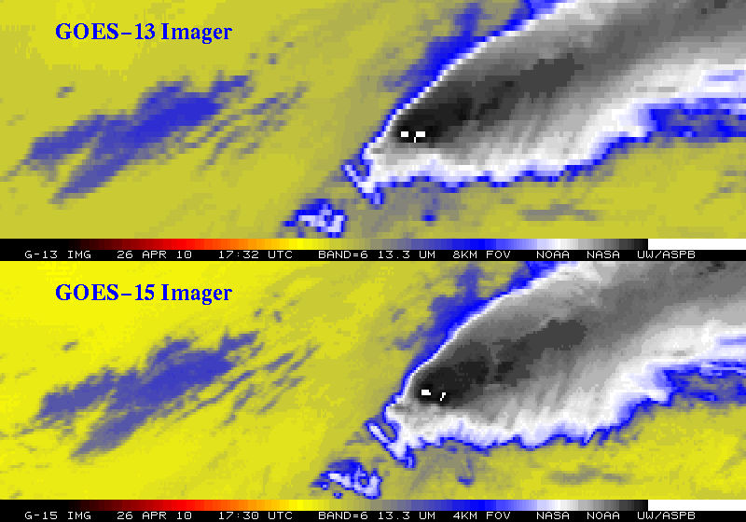
Improved spatial resolution of GOES-15 Imager band 6
The 13.3 um band 6 of the GOES-13 top panel) has an 8 km IGFOV (Instantaneous Geometric Field of View); while the same band on the GOES-15 (lower panel) has a 4 km IGFOV. Note the finer resolution of the cloud edges and the ‘cleaner’ image.
Notes:
GOES-14 (previously GOES-0) was launched on June 27, 2009.
The issue with the band 6 of the imager, was the detector order was initially flipped in the data stream. This was fixed on August 24, 2009 (not shown).
More information can be found at:
http://rammb.cira.colostate.edu/projects/goes-o/
http://cimss.ssec.wisc.edu/goes/blog/archives/3054
Don Hillger and Tim Schmit are co-leading the GOES-14 NOAA science test.
The above images were ingested by the SSEC data center in Madison, WI. Image generated by T. Schmit of NOAA NESDIS STAR ASPB.
###

Slide 9
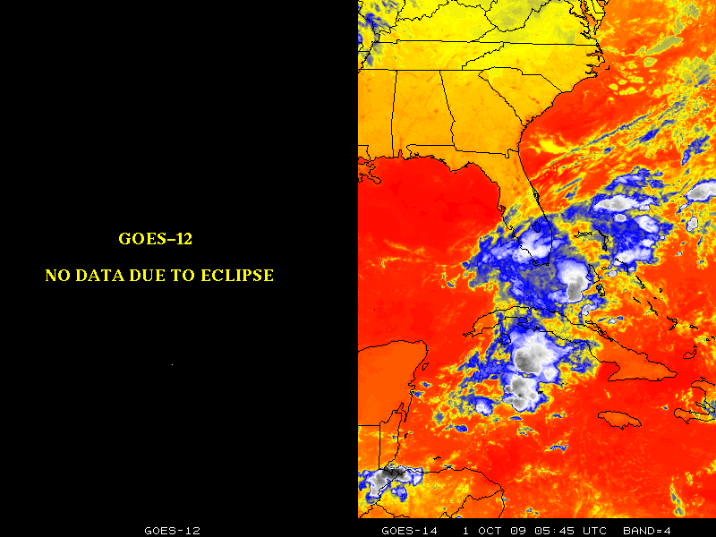
Operation through Eclipse (similar to GOES-14)

Slide 10
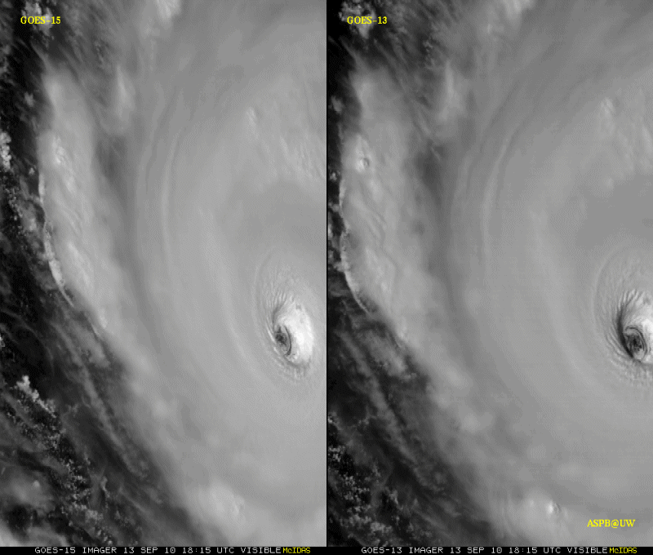
GOES-15 Science Test
The Science Test part of Post Launch Testing for GOES-15 occurred in the summer of 2010.
Comparisons with AIRS and IASI have found a bias of Imager bands 3 and 6. This has been mitigated by shifting the Spectral Responses.
Unique 1-minute rapid scan imagery acquired
GOES-15 data analysis will continue. All the GVAR data archived.
Many products generated in near real-time.
A NOAA Technical Report will be forthcoming.
1-min
30-min
Unique GOES-15 Imager Visible data from the recent NOAA Science Test
Notes:
Igor

Slide 11
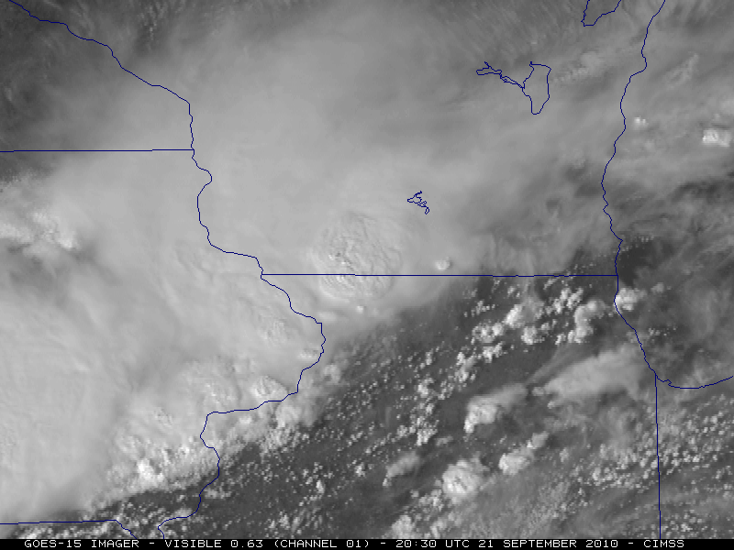
GOES-15 Science Test
The Science Test part of Post Launch Testing for GOES-15 occurred in the summer of 2010.
Comparisons with AIRS and IASI have found a bias of Imager bands 3 and 6. This has been mitigated by shifting the Spectral Responses.
Unique 1-minute rapid scan imagery acquired
GOES-15 data analysis will continue. All the GVAR data archived.
Many products generated in near real-time.
A NOAA Technical Report will be forthcoming.
GOES-15 Imager Visible data from the CIMSS Satellite blog
Notes:
Igor

Slide 12
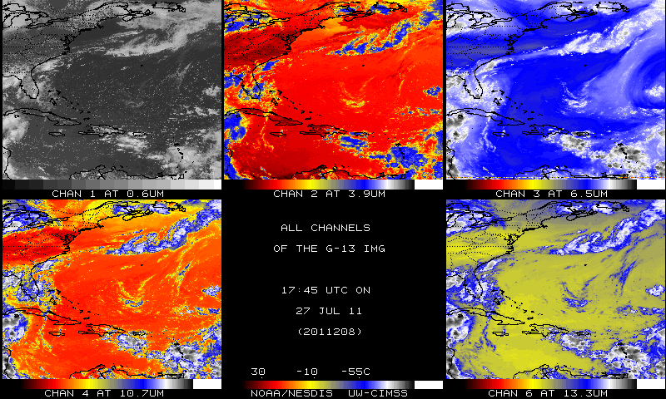
GOES-13 Imager (not remapped)
Data from SSEC data center

Slide 13
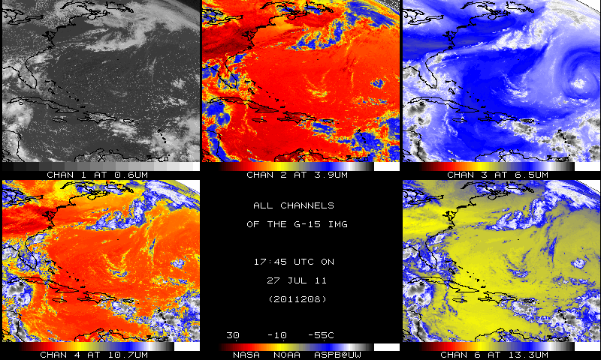
GOES-15 Imager (not remapped)
Data from SSEC data center

