Slide 1
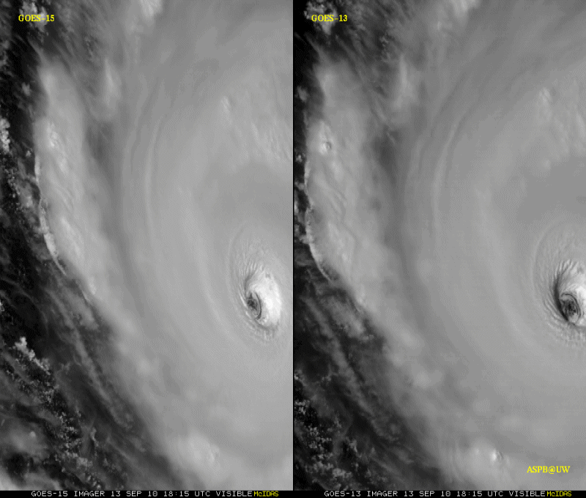
GOES-15 Science Test
The Science Test part of Post Launch Testing for GOES-15 occurred in the summer of 2010.
Comparisons with AIRS and IASI have found a bias of Imager bands 3 and 6.
Unique 1-minute rapid scan imagery acquired
GOES-15 data analysis will continue. All the GVAR data archived.
Many products generated in near real-time.
A NOAA Technical Report will be forthcoming.
1-min
30-min
Unique GOES-15 Imager Visible data from the recent NOAA Science Test
Notes:
Igor

Slide 2
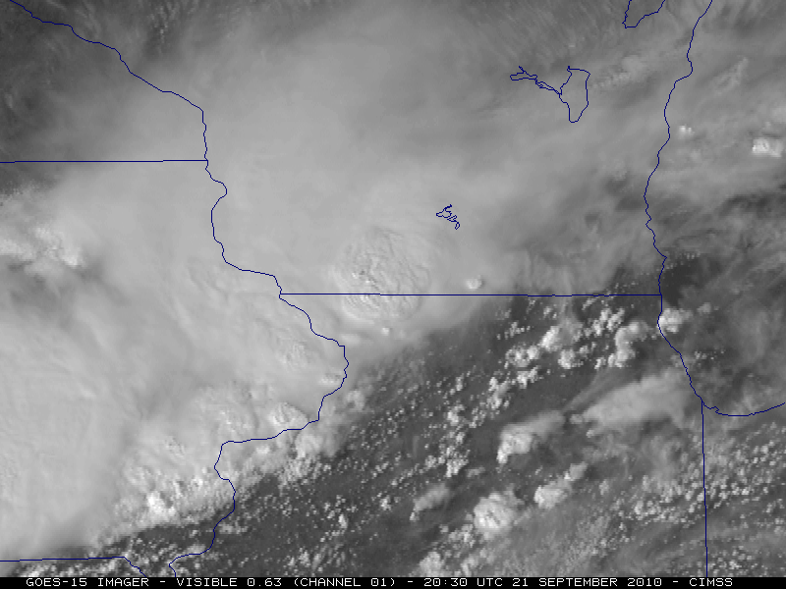
GOES-15 Science Test
The Science Test part of Post Launch Testing for GOES-15 occurred in the summer of 2010.
Comparisons with AIRS and IASI have found a bias of Imager bands 3 and 6.
Unique 1-minute rapid scan imagery acquired
GOES-15 data analysis will continue. All the GVAR data archived.
Many products generated in near real-time.
A NOAA Technical Report will be forthcoming.
GOES-15 Imager Visible data from the CIMSS Satellite blog
Notes:
Igor

