Slide 1
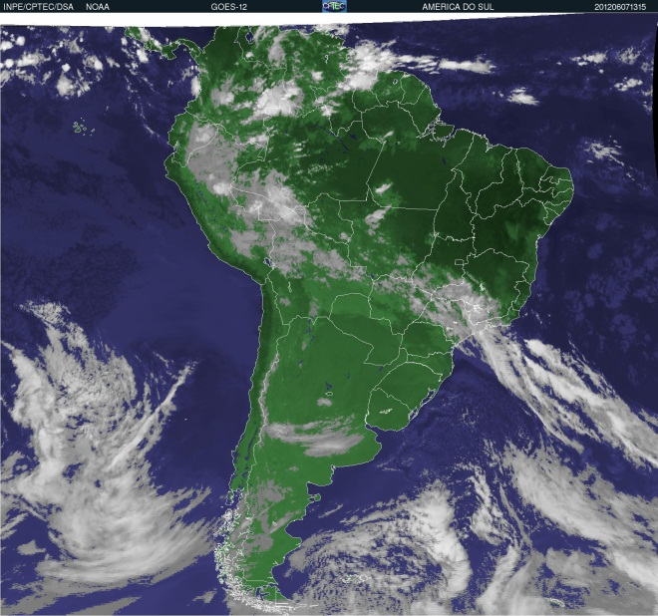
GOES-12 Imager
Cycle Slip
Timothy J. Schmit (tim.j.schmit@noaa.gov)
NOAA/NESDIS/Satellite Applications and Research
Advanced Satellite Products Branch (ASPB)
Madison, WI
Calibration Working Group
June 28, 2012
INPE
UW-Madison

Slide 2
Special Thanks to…
Hyre Bysal, John Tsui, J. Paul Douglass, Xiangqian Wu, etc.
Scott Lindstrom, Mat Gunshor, Scott Bachmeier, Chris Schmidt and many others!
Janean Hill, Jerry Robaidek, etc.
Matt Seybold, Natalie Donoho, Tom Renkevens, etc.
Sergio Pereira, Luiz T. Machado and all GOES-12 users.

Slide 3
Recent Timeline…
7-May-2012. Janean Hill (SSEC) mentions to Matt Seybold that GOES-12 ‘cycle slips’ (CS) are becoming more prevalent.
9-May-2012. First CIMSS blog on this topic.
15-May-2012. Increased SC confirmed by Hyre and crew. (See notes for 2010)
17-May-2012. Impacts on users given to management.
22-May-2012. NOAA suggests a 20-June-2012 side switch date.
28-May-2012. Users request an earlier date.
30-May-2012. NOAA agrees to an earlier date as the CS frequency increases and OSOP is able expedite background work for the side change.
1-June-2012. Calculations show only small brightness differences expected between sides.
5-June-2012. Notification email: GOES-12 (GOES-South America) Imager Electronics Side Swap is scheduled for June 6, 2012
6-June-2012. GOES-12 Imager Electronics Side Swap (16:15 UTC)
7-June-2012. Updated CIMSS blog. CS problem seems mitigated.
8-June-2012. Notification email: Update on GOES-12 (GOES-South America) Imager Electronics Side Switch on June 6, 2012
8-June-2012. Thank you from users for this competent and efficient team action in solving the serious problem!
Notes:
No new GIR was opened.
2/25/2010 – First GOES-12 cycle slip >>> GIR Opened on 3/11 (MOPS-0038)
5/26/2010 – Second GOES-12 CS and scan motor overload >>> new GIR (MOPS-0040)
9/15/2010 – ITT Report NOPQ DCN-748 recommends change of electronics side if CS frequency increases

Slide 4
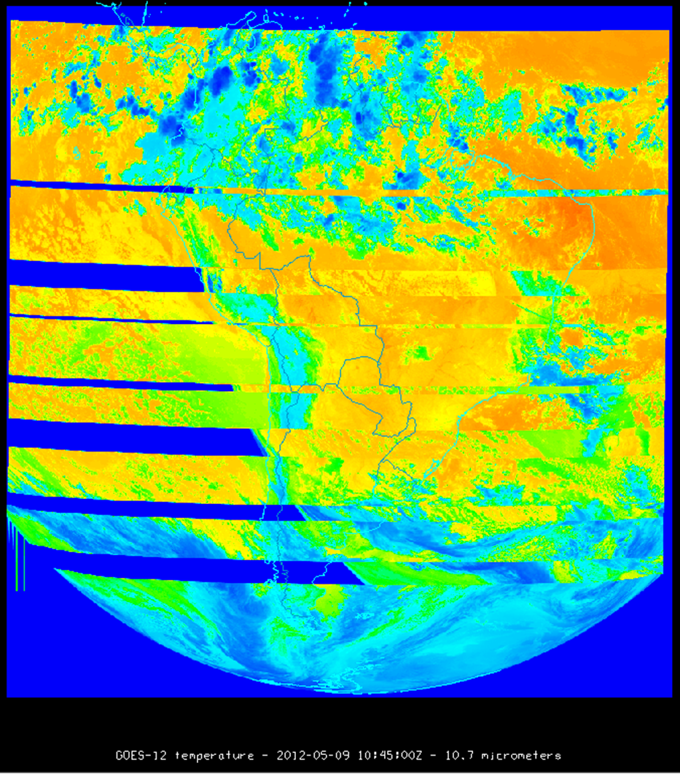
Cycle Slip Corrected by West Space Look
From Univ. of Wisconsin, CIMSS Web Site

Slide 5
Images Lost For Cycle Slip

Slide 6
Side Switch Pros and Cons
PROS
Likely to eliminate cycle slips
CONS
It is not a proven solution without risk
1-2 hours of data loss if switch back in case of an unexpected condition
New detectors; data discontinuity for scientists
Recommendations:
Switch to electronics side 2
Switch back to side 1 if worse data quality

Slide 9
Electronics Side Switch Operation
Update Website with Side-2 calibration coefficients and look up table for users
All SPSs to point to Side 2 – CDA
SPS Mode-1 for 5 days
Commanding is same as GOES-9
CPs: ZIFULOPS, ZILD4REG
STAR and UW to confirm image quality

Slide 10
Side 1 vs 2 electronics

Slide 11
Side 1 vs 2 electronics

Slide 12
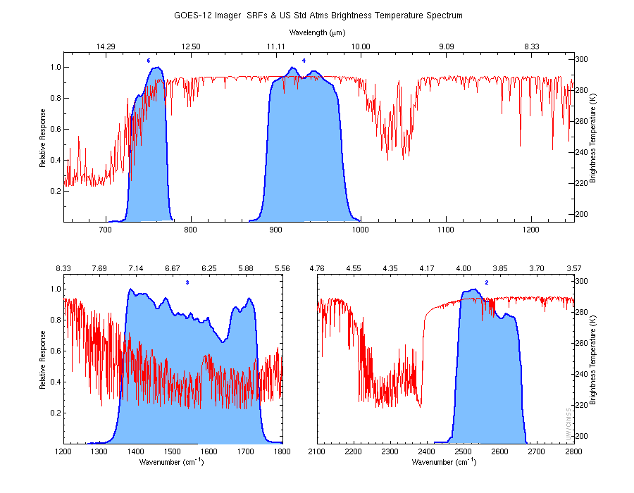
Delta TBB…
Note that there will be slight differences for a given input radiance in the computed brightness temperature for each band for the Side 2 Planck conversion coefficients versus the Side 1 Planck conversion coefficients (for bands 3 and 6).
These differences are much smaller than the instrument noise.
Band | TBB Diff (K) | Noise (K)
2a | 0.0001 | 0.13
2b | 0.0001 | 0.13
3a | -0.0001 | 0.15
3b | 0.0631 | 0.15
4a | -0.0001 | 0.11
4b | -0.0001 | 0.11
6 | 0.0119 | 0.19
Notes:
Difference is between sides.

Slide 13
Lessons…
Sometimes we need to make changes/take chances to improve the radiance products.
Listen to our users. Communication between operators, providers, stakeholders and users is key.
Sooner side 2 switch.
Consider to not update Planck coefficients if the spectral response functions haven’t changed.
Consider more ‘end of life’ tests, similar to what was done with GOES-9 (4 side switches)
Operating GOES-SA (South America) helps us:
Remapping experience
Side 2 switch experience
“hot” operational back-up (eg. When GOES-SA was used as GOES-East)

Slide 14
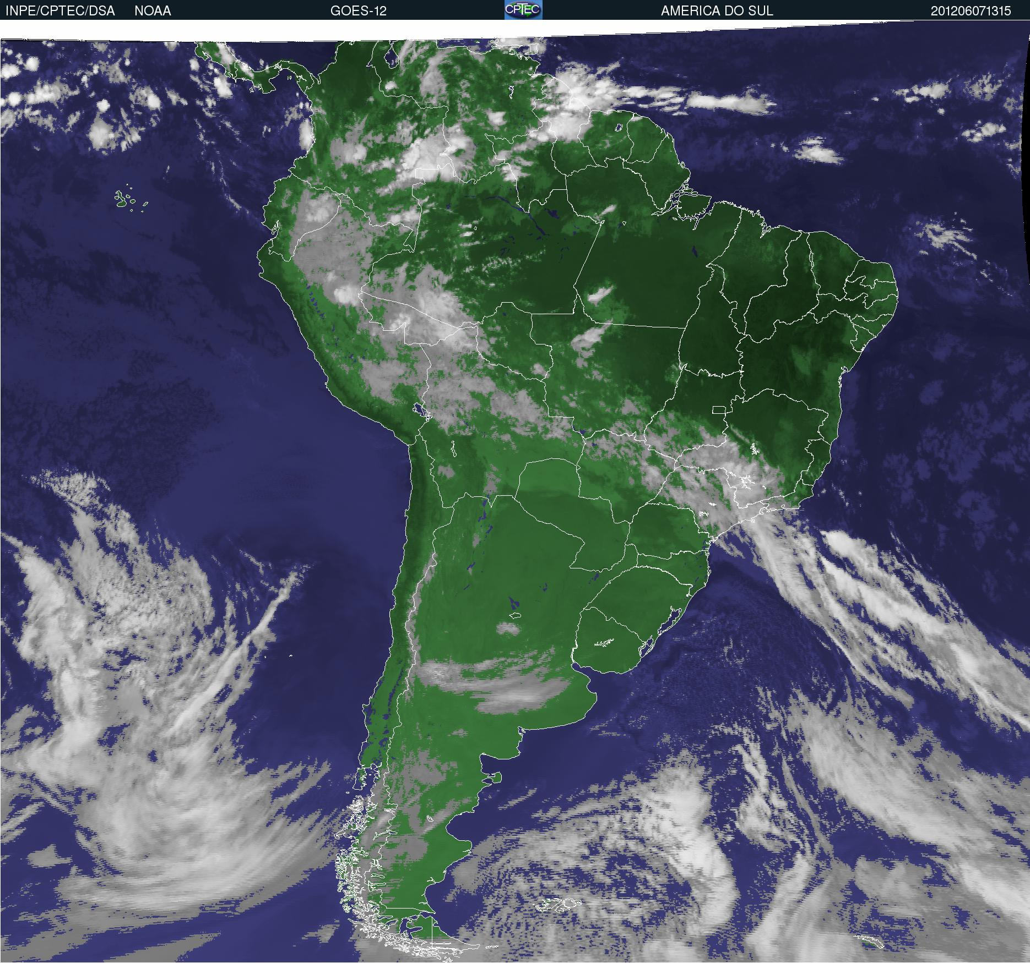
INPE

Slide 15
Related URLs…
Info:
http://www.ssd.noaa.gov/PS/SATS/GOES/SA/
CIMSS Satellite blogs
http://cimss.ssec.wisc.edu/goes/blog/archives/10307
http://cimss.ssec.wisc.edu/goes/blog/archives/10528
Near realtime GOES-12 images
http://cimss.ssec.wisc.edu/goes/rt/goessa.php
http://satelite.cptec.inpe.br/setores/?r=0&i=en
Satellite status:
http://www.oso.noaa.gov/goesstatus/componentStatusSummary.asp?spacecraft=12&subsystem=0

