Slide 1
The Advanced Baseline Imager (ABI) on the GOES-R Series
Timothy J. Schmit (tim.j.schmit@noaa.gov)
NOAA/NESDIS/Satellite Applications and Research
Advanced Satellite Products Branch (ASPB)
Madison, WI
AMS Conference
13th Annual Symposium on New Generation Operational Environmental Satellite Systems
January 23, 2017
UW-Madison

Slide 2
Thanks to…
Mat Gunshor
Brad Pierce
Jaime Daniels
Steve Goodman
Jordan Gerth
Scott Lindstrom
William Straka
GOES-R Program Office
Kathryn Mozer and Matt Seybold and the PRO Team
Steve Wanzong
SSEC data center
Kaba Bah and Joleen Feltz and Jim Nelson and Hong Zhang
Steve Miller and Dan Lindsey
JMA
ITT / Harris and the Entire GOES-R team!

Slide 3
Full Disk

Slide 4
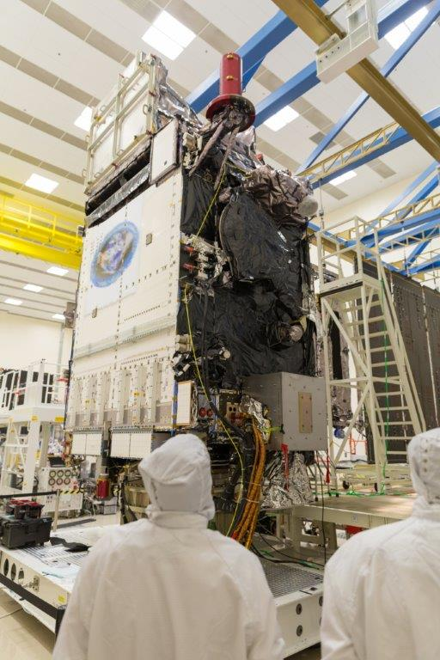
Outline
Introduction
GOES-16 ABI
Spectral
Spatial
Temporal
Products
Summary
Lockheed Martin

Slide 5
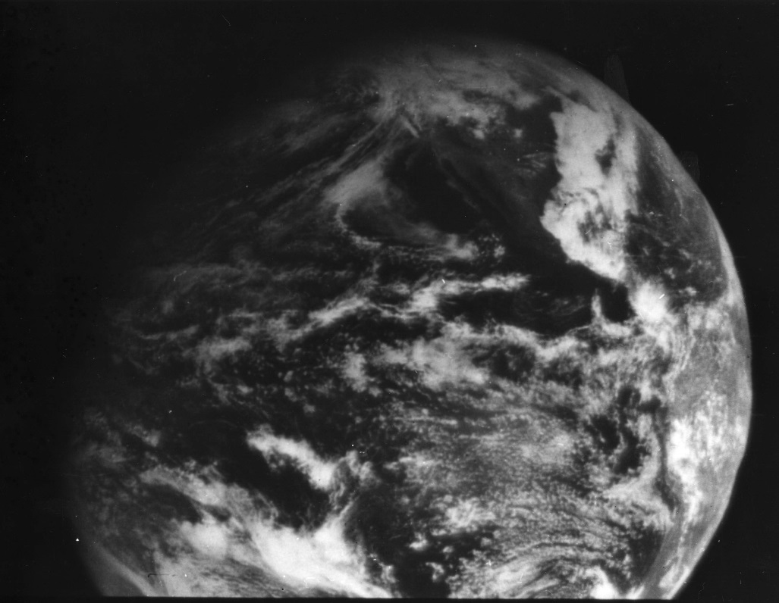
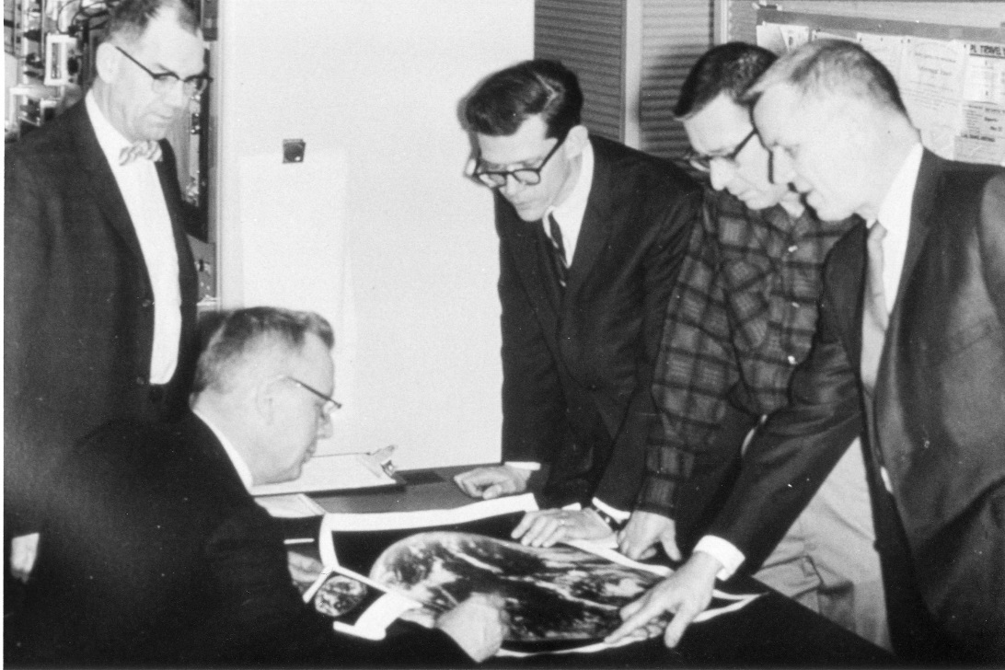
1966: ATS-1 launched
Applications Technology Satellite (ATS)-1 was the first geostationary imager, launched 6 December 1966. Imaging instrument designer and SSEC co-founder, Verner E. Suomi, proclaimed, “the clouds move, not the earth”.
11 December 1966
Notes:
http://cimss.ssec.wisc.edu/news/geo_image_anniversary.html

Slide 6
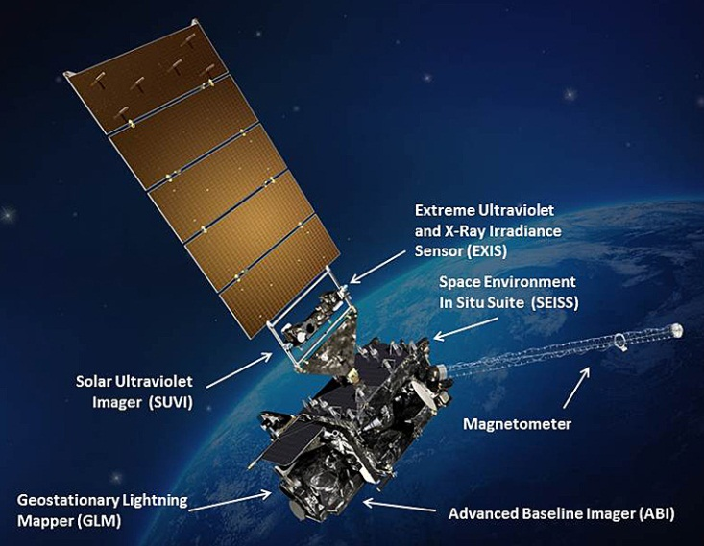
GOES-R
Next generation of NOAA/NASA geo weather satellites
R-Series includes 4 satellites (16, S, T, U)
First launched in Nov 2016
Represents first major upgrade in over 20 years
Earth-pointing instruments
Geostationary Lightning Mapper (GLM)
Advanced Baseline Imager (ABI)
3x more spectral bands
4x spatial resolution
5x temporal coverage
Space weather and solar imaging instruments
Space Environment in-Situ Sensor Suite (SEISS)
Magnetometer
Solar Ultra-Violet Imager (SUVI)
Extreme Ultraviolet and X-ray Irradiance Sensors (EXIS)

Slide 7
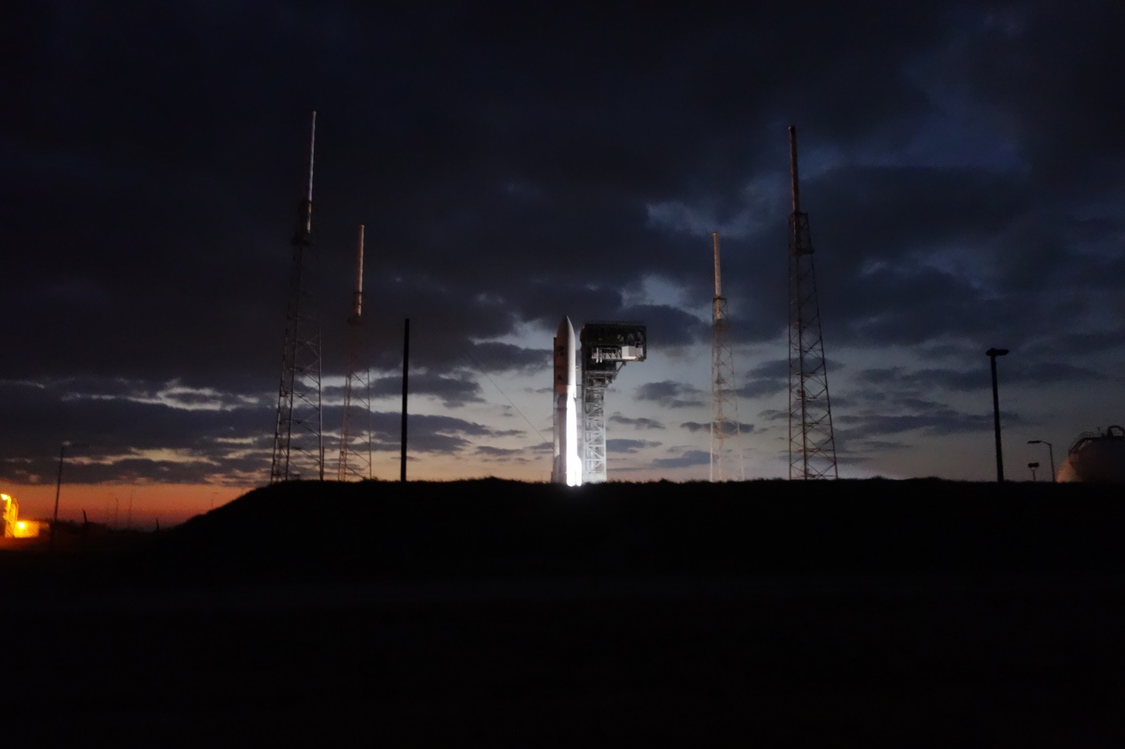

Slide 8
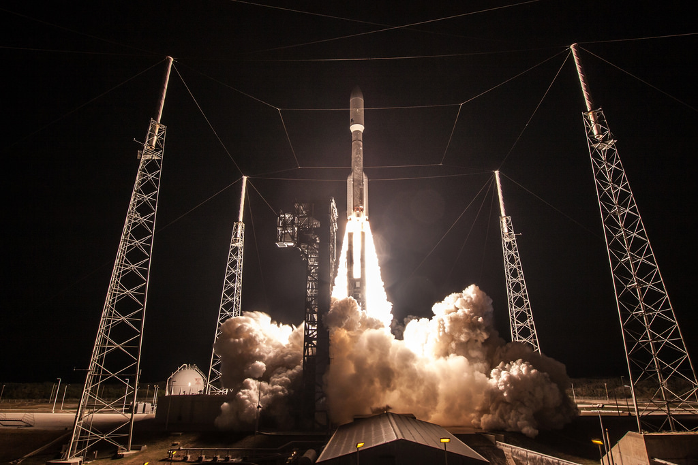
Credit: ULA / NOAA

Slide 9
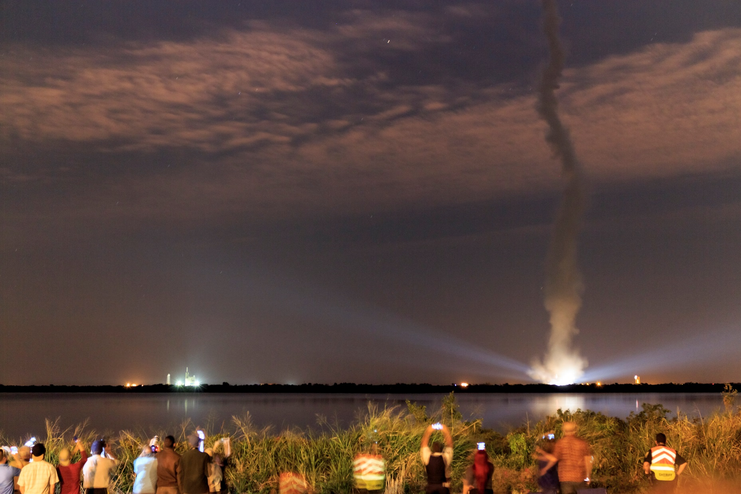
Credit: Chris Schmidt, CIMSS

Slide 10
The Advanced Baseline Imager:
ABI Current Imager
Spectral Coverage
16 bands 5 bands
Spatial resolution
0.64 μm Visible 0.5 km Approx. 1 km
Other Visible/near-IR 1.0 km n/a
Bands (>2 μm) 2 km Approx. 4 km
Spatial coverage
Full disk 4 per hour Scheduled (3 hrly)
CONUS 12 per hour ~4 per hour
Mesoscale 2 every 1-min n/a
Visible (reflective bands)
On-orbit calibration Yes No
Notes:
The ABI allows more bands, finer spatial resolution, faster refresh rates and on-orbit calibration of all bands!

Slide 11
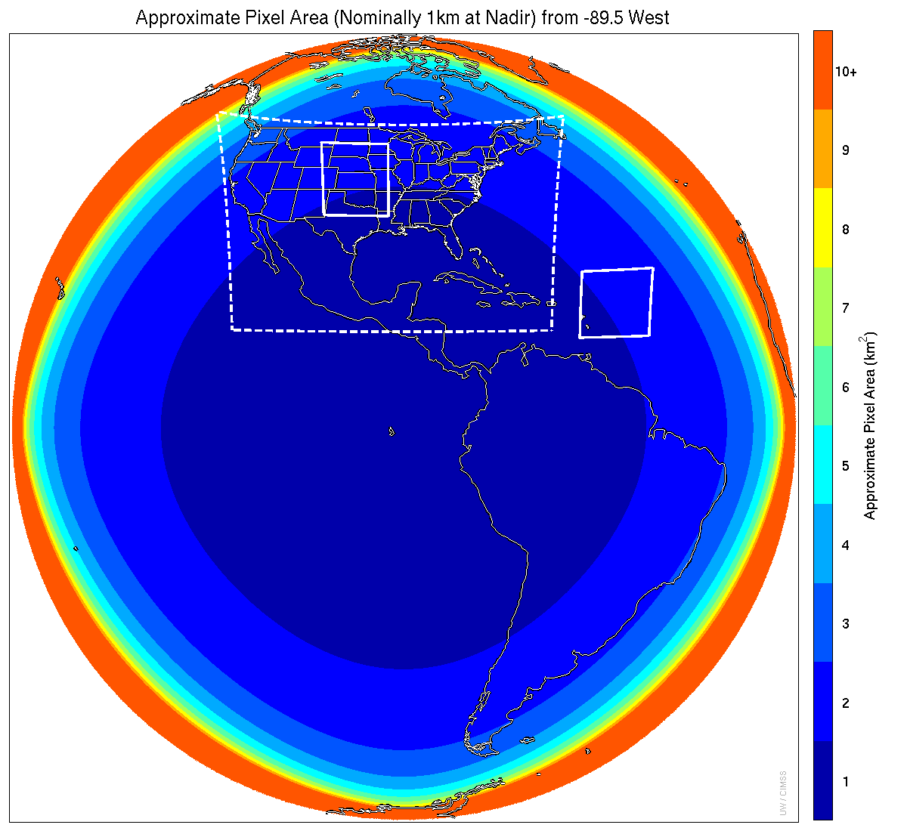
Meso-scale box locations are movable
1 min
5 min
1 min
15 min
Central
Scan mode (3) or ‘flex mode’ for the ABI:
- Full disk every 15 minutes + 5 min CONUS
+ 1-min mesoscale sectors (2 locations).
[Scan mode (4) or ‘Continuous Full Disk’ (CFD) is a full disk every 5 min]
Notes:
1-km² spatial resolution at satellite nadir. Pixel Areas are approximate. Each bin is rounded to the nearest 1km² until we get to 9.5km² and then all are binned into the red 10+ area. So the first, dark blue, ring covers pixel areas from 1 to 1.49km² and is labeled “1”, above 1.5 to below 2.5km² goes into the next ring and is called “2”, etc. GOES-Test location. PUG CONUS sector. Two meso-scale image sectors shown; these are selectable. The same central lat/lon used for these mesoscales produces a different sized and shaped area for different satellite locations.

Slide 12
Coverage (Full Disk)

Slide 13
Coverage (CONUS)

Slide 14
Coverage (Meso)

Slide 15
Coverage (Meso)

Slide 16
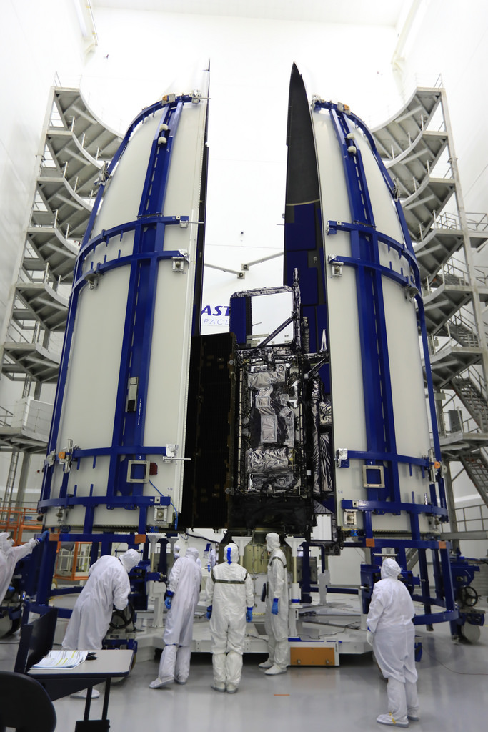
Outline
Introduction
GOES-16 ABI
Spectral
Spatial
Temporal
Products
Summary
GOES-R

Slide 17
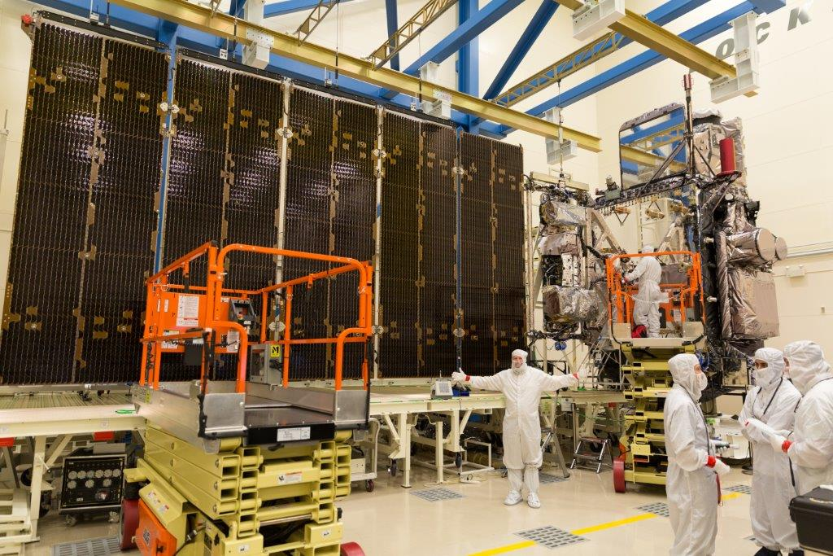
GOES-R Advanced Baseline Imager (ABI)
Spectral
Improved!
Spatial
Improved!
Temporal
Improved!
Lockheed Martin

Slide 18
ABI: Bands 1-6 (Visible / NearIR)
ABI Band | Wavelength (µm) | Wavelength range (µm) | Sub-point pixel spacing (km) | Descriptive Name
1 | 0.47 | 0.45 - 0.49 | 1 | “Blue”
2 | 0.64 | 0.60 - 0.68 | 0.5 | “Red”
3 | 0.864 | 0.847 - 0.882 | 1 | “Veggie”
4 | 1.373 | 1.366 - 1.380 | 2 | “Cirrus”
5 | 1.61 | 1.59 - 1.63 | 1 | “Snow/Ice”
6 | 2.24 | 2.22 -2.27 | 2 | “Cloud Particle Size”
Six visible or near visible bands on ABI, one on heritage imager
Notes:
Based on Schmit et al, 2017. stars = today’s imager band.

Slide 19
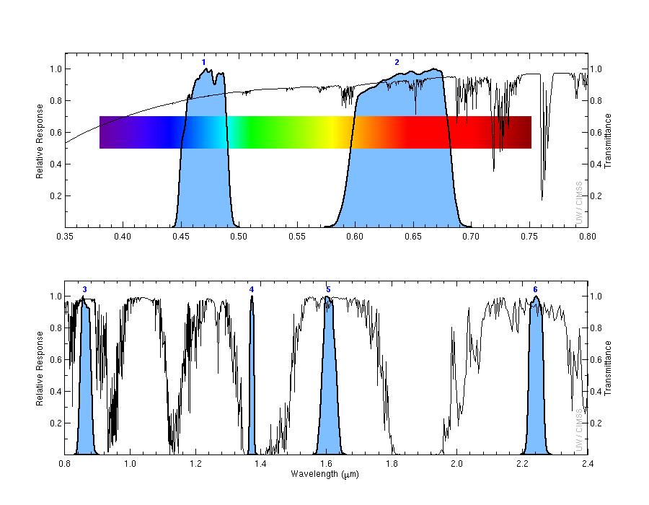
ABI Spectral Bands (1-6)
Visible
Near-IR

Slide 20
ABI: Bands 7-16 (Infrared)
ABI Band | Wavelength (µm) | Wavelength range (µm) | Sub-point pixel spacing (km) | Descriptive Name
7 | 3.90 | 3.80 - 3.99 | 2 | “Shortwave window”
8 | 6.19 | 5.79 - 6.59 | 2 | “Upper-level Water Vapor”
9 | 6.93 | 6.72 - 7.14 | 2 | “Mid-Level Water Vapor”
10 | 7.34 | 7.24 - 7.43 | 2 | “Lower/Mid-level Water Vapor”
11 | 8.44 | 8.23 - 8.66 | 2 | “Cloud-top Phase”
12 | 9.61 | 9.42 - 9.80 | 2 | “Ozone”
13 | 10.33 | 10.18 - 10.48 | 2 | “Clean longwave window”
14 | 11.21 | 10.82 - 11.60 | 2 | “Longwave window”
15 | 12.29 | 11.83 - 12.75 | 2 | “Dirty longwave window”
16 | 13.28 | 12.99 - 13.56 | 2 | “CO₂”
10 infrared bands on the ABI, four on heritage imager
Notes:
Based on Schmit et al, 2017. stars = today’s imager band.

Slide 21
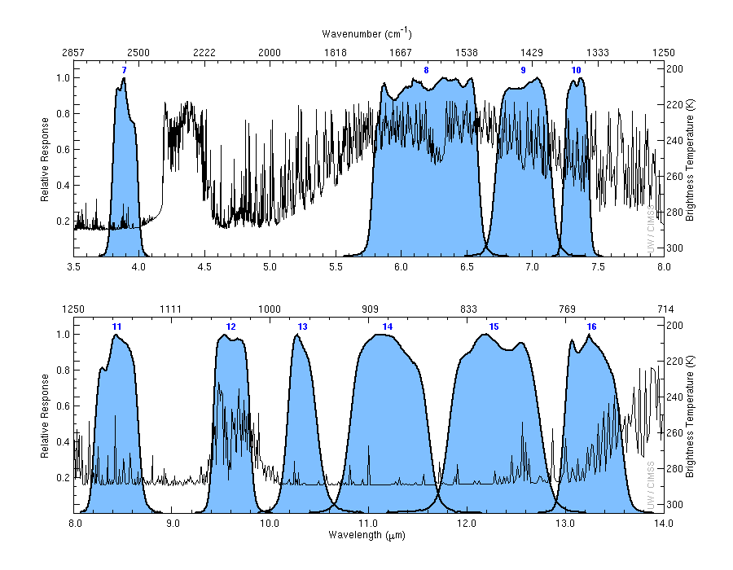
ABI IR Spectral Bands (7-16)
cool
hot

Slide 22
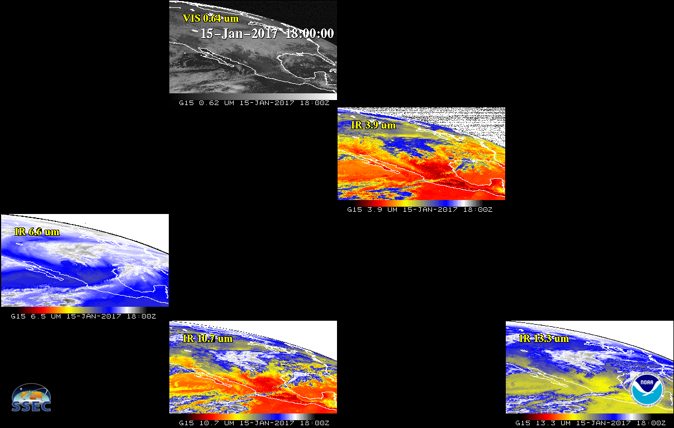
Current GOES Spectral Bands (5)
VIS
1 VIS
0 NIR
4 IR
NIR
WV
IRW
CO2
GOES-West

Slide 23
ABI Spectral Bands (16)
2 VIS
4 NIR
10 IR

Slide 24
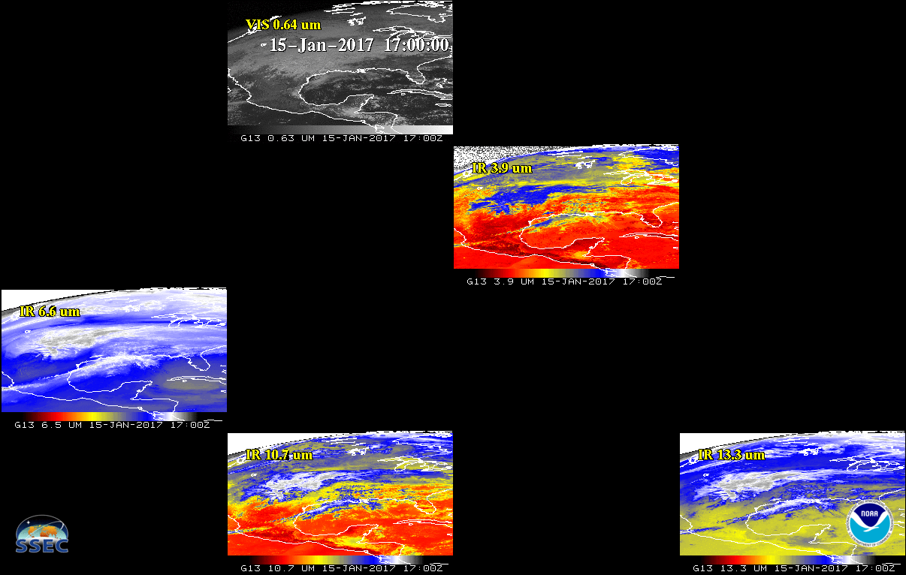
Current GOES Spectral Bands (5)
VIS
1 VIS
0 NIR
4 IR
NIR
WV
IRW
CO2
GOES-East

Slide 25
Spectral
Set thru the 16 spectral bands

Slide 26
Spatial

Slide 27
Spatial

Slide 28
Spatial

Slide 29
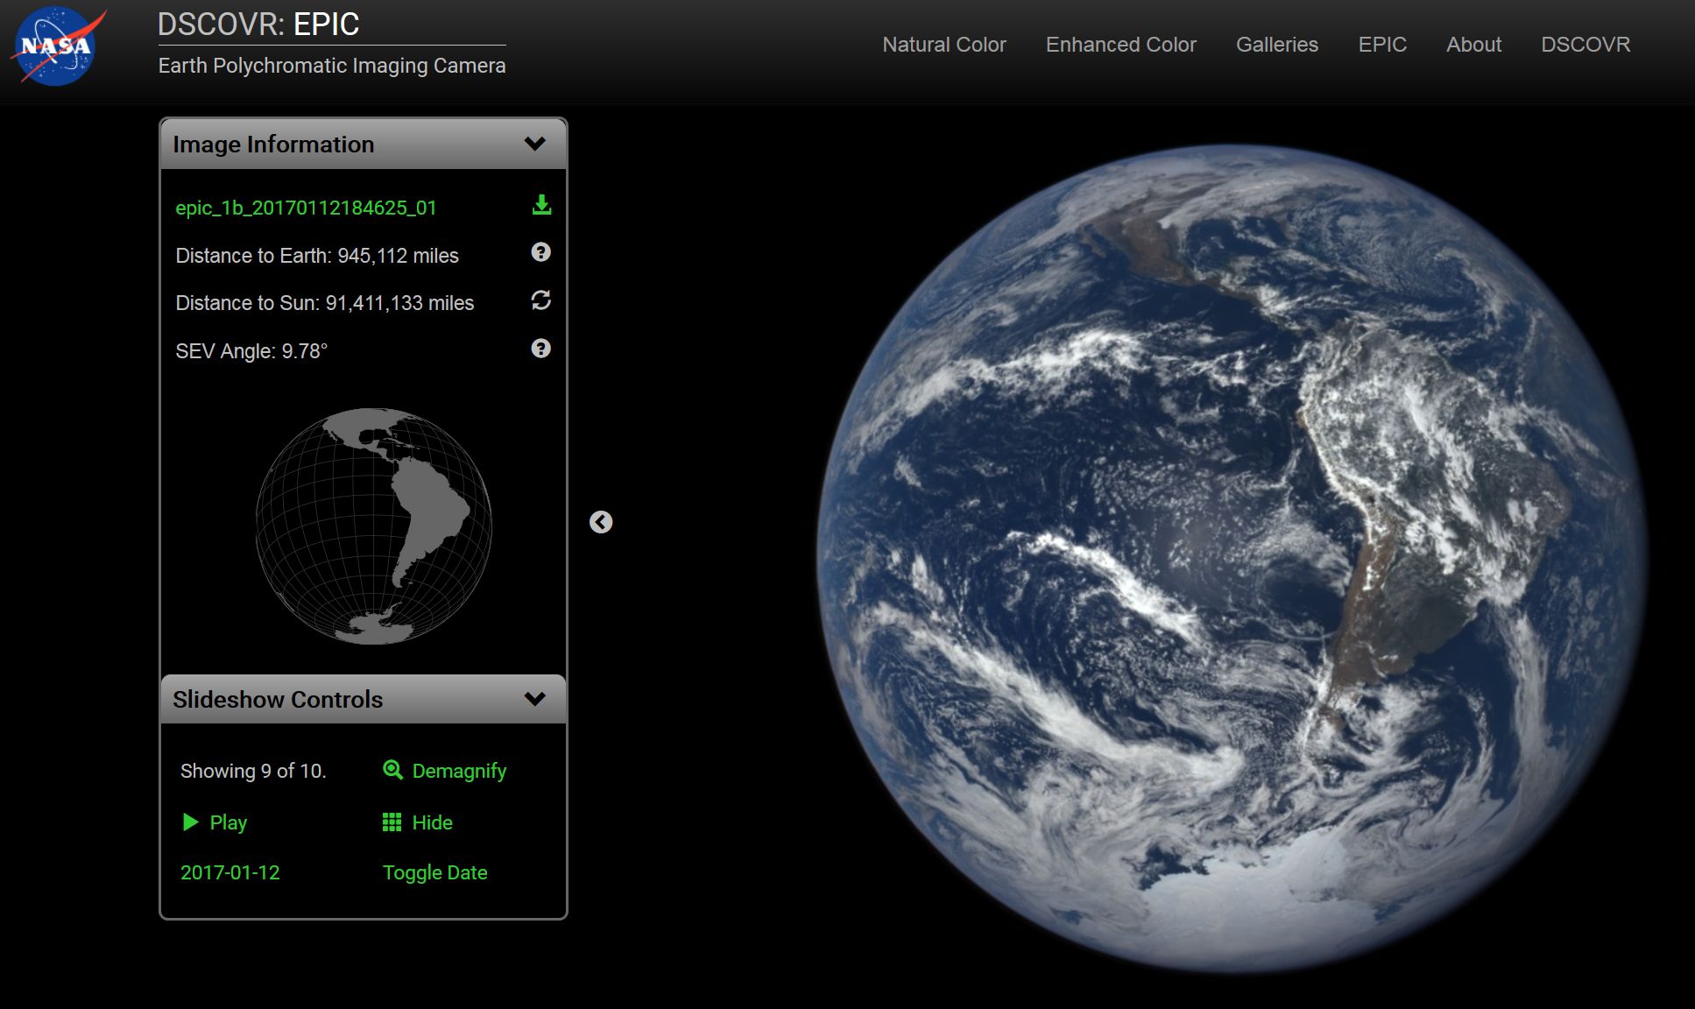
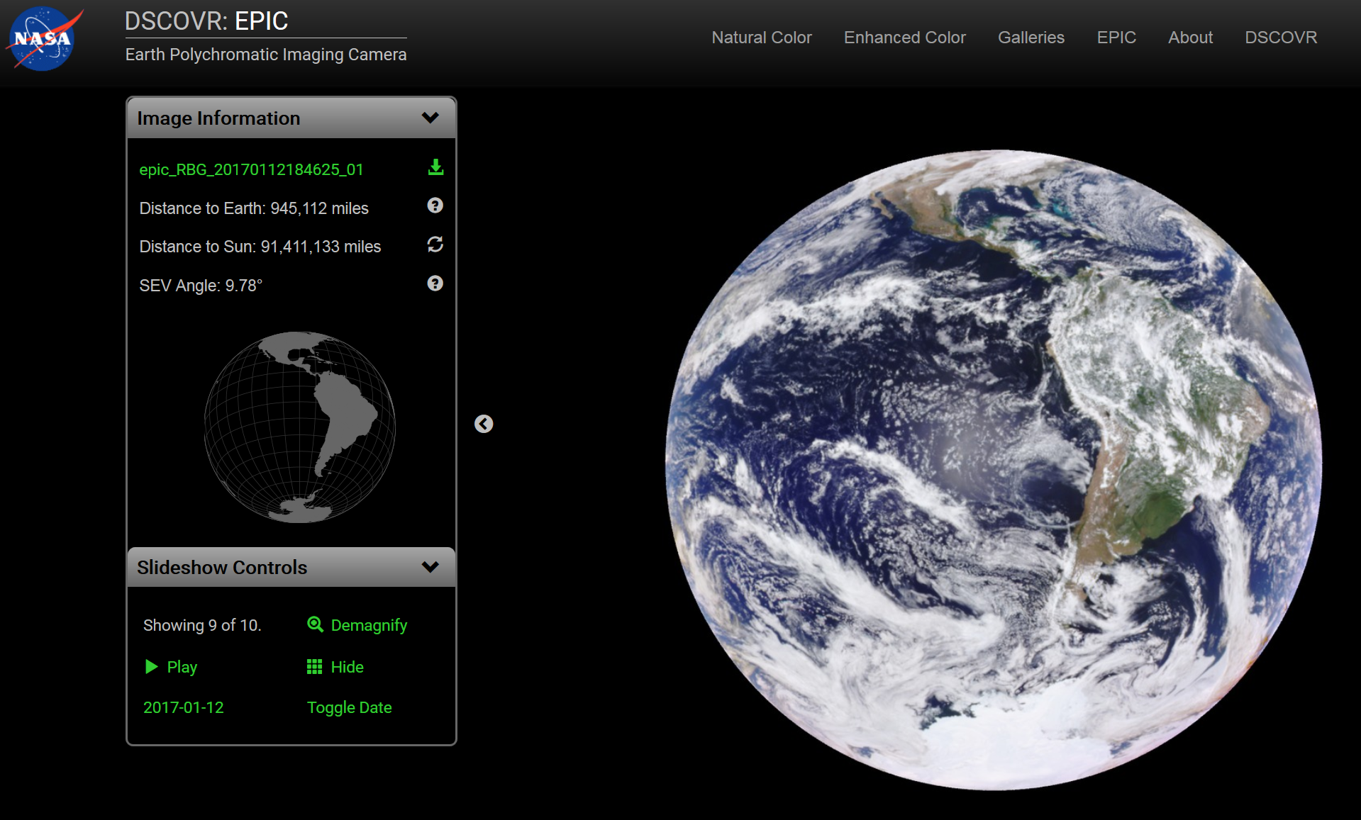
Natural vs Enhanced Color
Epic on DSCOVR (https://epic.gsfc.nasa.gov)

Slide 30
Full Disk
Natural Color
Enhanced

Slide 31
Temporal

Slide 32
Temporal

Slide 33
Temporal

Slide 34
http://www.goes-r.gov
Notes:
The subjects of this GOES-R Baseline products training are the aerosol products boxed in yellow.

Slide 35
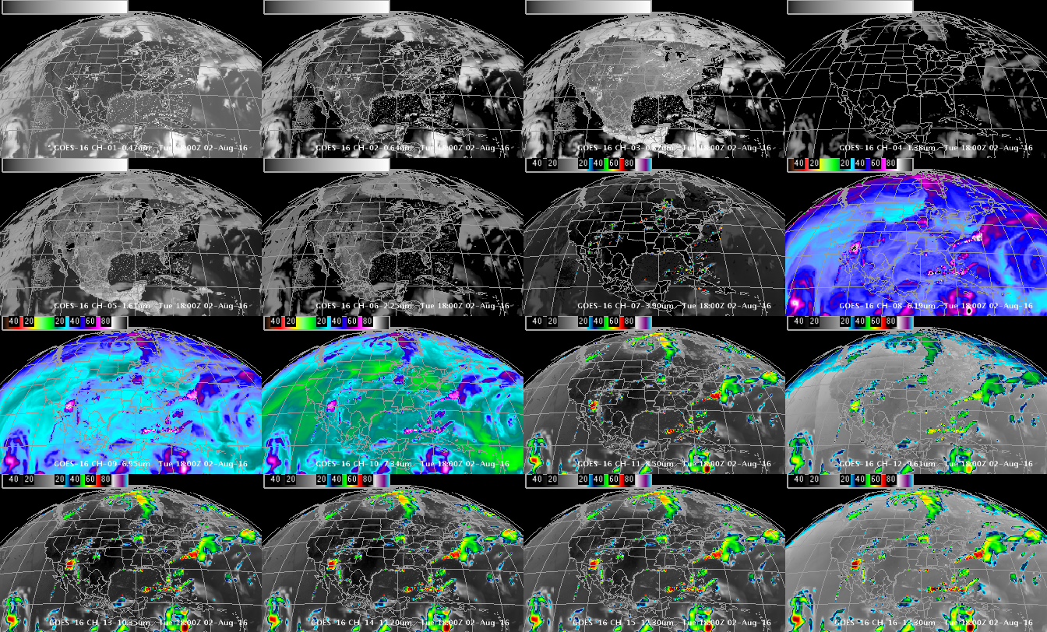
Simulated ABI Spectral bands (in AWIPS)
0.47 μm
0.64 μm
0.86 μm
1.37 μm
1.6 μm
2.2 μm
3.9 μm
6.2 μm
6.9 μm
7.3 μm
8.4 μm
9.6 μm
10.3 μm
11.2 μm
12.3 μm
13.3 μm
GOES-R ABI Imagery simulated at UW via AWG Proxy, processed via the Ground System, acquired via NOAAPort, shown in AWIPS-II (default enhancements)

Slide 36
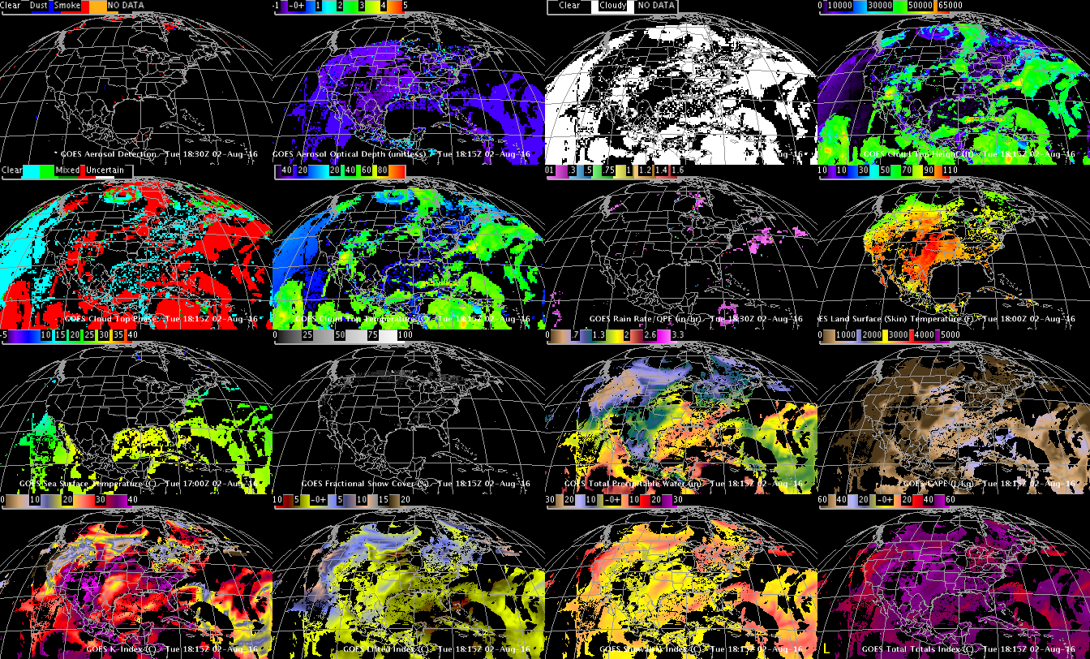
Simulated ABI (select) Derived Products (in AWIPS)
Aerosol Detection
Aerosol Optical Depth
Cloud Mask
Cloud Top Height
Cloud Top Phase
Cloud Top Pressure
Rain Rate
LST
SST
Snow
TPW
CAPE
K-index
Lifted Index
Showalter
Total Totals
Using GOES-R ABI Imagery simulated at UW via AWG Proxy, processed via the Ground System, acquired via NOAAPort, in AWIPS-II (default enhancements)

Slide 37
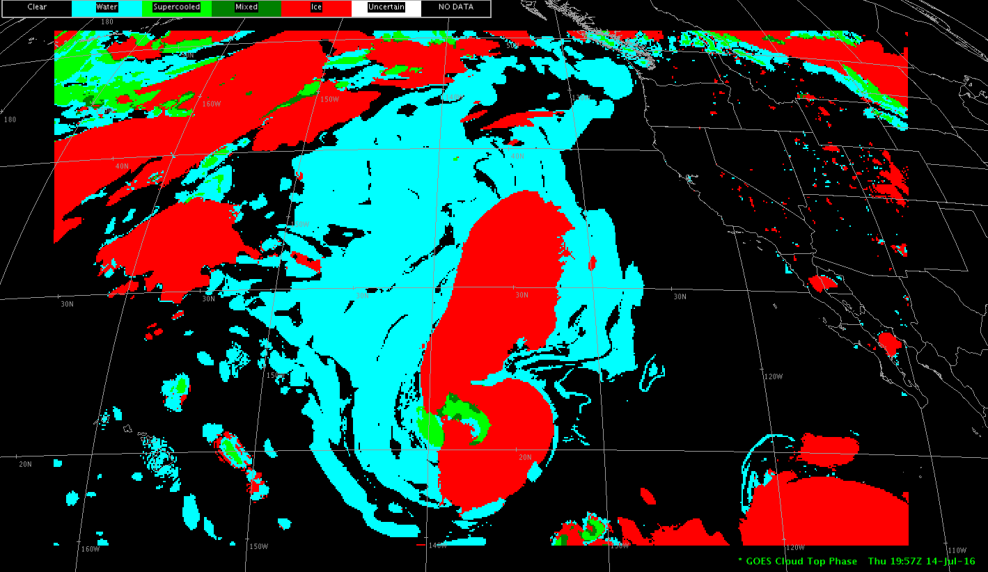
DOE-4 Simulated ABI Derived Products
Cloud Top Phase

Slide 38
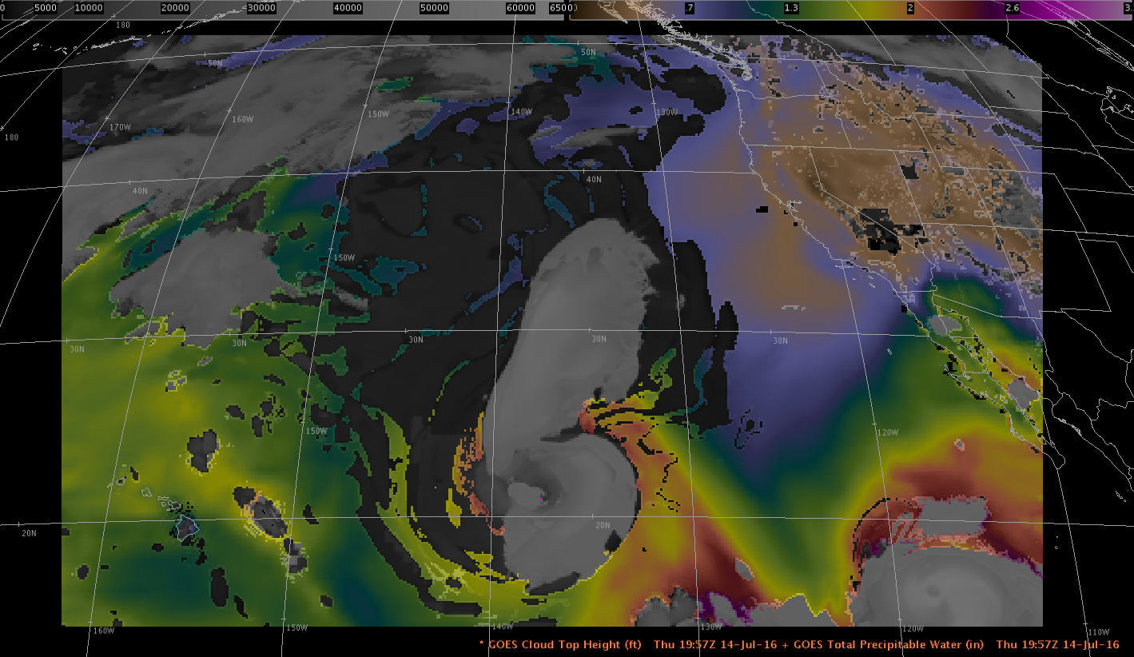
DOE-4 Simulated ABI Derived Products
Cloud Top Height + TPW (Total Precipitable Water)

Slide 39
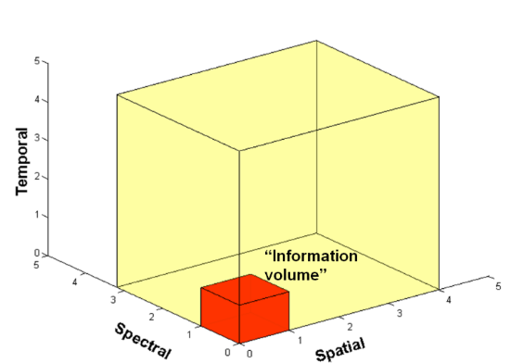
Two Groups of Users of ABI
Direct use:
Radiances/imagery
Numerical models
Forecasters (Civilian, military, private sector, international, etc.)
Broadcasters
General public/private sector/Internet
Derived satellite products
Numerical models
Forecasters (Civilian, military, private sector, international, etc.)
Broadcasters
General public/private sector/Internet
Users of forecast/services which use data/products
Basically everyone!

Slide 40
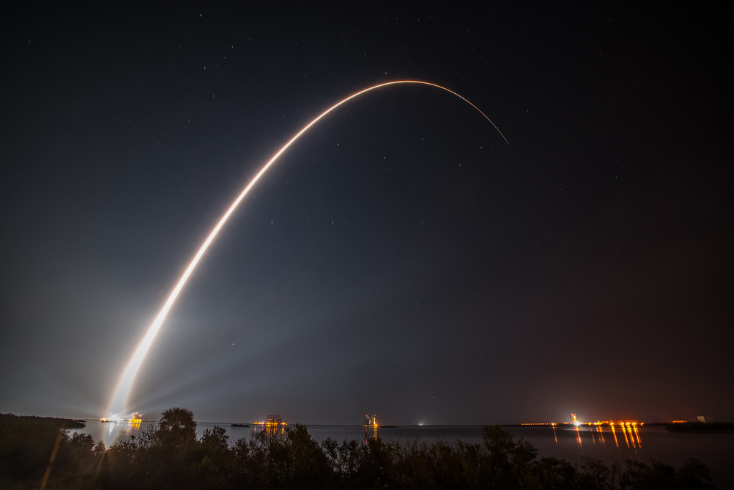
Outline
Introduction
GOES-16 ABI
Spectral
Spatial
Temporal
Products
Summary
GOES-R / NOAA

Slide 41
Summary
1. The GOES-R ABI provides mission continuity
2. Two times the image navigation quality
3. Three times the number of imaging bands
4. Four times the spatial resolutions
5. Five times the coverage rate
- Special GOES-14 1-min data pathfinder
http://www.goes-r.gov

Slide 42
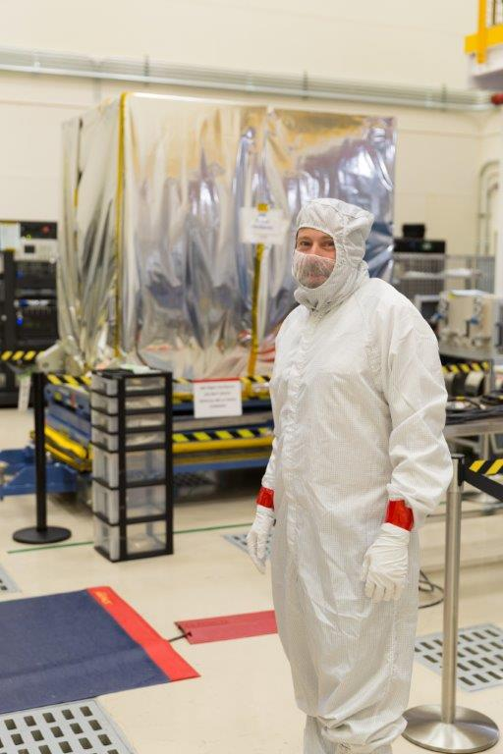
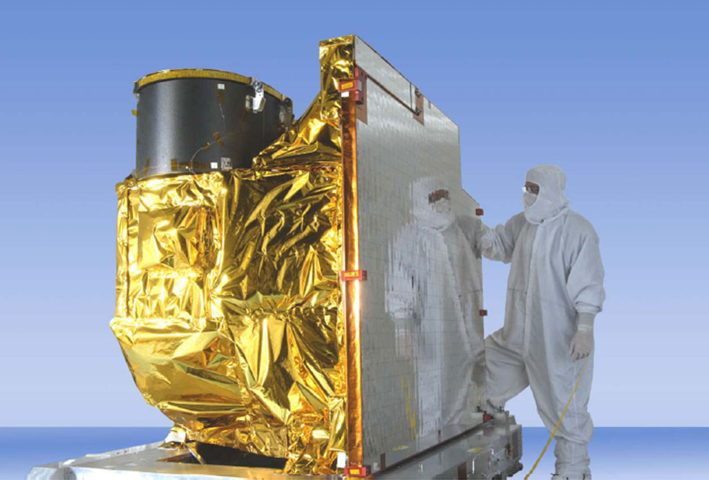
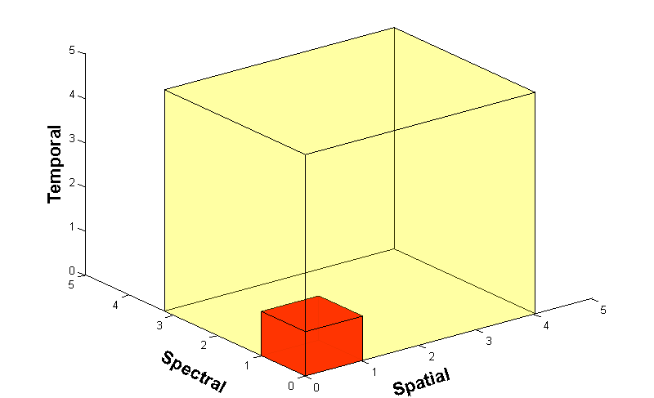
Advanced Baseline Imager (ABI)
ABI on GOES-S
5
4
3
X
Faster coverage (5-minute full disk vs. 25-minute)
X
Improved spatial resolution
(2 km IR vs. 4 km)
X
More spectral bands (16 on ABI vs. 5 on the current imager)
Notes:
Slide from J. Gerth, CIMSS.

Slide 43
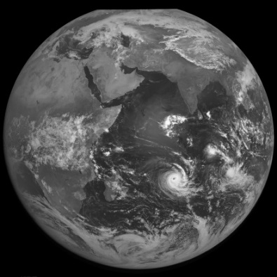
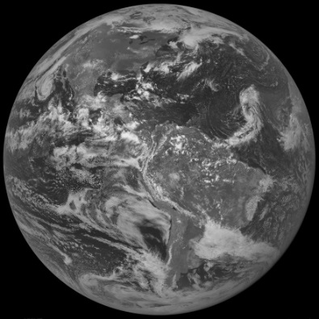
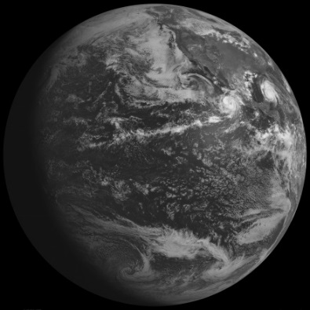
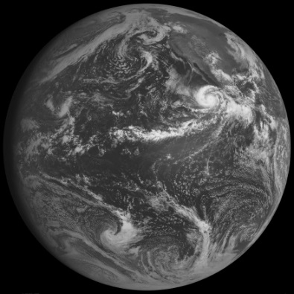
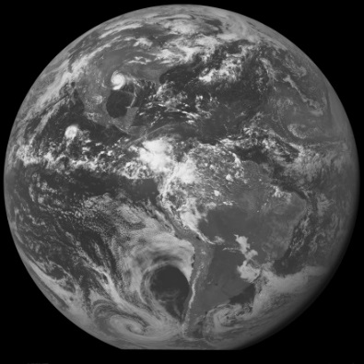
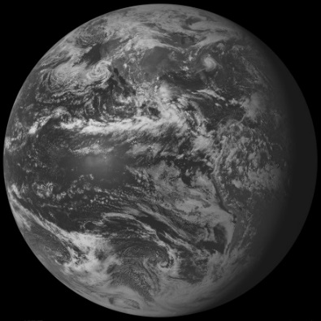
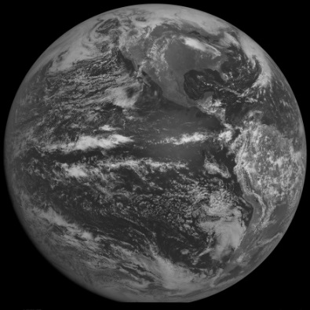
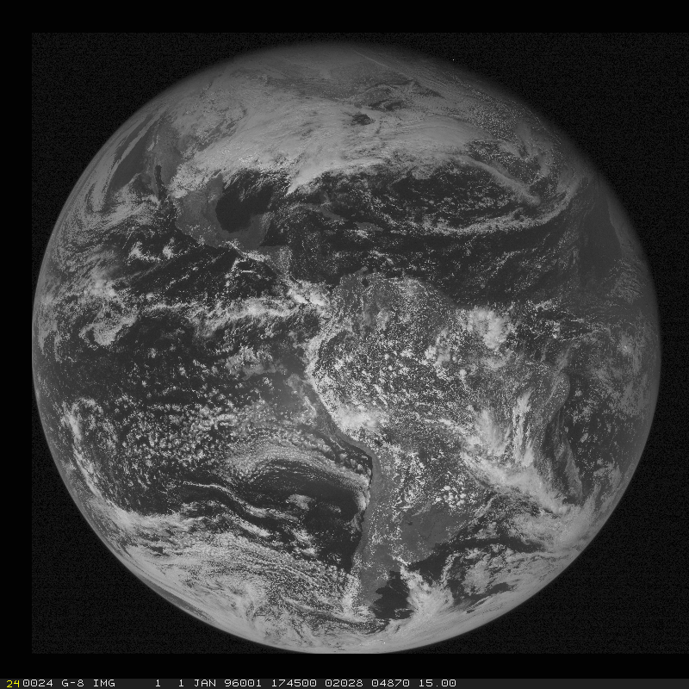
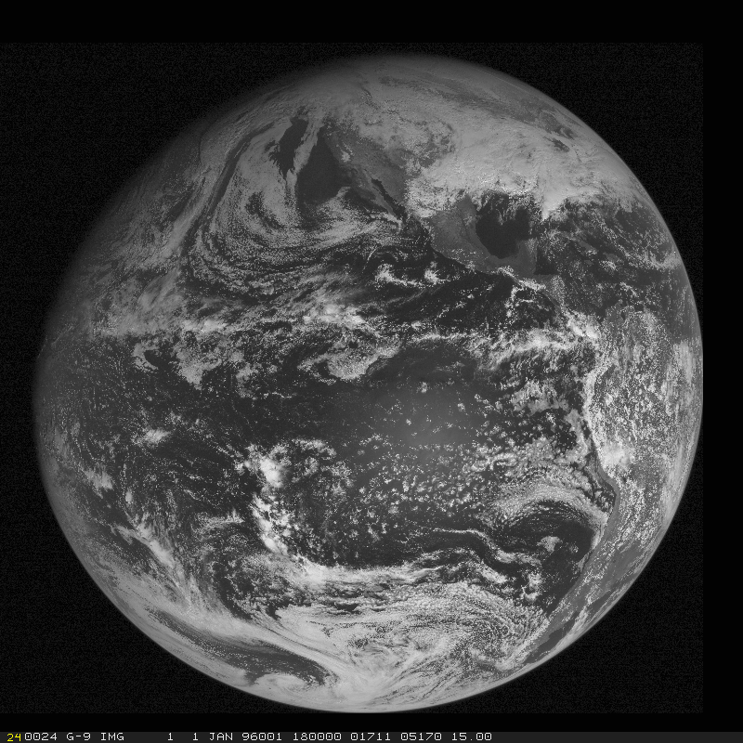
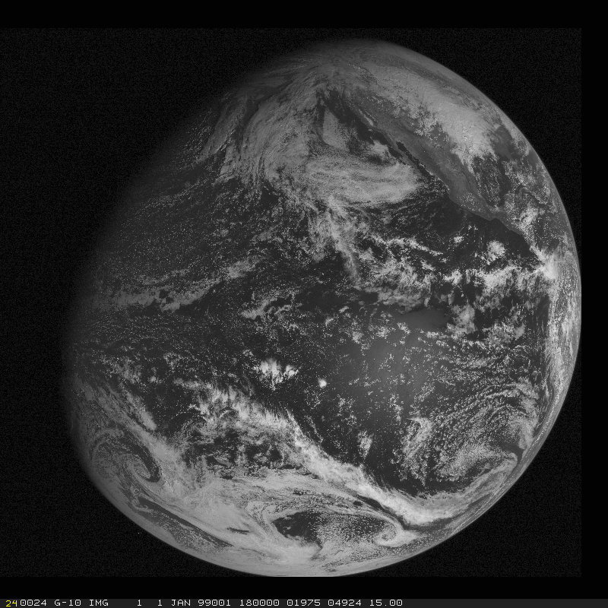
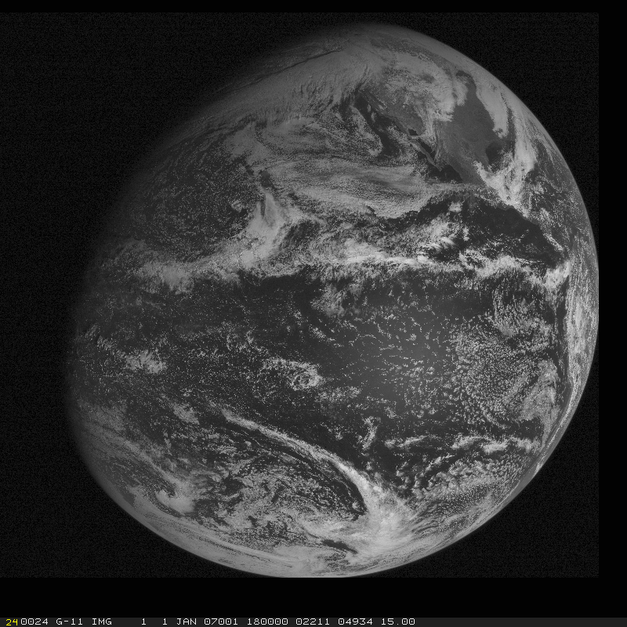
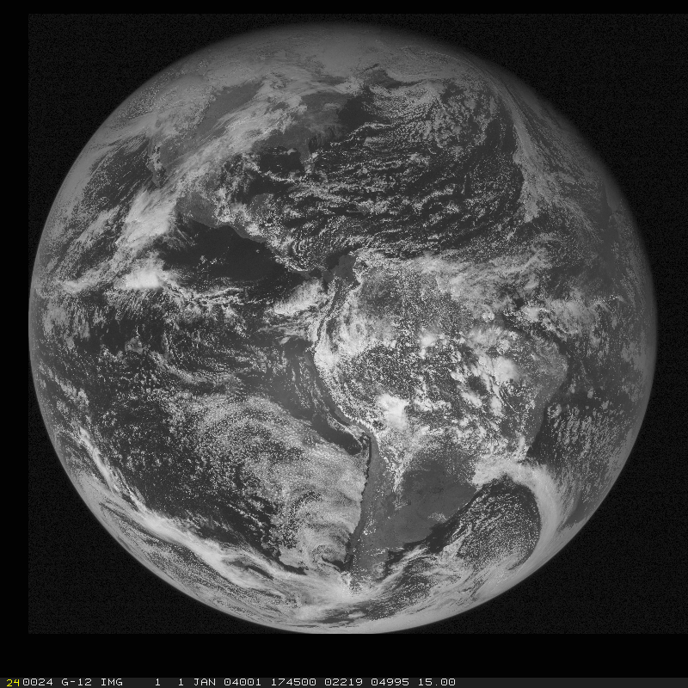
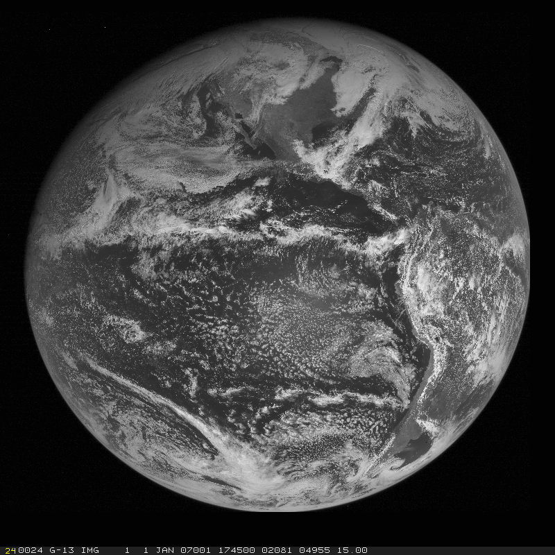
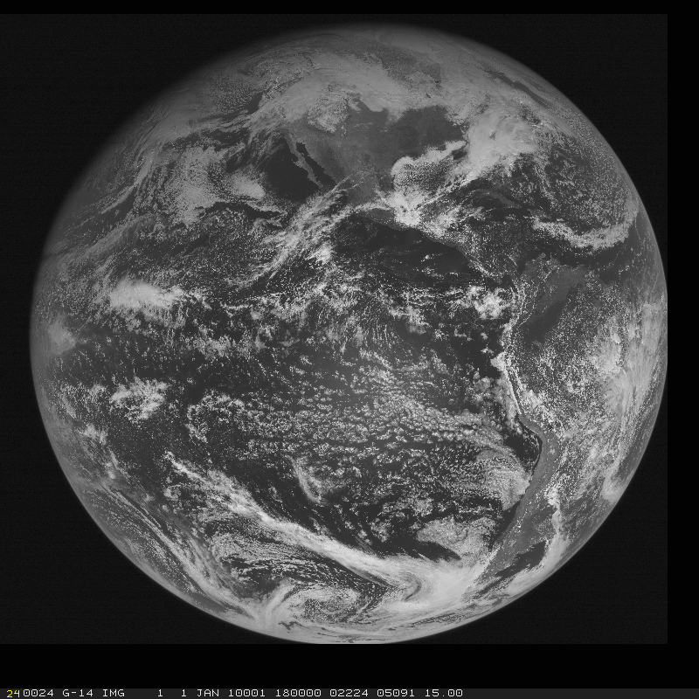
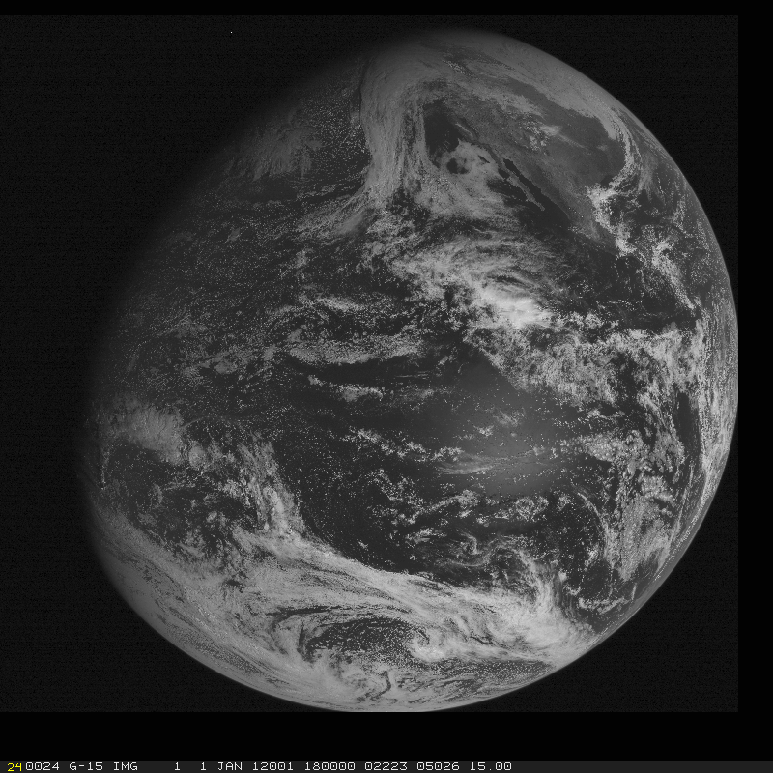
GOES Continuity
GOES-1
GOES-2
GOES-3
GOES-4
GOES-5
GOES-6
GOES-7
GOES-8
GOES-9
GOES-10
GOES-11
GOES-12
GOES-13
GOES-14
GOES-15

Slide 44
GOES Continuity
GOES-1
GOES-2
GOES-3
GOES-4
GOES-5
GOES-6
GOES-7
GOES-8
GOES-9
GOES-10
GOES-11
GOES-12
GOES-13
GOES-14
GOES-15
GOES-16

Slide 45
Conclusions
The ABI on the GOES-R series continues the critical continuity of geostationary imagers and will have huge positive societal impacts, given its improved temporal, spatial, spectral and radiometric attributes.
Impact areas include, but are not limited to: weather, Numerical Weather Prediction, severe weather, hazards (volcanic ash plumes), aviation, environmental (fires), health (smoke), oceanographic, cryosphere, land, etc.
Part of a global constellation.

Slide 46
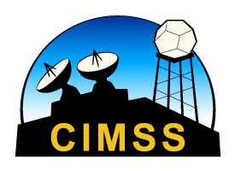
Thanks to…
Thousands who helped with the ABI on the GOES-R series.
These logos aren’t meant to cover everyone, but represent the contributions of many, from the government, private industry and academia.

Slide 47
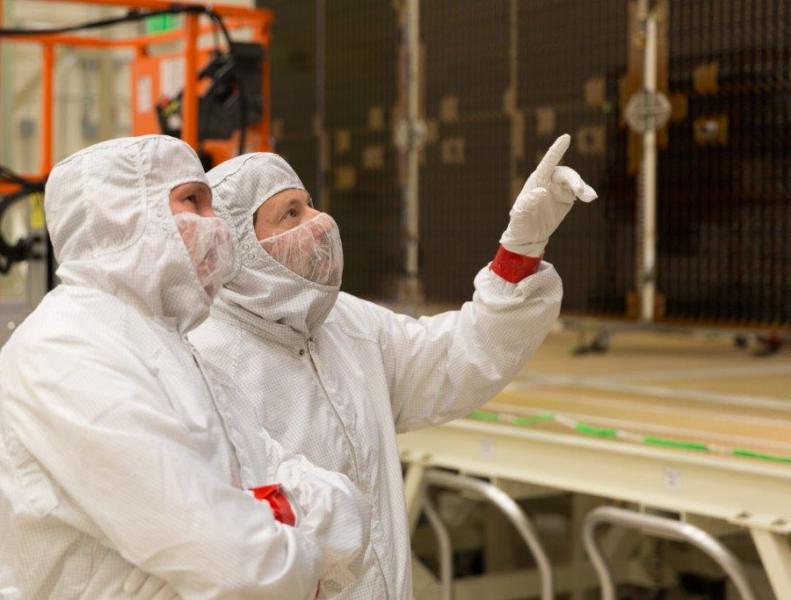
GOES-R Series web site
http://www.goes-r.gov
Lockheed Martin

