Slide 1
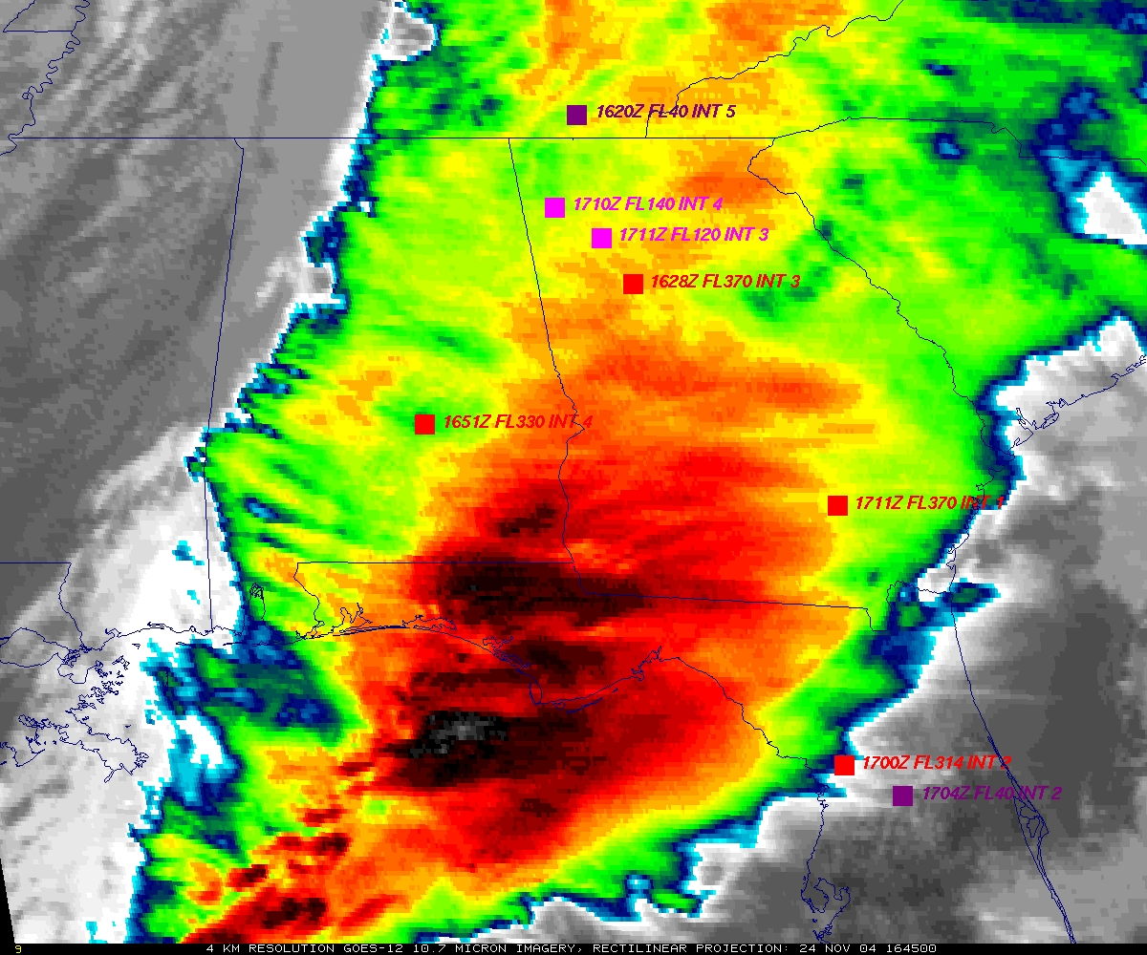
GOES
Figure courtesy of K. Bedka and W. Feltz

Slide 2
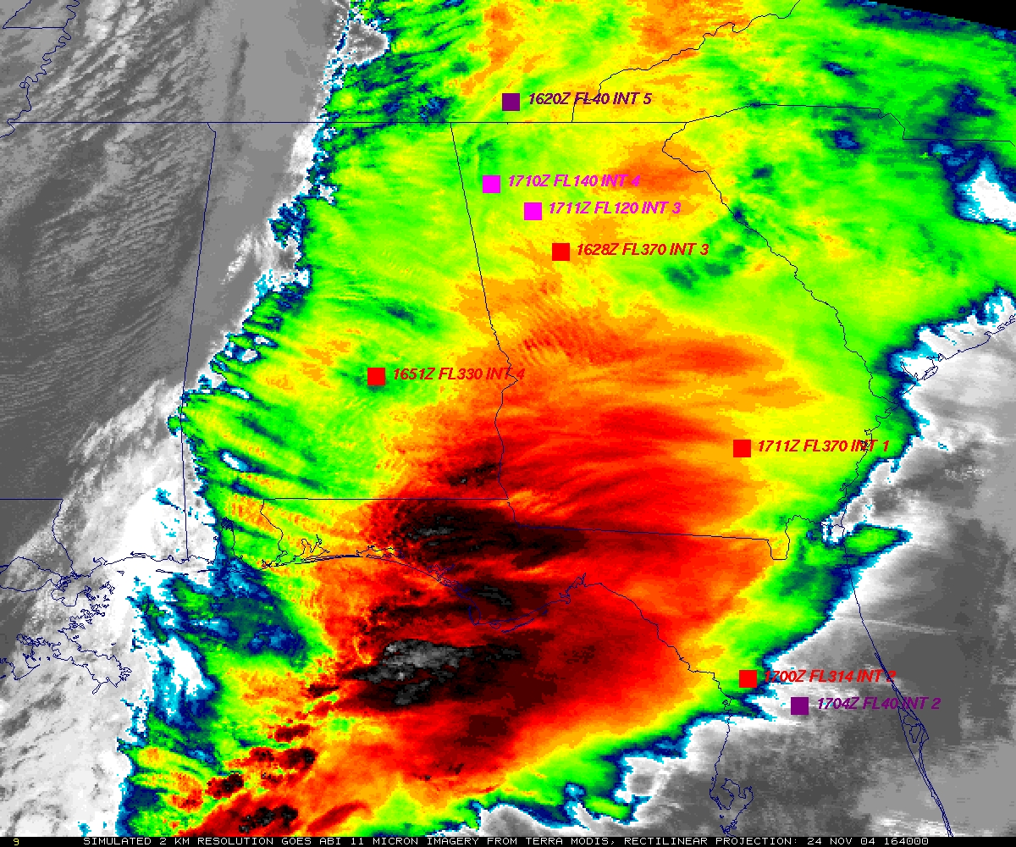
“ABI” from MODIS
Figure courtesy of K. Bedka and W. Feltz

Slide 3
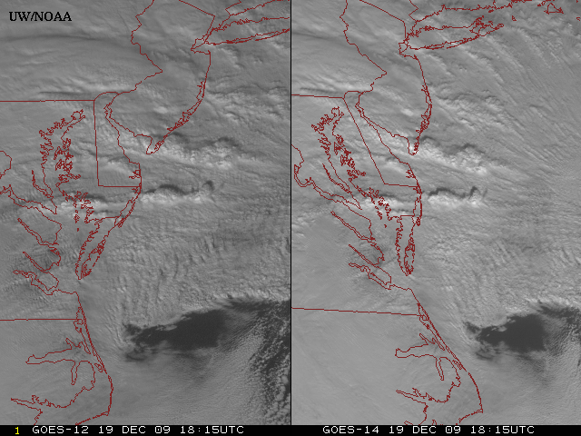
Sample “1-min” imagery
GOES-12
GOES-14
Visible data from the GOES-14 NOAA Science Test, lead by Hillger and Schmit
Notes:
Note the number of different levels of motion you can see (the cyclonic low level circulation over the ocean through the breaks in the higher clouds)... and you can't distinguish those on the GOES-12 loop.

Slide 4
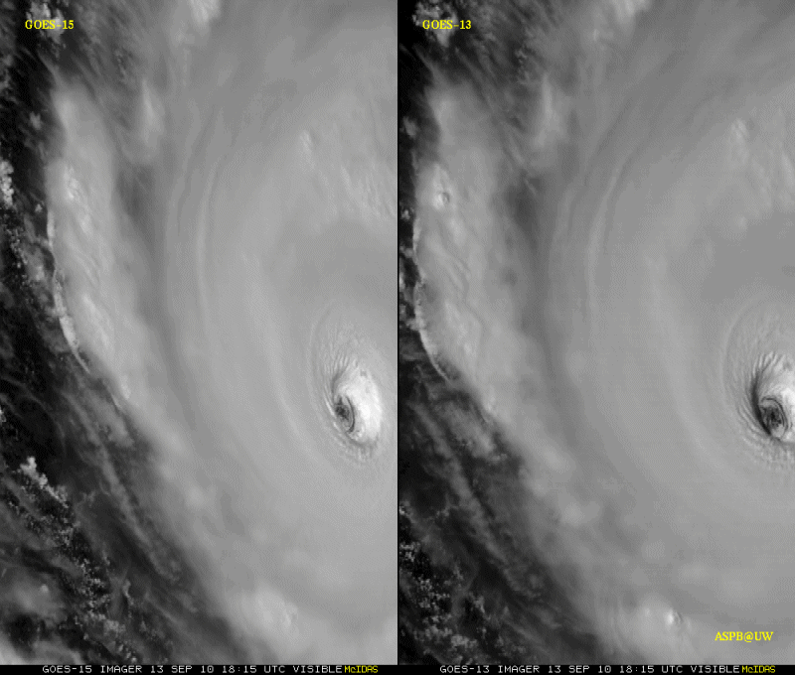
Sample “1-min” imagery
1-min
30-min
Visible data from the GOES-15 NOAA Science Test, lead by Hillger and Schmit
Notes:
Igor

Slide 5
ABI “Baseline” Products
Wavelength Micrometers | 0.47 | 0.64 | 0.865 | 1.378 | 1.61 | 2.25 | 3.90 | 6.185 | 6.95 | 7.34 | 8.5 | 9.61 | 10.35 | 11.2 | 12.3 | 13.3
Channel ID | 1 | 2 | 3 | 4 | 5 | 6 | 7 | 8 | 9 | 10 | 11 | 12 | 13 | 14 | 15 | 16
Baseline Products
Aerosol Detection | ✓ | ✓ | ✓ | ✓ | ✓ | ✓ | ✓ |  |  |  |  |  |  | ✓ | ✓
Aerosol Optical Depth | ✓ | ✓ | ✓ |  | ✓ | ✓
Clear Sky Masks |  | ✓ |  | ✓ | ✓ |  | ✓ |  | ✓ | ✓ | ✓ |  |  | ✓ | ✓
Cloud & Moisture Imagery | ✓ | ✓ | ✓ | ✓ | ✓ | ✓ | ✓ | ✓ | ✓ | ✓ | ✓ | ✓ | ✓ | ✓ | ✓ | ✓
Cloud Optical Depth |  | ✓ |  |  |  | ✓ | ✓ |  |  |  |  |  |  | ✓ | ✓
Cloud Particle Size Dist. |  | ✓ |  |  |  | ✓ | ✓ |  |  |  |  |  |  | ✓ | ✓
Cloud Top Phase |  |  |  |  |  |  |  |  |  | ✓ | ✓ |  |  | ✓ | ✓
Cloud Top Height |  |  |  |  |  |  |  |  |  |  |  |  |  | ✓ | ✓ | ✓
Cloud Top Pressure |  |  |  |  |  |  |  |  |  |  |  |  |  | ✓ | ✓ | ✓
Cloud Top Temperature |  |  |  |  |  |  |  |  |  |  |  |  |  | ✓ | ✓ | ✓
Hurricane Intensity |  |  |  |  |  |  |  |  |  |  |  |  | ✓
Rainfall Rate/QPE |  |  |  |  |  |  |  | ✓ |  | ✓ | ✓ |  |  | ✓ | ✓
Legacy Vertical Moisture Profile |  |  |  |  |  |  |  | ✓ | ✓ | ✓ | ✓ | ✓ | ✓ | ✓ | ✓ | ✓
Legacy Vertical Temp Profile |  |  |  |  |  |  |  | ✓ | ✓ | ✓ | ✓ | ✓ | ✓ | ✓ | ✓ | ✓
Derived Stability Indices |  |  |  |  |  |  |  | ✓ | ✓ | ✓ | ✓ | ✓ | ✓ | ✓ | ✓ | ✓
Total Precipitable Water |  |  |  |  |  |  |  | ✓ | ✓ | ✓ | ✓ | ✓ | ✓ | ✓ | ✓ | ✓
Downward Solar Insolation Surf | ✓ | ✓ | ✓ |  | ✓ | ✓
Reflected Solar Insolation TOA | ✓ | ✓ | ✓ |  | ✓ | ✓
Derived Motion Winds |  | ✓ |  |  |  |  | ✓ | ✓ | ✓ | ✓ |  |  |  | ✓
Fire Hot Spot Characterization |  | ✓ |  |  |  |  | ✓ |  |  |  |  |  |  | ✓ | ✓
Land Surface Temperature |  |  |  |  |  |  |  |  |  |  |  |  |  | ✓ | ✓
Snow Cover | ✓ | ✓ | ✓ |  | ✓ | ✓ | ✓ |  |  |  |  |  | ✓
Sea Surface Temperature |  |  |  |  |  |  | ✓ |  |  |  | ✓ |  | ✓ | ✓ | ✓
Volcanic Ash: Detection/Height |  |  |  |  |  |  |  |  |  | ✓ | ✓ |  |  | ✓ | ✓ | ✓
Radiances | ✓ | ✓ | ✓ | ✓ | ✓ | ✓ | ✓ | ✓ | ✓ | ✓ | ✓ | ✓ | ✓ | ✓ | ✓ | ✓
Bands may also be used by needed “upstream” products, such as the cloud mask.

Slide 6
ABI “Future Capability” Products
Wavelength Micrometers | 0.47 | 0.64 | 0.865 | 1.378 | 1.61 | 2.25 | 3.90 | 6.185 | 6.95 | 7.34 | 8.5 | 9.61 | 10.35 | 11.2 | 12.3 | 13.3
Channel ID | 1 | 2 | 3 | 4 | 5 | 6 | 7 | 8 | 9 | 10 | 11 | 12 | 13 | 14 | 15 | 16
Future Capability Products
Cloud Layer/Heights |  |  |  |  |  |  |  |  |  |  |  |  |  | ✓ | ✓ | ✓
Cloud Ice Water Path |  |  |  |  |  |  | ✓ |  |  |  |  |  |  | ✓ | ✓
Cloud Liquid Water |  | ✓ |  |  |  | ✓ |  |  |  |  | ✓
Cloud Type |  |  |  |  |  |  |  |  |  | ✓ | ✓ |  |  | ✓ | ✓
Convective Initiation |  |  |  |  |  |  |  | ✓ | ✓ | ✓ | ✓ | ✓ |  | ✓ | ✓ | ✓
Trop. Fold Turbulence |  |  |  |  |  |  |  | ✓
Low Cloud and Fog |  | ✓ |  |  |  |  | ✓
Enhanced-V/Overshooting Top |  |  |  |  |  |  |  |  |  |  |  |  |  | ✓
Aircraft Icing Threat |  | ✓ |  |  |  | ✓ | ✓ |  |  | ✓ | ✓ |  |  | ✓ | ✓ | ✓
SO₂ Detection |  |  |  |  |  |  |  | ✓ |  | ✓ | ✓ |  |  | ✓ | ✓
Visibility (no direct use of ABI bands)
Upward Longwave Radiation (TOA) |  |  |  |  |  |  |  | ✓ |  | ✓ | ✓ |  | ✓ |  |  | ✓
Downward Longwave Radiation (SFC) |  |  |  |  |  |  |  |  | ✓ | ✓ | ✓ | ✓ | ✓ | ✓ | ✓ | ✓
Upward Longwave Radiation (SFC) |  |  |  |  |  |  |  |  |  |  | ✓ |  | ✓ | ✓ | ✓
Total Ozone |  |  |  |  |  |  |  | ✓ | ✓ | ✓ |  | ✓ | ✓ | ✓ | ✓ | ✓
Aerosol Particle Size | ✓ | ✓ | ✓ |  | ✓ | ✓
Surface Emissivity |  |  |  |  |  |  |  | ✓ | ✓ | ✓ | ✓ | ✓ | ✓ | ✓ | ✓ | ✓
Surface Albedo | ✓ | ✓ | ✓ |  | ✓ | ✓
Vegetation Index |  | ✓ | ✓
Vegetation Green Fraction |  | ✓ | ✓
Flood/Standing Water |  | ✓ | ✓ |  | ✓ |  |  |  |  |  |  |  |  | ✓ | ✓
Rainfall Potential (no direct use of ABI bands) |  |  |  |  |  |  |  | ✓ |  | ✓ | ✓ |  |  | ✓ | ✓
Rainfall Probability (no direct use of ABI bands) |  |  |  |  |  |  |  | ✓ |  | ✓ | ✓ |  |  | ✓ | ✓
Snow Depth (no direct use of ABI bands) | ✓ | ✓ | ✓ |  | ✓ | ✓ | ✓ |  |  |  |  |  | ✓
Sea & Lake Ice: Age (no direct use of ABI bands) |  | ✓ | ✓ |  | ✓ |  |  |  |  |  |  |  |  | ✓ | ✓
Sea & Lake Ice: Concentration |  | ✓ | ✓ |  | ✓ |  |  |  |  |  |  |  |  | ✓ | ✓
Sea & Lake Ice: Motion |  |  |  |  |  |  |  |  |  |  |  |  |  | ✓
Ocean Currents |  |  |  |  |  |  |  |  |  |  |  |  |  | ✓
Ocean Currents: Offshore |  |  |  |  |  |  |  |  |  |  |  |  |  | ✓
Absorbed Shortwave Radiation | ✓ | ✓ | ✓ | ✓ | ✓ | ✓
Ice Cover |  | ✓ | ✓ |  | ✓ |  |  |  |  |  |  |  |  | ✓ | ✓

Slide 7
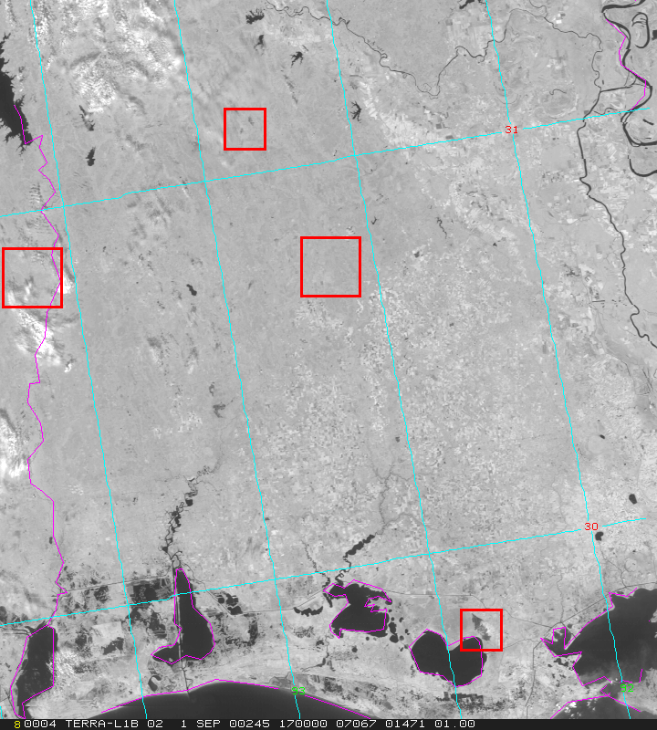
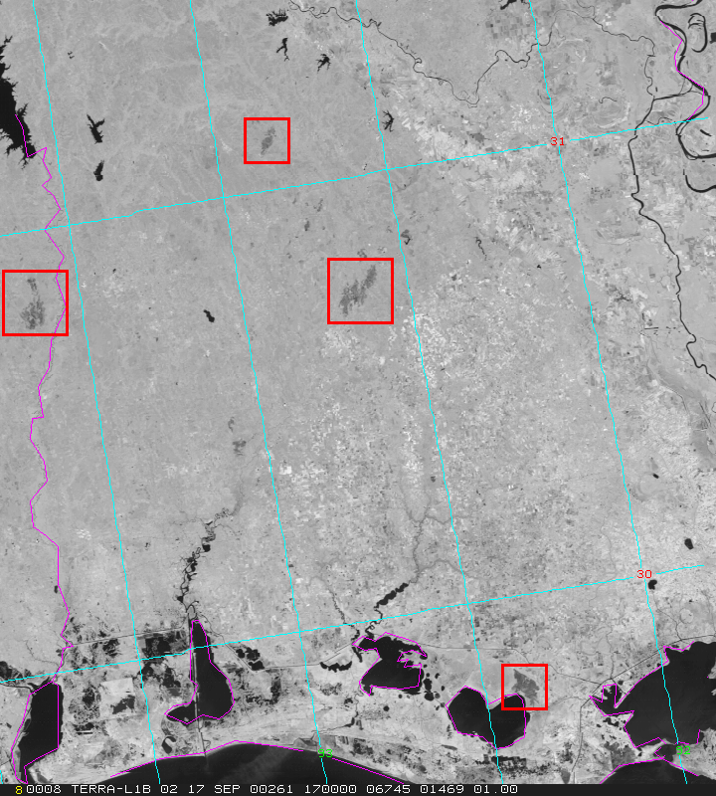
MODIS Detects Burn Scars in Louisiana
01 September 2000-- Pre-burning
17 September 2000-- Post-burning
Burn Scars
ABI will allow for diurnal characterizations of burn areas, this has implications for re-growth patterns.
Scars (dark regions) caused by biomass burning in early September are
evident in MODIS 250 m NIR channel 2 (0.85 μm) imagery on the 17th.
CIMSS, UW
MODIS Data from GSFC DAAC
Notes:
Figures from Chris Moeller, of CIMSS. The traditional visible 0.6um band does not show the burn scars (not shown).

