Slide 1
GOES-R ABI “Flex” Mode (3) “CONUS” Coverage:
Increase separation between CONUS views from West and East
Timothy J. Schmit (tim.j.schmit@noaa.gov)
NOAA/NESDIS
Satellite Applications and Research
Advanced Satellite Products Branch (ASPB)
Madison, WI
Jordan Gerth, Mat Gunshor, Kaba Bah, Will Straka and several others
CIMSS
March 28, 2014

Slide 2
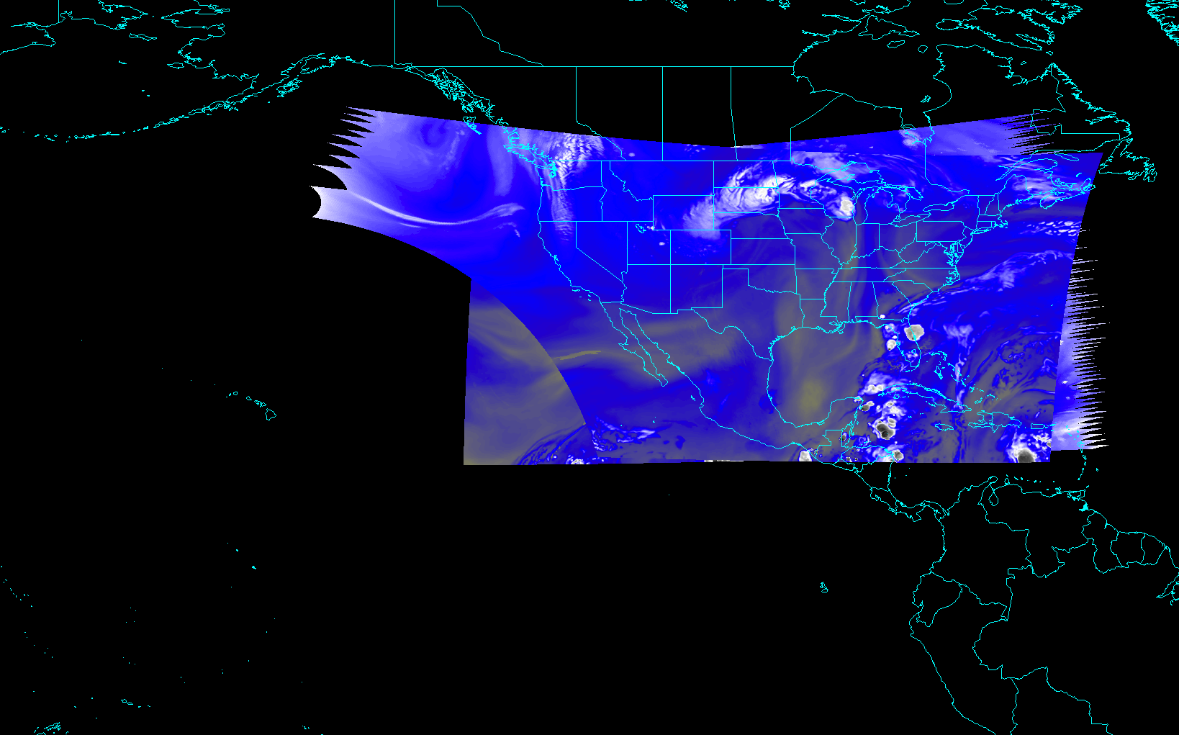
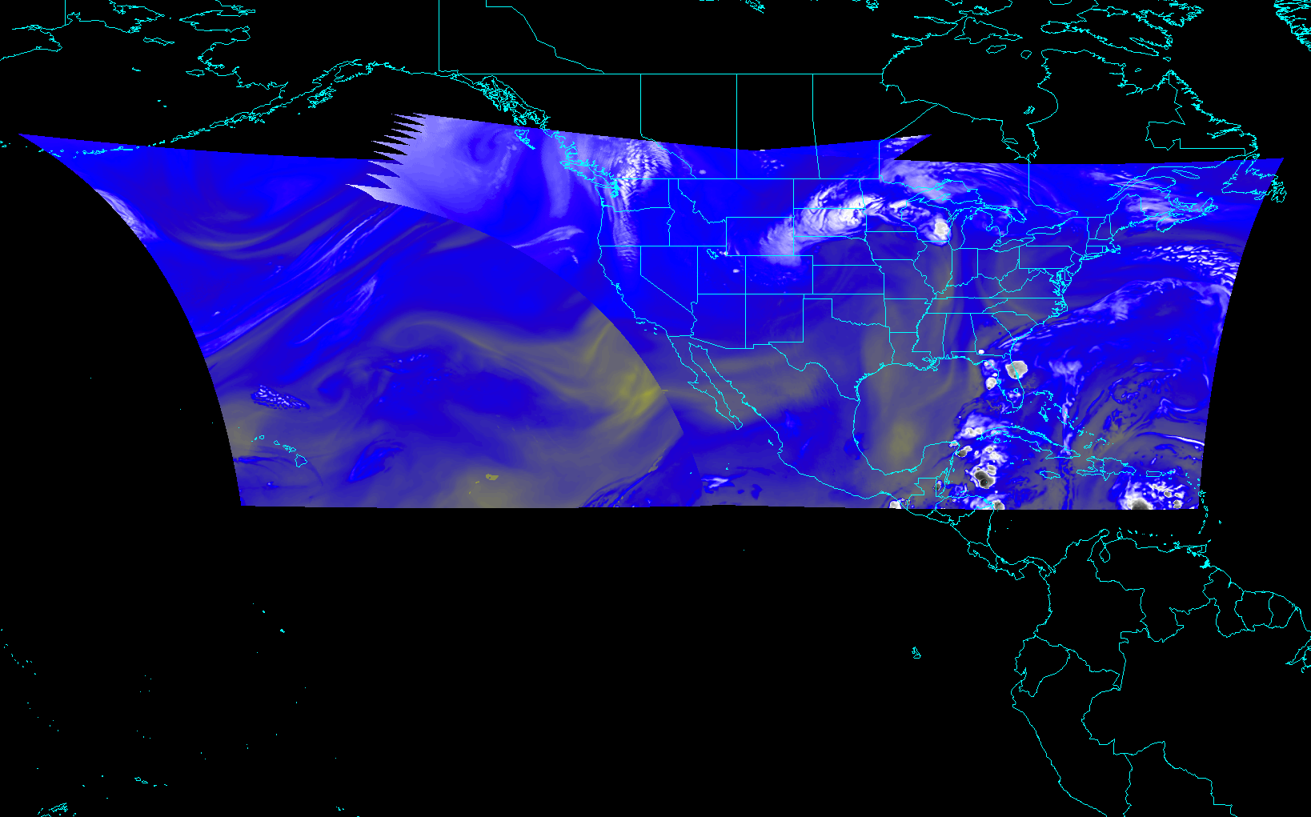
Outline
Background
Concerns/Solution
Proposal
Exploratory Scan Modes
Conclusions
Back-up material
current
proposed

Slide 3
Background
Current plans for the center point of the GOES-R CONUS sectors from both the East and West satellites are centered over CONUS.
This implies a ‘one-satellite’ system and not the planned ‘two-satellite’ system. And hence a change should be considered to be more consistent with today’s GOES operations.
Instrument and ground system can support a shift of these center points. A ground system change would be needed to change the shape or timing of a CONUS sector.

Slide 4
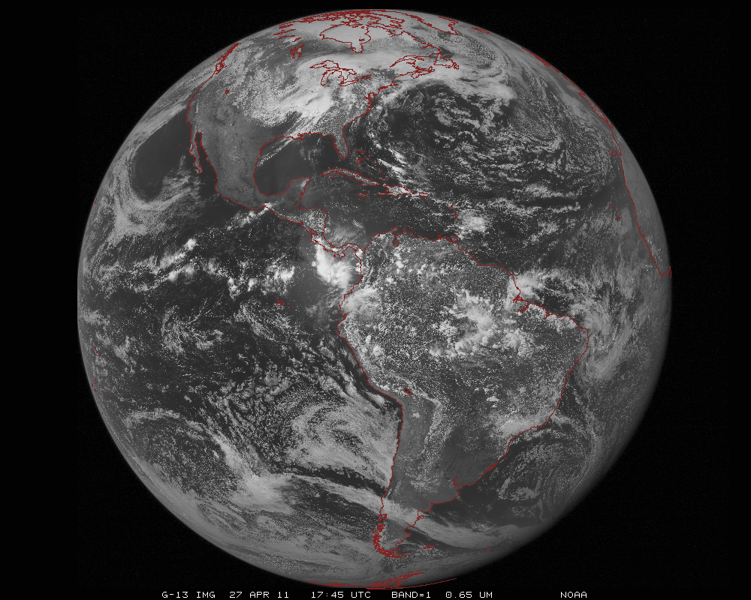
ABI scans about 5 times faster
than the current GOES imager
Scan mode (3) for the ABI:
- Full disk images every 15 minutes + 5 min CONUS images + mesoscale.

Slide 5
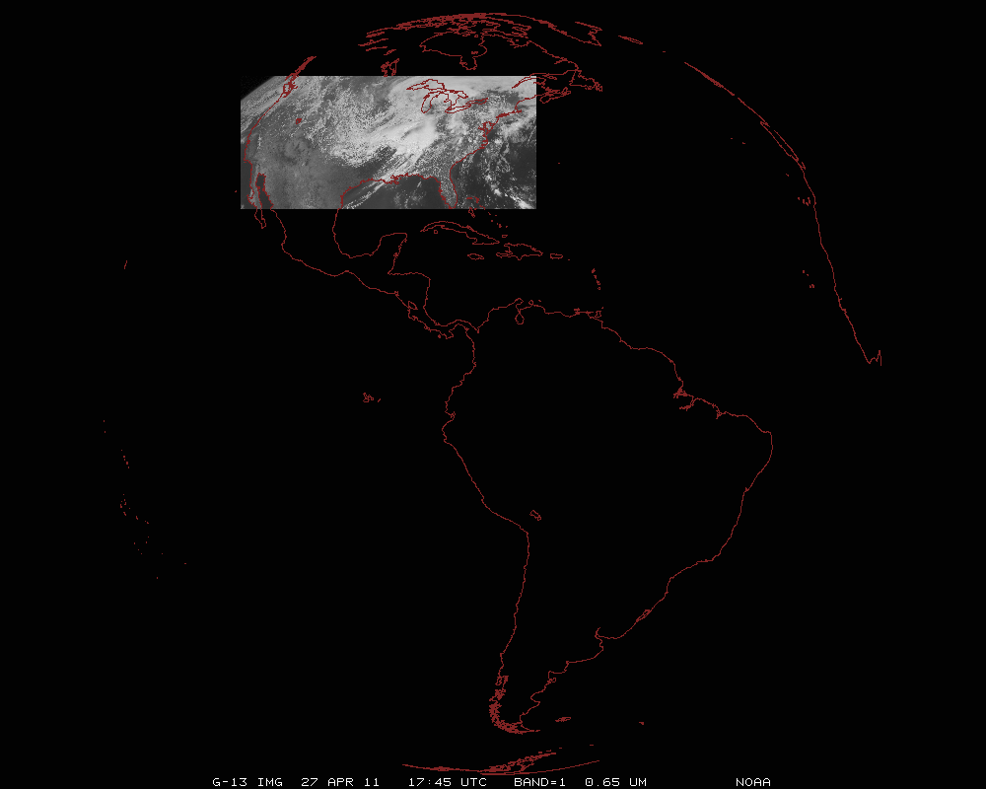
ABI can offer Continental US images every 5 minutes for routine monitoring of a wide range of events (storms, dust, clouds, fires, winds, etc).
This is every 15 or 30 minutes with the current GOES in routine mode.
Notes:
Approx. size of CONUS

Slide 6
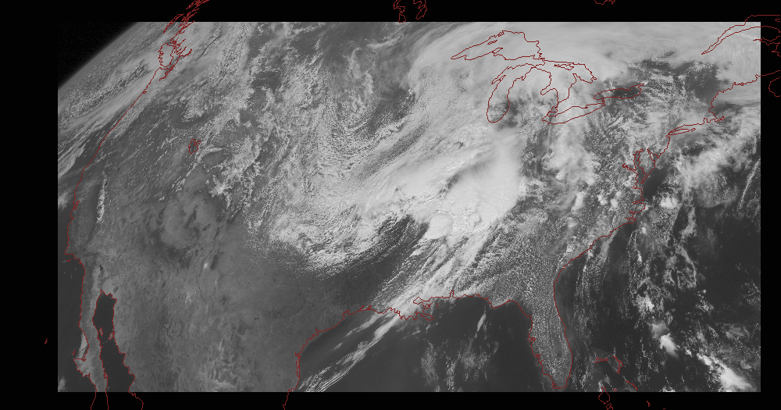
Notes:
Approx. size of CONUS

Slide 7
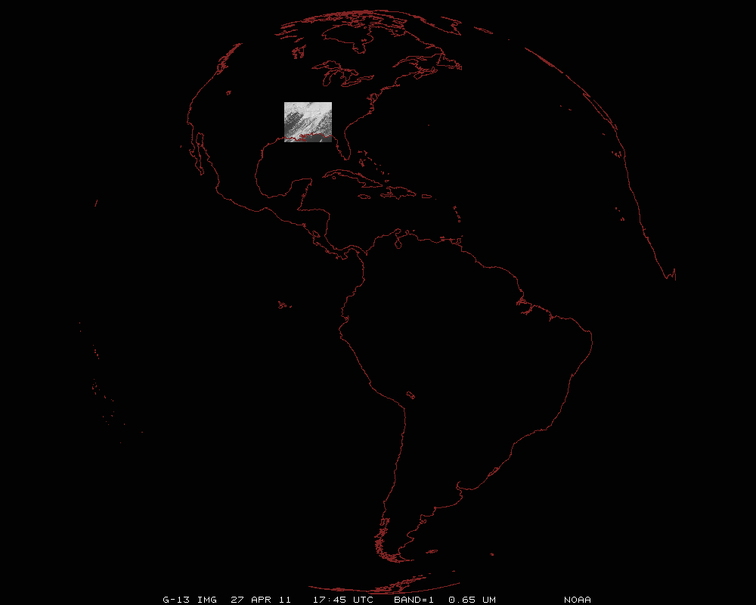
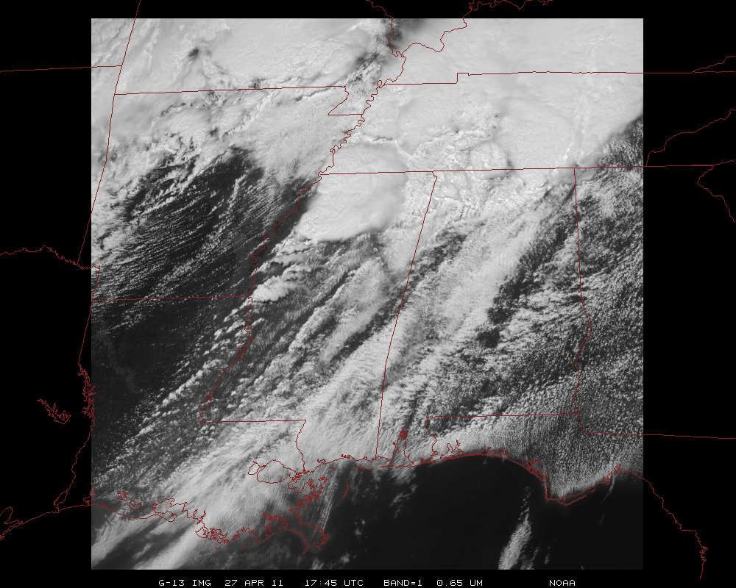
Mesoscale images every 30 seconds for rapidly changing phenomena
(thunderstorms, hurricanes, fires, etc). Or two regions every 60 seconds.
Notes:
Approx. size of meso-scale showing “Franklin”.

Slide 8
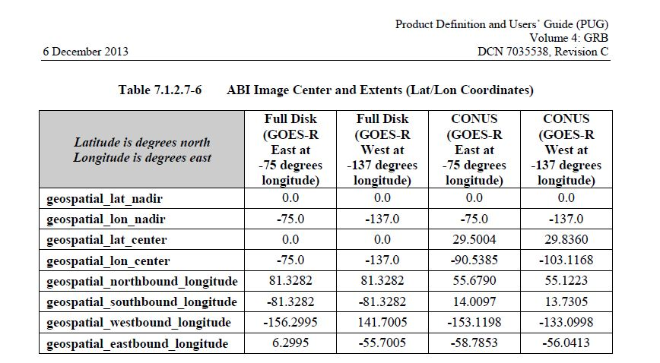
Volume 4 of the PUG (version C)
http://www.goes-r.gov/users/docs/PUG-GRB-vol4-verC.pdf

Slide 9
Concerns/Solutions
Current plans for the ABI on GOES-R call for all of the CONUS to be scanned by both the GOES-West and –East (most likely at the same time), while not scanning important parts of the Pacific (as we scan today)
Consider optimizing the planned ABI CONUS sector
(e.g., moving the GOES-West ‘CONUS’ sector towards the west and GOES-East ‘CONUS’ sector slightly east)
Time is of the essence if these schedules are to modified (requirement documents, test data, data flow, etc.)

Slide 10
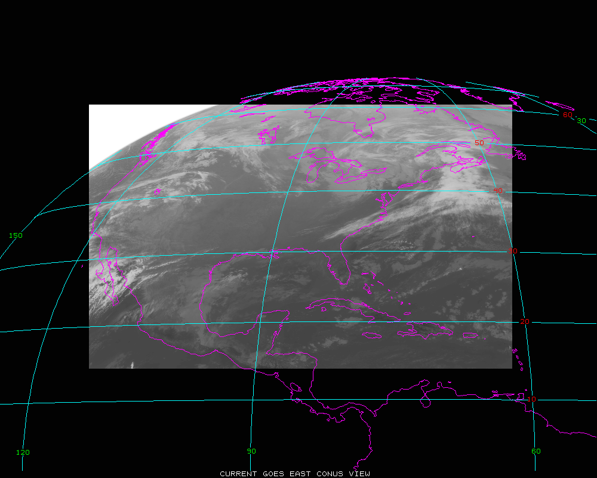
Current GOES CONUS from East
Note coverage east of Puerto Rico

Slide 11
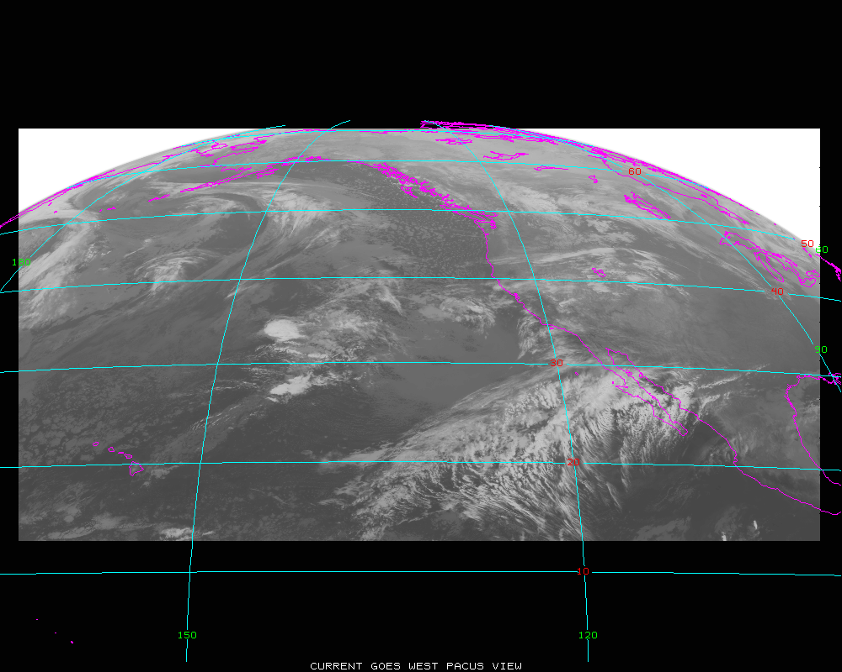
Current GOES PACUS from West
Note coverage both east and west of Hawaii

Slide 12
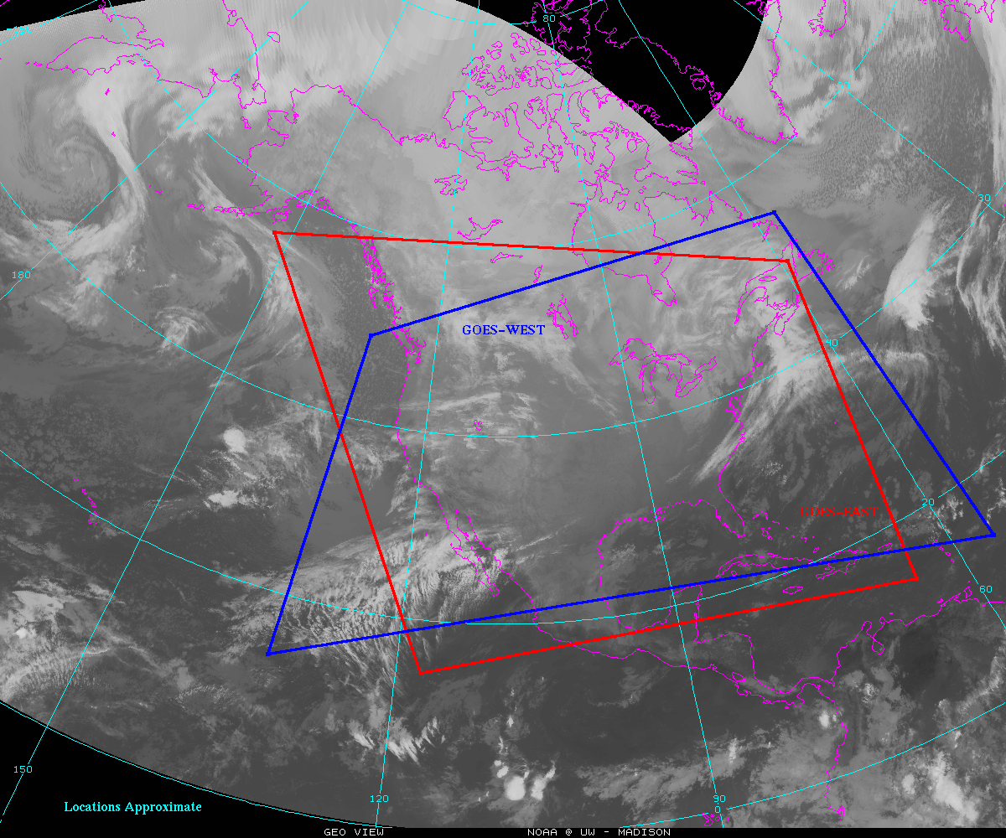
Current Plans for ABI CONUS sectors
space
space
space
Note lack on coverage of Hawaii and much of the eastern Pacific

Slide 13
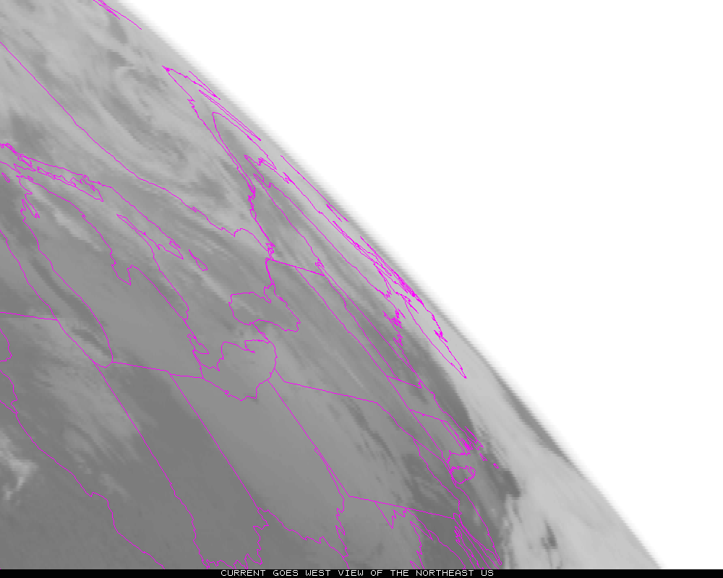
Current view of Northeast US from 135W
Note very poor view angle from a Western GOES

Slide 14
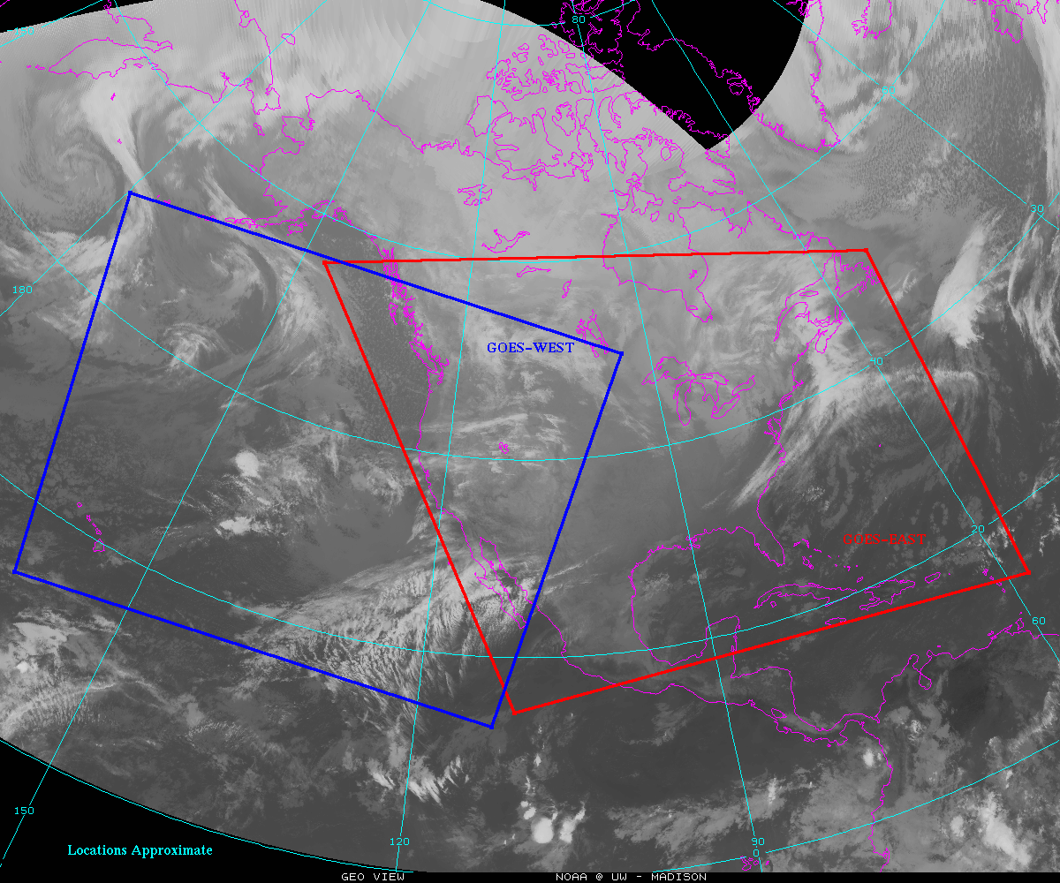
Option for moving ABI from GOES-West to the West (and East sector to the East)
PROPOSED

Slide 15
Option for moving ABI from GOES-West to the West (and East sector to the East) with potential/re-locatable Alaska one-minute mesoscale sector (approximate coverage)
PROPOSED

Slide 16
Option for moving ABI from GOES-West to the West (and East sector to the East) with potential/re-locatable Alaska one-minute mesoscale sector (approximate coverage) and additional sector for Hawaii or American Samoa from West and two locations via the Eastern satellite
PROPOSED
Notes:
Of course there would also be 2 meso possible from the ABI at GOES-East

Slide 17
Current Plans for ABI CONUS sectors
space
space
space

Slide 18
Proposal
Move the GOES-West ‘CONUS’ sector to the west, to get less overlap over CONUS and extend coverage over the North Pacific (including Hawaii)
Move the GOES-East CONUS sector to the east, to get less overlap and more coverage to the east of Puerto Rico and for tropical waves/TC

Slide 19
ABI CONUS Center Points
Satellite | Current | Current | Proposed | Proposed
 | Latitude | Longitude | Latitude | Longitude
GOES-West | 29.5004 | -103.1168 (PUG via lat/long) | 30.0 | -137.0
GOES-East | 29.8360 | -90.5385 | 30.0 | -87.0

Slide 20
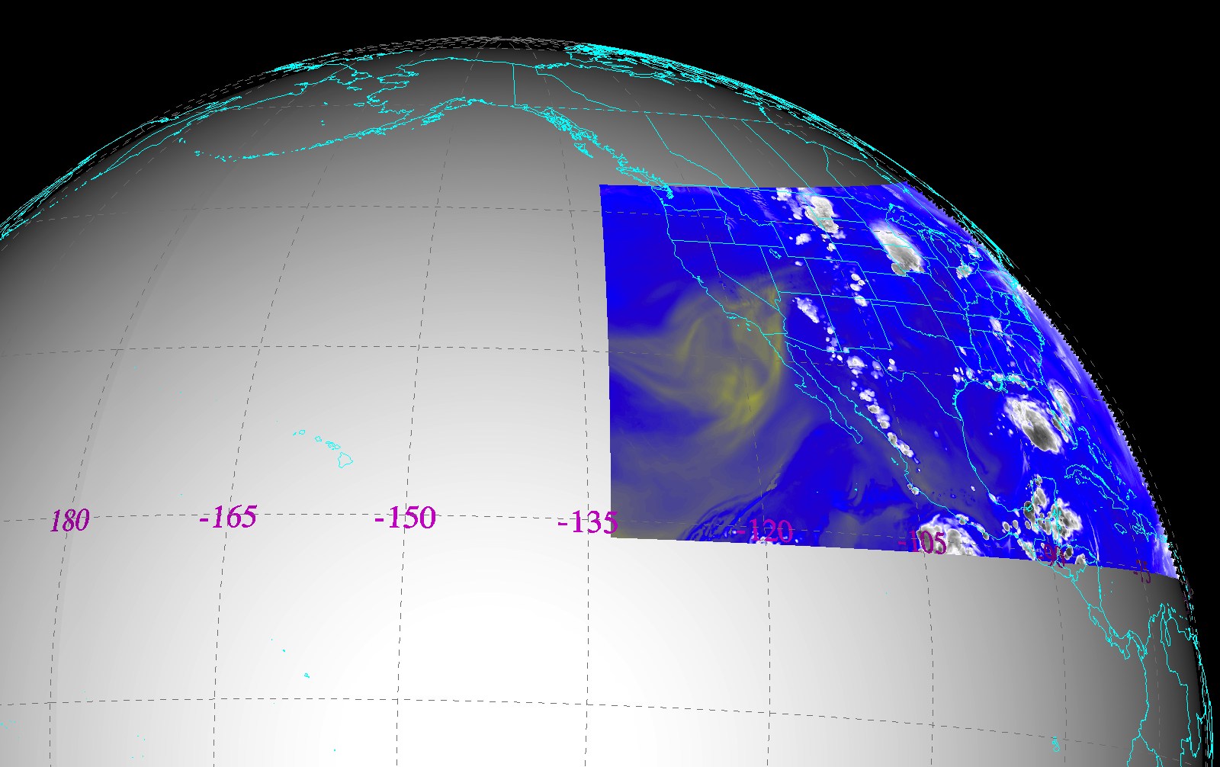
CONUS from West (current plan)
Simulated ABI band 9 (7 micrometer) brightness temperature at 21:45 UTC
Notes:
Imagery shown in McIDAS-V

Slide 21
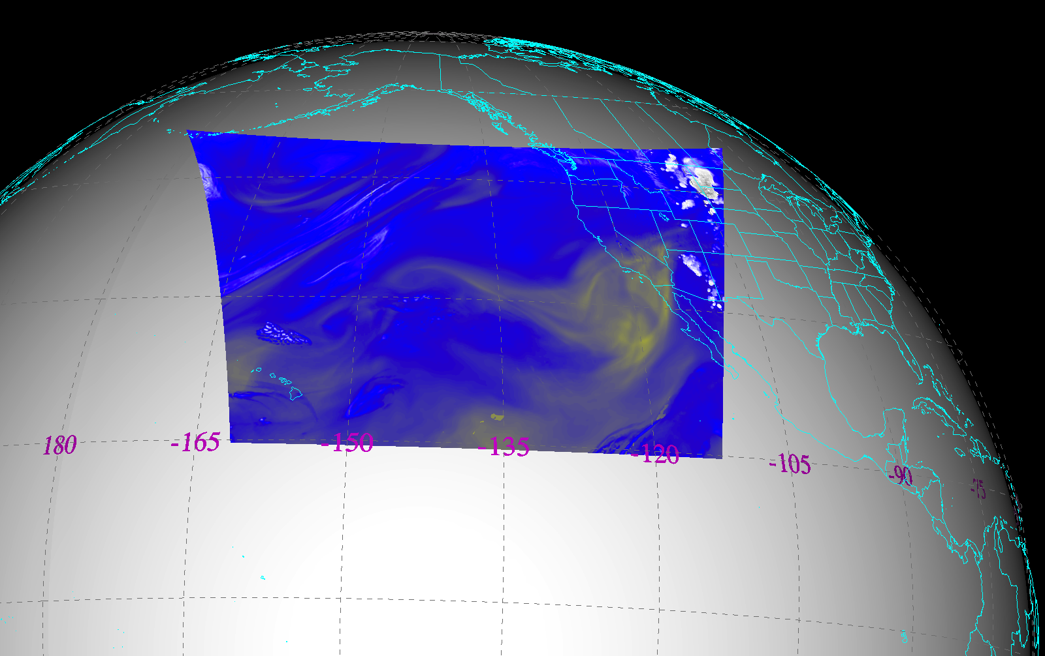
CONUS from West (proposed)
Simulated ABI band 9 (7 micrometer) brightness temperature at 21:45 UTC
Notes:
Imagery shown in McIDAS-V

Slide 22
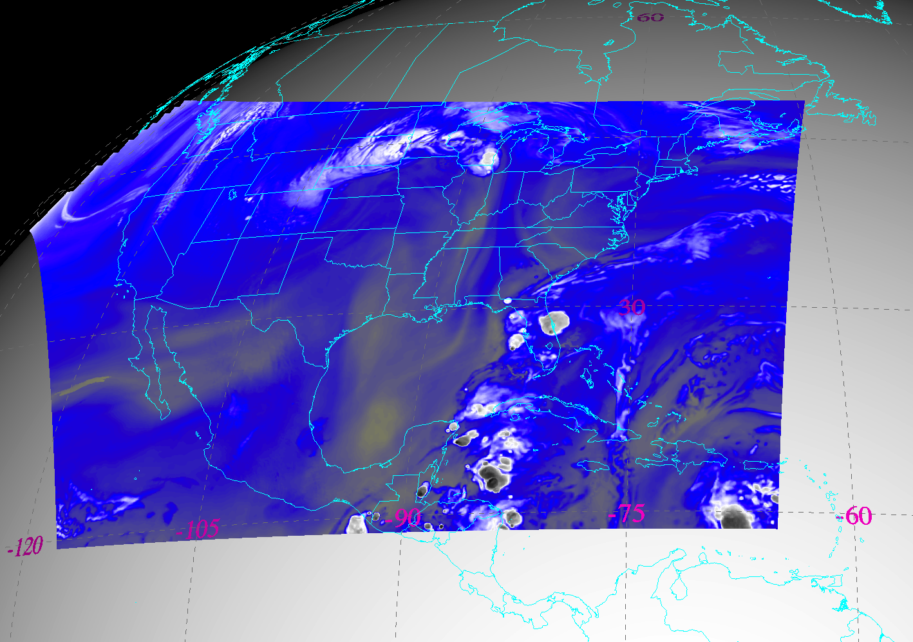
CONUS from East (current plan)
Simulated ABI band 9 (7 micrometer) brightness temperature at 21:45 UTC
Notes:
Imagery shown in McIDAS-V

Slide 23
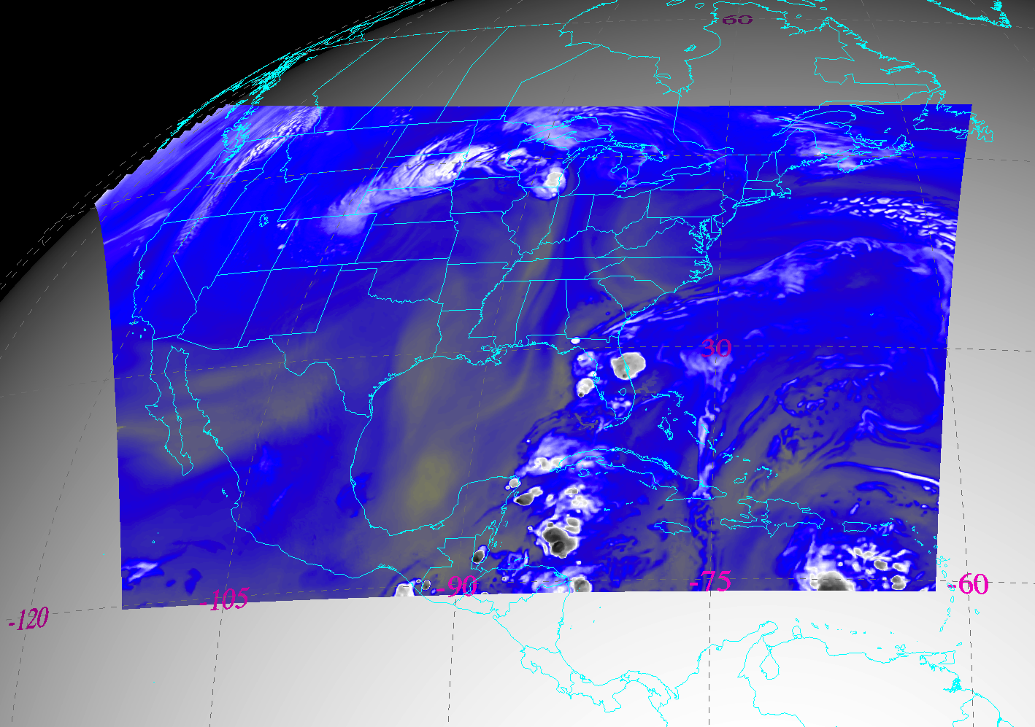
CONUS from East (proposed)
Simulated ABI band 9 (7 micrometer) brightness temperature at 21:45 UTC
Notes:
Should this be moved to the east yet to cover Montserrat? (16N 62W).

Slide 24
CONUS from East and West (current)
Notes:
Different days simulated.

Slide 25
CONUS from East and West (proposed)
Notes:
Different days simulated.

Slide 26
Exploratory Scan Modes
In the future, when possible, consider to reshape ‘PACUS’ and/or the ‘mesoscale’ to be a more efficient system (e.g. the size aspect ratio of the CONUS scan or a “half-height” mesoscale, double wide).
These would take a ground system change.
At a minimum, data in mode 3 and 4 can be collected during the Post Launch Testing phase.

Slide 27
Exploratory ABI Scan Strategies
There are some alternative ABI scan strategies to Mode 3 and Mode 4.
Option
A
&
One “CONUS” sector every 2 minutes
Every 10 minutes
Option
B
One mesoscale sector
every 30 seconds (one or two locations)
&
Every 6 minutes
Option
C
Every 3.75 minutes
One mesoscale sector
every 30 seconds (one or two locations)
&
Every 15 minutes
Notes:
Scan areas and timing are approximate.

Slide 28
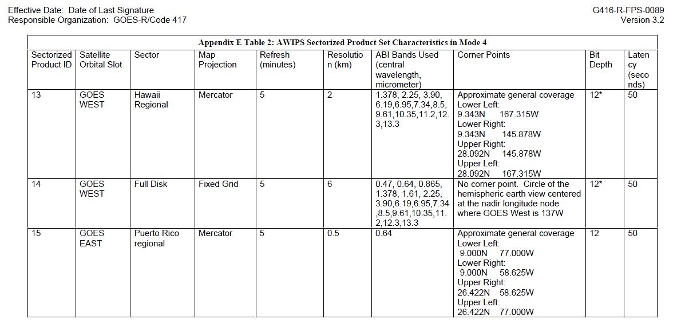
Ground System FPS, Appendix E
Outside of CONUS, Hawaii, Alaska and Puerto Rico, imagery will be 6 km in AWIPS.
At some point, the GS FPS file will be posted on the GOES-R web page.
(File available upon request)

Slide 29
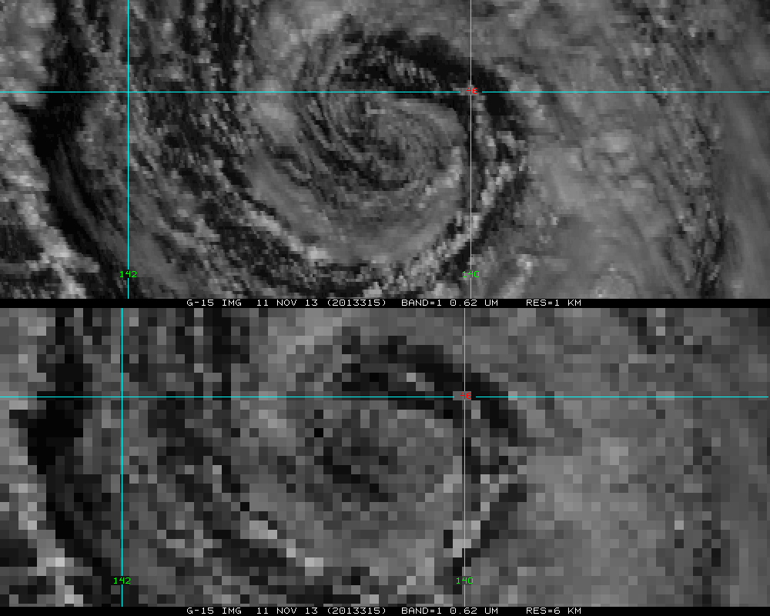
Notes:
ABI band 2 (0.6 micrometers) will be finer resolution than the imagery shown and the 6km may be worse since this is 6km in a Mercator.

Slide 30
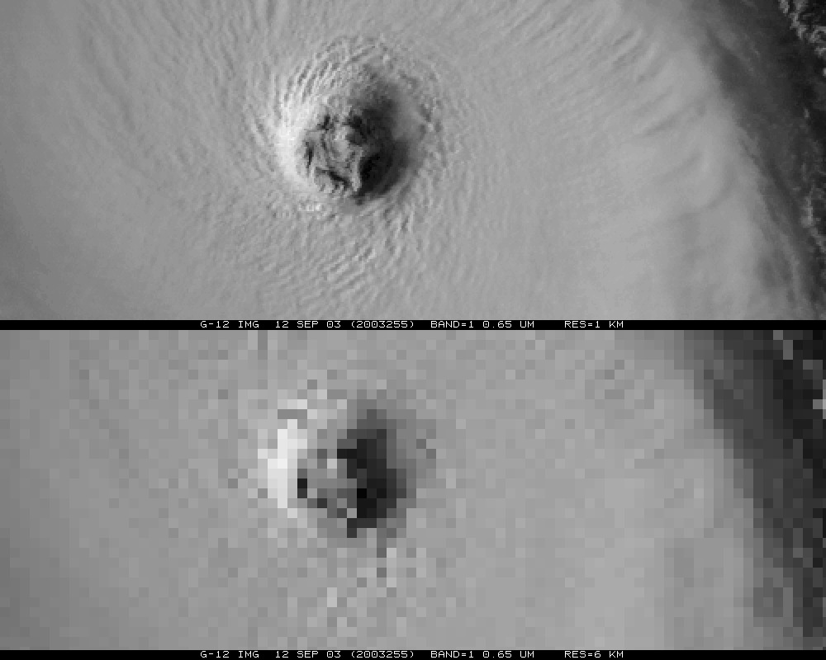
Notes:
ABI band 2 (0.6 micrometers) will be finer resolution than the imagery shown.

Slide 31
Conclusions
Current plans call for the GOES-West CONUS to be over CONUS (and not to the west, as the current PACUS), this means that more ‘up stream’ imagery on AWIPS will be at the 6km spatial resolutions. (Hence there will be less ‘6 km’ data if the CONUS sectors are more separated.)
Hence, it’s a good plan for the national centers, etc. to get their data via a GOES-R GRB, and hence can acquire full resolution imagery, outside of the certain sectors.
The ‘West’ CONUS should be moved much farther to the West and the ‘East’ CONUS should be slightly shifted to the East.
Time is of the essence for requesting these changes

Slide 32
Back-up Material
Consider sending the full GRB data to AWIPS once in the ABI Fixed Grid Format (FGF) and have AWIPS do any local remapping.
This could streamline the process of making different resolution images for various projections

Slide 33
Current plans call for GOES-R to have a 6 month check-out and then replace GOES-15 as the Western GOES. GOES-S is slated to replace GOES-14 in 2020 as the eastern GOES.
Notes:
http://www.nesdis.noaa.gov/pdf/flyout_pdf/GOES_Flyout_Chart_10_01_13.pdf

Slide 34
GOES-R Post-Launch Product Validation Stages (Nominal Timeline)
Launch & Orbit Raising
Post-launch Testing (PLT) - 180 Days
Operations
<=5yrs Storage + >=8.4 Yrs Ops
Activation & Characterization Test (ACT)
Initial Checkout
System Performance Operational Test (SPOT)
Post-Handover Product Validation
Cal/INR Checkout
*Post-Launch Product Testing (PLPT)
14 Days
40 Days
14 Days
84 Days
42 Days
1 Year
1 Year
Contingency Operations Readiness Review (CORR)
Operational Acceptance Review (OAR) – Handover to OSPO
ABI (L1b)
ABI (KPP)
ABI (Other L2+)@
Unvalidated Product
Beta
Provisional
Comprehensive
@ Maturity level may vary for each product, as product availability is driven by maturity of
algorithm implementation, as well as the existence of science phenomena and associated ground-truth data.
* NOAA Science Test
Provisional values are only drafts.
Notes:
Last updated: 9/9/2013

Slide 35
Combined AWIPS image
The seam in AWIPS for combined imagery over CONUS is at approximately 115W.
This means that the data on the far edge isn’t used in the composites for AWIPS.

Slide 36
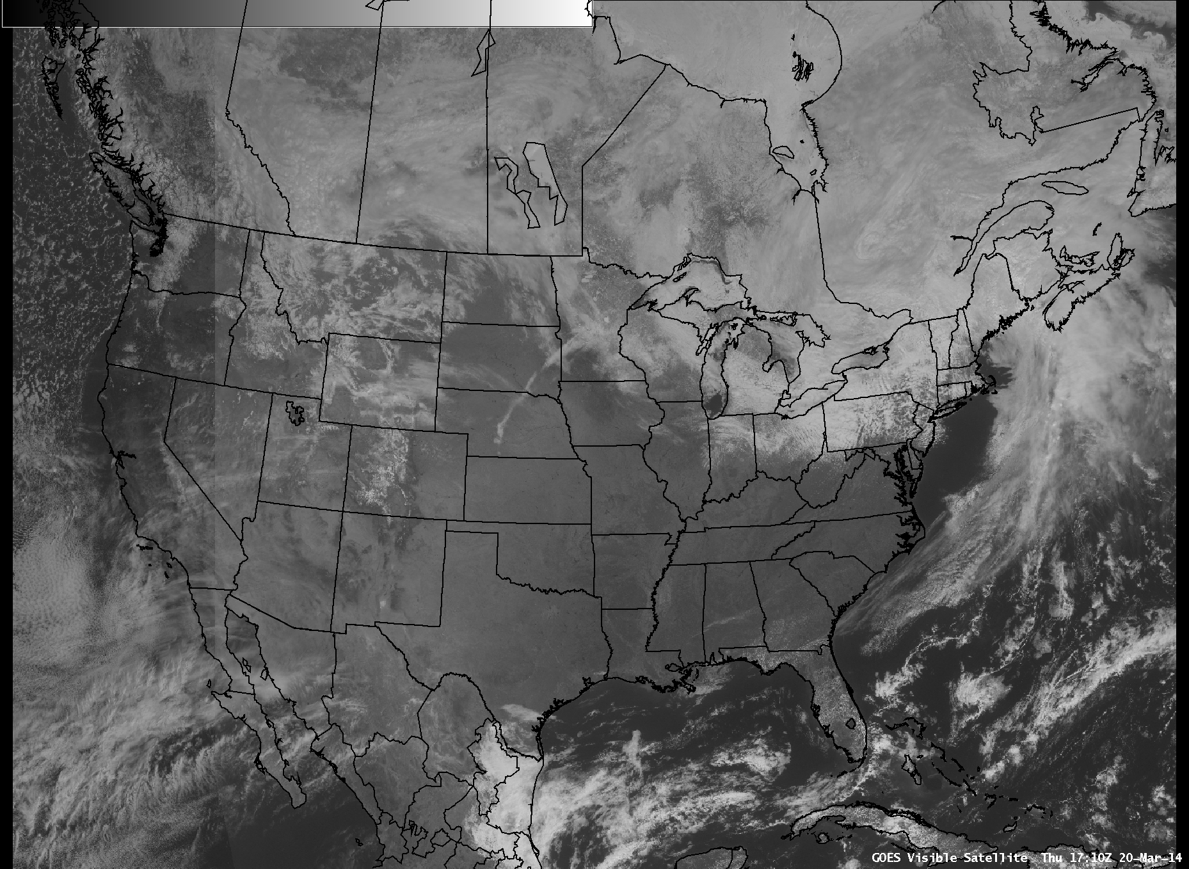
seam

Slide 37
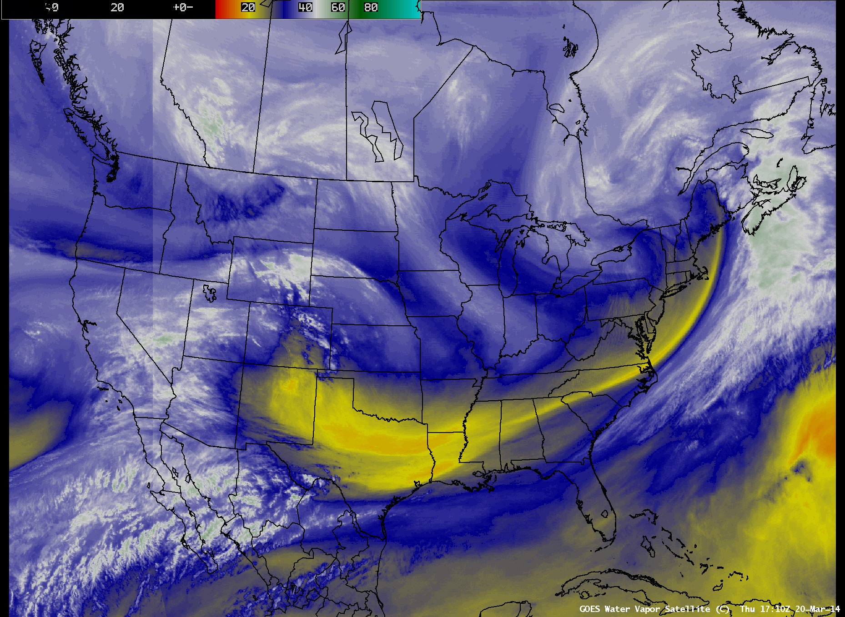
seam

Slide 38
ABI CONUS Center Points
Satellite | Current | Current | Proposed | Proposed
 | Latitude | Longitude | Latitude | Longitude
GOES-West | 29.5004 | -103.1168 (PUG via lat/long) | 30.0 | -137.0
 |  | -102.8004 (PUG via x,y)
 |  | -102.5111 (ITT doc)
GOES-East | 29.8360 | -90.5385 | 30.0 | -87.0

