Slide 1
GOES-R ABI “Flex” Mode (3) “CONUS” Coverage:
Increase separation between CONUS views from West and East
Timothy J. Schmit (tim.j.schmit@noaa.gov)
NOAA/NESDIS
Satellite Applications and Research
Advanced Satellite Products Branch (ASPB)
Madison, WI
Mat Gunshor, Jordan Gerth, Kaba Bah, Will Straka and several others
CIMSS
April 25, 2014

Slide 2
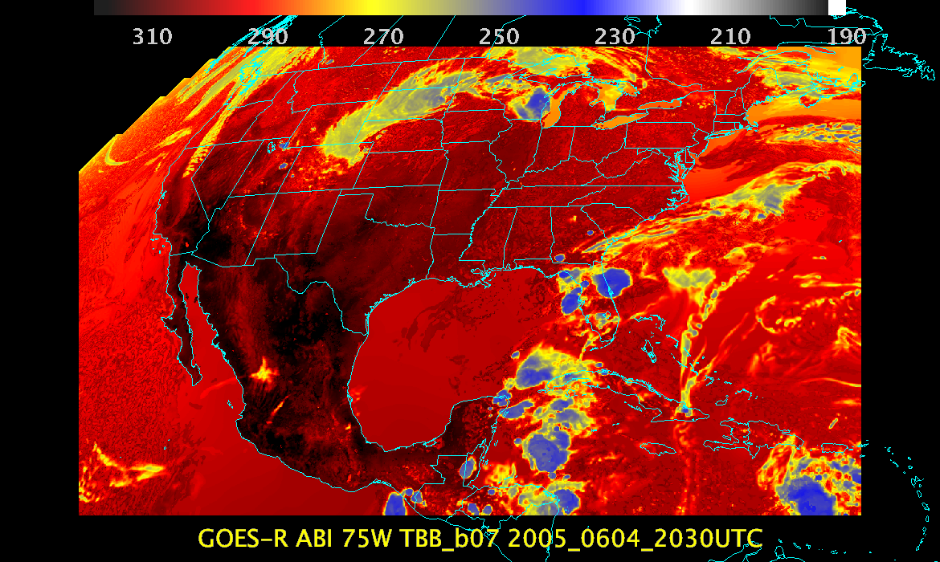
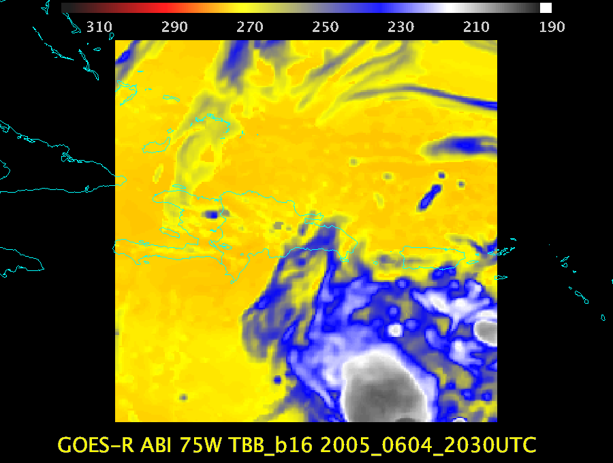
ABI Scan Mode 3 (“flex”)
Scan mode (3) or ‘flex mode’ for the ABI:
- Full disk every 15 minutes + 5 min CONUS
+ 1-min mesoscales (2 locations).

Slide 3
ABI CONUS Center Points
Satellite | Current | Current | Proposed | Proposed
 | Latitude | Longitude | Latitude | Longitude
 |  |  | (approximate) | (approximate)
GOES-West | 29.8360 | -103.1168 (PUG via lat/long) | 30.0 | -137.0
GOES-East | 29.5004 | -90.5385 | 30.0 | -87.0

Slide 4
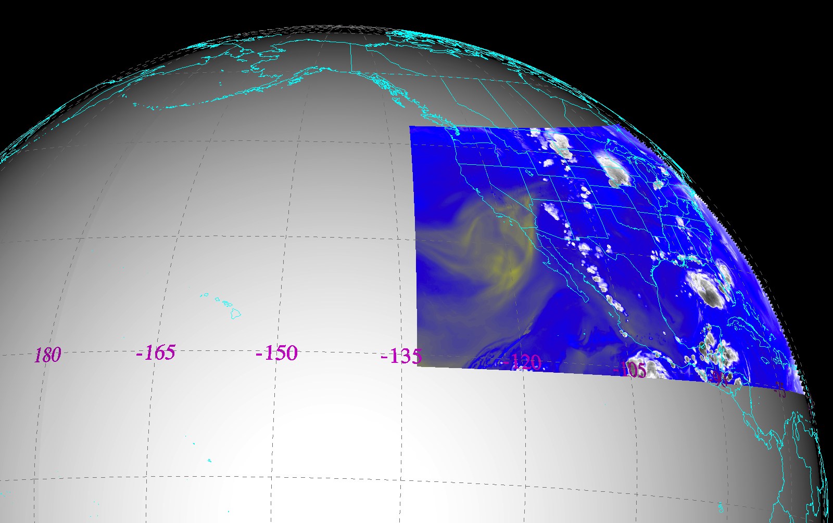
CONUS from West (current ABI plan)
Simulated ABI band 9 (7 micrometer) brightness temperature at 21:45 UTC
Notes:
Imagery shown in McIDAS-V

Slide 5
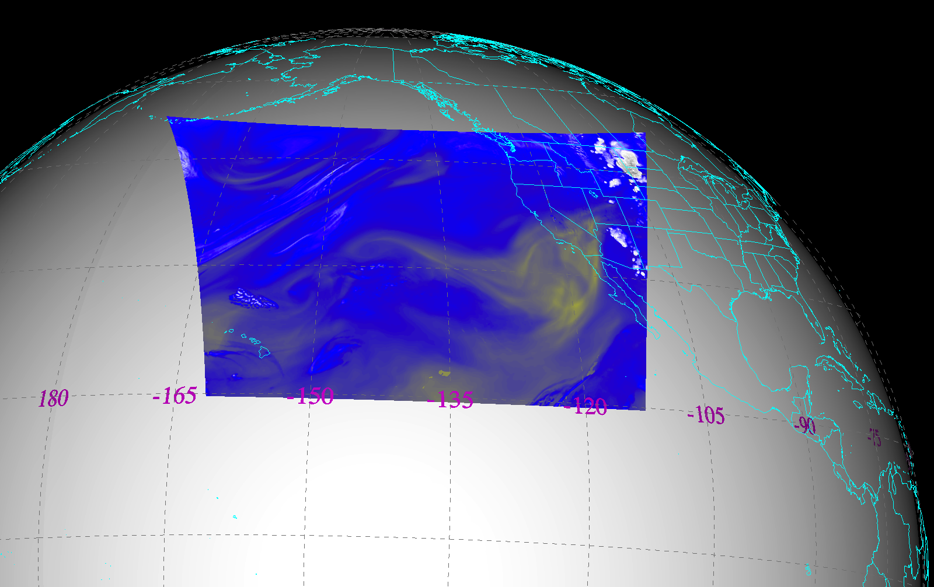
CONUS from West (proposed)
Simulated ABI band 9 (7 micrometer) brightness temperature at 21:45 UTC
Notes:
Imagery shown in McIDAS-V

Slide 6
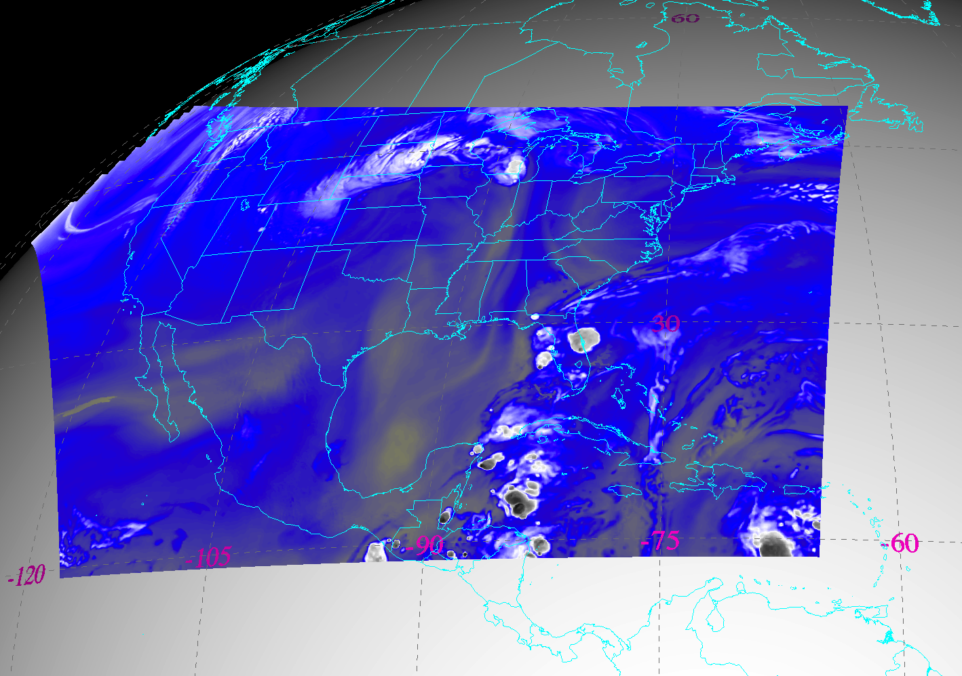
CONUS from East (current ABI plan)
Simulated ABI band 9 (7 micrometer) brightness temperature at 21:45 UTC
Notes:
Imagery shown in McIDAS-V

Slide 7
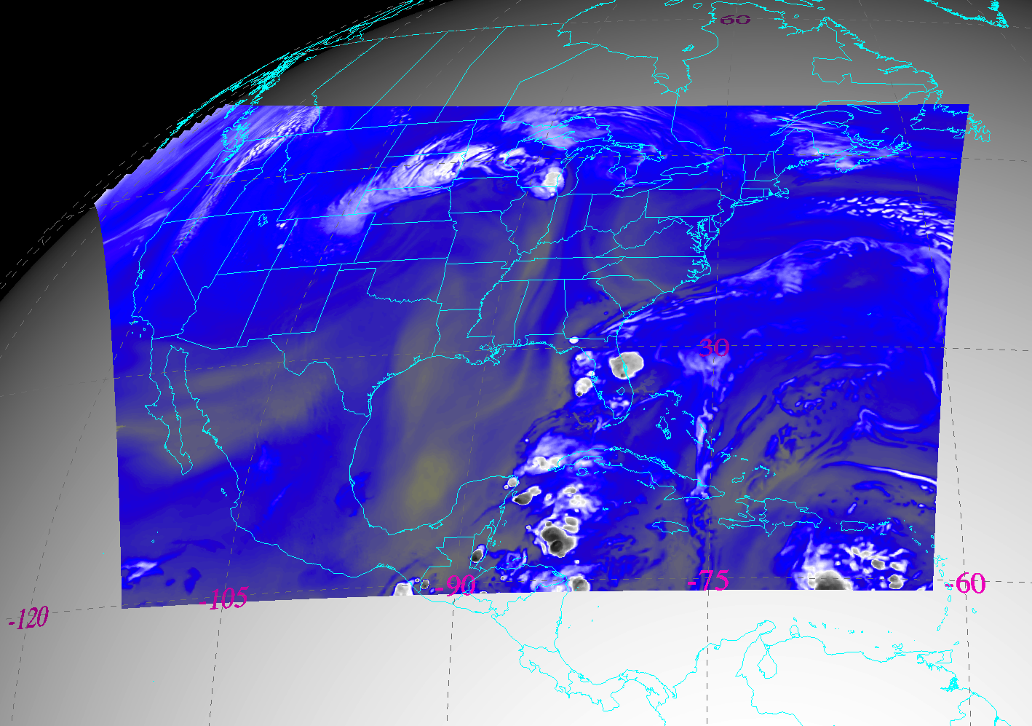
CONUS from East (proposed)
Simulated ABI band 9 (7 micrometer) brightness temperature at 21:45 UTC
Notes:
Should this be moved to the east yet to cover Montserrat? (16N 62W).

Slide 8
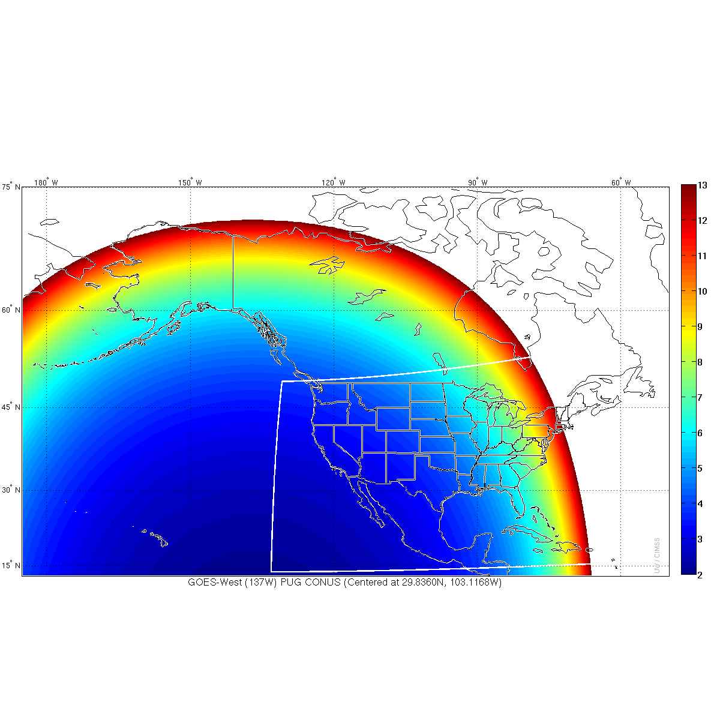
ABI IR Pixel size from West
(current plan for ABI CONUS scan)
IR resolutions greater than 13 km not shown.
Notes:
Infrared (IR)

Slide 9
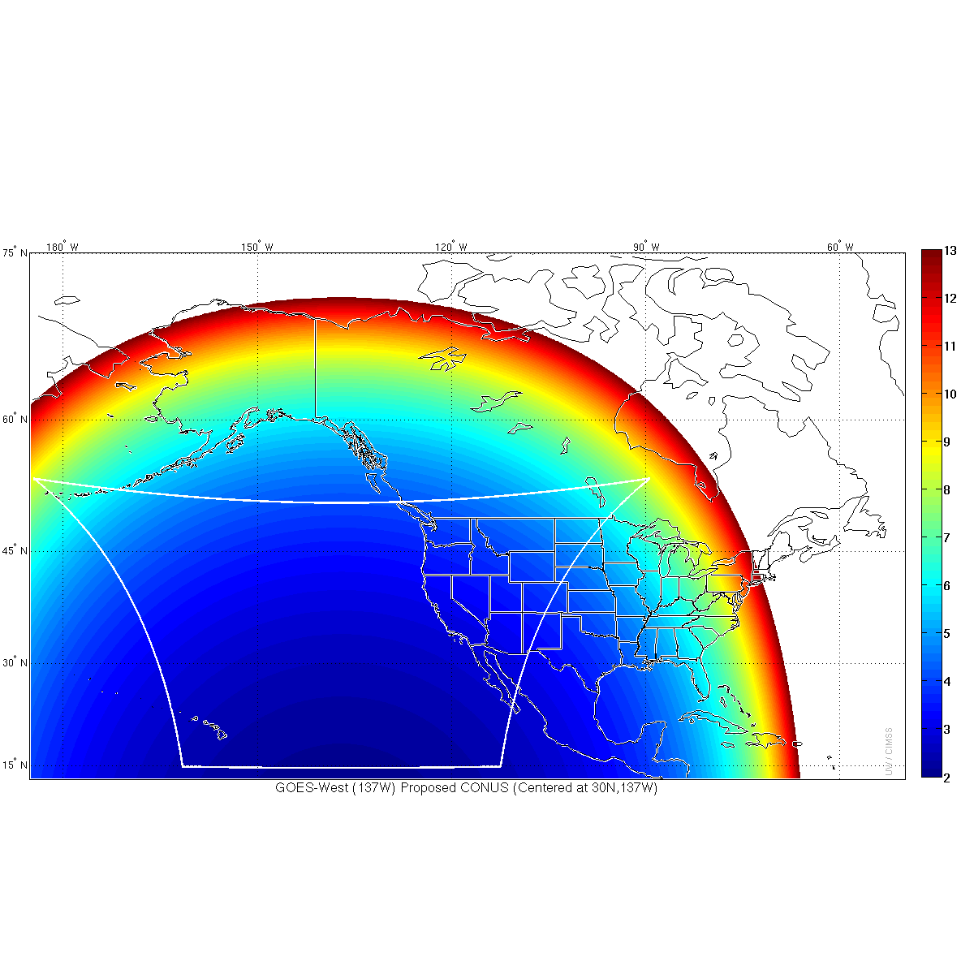
ABI IR Pixel size from West
(proposed ABI CONUS scan)

Slide 10
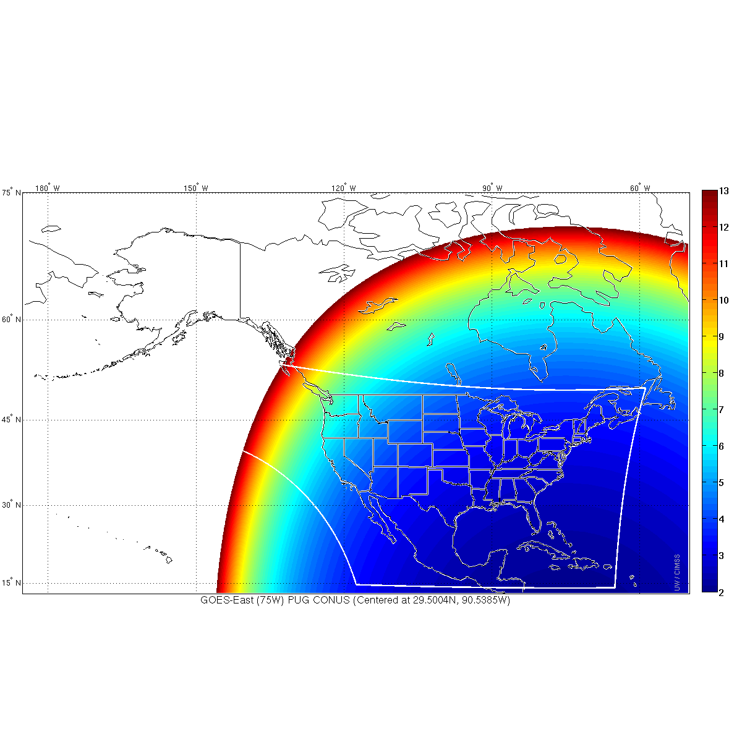
ABI IR Pixel size from East
(current plan for ABI CONUS scan)

Slide 11
ABI IR Pixel size from East
(proposed ABI CONUS scan)

Slide 12
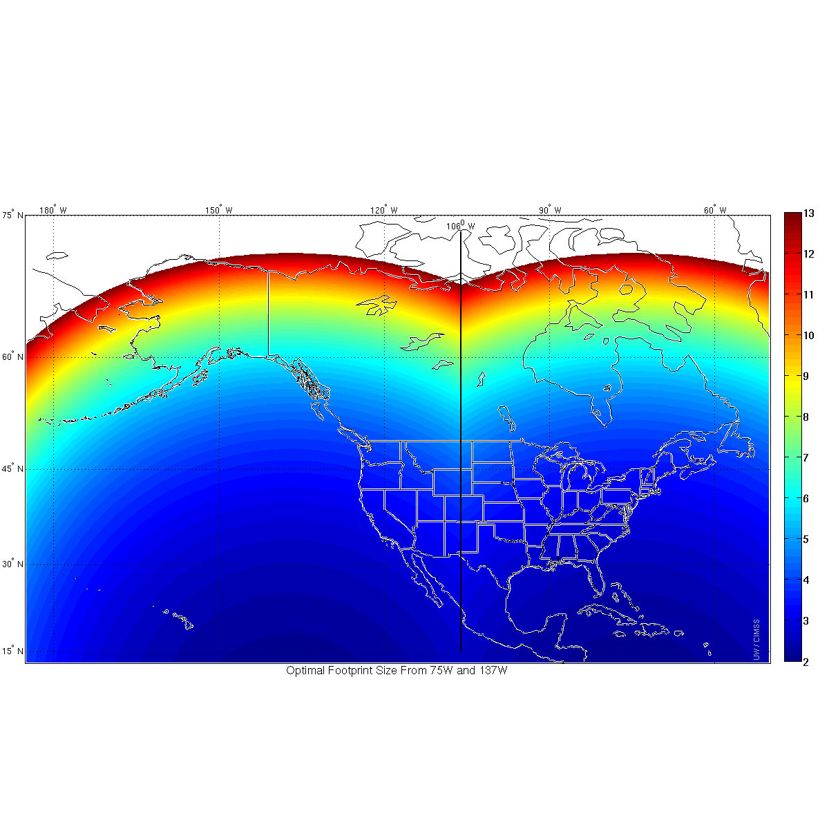
ABI IR Pixel size from West and East
(only showing out to 80 degrees view)

Slide 13
ABI IR Pixel size from West and East
(proposed ABI CONUS West and East)
East Optimal
West Optimal

Slide 14
ABI IR Pixel size from West
(proposed ABI CONUS scan)

Slide 15
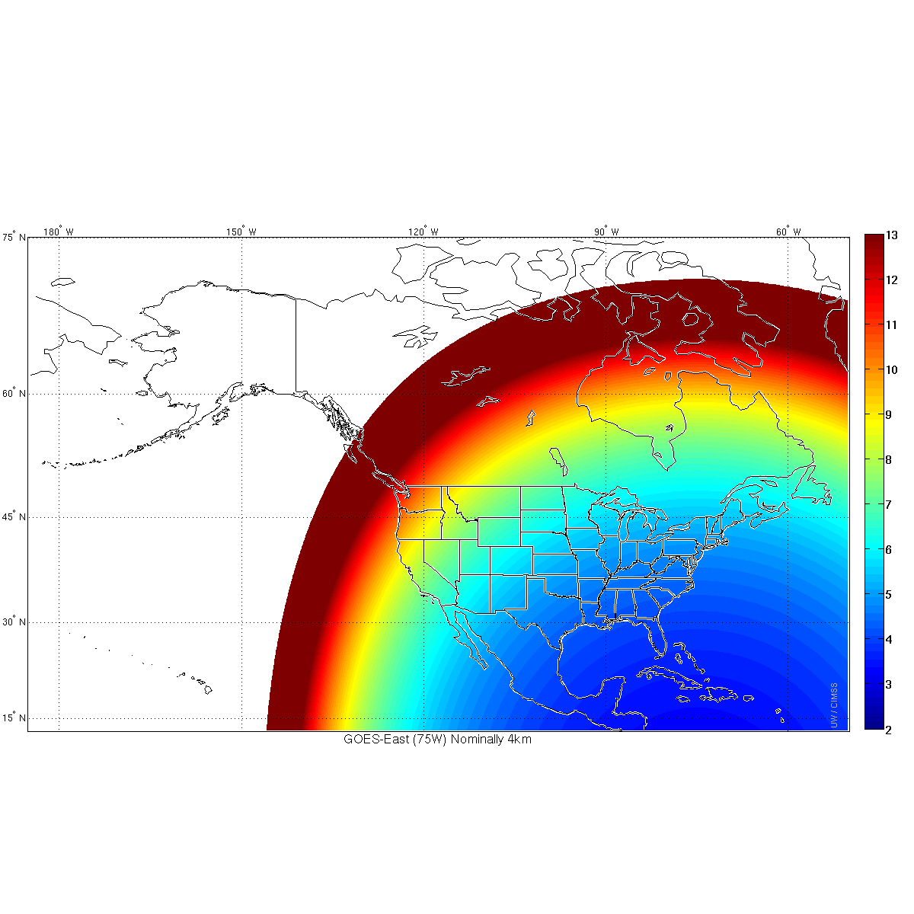
“Current GOES” IR Pixel size from East
(approximate size from 75W)
Notes:
Used an average box size to account for east-west over-sampling.

Slide 16
“Current GOES” IR Pixel size from East
(approximate size from 75W)
Notes:
Used an average box size to account for east-west over-sampling.

Slide 17
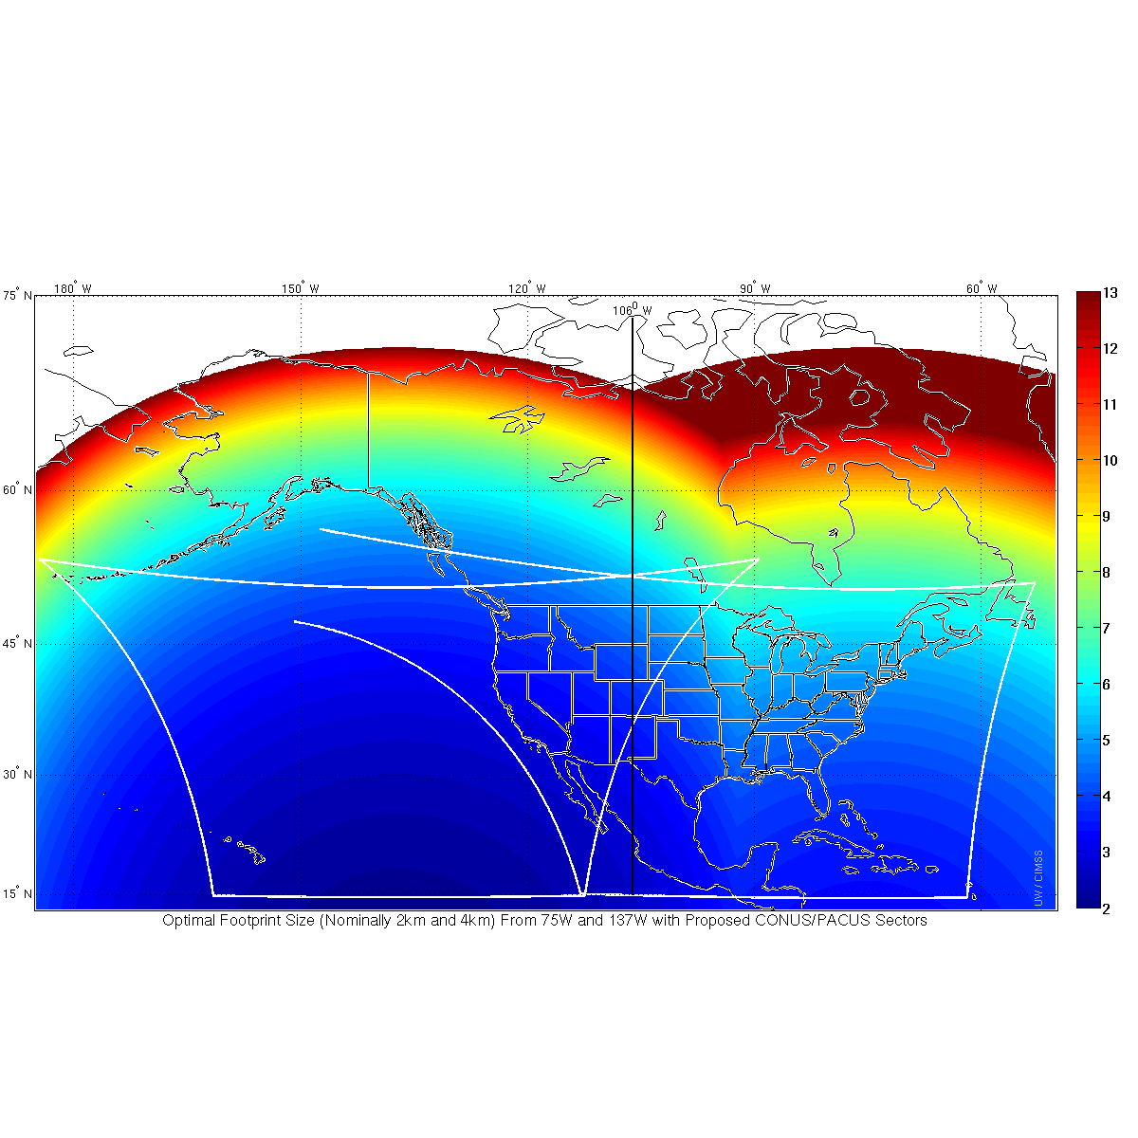
ABI IR pixel size from West and “GOES” from East
(proposed ABI CONUS West and East)
West Optimal
East Optimal

Slide 18
Conclusions
Current plans call for the GOES-West ABI CONUS sector to be over CONUS (and not to the west, as the current PACUS). Plus, current plans call for the GOES-East ABI CONUS sector cut-off just to the east of Puerto Rico.
No 5-min coverage of Hawaii in ABI mode 3 with the current “CONUS” sector position.
Both proposed sectors maximize ideal resolution coverage per the aforementioned analysis of how the satellite pixel size varies with view angle.
The ‘West’ CONUS should be moved much farther to the West and the ‘East’ CONUS should be slightly shifted to the East to optimize ideal viewing from space.

Slide 19
Proposal
The NOAT (NWS Operational Advisory Team) suggests that the GOES-R ABI (Advanced Baseline Imager) "CONUS" sector center point, as scanned from the western geostationary position, be moved significantly to the west. This adjustment means more coverage of an area with favorable viewing geometry and would extend coverage over the North Pacific (including Hawaii). The center point would move to approximately: 30N and 137W.
In addition, the GOES-R ABI CONUS sector center point, as scanned from the eastern geostationary position, should be moved slightly to the east. This adjustment means slightly more coverage of an area with favorable viewing geometry and would extend coverage to the east of Puerto Rico and for tropical waves/tropical cyclones in the Atlantic. The center point would move to approximately: 30N and 87W.

Slide 20
Back-up Material

Slide 21
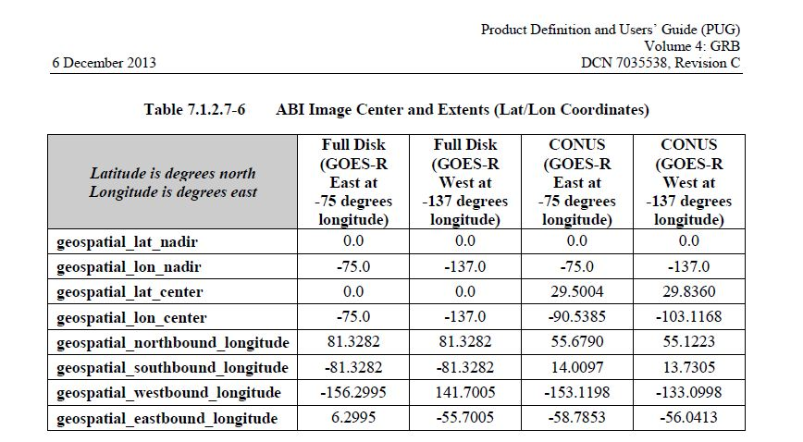
Volume 4 of the PUG (version C)
http://www.goes-r.gov/users/docs/PUG-GRB-vol4-verC.pdf

Slide 22
Current plans call for GOES-R to have a 6 month check-out and then replace GOES-15 as the Western GOES. GOES-S is slated to replace GOES-14 in 2020 as the eastern GOES.
Notes:
http://www.nesdis.noaa.gov/pdf/flyout_pdf/GOES_Flyout_Chart_10_01_13.pdf

Slide 23
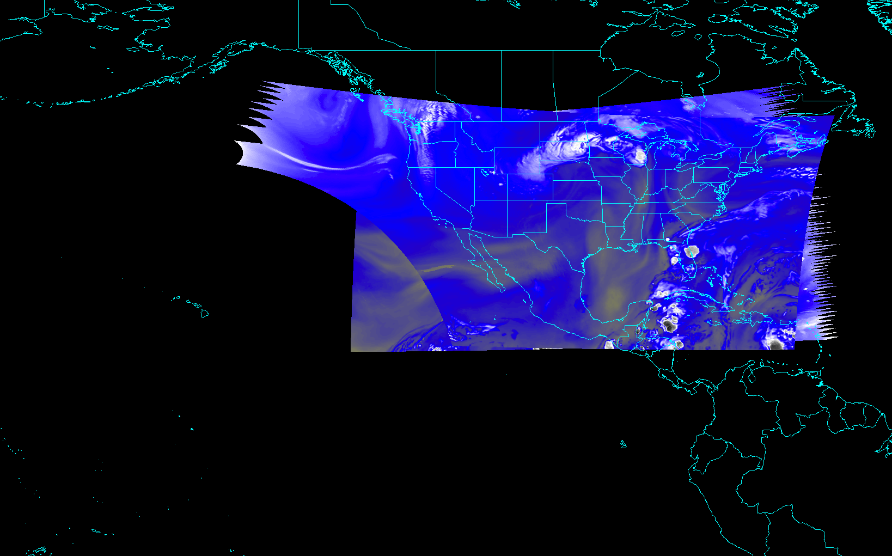
CONUS from East and West (current)
Notes:
Different days simulated.

Slide 24
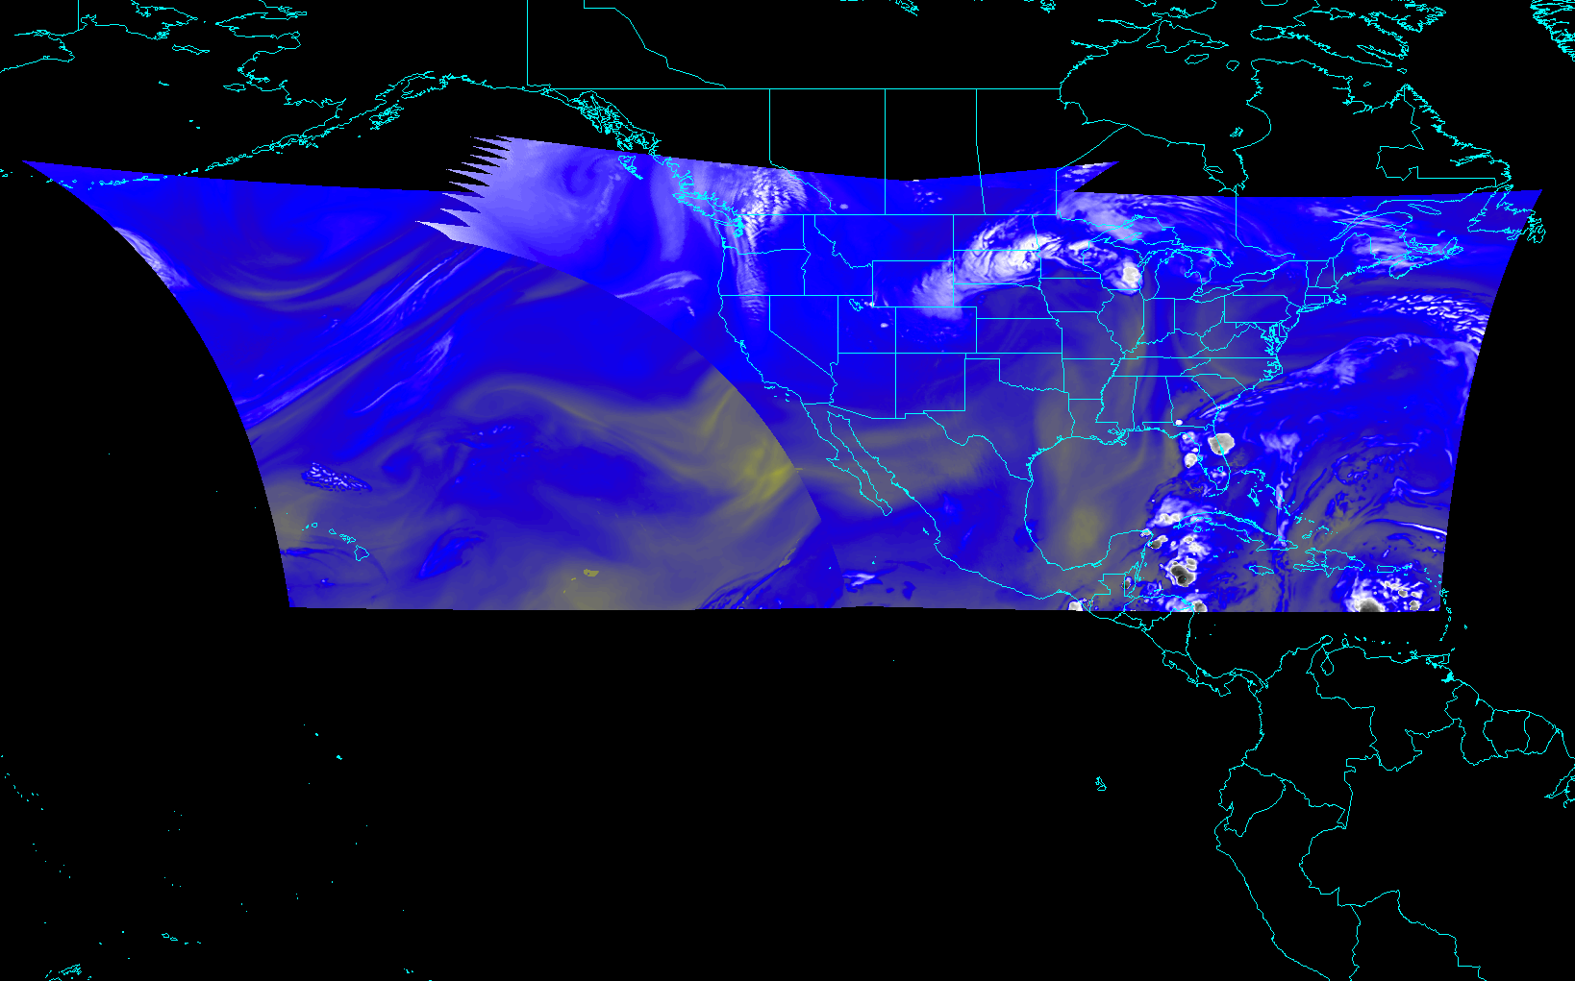
CONUS from East and West (proposed)
Notes:
Different days simulated.

Slide 25
Exploratory Scan Modes
In the future, when possible, consider to reshape ‘PACUS’ and/or the ‘mesoscale’ to be a more efficient system (e.g. the size aspect ratio of the CONUS scan or a “half-height” mesoscale, double wide).
These would take a ground system change, most likely sometime after GOES-R Post Launch Test.
At a minimum, data in mode 3 and 4 will be collected during the Post Launch Testing (PLT) phase. Ideally these other ‘exploratory’ modes can also be run during the PLT.

Slide 26
Exploratory ABI Scan Strategies
There are some alternative ABI scan strategies to Mode 3 and Mode 4.
Option
A
&
One “CONUS” sector every 2 minutes
Every 10 minutes
Option
B
One mesoscale sector
every 30 seconds (one or two locations)
&
Every 6 minutes
Option
C
Every 3.75 minutes
One mesoscale sector
every 30 seconds (one or two locations)
&
Every 15 minutes
Notes:
Scan areas and timing are approximate.

Slide 27
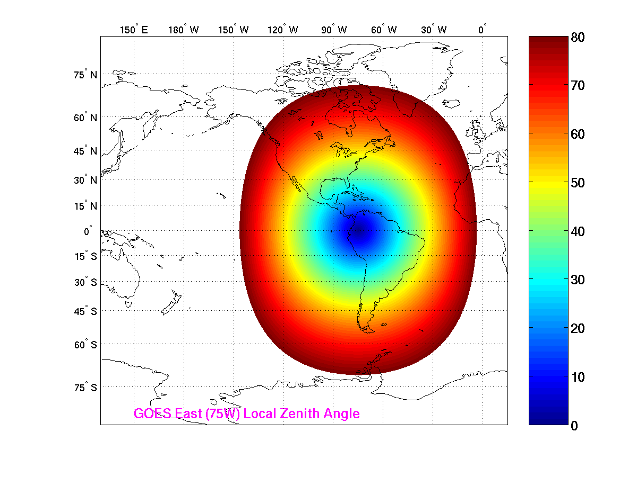
Local Zenith Angle (nadir is 0 degrees; only goes to 80 degrees)
Bulls-eye location based on fixed satellite position
CIMSS

Slide 28
ABI IR Pixel size from West
(proposed ABI CONUS scan)

Slide 29
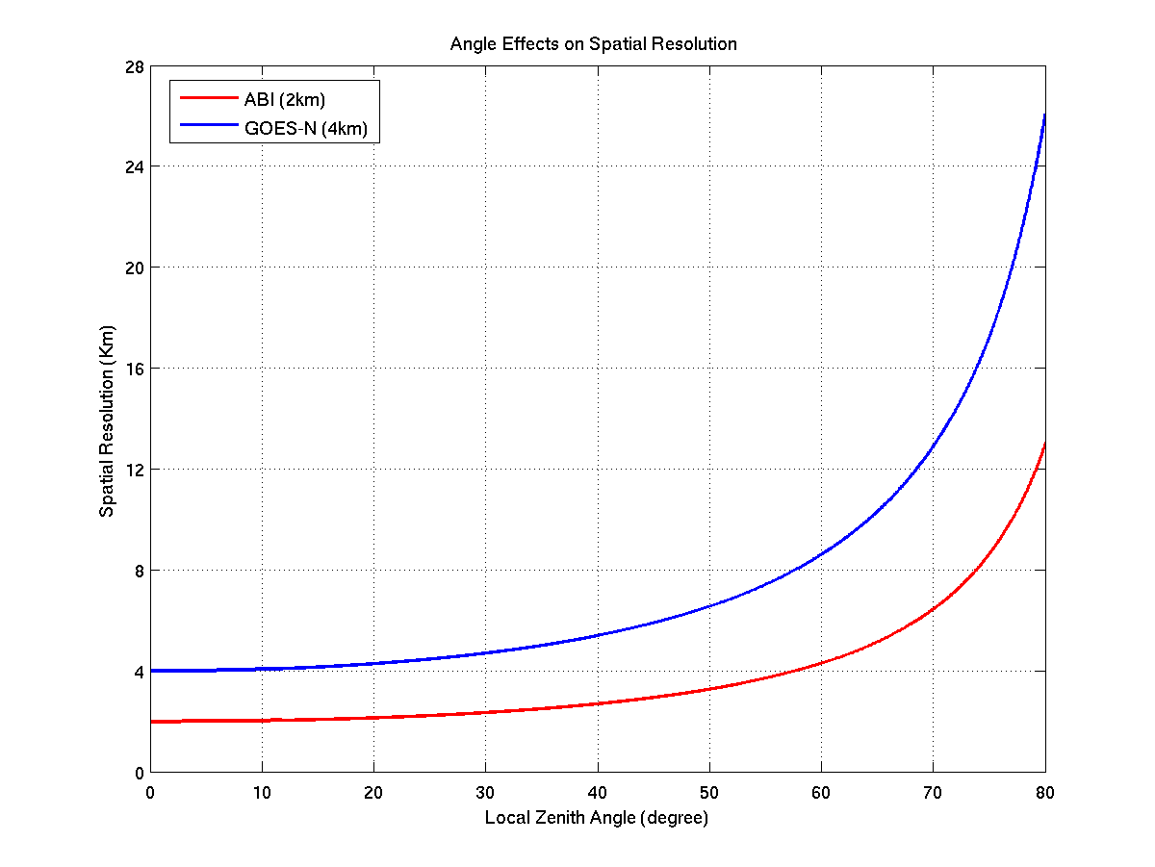
Local Zenith Angle versus Spatial Resolution
CIMSS

Slide 30
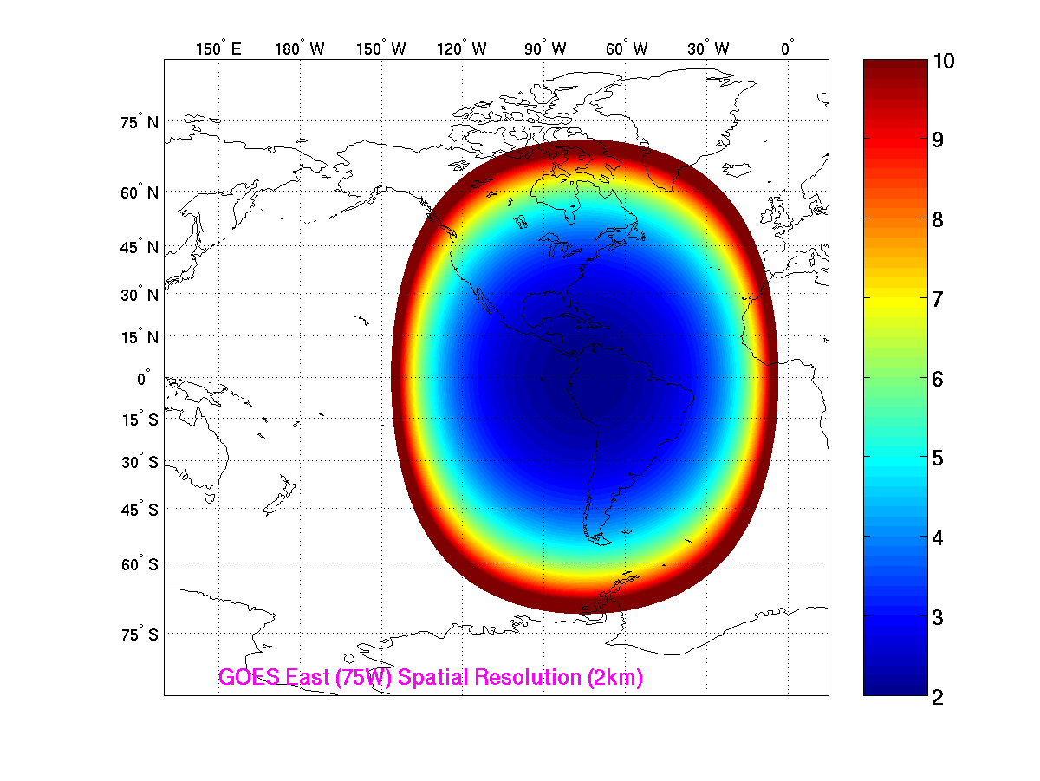
Spatial Resolution (km) from 75W
CIMSS
Notes:
limited by local zenith angle less that 80 degrees

Slide 31
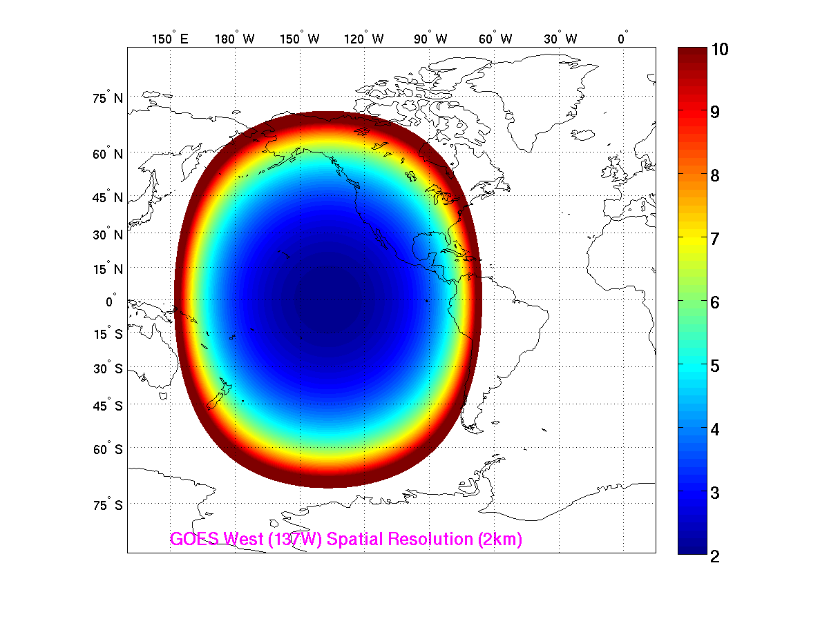
Spatial Resolution (km) from 137W
CIMSS
Notes:
limited by local zenith angle less that 80 degrees

