Slide 1
Discussion on the Status of GOES NearCast Products in the GOES-R Proving Grounds
William Line¹
Tim Schmit²
Ralph Petersen³
And thanks to many others (Robert Aune, Jun Li, etc.)!
¹CIMMS/University of Oklahoma and NOAA/NWS/Storm Prediction Center, Norman, Oklahoma
²NOAA/NESDIS Satellite Applications and Research, Advanced Satellite Products Branch, Madison, Wisconsin
³CIMSS/SSEC/University of Wisconsin – Madison, Madison, Wisconsin

Slide 2
OUTLINE
Fundamental Questions to address
Satellite Retrievals (Tim Schmit)
NearCast Model (Bill Line)
  Background
  Examples
  Demonstrations and Feedback

Slide 3
Fundamental Questions:
  Will GOES-R Legacy Sounding Products provide same level of information as current GOES Sounder?
    GOES sounding process melds NWP, Surface Obs and Satellite radiance
    Continuously corrects model ‘first guess errors’
  How can NearCasts help operational forecasters?
    Expand utility of GOES-R products from ‘only observations’ to ‘forecasting tools’
    Provide real-time means of monitoring model performance
      Especially important for under-observed moisture fields
  What is the “Operationalization” process for GOES-R RR/PG applications? (Group Discussion Topic)

Slide 4
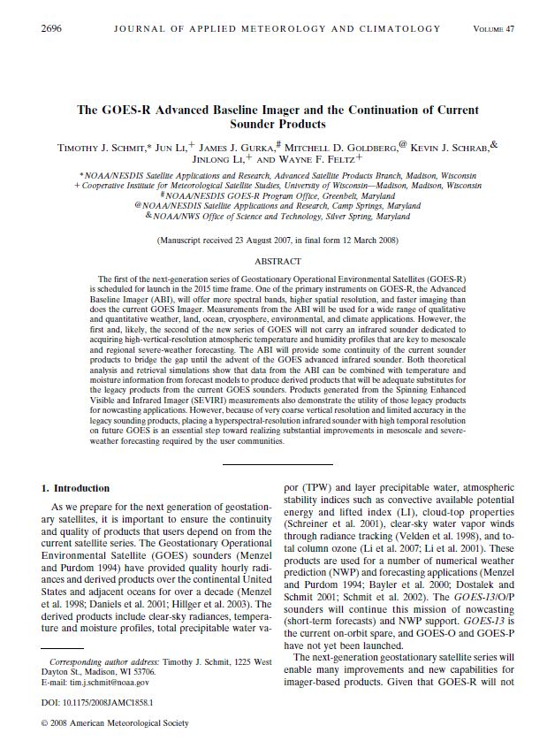
The GOES-R Advanced Baseline Imager and the continuation of current GOES sounder products
Schmit, T. J., J. Li, J. J. Gurka, M. D. Goldberg, K. Schrab, Jinlong Li, and W. Feltz, 2008: The GOES-R Advanced Baseline Imager and the continuation of current GOES sounder products, J. of Appl. Meteorol. and Climatology, 47, 2696 – 2711.
(Download)

Slide 5
GOES-R ABI Products
Baseline Products
Future Capabilities
Advanced Baseline Imager (ABI)
Aerosol Detection (Including Smoke and Dust) Aerosol Optical Depth (AOD) Clear Sky Masks Cloud and Moisture Imagery Cloud Optical Depth Cloud Particle Size Distribution Cloud Top Height Cloud Top Phase Cloud Top Pressure Cloud Top Temperature Derived Motion Winds Derived Stability Indices Downward Shortwave Radiation: Surface Fire/Hot Spot Characterization Hurricane Intensity Estimation Land Surface Temperature (Skin) Legacy Vertical Moisture Profile Legacy Vertical Temperature Profile Radiances Rainfall Rate/QPE Reflected Shortwave Radiation: TOA Sea Surface Temperature (Skin) Snow Cover Total Precipitable Water Volcanic Ash: Detection and Height
Advanced Baseline Imager (ABI)
Absorbed Shortwave Radiation: Surface Aerosol Particle Size Aircraft Icing Threat Cloud Ice Water Path Cloud Layers/Heights Cloud Liquid Water Cloud Type Convective Initiation Currents Currents: Offshore Downward Longwave Radiation: Surface Enhanced “V”/Overshooting Top Detection Flood/Standing Water Ice Cover Low Cloud and Fog Ozone Total Probability of Rainfall Rainfall Potential Sea and Lake Ice: Age Sea and Lake Ice: Concentration Sea and Lake Ice: Motion Snow Depth (Over Plains) SO₂ Detection Surface Albedo Surface Emissivity Tropopause Folding Turbulence Prediction Upward Longwave Radiation: Surface Upward Longwave Radiation: TOA Vegetation Fraction: Green Vegetation Index Visibility
Notes:
http://www.goes-r.gov/products/baseline.html

Slide 6
Requirements
Product | Accuracy | Precision | Sector (refresh) | horizontal resolution
Temperature profile (K) | 1K below 400 hPa and above boundary | 2K below 400 hPa and above boundary | CONUS: 30 min Full Disk : 60 min Mesoscale: 5 min | 10 km
Moisture profile (RH) | Sfc-500 mb: 18% relative humidity; 500-300 mb: 18% relative humidity; 300-100 mb: 20% relative humidity | Sfc-500 mb: 18% relative humidity 500-300 mb: 18% relative humidity 300-100 mb: 20% relative humidity | CONUS: 30 min Full Disk : 60 min Mesoscale: 5 min | 10 km
Derived stability indices | LI: 2 K CAPE: 1000 J/ kg SI: 2 K TT: 1 KI: 2 | Lifted Index: 6.5 K CAPE: 2500 J/ kg Showalter index:6.5 K Total totals Index:4 K index: 5 | CONUS: 30 min Full Disk : 60 min Mesoscale: 5 min | 10 km
TPW | 1 mm | 3 mm | CONUS: 30 min Full Disk : 60 min Mesoscale: 5 min | 10 km
Notes:
6
To a quick review of most stringent requirements.
http://www.goes-r.gov/products/ATBDs/baseline/Sounding_LAP_v2.0_no_color.pdf

Slide 7
Can the GOES-R ABI Supply Current GOES Sounder Continuity Operational Products?
Yes. The needed ‘continuity’ products from today's sounder can be provided by the ABI.
3 Key Aspects to Consider
Spatial Resolution
Refresh Rate
Performance
cira 2006
Notes:
TPW=Total precipitable water; LI=lifted index; ABI=Advanced Baseline Imager

Slide 8
Spatial Resolution Comparisons
IR spatial/horizontal resolution of current sounder
  10 km (at sub-point)
IR spatial/horizontal resolution of ABI
  2 km (at sub-point)
ABI also have finer visible and near IR bands to help the product performance
GOES-R plans call to average the ABI to 10 km, to better match current sounder

Slide 9
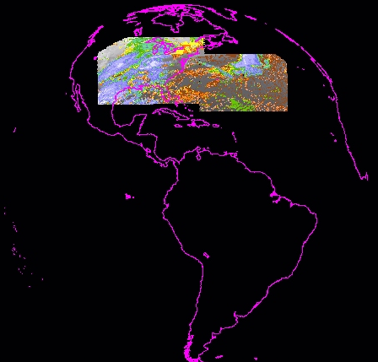
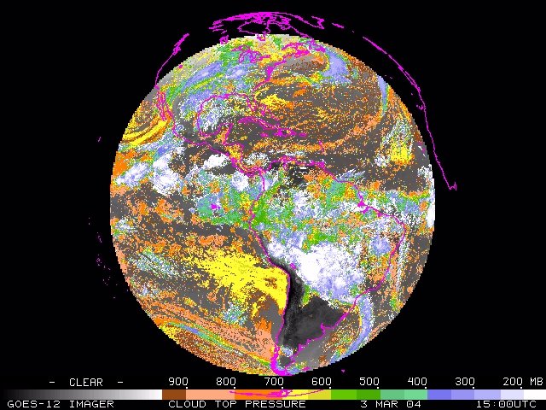
Much improved Coverage with ABI over the current Sounder
Current GOES Sounder coverage in one hour
ABI in 5 minutes
GOES-R plans call to produce CONUS retrievals every 30 minutes.
Cloud Top Pressure
CIMSS
Notes:
A GOES-12 Imager Full Disk cloud-top pressure image. There’s also good correlation with GOES-12 sounder images.
Possible uses:
NWP assimilation
Aviation interests
ASOS support
cloud climatology
From Tony S.

Slide 10
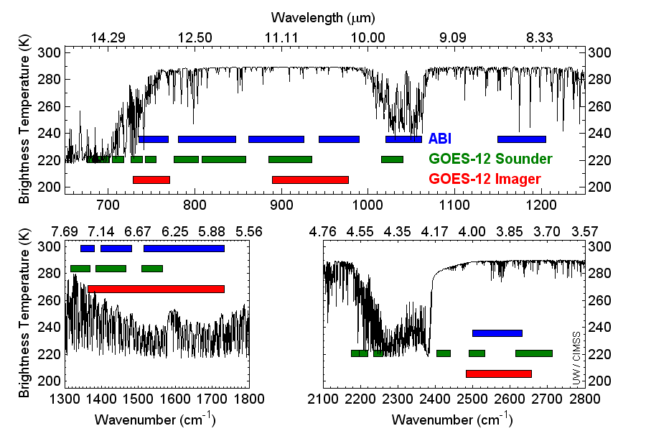
LW: T/q/Clouds&Cloud-Clearing/O₃
SW: T
MW: q
ABI (blue) and current GOES sounder (green) spectral coverage compared showing a high spectral resolution brightness temperature spectrum (black). ABI will allow for an improved cloud mask.
Notes:
Schmit, T. J., M. M. Gunshor, W. P. Menzel, J. J. Gurka, J. Li, and A. S. Bachmeier, 2005: Introducing the next-generation Advanced Baseline Imager on GOES-R. Bull. Amer. Meteor. Soc., 86, 1079-1096.
LW= LongWave; MW=MidWave; SW=Shortwave

Slide 11
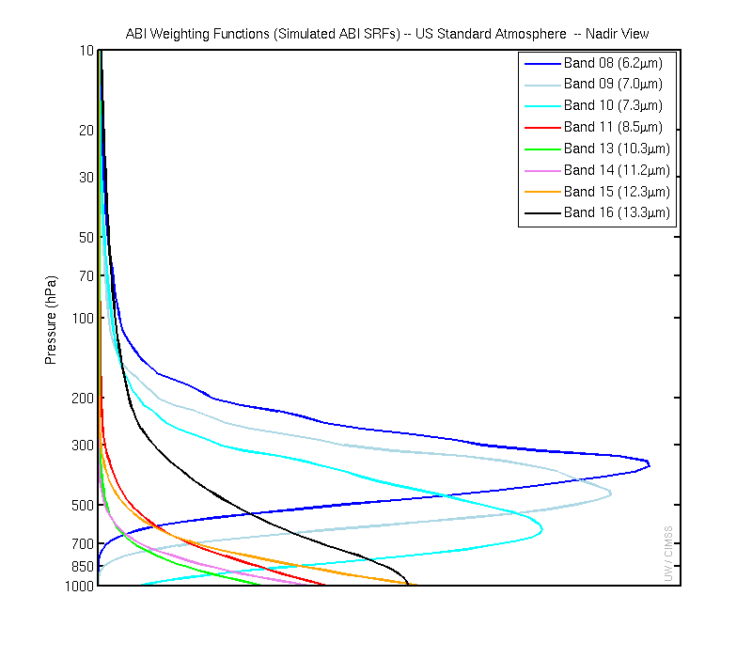
GOES-R ABI Weighting Functions
(moisture sensitive bands)
Tropospheric Moisture Channels
Note that both the ABI and GOES Sounders have 3 mid-tropospheric water vapor bands. The ABI does have a ‘cleaner’ 10.35 micrometer band.

Slide 12
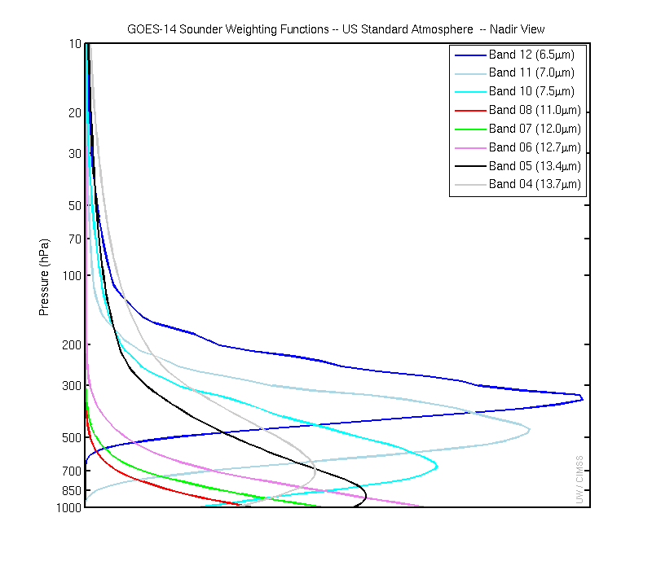
GOES-13 Sounder WFs
(moisture sensitive bands)
Tropospheric Moisture Channels
Both the ABI and GOES Sounders have 3 mid-tropospheric water vapor bands. The ABI does have a ‘cleaner’ 10.35 micrometer band that the GOES Sounders do not.

Slide 13
Profile information content analysis
J. Li et al
CIMSS
In general, note that the moisture content is similar between the ABI and the current GOES Sounder. The Sounder does show more temperature information than the ABI.
More than 300 profiles over CONUS with lifted index <0 (unstable atmosphere) are used in analysis.
This information content does not include any spatial or temporal differences.
November 6th, 2006

Slide 14
The relative vertical number of independent pieces of information of the moisture content is similar between the ABI and the current GOES Sounder.
When the information from the first guess is included via a retrieval (or data fusion), than the moisture information is enhanced and is again comparable to the GOES Sounder.
Notes:
Profile information content analysis
J. Li et al
CIMSS
In general, note that the moisture content is similar between the ABI and the current GOES Sounder. The Sounder does show more temperature information than the ABI.
More than 300 profiles over CONUS with lifted index <0 (unstable atmosphere) are used in analysis.
This information content does not include any spatial or temporal differences.
November 6th, 2006
The relative vertical number of independent pieces of information is shown. Note that the moisture content is similar between the ABI and the current GOES Sounder. The Sounder does show more temperature information than the ABI. Caveat: Even if two systems have the same number of pieces of information, they may represent different vertical levels. This information content analysis does not account for any spatial or temporal differences.

Slide 15
Regional simulation (06Dec2006)
Using time/space collocated RAOB/Forecast over CONUS
HES option 1a assumption, GOES-12 (for GOES-N class), ABI were used in simulation. PORD noise were used for HES.
HES option 1a:
  675-1200 with 0.625 cm⁻¹ spectral resolution
  1689-2150 with 1.250 cm⁻¹ spectral resolution
  2150-2400 with 2.50 cm⁻¹ spectral resolution
~900 independent profiles are retrieved
Lifted index and TPW (including layer TPW) are used for performance analysis

Slide 16
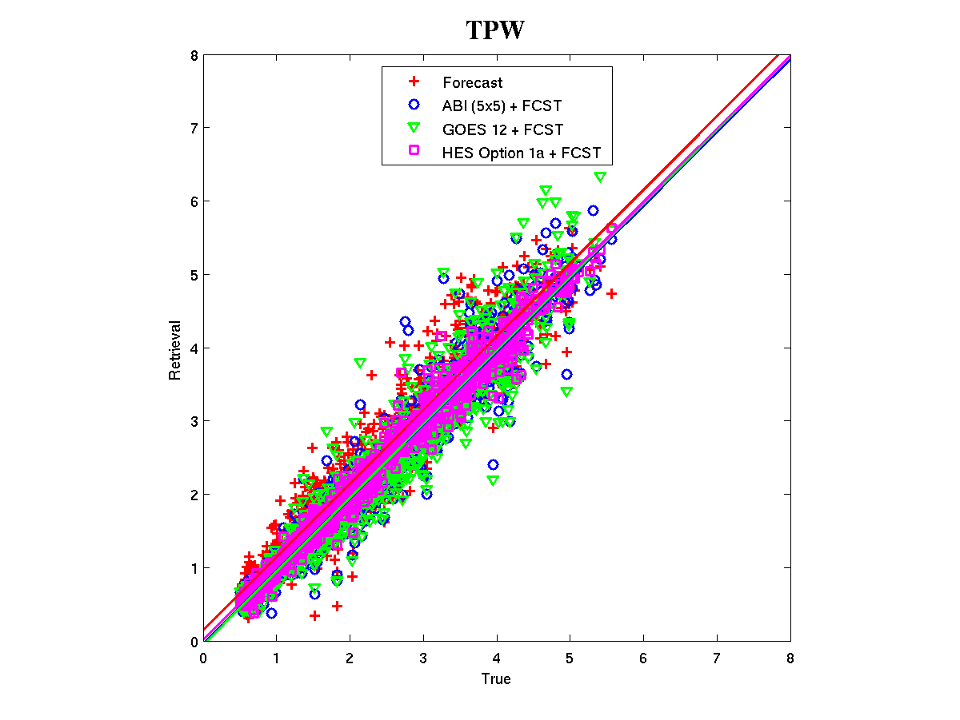
ABI Retrieval Performance
Regional simulation (06Dec2006)
RMSE
Forecast: 0.40
ABI (5X5) + fcst: 0.32
GOES Sounder + fcst: 0.37
HES + fcst: 0.16
Notes:
Using time/space collocated RAOB/Forecast over CONUS
HES option 1a assumption, GOES-12 (for GOES-N class), ABI were used in simulation. PORD noise were used for HES.
HES option 1a:
675-1200 with 0.625 cm⁻¹ spectral resolution
1689-2150 with 1.250 cm⁻¹ spectral resolution
2150-2400 with 2.50 cm⁻¹ spectral resolution
~900 independent profiles are retrieved
Lifted index and TPW (including layer TPW) are used for performance analysis

Slide 17
There are many operational and research applications from the current GOES sounder. The data and products are being used by the NWS and others. Applications include, but are not limited to: nowcasting and short-term forecasting (instability, clouds, moisture, skin temperature), and NWP (radiances – over water, clouds, layer PW, winds).
ABI, in conjunction with a first guess, can supply the needed ‘continuity’ products (radiances, TPW, LI, skin temperature, clouds, winds) from today's low-spectral resolution sounder. Given the better scan rate and field-of-view size, the ABI plus forecast information will be comparable to the GOES-N class sounder. For example, ABI offers a reduced data latency, compared to the current sounder.
ABI legacy atmospheric products have been validated with various in-situ measurements, ABI products have more spatial coverage than GOES Sounders.
To meet validated user requirements a fully capable (high spectral resolution) sounder with high spectral resolution and faster scanning is needed.
Conclusions (satellite retrievals)

Slide 18
Select References
Schmit, T. J., J. Li, J. J. Gurka, M. D. Goldberg, K. Schrab, J. Li, W. Feltz, 2008: The GOES-R ABI (Advanced Baseline Imager) and the continuation of current sounder products. J. of Appl. Meteor., 47, 2696–2711.
Jin, Xin, Jun Li, Timothy J. Schmit, Jinlong Li, Mitchell D. Goldberg, and James J. Gurka, 2008: Retrieving Clear Sky Atmospheric Parameters from SEVIRI and ABI infrared radiances. J. Geophys. Res., 113, D15310.
Schmit, T. J., J. Li, S. A. Ackerman, and J. J. Gurka, 2009: High spectral and temporal resolution infrared measurements from geostationary orbit, Journal of Atmospheric and Oceanic Technology, 26, 2273 - 2292.
Li, Jun; Liu, Chian-Yi; Zhang, Peng and Schmit, Timothy J., 2012: Applications of full spatial resolution space-based advanced infrared soundings in the preconvection environment. Weather and Forecasting, Volume 27, pp.515-524.
Xie, Hua; Nalli, Nicholas R.; Sampson, Shanna; Wolf, Walter W.; Li, Jun; Schmit, Timothy J.; Barnet, Christopher D.; Joseph, Everette; Morris, Vernon R. and Yang, Fanglin, 2013: Integration and ocean-based prelaunch validation of GOES-R Advanced Baseline Imager legacy atmospheric products. Journal of Atmospheric and Oceanic Technology, 30, 2013, 1743–1756.
Lee, Yong-Keun, Zhenglong Li, Jun Li, and Timothy J. Schmit, 2013: Evaluation of the GOES-R ABI LAP retrieval algorithm using the current GOES sounder, Journal of Atmospheric and Oceanic Technology (in press).

Slide 19
NearCast Model
William E. Line¹, Ralph Petersen² and Robert Aune³
¹CIMMS/University of Oklahoma and NOAA/NWS/Storm Prediction Center, Norman, Oklahoma
²CIMSS/SSEC/University of Wisconsin – Madison, Madison, Wisconsin
³NOAA/NESDIS/STAR, Advanced Satellite Products Branch, Madison, Wisconsin

Slide 20
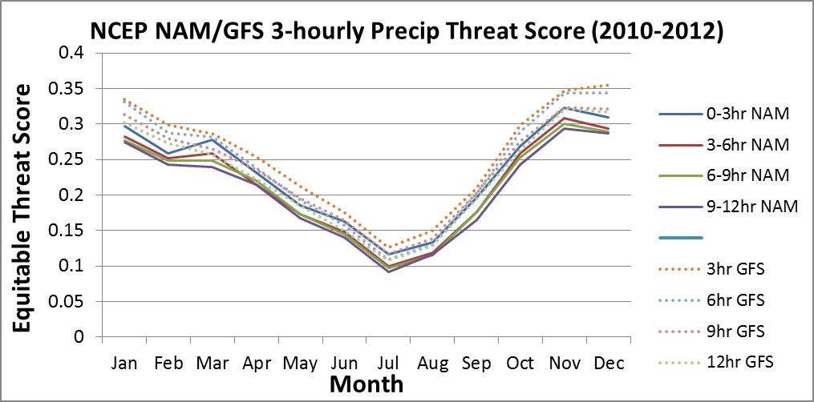
Motivation
NWP performance in predicting the occurrence and non-occurrence of short-term precipitation and disruptive weather events needs to be improved, especially in the warm season.
  This is due in part to our inability to observe and predict mesoscale moisture features
Satellite observations reveal details about the vertical moisture and stability structure of atmospheric layers
GOES retrieval process is data fusion: melds NWP, surface obs, and satellite radiance information.
GOES retrieval process provides corrections to errors in the model first guess, especially in the warm season
GOES retrievals are not being used in NWP

Slide 21
A Fundamental Question for Operational Forecasting :
How can details observed repeatedly in the moisture fields by Geostationary satellites be preserved in
in objective guidance tools that can be available to forecasters immediately after the observations are made?
Ultimately, the proper way to use GOES-R clear-air moisture data will be through use in improved, very-frequently updated NWP systems.
  This will not be available for many years
    Minimal model use of WV radiances now – NO use of GOES sounding products
  Model output will always lag observations by an hour or more
  Until then, we need a simple, fast means of providing objective short-range forecast of detailed horizontal moisture structures immediately after the GOES observations are made

Slide 22
A Solution: NearCast Model
Takes advantage of the detailed, under-utilized satellite moisture retrievals in a data-driven trajectory model
Lagrangian model dynamically projects satellite temperature and moisture data forward in space and time to 9 hours at multiple atmospheric levels
  Expands the utility of sounding products from observations to forecast tools
  Large timestep (10-15 minutes) leads to quick run-times (1-2 minutes) and small data latency
  Model updates when new observations are available (hourly for current GOES)
  No smoothing of data, so details detected in the observations (moisture minima, maxima, boundaries preserved) are preserved
  Observations are preserved at full resolution (10 km with current GOES sounder)
  Model retains up to 10 hours of previous observations, filling in data-gaps, further utilizing every observation

Slide 23
What are we trying to improve?
Short-range forecasts of timing and location of convection
- including hard-to-forecast, summer-time convection
NearCast model provides forecasters with analyses and 1-9 hour, observation-based forecasts of the pre-convective environment
  Vertical moisture and stability information helps forecasters to:
    predict where/when convection is more (and less) likely to occur in the near future
    assess whether the downstream environment will support persistence or further growth of existing convection
    monitor NWP model performance

Slide 24
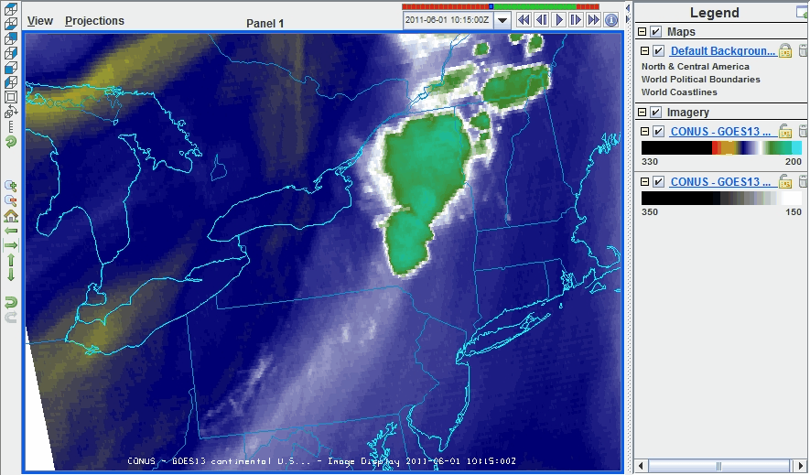
How can Satellite Observations be Used to Gauge Convective Potential?
Objective #1: Determine sources of lower-level moisture/heat
Equivalent Potential Temperature (Theta-e) combines information about the temperature and moisture content (thermal energy) of air
Objective #2: Mimic
what we’ve observed on
WV imagery for years:
  Tactic: Identify areas where
  θe decreases with height (convective instability)
Upper-Level Water Vapor Imagery:
Warm colors = dry, Cool colors (blues) = wet
Notes:
Theta-e: It is the temperature a parcel of air would have if it were brought adiabatically to 1000 hPa AND all of its water vapor were to condense, releasing its latent heat.
This variable is useful for comparing both moisture and temperature of air at different levels of the atmosphere. Convective Instability

Slide 25
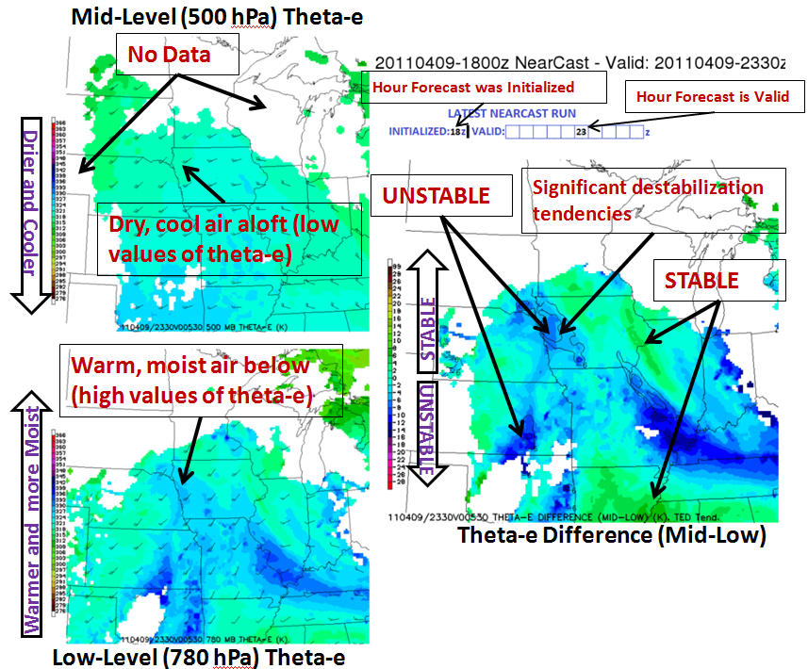
NearCast Output
Theta-e computed within each layer
Theta-e difference, or lapse rate (convective instability of a layer)
  And theta-e difference (stability) time tendencies
Layer PW information
Note: Each field represents a 200-300 hPa thick layer average, the resolving power of GOES/GOES-R
This convective instability parameter is an objective way to show where dry/cool air at the upper levels is moving over relatively warm/moist air at the low levels.
Notes:
This is something we have seen from satellite observations for decades, which we are mimicking here in forecasts

Slide 26
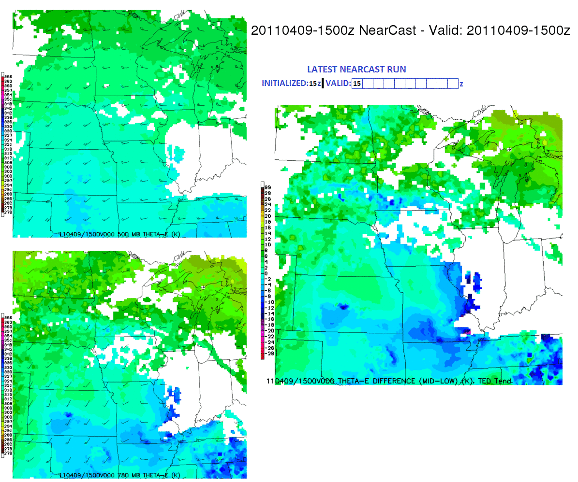
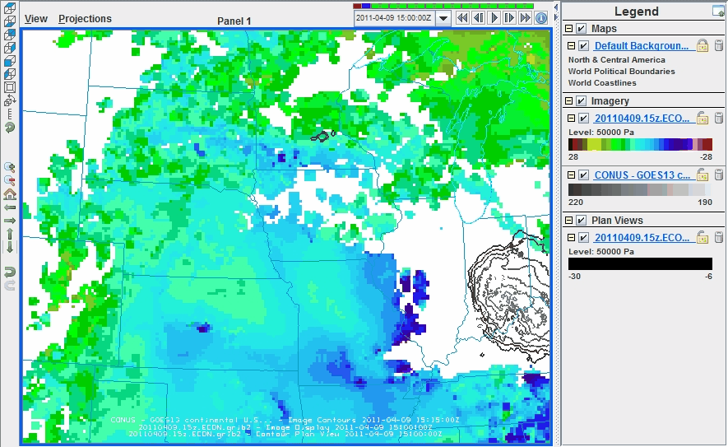
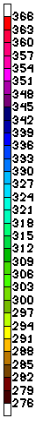

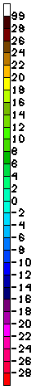
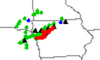
April 09, 2011 1500 UTC NearCast Forecast
Convective Instability (theta-e diff) Forecast
Mapleton, IA EF3 Tornado
Convection initiated within forecasted location of convective instability max and most rapid destabilization tendencies by 2230 UTC.
WARM/MOIST – High θe
STABLE
UL (500 mb) Theta-e
UNSTABLE
Theta-e Difference (Mid-Low)
Cool/dry – Low θe
LL (780 mb) Theta-e
Thin contour- destabilization tendencies <-6K/2hr
Thick contour – Cloud-Top Temps <220K
Notes:
LL:Ridge of low-level theta-e max projected to move northeastward from central Kansas into northwest Iowa by 00z.
Gradient in low-level theta-e tightens as max advances northward
UL: At upper level, dry air moving into eastern Nebraska by 00z.
Diff: This correlated to a max in convective instability moving northeast into eastern Nebraska and western Iowa between 21z and 00z
This region was stable before quickly becoming very unstable.
2 hr.. theta-e difference tendency (rate of destabilization) depicts locations that would experience the most rapid destabilization (-9K/2hr), further narrowing down where and when the environment would be most conducive to convective development.
Warm/moist sector of developing cyclone/warm front

Slide 27
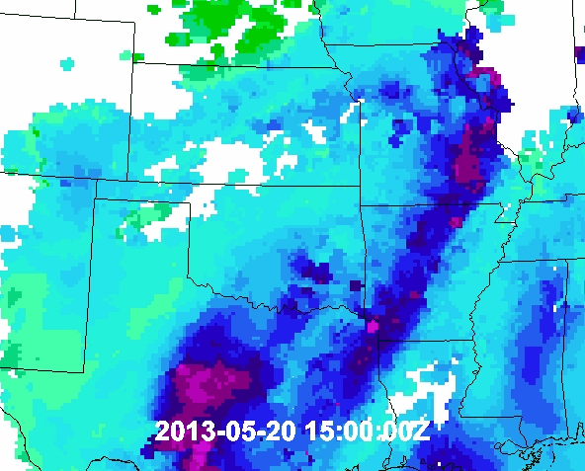
May 20, 2013 1500 UTC NearCast Forecast
Convective Instability (theta-e diff) Forecast
Moore, OK EF5 Tornado
Rapid convective development along moisture/instability gradient by 2000 UTC as LL moisture surged northward along boundary.
Continued to develop and move with the forecasted movement of the boundary
Thin contour- destabilization tendencies <-6K/2hr
Thick contour – Cloud-Top Temps <220K
Notes:
Initiation along forecasted position of moisture boundary as surge of moisture enters central OK. Dryline/cold front

Slide 28
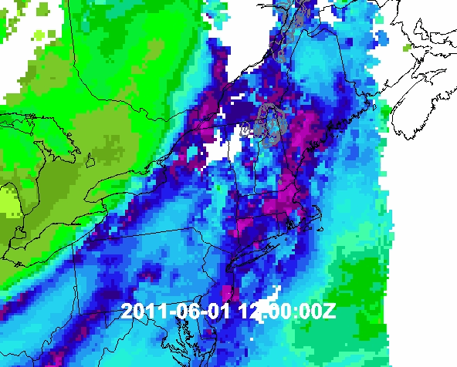
June 01, 2011 1200 UTC NearCast Forecast
Convective Instability (theta-e diff) Forecast
Springfield, MA EF3 Tornado
Strongest convection developed along cold front between 1500 and 2100 UTC
Initiated and moved along forecasted movement of the boundary
Thin contour- destabilization tendencies <-6K/2hr
Thick contour – Cloud-Top Temps <220K
Notes:
Initiation and movement along cold front

Slide 29
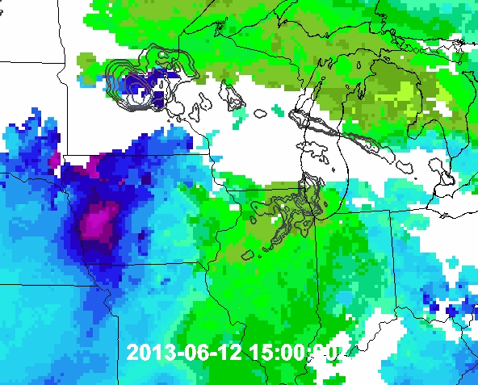
June 12, 2013 1500 UTC NearCast Forecast
Convective Instability (theta-e diff) Forecast
June 12/13 2013 Derecho/MCS
Initial convection developed between 2000 and 2100 UTC in northern Illinois along moisture/instability gradient
Thin contour- destabilization tendencies <-6K/2hr
Thick contour – Cloud-Top Temps <230K
Notes:
Initiation along eastward push of low-level moisture and convective instability. Warm moist sector of developing cyclone

Slide 30
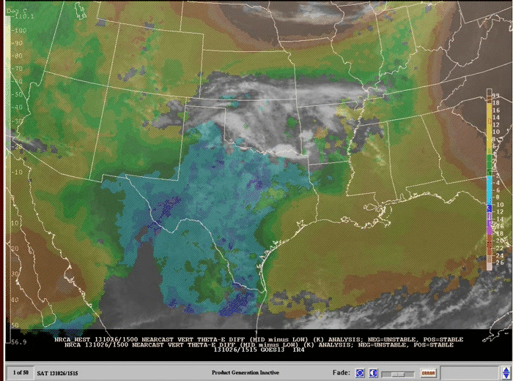
October 26, 2013 NearCast Analysis Loop in SPC NAWIPS
Convective Instability (theta-e diff) Analysis, IR Overlay
Texas severe hail/wind
Convection developed with observations of greatest convective instability
Forecasters like viewing recent analyses of NearCast moisture and stability fields
STABLE UNSTABLE
Notes:
It is also useful for forecasters to view recent past analyses of the NearCast fields. This allows them to see the most recent observed evolution of moisture and stability in the atmosphere along with satellite/radar imagery.

Slide 31
United States Cases Analyzed in Detail with NearCast Model
April 09, 2011
May 24, 2011
June 01, 2011
June 08, 2011
August 17, 2011
November 08, 2011
February 29, 2012
April 13, 2012
April 14, 2012
April 15, 2012
April 26, 2012
April 28, 2012
December 25, 2012
May 24, 2012
May 25, 2012
May 27, 2012
May 28, 2012
May 29, 2012
June 29, 2012
July 30, 2012
January 30, 2013
April 17, 2013
April 29, 2013
May 08, 2013
May 19, 2013
May 20, 3012
May 31, 2013
June 12, 2013
July 22, 2013
September 04, 2013
September 12, 2013
October 03, 2013
October 04, 2013
And more …
Notes:
Other cases analyzed in at least some detail by Bill Line.

Slide 32
SEVIRI Retrievals as GOES-R Surrogate
GOES-R NearCast
NearCast model will utilize GOES-R baseline products: ‘legacy vertical temperature and moisture profiles’, which provide information that is a continuation of the current GOES sounder products:
  Similar spectral information (3 tropospheric moisture channels)
  Same spatial information (10 km, may be improved)
  Sub-hourly availability (every 30 minutes, possibly more)
NearCast model is being run in real-time over Europe using SEVIRI (European imager) retrievals
  One fewer tropospheric moisture channel than GOES-R
  Sub-hourly availability removes gaps in analyses and forecasts
  Demonstrated in 2013 ESSL testbed
Notes:
Severe used as proof of concept

Slide 33
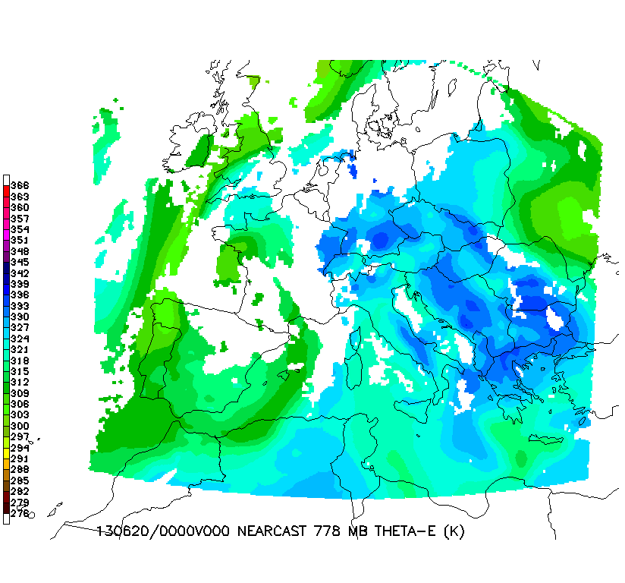
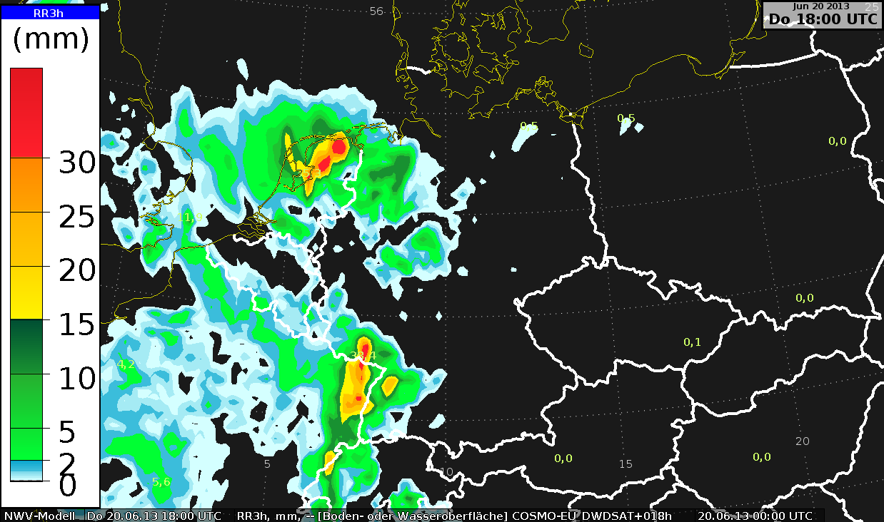
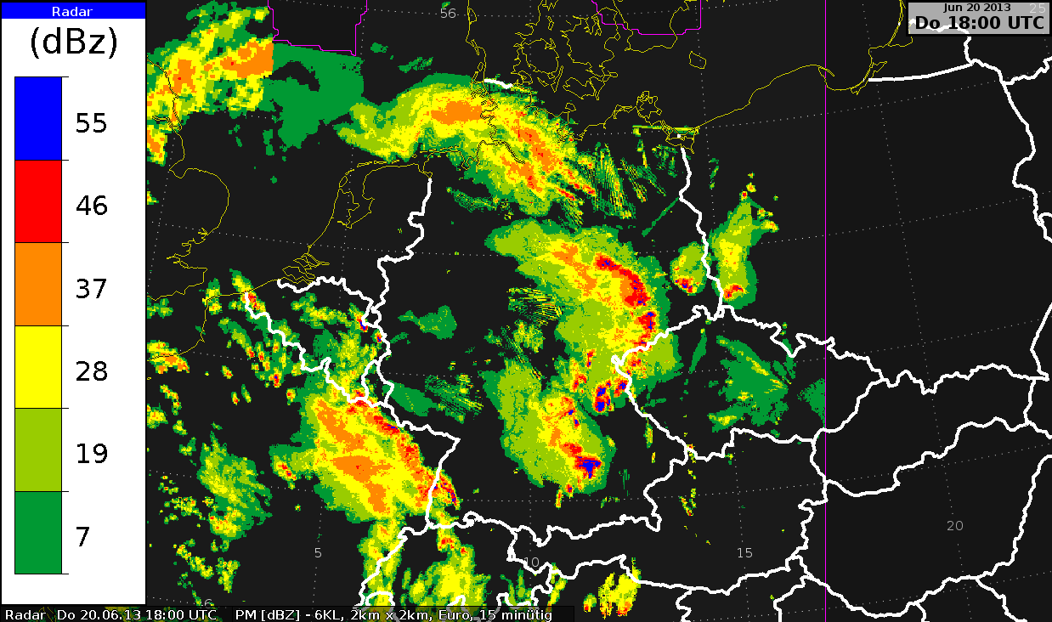
24 hr loop of NearCast Lower-level θe Analyses
(Fills gaps using ‘on-time’ observations alone)
Available even after clouds form and data obscured
June 20, 2013
Convection over Eastern Germany missed by all NWP guidance
o
.
______________________________________________________________________________ COSMO_EU 00Z forecast valid 1800UTC Radar Observation from 1800 UTC
Notes:
Germany severe (wind, hail, heavy rain) convection. NWP models had convection in western Germany, not in East. SEVIRI observed high levels of LL moisture (high theta-e) in eastern Germany, where convection actually did develop, contrary to what the nwp models had said.

Slide 34
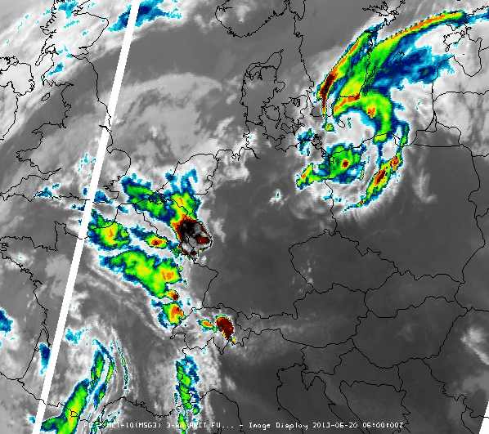
20 June 2013 – Eastern Germany Convection
Forecaster Comments:
“The NearCast gave a very good indication of where convection was started.
It’s really impressive to see that the convection was initiated at the northern edge of the ThetaE maximum over northeaster Bavaria and at another smaller ThetaE maximum located at the alpine foothills in the southwest of Bavaria.
  There are some hills around 600 - 1000 m high which possibly could have helped to trigger convection.
  Out of these cells, only the MCS over eastern Germany developed.
Because the operational models missed this convective initiation there, they also missed the development of the MCS.
If we had had NearCast, we would have been able to make a first estimation of the position where the convection would be most probably initiated.
The NearCast would (have) improved the forecast of this day.”
Christian Herald, DWD Forecaster
06-23 UTC IR Loop

Slide 35
NearCast Model in HWT Spring Experiment
(2011, 2012, and 2013)
Select feedback:
I used it both as a forecast tool and an analysis tool.
It really had a clear picture of the gradient of moisture and showed a strong push of cooler/dryer air where storms did not end up forming.
The product helped a lot to focus on the anticipated area of initiation.
... monitored what environment the storms were moving into... helpful in identifying intensification.
That was my favorite product...
Would definitely like to see this in my home WFO.
Notes:
HWT Comments: http://www.goesrhwt.blogspot.com/
GOES-R PG Demonstration reports: www.goes-r.gov/users/pg-activities-01.html

Slide 36
NearCast Model in AWT Summer Experiment
(2012, 2013)
Select feedback:
The product was VERY useful in terms of assessing where the atmosphere would be most favorable for convection should there be a trigger and/or broad-scale lift support.
It may aid in evaluating the evolution of mid-level instability in data void areas and between radiosonde launches in both space and time.
This was of particular use over off shore regions where flight routes exist, but observations are much more sparse.
… it was used to provide situational awareness for convective initiation and behavior later in the afternoon.

Slide 37
NearCast Model at SPC
At the request of SPC (Steve Weiss):
  NearCast model 1-9 hour forecasts and analyses were moved into operations in September 2013 for demonstration and evaluation by SPC forecasters
  Year-round demonstrations allow for product to be evaluated over difference seasons and weather regimes.
Early comments so far:
  This is great because it is information we do not already have available
  I like that it is observation-based.
  This could be particularly useful in the south, where we have pulse thunderstorms, to show the moisture gradients.
  Forecasters really like to view the analysis fields (especially theta-e difference) with satellite imagery overlaid.

Slide 38
Future Demonstrations
Continued demonstrations in HWT (EWP and EFP)
Continued demonstrations in AWT
  Bring into AWC ops areas in future (CSIG, CCFP)
Continued demonstrations in SPC ops
Demonstrations in OPC/WPC to begin this summer
Continue ongoing WFO demo at MKX

Slide 39
Conclusion/Discussion
Legacy atmospheric profiles will be generated (as a baseline product) from the ABI, providing comparable quality to the current sounder, especially for moisture.
Demonstrations of NearCast products using GOES retrievals to date have shown significant potential both for
  filling a time/space observational gap and
  extending the use of these observations to short-range predictions of moisture and stability that would otherwise not be available to forecasters.
The planned demonstrations with the NearCast product will continue/begin at SPC, AWC, OPC and WPC
Jim Yoe: “The section showing that ABI will provide the requisite information content to make the capability viable in the GOES-R era is very convincing. Therefore I am naturally excited to see … expanded evaluations.”
Key discussion question: What is the Path to Operations for GOES-RRR and PG products that will be using ABI baseline products?

Slide 40
Back-up Slides (Tim)

Slide 41
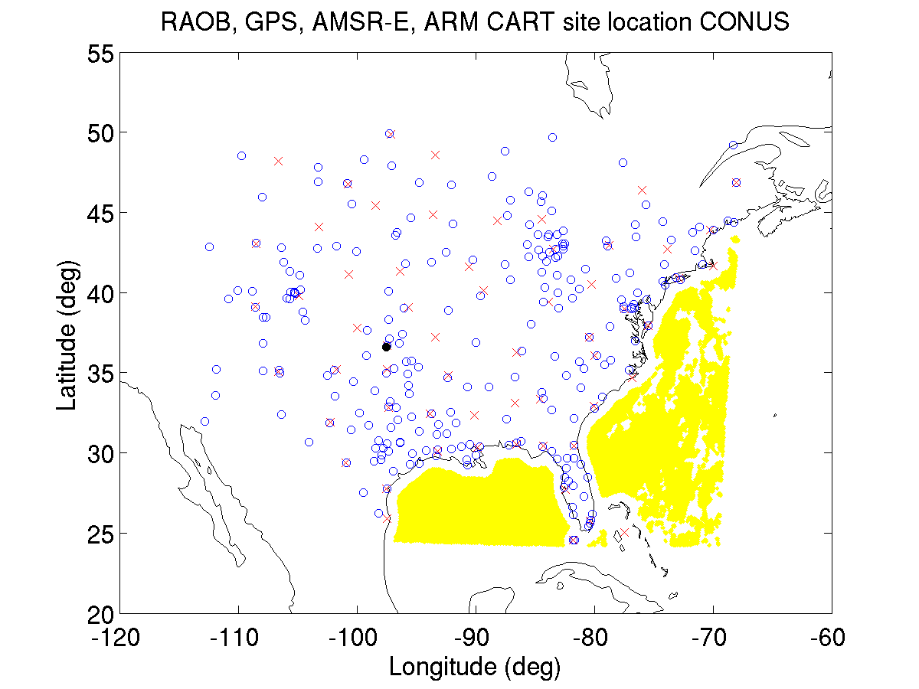
ABI algorithm and product validation with GOES Sounder
(Lee et al. 2013)
x : RAOB
o : GPS
: ARM CART
: AMSR-E
Data collected over the period between
Feb. 11, 2011- Aug. 30, 2012.
For AMSR-E,
Feb. 11, 2011- Oct. 4, 2011
Almost full coverage of CONUS and year round!

Slide 42
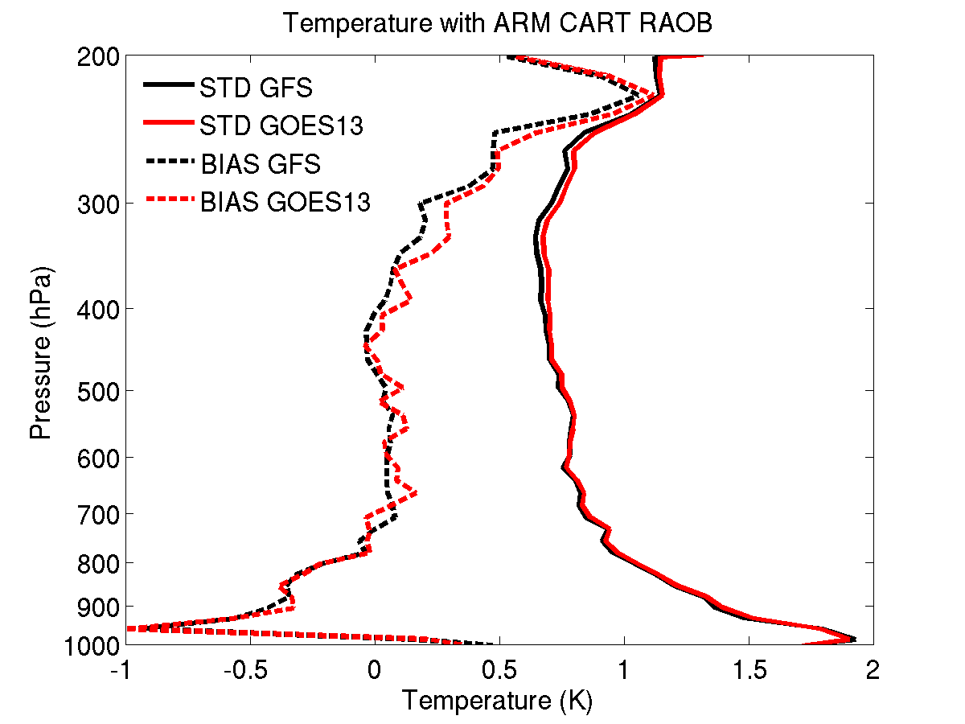
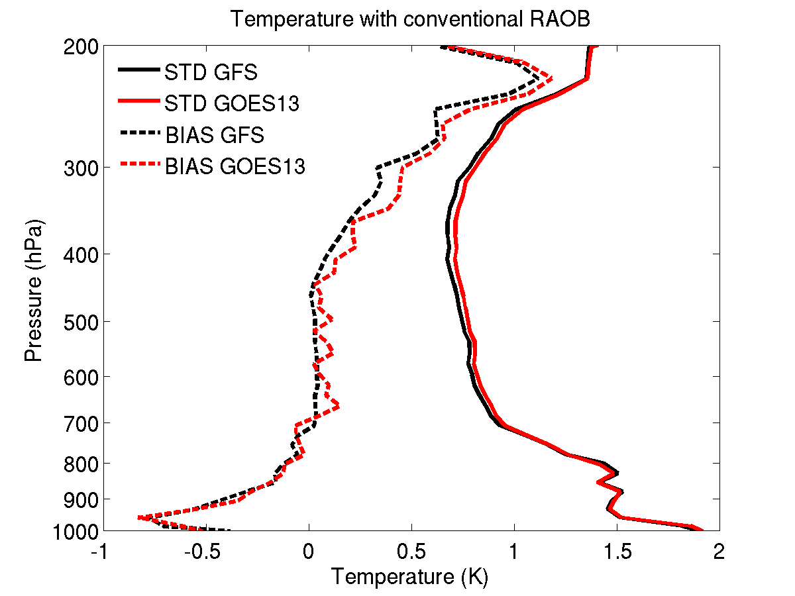
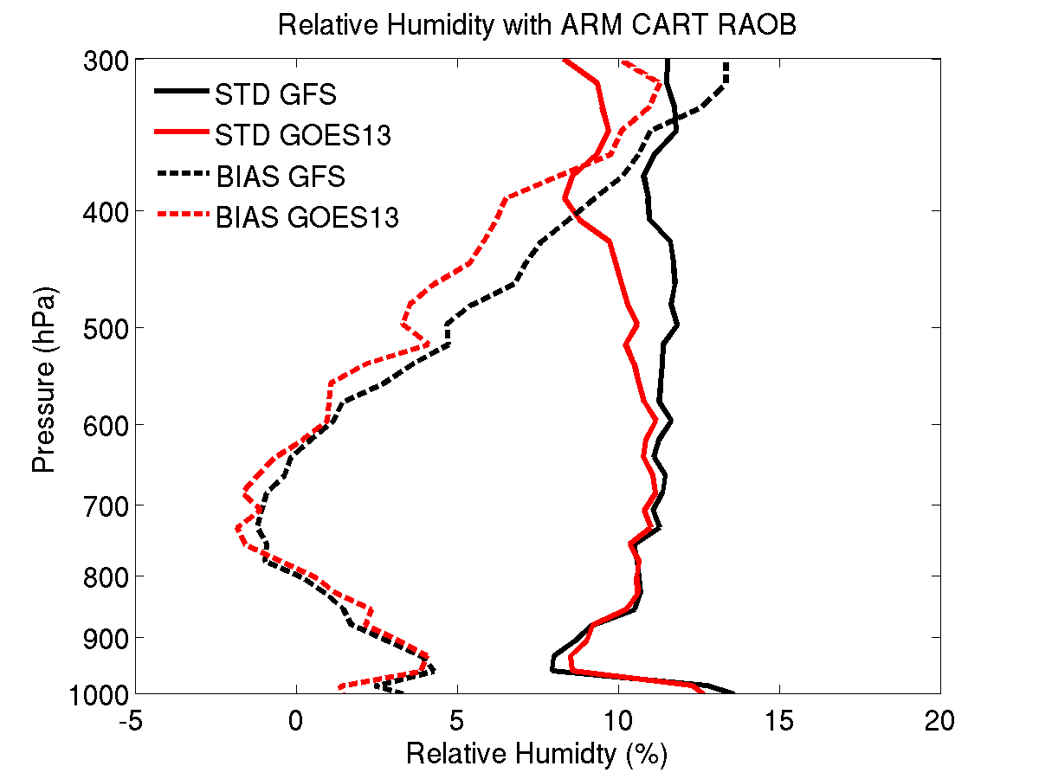
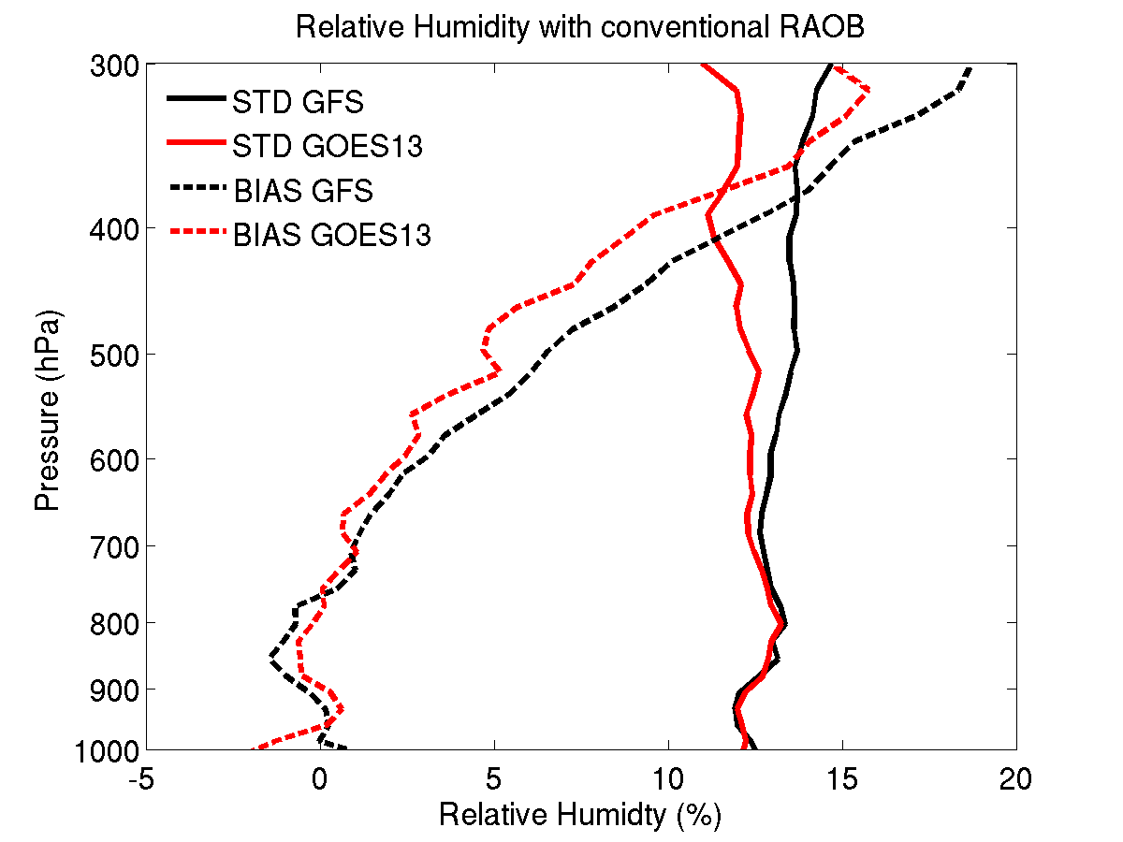
ARM CART
Conventional RAOB
T
ARM CART
Conventional RAOB
RH
Both accuracy (BIAS) and precision (STD) of RH are improved above 700 hPa.
GOES-R ABI LAP algorithm is applied to GOES-13 Sounder radiance measurements.

Slide 43
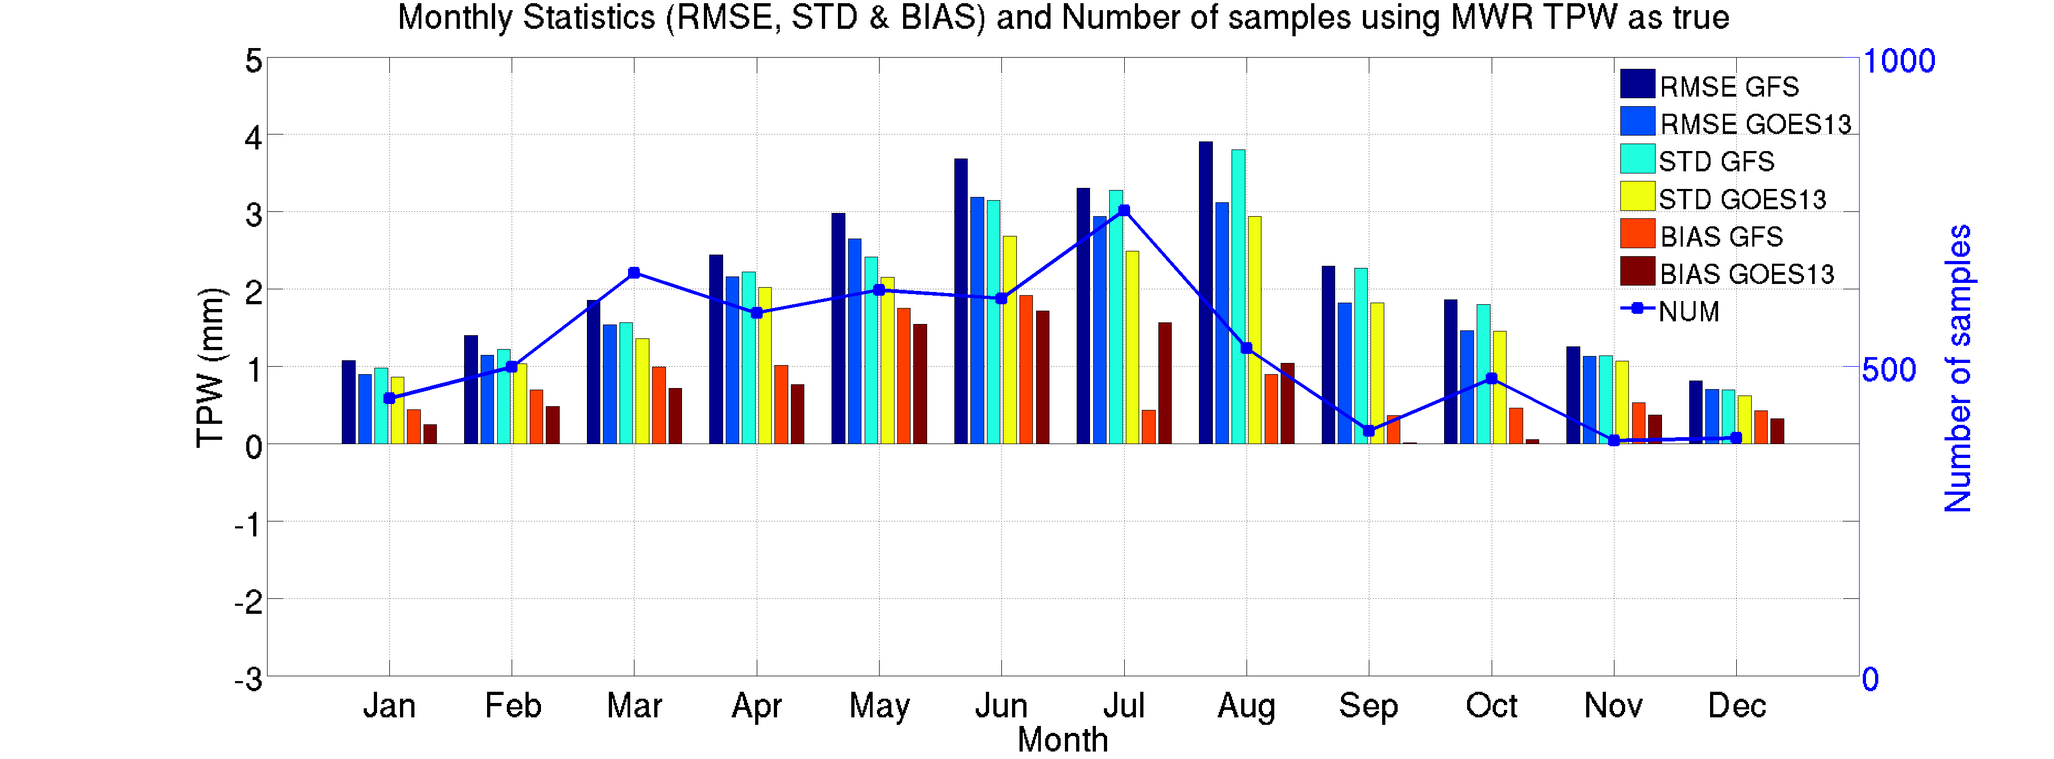
ARM CART site MWR TPW
GOES-R ABI LAP algorithm is applied to GOES-13 Sounder radiance measurements for validation.

Slide 44
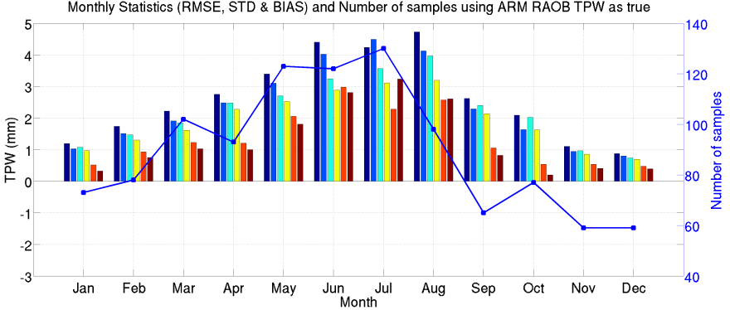
ARM CART site RAOB TPW
GOES-R ABI LAP algorithm is applied to GOES-13 Sounder radiance measurements for validation.

Slide 45
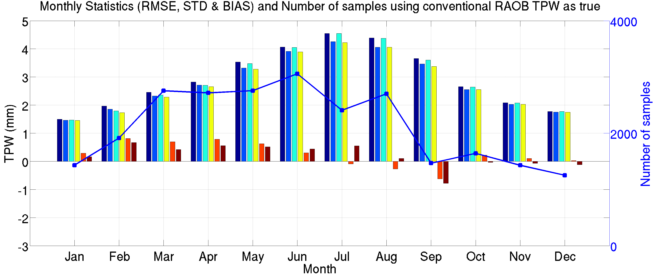
Conventional RAOB TPW
GOES-R ABI LAP algorithm is applied to GOES-13 Sounder radiance measurements for validation.

Slide 46
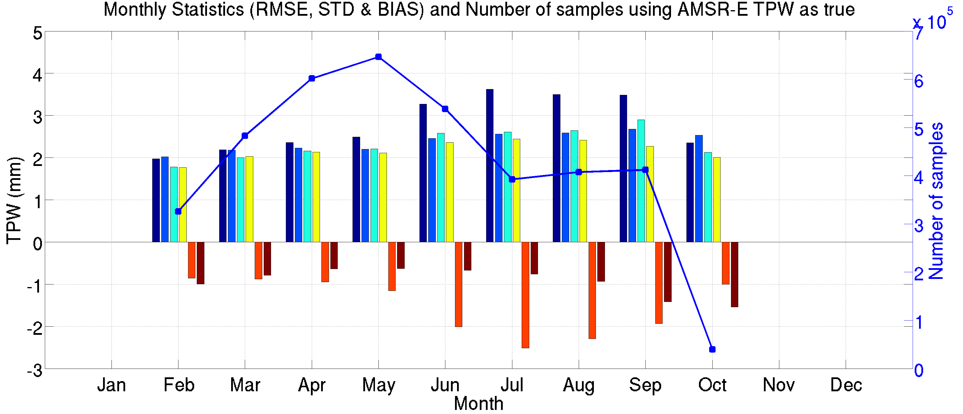
AMSR-E TPW (over ocean only)
GOES-R ABI LAP algorithm is applied to GOES-13 Sounder radiance measurements for validation.

Slide 47
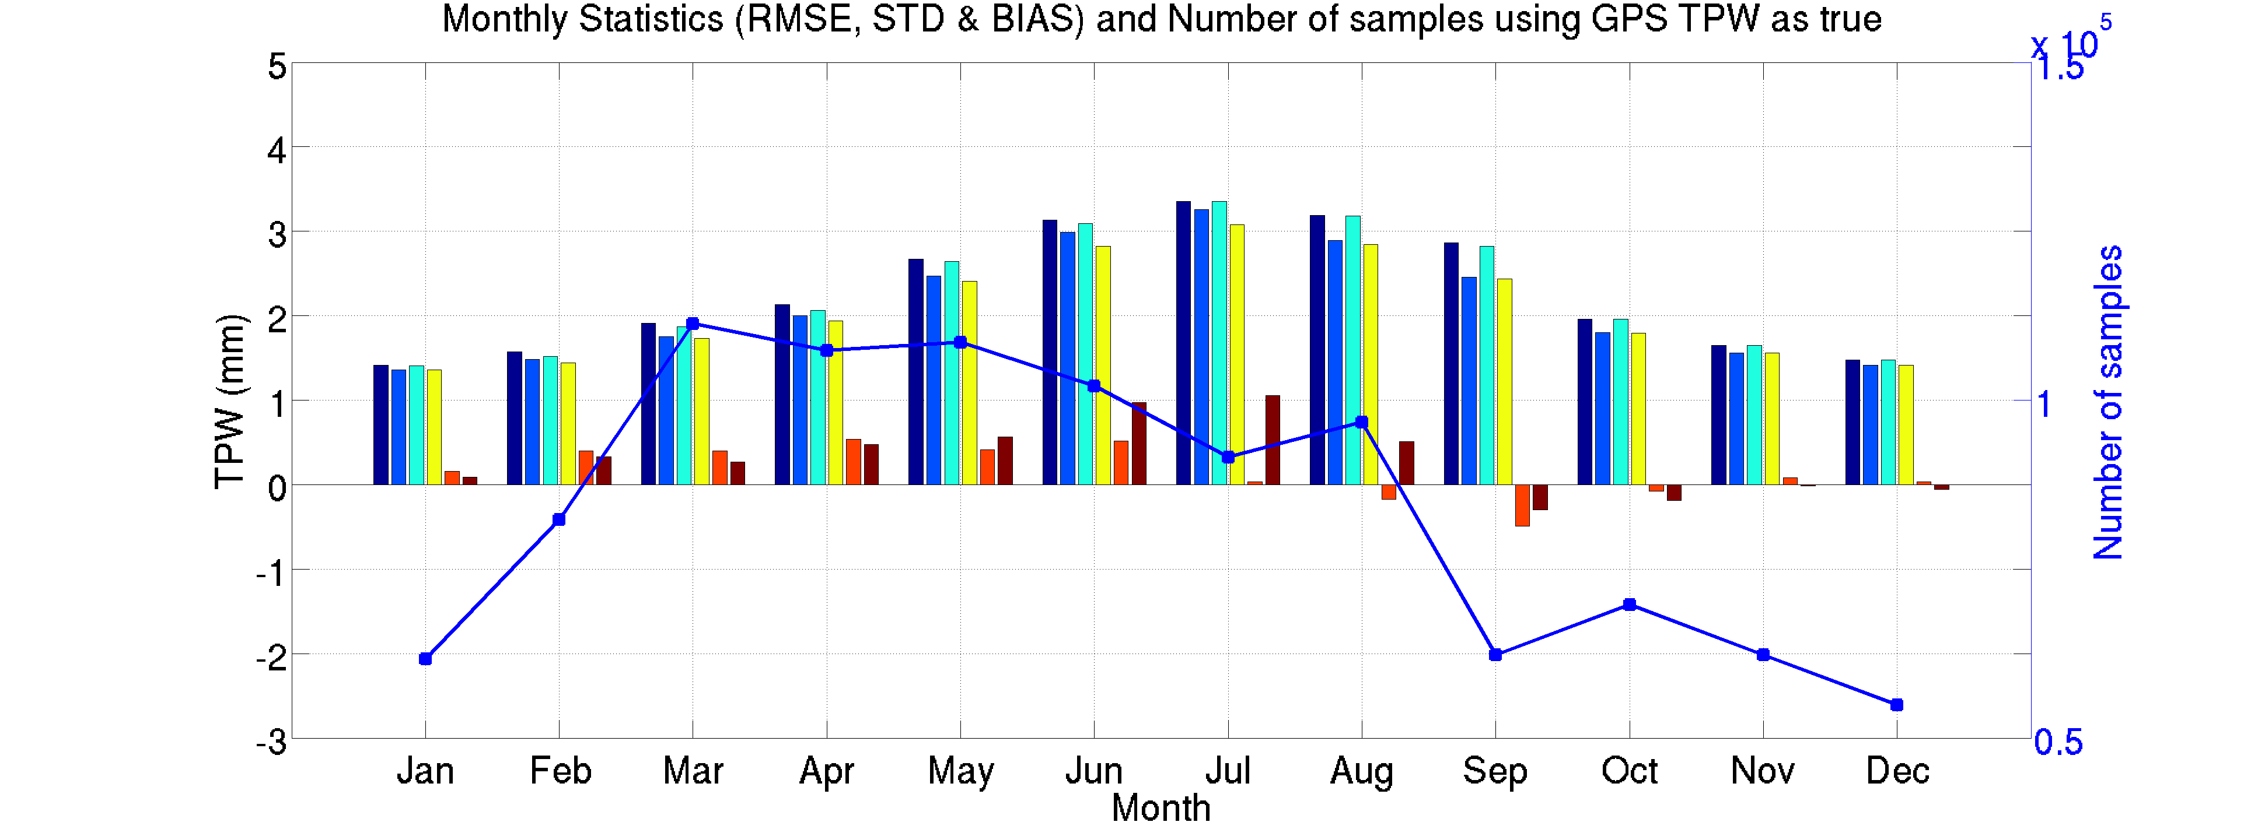
GPS Met TPW
GOES-R ABI LAP algorithm is applied to GOES-13 Sounder radiance measurements for validation.

Slide 48
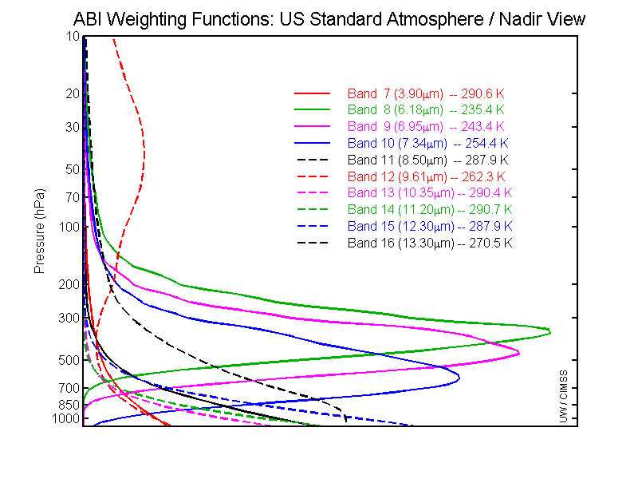
GOES-R ABI Weighting Functions
ABI has 1 CO2 band, so (if used stand-alone) the upper-level temperature will be degraded compared to the current sounder, although the retrieval process uses a NWP first guess.

Slide 49
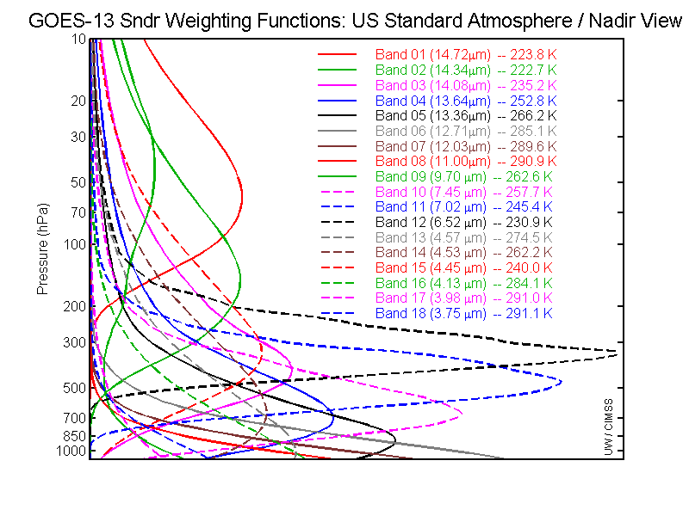
GOES-13 Sounder WFs
The GOES sounder has 5 CO2 bands, more SW bands than the ABI, yet they have comparable moisture bands (in fact, the ABI has a 10.3 micrometer band).

Slide 50
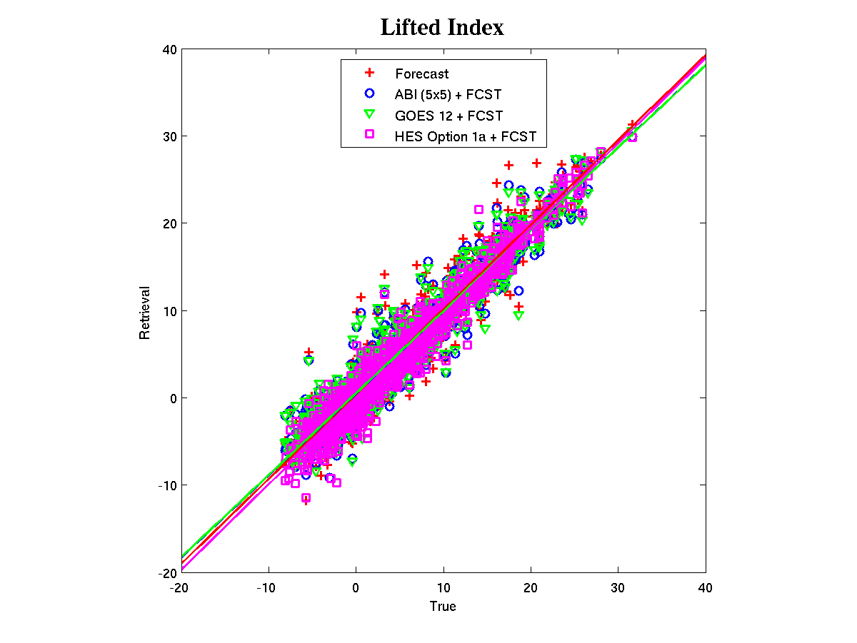
Regional simulation (06Dec2006)
RMSE
Forecast: 2.27
ABI (5X5) + fcst: 2.19
GOES Sounder + fcst: 2.22
HES + fcst: 1.79
Notes:
Using time/space collocated RAOB/Forecast over CONUS
HES option 1a assumption, GOES-12 (for GOES-N class), ABI were used in simulation. PORD noise were used for HES.
HES option 1a:
675-1200 with 0.625 cm⁻¹ spectral resolution
1689-2150 with 1.250 cm⁻¹ spectral resolution
2150-2400 with 2.50 cm⁻¹ spectral resolution
~900 independent profiles are retrieved
Lifted index and TPW (including layer TPW) are used for performance analysis

Slide 51
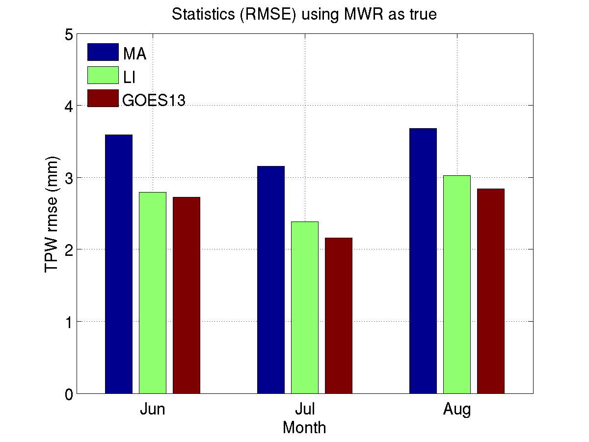
GOES-R LAP (Legacy Atmospheric Profiles) algorithm (GOES13) betters both current (Li) and previous (Ma) operational GOES sounding algorithms in terms of TPW bias and RMSE. Note that Li-algorithm has been operational since February 2013.
Li et al. (2008): current operational GOES sounding algorithm
Ma et al. (1999): previous operational GOES sounding algorithm
GOES-R ABI LAP algorithm is applied to GOES-13 Sounder radiance measurements.

Slide 52
Back-up Slides (Bill/Ralph)

Slide 53
Motivation
NCEP/EMC
Threat score of 0.20 = 1 correct with 4 wrong
Threat score of 0.14 = 1 correct with 6 wrong >>>>>>
Threat score of 0.10 = 1 correct with 9 wrong
Need both to increase Probability of Detection and reduce False Alarm Rate
Forecast
Correct
Observed

Slide 54
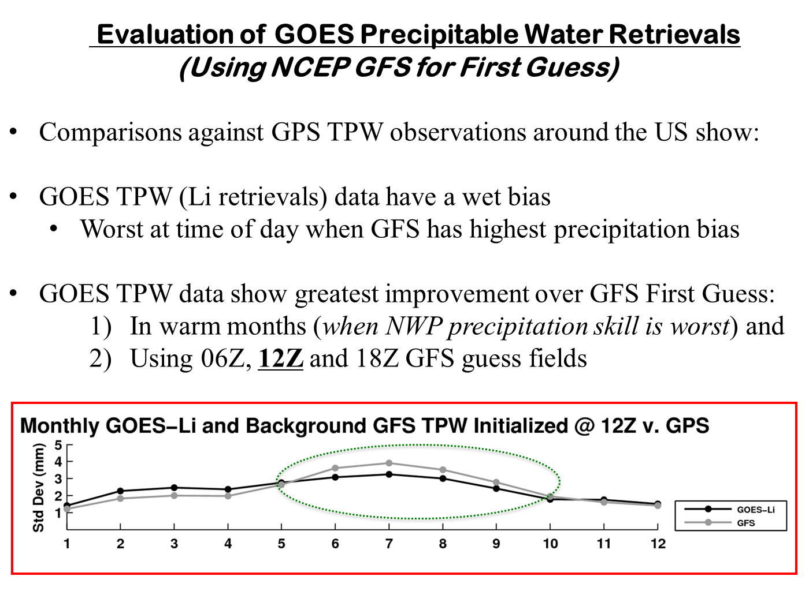
First, assure that the Satellite Soundings add information

Slide 55
The importance of Preserving Previous Observations in NearCast Analyses and Forecasts
NearCasts analyses/forecast displays retain up to 10 hours of earlier observations in their hourly updates by including data projections (forecast trajectories) from previous model cycles, with recent observations weighted most heavily
CURRENT CYCLE
ANALYSIS
6HR FORECAST
Notes:
This increases data coverage at the analyses and forecasts by using previous observations to fill in areas that have become or will become cloud covered (IR data voids).
Preserving the earlier obs.

Slide 56
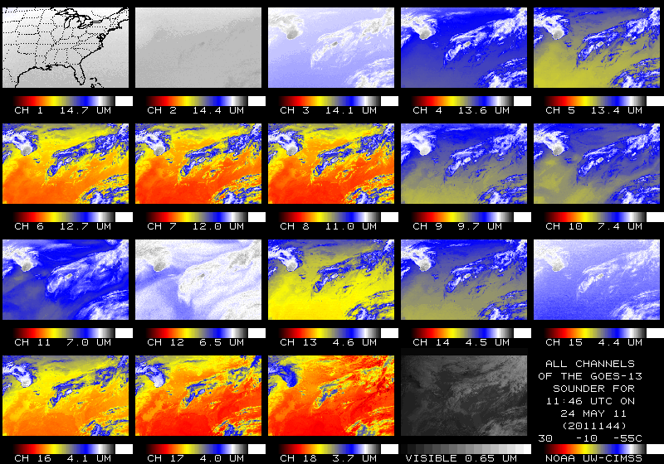
Raw Sounding Data
Do these satellite data add info to the 1st guess profile about the moisture structure of the atmosphere?
Retrieval:
  Model provide a first guess profile (surface reports, SST, GFS forecast).
  Perturb this profile, and resulting calculated radiances, until those radiances match the observed radiances.
  When this is satisfied, the perturbed profile is the retrieved profile
Notes:
Li retrieval algorithm being used now, improvement upon Ma.

Slide 57
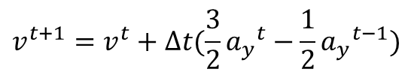
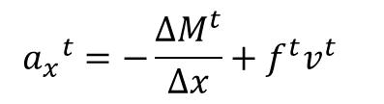
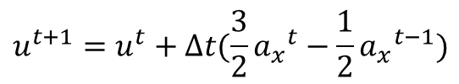


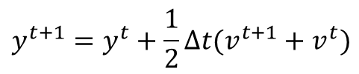
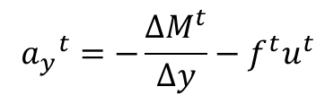
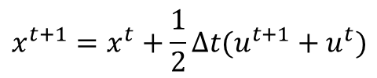
Explicit Trajectory Approach
Method uses an initial wind (obtained from forecast gridded velocity field) to start trajectories.
Trajectories are dynamically updated at every timestep using (forecasted) pressure gradient fields.
At each time increment, the acceleration of every parcel is updated using the inviscid equations of motion
$${{ a}_{x}}^{t}=−\frac{{∆M}^{t}}{∆x}+f^{t}v^{t}$$
$${{ a}_{y}}^{t}=−\frac{{∆M}^{t}}{∆y}−f^{t}u^{t}$$
Then, parcel velocities and positions are updated, based on the discrete model formulation of Greenspan (1972, 1973):
$$u^{t+1}=u^{t}+∆t(\frac{3}{2}{a_{x}}^{t}−\frac{1}{2}{a_{x}}^{t−1})$$
$$x^{t+1}=x^{t}+\frac{1}{2}∆t(u^{t+1}+u^{t})$$
$$v^{t+1}=v^{t}+∆t(\frac{3}{2}{a_{y}}^{t}−\frac{1}{2}{a_{y}}^{t−1})$$
$$y^{t+1}=y^{t}+\frac{1}{2}∆t(v^{t+1}+v^{t})$$
The initial timestep requires a special “startup” formula to update parcel velocities
$$u^{1}=u^{0}+{a_{x}}^{0}∆t$$
$$v^{1}=v^{0}+{a_{y}}^{0}∆t$$
(Petersen and Uccellini, 1979)

Slide 58
Model Validation Efforts
Thus far have been subjective
Objectively, compare NearCast forecasts with:
  Analyses themselves
  Reports
  Raman Lidar
  Tendencies in in GPS (% change)

Slide 59
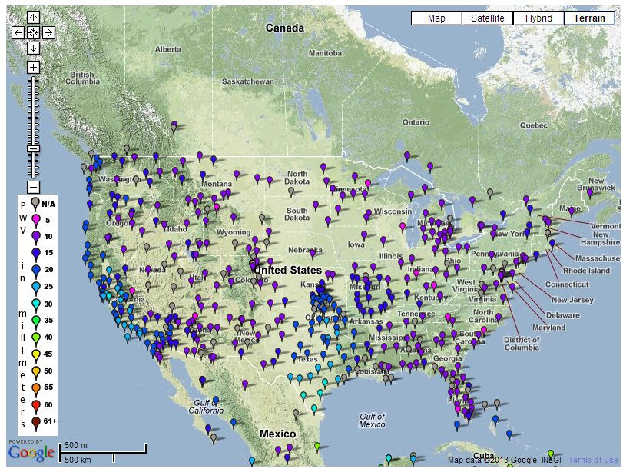
GPS
We can derive the total water vapor content of the atmosphere from the propagation delay of GPS radio signals through the atmosphere.
  Delay in signal is much stronger in wet atmosphere then in dry.
http://www.suominet.ucar.edu

Slide 60
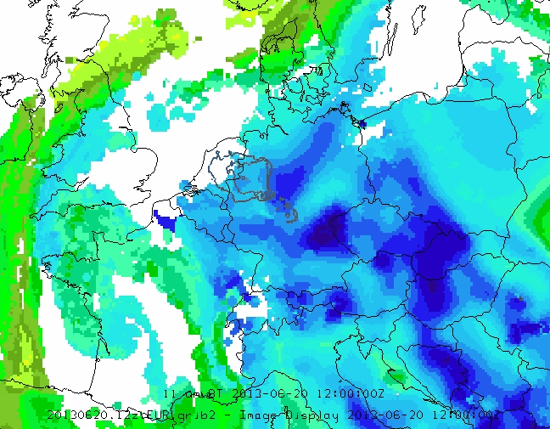
Verification of EUMETSAT 1200 UTC NearCast
Convective Instability Forecast
Thick contour – Cloud-Top Temps <220K

Slide 61
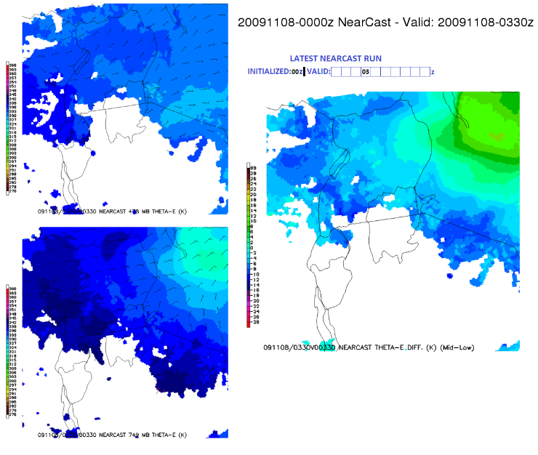
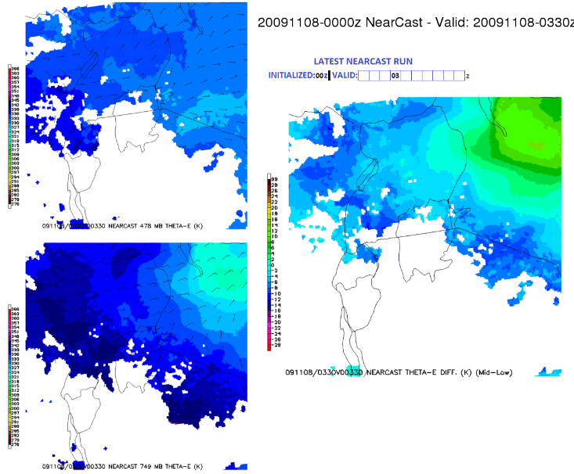
SEVIRI NearCast cases documented
Europe
  November 12, 2012
  November 16, 2012
  November 28, 2012
  November 28, 2012
  May 02, 2013
  May 03, 2013
  June 20, 2013
Lake Victoria, Africa
  October 31, 2010
  November 08, 2009
  November 29, 2009
November 08, 2011 0000 UTC –
Lake Victoria, Africa, 3.5 Hour forecast

Slide 62
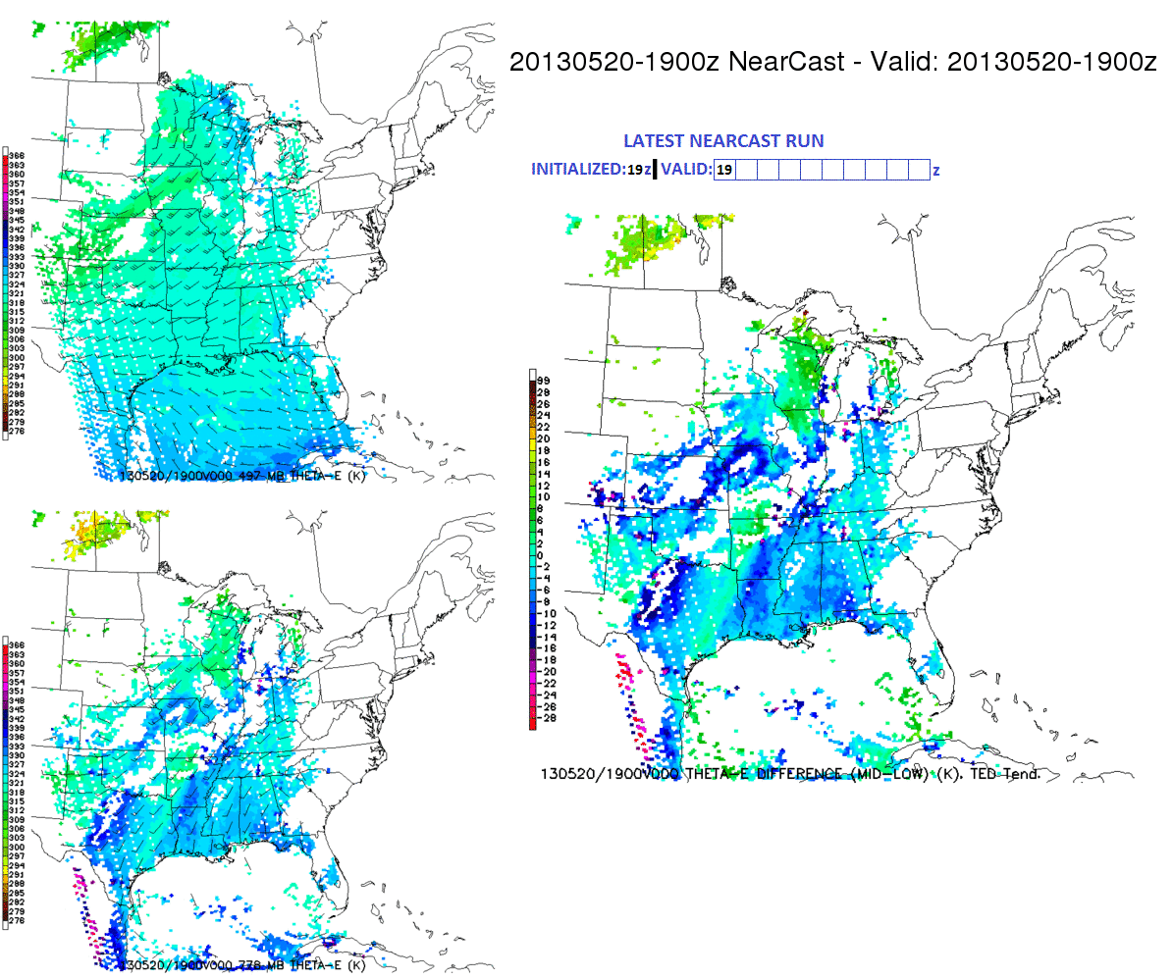
POES NearCasts
Under development: NearCast model utilizing polar sounding data
  Utility over Alaska Region
1900 UTC NearCast model cycle utilizing CrIS sounding data (1 pass)

Slide 63




How the Lagrangian NearCasts work:
1 - Interpolate wind data to locations of full resolution GOES multi-layer moisture & temperature observations, including Maxima/Minima
2 - Move these high-definition data to future locations, using dynamically changing winds with ‘long’ (10 min.) time steps.
3 - Create grids from these ‘projected parcels’ for display and diagnosis
a) Combine outputs to produce a variety of derived parameters
b) Compare between layers to derive “Stability Indices” that can be combined with ‘conventional tools’ to identify mesoscale areas where severe convective can/cannot develop
c) NearCasts transform GOES IR Sounding from observations to forecasts, adding forecaster utility - even after convection initiates.
13 April 2006 – 2100 UTC
900-700 hPa GOES PW
0 Hour Obs Locations
13 April 2006 – 2100 UTC
900-700 hPa GOES PW
3 Hour NearCast Image
NearCast of Vertical Moisture Gradient (Convective Instability)
(900-700 hPa GOES PW -700-500 hPa GOES PW)
3 Hour NearCast : Valid 0000UTC
Verification
Updated Hourly - Full-resolution 10 km data - 10 minute time steps
Notes:
The Lagrangian approach determines the future location of atmospheric tracers (in this case mid- and low-level moisture observations from GOES) through simple forward transport of the parcels from one location to the next using a 10-15 minute time step.
The wind field changes during the NearCast period are determined by solving the Primitive Equations of Motion in their simplest (Total Derivative) form, where accelerations of air parcels are determined from the difference of the Coriolis and Pressure Gradient forces at each parcel location. This eliminates 1) the need to calculate the highly non-linear inertial advective terms in Eulerian Model (fixed grid) form of the equations, 2) the time-step limitations imposed in grid point models (compared to a 10 km Eulerian model which uses 10-15 sec time steps, the Lagrangian model transporting 10 km GOES moisture products can use 10-15 minute time steps), and 3) the smoothing of moisture fields which is inherent in advection calculations used in grid-point models.
The key outputs from the NearCast Model are 1) projections of future mid- and lower-level moisture/temperature fields (in the layers observed by GOES) and 2) derived fields identifying areas where Stability Parameters (in the case shown here Convective Instability) indicate that convection is likely (or not likely) to form in the near future. For this example, Convective Instability occurs when lower-level moisture is overlaid by dry air aloft. The process of Convective Destabilization commonly occurs through the differential transport between the lower- and mid- troposphere, a result of both directional and speed shear across the layers. When Convective Instability occurs, lifting of the entire layer can change it from being stable to absolutely unstable over a very short time period. It should be noted that similar differential advection processes produce the major changes to other Stability Indices as well. These types of scenarios are optimal for using GOES IR products, since 1) the convective destabilization occurs in areas which had previously be stable and therefore are very likely to have been free of clouds and 2) it relies in part on one of the best observations from GOES - the location and depth of mid-tropospheric dryness/moisture.
Although it was not included as a project task in last years briefing, a number of additional stability parameters are in the process of being added to the NearCasting system. The choice of which Stability Parameters to include is being made to assure that they reflect those observations that GOES performs best, 2-3 layers of moisture and 5-6 layers of temperature. Candidate indices include: Lifter Index (using both surface and lower-tropospheric temperature/moisture data), Totals index, CAPE, CINH, K Index, as well as Ensembles of Combined Indices. These indices are very similar to those developed (or under consideration) for the MeteoSat GII products.
Actual observations of areas of Convective Instability itself are relative rare using only GOES water vapor observations because, and even when they do occur, they often become quickly obscured by the subsequent formation of convective clouds and cirrus outflow shields. The fact that the NearCast System projects the moisture observations to future locations allows earlier observations taken in stable conditions (before the convection forms) to be projected into the future – providing a picture of the amount of support that will be available for the subsequent convection and whether additional storms are likely to develop under the first cirrus shield.

Slide 64

October 4, 2013 NearCast Analysis Loop
Convective Instability Analyses
Nebraska/Iowa tornados and KS/OK hail/wind along cold front
Forecasters can view the recent past evolution of NearCast moisture and stability fields in conjunction with satellite/radar imagery and other fields.
Thick contour – Cloud-Top Temps <220K
Notes:
It is also useful for forecasters to view recent past analyses of the NearCast fields. This allows them to see the most recent observed evolution of moisture and stability in the atmosphere along with satellite/radar imagery.

Slide 65

1200 UTC NearCasts using
EUMETSAT Retrievals from 0400-1200 UTC
WARM/MOIST – High θe
UL (~480 mb) Theta-e
Cool/dry – Low θe
Vertical Theta-e Difference
Concentration of
large lower-level θe and
development of strong vertical θe gradients already anticipated in 1200 UTC NearCasts
LL (~795 mb) Theta-e

Slide 66
How can Satellite Observations be Use
to Gauge
Convective Potential?
Objective #1: Determine sources of lower-level moisture/heat
Equivalent Potential Temperature (Theta-e) combines information about the temperature and moisture content (thermal energy) of air
Objective #2: Mimic
what we’ve observed on
WV imagery for years:
Convection often forms in areas where upper-level dry streaks overtake warm/moist air at lower levels
This process could include a number of different factors influencing the
development of convections, including:
Convective Instability,
IPV forcing, (Deformation/Frontogenesis)
Slantwise Convective Instability,
Wet Downburst Potential, . . .
  Tactic: Identify areas where
  θe decreases with height
Upper-Level Water Vapor Imagery:
Warm colors = dry, Cool colors (blues) = wet
Notes:
Theta-e=It is the temperature a parcel of air would have if it were brought adiabatically to 1000 hPa AND all of its water vapor were to condense, releasing its latent heat.
This variable is useful for comparing both moisture and temperature of air at different levels of the atmosphere. Convective Instability
, stable
, unstable

Slide 67

April 09, 2011 1500 UTC NearCast Forecast
Convective Instability Forecast
Mapleton, IA EF3 tornado
Convection initiates within forecasted convective instability max and most rapid destabilization tendencies by 2230 UTC.
Warm front/WAA
Validation: Surface GPS Total Precipitable Water
at Omaha, Nebraska
STABLE
STABLE
WARM/MOIST – High θe
UL (500 mb) Theta-e
UNSTABLE
Validation: Surface GPS Total Precipitable Water
at Topeka, Kansas
Theta-e Difference (Mid-Low)
Convection initiates within forecasted convective instability max and most rapid destabilization tendencies by 2230 UTC.
LL (780 mb) Theta-e
Cool/dry – Low θe
UNSTABLE
LL (780 mb) Theta-e
Thin contour- destabilization tendencies
Thick contour – Cloud-Top Temps <220K
Notes:
LL:Ridge of low-level theta-e max projected to move northeastward from central Kansas into northwest Iowa by 00z.
Gradient in low-level theta-e tightens as max advances northward
UL: At upper level, dry air moving into eastern Nebraska by 00z.
Diff: This correlated to a max in convective instability moving northeast into eastern Nebraska and western Iowa between 21z and 00z
This region was stable before quickly becoming very unstable.
2 hr.. theta-e difference tendency (rate of destabilization) depicts locations that would experience the most rapid destabilization (-9K/2hr), further narrowing down where and when the environment would be most conducive to convective development.

Slide 68


May 20, 2013 1500 UTC NearCast Forecast
Convective Instability Forecast
Moore, OK EF5 tornado
Rapid convective development along moisture/instability gradient by 2000 UTC
Continued to develop and move with the forecasted movement of the boundary
Thick contour – Cloud-Top Temps <220K
Notes:
Initiation along dry line as surge of moisture enters central OK

Slide 69


June 01, 2011 1200 UTC NearCast Forecast
Convective Instability Forecast
Strongest convection began development along cold front between 1500 and 2100 UTC
Initiated and moved along forecasted movement of the front
Thick contour – Cloud-Top Temps <220K
Notes:
Initiation and movement along cold front

Slide 70

June 12, 2013 1500 UTC NearCast Forecast
Convective Instability Forecast
June 12/13 2013 Derecho/MCS
Convection initiated between 2000 and 2100 UTC in northern Illinois in warm/moist sector of developing cyclone
Thick contour – Cloud-Top Temps <220K

